Slide 1
Spain Builds an American Empire
Thanks to their colonies in America, Spain becomes the richest, most powerful nation in the world during much of the 16th century

Slide 2
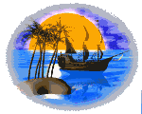
Setting the Stage
Attempting to find an alternate route to Asia, Christopher Columbus sailed west from Spain. Columbus never reached Asia, but he did discover a whole new world.

Slide 3
The voyage of Columbus would bring together peoples of Europe, Africa, and the Americas

Slide 4
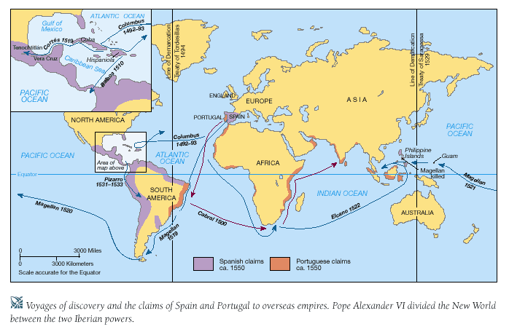

Slide 5
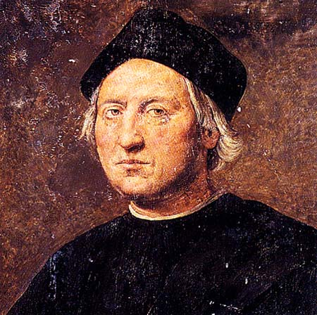
Christopher Columbus
In 1492…
  Nina, Pinta, and Santa Maria land somewhere in the Bahamas.
    Columbus thought it was the East Indies.
      Inhabitants – Taino
      Claims island – San Salvador

Slide 6
Columbus’ First Meeting with Natives
“I present them with red caps, and strings of glass beads to wear upon the neck, and many other trifles of small value, wherewith they were very much delighted, and became wonderfully attached to us. Afterwards they came swimming to the boats where we were, bringing parrots, balls of cotton thread, javelins, and many other things, which they exchanged for articles we gave them… in fact they accepted anything and gave what they had with the utmost good will. “
Christopher Columbus, Journal of Columbus

Slide 7
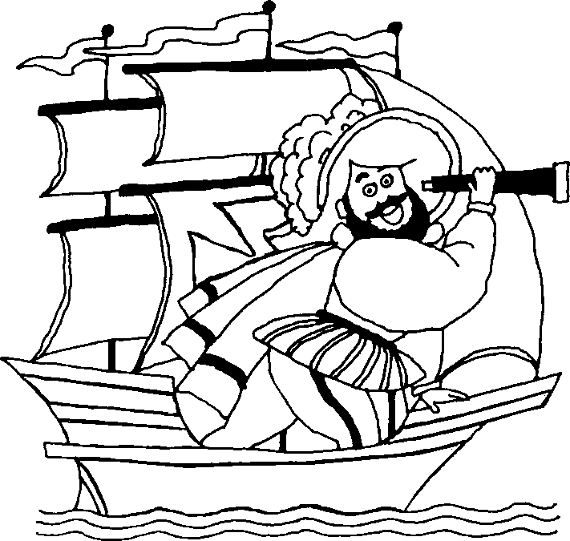
Christopher Columbus
Not finding gold, Columbus leaves San Salvador.
  “It was my wish to bypass no island without taking possession.”
Return to Spain – three more trips planned.
  Intended to establish Spanish colonies (lands controlled by another nation)
  Second voyage – Sept. 1493
    17 ships with 1,000 soldiers,
    crewmen, and colonists.

Slide 8
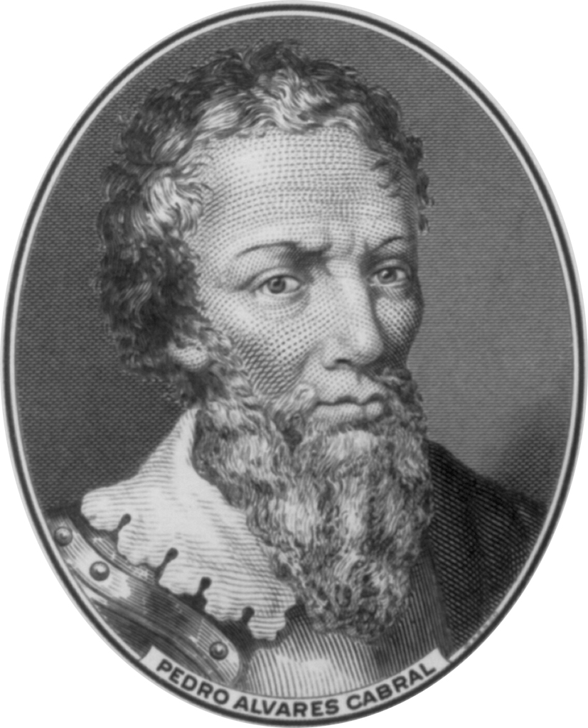
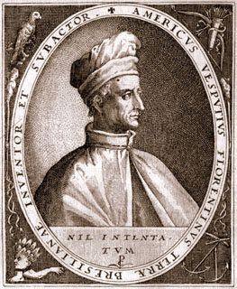
More Explorers
Pedro Alvares Cabral
  Portugal
  1500 – Claims Brazil
Amerigo Vespucci - Portugal
  1501 – explored eastern South America (still thinks it is Asia)
  Claims it as a “new world”
  1507 – German cartographer names the new continent “America” after Vespucci

Slide 9
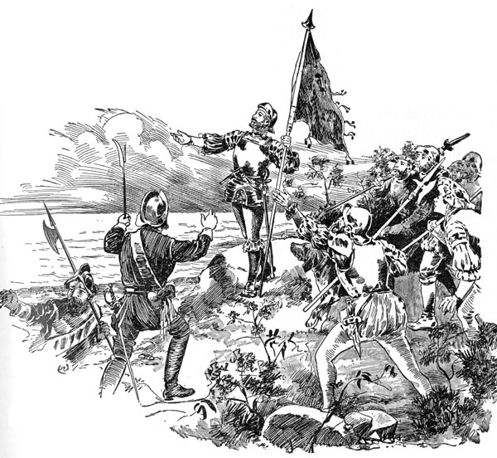
More Explorers
Vasco Nunez de Balboa – Spain
  First European to see the Pacific Ocean after marching through Panama
Ferdinand Magellan – Portugal
  1519 - Convinces king of Spain to fund exploration of the Pacific.
  Leaves w/ 230 men & 5 ships
  Sails around the tip of s. America
  He names the “Pacific Ocean”
  1522 – 18 men and one ship return (minus Magellan who was killed in the Philippines)
    First to circumnavigate the globe.

Slide 10
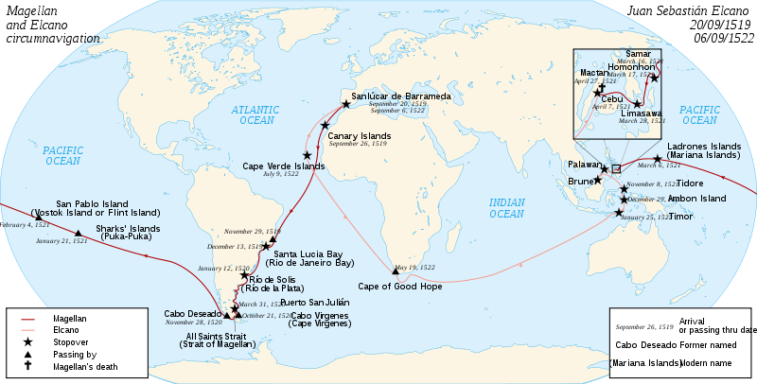
Magellan’s Journey

Slide 11
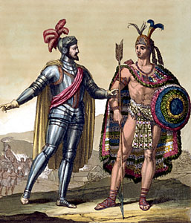
More Explorers
Hernando Cortes – Spain
  First of the conquistadors
  Settled colonies in Mexico, South America, and the US
  How he conquered Aztec Empire in 1521
    Used muskets and cannons
    Enlisted various native groups who hated Aztecs
    Disease – Measles, mumps, smallpox, and typhus
      Hundreds of thousands natives died

Slide 12
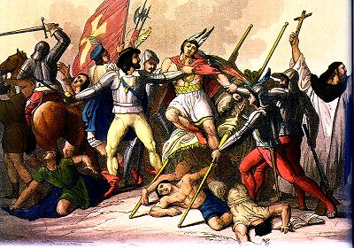
More Explorers
Francisco Pizarro – Spain
  Atahualpa is kidnapped and Incans forced to pay ransom
  After they pay ransom, Spanish strangle Atahualpa
  Conquers Incan Empire in Peru in 1533

Slide 13
By the middle of 16th century, Spain had created an American Empire
  New Spain (Mexico, part of Guatemala)
  Lands in Central and South America, Caribbean

Slide 14
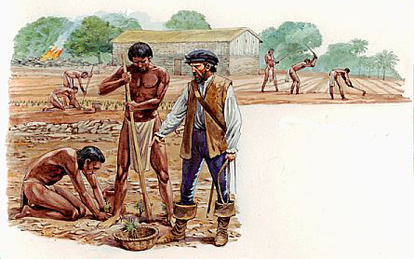
Impact of the Conquistadors
Mestizo – mixed Spanish and Native American people.
Encomienda – Labor system forced upon the natives
  Similar to
  slavery
  Farmed, ranched, or mined for the Spanish landlords
  Many abused natives & forced them to work to death

Slide 15
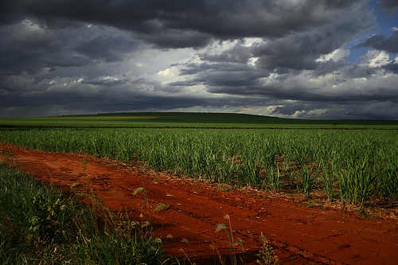
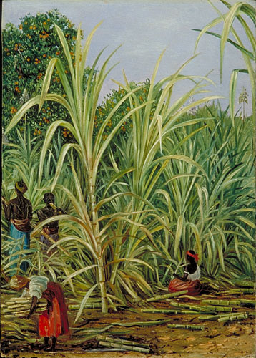
Brazil
Brazil stayed out of Spanish control because Cabral claimed it for Portugal.
  Huge amount of sugar production is initiated.

Slide 16
Spain’s Influence Expands
American colonies make it the richest, most powerful nation in world during the 16th century.
Ushers in a golden age of art and culture
Builds powerful navy to protect its treasure-filled ships
Create a powerful army

Slide 17
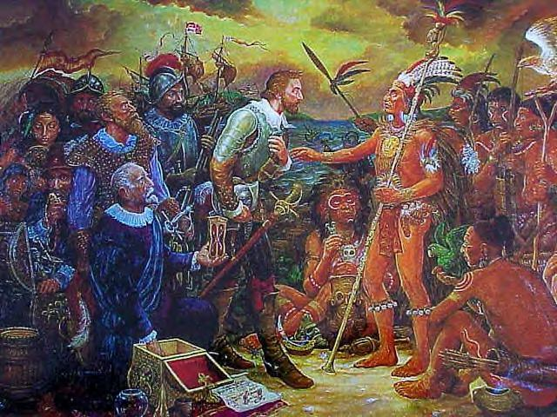
Expansion
Things are so good for Spain that they expand north.
1513 – Juan Ponce De Leon claims modern-day Florida for Spain.

Slide 18
Exploration in Southwest
Francisco Vasquez de Coronado explores AZ, NM, TX, OK, and KS.
Doesn’t find gold, so Spain sends mostly priests instead of conquistadors

Slide 19
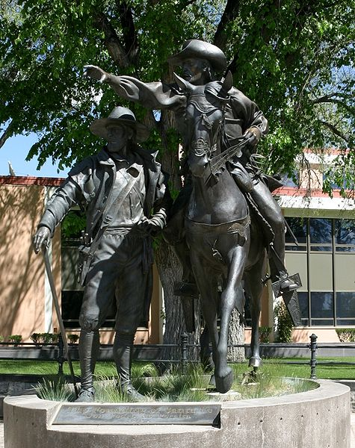
Expansion
Spain sends priests to explore modern-day US.
  Why?
1609-1610 – Pedro de Peralta settles Santa Fe on the Rio Grande.
  Becomes headquarters for Catholics in America.

Slide 20
You Can’t Make Everyone Happy
Both priests and natives are unhappy with Spanish rule. Why?
  Encomienda
  “There is nothing more detestable or more cruel than the tyranny which the Spaniards use toward the Indians for the getting of pearl” – Dominican Monk

Slide 21

Changes
1542 – encomienda abolished
  Suggest Africans as a substitute
Native resistance – happened since day one.
  1680 – Pueblo Resistance in New Mexico
    Pueblo push Spanish back into modern-day Mexico

Slide 22
What would you take to sea?
You are about to undertake a long sea voyage.
1. Choose among the four or five of you what duties you will have on
the ship. What role will you play?
2. What type of ship will you choose for your journey?
3. Take a look at the world map or globe in your classroom. Where are
you sailing from? What is you destination?
4. What personal supplies will you need to survive this trip?
5. What kind of knowledge do you need to steer the ship in the right
direction?
6. What supplies will you need to keep the ship sailing?
7. Will your sailors and ship survive the journey?

