Slide 1
Trans-Atlantic Trade: Conditions of Trade & Slaves
You will be assigned a “specific” leg of the Triangular Trade. Read about your assigned leg of the Triangular Trade taking note on items traded, and write a brief explanation of how the people/country benefitted from those items.
Then you will analyze a Primary Source document set related to your leg of the Triangular Trade. Look carefully at each source. Evaluate and list six observations/facts about the condition of enslaved Africans on your assigned leg of the Triangular Trade.
You will need one person to present your notes to the class. Each individual person will want to take notes on these presentations.

Slide 2
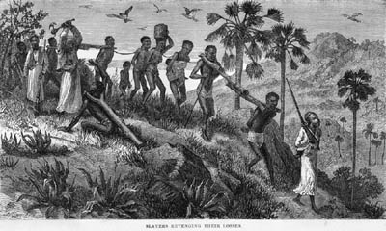
Enslavement in Africa

Slide 3
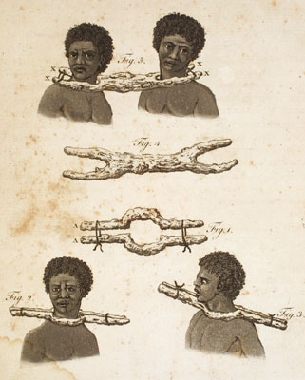
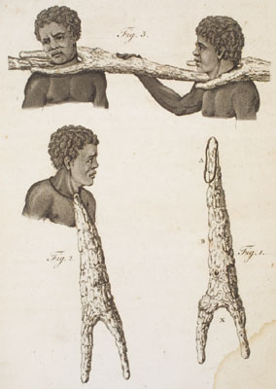

Slide 4
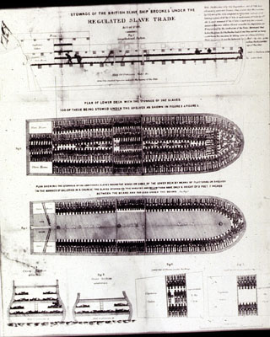
Middle Passage

Slide 5
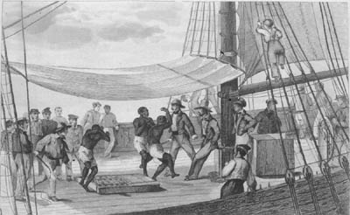
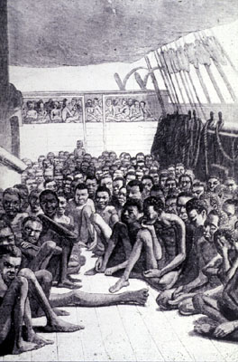

Slide 6
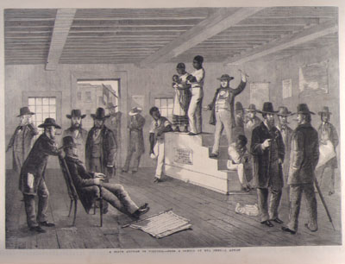
Slave Auctions in Americas

Slide 7
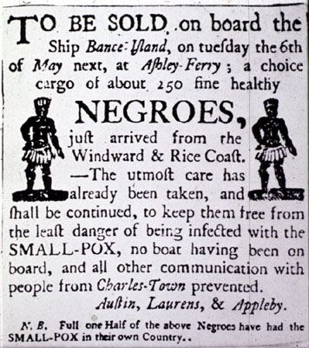
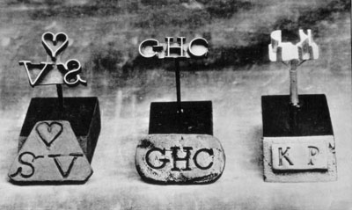
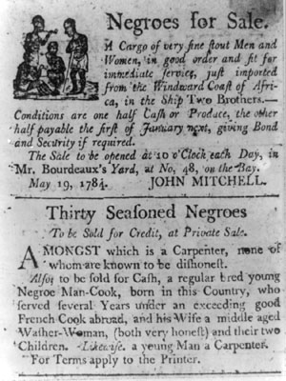
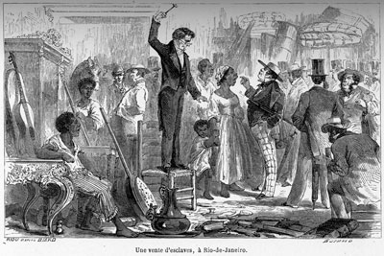

Slide 8
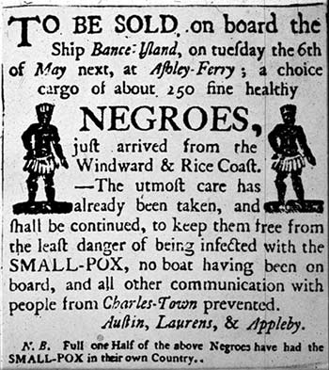
The Atlantic Slave Trade
The labor needs of Europeans leads them to enslaving millions of Africans in the Americas.

Slide 9
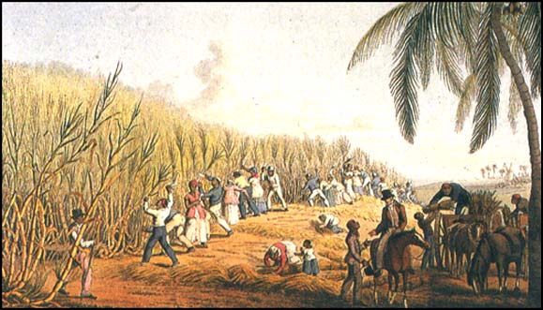
Definition
Slavery: social institution defined by law and custom as the most absolute and involuntary form of human servitude.

Slide 10
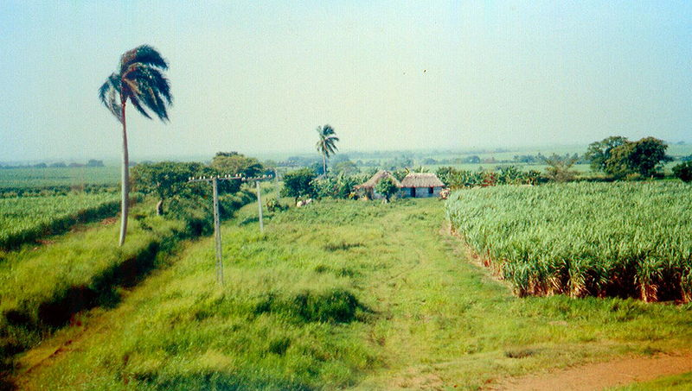
Why the Slave Trade?
Sugar plantations and tobacco farms required a large supply of workers.
Native Americans were once the labor force, but…

Slide 11
Why the Slave Trade?
Sugar in England – Before 17th century, sugar was rare in Europe.
By 1700, English consumed 4lbs per year.
By 1750, consumption doubled.
By 1800, it was 18 lbs. per year.

Slide 12
Why the Slave Trade?
Flow of sugar from America depended on the flow of slaves from Africa.
Average American today?
156 pounds (31 five pound bags)

Slide 13
Causes
Sugarcane plantations
Africans already exposed to disease.
Existence of slavery in Africa
Spread of Islam caused an increase.
Why?
African merchants
Would capture Africans to be enslaved.
Traded in exchange for gold, guns, and other goods.

Slide 14
Triangular Trade
Connected Europe, Africa and Asia, and the American continents
First leg: Europeans transported goods (guns, cloth, etc.) to the west coast of Africa.
These items traded for captured Africans.
Second leg: The Africans were then sold in the West Indies in exchange for sugar, coffee, tobacco, cotton, etc.
Third leg: These raw materials then went to Europe for manufacturing.

Slide 15
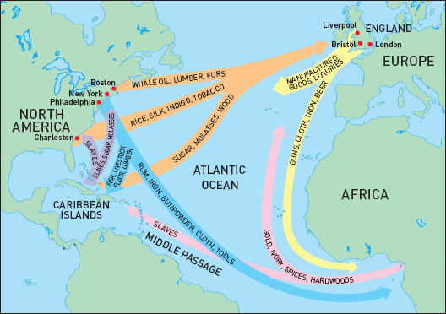

Slide 16
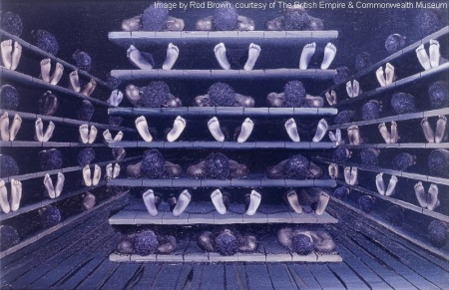
Middle Passage
Middle portion of the triangular trade
Packed ships as full as possible.
Death was very common.
Died from physical abuse and disease.
About 20% of Africans died during each trip.

Slide 17
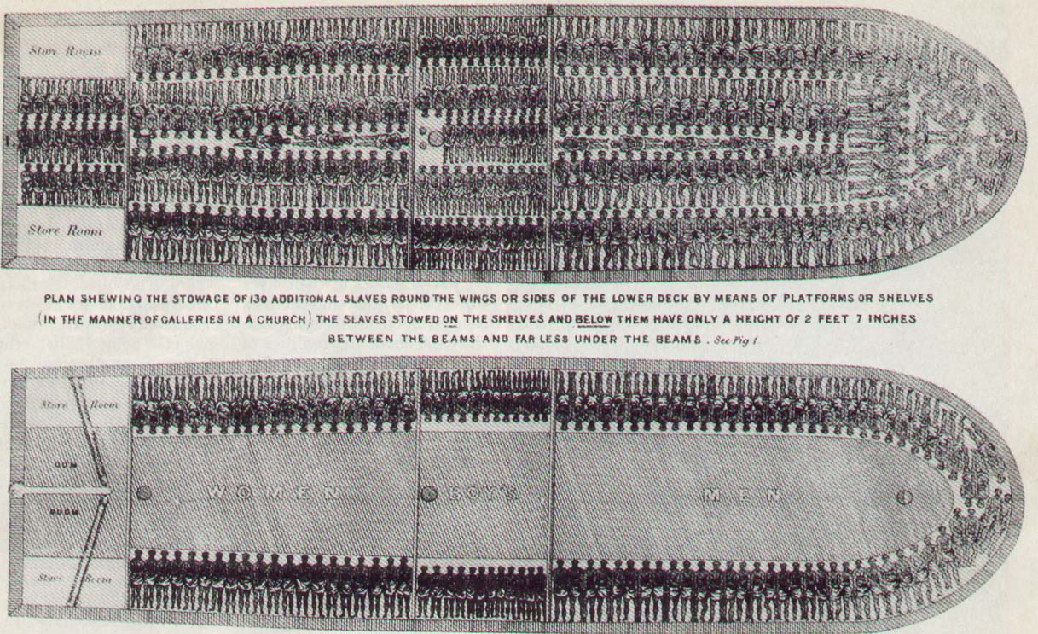

Slide 18
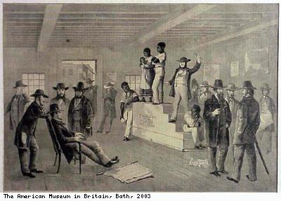
Life in the Americas
Slave markets – captured Africans would usually go to slave markets and sold to the highest bidder.

Slide 19
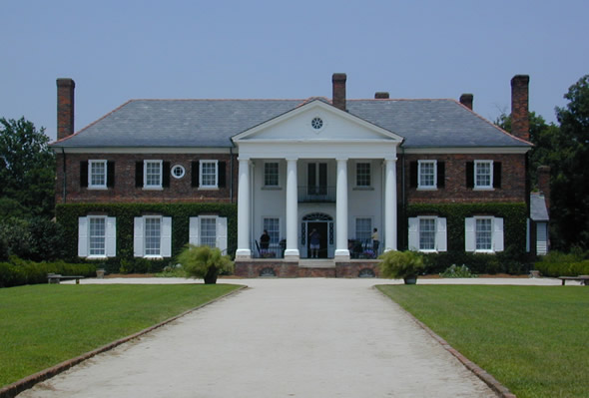
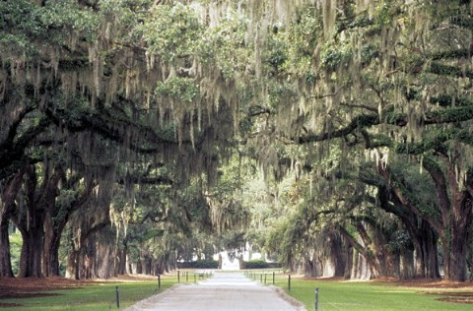
Life in the Americas
Life as a slave
Rural slavery: most worked on plantations in groups of ten or more.
Most work in the fields.
“Big House”
Some slaves worked here.
Is this good or bad?

Slide 20
Life in the Americas
Urban slavery: slaves who worked in mills and ships.
Carpentry and blacksmithing

Slide 21
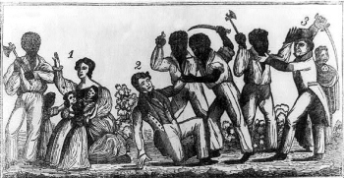
Life in the Americas
Education discouraged
Why?
Stono Rebellion in South Carolina (near Charleston) in 1739.

Slide 24
Consequences of the Slave Trade
Numerous cultures in Africa lost generations of people.
Some were the fittest and most able.
Families were torn apart.
Diverse society

