Slide 1
Journal
What is the best system/form of government? Why?
Please be sure to give a fully explained answer.

Slide 2
Today
Journal #(I have no idea, the next one in line)
Good things
Hand in take-home tests
Any questions?
Anyone want to share news articles?
Absolutism Intro-
New rules
What is Absolutism?

Slide 3
Standards
SS.HS-5-
5- The students will demonstrate an understanding of the influence of ideas and technology on the development of nation-states and empires in the sixteenth through nineteenth centuries.
5.1- Explain how the scientific revolution in Europe led to the questioning of orthodox ideas.
5.2- Analyze the ideas of social equality, democracy, constitutionalism and nationalism brought about by the Enlightenment and their effects on institutions.

Slide 4
Absolutism
Definition: . the principle or the exercise of complete and unrestricted power in government.
2. any theory holding that values, principles, etc., are absolute and not relative, dependent, or changeable.

Slide 5
Its been a while- let’s Review
16th Century
Where did we last leave Spain?
The Dutch?
The French?
The English?
Anyone else we are forgetting?

Slide 6
The Theory of Absolutism
Rulers wanted to be absolute monarchs.
This means king or queens who control every aspect of society.
Believe in divine right.
God created the monarchy and the monarch was God’s representative on earth.
Absolute monarch answers only to God!

Slide 7
Are there any benefits to absolutism?
Can you think of any situation in which this would be beneficial?
In which ways would it not be beneficial?

Slide 8
Growing power of the monarchs
What reasons can you think of for the growing power of monarch?
Decline of feudalism, rise of cities, more centralized authority.
How is it that ABSOLUTISM could even come about?
Middle class tended to back the monarchy- why?
What would be some reasons monarchs would turn to absolutism?
Territorial disputes, increasing warfare and need for increasing taxes, take power away from the lords.

Slide 9
france

Slide 10
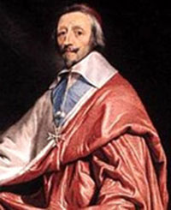
Absolute Rulers- Background Info
Louis XIII and Cardinal Richelieu (1610)
Louis- weak king
Richelieu was political mastermind
Put restrictions on Protestants
Weakened the nobles
France becomes involved in the 30 years war.

Slide 11
Louis XIV- 1643
Nobles attempt to rebel against the authority of king and cardinal.
This is worse for them- they simply live with the king’s absolute power.
Louis took away religious tolerance for Protestants (Huguenots)

Slide 12
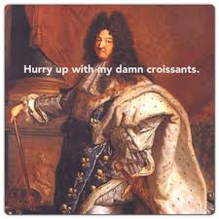
Louis’ Grand Style
Spent a fortune!
“Once devoured four plates of soup, a whole pheasant, a partridge in garlic sauce, two slices of ham, a salad, a plate of pastries, fruit, and hard-boiled eggs” in one sitting!
King would wake and 100 men of the nobility would be waiting to help him dress.
Beautiful and immense Palace of Versailles.
France in the most powerful country in Europe under Louis!
Center of the arts.
Opera, ballet, literature
Purpose of art was to glorify the king!

Slide 13
Russia

Slide 14
Peter the Great- CZAr (tsar) of russia (1696)
One of Russia’s great reformers.
Increases the power of the czar!
Goes on “Grand Embassy” to western Europe
Why would he want to do this?
What does the term Westernization mean?
Why do you think Russia is so different from Western Europe?
Geography, religion, Mongols

Slide 15
Russia Westernizes Under Peter
Potatoes are introduced
Started the first newspaper
Raised the statues of women
Ordered nobles to wear western clothing
Advanced education
Established port city of St. Petersburg to aid with trade

Slide 16
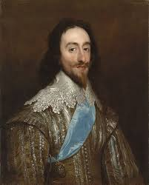
England- Charles I
Elizabeth dies and her nephew James I takes over.
James son is Charles.
Charles I becomes king in 1625
Charles always needed money- if Parliament said no, he would dissolve it.
1628- Parliament makes Charles sign the Petition of Rights stating:
He would not imprison subjects without due cause
Would not levy taxes without Parliament’s consent
Would not house soldiers in private homes
Would not impose martial law in peacetime.

Slide 17
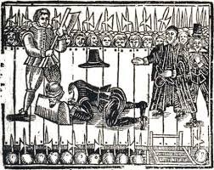
UH OH…
Charles signs Petition of Right… and ignores it.
Dissolves Parliament and refuses to call it back into session.
Popularity continued to decrease.
1641- Parliament passed laws to limit royal power.
Charles tries to arrest members of Parliament and flees to the North where he raises an army.
English Civil War begins!
Oliver Cromwell vs. Charles- Charles is executed!

Slide 18
Limit on Monarch’s Power
1688- William and Mary of England
At coronation they recognized Parliament as their partner in governing.
From absolute monarchy to constitutional monarchy.
English Bill of Rights: drafted by Parliament in 1689.
No suspending Parliament’s laws
No levying taxes without their consent
No interfering with freedom of speech
No penalty for a citizen who petitions the kings about grievances.

Slide 19
What do the following terms mean?
Social Equality
Constitutionalism
Nationalism
Why are they important for us to know about and understand?

Slide 20
In Groups
If you were faced with an absolute ruler, what limits would you want on his or her power?
Make a list of 10 limits you would want in your “Petition of Rights”.
What can your ruler do or not do?

