Slide 1
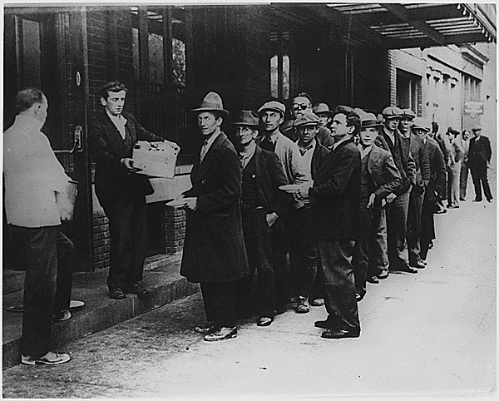
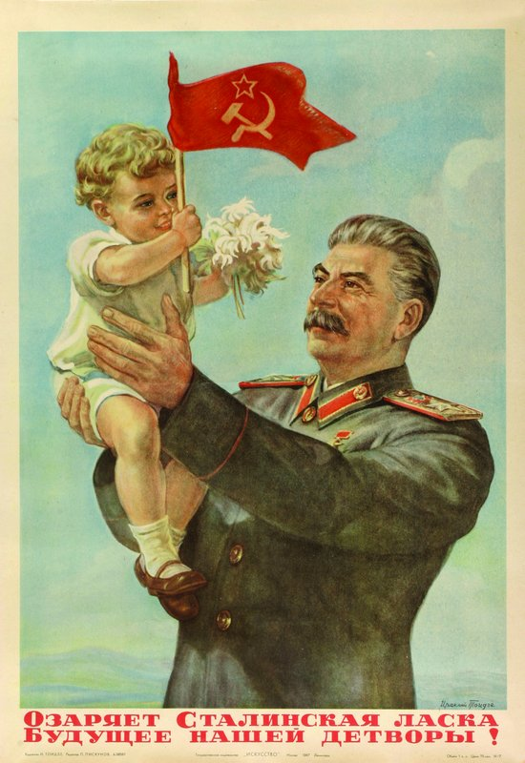
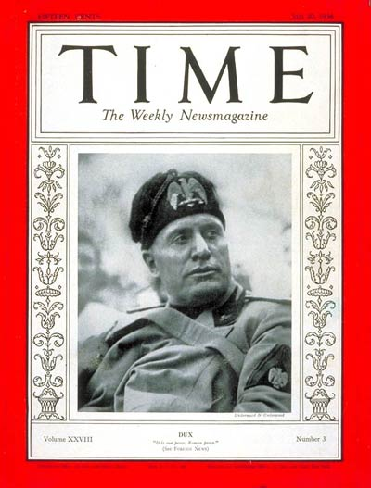
The Age of Anxiety

Slide 2
“Prague Street” by Otto Dix

Slide 3
Adolf Hitler
This is one of the few known photographs of a young Adolf Hitler, taken in 1923.

Slide 4
Seven Deadly Sins, Otto Dix
In his disturbing painting of the Seven Deadly Sins (1933), Otto Dix features Hitler, clearly identified by a black moustache, in the guise of envy.
Catalogues the excess and horror of the depression years in Germany
Hitler is depicted as gluttonous child
Fearing retribution while the Führer remained in power, Dix added the moustache after Hitler's death.

Slide 5
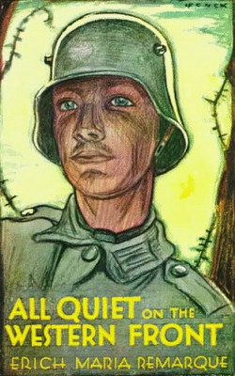
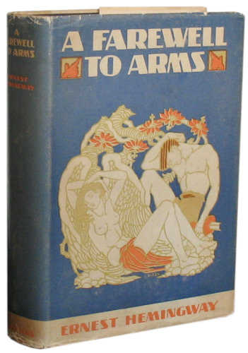
Probing Cultural Frontiers
The “lost generation”
It was a term used to describe the pessimism of US and European thinkers after the war
Looking for meaning in life
Postwar poetry and literature reflects the disillusionment with Western culture
Novels such as All Quiet on the Western Front, and Hemingway’s A Farewell to Arms
Ex. American poet T.S. Elliot
Western culture has lost it’s spiritual values
Postwar world is barren “wasteland”, drained of hope and faith

Slide 6
And as I sat there brooding on the old unknown world, I thought of Gatsby’s wonder when he first picked out the green light at the end of Daisy’s dock. He had come a long way to this blue lawn, and his dream must have seemed so close that he could hardly fail to grasp it. He did not know that it was already behind him, somewhere back in the vast obscurity beyond the city, where the dark fields of the republic rolled under the night.
Gatsby believed in the green light, the …future that year by year recedes before us. It eluded us then, but that’s no matter-tomorrow we will run faster, stretch our the arms farther…And on fine morning-
So we beat on, boats against the current, borne back ceaselessly into the past.
F.Scott Fitzgerald, The Great Gatsby

Slide 7
“Prague Street”, Otto NIX

Slide 8
George Grosz, Pillars of Society, 1926

Slide 9
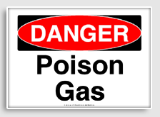
Attacks on the Ideal of Progress and Capitalism
Science tarnished by the technological horrors of WWI
War loosened hold of tradition
Casualties promoted social mobility allowing commoners move into positions previously dominated by aristocrats
Most western societies granted universal suffrage to all men and women
Women in US, Britain, Germany, Sweden, and Austria gained right to vote
Flappers: Abandon restrictive clothing & hairstyles , wore makeup, drive, smoke in public, open sexuality
-Many idealized “elite rule” and see democracy as a product of decay and lacked values

Slide 10
Consumerism, Radio, Movies
Consumerism
Acquire washing machines, vacuum cleaners, gas ovens, etc.
Radio and Movies
Vehicles of pop culture
American Jazz and Hollywood stars become international celebrities

Slide 11
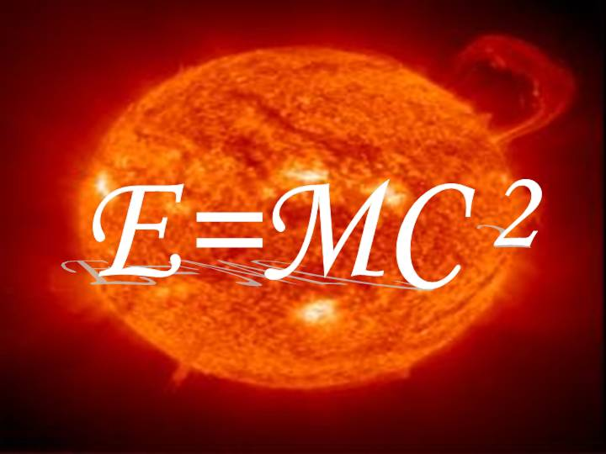
Revolutions in Physics and Psychology
Albert Einstein’s theory of relativity, 1906
Time, space, energy, and mass are not fixed but relative to one another
“C” or “speed of light” is the only constant in the universe
Reality and truth was merely a set of mental constructions
Einstein became symbolic for the revolution in physics.

Slide 12
Albert Einstein
One of the best-known faces of the twentieth century, Albert Einstein was the symbol of the revolution in physics.

Slide 13
Freud’s Psychoanalytical theory 1896
Developed psychoanalysis to analyze minds of patients
Argued psychological problems were caused by trauma and later repressed
Trauma came from sexual experiences in early childhood
Guided patients to interpret dreams since they held key to your unconscious mind
Ex. Oedipus complex
Controversial among psychologists and public
Today his psychoanalysis methods are influential

Slide 14
Freud
A striking painted portrait of Sigmund Freud. Freud formulated psychoanalysis, a theory and clinical practice to explore the mind and, by extension, its creations, such as literature, religion, art, and history

Slide 15
Experiments in Art
Paul Gauguin, Nafea Fan Ipoipo (“When are you to be married?”; 1892). Gauguin sought the spiritual meaning for his art in the islands of the South Pacific. This painting of two Tahitian women revealed his debt to impressionism, but also showed his innovations: strong outlines, flat colors, and flattened forms.

Slide 16
Picasso
Pablo Picasso's Les Demoiselles d'Avignon (1907) was the first of what would be called cubist works. This image had a profound influence on subsequent art.

Slide 17
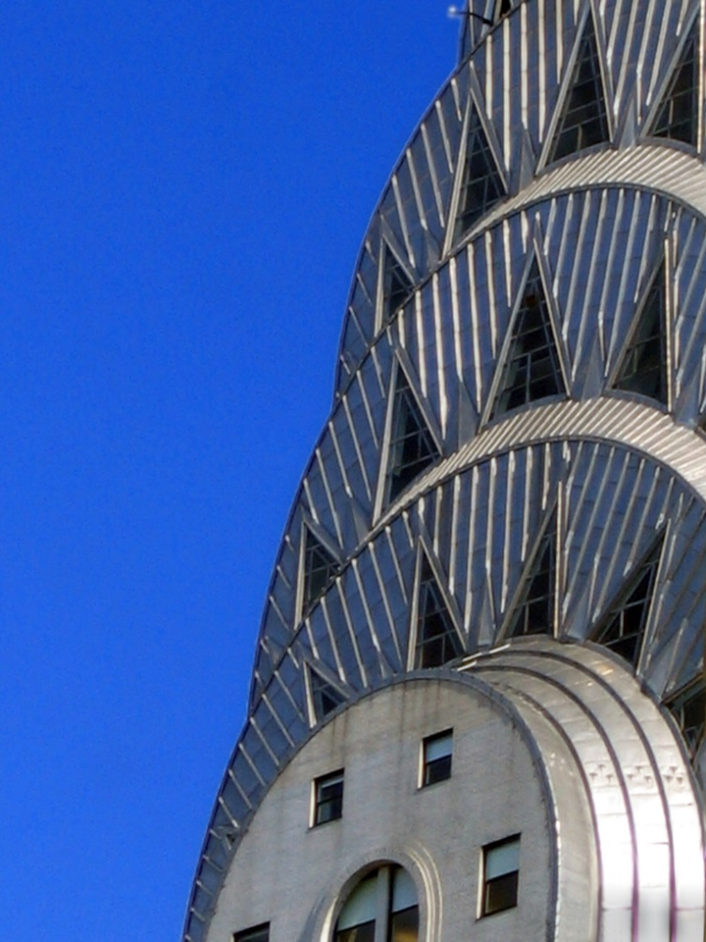
Technology and the Environment
Architecture
Skyscraper transforms the urban environment
Ex. New York and Chicago
Detail of the art deco crown of the Chrysler Building
Empire State Building, 1932

Slide 18
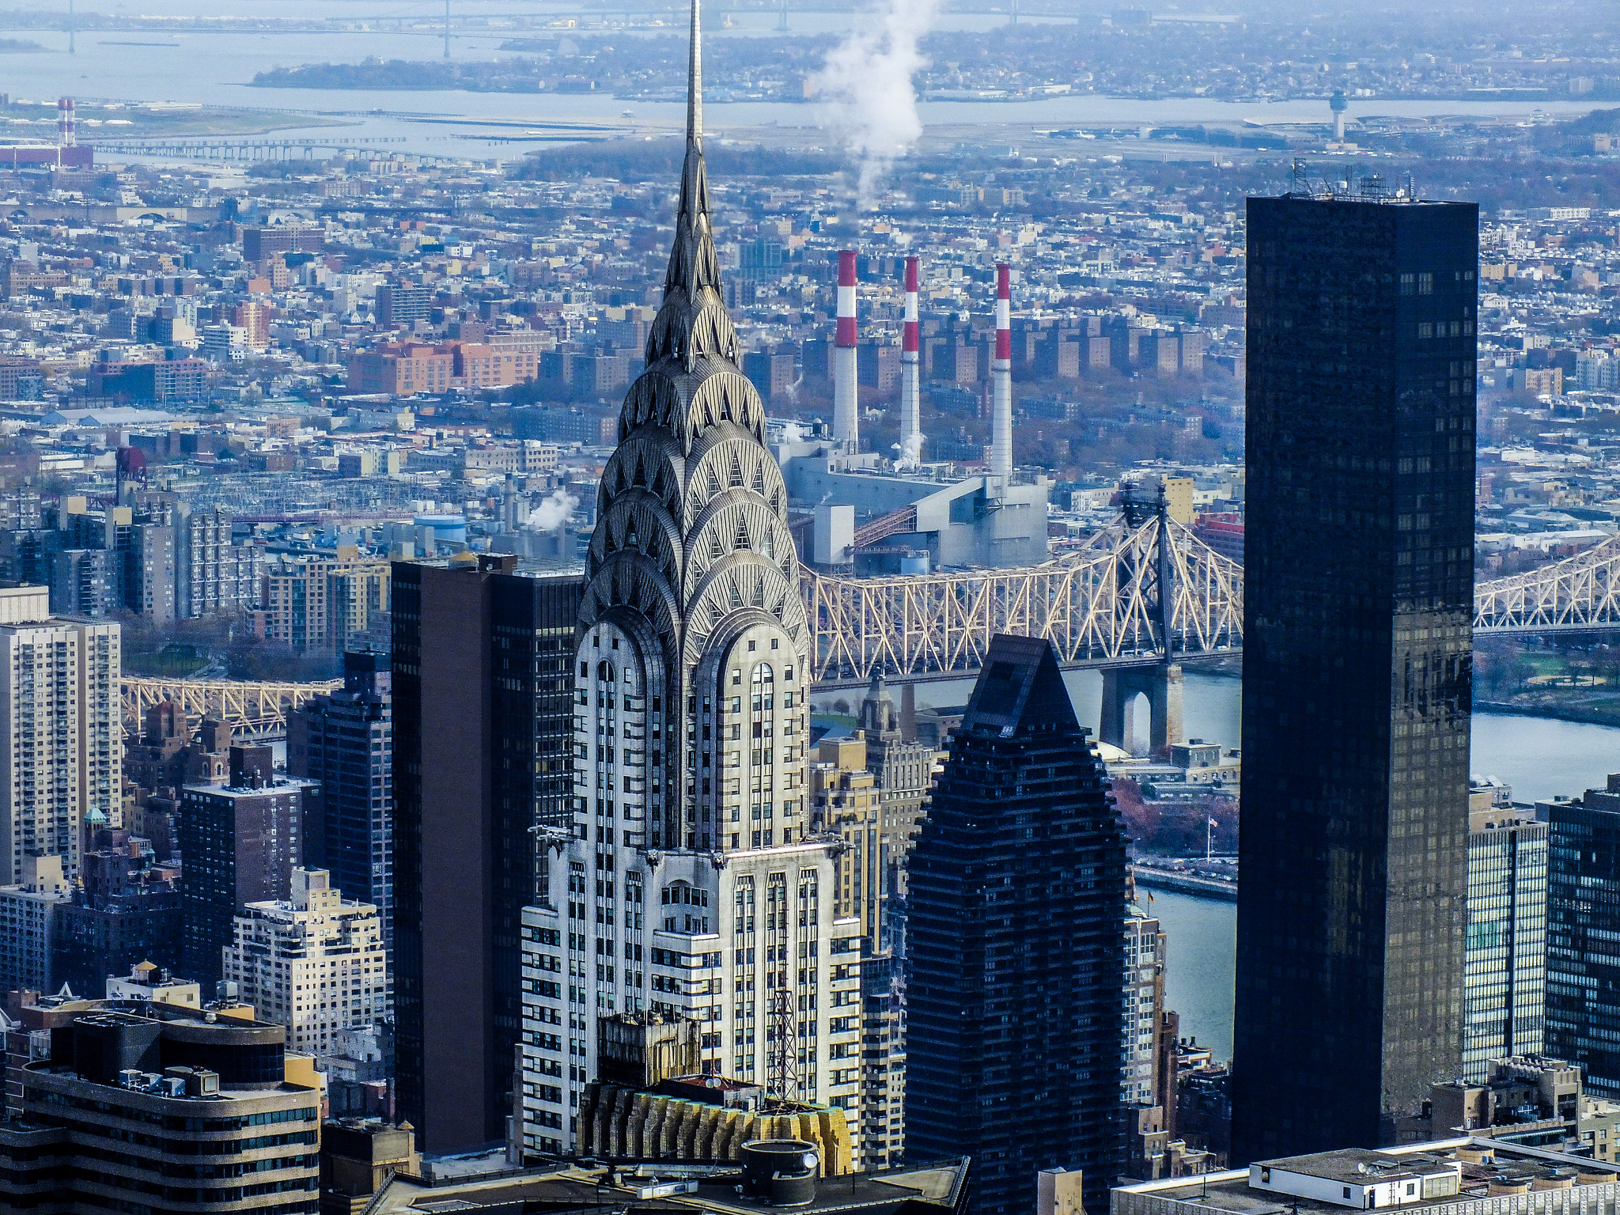
Chrysler Building was the world’s tallest building for 11 months until the Empire State Building surpassed it in 1931. Art deco style, brick and steel,

Slide 19
Functional Architecture
Designed by Walter Gropius in 1925, this building introduced the functional international style of architecture that dominated for the next half century.

Slide 20
Paris city view
European cities limited height of buildings to protect architectural heritage

Slide 21
Swiss architect: Le Corbusier’s Villa Savoye in Legos
Simplicity of form, absence of surface ornamentation, easy manufacture, and inexpensive materials

Slide 22
American Architect: Frank Lloyd Wright
“Falling water” is located in Mill Run, Pennsylvania 1937. Known as “organic architecture”

Slide 23
Another example of Frank Lloyd Wright: Guggenheim Museum in NYC, 1959

Slide 24
Experimentation in Art
Modern painting: when photography can reproduce nature, why should painting?
No widely accepted standards of art
Some sought to express feelings and emotions through violent distortion and color
Others tap into subconscious mind
Salvador Dali
The Persistence of Memory, Salvador Dali, 1931 from MoMA, NYC

Slide 25
Pablo Picasso-Cubism (1881-1973)
The Three Musicians, 1921
Dora Maar au Chat, 1941

Slide 26
Guernica, Picasso 1937
Commissioned in response to the German/Italian bombing of Guernica during the Spanish Civil War in 1937
Became symbol of the tragedies of war, especially to civilian populations

Slide 28
The Global Depression
Global economy & European gov’ts weak in 1920’s as they recover
Many coalition gov’ts that were
1919 German Weimar Republic was the democratic gov’t set up after WWI
Germany suffers hyperinflation1923
Caused by war reparations and economic failures
Kept printing $
Aug. 1922 –Nov. 1922 prices rose 1 trillion %
1923, $1 = 4 trillion German marks
International committee helps stabilize economy –Dawes Plan
Gov’ts and businesses try to rebuild, however short-lived
German children use sacks of $ as building blocks during the 1923 inflation.

Slide 29
Dawes Plan 1923
The loan from the US for $200 million to stabilize German currency and strengthen their economy

Slide 30
What led to the Great Depression?
Historians find it a complicated task
US economy booms during 20’s and wartime demand had stimulated industrial and agricultural capacity
However:
By late 20’s, farms and factories producing more than could be sold
Europeans couldn’t afford to buy the products also
Germany and Austria made reparation payments with US loans
Britain and France were indebt to US, but depended on the reparations to pay their loans
US economic boom prompted many to speculate and invest beyond their means
Buy stocks on margin

Slide 31
The Crash of 1929
Black Thursday: October 24, 1929 stocks plummet and investors lost life savings
Nearly 13-16 million shares traded on that day-record
Prices dropped so fast that stock ticker couldn’t keep up
Exchange lost $14 billion in value or 10% of US federal budget that year (Time)
Eleven Wall Street financiers committed suicide by jumping out skyscrapers
Banks closed
Outside NYSE on Black Thursday

Slide 32
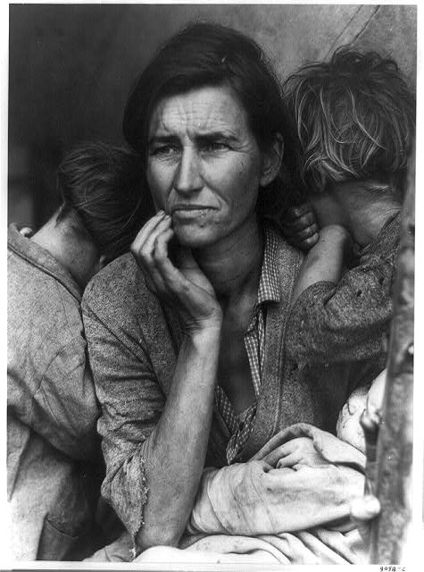
Effects of the Stock Market Crash
Deepest depression in history
Consumers reduced purchases
Businesses cut production
By 1932, unemployment at 25%
Farmers bankrupt
In 1930, US gov’t imposed the Smoot-Hawley tariff on imported manufactured goods, highest in American history
Tariff-taxes charged by gov’t on imported goods
Ex. Protectionism
Countries retaliate with their own tariffs
B/n 1929-1932, global industrial production was down 36% and world trade dropped to 62%
Migrant Mother. 4 million migrants were on the road by the end.

Slide 33
Personal Suffering
In January 1932, ten thousand hunger strikers marched on Washington, D.C., seeking government relief for their misery.

Slide 34
Soup kitchens and breadlines became commonplace in the United States during the earliest, darkest years of the Great Depression. They fed millions of starving and unemployed people.

Slide 35
Human faces of the Great Depression: children bathing in the Ozark Mountains, Missouri, 1940.

Slide 36
Depression in Industrial Nations
Spread to Europe by 1931
France and Britain weather it by making colonies purchase their products
German unemployment reaches 6 million by 1932
½ German pop. lived in poverty while those in jobs saw salaries cut
Japan’s farmers suffer crop failures
Families eat tree bark and roots to survive

Slide 37
Hoover Dam
Constructed from 1931-1935 during the Depression. B/n 10-20 thousands of the unemployed come to southern Nevada to gain work.

Slide 38
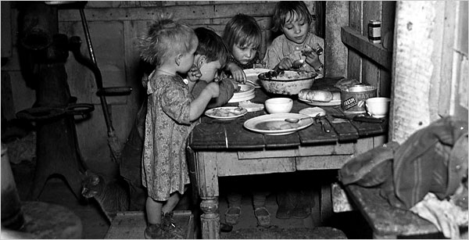
Despair and Gov’t Action
By 1933, unemployment in industrial societies reached 30 million
For a short period of time, women stayed employed b/c only paid 2/3 of amount of men
Struggle for food, clothing, shelter
Marriage, childbearing, divorce decline
Suicide goes up
Social divisions and class hatreds become stronger
Adolescents finish school to face a nonexistent job market

Slide 39
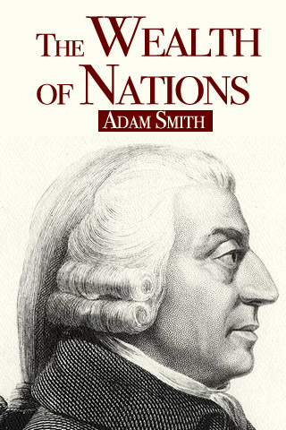
Economic Experimentation
Classic economic thought said that capitalism was a self-correcting system that operated when left to its own
Didn’t necessarily work in the 1930s

Slide 40
John Maynard Keynes
Most influential economist of 20th c. who wrote The General Theory of Employment, Interest, and Money
His answer to Great Depression
Gov’t needs to stimulate the economy by increasing $ supply, lower interest rates, and encourage investment
Gov’t should undertake public work projects to provide jobs and redistribute incomes through tax policy
It will reduce unemployment and increase consumer demand

Slide 41
Political Repercussions From the Depression
FDR was elected president in 1932 on a “New Deal” platform
Social Security
FDIC
Civil Conservation Corp.
Germany and Japan turn to radical leaders who turn their nations into military machines hoping to acquire empires & self-sufficient economies

Slide 42
Depression in Asia, Africa and Latin America
China was little affected by trade with other countries b/c of political problems
Latin America saw unemployment, homelessness increase
Military officers seize power
Imitate dictatorships of Europe
Russia not affected b/c of Stalin’s Five Year Plan
Africa
Egypt dependent on cotton exports was hit
Gov’t becomes more autocratic
Southern Africa boomed
Copper deposits cheaper here

Slide 43
Communism in Russia
Must defend the world’s 1st “dictatorship of the proletariat”
Civil War in 1918-1920: Reds-Bolsheviks v. Whites
Bolshevik Red Army wins
Tsar executed as well as enemies of revolution
Lenin institutes the NEP: New Economic Policy 1921
-Temporarily restores market economy
-Large industry, banks, transportation, communications stay under state control
NEP-Period Marketplace 1921
Small-scale private trade brought rural
foodstuff into city marketplaces.

Slide 44
The Stalin Revolution
1920’s recover from Revolution & civil war
1929, Stalin leads them to economic and social transformation
Part of the Bolshevik Revolution, works his way up w/in party
Makes himself absolute dictator

Slide 45
Totalitarianism
A gov’t that takes total, centralized state control over every aspect of public and private life
Mass communications made it possible to reach into all aspects of their lives
Joseph Stalin at a Soviet congress in 1936. By 1928 Stalin had prevailed over his opponents to become the dictator of the Soviet Union, a position he held until his death in 1953.

Slide 47
Methods of Control
Police Terror
To enforce gov’t policies
May use spying, brutal force, or murder
Indoctrination
Instruction in the gov’ts beliefs
Begins very young
Propaganda and Censorship
Biased or incomplete information to sway people to accept beliefs
Control mass media
Suggesting that it is incorrect is treason and punished
Imprisonment or killed
Religious or ethnic persecution
“Enemies of the state”

Slide 48
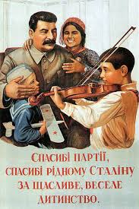
Propaganda and Censorship
Controlled all newspaper, motion pictures, radio etc.
Writers, composers, artists censored
No toleration of individual creativity
Rewarded those artists who created works of propaganda
All glorified the achievements of the Communist state, Stalin

Slide 49
Five Year Plans
Plans to industrialize the Soviet Union rapidly
Set goals for output of steel, electricity, and machinery
Created whole industries and cities from scratch
Peasants work in mines, factories, offices
Roads, canals, railroads cut landscape

Slide 50
Education and Indoctrination
Control of education
From nursery schools to universities
Learned virtues of Communist Party
Party leaders lecture on ideals
Stress importance of sacrifice and hard work to build Communist state

Slide 51
Religious Persecution
Replace religious teachings with ideals of communism
“Museums of atheism” displayed exhibits to show religious beliefs were superstition
Russian Orthodox church was the target of persecution
Leaders killed or sent to camps
Destroy churches and synagogues

Slide 52
Women’s Role in Soviet Society
Soviet women won equal rights after Bolshevik Revolution 1917
Under Five Year Plan, they are forced to join labor force
Same jobs as men
Work in factories, built dams, roads
Careers in science engineering
75% of Soviet doctors were women in 1950
Motherhood was patriotic duty to provide state with future, loyal, obedient citizens
Liberated women-build up socialism
1926

Slide 53
Collectivization of Agriculture
Men and women drive tractors out of one of the Soviet Union's Machine Tractor Stations to work fields where mechanization had been a rare sight.

Slide 54
Collectivization of Agriculture
Consolidated the small private farms into vast collectives
Farmers had to work together in commonly owned fields
Collectives required to supply gov’t w/ fixed amount of food and distribute the rest
Kulaks (better-off peasants) resisted
Soldiers came at gunpoint & burnt crops, smashed equipment, slaughter livestock
½ of horses & cattle and 2/3 of sheep & goats slaughtered
Stalin orders the liquidation of kulaks as a class
8 million executed, sent to gulags, or starve to death

Slide 55
Famine
Peasants left to farm were least competent
Could not plant or harvest enough to meet demands of cities
Gov’t took everything they found
1933-34 famine killed some 5 million people

Slide 56
Stalin’s Second Five Year Plan
Ran from 1933-37 emphasized heavy industry to produce armaments
Metals and machines increase 14 x over but consumer goods scarce
Leaves Soviets without clothing, food, and housing

Slide 57
The Great Purge
A campaign of terror directed at eliminating anyone who threatened power
Estimate 8-13 million deaths
Stalin used secret police, the NKVD, to prevent rebellion
Arrested engineers and technicians for fear of counterrevolutionary ideas
Expelled 1 million members of Communist party
Great Purge Trials
Accused Communist party members of treason
Executed or sent to “gulags” or forced labor camps for “crimes against the Soviet state”

Slide 58
Gulags
People from all walks of life arrested for any or no reason
Millions sent without trials to gulags
There they die of exposure of malnutrition
At height, some 8 million sent/ 1 million die

Slide 59
Outcome of Stalin’s Regime
Citizens supported his regime with new industries, cities, employment opportunities for everyone
His brutal methods helped them industrialize faster than any country had done
By late 1930’s, USSR was the 3rd largest industrial power after US and Germany

Slide 60
Fascism
A political movement that promotes extreme form of nationalism and militarism.
It pledges loyalty to an authoritarian leader who guides and brings order
The state is supreme
It is more important than the individual
It includes a denial of individual rights
It includes a dictatorial one-party rule
Wore uniforms of certain color, used special salutes, held mass rallies
Word comes from Latin for fascis, a bundle of wooden rods tied around an ax handle. This was a symbol of authority in ancient Rome.

Slide 61
Comparing Fascism to Communism
Fascism
Did not seek classless society
Seek classless society
Dictator with one party rule
Internationalist, who were hoping to unit workers worldwide
State is supreme and no individual rights
They were nationalists
It has a place and function
Communism

Slide 62
Mussolini’s Italy
Seeking radical answers in response to WWI
Italy disappointed
Benito Mussolini (1922-1943)
Great orator who glorified warfare and & Italian nation
Leader of the Fascist party in Italy
1922 appointed prime minister
Known for his bombastic speeches, spectacular parades, and signs proclaiming “Il Duce is always right!”

Slide 63
Fascism in Italy
Install Fascist members in all gov’t jobs, crush opposition parties
1,000s imprisoned, exiled, or executed
Take over press, education, youth activities and gave employers control over workers
Mussolini’s genius was how he applied modern mass communications & advertisements to political life
His techniques will be mimicked by others in Europe, Latin America, China, and Japan
1936 Mussolini forms alliance with Hitler known as the Rome-Berlin Axis-…”world history would revolve around a Rome-Berlin Axis”
“…the twentieth century will be a century of fascism, the century of Italian power.” Mussolini, 1932

Slide 64
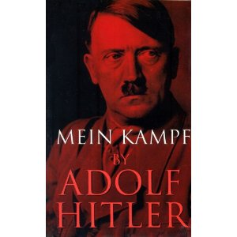
Nazism
1921 Hitler becomes chairman of the National Socialist German Workers Party –Nazi Party
1923 Hitler and party attempt to overthrow the democratic Weimar Republic
Hitler is jailed and released in 1924
Writes Mein Kampf in prison
He reorganizes with goal of gaining power legally
Hitler and all defendants before trial after the attempted coup d’etat known as the Beer Hall Putsch.

Slide 65
Hitler’s Goals from Mein Kampf
Believed Germany should incorporate all German-speaking areas

Slide 66
The Master Race
The most intense hatred was for the Jews
Blamed for every disaster of the Germans
The defeat of WWI
Looked for the day when the “Master Race” would dominate
“Alpine Race “ French and Italian
Russian and Eastern Slavs – The slaves of the master race
Aryan Race- Germans, Scandinavian, Britons

Slide 67
Lebensraum
Goal was to repeal the humiliation and military restrictions of Treaty of Versailles
Plan to annex all German-speaking territory to Germany
Living space to the east
Plan to eliminate all Jews

Slide 68
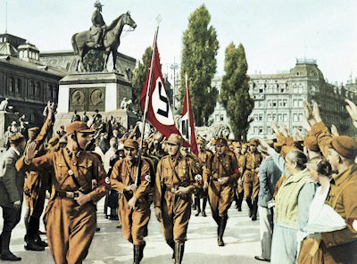
The Nazi Party in the 1920’s
For most Germans, his ideas are too extreme
When Depression hits, they gain supporters among the unemployed and property owners frightened by the growing popularity of Communism

Slide 69
The Third Reich
Hitler’s promise: A German Third Reich that would endure for a 1,000 years.
B/n 1930-32, the Nazi Party became the largest party in parliament
President Paul von Hindenburg offers him chancellorship
1933 Hitler becomes chancellor of Germany where he quickly assumed dictatorial powers
Nazis in charge of gov’t agencies, education, professional organizations
Banned all other political parties and threw their leaders into concentration camps or murdered
Political prisoners lined up at a concentration camp at Oranienburg

Slide 70
A 1924 painting of Hitler as a knight in shining armor, as the standard-bearer for National Socialism, became the state-sanctioned Hitler portrait for 1938; reproductions in poster and postcard form proved very popular.

Slide 71
The Racial State
Jews
Deprived of their citizenship and civil rights
Prohibited from marrying Aryans
Ousted from professions
Confiscated their property
Introduce measures to improve quantity and quality of the German race
Encouraged procreation among young people
Allowances and rewards for having children
“Mother and Child” was the slogan on this poster, idealizing and encouraging motherhood. The background conveys the Nazi predilection for the wholesome country life, a dream that clashed with the urban reality of German society.

Slide 72
Nazi Eugenics
Obsessed with “quality”, regime initiated a compulsory sterilization program for men and women whom they identified as having sicknesses
Schizophrenia, feeblemindedness, manic depression, hereditary blindness or deafness, chronic alcoholism, physical deformities
Also sanction abortions for them
200,000 euthanized and becomes precursor to the systematic extermination of the Jews
“This person suffering from hereditary defects costs the community 60,000 Reichsmark during his lifetime. Fellow German, that is your money, too.”

Slide 73
A Nazi “racial expert” uses a caliper to measure the racial purity of a German.

Slide 74
Anti-Semitism
1933 the Nazis initiate systematic measures to suppress Jewish population
Nuremberg Laws deprived them of citizenship, marriage or intercourse w/ Germans
Jewish civil servants lost jobs, lawyers, doctors lost non-Jewish clients
Liquidation of Jewish-owned businesses and purchased them at low prices
Throughout 1930s thousands left
Under a sign saying "With the Stürmer against the Jews" is a page display beneath the Nazi slogan "The Jews are our misfortune."

Slide 75
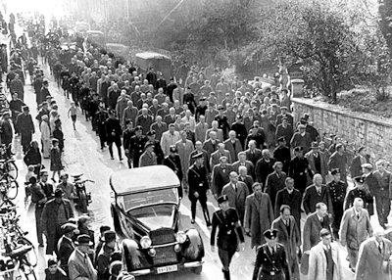
Kristallnacht- “Night of the Broken Glass”
Goal was for Jewish emigration
Gained urgency after Kristallnacht
Nov. 9-10, 1938, the Nazis arranged for the destruction of 1000s of Jewish stores, burning most synagogues, and the murder of more than 100 Jews
Became a signal to Jews of what would come
250,000 left by 1938
Aftermath of Kristallnacht
Jewish men at Baden-Baden in Germany are marched off under heavy guard to a concentration camp - marking the advent of Nazi mass roundups of Jews.

