Slide 1
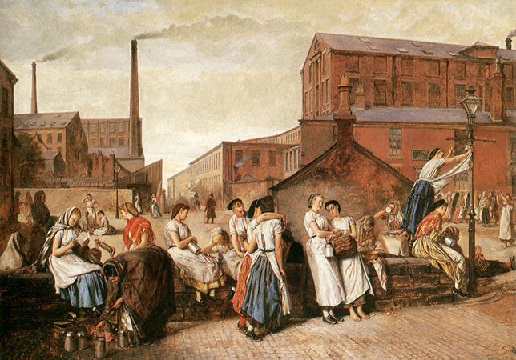
An Age of Revolution, Industry, and Empire 1750-1900
The Making of Industrial Society

Slide 2
Industrial Revolution
The transformation of the economy, the environment, the living conditions, occurring 1st in England in the 18th c., that resulted from the use of steam engines, the mechanization of manufacturing in factories, and innovations in transportation and communication.
By end of 19th c., factories became predominant site of industrial production in Europe, US, and Japan
The need to invest in expensive equipment encouraged large scale businesses: corporations, trusts, cartels
The most profound transformation in human life since the Agricultural Revolution.

Slide 3
The world in 1750…
By mid 18th c., several places in world had growing and dynamic economies
Western Europe
China
Japan
Had agricultural growth, larger populations and specialization, navigable rivers to facilitate trade, and banking institutions
But issues such as soil depletion and deforestation threatened population growth and consumption levels

Slide 4
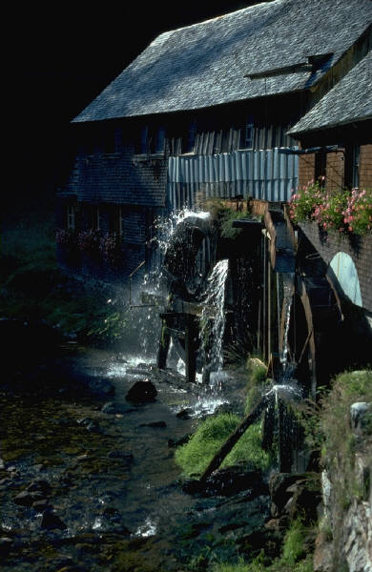
Why did England have the head start?
Enjoyed rising standard of living in the 18th c. b/c of trade and good harvests
World’s leading exporters of manufactured goods
Tools, guns, hardware, clocks
Naval power
Fluid society
Good water transportation
Indented coastline, rivers, canals
Unified internal market which encouraged regional specialization
Very active in export or overseas trade
Financial and insurance institutions, patent system
B/n 1789-1815, continental Europe engrossed in revolutions and war
Britain had all of the factors of production: Resources needed to produce goods and services that was needed
Land, labor, and capital

Slide 5
Another Agricultural Revolution
Potatoes, corn introduced to Europe
Crop rotation-Farm all land w/out stripping nutrients
Enclosures-Lands enclosed by fence or hedges by wealthy landowners in Britain who can afford to try out new methods
Selective breeding

Slide 6
With selective breeding, only the fittest and strongest males allowed to mate.

Slide 7
Resources for Industrialization
Coal in England
Wood had always been primary source for iron production, home heating cooking
Caused deforestation however
Coal was abundant in Britain
Easy access to water transport, centers of commerce, and pools of skilled labor
Substitute it for wood
Needed it to expand iron production
A woman working as a drawer in a British coal mine drags her coal cart with the aid of a belt and chain. Manually produced coal fueled the machines of early industrial society. What specific risks might have been associated with this kind of job?

Slide 8
Ecological Relief for Britain
Economic relationship with Americas gave them relief
Supply them with primary products
Sugar and cotton
Grain, timber, beef after 1830
Markets for manufactured goods in Americas
Migration to Americas also served as outlets for their surplus population

Slide 9
Foundations of Industrialization
Mechanization of Cotton Industry
Cotton replaces wool
Demand for cotton so strong that it lead to inventions that rapidly mechanized the industry
1769 Richard Arkwright invented the water frame, a machine that spun strong cotton threads at once
Used water wheel for power so built near fast-flowing river
1779 “Mule”-mechanical spinning device
Produced a strong, thin thread called muslin
Finer than the human made and cost less
Took India 500 hours to spin 1 lb. /self-acting mule =80 minutes
Undersell the high-quality from India
1785 Edmond Cartwright patented a water-drive power loom
1830 ½ million people working in cotton business
Richard Arkwright became the wealthiest and most successful textile manufacturer of the Industrial Revolution

Slide 10
Water Frame
1769 Water Frame by Richard Arkwright
Larger, more complex
Needed a source of water to power it
Water wheel
Machines located in a building next to a fast-flowing river

Slide 11
Textile factory
An 1835 engraving depicts female workers at a textile factory. The shift to machine-based manufacturing commonly started with the mechanization of the textile industries, not only in Great Britain, but also in other industrializing lands, such as the United States and Japan.

Slide 12
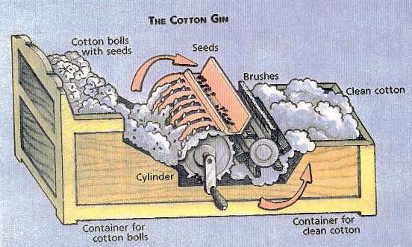
Cotton Industry Effects
Needed few skilled labor
Often hired children to tend spinning machines
Power looms replace hand weaving so $ of cloth fell by 90% b/n 1782-1812
Cotton became US’s most valuable crop
Eli Whitney’s cotton gin allowed for spread of cotton farming in southern states
By 1850’s, the southern states were producing 5/6th’s of the world’s total
By 1840, US had 1200 cotton mills, 2/3rd’s of them in New England

Slide 13
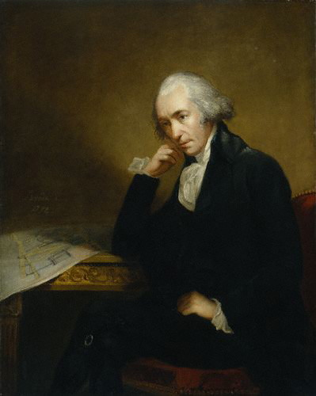
Steam Power
1765 James Watt
An instrument maker, University of Glasgow
1769 he improved on steam engine by making it faster and use less fuel
Use the term horsepower to measure the energy generated by his steam engine, which did the work of numerous animals
By 1800, widespread use in British Isles
In the textile industry where greater productivity and cheaper prices
In transportation: aids British imperialism and global trade

Slide 14
Water Transportation: Steamship
1807 American Robert Fulton ordered a steam engine from Boulton and Watt and built a steamship
1st successful trip in 1807 New York Harbor
By mid-1800s, water transportation used throughout a network of canals in England

Slide 15
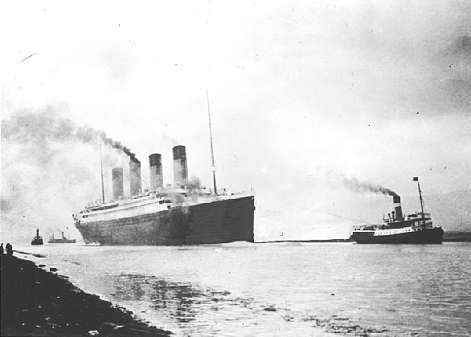
Transportation: Rail
1815 first steam powered locomotive
The Rocket-1829 went 28 mph
Mid-19th century steamships replace sailing ships
Railroads and steamships lower the cost of transportation and create dense transportation network
RMS Titanic on April 12, 1912

Slide 16
Railway Age Begins
First class passengers ride in the covered car; all other in open cars
Steam-driven locomotives drove English industry after 1820
1825 1st railway line ran from Yorkshire coal field to port of Stockton on North Sea (27 miles)
Between 1830-1870, Britain laid 13,000 miles throughout

Slide 17
The popularity of railroads, long a symbol of the Industrial Revolution, is illustrated in this early-nineteenth-century watercolor, which shows a miniature train offered as a paid amusement for enthusiasts in London’s Euston Square.
(Science Museum, London, UK/The Bridgeman Art Library)

Slide 18
Measuring the Industrial Revolution
Railroads are one useful measure of industrial development. This graph illustrates both Britain’s head start and the beginning catch-up efforts of other countries

Slide 19
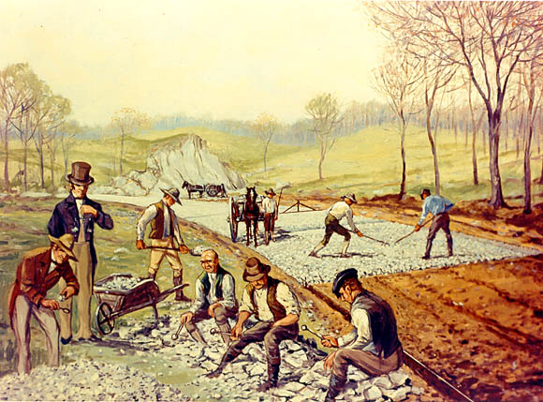
Road Transportation
John McAdam, Scottish engineer improved roads
Road beds layered with large stones at bottom
Smooth top layer of crushed rock
Prevent sinking in mud
Private investors formed companies that built roads
Called “turnpikes” b/c charged people to pay toll at the tollgate

Slide 20
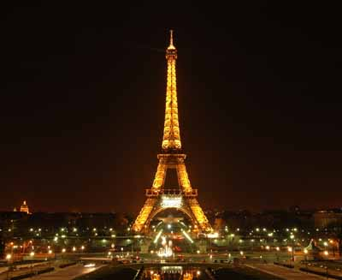
Iron and Steel
Iron
British began using coke, a purified form of charcoal, as fuel to make iron
Cheaper than charcoal so made iron cheaper and used more
Steel is stronger, but more expensive
Steel
Much harder, stronger, and more resilient than iron
1856 Bessemer converter used to make steel cheaper
Age of Steel
19th c. strong increase in use of steel
The Eiffel Tower was constructed for the 1889 World’s Fair in Paris. Originally criticized by French artists and intellectuals, but now serves as one of the cultural icons of the world.

Slide 21
Railcars
Wonder, power, and speed
“The iron rail proved a magicians’ road. The locomotive gave a new celerity to time. It virtually reduced England to a sixth of its size. It brought the country nearer to the town and the town to the country… It energized punctuality, discipline, and attention; and proved a moral teacher by the influence of example.”
What marks this family as middle class?
What does the poem at the top of the image suggest about the place of “home” in industrial Britain? How does the image itself present the railway car as a home away from home?

Slide 22
Crystal Palace Exhibition of 1851
Ex. of British pride, achievement and superiority
Housed in huge modernistic structure of cast iron and glass
Constructed in 9 months
Attracted 6 million visitors and 14,000 exhibits from around the world
The engraving from the exhibition’s “machinery department” first published in a London newspaper, illustrates the growing tendency of Europeans to view “technology as the main measure of human achievement.”²⁸
The Machinery Department of the Crystal Palace (Mary Evans Picture Library/The Image Works)
Notes:
Att

Slide 23
Crystal Palace, London, 1851, celebrated the “works” of industry of all nations.

Slide 24
The Factory System
Early modern Europe
Putting-out system
Wanting to avoid guild restrictions on prices and wages
The Factory
Became the method of production in industrial economies
Emerged in late 18th c. with British textile industry
Brought together more workers than ever before
Example of the mass production of pottery and Wedgwood
Required a division of labor
Broke it down into simple repetitive tasks
Unloading clay, mixing it, pressing flat pieces, dipping it in glaze, putting handles on the cups, packing kilns
Required a degree of coordination, work discipline, and close supervision
Required new innovative machinery
Ex. Josiah Wedgwood 1730-1795
English industrialist whose pottery works were the first to produce fine-quality pottery by industrial methods
Had wooden leg
When spotted inferior work, he dumped it on factory floor and crushed in with peg leg
“This will not do for Josiah Wedgwood”
Wedgwood plate 1780

Slide 25
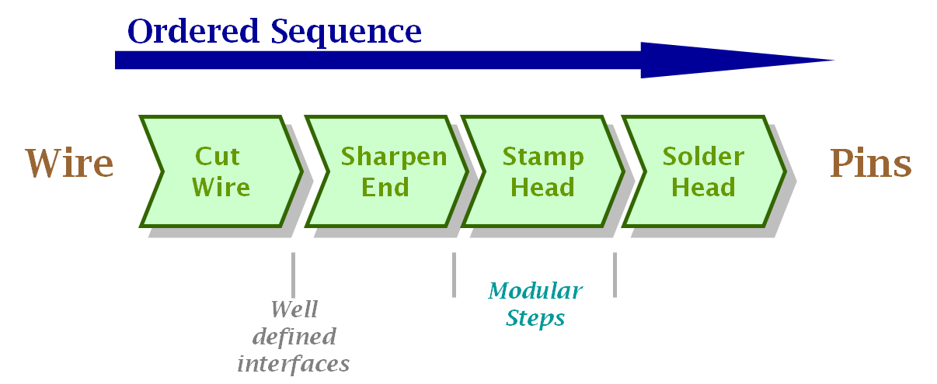
Division of Labor
“One man draws out the wire, another straights it, a third cuts it, a fourth points it, a fifth grinds it at the top for receiving the head;…and the important business of making a pin is, in this manner, divided into about 18 distinct operations.”
Adam Smith, Wealth of Nations 1776

Slide 26
Working Conditions in Factory
Led to an “owner class”
Workers lose status b/c become just wage-earners
Lose artisan skills
Clocks, machines, shop rules dictate work routines
Harsh work discipline, fast pace, frequent accidents or fatalities
6 days/ 12-14 hours
Gas lighting expanded the work day
Workers tend to a massive steam hammer under dangerous conditions.

Slide 27
Rise of Industrial Cities
After 1800, most of European populations moved to cities b/c of the growth of the factory system
B/n 1800-1850, the number of cities in Europe over 100,000 rose from 22 to 47
Period of urbanization and population growth
London grew to over 1 million by 1800-Europe’s largest city (Paris 2nd)
Manchester is case study w/ 300,000 by 1850
Center of Britain’s cotton industry

Slide 28
Industrial Britain
The dirt, smoke, and pollution of early industrial societies are vividly conveyed in this nineteenth-century engraving of a copper foundry in Wales.
(Bibliothèque des Arts Décoratifs Paris/Gianni Dagli Orti/The Art Archive)

Slide 29
Living Conditions
No building codes
Lack housing, education, and police protection
Unpaved streets
Garbage in heaps
Workers live in dark, dirty shelters w/ family in one bedroom
Disease and epidemics widespread
Cholera
Rickets: bone disease caused by lack of sunshine
1850 average life expectancy in England was 39.5
December 1912 issue of Le Petit Journal

Slide 30
Urban Poor of Industrial Society
This 1866 political cartoon shows an impoverished urban family forced to draw its drinking water from a polluted public well, while a figure of Death operates the pump. (The Granger Collection, New York)

Slide 33
Living Conditions
Well-to-do merchants and factory owners built luxurious homes in suburbs
Not much contact b/n rich and poor in industrial cities
Benjamin Disraeli’s novel, Sybil, published in 1845 describes these 2 ends of the spectrum:
“two nations between whom there is no intercourse and no sympathy; who are ignorant of each other’s habits, thoughts and feelings, as if they were dwellers in different zones or inhabitants of different planets.”

Slide 34
Working Class Women and Children
Women
Children
Work as domestic servants
1/3 of Europeans were one at some point in her life
Rural women take job and send $ back or saved it for dowry
Work at home if have small kids
Laundry
Embroidery
Take in lodgers
Work in textile factories
Earn 1/3 or ½ of as much as men
Long hours
Bring them to work at 5 or 6
No public school or day-care
Employers prefer them b/c cheaper, more docile
14-16 hour days
2/3’s were children in some cotton mills
Beaten if sleep or made mistake
Many families needed them to work to survive

Slide 35
Inside the Factory: Lewis Hine, Child Labor, 1912 (Oil over photograph, 1912, by Lewis W. Hine. The Granger Collection, New York)
A vegetable cannery in Baltimore in 1912
Lewis Hines spent much of his professional life documenting child labor and were influential in passage of child labor laws.

Slide 36
Women in Textile Industry
This 1909 photograph shows a young girl being instructed by a male supervisor on how to use a spinning machine. Women, not men, made up the bulk of the early labor force in the textile industry, principally because women were presumed easier to discipline than men and because women's smaller hands allegedly made them better suited for working with machines.

Slide 37
The New Middle Class of British Society
Entrepreneurs whose money came from manufacturing
Also includes skilled workers, professionals, wealthy farmers
Ex. Arkwright and Wedgwood
Will earn their way into high society
British aristocracy looked down on them for gaining wealth in the “vulgar” business world
Late 19th c. before considered equals
Gradually, a larger middle class, neither rich nor poor emerges also
Enjoy a comfortable standard of living
Doctors, lawyers, managers of factories
Politically were liberals
Thrift and hard work, rigid morality

Slide 38
Middle-Class Women in Britain
Middle-class women
Confined to the home
Homemakers, wives, mothers
Moral center for family and educators of “respectability”
Managers of consumption as “shopping” became a central activity
“Cult of domesticity” where they became responsible for home, servants, education of children, and family’s social life
Portrait of the Bellelli family by Edgar Degas. Husband and father at desk, suggesting his role in business, whereas wife and mother stands w/ children, suggesting her domestic role.

Slide 39
Cult of Domesticity in poetry
“Man for the field and woman for the hearth:
Man for the sword and for the needle she:
Man with the head and woman with the heart:
Man to command and woman to obey.
All else confusion.”
English poet Alfred, Lord Tennyson, aptly expressed this understanding in his poem “The Princess”

Slide 40
Industrial Workers at Play
European Soccer
American baseball
Gamble, socialize at pubs
Stage dog or rooster fighting
.
A small group of Englishmen find entertainment in a cockfight, a blood sport between two roosters. Cockfighting was a pastime already practiced in the Indus Valley by 2000 b.c.e. Banned out-right in England and Wales and in the British Overseas Territories with the Cruelty to Animals Act in 1835, it nonetheless remains a popular form of entertainment worldwide.

Slide 41
Positive Effects of Industrial Society
Brings wealth for the nation
Jobs for workers
Raised material standards of living
Healthier diets
Expanded educational opportunities
Reductions in cost of clothing, so variety
Mass produced
Except for the poor, all could afford several changes of cloths
Homes filled w/ furniture, cabinets, decorative objects-consumer goods
Eventually higher wages, shorter hours, better conditions
Exhibitors from around the world displayed fine handicrafts and manufactured goods at the Crystal Palace in London 1851.

Slide 42
John Leech, Capital and Labor
In critiques of the industrial era, social issues loomed far larger than environmental concerns. Visual Source 18.6, an image by British artist John Leech, was published in 1843 in Punch, a magazine of humor and social satire. It reflects a common theme in the artistic and literary representations of industrial Britain.
How are the sharp class differences of industrial Britain represented in this visual source?
How does this visual source connect the Industrial Revolution with Britain’s colonial empire? Notice the figure in the upper right reclining in exotic splendor, perhaps in India.

Slide 43
Population Growth
Growth reflects rising prosperity and standards of living
Early industrializing societies, birthrates were high, but death rates fell b/c of better diet and disease control
Ex. smallpox vaccine
Demographic transition
Shifting pattern of fertility and mortality
At first, lower fertility and mortality falls even faster, so continue to see increase in population
Over time fertility rates decline leading to lower population growth and stability
Reason: voluntary birth control through contraception
See this in Europe, United States, and Japan

Slide 44
A French newspaper sponsored free smallpox vaccinations in 1905; the serum of a cow infected with cowpox is being injected into waiting Parisians.

Slide 45
Urbanization and Migration
Move to City for Work
Japan
Europe
United States
Gustave Dore, a French book illustrator, sketched an image of Wentworth Street, Whitechapel, in London. By the middle of the nineteenth century, population shifts from rural areas to London made Whitechapel synonymous with poverty and overcrowding. Small dark avenues such as Wentworth Street contained the greatest suffering, filth, and danger.

Slide 46
Rise of Industrialization in Europe
After 1815, economies of Europe ready
Starts in places with large amounts of coal and iron ore like Britain
Belgium, n. France, w. Germany, Prussia
Create technical schools
Eliminate internal tariff barriers, tolls
Encourage formation of joint-stock companies
By 1830, the political climate in Europe was as favorable as Britain ½ century earlier

Slide 47
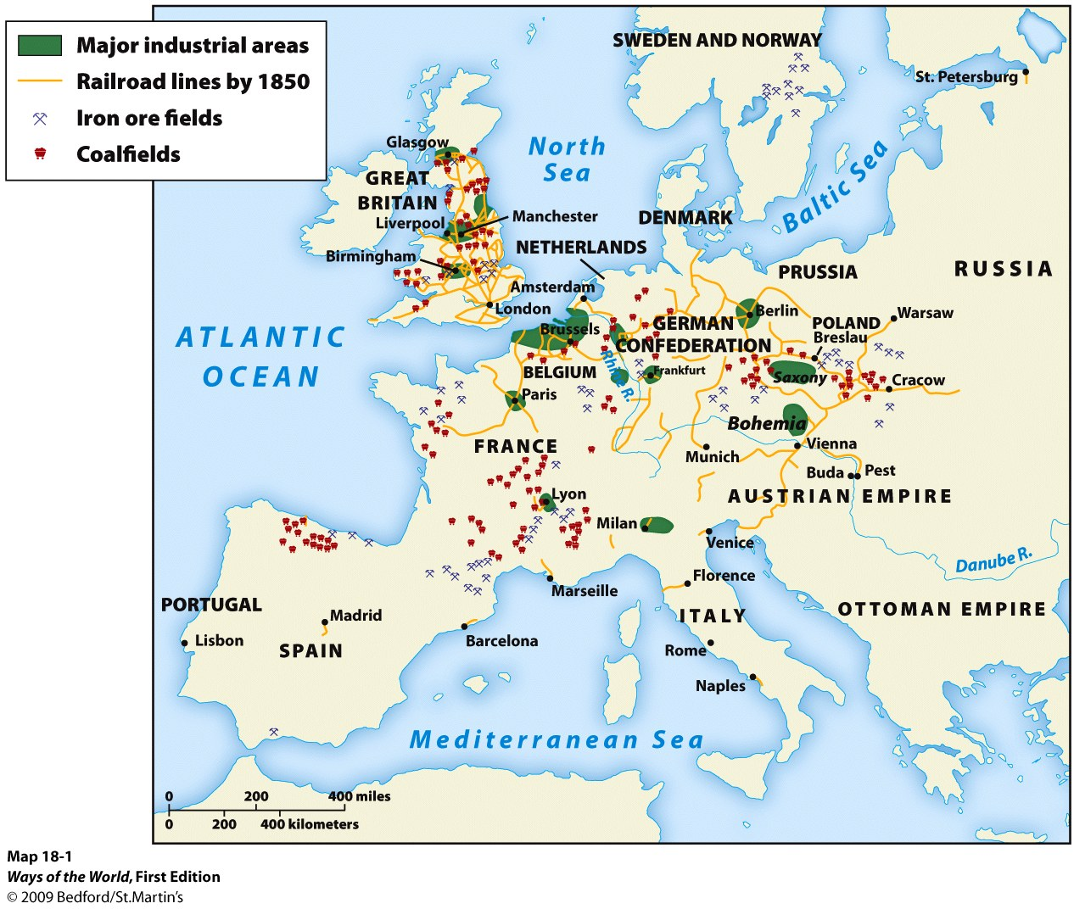

Slide 48
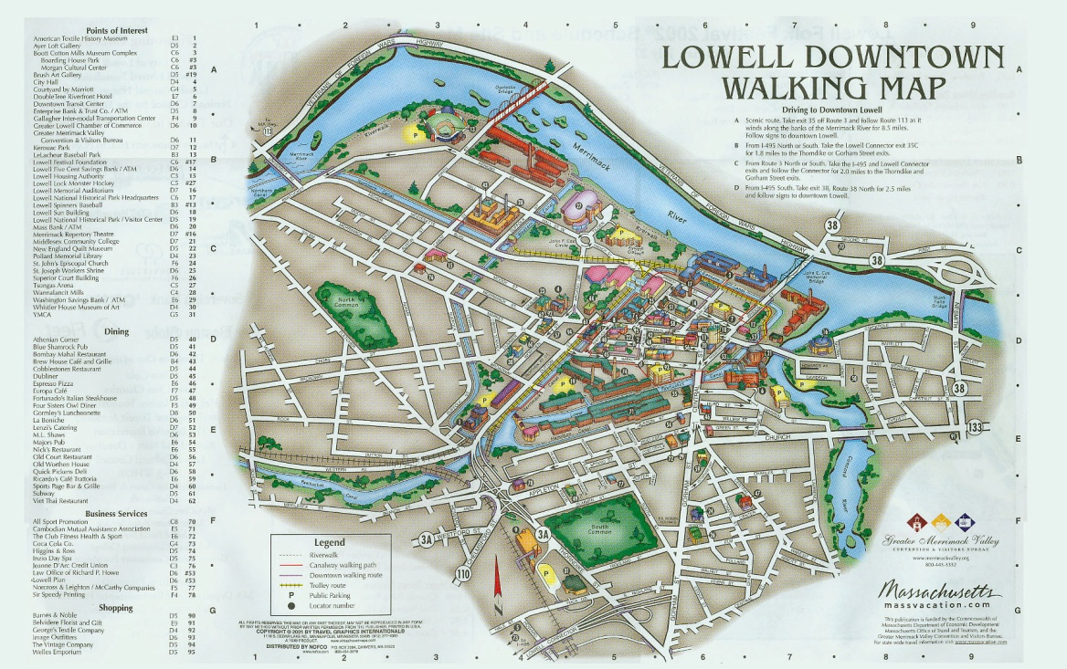
Industrial Development in the US
Began in the textile industry
1789 British mill worker, Samuel Slater, emigrated to US and from memory built a spinning machine
Used in Rhode Island to produce thread
1813 Francis Cabot Lowell of Boston opened a weaving factory
Mechanized every stage in the manufacturing of cloth
His factory earned enough money that he opened in another town
After his death, it was named after him, Lowell, Massachusetts
Single women flock to mills
Textiles, clothing manufacturing and shoemaking all underwent mechanization in North East

Slide 49
Expansion in the US
US after the Civil War experiences a technological boom
B/c of resources such as oil, coal, and iron; inventions such as the light bulb and telephone
Cities grew b/c of the location on railroad lines

Slide 50
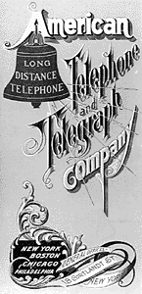
Rise of Corporations
Corporation
A business owned by stockholders who share in profits but are not personally responsible for its debt
Stock
Owner of stock has certain rights of ownership in the corporation
Part ownership in the corporation
They were able to raise large amounts of $ to invest in the industrial equipment

Slide 51
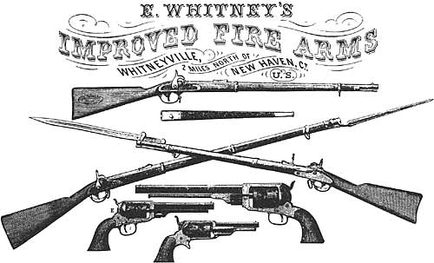
Industrial Capitalism
Mass Production
Eli Whitney also developed the technique of using machine tools to produce interchangeable parts in making firearms
Henry Ford = assembly line
Big Business: Joint Stock Co.
English East India Company
Corporation
Becomes most common form of business in 1850-1860’s
Private owned business thru purchase of stock representing shares in company

Slide 52
Monopoly
Big business of late 19th c. wanted to outperform competitors and eliminate competition
Definition: the exclusive possession or control of the supply or trade in a commodity or service.
W/ absence of competition, have higher prices and inferior products
Large scale businesses formed trusts and cartels to have a monopoly
Goal is to control supply by either vertical or horizontal organization

Slide 53
Standard Oil Company and Trust
Standard Oil Co.
Example of Vertical integration
Dominate all facets of the industry
Oil drilling, processing, refining, marketing, distribution in US
For example, an oil refining business would be vertically integrated if it owned or controlled pipeline companies, railroads, barrel manufacturers, etc.
Founded by John D. Rockefeller
This is a 1911 photograph of Standard Oil's refinery in Richmond, California. Established in 1870 as an Ohio corporation, Standard Oil was the largest oil refiner in the world and operated as a major company trust. It was one of the world's first and largest multinational corporations until it was broken up by the United States Supreme Court in 1911. John D. Rockefeller, the company's founder, became the richest man in history.

Slide 54
Impact of Industrialization
Shifted the balance of power in the world
Widened the gap b/n industrialized and less-developed powers
Imperialism
Industrialized countries look to gain colonies as resources and new markets
Europe, Russia, Japan, and US
Rise of middle class
Fuels powerful movement for social reform
Crystal Palace, London, 1851, celebrated the “works” of industry of all nations.

Slide 55
Philosophers of Industrialization
Laissez faire
Idea that gov’t should refrain from interfering in economic affairs
“Let do”
Let owners of business and industry set working conditions without interference

Slide 56
Adam Smith 1723-1790
Classic example of laissez faire economics
Wrote The Wealth of Nations in 1776
Argued that economic liberty guaranteed economic progress
Social harmony would result without gov’t as if “by an invisible hand”
Three laws of economics
Law of self-interest
Law of competition
Law of supply and demand

Slide 57
Capitalism
Economic system in which factors of productions are privately owned and money is invested in business ventures to make a profit

Slide 58
Urban Problems
Water and air pollution
Diseases among trade
Cholera, typhus, tuberculosis

Slide 59
The Socialist Challenge
Socialists deplored economic inequalities, exploitation of laborers
Want to expand Enlightenment understanding of equality
Had a shared vision, but different views on how to establish it

Slide 60
Social Protest
Socialism, a response to the injustices and inequalities of industrial capitalism, spread throughout Europe in the nineteenth and early twentieth centuries. Here a group of French socialists in 1908 are demonstrating in memory of an earlier uprising, the Paris commune of 1871. (Demonstration at Père-Lachaise for the commemoration of the Paris Commune, by Socialist party, French Section of the International Workingmen’s Association, group of La Villette, 1st May 1908 [colored photo], Gondry, [19th–early 20th century]/Private Collection/The Bridgeman Art Library)

Slide 61
Utopian Socialists
Establish model communities based on the principle of equality
Ex. The cotton mill at New Lanark in Scotland
Workdays of 10 hours
Spacious housing with low rent
Store with fair prices
Education for children

Slide 62
Karl Marx and Freidrich Engels
German theorists who scorn utopian socialists as unrealistic, unproductive
Theory:
Social problems were the results of a capitalist economy
Society is made up of 2 classes
Capitalists or Bourgeoisie- owners
Proletariat- working class
Intense competition b/n capitalists led to ruthless exploitation of the working class
State, courts, police all in favor of the ruling class
Karl Marx (1818-1883): German philosopher, political economist, historian, sociologist, and communist revolutionary.

Slide 63
Communist Manifesto
Written by Karl Marx and Freidrich Engels
History has been the “history of struggle b/n social classes”
Claimed that excess of capitalism would lead to a revolution
Eventually capitalism would grind to a halt
Exploited proletariat would overthrow the system and create a “dictatorship”
Abolish private property and destroy capitalist order
Lead to a fair, just, egalitarian society

Slide 64
Social Reform
Goal: To persuade gov’t authorities to attack abuses of early industrialization and provide security for working class
Examples
England: Limit underground work for women and work hours for women and children
By 1832, a series of Parliamentary acts expanded the universal male suffrage
1880, Otto von Bismarck’s Germany provided medical insurance, social security, unemployment compensation

Slide 65
Trade Unions
Formed to represent the interests of industrial workers
Tried to eliminate the abuses of early industrial society and improve lives of workers
Tension when union members strike
Didn’t seek to destroy capitalism but make employers more responsive to their needs

Slide 66
The Strike

Slide 67
Industrialization in Japan
Imperial authorities pushed it
Hired foreign experts to instruct Japanese workers and managers in the techniques
Established schools, universities specializing in scientific and technical fields
Gov’t support responsible for building rail, mines, industries such as shipbuilding, armaments, silk, cotton, chemicals, glass
Once established, they sold them off to private entrepreneurs
Built large industrial empires called zaibatsu “wealthy cliques”
By 1900, they were the most industrialized nation in Asia
Tomioka Silk Factory today, established in the 1870’s, it was one of the earliest mechanized textile factories in Japan.

Slide 68
Industrialization in Russia
1870, Russian tsarist gov’t promotes industrialization by encouraging the construction of railroads
Trans-Siberian Railroad
Stretched 5,600 miles
Constructed b/n 1891-1904
Linked Moscow to Vladivostock on the Pacific Ocean
35,000 miles by 1900
Stimulated development of coal, iron, steel
Count Sergei Witte, finance minister (1892-1903)
Oversaw construction of Trans-Siberian Rail
Reformed commercial law, supported steamship companies, promoted nautical and engineering schools
Invited foreign investors to Russia
Established savings banks for Russians
By 1900 Russia produced ½ world’s oil and 4th in world for steel production
Snow in late April, Siberia 2009

Slide 70
International Division of Labor
Increases demand for raw materials
Agricultural products of Africa, Asia, Americas, Australia, eastern Europe
Economic development is better in some lands colonized for export of raw materials
Canada, Argentina, Australia, South Africa
Economic dependency more common in other countries
Foreign investors owned and controlled plantations and production
World divided into consumers and producers

