Slide 1
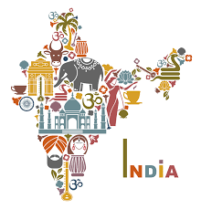
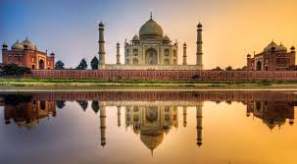
British Imperialism in India
Thatcher| Honors World History

Slide 2
Standards
MWH 5- SWBAT understand development of nation-states and empires in the 16th-19th centuries.
MWH 6- SWBAT demonstrate an understanding of the creation of nation-states in Europe and the struggle of non-Europeans to gain/maintain sovereignty.

Slide 3
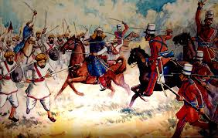
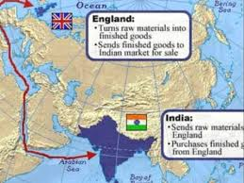
Essential Question- Did British imperialism in India have more positive or negative impacts on the country?

Slide 4
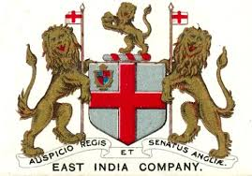
Do you remember…
What is Britain’s relationship with India historically?
What have we previously learned about india?

Slide 5
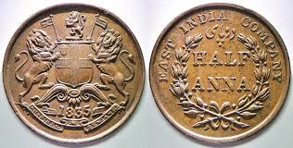
British East India Company
Britain officially controlled the East India Company.
East India Company operated fairly independently from the British government.
East India Company had its own soldiers- Sepoys (Indian Soldiers)
“a delicate and dangerous machine, which a little mismanagement may easily turn against us.”
East India Company dominates in India.

Slide 6
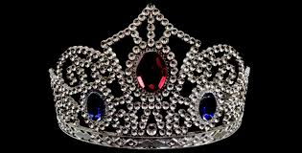
“Jewel in the Crown”
Britain considered India to be the brightest “Jewel in the crown” due to the county’s potential.
After the Industrial Revolution- Britain needed India for its Raw Materials but also because it had a large potential market. (300 million people!)

Slide 7
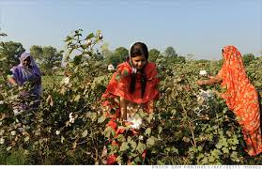
British Rule in India
British set up restriction to prevent Indian economy from operating on its own.
British policies-
India had to provide Britain with raw materials.
Indians had to buy British goods.
Indian competition with British goods was prohibited.

Slide 8
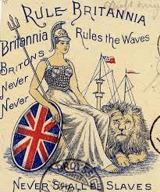
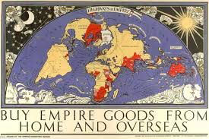
Impact of Colonialism
Think back to your DBQ…
What were some of the positives and negatives of British Imperialism in India?

Slide 9
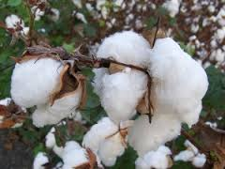
Negatives
The British held much of the political and economic power.
Restricted Indian-owned industries.
Emphasis on cash crops.
Traditional Indian customs were threatened.

Slide 10
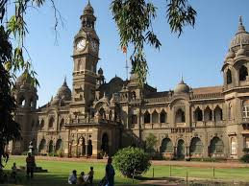
Any Positives?
Held the world’s third largest railroad.
Railroad helped India to develop a modern economy.
Canals, Telegraph, dams, bridges etc. were brought to India.
Sanitation and public health improved.
Schools and colleges founded and literacy increased.
British rule helped end local warfare.

Slide 11
Sepoy Mutiny
Are the British trying to convert us to Christianity?
Some Indians also felt that the British were being very racist towards them.
Indians begin to feel resentment. With an increase in Nationalism many began to rebel.

Slide 12
Rebellion Continued
Sepoys think that cartriges of new rifles they received were greased with beef and pork fat- why would this be a problem?
Many of the sepoys refused to accept the cartridges and were jailed.
The sepoys rebelled and marched on Delhi.
The rebellion spread to northern and central India and has become known as the sepoy mutiny.
The East India Company took more than a year to regain control of the country (the British government sent troops to help them).

Slide 13
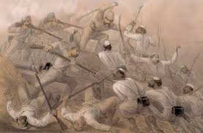
Sepoy Mutiny (rebellion)
With Indians clearly outnumbering the British, why do you think it is that the British were not easily defeated and India liberated from British rule after the rebellion?

Slide 14
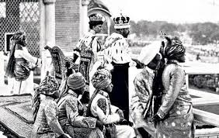
After the Mutiny
The British government took direct control of India.
The part of India under direct British rule was called The Raj. (This was a term used to refer to the years 1757-1947).
The mutiny fueled the racist attitudes of the British.
Distance between Indians and British increased.

Slide 15
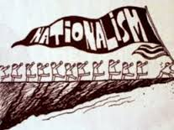
Nationalism in India
British rule had made India more westernized and modernized. – What examples do you remember from your reading?
What traditions were lost or changed?
Indians began to want more control over their country after 1800.
Two groups were formed-
Indian National Congress- 1885
Muslim League- 1906
These two groups began to call for self-government.

Slide 16
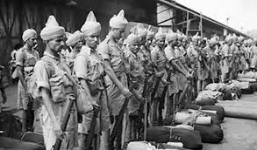
Nationalism Continued
After WWI the British begin to lose control of India.
Over 1 million Indians enlisted in the British army.
The British government promised reforms in return for service.
After WWI Indians were once again treated as second-class citizens.
Violence and unrest begins in India after WWI.
Amritsar Massacre begins explosion of anger across India.

Slide 17
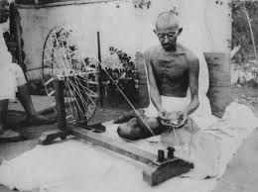
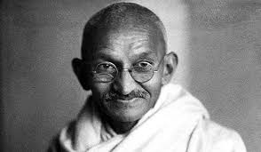
Mohandas Gandhi
Gandhi becomes a leader of the Independence Movement. Gandhi’s teachings blended ideas from all major world religions.
Gandhi attracted millions of followers- soon they began to call him Mahatma meaning “great soul”.

Slide 18
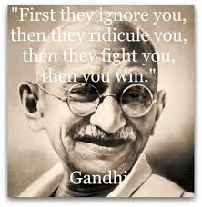
Civil Disobedience
What does this term mean? Where have you heard it previously?
Gandhi wanted to weaken the British government’s authority and economic power over India.
Calls for:
Boycotts – Many stopped buying British goods.
Strikes and Demonstrations – Many were jailed
The Salt March- Gandhi and his followers were protesting the tax on salt. (60,000 arrested).
A journalist witnessed the salt march and soon the story became world news.

Slide 19
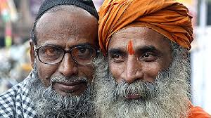
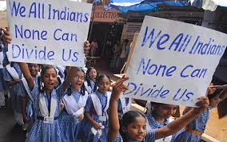
India Gains Independence
1935- Britain grants India some limited self-rule.
This causes some tension between Hindus and Muslims. (1940s- India had 350 million Hindus and 100 million Muslims).
After WWII many begin to question the idea of colonialism- why?

Slide 20
India and WWII
Britain committed Indian troops without their consent.
Gandhi and others protested this humiliation.
After WWII- Britain in debt and decides to hand over India, but to who?
Partition- Giving separate areas to Hindus and Muslims- India and Pakistan.
This caused Hindus, Muslims, Sikhs, and the many princes of India had to decide where to go.
1947- 10 million people in India were relocating! Many fought and died.

Slide 21
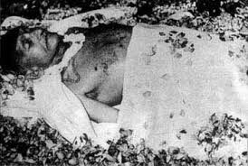
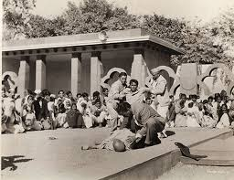
Death of Gandhi
In 1948 even Gandhi became a victim of violence.
Gandhi was shot and killed by a Hindu extremist on January 30th, 1948.
Shot because he was thought to be too tolerant of Muslims.

Slide 22
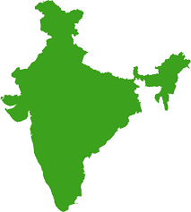
Modern India
After India’s Independence it became the World’s largest democracy.
Jawaharial Nehru becomes India’s first Prime Minister.
India remains an unstable nation.
Thought to surpass China in population by 2035.
Social Inequality
Religion strife
India and Pakistan are building nuclear programs

