Slide 1
Emperor Charlemagne and His Elephant
Abu al-Abbas symbolized relations with the Carolingian and Abbasid empires.
Until Charlemagne’s death, the elephant accompanied him on many of travels.

Slide 2
Overview of the Byzantine Empire
Lasts for almost 1000 years
Constantinople the most important European city throughout this time period
Two branches of Christianity
Cultural and political influence spread to new civilizations in the Balkans and western Russia
Christian missionaries spread it northward
Major agent for interregional trade
More of south to north trade pattern

Slide 3
Geography of the Byzantines
Capital: Byzantium
On the Bosporus Strait
Commercial, strategic value of location
Constantine names capital after himself (Constantinople), moves capital there 340 CE
Becomes the “New Rome”
Filled w/ libraries, museums, art
Constructs palaces, churches, baths, public buildings
1453 falls to the Ottoman Turks

Slide 4
Caesaropapism
Power centralized in figure of Emperor
Does not claim divinity, rather divine authority
Emperor rules as secular lord but also plays an active and prominent role in ecclesiastical affairs
Define: Of or relating to Christian Church or its clergy
Exalted, absolute rule
Dress and court etiquette reinforces authority
Bejeweled crown, purple robes reserved for ruling only
Prostration 3 x, and kiss hands and feet before speaking
Rulers above law, complex bureaucracy
Justinian wears purple robes in the mosaic from the church of San Vitale in Ravenna, Italy. It depicts him in the company of ecclesiastical, military, and court officials.

Slide 5
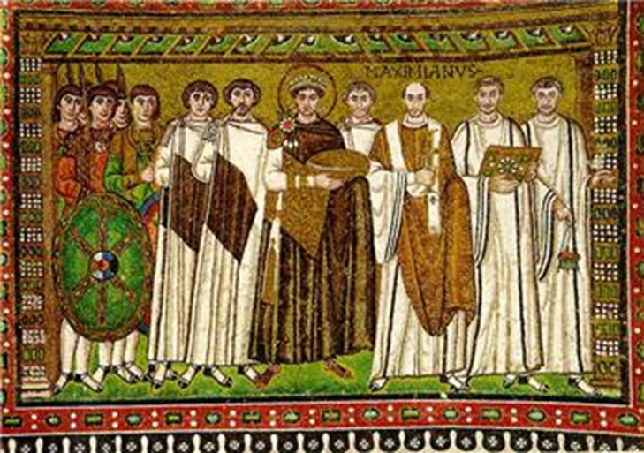

Slide 6
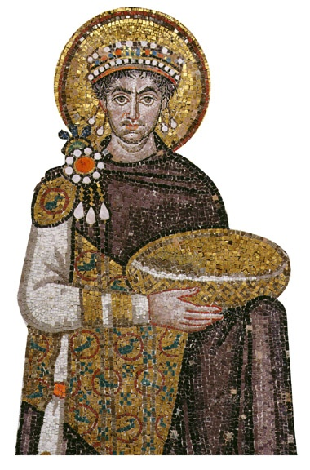
Justinian and Theodora
The “sleepless emperor” b/c so energetic
Rule w/ wife, Theodora as advisor
Daughter of a bear keeper in the circus
Worked as a striptease artist
Uses army to contain riots in Hippodrome: Nika Revolt
Ambitious construction program
Hagia Sophia
Justinian Code: Law code that last 900 years and influences European law
Most significant contribution
Took Roman law and added to it
Made “Greek” official language of empire

Slide 7
Hagia Sophia or Church of Holy Wisdom
Turned into a mosque by Ottomans
Ranks as one of the most important examples of Christian architecture

Slide 9
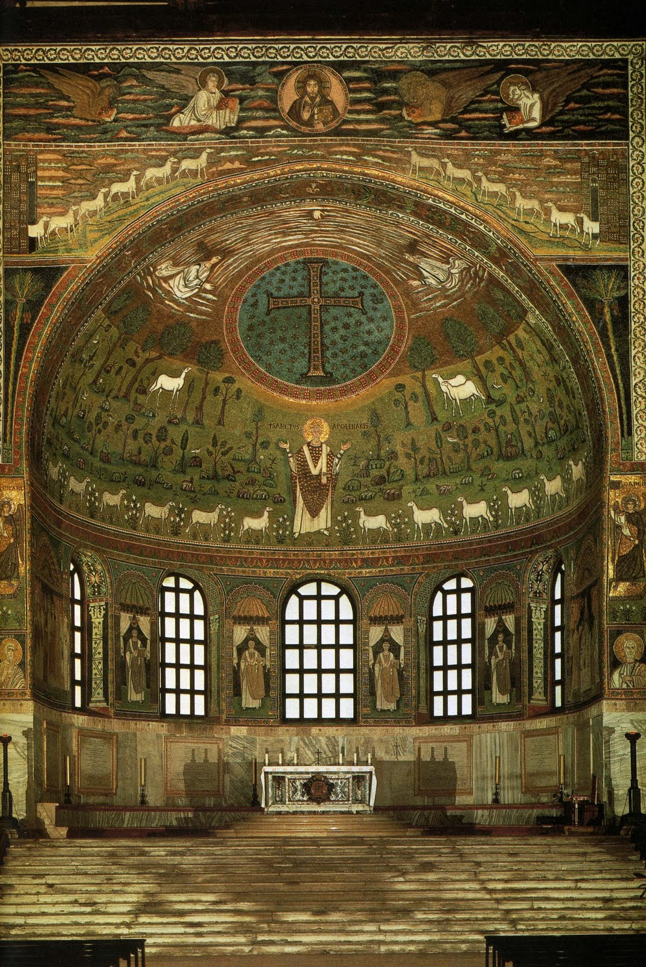
Byzantine Conquests
B/n 535-565, gain control of Italy, Sicily, nw Africa, southern Spain
Hard to sustain long –term
Abandon Rome after Justinian and leave Ravenna, on Adriatic coast as the headquarters
Possesses examples of Byzantine art and architecture
Byzantine church in Ravenna, Italy

Slide 11
Muslim Conquests
7th century Arab Muslim expansion
Captured Egypt, Syria, Tunisia
By end of 12th c. 2/3s of Christians lived in former Byzantine territories and had adopted Muslim faith
Besieged Byzantium 674-678, 717-718
Defense made possible through use of “greek fire”
Compound of sulfur, lime, and petroleum
Burned even on water so hazard w/ wooden ships
Allows them to retain Anatolia, Greece, and Balkan region
A manuscript illustration depicts Byzantine naval forces turning Greek fire on their Arab enemies.

Slide 12
The Theme System
Response to challenge of Islam
Reorganization of Byzantine society into Themes (provinces) under control of generals
In charge of military administration and civil administration
Soldiers from peasant class, rewarded with land grants
Theme system enabled them to mobilize quickly and resist further Islamic advances.

Slide 13
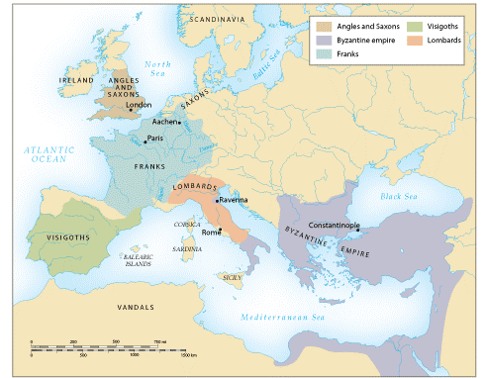
The Rise of the Franks
Last Roman emperor deposed by Germanic general Odoacer, 476 CE
Urban population declines as continuing invasions and power struggles disrupt trade and manufacturing
Germanic kingdoms emerge as successor states
Many convert to Christianity and adapted Roman law to their needs

Slide 14
The Franks
Most successful and influential of the Germanic peoples
Conquered Gaul: France
They convert to Christianity after Clovis
Brought them an allegiance of the Christian population as well as the pope
Baptism of Clovis, king of the Franks

Slide 15
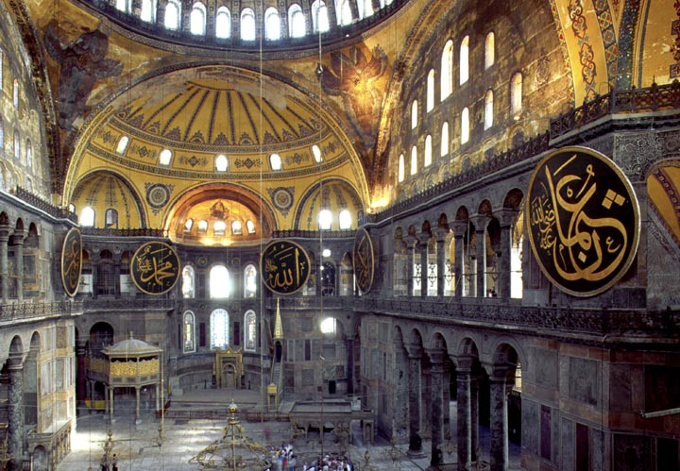
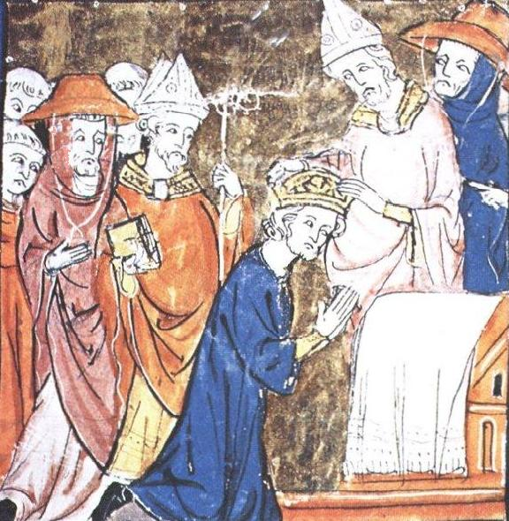
The Two Worlds of Christendom
Crowning of Charlemagne in 800 CE
Christian Societies in Byzantium and Western Europe

Slide 16
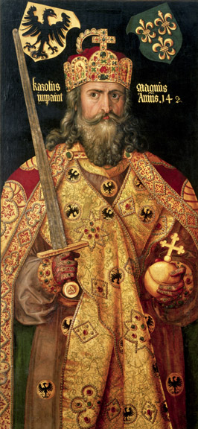
Charlemagne (768-814 CE)
Grandson of Charles Martel
Centralized imperial rule
Reestablished in a society disrupted by invasion
Functional illiterate, but sponsored extensive scholarship
Spoke Latin, some Greek
Maintained diplomatic relations w/ Byzantines and Abbasid caliphate
Major military achievements

Slide 17
Charlemagne’s Administration
Capital at Aachen, Germany
Most of his reign spent on horseback
Constant travel throughout empire to maintain authority
“Counts” were the aristocratic deputies that held political, military, and legal authority in the local jurisdictions
Imperial officials: missi dominici (“envoys of the lord ruler”)
Job was to bring “counts” under tight control
Continued yearly circuit travel
Charlemagne’s Empire by 814 CE

Slide 18
Charlemagne as Emperor
Hesitated to challenge Byzantines by taking title “emperor”
Pope Leo III crowns him as emperor in 800
Planned in advance?
Challenge to Byzantium
Charlemagne’s coronation in the Vatican by Raphael

Slide 19
Louis the Pious
Son of Charlemagne
Lost control of courts, local authorities
Civil war erupts between three sons
Empire divided in 843

Slide 20
Carolingian Empire of 9th Century CE
Charlemagne’s Carolingian Empire brought a temporary unity to parts of Western Europe, but it was subsequently divided among his three sons, who waged war on one another.

Slide 21
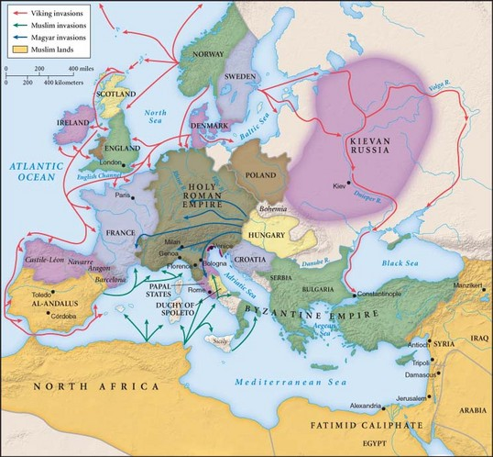
Invasions
8th-9th century, invaders pillage the Frankish realm in search of wealth stored in towns and monasteries
Muslims
Magyars
Descendants of nomadic peoples who settled in Hungary
Expert horsemen
Vikings
Nordic peoples of Scandinavia b/c of population growth
Depended on the shipbuilding techniques

Slide 22
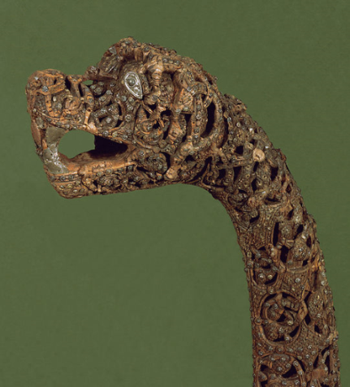
Viking Invasions
From village of Vik, Norway (hence “Viking”)
Raided the British Isles
Over time mounted invasions and plundered settlements from Russia, eastern Europe, Mediterranean lands
Boats with shallow drafts , sails, and oars capable of river travel as well as open seas
Timed attacks to take advantage of tides
Attacked villages, cities from 9th century
Constantinople sacked three times
Carolingians had no navy, dependent on local defenses

Slide 23
Viking Ships
The Oseberg ship, pictured here, is the best-preserved Viking vessel from the early middle ages. Built about 800 c.e., it served as a royal tomb until its discovery in 1903. A ship this size would accommodate about forty men.

Slide 24
Viking Siege of Paris 885 CE
700 ships sail up the Seine River
Example of one of the sizable cities in Western Europe that was besieged

Slide 25
More examples of Viking Raids
Constantinople (3x)
Raid by following Russian Rivers
Danish Vikings prepare to invade England in this manuscript illustration produced at an English monastery about 1130. The geographic range of Viking activity extended from England, France, northern Germany, and Russia to territories throughout the Mediterranean basin.

Slide 26
Devolution of Political Authority
Devolution –transfer of power from central to local
Had to depend on local protection against Muslim, Viking, and Magyar invasions
Western Europe becomes a society of competing regional states

Slide 27
Economy in Byzantine Empire
Economic powerhouse
Peasantry
Ex. free peasants and (b/c of theme system) soldiers allotted land after service
Manufacturing
Arts, crafts such as glassware, linen, woolen textiles, gems, jewelry in gold, silver
Silk
Regulations only allow individuals to participate in one activity to prevent monopoly
Ex. weaving, dyeing, sales
Trade
East/West routes and North/South routes
Byzantine coin, the Bezant, served as standard currency of Mediterranean basin
Byzantine Silk

Slide 28
Byzantine Silk
The Byzantine historian Procopius reported that two Christian monks from Persia traveled to China, where they observed the techniques of silk production, which at that time were unknown outside China.
According to Procopius, the monks hollowed out their walking staffs and filled them with silkworm eggs, which they smuggled out of China, through their native land of Persia, and into the Byzantine empire.
It is likely that Procopius simplified a more complex story by focusing attention on the monks, who by themselves could hardly have introduced a full-blown silk industry to Byzantium.
The production of fine, Chinese-style silks required more than a few silkworm eggs. It called also for the mastery of sophisticated technologies and elaborate procedures that probably reached Byzantium by several routes.

Slide 29
Peasants—probably sharecroppers—receive seeds and tend to vineyards in this painting from a Byzantine manuscript. What does this illustration suggest about the relationship between the two landowners or overseers (left, in the top register) and the five laborers?

Slide 30
The Two Worlds of Christendom
Crowning of Charlemagne in 800 CE
Christian Societies in Byzantium and Western Europe

Slide 31
Charlemagne (768-814 CE)
Grandson of Charles Martel
Centralized imperial rule
Reestablished in a society disrupted by invasion
Functional illiterate, but sponsored extensive scholarship
Spoke Latin, some Greek
Maintained diplomatic relations w/ Byzantines and Abbasid caliphate
Major military achievements

Slide 32
Charlemagne’s Administration
Capital at Aachen, Germany
Most of his reign spent on horseback
Constant travel throughout empire to maintain authority
“Counts” were the aristocratic deputies that held political, military, and legal authority in the local jurisdictions
Imperial officials: missi dominici (“envoys of the lord ruler”)
Job was to bring “counts” under tight control
Continued yearly circuit travel
Charlemagne’s Empire by 814 CE

Slide 33
Charlemagne as Emperor
Hesitated to challenge Byzantines by taking title “emperor”
Pope Leo III crowns him as emperor in 800
Planned in advance?
Challenge to Byzantium
Charlemagne’s coronation in the Vatican by Raphael

Slide 34
Louis the Pious
Son of Charlemagne
Lost control of courts, local authorities
Civil war erupts between three sons
Empire divided in 843

Slide 35
Carolingian Empire of 9th Century CE
Charlemagne’s Carolingian Empire brought a temporary unity to parts of Western Europe, but it was subsequently divided among his three sons, who waged war on one another.

Slide 36
Invasions
8th-9th century, invaders pillage the Frankish realm in search of wealth stored in towns and monasteries
Muslims
Magyars
Descendants of nomadic peoples who settled in Hungary
Expert horsemen
Vikings
Nordic peoples of Scandinavia b/c of population growth
Depended on the shipbuilding techniques

Slide 37
Viking Invasions
From village of Vik, Norway (hence “Viking”)
Raided the British Isles
Over time mounted invasions and plundered settlements from Russia, eastern Europe, Mediterranean lands
Boats with shallow drafts , sails, and oars capable of river travel as well as open seas
Timed attacks to take advantage of tides
Attacked villages, cities from 9th century
Constantinople sacked three times
Carolingians had no navy, dependent on local defenses

Slide 38
Viking Ships
The Oseberg ship, pictured here, is the best-preserved Viking vessel from the early middle ages. Built about 800 c.e., it served as a royal tomb until its discovery in 1903. A ship this size would accommodate about forty men.

Slide 39
Viking Siege of Paris 885 CE
700 ships sail up the Seine River
Example of one of the sizable cities in Western Europe that was besieged

Slide 40
More examples of Viking Raids
Constantinople (3x)
Raid by following Russian Rivers
Danish Vikings prepare to invade England in this manuscript illustration produced at an English monastery about 1130. The geographic range of Viking activity extended from England, France, northern Germany, and Russia to territories throughout the Mediterranean basin.

Slide 41
Devolution of Political Authority
Devolution –transfer of power from central to local
Had to depend on local protection against Muslim, Viking, and Magyar invasions
Western Europe becomes a society of competing regional states

Slide 42
Economy in Byzantine Empire
Economic powerhouse
Peasantry
Ex. free peasants and (b/c of theme system) soldiers allotted land after service
Manufacturing
Arts, crafts such as glassware, linen, woolen textiles, gems, jewelry in gold, silver
Silk
Regulations only allow individuals to participate in one activity to prevent monopoly
Ex. weaving, dyeing, sales
Trade
East/West routes and North/South routes
Byzantine coin, the Bezant, served as standard currency of Mediterranean basin
Byzantine Silk

Slide 43
Byzantine Silk
The Byzantine historian Procopius reported that two Christian monks from Persia traveled to China, where they observed the techniques of silk production, which at that time were unknown outside China.
According to Procopius, the monks hollowed out their walking staffs and filled them with silkworm eggs, which they smuggled out of China, through their native land of Persia, and into the Byzantine empire.
It is likely that Procopius simplified a more complex story by focusing attention on the monks, who by themselves could hardly have introduced a full-blown silk industry to Byzantium.
The production of fine, Chinese-style silks required more than a few silkworm eggs. It called also for the mastery of sophisticated technologies and elaborate procedures that probably reached Byzantium by several routes.

Slide 44
Peasants—probably sharecroppers—receive seeds and tend to vineyards in this painting from a Byzantine manuscript. What does this illustration suggest about the relationship between the two landowners or overseers (left, in the top register) and the five laborers?

Slide 45
Feudalism
Feudalism is characterized as the political and social order of medieval Europe
Local political and military elites worked in ad hoc ways to organize their territories and maintain social order
Organized small private armies of armed retainers
Examples
Retainers sometimes rewarded w/
Land grants
Rights to income generated by mill
Right to receive rent or payment from the village
Might maintain them in own household

Slide 46
Peasants in Western Europe
Obliged to provide labor services and payments of rents to lord
Portion of harvest, a chicken, dozen eggs
Unable to move from land
Males work 3 days in fields
Women churn butter, made cheese, brew beer, spun thread, wove cloth, keep sheep, cattle
Fees charged for marrying serfs of another lord

Slide 47
Monasteries
Monasteries were the principal centers of literacy in western Europe during the early middle ages.
In this manuscript illustration, one monk copies a manuscript, another makes geometric calculations, a third cuts parchment, two work on the building, and one more rings the bells that call monks and members of the surrounding community to religious services.

Slide 48
A fourteenth-century manuscript illustration shows St. Benedict with his crosier, the staff carried by abbots to symbolize their position (above), and meeting with two monks beside a fishpond at their monastery (below).
What does the fishpond suggest about the economic significance of monasteries?

Slide 49
Comparison of Christian Europe
Both
Christianity serves as the source of religious, moral, and cultural authority for both
Both support ecclesiastical hierarchies with networks of monasteries
Work to extend Christianity through missionaries
Divisions
Doctrine, ritual, and church authority
Consecrated in 1094, this ornate cathedral, although located in Venice, Italy, is a classic example of Byzantine architecture. Such churches represented perhaps the greatest achievement of Byzantine art and were certainly the most monumental expressions of Byzantine culture. (Erich Lessing/Art Resource, NY)

Slide 50
Religious Rivalry
Ritual disputes
Beards on clergy –West shaved
Unleavened bread for Mass in West-Leavened in East
Theological disputes
Iconoclasm
Nature of the Trinity
This illustration from a psalter prepared about 900 c.e. depicts an iconoclast whitewashing an image of Jesus painted on a wall.

Slide 51
Schism
Arguments over hierarchy, jurisdiction
Autonomy of Patriarchs, or Primacy of Rome?
1054 Patriarch of Constantinople and Pope of Rome excommunicate each other
East: Orthodox Church
West: Roman Catholic
The eastern and western churches remain split to this day

Slide 52
Influence on Slavic Cultures
Missionaries sent to Balkan lands and converted the Slavs to Orthodox Christianity
Saints Cyril and Methodius
Create Cyrillic alphabet
Adapted from Greek but represents Slavic sound
Slavic lands develop orientation to Byzantium
Cyrillic alphabet worldwide

Slide 53
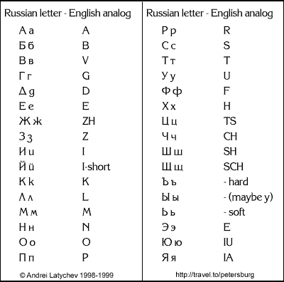
Cyrillic Alphabet

Slide 54
Kievan Rus
Vladimir the Great
989 converted to Orthodox Christianity and ordered subjects to follow
Known for “drunkeness and a harem of 800 girls”
After his conversion, see the Byzantine influence flow rapidly to Russia

Slide 55
Byzantine Influence of Russia
Cyrillic alphabet, literacy, Orthodox missions spread
Byzantine teachers establish schools
Byzantine art and architecture dominate Kiev
Icons became a traditional form of art
Onion domes on churches copied Constantinople
Princes of Kiev establish “caesaropapist” control over the Russian Orthodox church
Compile a law code like Byzantines
By 16th c., Moscow claimed to be Europe’s 3rd Rome

