Slide 1
India

Slide 2
India after the fall of the Gupta dynasty
451 CE the White Huns from Central Asia invaded and disrupted administration
Mid 6th century Gupta Empire collapsed
From the end of the Gupta until the 16th century, when the Turkish Mughals extended their empire, India was politically divided

Slide 3
The quest for centralized power
Northern India
  Turbulent and chaotic
Southern India

Slide 4
Islamic introduced to Northern India
The Sind were conquered by Arab Muslims and passed to Abbasids
Muslim merchants formed small communities in all major cities of coastal India
Turkish migrants and Islam: Turks convert to Islam in tenth century
  Some moved to Afghanistan and established an Islamic state
  Mahmud of Ghazni, Turk leader in Afghanistan, made expeditions to northern India
The sultanate of Delhi (1206-1526 C.E.)
  Mahmud's successors conquered north India, 1206
  Established an Islamic state known as the sultanate of Delhi
  Sultans' authority did not extend far beyond the capital at Delhi
  Islam began to have a place in India

Slide 5
Hindu kingdoms of Southern India
Politically divided but relatively peaceful
The Chola kingdom (850-1267 C.E.) was a larger kingdom
  At its high point, conquered Ceylon and parts of southeast Asia
  Navy dominated waters from South China Sea to Arabian Sea
  Not a tightly centralized state; local autonomy was strong
  Began to decline by the twelfth century

Slide 6
The Kingdom of Vijayanagar (1336-1565 CE)
Based in northern Deccan
Established by two Indian brothers
They renounced Islam in 1336 and returned to their Hindu faith
Muslim merchants continue to trade w/out problems

Slide 7
Production and Trade in Indian Ocean basin
Agriculture in the monsoon world
  The monsoons (rains in spring and summer)
  Irrigation systems were needed for dry months
    No big river in south India; waterworks included dams, reservoirs, canals, wells
    Stored rainwater in large reservoirs connected to canals
    One reservoir constructed during the eleventh century covered 250 square miles
Population growth: 53 million in 600 C.E. to 105 million in 1500 C.E.
Urbanization took place in Delhi and other large port cities

Slide 8
Trade and economic development of southern India
Internal trade
  Self-sufficient in staple food
  Metals, spices, special crops found only in certain regions
  Through trade, south India and Ceylon experienced rapid economic growth
Temples and society in south India
  Hindu temples served as economic and social centers
  Possessed large tracts of land, hundreds of employees
  Temple administrators were to maintain order, deliver taxes
  Served as banks; engaged in business ventures

Slide 9
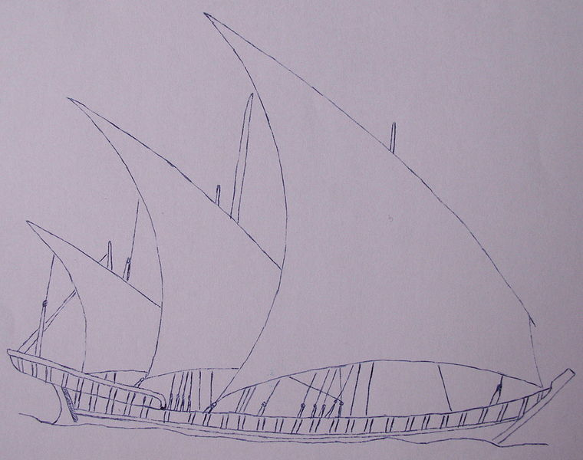
Cross-cultural trade in Indian Ocean basin
Dhows and junks--large ships involved in maritime trade in Indian Ocean
Dhows: Used by the Indian, Persian, Arab sailors
Triangular sails
Carried 100 tons in 1000, then 400 tons in 1500
Junks: Large

Slide 10
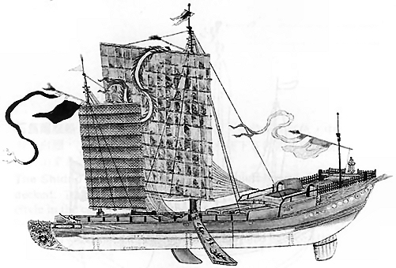
Junks
Chinese vessels used for naval and commercial expansion
Carried 1,000 tons of cargo
Used throughout Indian Ocean
Multiple sails to allow for more power
Junk from Song Dynasty in 13th century

Slide 11
Port cities in India
Because of their location, they were an emporia
Indian port cities, were clearinghouses of trade and cosmopolitan centers
Hindus, Buddhists, Muslims, Jews etc. did business with counterparts all over the eastern hemisphere
  Trade goods from all over
  Specialized production of high quality textiles
  Sugar, leather, stone, iron, steel

Slide 12
Kingdom of Axum
The kingdom of Axum was a Christian empire centered in Ethiopia
Resisted pressures of Islam
  Maintained independence b/c of prosperous trade w/ Indian Ocean and Mediterranean
Stayed prosperous through trade
Controlled Adulis, most prominent port on Red Sea
  Funneled gold, ivory, and slaves from sub-Saharan Africa to Egypt, Med. Region, and Indian Ocean

Slide 13
Caste and Society
Caste provided guidance in absence of centralized political authority
Caste helped to integrate immigrants (Turks, Muslim merchants) into Indian society
Caste and social change: guilds and subcastes (jatis)
Expansion of caste system, especially to southern India

Slide 14
The Development of Hinduism
Hinduism predominated in southern India, Islam in the north
Vishnu and Shiva
  Decline of Buddhism benefited Hinduism
  The growth of Vishnu and Shiva cults (and other gods associated with them)
Devotional cults: to achieve mystic union with gods as a way of salvation
Shankara: philosopher (ninth century) who preferred disciplined logical reasoning
Ramanuja: philosopher (eleventh and twelfth centuries) believed that understanding of ultimate reality was less important than devotion

Slide 15
Islam and Its appeal
Conversion to Islam occurred in a slow and gradual way
  Some converted for improving their lower social statuses
  Often an entire caste or subcaste adopted Islam en masse
  By 1500, about 25 million Indian Muslims (1/4 of population)
Sufis
  The most effective missionaries, they had a devotional approach to Islam
  Permitted followers to observe old rituals and venerate old spirits
  Emphasized piety and devotion
The bhakti movement
  Sought to erase distinction between Hinduism and Islam
  Guru Kabir (1440-1518), important bhakti teacher, taught that Shiva, Vishnu, and Allah were one deity

Slide 16
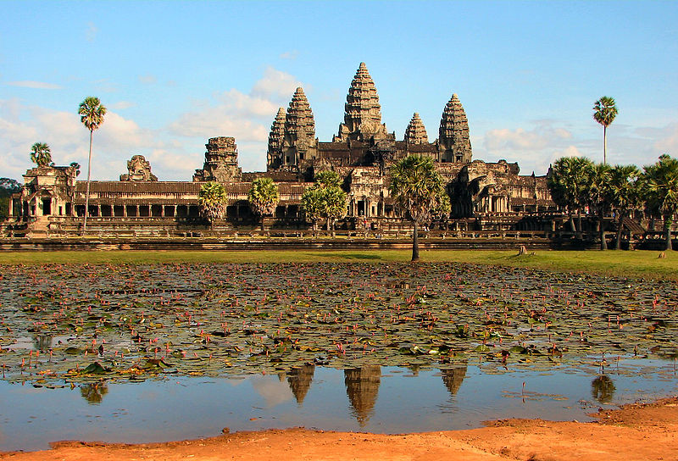
Angkor (889-1431 CE)
Kingdom built by Khmers at Angkor Thom, later Angkor Wat
The city was a microcosmic reflection of Hindu world order
Turned to Buddhism during the twelfth and thirteenth centuries
Thais invaded the capital in 1431, and Khmers abandoned it

Slide 17
Arrival of Islam in SE Asia
Conversion to Islam was slow and quiet
  Ruling elite converted in cities while rural residents retained their traditions
  Islam was not an exclusive faith in southeast Asia
  Sufis appealed to a large public in these countries

Slide 19
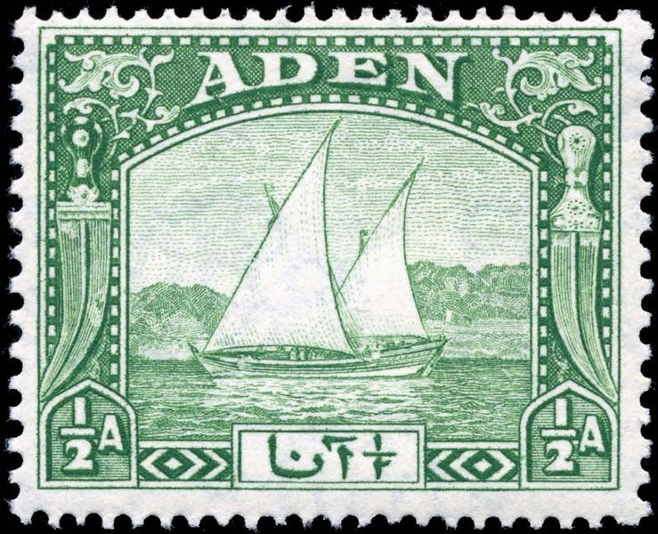
1937 Stamp

