Slide 1
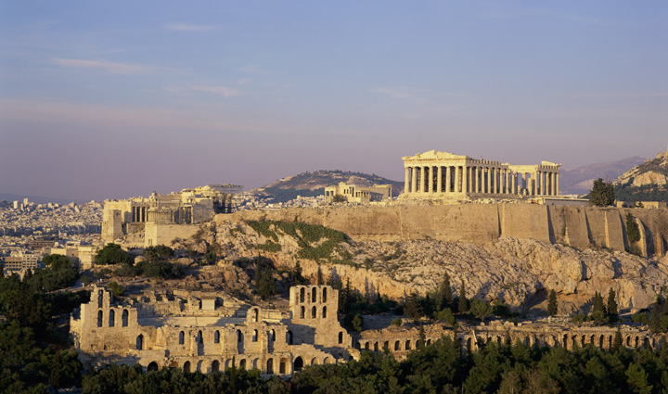
Ancient Greece

Slide 2
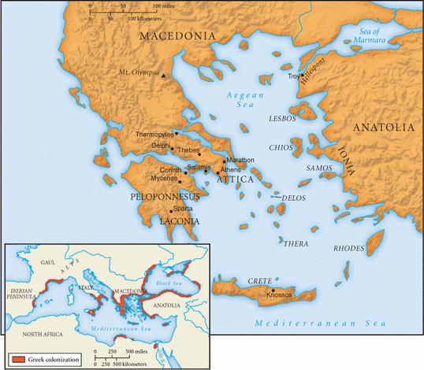
Ancient Greece
Balkan Peninsula with steep mountains and valleys
Includes 1,000s islands
See 100’s of city-states emerge
Lack of resources on mainland
Mediterranean Sea becomes their “highway” for trade and resources

Slide 3
AP Exam Tip
The interaction of geography and climate with the development of human society is important to understand.
A frequent key comparison point on the exam is the difference between the Greek polis and nomadic groups of that time.
Be prepared to explain why people moved and the impact those moves had on a region.
It is important to understand the various Greek approaches to philosophy, but only Aristotle is typically tested on the multiple choice section of the exam.
Social inequality is a major comparison point. (Ex. Slavery, women)

Slide 4
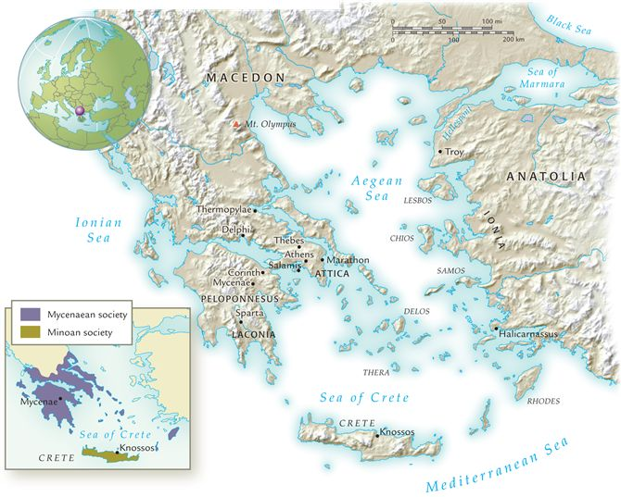
Classical Greece, 800–350 b.c.e.
To what extent did geography encourage Greeks to venture into the Mediterranean Sea?

Slide 5
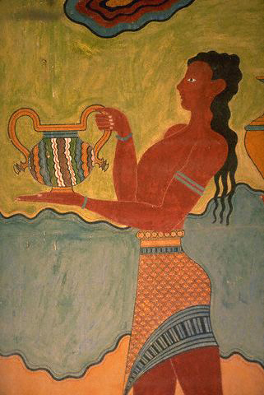
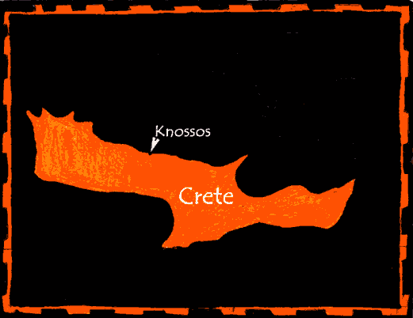
Early Greek Society: Minoans
  Island of Crete
  Major city: Knossos
  King Minos and Minotaur myth
C. 2200 BCE center of maritime trade
  Traded Cretan wine, olive oil, and wood for grains, textiles, and manufactured goods
    Pottery vessels found in Sicily
    Established colonies around Aegean Sea to mine copper and tin

Slide 6
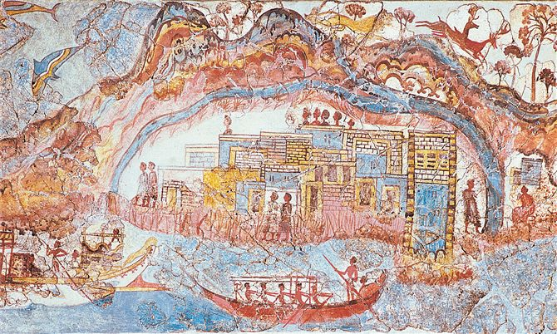
A magnificent fresco from the town of Akrotiri on the island of Thera depicts a busy harbor, showing that Akrotiri traded actively with Crete and other Minoan sites. The volcanic eruption of Thera about 1628 b.c.e. destroyed Akrotiri.

Slide 7
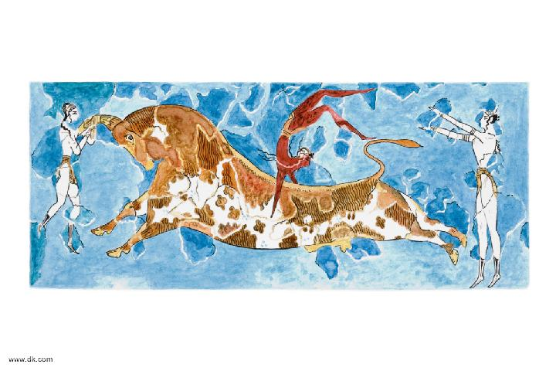
Bulljumping?

Slide 8
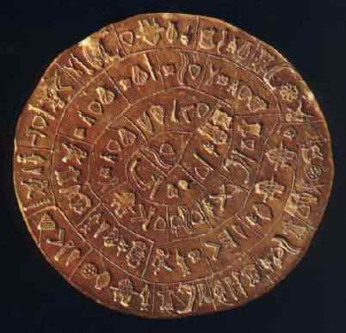
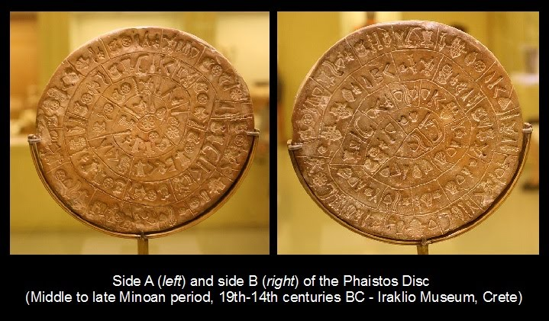
Phaistos Disk, 1700 BCE
Undeciphered syllabic alphabet (Linear A)
  Used to keep detailed records of economic and commercial matters
  Phaistos Disk found in 1908 on Crete
    Printing?...

Slide 9
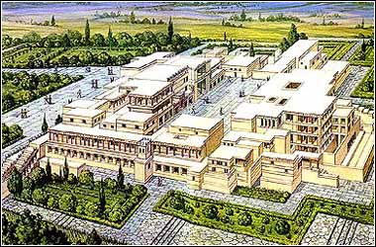
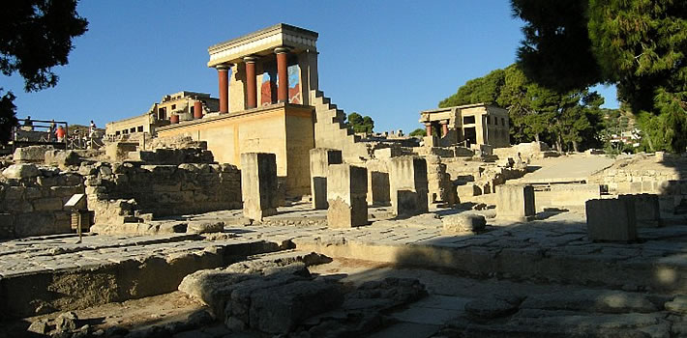
Decline of Minoan Society
Series of natural disasters after 1700 BCE
  Earthquakes, volcanic eruptions, tidal waves
  After, built the luxurious complexes with indoor plumbing & drainage b/n 1600-1450
  BCE
Foreign invasions after 1450 BCE
Foreign domination by 1100 BCE
Legacy: Traditions of maritime trade, writing, and construction influenced GREEKS

Slide 10
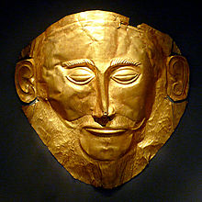
Mycenaean Society
Indo-European invaders descend through Balkans into Peloponnesus, c. 2200 BCE
Influenced by Minoan culture
  Adapted Linear A to own language
  Devised a syllabic script Linear B
  Built fortresses and palaces after 1450 BCE
Major settlement: Mycenae
Warrior-kings
Military expansion throughout region
  Overpower Minoans and took over Cretan palaces
Established settlements in Anatolia, Sicily, southern Italy
Mask of Agamemnon ?

Slide 11
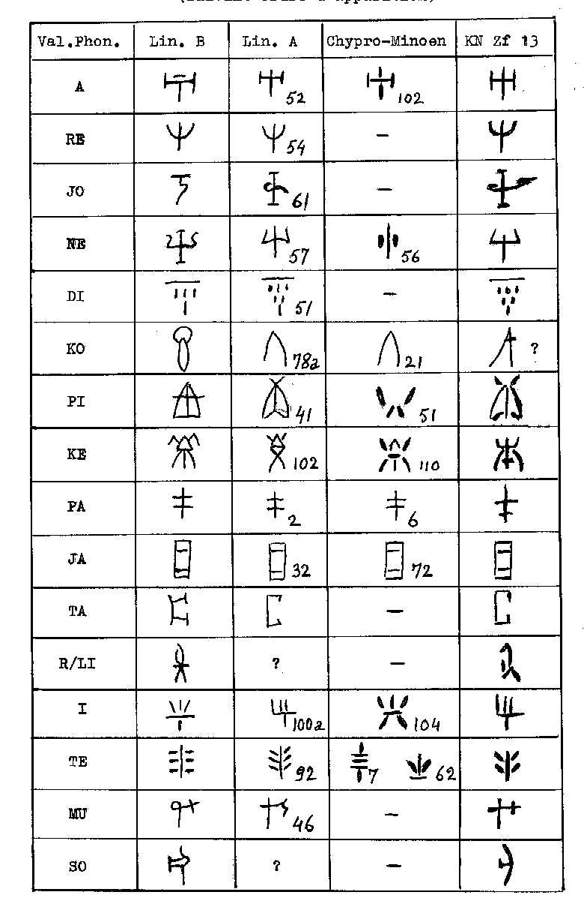
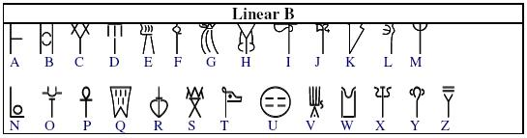
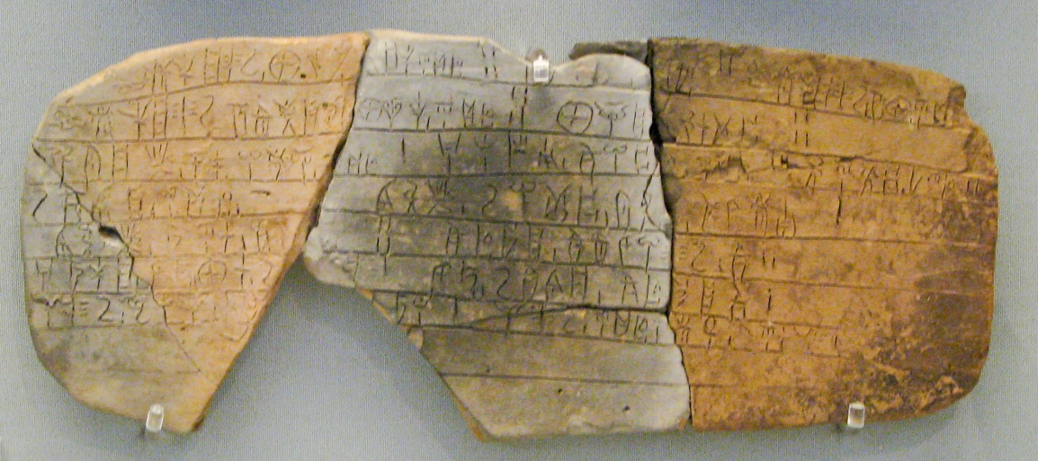
Writing
Linear A is Minoan’s script
  Not deciphered
Linear B is Mycenaean’s script
  Predates Greek alphabet
  Dies out with the end of the Mycenaean civilization

Slide 12
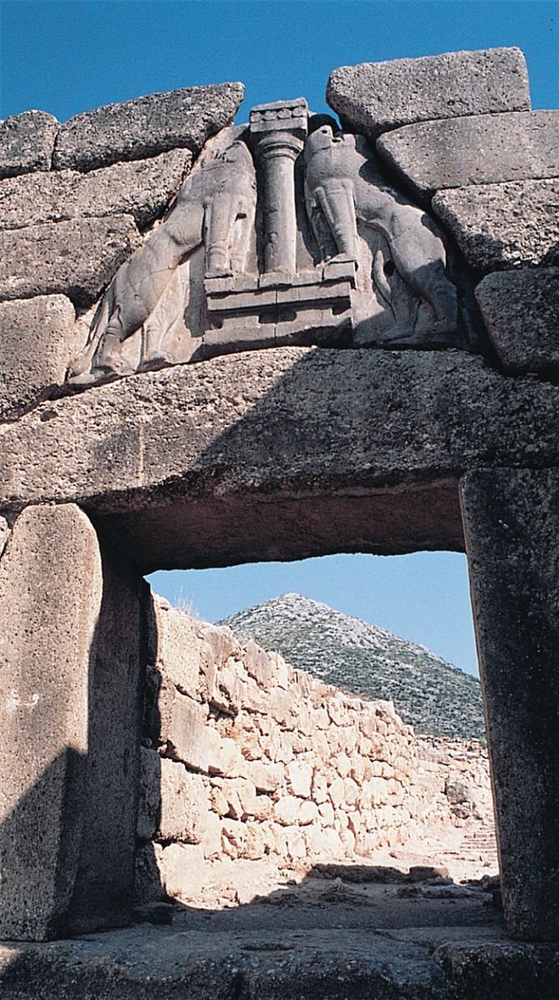
Ruins of Mycenae
The Lion Gate at Mycenae illustrates the heavy fortifications built by Mycenaeans to protect their settlements.

Slide 13
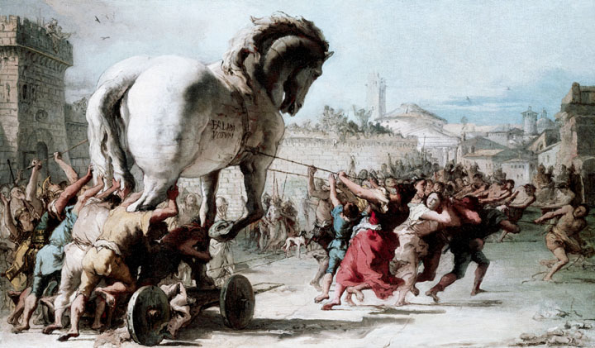
Chaos in the Eastern Mediterranean
Known as the Dark Ages
  Depopulation, poverty, isolation
Political turmoil, chaos from 1100 to 800 BCE
  Coincides with the description in Homer’s epics
  Invasions and civil disturbances
  Palace in ruins
  Writing in Linear A and B disappears
Trojan war, c. 1200 BCE
  Homer’s The Iliad
  Sequel: The Odyssey
  Once thought to be fictional, archaeological evidence has been found
Mycenaean civilization disappears

Slide 14
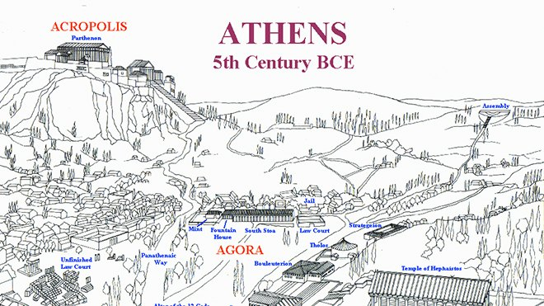
The Polis: City-States
Urban center, dominating surrounding rural areas
  Featured an acropolis: fortified top for refuge
  Agora: Open area for assembling, gov’t bldgs, marketplace
Each waged war w/ hoplites
  Heavily armed infantrymen who fought in closely packed “phalanx formation”
All were highly independent in character
  EX. Sparta: Oligarchy w/ Council of Elders
    Rule by few
    28 men over 60
    From wealthier /influential part of society
    Serve for life

Slide 15
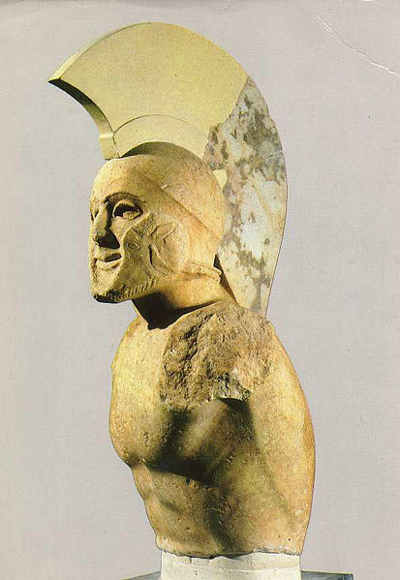
Sparta
From Peloponnese
Highly militarized society
Invaded neighbors, Messenia, and subjugated peoples: helots
  Serfs, tied to land
  Provide for Sparta
  Outnumbered Spartans 10:1 by 6th c. BCE
Military society developed to control threat of helot rebellion

Slide 16
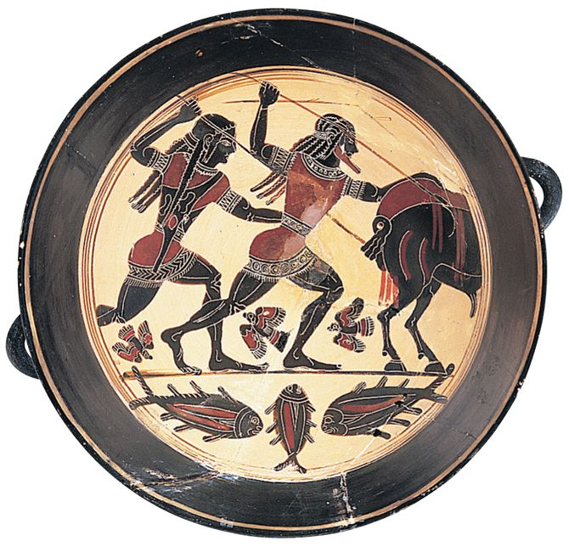
A painted cup produced in Sparta about 550 b.c.e. depicts hunters attacking a boar. Spartans regarded hunting as an exercise that helped to sharpen fighting skills and aggressive instincts.

Slide 17
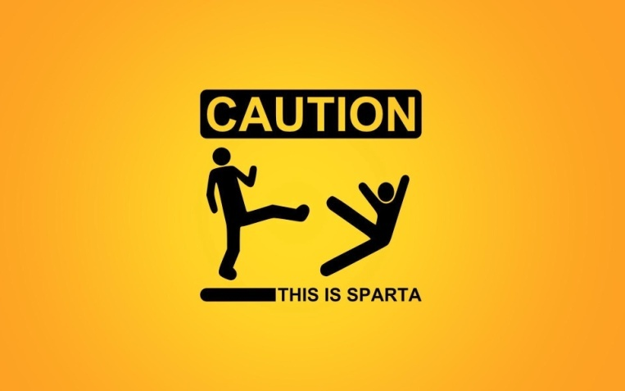
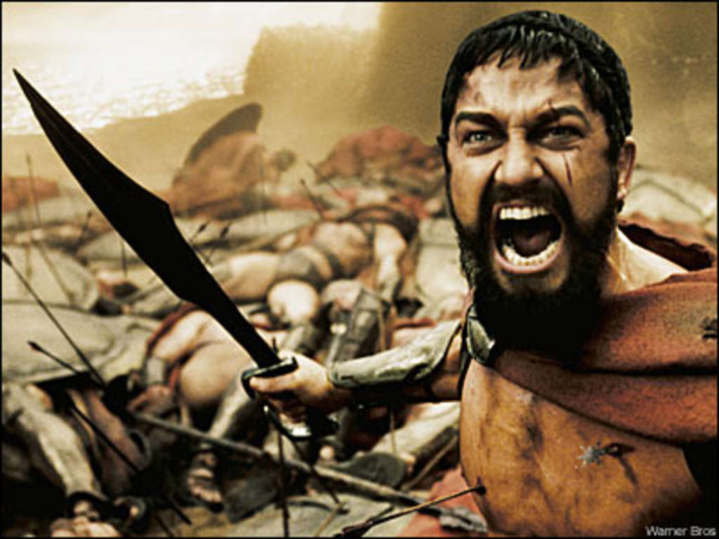
Spartan Society
Austerity was the norm
  No jewelry or elaborate clothes
Used iron bars for $ b/c no coins
Forbidden to engage in commerce
Known for simplicity, frugality, and austerity = “Spartan”
Boys removed from families at age seven
  Received military training in barracks
  Active military service follows
Marriage, but no home life until age 30

Slide 18
Athens and the Road to Democracy
Create a gov’t based on democratic principles
  Open to all free adult males
  Not to women, foreigners, or slaves
B/c of the prosperity of maritime trade 7th c. BCE, aristocrats increase their landholding and dominate smaller landholders
  Small landowners can’t compete
  Forced into debt slavery
Leads to class conflict

Slide 19
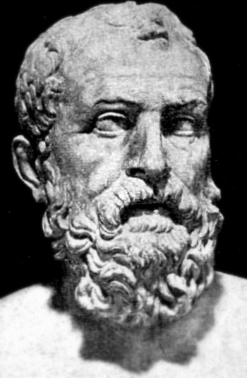
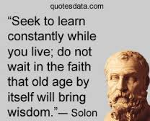
Athenian Democracy
Solon’s Reforms
  Aristocrats to keep large landholdings
  But forgive debts, ban debt slavery
Later reforms gradually transformed Athens to democratic state
    Allowed representation in the common classes in the Assembly
    Paid salaries to office holders
      No longer just the wealthy
Solon 630-560 BCE
Solon

Slide 20
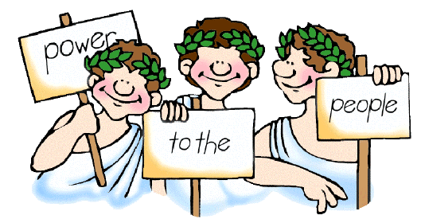
Greek “Citizenship”
Distinctive feature of Greek Civilization w/ some of the city-states
  Popular participation
  Free people run the affairs of the state, have equality before the law
  Ex. Athens-Male citizens vote on policy
Unique compared to rigid hierarchies, inequalities, and absolute monarchies of Persia or other ancient civilizations
Varied over time and from city to city
Originally only the wealthy became citizens, however opens up for the middle, lower classes

Slide 21
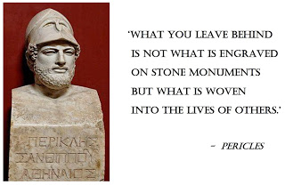
Pericles – Age of Pericles
Ruled 461-429 BCE
High point of Athenian democracy
  Men of all classes chosen by lot to fill gov’t offices, and being paid so they could participate
  Assembly of all citizens was focal point
Aristocratic but popular
Massive public works
  Provided employment for construction workers/ laborers
Encouraged cultural development
  Community of poets, philosophers, dramatists, artists, architects
The image of Pericles, wearing a helmet that symbolizes his post as Athenian leader, survives in a Roman copy of a Greek statue.

Slide 22
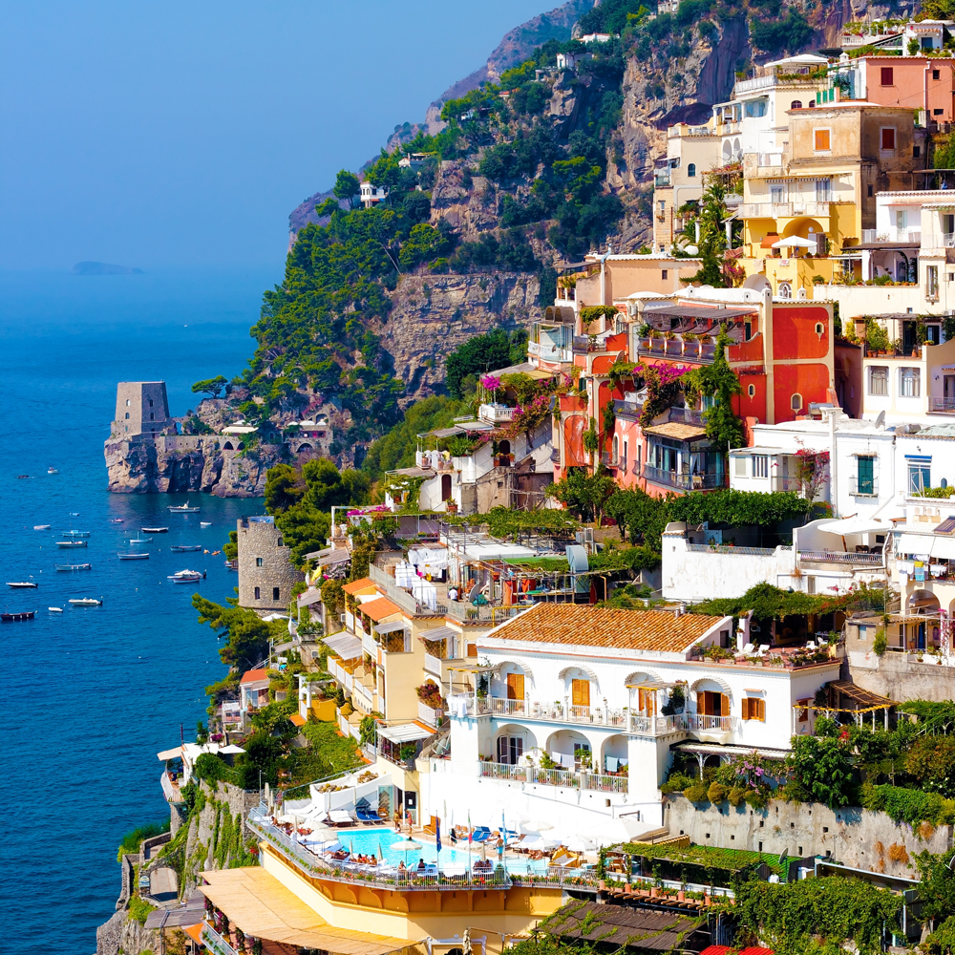
Greek Colonization
B/c of population pressure, Greeks colonize
Spreads their culture throughout Aegean, Black, and Mediterranean Sea
Sicily and southern Italy most popular sites
  Ex. Region around modern Naples- “Neapolis” or new polis
  Fertile fields and access to copper, zinc, tin and iron
Naples, Italy

Slide 23
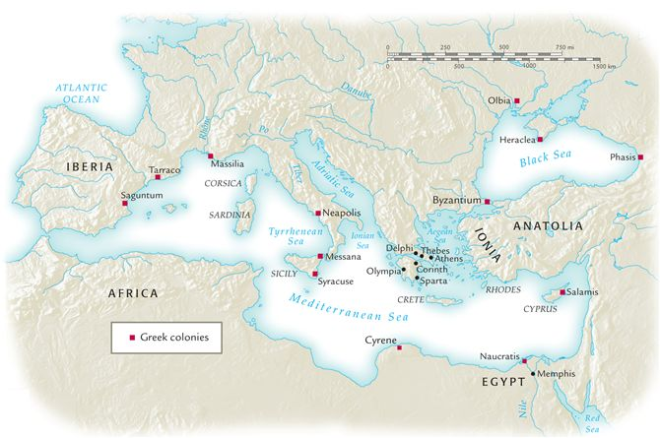
Classical Greece and the Mediterranean basin, 800–500 b.c.e.
All the Greek colonies were located on the coastlines of the Mediterranean Sea and the Black Sea.
In what ways did the colonies serve as links between Greece and the larger Mediterranean region?

Slide 24
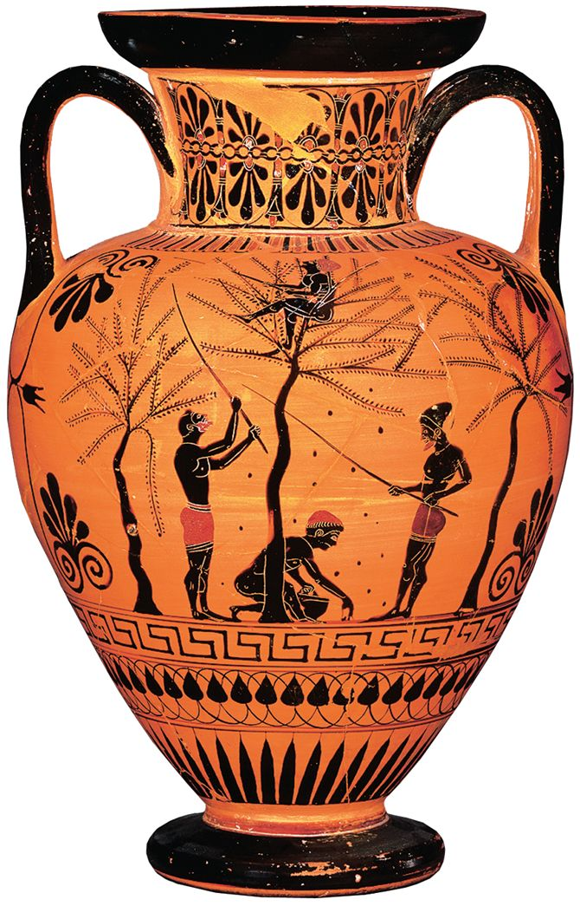
Trade and Integration of the Mediterranean Basin
All through Greek Isles, Mediterranean Sea, Black Sea, and Anatolia
Greece: little grain, but rich in olives and grapes
Colonies further trade
Commerce is the basis of much of economy
  Ex. Athens, Corinth
Harvesting olives. In this painting on a vase, two men knock fruit off the branches while a third climbs the tree to shake the limbs, and another gathers olives from the ground.

Slide 25
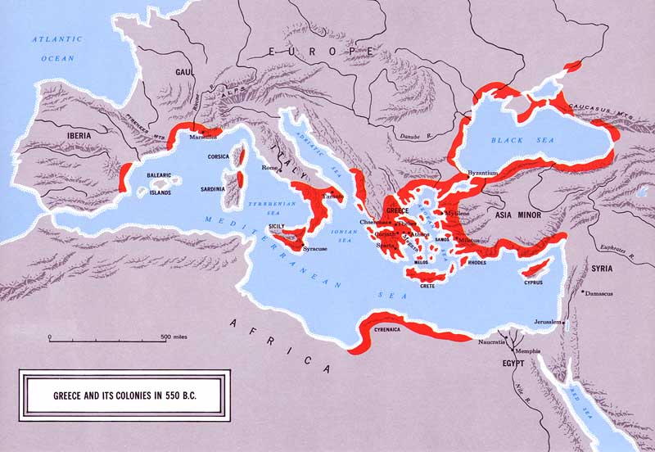
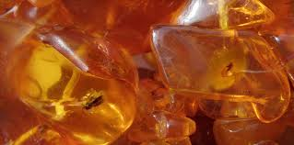
Access to new resources
Ex. Black Sea
Supplied fur, fish, grain, timber, honey, gold, amber as well as slaves from s. Russia
Amber

Slide 26
“Thinking About Encounters”

Slide 27
Effects of Greek Colonization
Trade throughout region
Communication of ideas
  Language, culture
Political and social effects

Slide 28
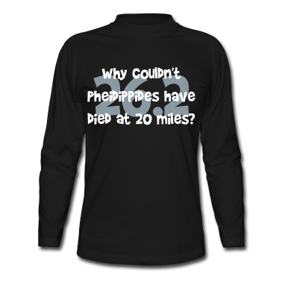
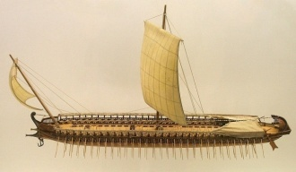
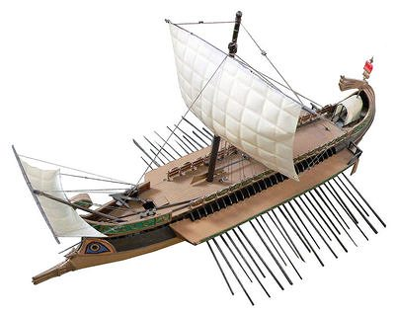
Persian Wars (500-479 BCE)
Revolt against Persian Empire 500 BCE in Ionia
  Leads to Persian Wars
  490 BCE Darius sends fleet to punish the Greeks
490 BCE, Battle of Marathon –Defeat Persia
480 BCE, successor Xerxes returns to Greece
Battle of Thermopylae (300 Spartans)
Salamis
  Advantage Persians burn Athens, but driven out in the strait near e using the “trireme”
Plataea is last land battle where Persian threat is over
Greek Trieme

Slide 29
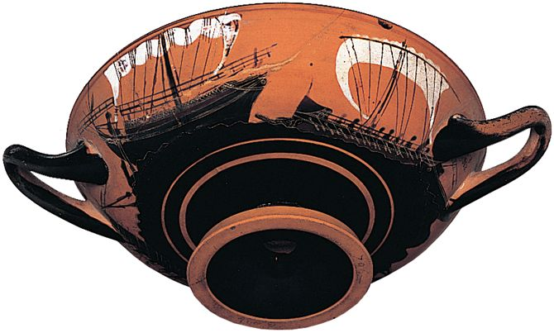
Trireme
Athen’s naval technology made them powerful and wealthy
Military ships couldn’t depend on wind only so needed many oars for power
Mast
Sails
Propelled by 170 rowers
  From lower classes
Metal-tipped rams
Pair of steering rudders in back
Two Greek ships under sail, a merchant vessel (left) and a galley (right) powered by oars as well as sails.

Slide 30
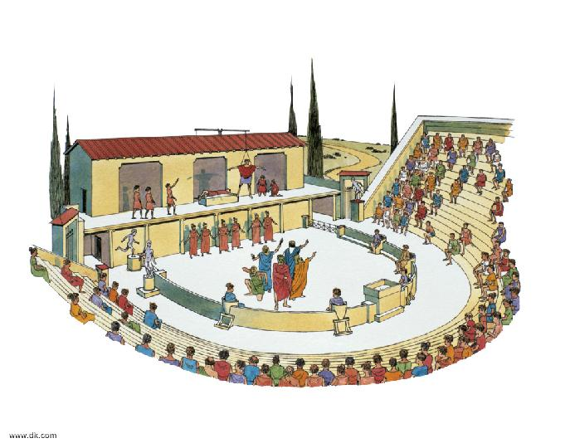
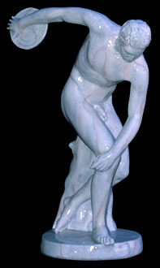
The Delian League
Poleis create Delian League to forestall more Persian attacks
Led by Athens
  Massive payments to Athens fuels Periclean expansion
  Promote their economic interests
    Athen’s port, Piraeus became most important commercial center in eastern Med. Sea
    Built Parthenon during Pericles time
    Promoted plays: tragedies and comedies
    Artists and thinkers attracted to Athens
  Resented by other poleis

Slide 31
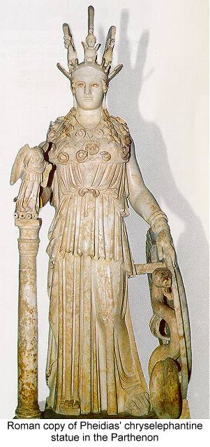
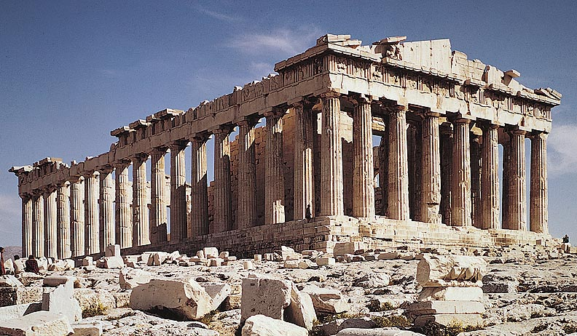
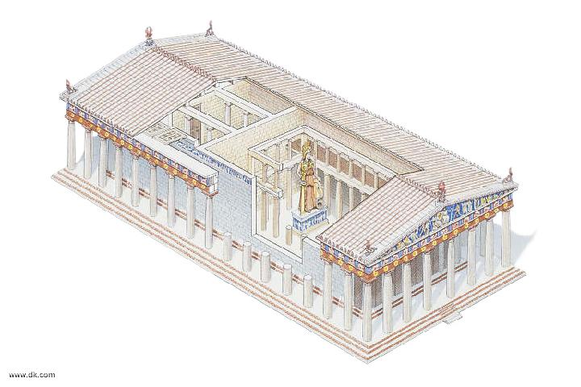
Golden Age-Age of Pericles

Slide 32
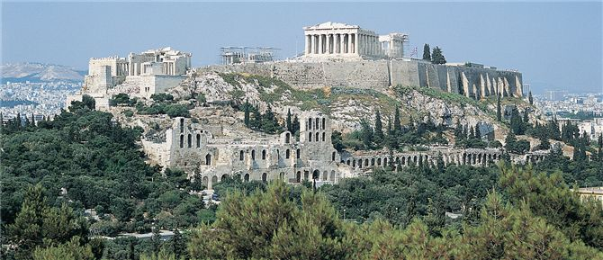
Parthenon
Pericles organized the construction of numerous marble buildings, partly with funds collected from poleis belonging to the Delian League. Most notable of his projects was the Parthenon, located at the top of the Acropolis (the elevated fortress overlooking Athens). A temple dedicated to the goddess Athena, the Parthenon symbolizes the prosperity and grandeur of classical Athens.

Slide 33
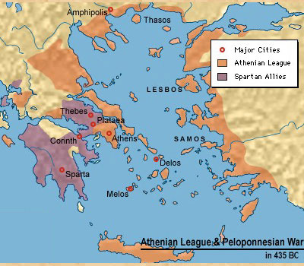
The Peloponnesian War
Civil war in Greece, 431-404 BCE
Poleis allied with either Athens or Sparta
Favored one side or the other but by 404 BCE, Athens forced to surrender
Debilitating and demoralizing conflict that weakened poleis
  Could not agree to form alliance against Macedonian threat

Slide 34
Example of Athenians Brutal Tactics
Described by the historian Thucydides who wrote a history of the war
  “When the small island of Melos refused to acknowledge the authority of Athens, …Athenian forces conquered the island, massacred all the men of military age, and sold women and children into slavery.”
Athens lost reputation as moral and intellectual leader and becomes known as the arrogant, insensitive imperialist power

Slide 35
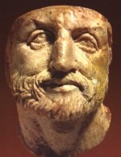
Kingdom of Macedon
Frontier region to north of Peloponnesus
King Philip II (r. 359-336 BCE) builds massive military
350 BCE encroaches on Greek poleis to the south, controls region by 338 BCE

Slide 36
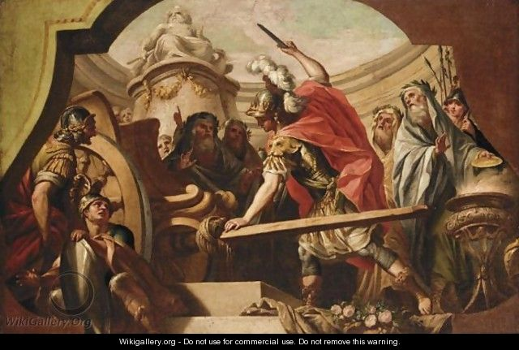
Alexander the Great
Son of Philip II
Takes throne at 20
Tutored by Aristotle
Learned to ride, use weapons, military training at young age
Many legends about him
  Horse-Bucephalus, Gordian knot, descended from Achilles, Iliad inspired him
Numerous cities named after him
  Alexandria, Egypt most famous

Slide 37
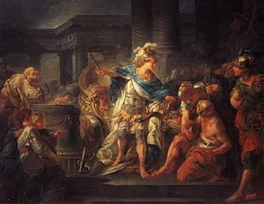
Visits city of Gordian
Prophecy said that it could only be untied by future conqueror of Asia

Slide 38
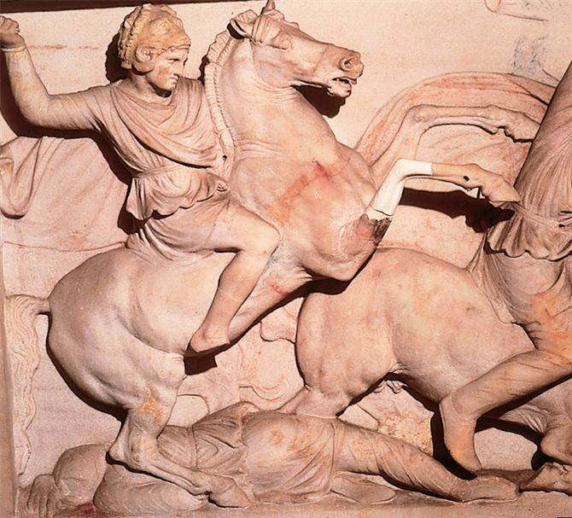
Alexander the Great
Invasion of Persia successful
Conquer Egypt and made pharaoh
Turned back in India when exhausted troops mutinied
After death, empire divided

Slide 39
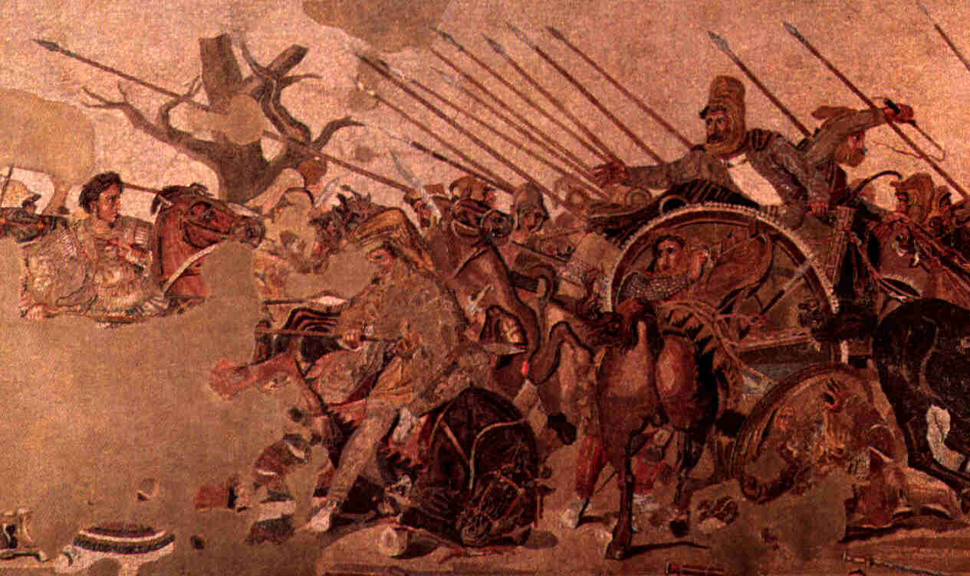
Roman mosaic depicting Alexander and Darius III meeting at Battle of Issus

Slide 40
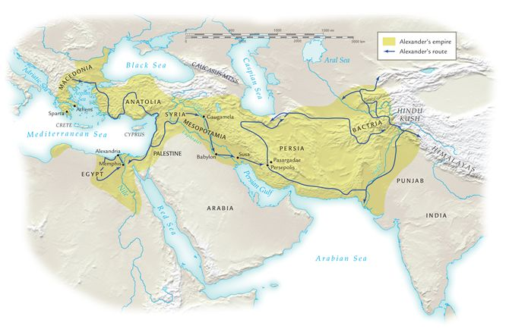
Alexander's empire, ca. 323 b.c.e.Compare the boundaries of Alexander's empire with those of the Achaemenid empire as depicted in Map 7.1.
How was Alexander able to bring such extensive territories under his control?

Slide 41
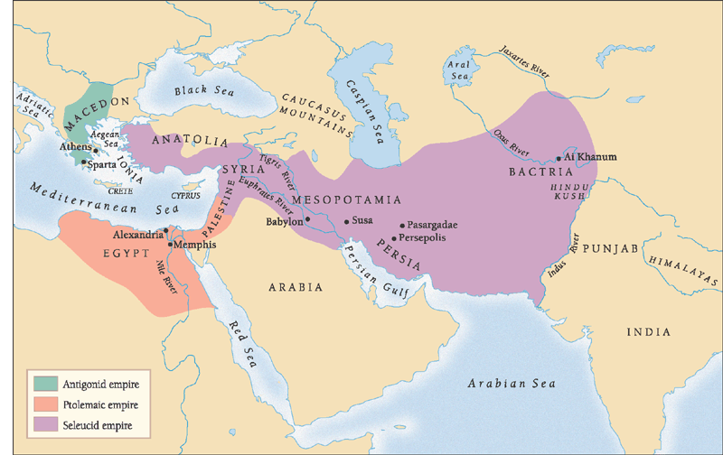
The Hellenistic Empires
After Alexander’s death, competition for empire
Divided by generals
  Antigonus: Greece and Macedon
  Ptolemy: Egypt
  Seleucus: Persian Achaemenid Empire
Economic integration
Hellenism: Mixing of the Greek, Persian, Egyptian, and Indian culture

Slide 42
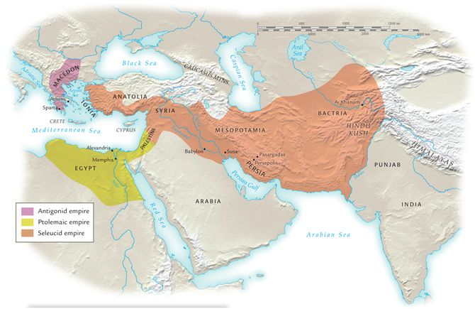
The Hellenistic empires, ca. 275 b.c.e. Note the differences in size between the three Hellenistic empires.
Consider the geographical conditions and economic potential of the three empires.

Slide 43

The Antigonid Empire
Smallest of Hellenistic Empires
Greek cities often resented rule and sought independence
  Struck deals where they accept rule in exchange for tax relief and local autonomy
  Athens and Corinth continue to flourish b/c of trade

Slide 44

The Ptolemaic Empire
Wealthiest of the Hellenistic empires
Established state monopolies
  Textiles, salt, beer
Capital: Alexandria becomes the center of the Hellenistic World
  Important port city
  Major museum, library
Alexander’s tomb
Alexandria’s Lighthouse
Library -1st research library of known world
Coin of Cleopatra VII

Slide 45

The Seleucid Empire
Massive colonization of Greeks
Export of Greek culture, values as far east as India
  Ex. Bactria
    Ashoka’s edicts in Greek

Slide 46
Reverberations of Long-Distance Trade Networks
Greeks traveled long distances, both by land and see, to trade during the Hellenistic Era. As trade circulated between Greece and the many and growing Greek colonies, Greek language, cultural traditions, and political structures accompanied material items such as wine, slaves, and timber.
Consider whether nonmaterial or material items were more important agents of change over the long term in Greek long-distance trade networks.

Slide 47

Panhellenic Festivals
Useful for integrating far-flung colonies
Best known of the festivals: Olympic Games begin 776 BCE
  Sent best athletes of the polis to Olympia
  Footracing, long jump, boxing, wrestling, javelin, discus throwing
  Winners received olive wreaths
  Every 4 years for over 1000 yrs.
  In the nude
  Females not allowed-young women had their own games
Sense of collective identity
  Featured athletic, literary, and musical contests where individuals compete to win glory for polis

Slide 48
Patriarchal Society
Greek women fell to authority of fathers, husbands, or sons
Women as goddesses, wives, prostitutes
Marriage unequal
  Arranged by male w/parents
  Wife most likely teenager w/ no formal education
  Wife had no political rights, limited legal protection
  Husband & wives had limited contact
  Men slept in men’s quarters
Limited exposure in public sphere
  Escorted by chaperone or servant w/ veil
Sparta partial exception
  Athletics, went out in town, occasionally took up arms,
Sappho- female poet from 600 BCE, example of educated upper class women
  Less privileged women contributed to household
Role of infanticide in Greek society and culture

Slide 49

Slavery
Prominent means of mobilizing labor
Debt slaves
Captured in war or from trading ports
  Ex. Scythians (Ukraine)
  Ex. Nubians (Africa)captured and sold by Egypt
Property of owner: Chattel slavery
Used as hard labor, domestic servants, or even business
  EX. Slave named Pasion, clerk at bank who turned profits for masters
    Gained his freedom, took over mgt of bank, outfitted 5 warships, and granted Athenian citizenship
A slave carrying a lantern guides his drunken master home following a party.

Slide 50

Learning in Greece
Astronomy, math, medicine, geometry, architecture
Began to rely on observation, evidence, rational thought, and human reason
Borrowed Phoenician alphabet and added vowels to represent speech
  Allowed for communication of abstract ideas
    Ex. Philosophy
Raphael’s School of Athens

Slide 51

Socrates (470-399 BCE)
The Socratic Method
  Questioning of assumptions and logic
Know from his student Plato
Urged the pursuit of wisdom and virtue
  Ethics and morality more important than wealth, fame, and superficial attributes
Played role of public gadfly (one who challenges people in positions of power, the status quo, or popular position)
Condemned on charges of immorality and corrupting the youth of Athens
Forced to drink hemlock and died in 399 BCE
Tradition holds that Socrates was not a physically attractive man, but his statue emphasizes his sincerity and simplicity. Judging from his clothing and posture, how might the sculptor have characterized Socrates?
Tradition holds that Socrates was not a physically attractive man, but this statue emphasizes his sincerity and simplicity. Judging from his clothing and posture, how might the sculptor have characterized Socrates?

Slide 52

“The unexamined life is not worth living” Socrates
Jacques Louis David’s neoclassical work from 1787, The Death of Socrates.

Slide 53

Plato (430-347 BCE)
Wrote down Socratic thought
Theory of Forms or Ideas
  Ex. Quality of virtue; world is a pale , imperfect reflection of genuine reality
    The ideal qualities are only understood by philosophers seeking wisdom
Wrote The Republic
  Described an ideal society
  Philosophical elite would rule as kings
    Advocated an intellectual aristocracy
  The less intelligent classes would work at functions that best suited them

Slide 54



Slide 55

A mosaic from the Italian town of Pompeii, near Naples, depicts Plato (standing at left) discussing philosophical issues with students. Produced in the early first century c.e., this illustration testifies to the popularity of Greek philosophy in classical Roman society.

Slide 56

Aristotle (389-322 BCE)
Student of Plato
Tutor of Alexander the Great
Rely on senses to provide accurate info of world and depend on reason to sort out
Emphasis on empirical findings, reason
Wrote on biology, physics, astronomy, psychology, ethics, and literature
  Ex. Ethics: “Virtue” was a product of rational thought and could be learned
Massive impact on western thought
Christian scholastic philosophers of Europe called him “The master of those who know.”

Slide 57
Herodotus
Wrote about the Greco-Persian Wars to discover “the reason why they fought one another”
“Father of history”

Slide 58

Hippocrates
Hippocratic Oath
Explained the functions of the body
Believed body composed of 4 fluids which when out of balance caused ailments
Traced origins of epilepsy to heredity

Slide 59
Hellenistic Philosophies
Epicureans
  Pleasure is the greatest good, a state of quiet satisfaction
Skeptics
  Doubted possibility of certainty in anything
Stoic
  Most influential
  Concentrate on the duty, virtue to aid others
  Emphasis on inner peace

Slide 60
Greek Theology
Polytheism
Zeus principal god
Religious cults
  -Fertility cult of Demeter
    For women
  Cult of Dionysis
    Celebrated also by mostly women in the Spring when wine produced fruit
  The Bacchae –play by Euripides
  Rituals eventually became more tame

Slide 61
Tragic Drama
Evolution from public presentations of cultic rituals
Major playwrights (5th c. BCE)
  Aeschylus
  Sophocles
  Euripides
Comedy: Aristophanes

