Slide 1
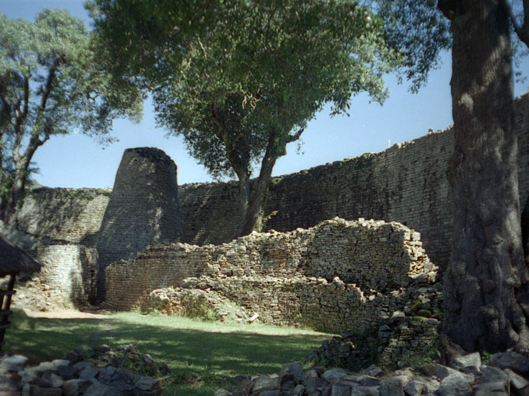
Chapter 19
States and Societies of Sub-Saharan Africa

Slide 2
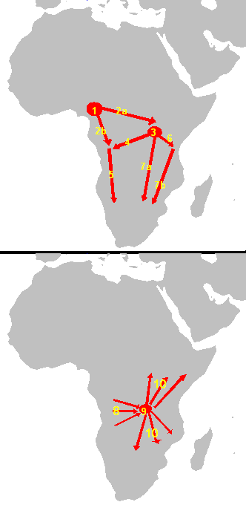
Effects of Early African Migrations: Bantu Peoples
Bantu-speaking peoples settle south of Equator
Agriculture, herding spreads with Bantu migrations
  Many hunting, gathering, fishing societies were absorbed into the Bantu peoples
  Yams, sorghum, millet were dietary staples among southern parts of Africa
  Cattle raising
Iron metallurgy spread to most of sub-Sahara Africa by 1000 CE
  Population exceeds 22 million

Slide 3
Cultivation of Bananas
Domesticated in south-east Asia
Malay sailors colonize Madagascar, 300-500 CE
  Introduce bananas, yams, chickens
Well-adapted to African climate
Food supply increases with this key crop and allows Bantu to expand more rapidly
  Nutritious supplement to the heavily forested areas that couldn’t cultivate millet, sorghum

Slide 4
Population Growth in Sub-Sahara
Significance of iron metallurgy and bananas to population
After 400 BCE, iron technology used
By 800 CE, bananas cultivated
By 1000 CE, Bantu had introduced both to most regions of sub-Sahara

Slide 5
Political Organization
Kin-Based Societies
Also called stateless, segmented societies
  No elaborate hierarchies, bureaucracies
Average population of village: 100
Ruled by elders, male heads of families
Family and kinship groups disciplined own members
Village chiefs negotiated on matters concerning 2 or more villages
Higher government authorities rare
Bantu peoples governed themselves thru family and kinship groups

Slide 6
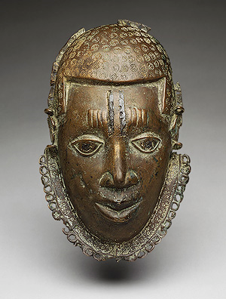
Chiefdoms
Population pressures after 1000 increase competition, disputes
  Led to organization of chiefdoms under the leadership of a powerful chief
Overrule kin-based groups
Some chiefs conquered neighbors and consolidated lands into small kingdoms
  Ex. Ife, Benin arose in forested regions of West Africa

Slide 7
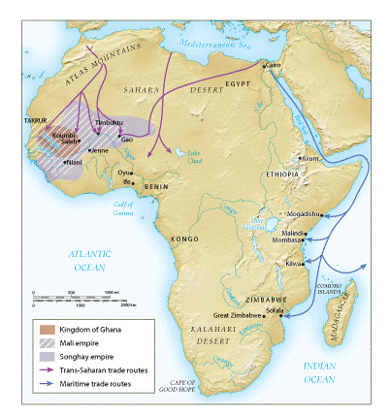
Kingdoms and empires of sub-Saharan Africa, 800-1500 CE

Slide 8

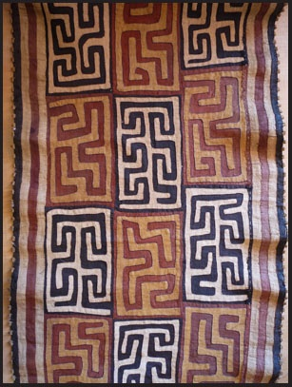
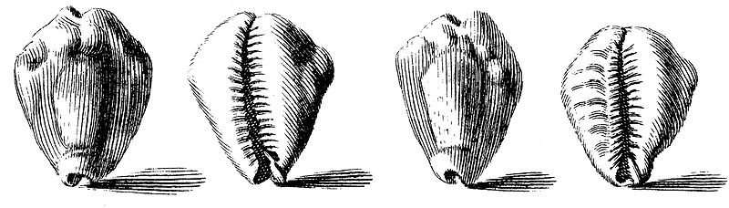
Kingdom of Kongo
One of the most prosperous kingdoms in basin of the Congo river
Participated actively in trade networks
  Copper, raffia cloth, cowry shell
Most centralized rule of the early Bantu kingdoms
  King, officials who oversaw military, judicial and financial affairs
Royal currency: cowry shells
Ruled 14th-17th century until undermined by Portuguese slave traders
Raffia cloth

Slide 9
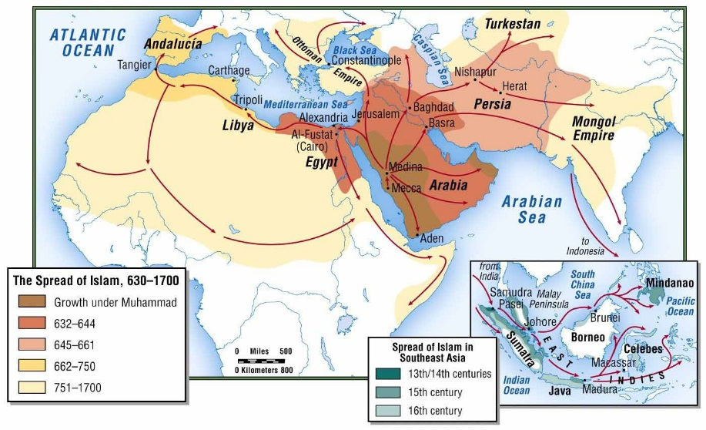
Islam Introduced to Sub-Saharan Africa
To West Africa by the trans-Saharan camel caravans
To coastal east Africa over the sea lanes of the Indian Ocean in vessels of merchant mariners

Slide 10
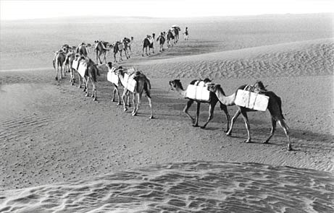
Islamic Kingdoms and Empires
Influences the political, social, religious, cultural, and economic development 8th century

Slide 11
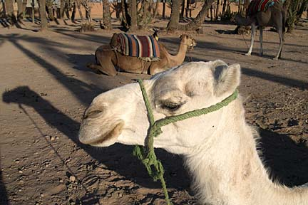
Trans-Saharan Trade and Islamic States in West Africa
Desiccation (remove moisture) created the Sahara beginning c. 5000 BCE
Introduction of Arabian camels revolutionizes trade
By 300 CE, replace horses and donkeys as preferred transport
  70-90 days to cross Sahara
  Camel saddles
  Also used in Central Asia
Arabs establish trading communities in Sub-Sahara
  Gao: terminus of caravan routes across Sahara that offered access to Niger River

Slide 12
Reverberations of…
The Diffusion of Technologies
Camels had been used for centuries by traders in Arabia and N.Africa-thanks especially to the camel saddle invented in about 200 CE-before Muslim traders made their way across the Sahara to West Africa in the 7th and 8th centuries. Camels, although living beings, can be considered technology b/c their use helped humans adapt the natural environment to their needs, making It possible to reliably and repeatedly traverse the vast Sahara desert. Think about the variety of ways that the diffusion of camels to sub-Saharan Africa-in terms of trade, urban growth, the accumulation of wealth, and the slave trade-affected the region over the very long term.

Slide 13
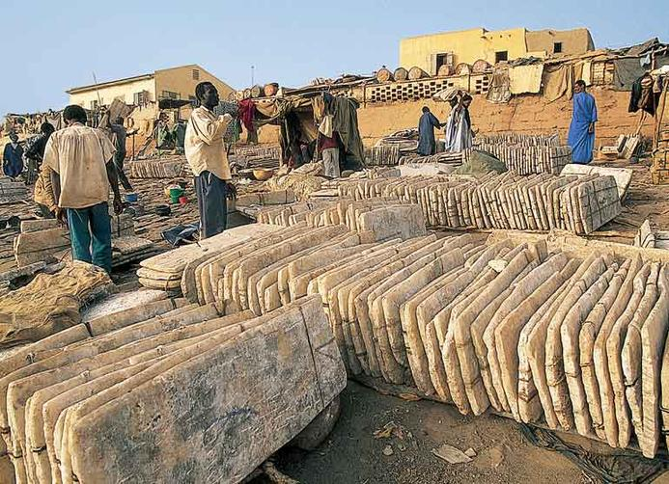
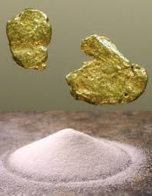
The Kingdom of Ghana/Gold-Salt Trade
Not related to modern State of Ghana
According to legend preserved by Arab travelers, as many as 22 kings ruled Ghana before Muhammad embarked on the hijra
  Developed 4th-5th c. CE when agricultural peoples sought protection against camel-riding nomads
Became center of African gold trade
  Muslim merchants in search of gold for consumers in Mediterranean and Islamic world
  Imported from south in region of Niger, Gambia, and Senegal rivers
  Kings taxed and controlled the gold trade
  Also sold ivory, slaves
Received horses, cloth, manufactured wares, and SALT
Known as the Gold-Salt Trade
West African Salt Mine

Slide 14
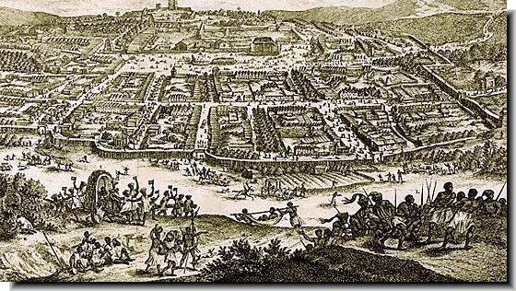
Capital: Koumbi-Saleh
Capital of Ghana and trading center
High point 9th-12th centuries
  Population 15,000-20,000
  Stone bldgs. and dozen mosques
  Large # of qadis and Muslim scholars
Military, cultural center
  Army of 200,000 warriors to protect gold sources, maintain order, kept allies and tributary states in line, and defend against nomads from Sahara

Slide 15
Islam in West Africa
Kings of Ghana convert 10th c.
Positive impact on trade, relations with north Africa
Didn’t impose it on society
Synthesized Islam with local traditions
  Observed traditional religious customs such as the practice of magic and keeping idols in woods around the palace

Slide 16
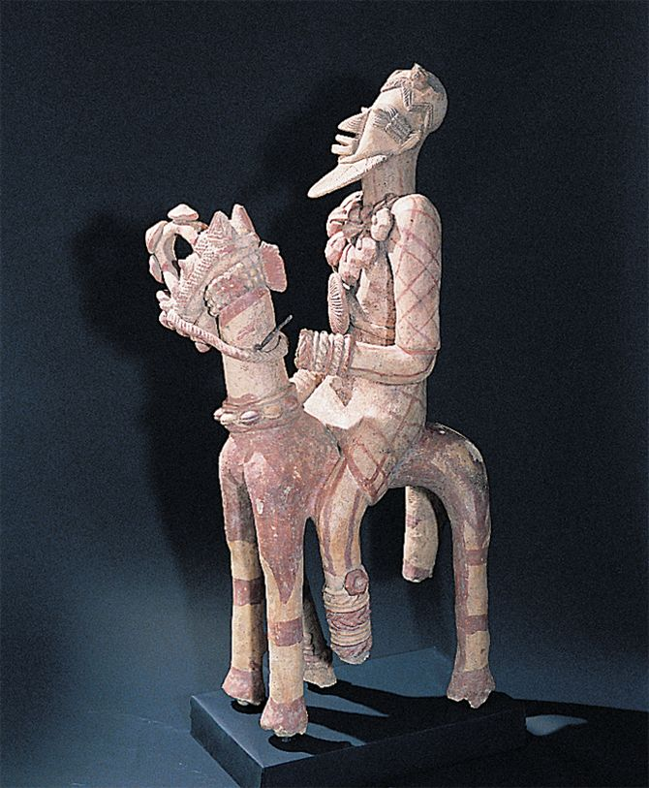
Decline of Ghana
Attacks by nomadic peoples from Sahara
Raids weakened the kingdom, collapsed
Fell to powerful Mali empire
This west African terra-cotta sculpture from the 13th or 14th c. depicts a helmeted and armored warrior astride a horse with elaborate harness and head protection.

Slide 17

Sundiata (r. 1230-1255)
13th c. founder of Mali
Story recited by griots until mid-20th c.
Sundiata’s father ruled a w.African kingdom
He had a difficult childhood, congenitally defective leg left him partially crippled
Father dies, enemies invade and kill royal offspring
Sundiata spared b/c thought his disability was not a threat
Overcomes his injury, learned to bow and arrow
Forced into exile where becomes a warrior
Returns to homeland and defeats enemies
Built the empire of Mali
Sundiata, the Lion Prince of Mali

Slide 18
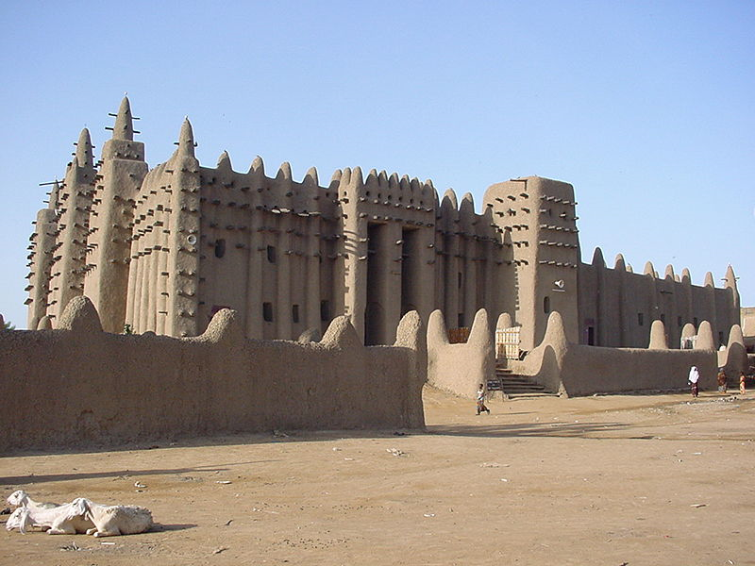
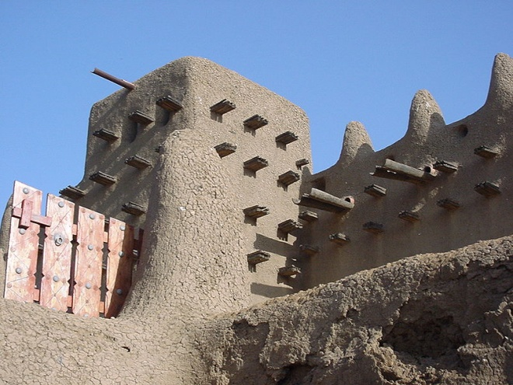
Mansa Musa (r. 1312-1337)
Highpoint of Empire
Grandson of Sundiata
Enormous caravans linked Mali to n. Africa where they taxed all trade
  Timbuktu, Gao, and Jenne became prosperous market cities
Rulers of Mali honored Islam by providing protection, lodging, and comforts for Muslim merchants from the north
Fervent Muslim
Performed Hajj in 1324-25
  Constructed numerous mosques
  Brought in African teachers, including 4 descendants of Muhammad to make Islam better known in Mali
  Established religious schools
Empire declines after his rule
The Great Mosque at Djenne

Slide 19
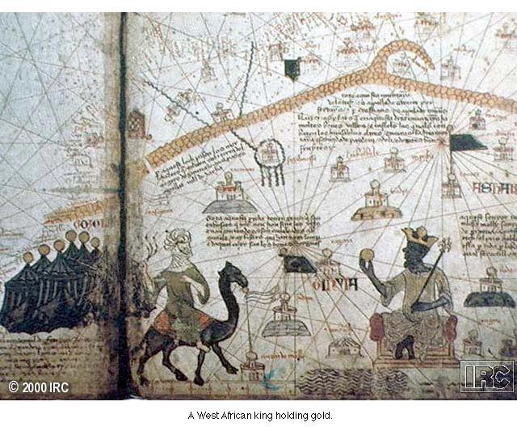
Mansa Musa
Mansa Musa enjoyed a widespread reputation as the wealthiest king in the world. On this map, prepared in 1375 by a cartographer from the Mediterranean island of Majorca, Mansa Musa holds a gold nugget about the size of a grapefruit. What does this illustration reveal about the image of west Africa in the Mediterranean world?

Slide 20
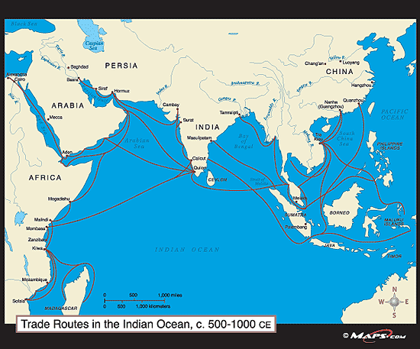
The Indian Ocean Trade and Islamic States in East Africa
East coast maritime trade weak until 2nd century
Bantu peoples populate coast by 2nd c. CE
  Found settlements on coast and interior regions of east Africa
  Builders of Swahili society
Swahili (Arabic for “coasters”) engage in trade with Arabs
  Bantu language with words and ideas borrowed from Arabic
10th century trade increases
  Swahili traded gold, slaves, ivory, tortoise shells, leopard skins for pottery, glass, textiles from Muslim merchants

Slide 21
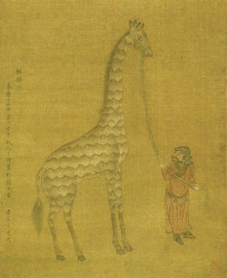
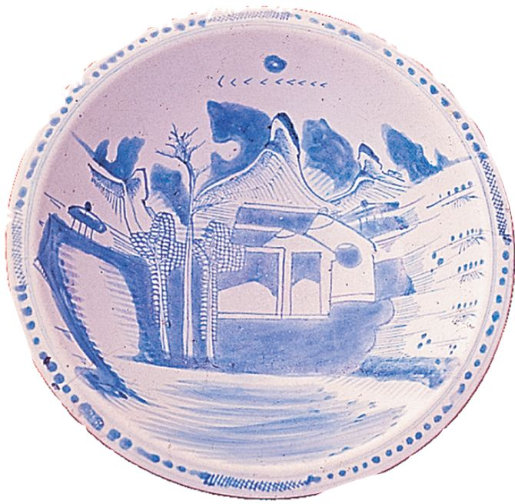
Trade with China
This fine piece of Chinese porcelain, probably produced in the fifteenth century, found its way into a Swahili tomb in modern Dar es Salaam, Tanzania.
An African giraffe was once brought to China as a gift to the emperor

Slide 22
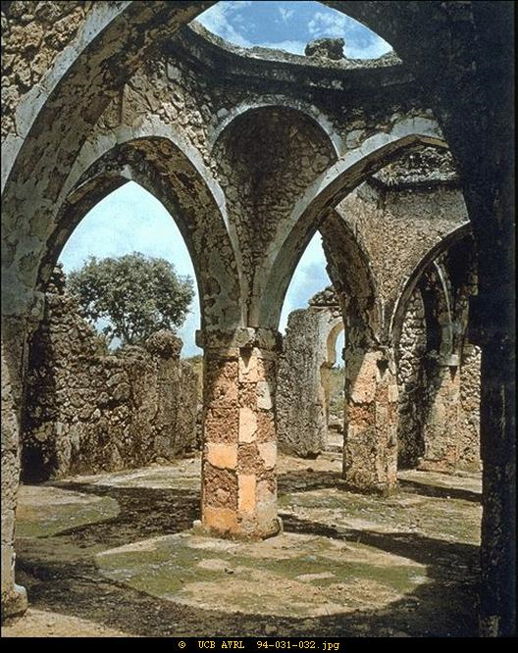
The Swahili City-States
Great wealth, 11th-12th centuries CE
Development of city-states
  Mogadishu, Lamu, Malindi, Mombasa, Zanzibar, Kilwa, Mozambique, Sofala
  Governed by king who supervised trade and organized public life
Architecture moved from wood/mud to coral, stone
Ruling elites and wealthy merchants dress in Chinese silk,set tables w/ porcelain
Ruins of a mosque at Kilwa, made of coral

Slide 23
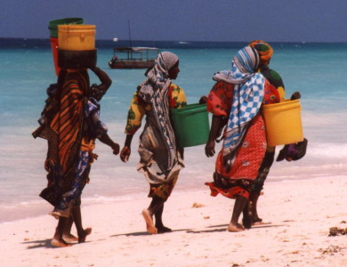
Kilwa
One of busiest on east African coast
  Farthest south that ships could sail and return in one monsoon season
Early Bantu fished, limited trade, 800-1000 CE
Turn to agriculture, increased trade in pottery and stoneware
Population of 12,000
Import cotton, silk, perfumes, pearls
Traded gold, slaves, ivory
Major trading center by 14th century
  Exporting over a ton of gold per year by 15th century CE

Slide 24
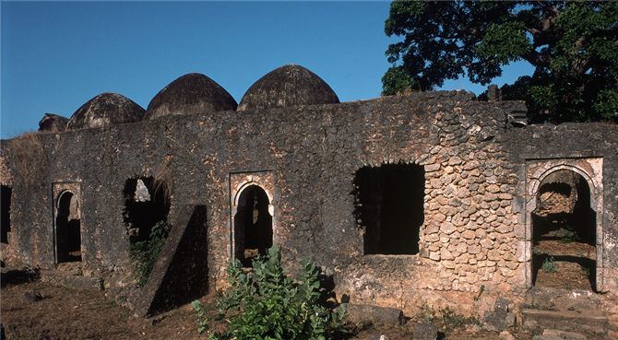
Ruins of Kilwa's Great Mosque, built during the thirteenth century, testify to the wealth that Indian Ocean trade brought to the city.

Slide 25
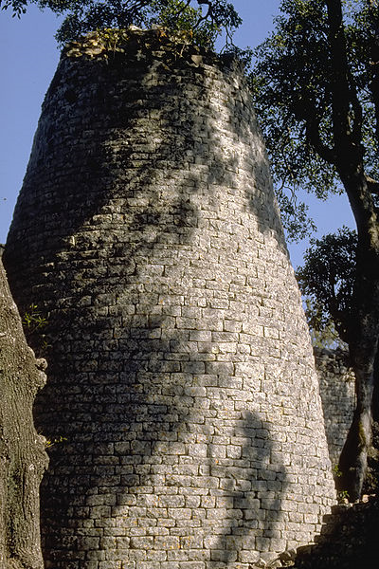
Zimbabwe
Kingdom east and central Africa
Means “dwelling of the chief”
Stone complex called “Great Zimbabwe” built early 13th century CE, capital
Population 18,000 in late 15th century
Managed trade between internal and coastal regions

Slide 26
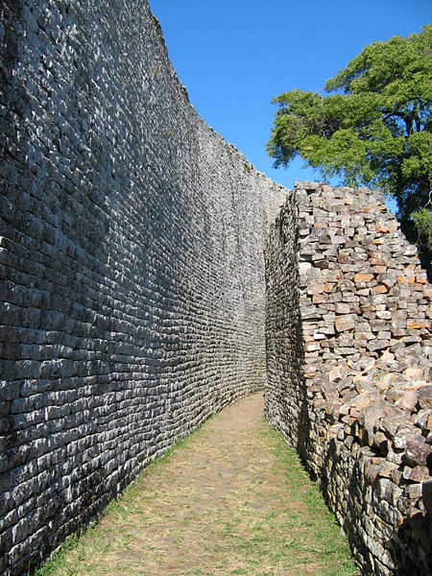
Great Zimbabwe
City of stones towers, palaces, public buildings
Stone walls 16’ thick, 32’ tall
Farm and raise cattle between Zambezi and Limpopo rivers
After 1000, Great Zimbabwe controls gold trade routes linking the inland gold fields to coastal trading city, Sofala
Leaders gain wealth by taxing traders, chiefs
Abandoned by 1450 for unknown reasons
  Overgrazing by cattle
  Farming worn out soil
  Used up salt and timber resources

Slide 27
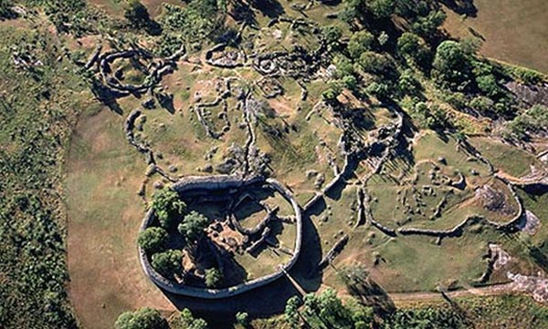
The massive stone complex of Great Zimbabwe, which featured very fine construction techniques, required the services of numerous expert masons and other craftsmen.

Slide 28
Islam in East Africa
Ruling elites in east Africa accept Islam without forcing general population to convert
Often retained pagan religious traditions and practices
Islam serves as social glue with other merchants, states

Slide 29
Arabian Society and Cultural Development
Some kingdoms, empires, city-states with well-defined classes
  Ruling elites, military nobles, admin officials, religious authorities, merchant class, artisans, business entrepreneurs, commoners, peasants, slaves
Other areas in sub-Saharan Africa continue to use traditional kin-based groups

Slide 30
Kinship Groups
Extended families, clans
Idea of private property less prevalent
Land held communally
Harvests distributed by elders

Slide 31
Sex and Gender Relations
Men work with specialized skills
  Tanning, iron work, blacksmith
  Heavy labor
Both sexes work in planting/harvesting
Male rule more common, but some expanded roles for women
  Merchants, some military activity
Islam did not change women’s status in Sub –Sahara
  Socialize freely w/ men outside their families
  Work openly

Slide 32
Age grades
From early agricultural period, Sudan
Peer groups of single age cohort
Crosses lines of family and kinship

Slide 33
Slavery
Practiced since ancient times
Most slaves captives of war
  Debtors
  Suspected witches
  Criminals
Used principally in agricultural labor
Slave possession a status symbol

Slide 34
Slave Trading
Increased trans-Saharan and Indian Ocean trade stimulates slave trade, 9th c. CE
Africa replaces eastern Europe as principal source of slaves
Creates internal African slave trade
  More powerful states attack smaller kinship-based groups
  10,000-20,000 slaves per year

Slide 35
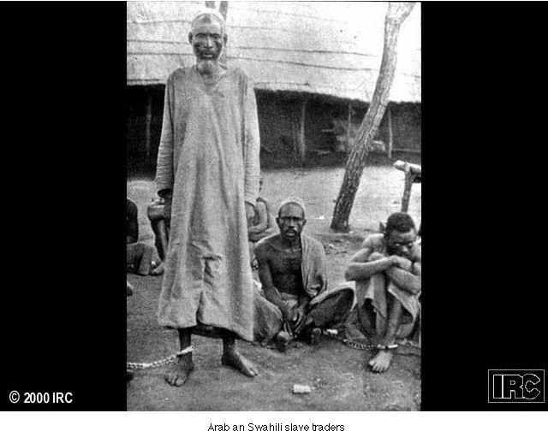
Arabian Swahili Slave Trade

Slide 36
The Zanj Revolt
Slaves from Swahili coast exported to work in Mesopotamia
  Sugarcane plantations
  Salt deposits
869 CE, slave Ali bin Muhamad mounts revolt of 15,000 slaves
Captures Basra
14 yrs. later crushed by Abbasids
B/n 750 and 1500, 10 million African slaves transported to foreign lands and served as foundation of Atlantic slave trade

Slide 37
African Religion
Great diversity of religious belief
Common element: single, male creator god
  Lesser deities associated with natural phenomena
Ancestor worship
Diviners
  Religious specialists, principally men
  Oracle reading, spells, other rituals
Limited emphasis on theology
Morality, balance of nature important

Slide 38
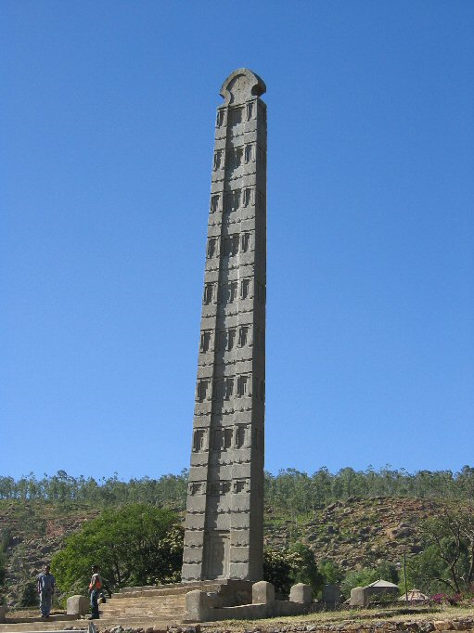
Early Christianity in North Africa
1st century: popular in Egypt, north Africa
  Initially weak in sub-Saharan Africa
The Christian Kingdom of Axum, 4th c. CE
  Ethiopia
  Merchants, then kings convert
  Bible translated into Ethiopian
  Isolated during Islamic period, renaissance during 12th century CE
  Massive churches carved out of solid rock

Slide 39
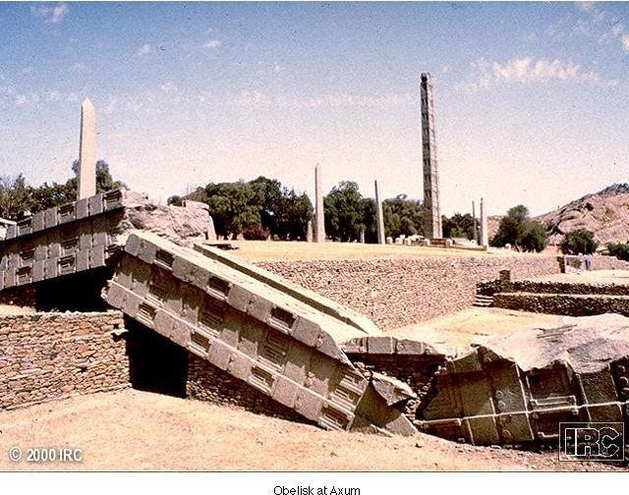
The Obelisk at Axum

Slide 40
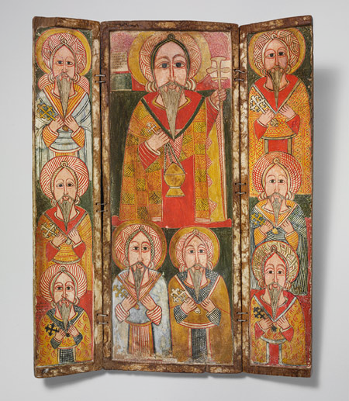
Ethiopian Christianity
Isolation from other Christian areas until 16th century
Independent development
Strong African influence
  Spirit world
  Amulets to protect from evil spirits

