Slide 1
Chapter 22
Reaching Out: Cross-Cultural Interactions

Slide 2
Motives for long-distance travel between 1000-1500 CE
Trade
Diplomacy
Missionary activity
The cross-cultural interactions that resulted helped spread technological innovations throughout the eastern hemisphere
Long-distance travel much more common than earlier areas

Slide 3
Thinking About Encounters: Long-distance Trade and Cross-Cultural Exchanges
W/ aid of long-distance travelers, many cultural traditions, technologies, and biological species spread widely through the eastern hemisphere.
What are the trade routes in eastern hemisphere?
Cultural traditions?
Technologies?
Biological species?

Slide 4
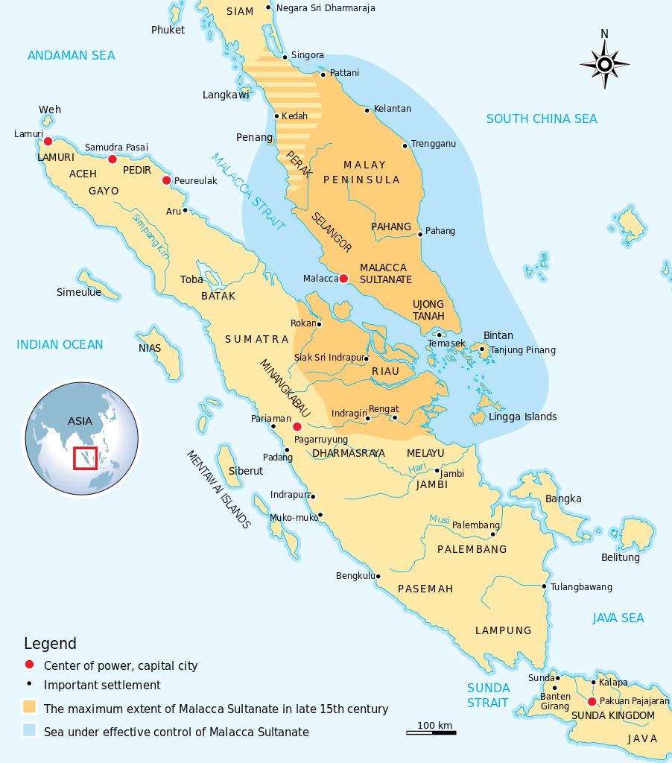
Patterns of Long-Distance Trade
Silk roads
  Luxury goods: silk, gems
Indian Ocean Trade
  Bulkier: steel, stone, coral, building material
Trans-Saharan caravan routes (Gold-Salt trade)
Growth leads to development of trading cities, emporium (center of commerce)
  Ex. Melaka-80 languages heard in streets
Melaka, founded in 1390, became principal clearinghouse of trade. Authorities maintained order in Strait of Melaka, a safe market, and levied reasonable fees on goods exchanged.

Slide 5
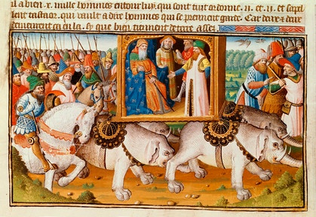
Best known “traveler”:
Marco Polo (1253-1324)
Example of long-distance travel
Traveled to China with merchant father, uncle
Enters service of Mongol Khubilai Khan
Returns to Venice after 17-year absence
Experiences recorded by fellow prisoner in Venice-Genoa conflict
Great influence on European engagement with Far East
  Mentions textiles, spices, gems, other goods

Slide 6
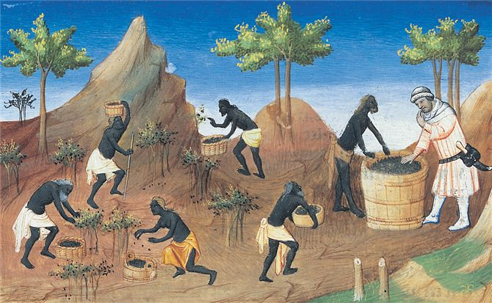
An illustration from a fourteenth-century French manuscript depicts Marco Polo picking pepper with local workers in southern India.

Slide 7
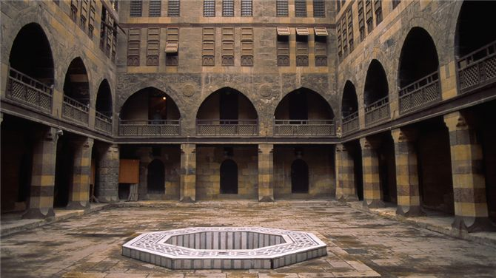
The massive walls of this caravanserai in Cairo protected travelers and their goods, while food, drink, and lodging were available inside for merchants as well as their animals.

Slide 8
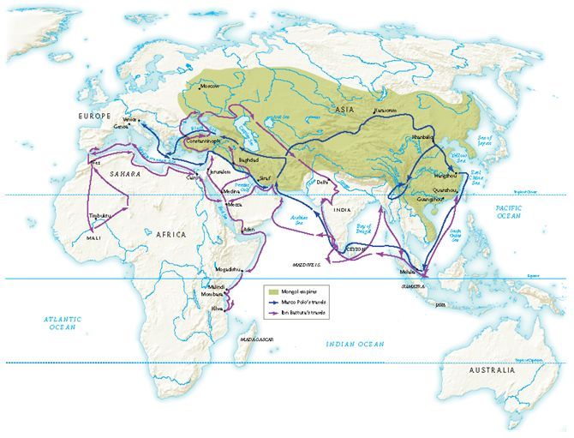
Travels of Marco Polo and Ibn Battuta.
Between them, Marco Polo and Ibn Battuta traveled across much of the Eurasian landmass, as well as parts of Africa and southeast Asia.

Slide 9
Political and Diplomatic Travel
Trade requires diplomatic relations after 1000 CE
Mongols, Christians recognize Muslims as common enemy, 13th century
  Ex. Crusades/Mongols-Abbasid empire
Pope Innocent IV invites Mongols to convert to Christianity
  Mongols counter-offer: Christians accept Mongol rule or face destruction

Slide 10
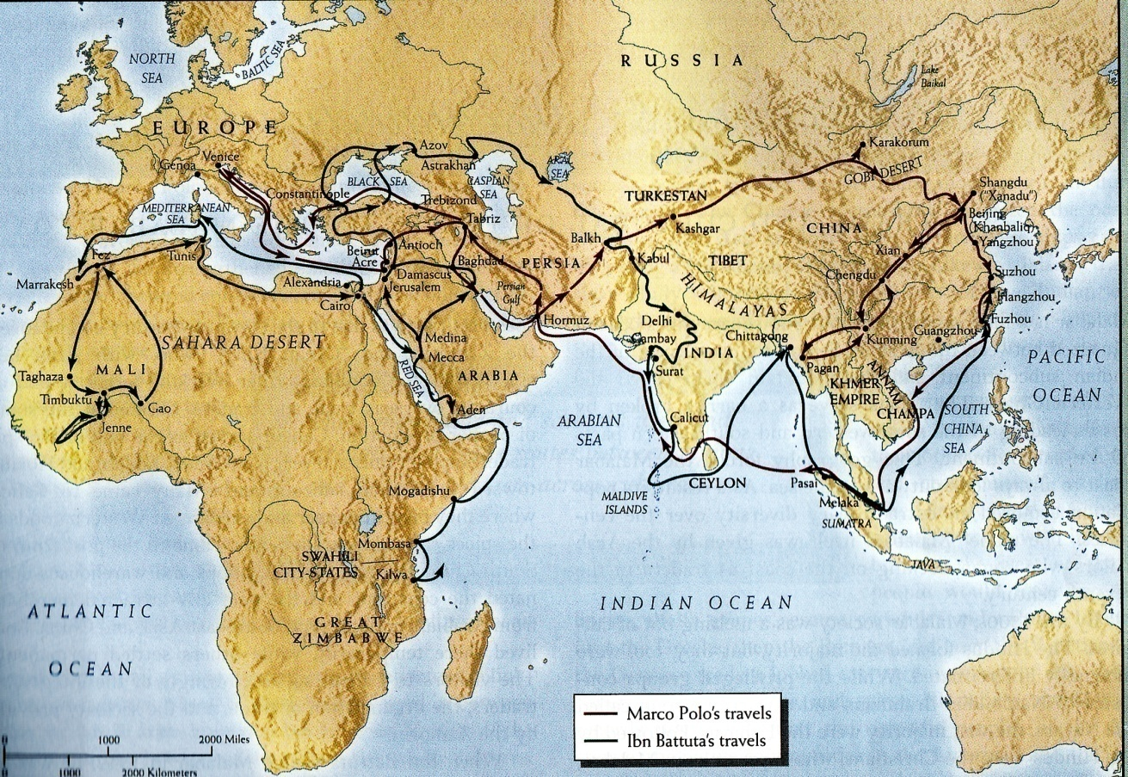
Diplomatic Travelers
Ibn Battuta (1304-1369) is example
  Islamic scholar, worked as qadi,in governments on extensive travel
  Strict punishment given out according to sharia
    80 lashes for drinking alcohol, hand amputations for theft
    Unable to convince women of Maldive islands to cover breasts
Ibn Battuta visited 44 modern countries and logged in 73,000 miles

Slide 11
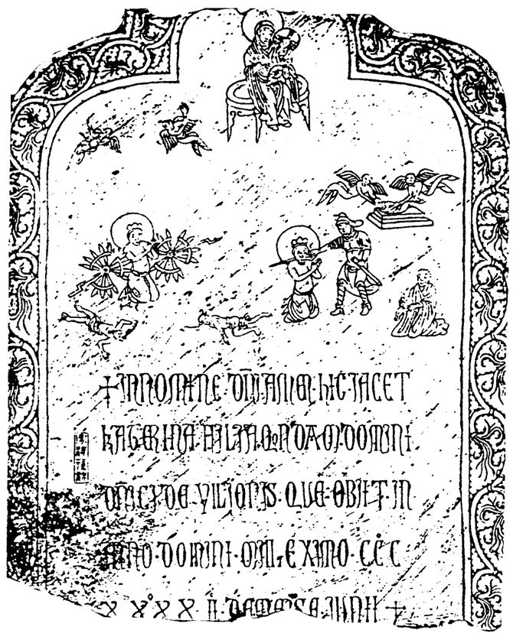
Missionary Travelers
Sufi missionaries travel throughout new Muslim territories, 1000-1500 CE
  Did not insist on strict doctrine, very flexible
  Spread Islamic values w/out resistance
Christian missionaries accompany, follow Crusaders
  Roman Catholic priests travel east to serve expatriate communities
  John of Montecorvino travels to China in 1291-dies 1328
    Italian Franciscan who worked to establish Christianity in China
    Attracts few Chinese, but respected among Chinese and Mongols
    Translates Biblical texts, builds Churches
Caterina Vilioni, daughter of the Venetian merchant Domenico Vilioni, died in the Chinese trading city of Yangzhou in 1342. Her tombstone, which shows she was part of the Roman Catholic community in Yangzhou, came to light during a construction project in 1951.

Slide 12
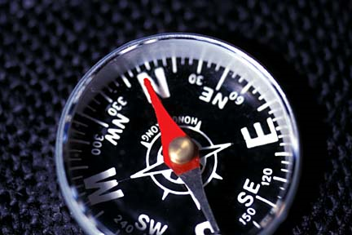
Cultural Exchanges
Songs and Stories – troubadours
European scientists consulted with Muslim and Jewish counterparts on understanding of natural world
The magnetic compass from China
  Invented in Tang or Song dynasty
  Spread during the 11th century in Indian Ocean basin
  Mid-12th century used in the Mediterranean and Atlantic Ocean

Slide 13
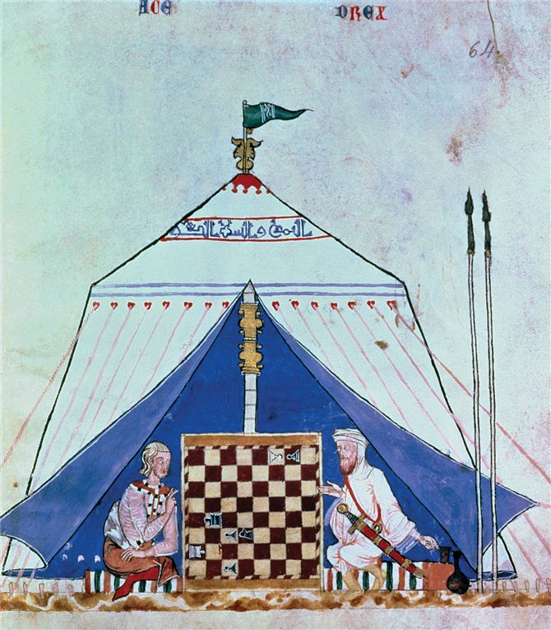
An illustration from a manuscript of 1282 depicts a Christian (left) playing chess with a Muslim (right). Chess was one of many cultural elements that passed from Muslim to Christian societies during the crusading era.

Slide 14
Spread of Crops
Muslim travelers introduce new crops to Sub-Saharan Africa
Citrus fruits, Asian rice, cotton
  Enrich diets by 1100
  Cotton fabrics worn by ruling elite and wealthy merchants
  Principal textile produced there by 1500
Sugarcane
  Muslims introduce crystallized sugar to European crusaders
  Demand increases rapidly
  Invest in sugar plantations in Mediterranean
  Europeans use Muslim precedent of having large populations of slaves work on sugarcane plantations

Slide 15

Gunpowder Technologies
Mongols spread gunpowder
  Mongols learn it from China and use it w/ catapults, trebuchets against Persia
  Muslims develop their own
Technology reaches Europe by 1258
  By Mongol-ruled Russia
  Primitive cannons used by 14th century

Slide 16
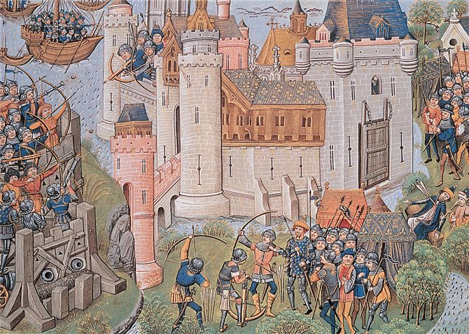
English forces besiege a French citadel during the Hundred Years' War (1337–1453). Note that the besiegers on the left side of this manuscript illustration employ cannons and smaller firearms that launch gunpowder bombs. Although essentially a dynastic conflict b/n 2 European ruling houses, the series of conflicts that constituted the 100 Years’ War had a significant impact on military technology and strategy and were major influence on developing notions of French and English NATIONALISM.

Slide 17
Examples of Crisis in Eurasia
Little Ice Age
Bubonic Plague

Slide 18
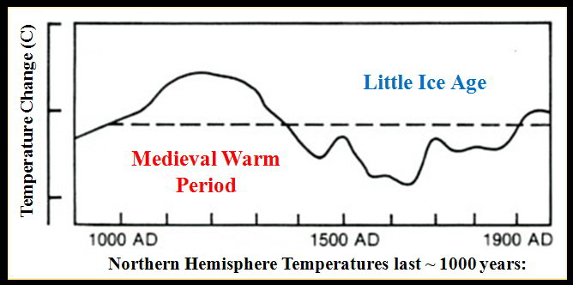
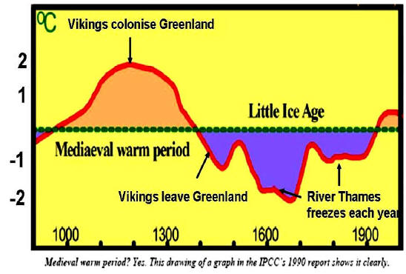
The “Little Ice Age”
About 1300 CE-1800 when temperatures were much cooler and shorter growing seasons
Effect
  Decline in agriculture lead to famine and starvation
  Norse settlers abandon Greenland

Slide 19
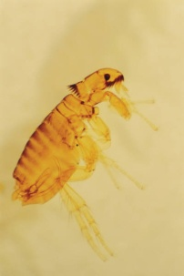
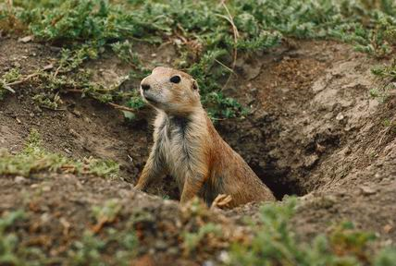

Bubonic Plague
  Appears 1st in China
  Carried by fleas on rodents
    Ex. Rats, squirrels, prairie dogs
    Fleas seek other hosts –Humans
    Yersinia pestis is the bacteria in stomach of fleas that infect the rodents
  Mongol campaigns spread disease from sw China to Chinese Interior in 1331
  Mongols, merchants, and travelers spread the plague westward
    Oases, trading towns, ports abundant breeding grounds
    By 1348, following trade routes, plague sparked epidemics in Western Europe

Slide 20
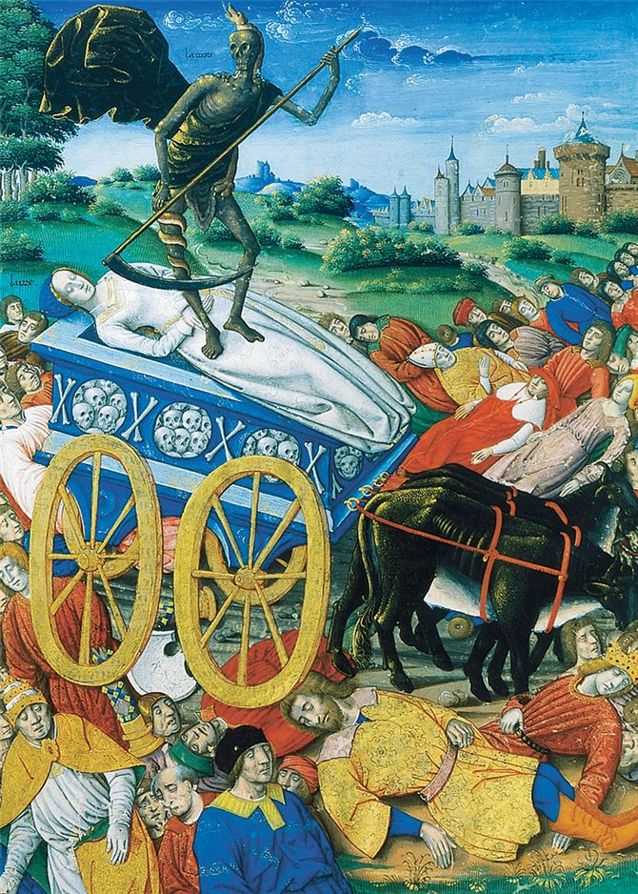
Spread of Plague
Mongols, merchants, travelers spread disease west
1346 Black Sea ports
1347 Mediterranean ports
1348 Western Europe
A painting of 1503 graphically communicates the horror felt by medieval Europeans when bubonic plague struck their communities. Here death takes away a cartload of victims while others die beside the road.

Slide 21
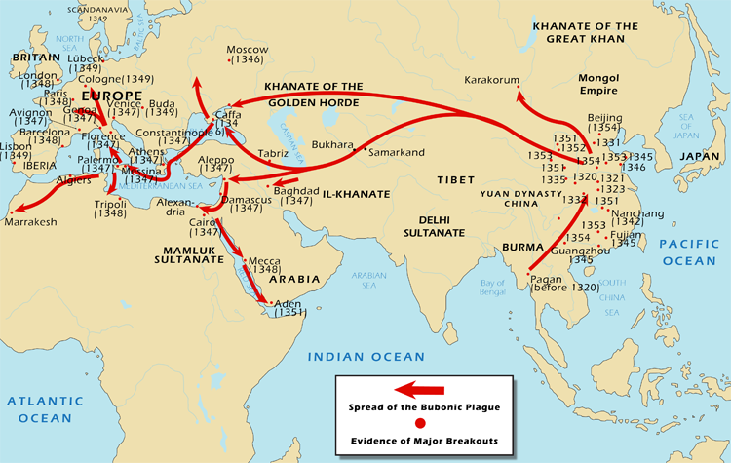

Slide 22
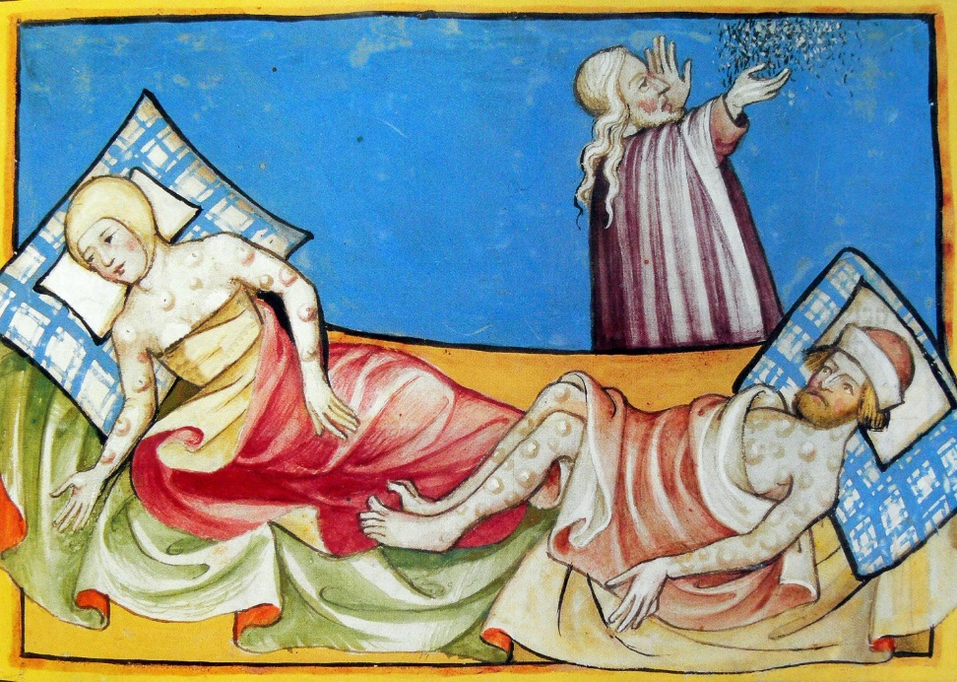
Symptoms of the Black Plague
Chills, high fever, delirium, vomiting, rapid heartbeat
Internal hemorrhaging discolored the inflammations blue and black
  “Black Death”
Inflamed and discolored lymph nodes in neck, armpits, groin area called “Buboes”
  Buboes, hence Bubonic
60-70% mortality rate, within days of onset of symptoms
Wiped out towns, villages etc.
In Europe, plague erupted in 1340s-late 17th century

Slide 23
Regions not affected by the Plague
Regions of Scandinavia b/c of long, cold winters which discouraged proliferation of rodents
India for reasons unknown
Sub-Saharan Africa

Slide 24
Population Decline (millions)

Slide 25
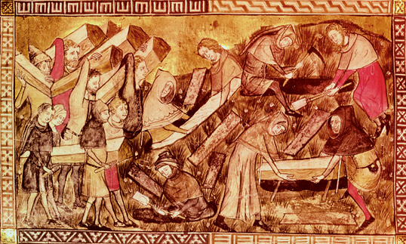
Burying the dead

Slide 26
Population Decline and Recovery
By 1500, China’s population rebounded to 100,000 million and Europe’s climbed to 81 million
  25% of European pop. Killed
Islamic societies in SW Asia, n. Africa, Egypt demographic recovery was more slow
  Ex. Egypt’s population did not reach preplague levels until 19th century

Slide 27
Social and Economic Effects
End of feudalism in Europe
Caused massive labor shortage b/c no group in society was spared
  Generated unrest
Urban workers demand higher wages
Population movements
  Urban worker and peasants leave to improve their circumstances
Governments attempt to freeze wages, stop serf movements
  Workers and peasants riots as a result

Slide 28
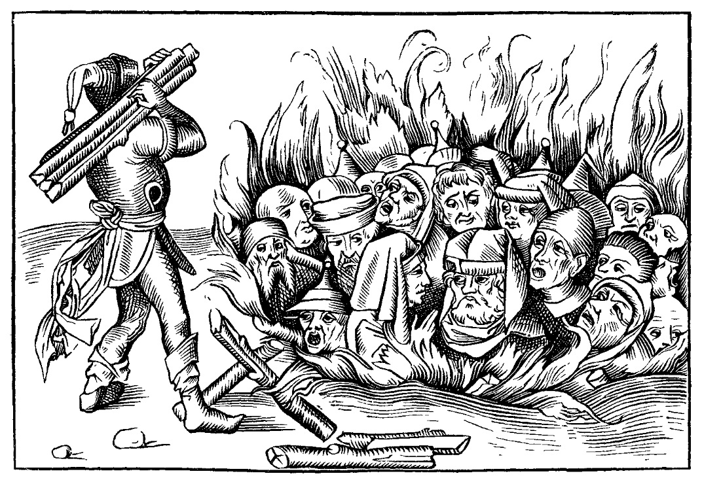
Persecution of Jews, Cologne 1349

Slide 29
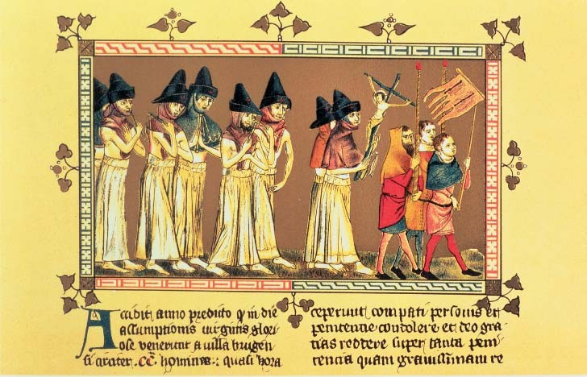
Religious Effect in Europe
Loss of faith in the Church
The Flagellants

Slide 30
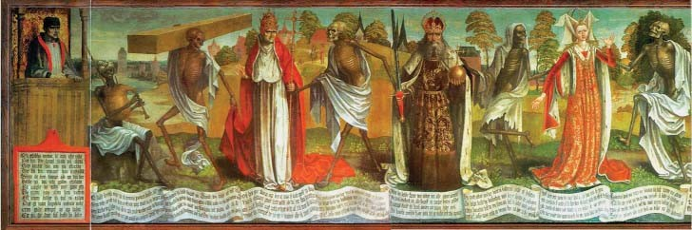
Art and the Black Death
Culture of Death

Slide 31
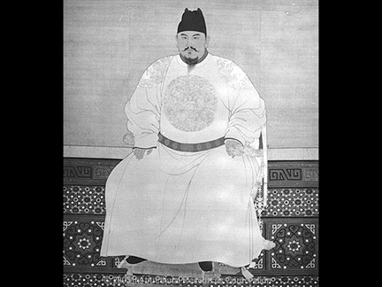
Recovery in China: The Ming Dynasty
Yuan dynasty collapses 1368, Mongols depart
  While plague rages
Impoverished orphan raised by Buddhist monks, works through military ranks, becomes Emperor Hongwu
Proclaims new Ming (“Brilliant”) dynasty, 1368-1644
Immediately takes steps to eliminate traces of Mongol rule

Slide 32
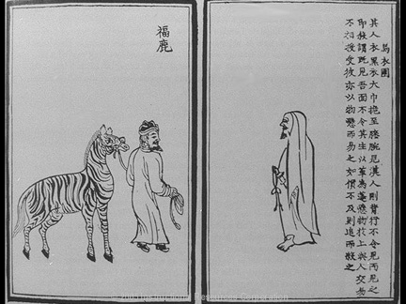
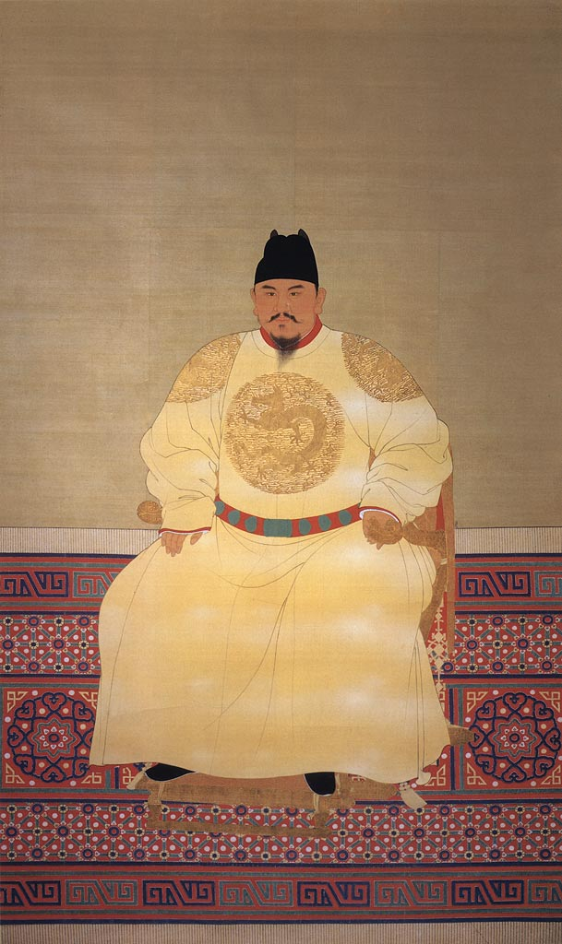
Ming Centralization
Reestablishes Confucian educational system
  To ensure talented officials/bureaucrats
Tightly centralized administration
  Ming emperors rule directly -no chief ministers
  Insisted on absolute obedience to the policies and initiatives
Relied on emissaries called Mandarins
  Special class of powerful officials implementing imperial policy
Heavy reliance on eunuchs
  Employed more extensively than predecessors
Centralized structure lasts through Qing dynasty in 1911

Slide 33
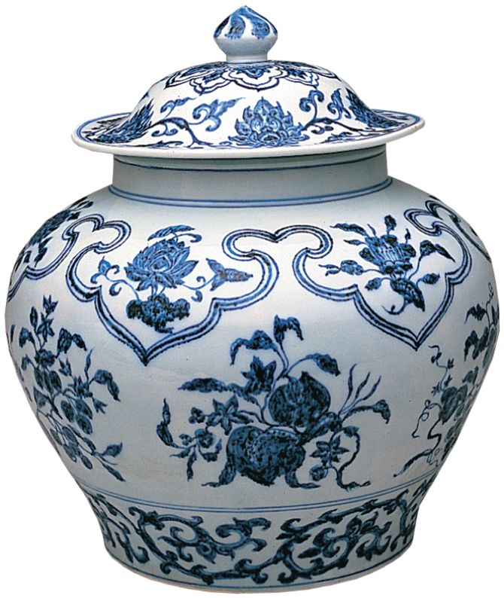
Economic and Cultural Recovery
  Promoted manufacturing of porcelain, silk, cotton textiles, lacquerware
Cultural revival
  Attempt to eradicate Mongol legacy by promoting traditional Chinese culture
    No Mongol names/ dress
  Emperor Yongle commissions 23,000-roll Encyclopedia
Ming artisans won worldwide fame for their blue-and-white porcelain, which inspired the founders of the Delft porcelain factory in the Netherlands. This covered jar dates from the early fifteenth century.

Slide 34
Recovery in Western Europe: State Building
  China: centralized Empire
  Europe: regional states
State-Building Required two elements
Fresh sources of finance
  Italian states:
  France: salt tax, sales tax
  England: hearth (chimney)tax, head tax, plow tax
Establish large standing armies
  French Louis XI (1461-1483) had army of 15,000

Slide 35
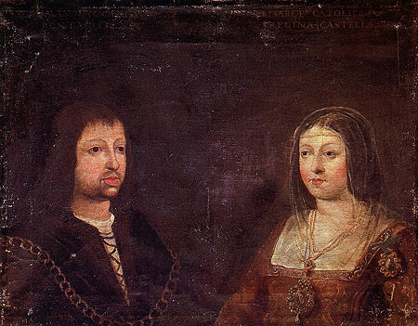
Spain
Fernando of Aragon marries Isabel of Castile, 1469
Major political and economic alliance
Completes Reconquista, expanded beyond Iberian peninsula to Italy
Funded Columbus’ quest for western route to China

Slide 36
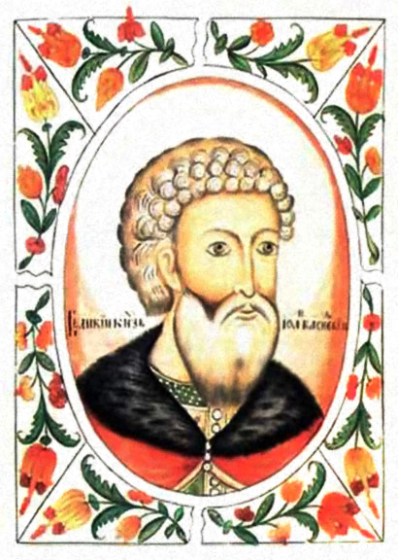
Russia- Ivan the Great (reigned 1462-1505)
After 14th c., Mongol power wane
In 1480, Prince Ivan III, stopped paying tribute to Mongol khan and declares independence
Made Moscow the center of a large, powerful state modeled after Byzantine Empire
  Third Rome
1st Calls himself “Czar” –Russian for Caesar

Slide 37
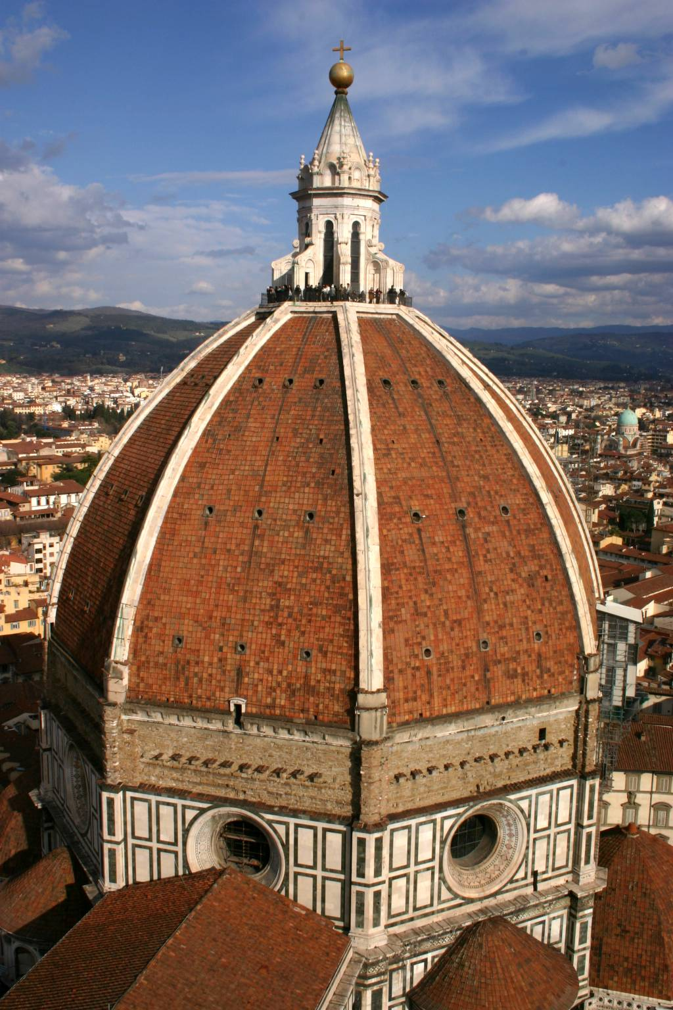
The Renaissance, 14th-16th centuries
“rebirth” of classical culture: Greece /Rome
Italian artists use perspective
Work with real human anatomy and musculature
  Leonardo da Vinci (1452-1519)
Architecture: domed cathedrals
  Imitation of Roman domes
Brunelleschi’s dome on cathedral of Florence

Slide 38
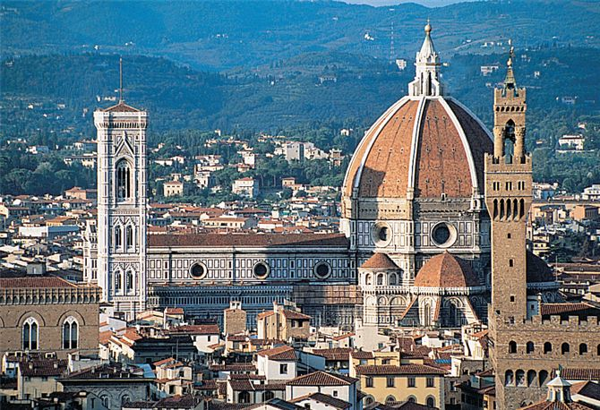
Brunelleschi's magnificent dome on the cathedral of Florence dominates the city's skyline even today.

Slide 39
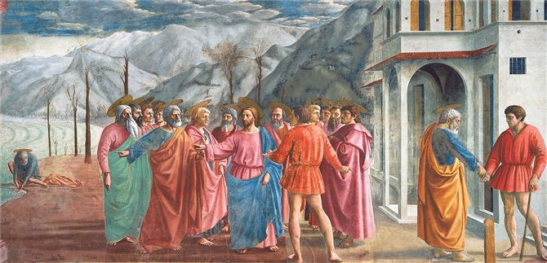
The Florentine painter Masaccio was a pioneer of Renaissance art. His fresco Tribute Money, produced about 1427, relies on the technique of linear perspective to depict figures in realistic relationship to one another and their surroundings. How does linear perspective lend a sense of depth to this scene?

Slide 40
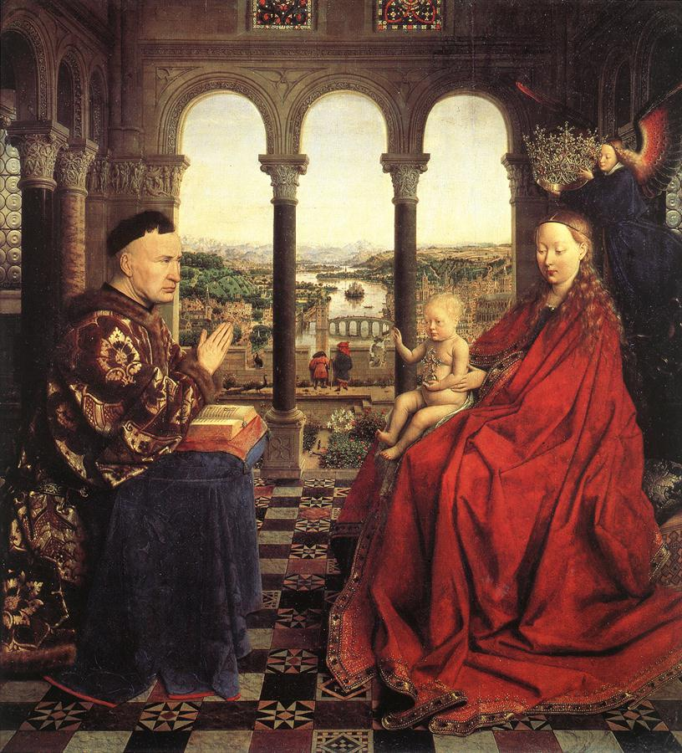
Jan van Eyck, The Virgin of Chancellor Rolin
What make this Renaissance art?

Slide 41
Humanism
The cultural and intellectual movement of the Renaissance that emphasized human potential to attain excellence and promoted the study of the literature, art, and the classics of Greece and Rome
  Humanists
    Refers to scholars interested in the humanities: literature, history, and moral philosophy
Renaissance humanists deeply devoted to Christianity
  Desiderius Erasmus (1466-1536) publishes Greek New Testament along with Latin translation with copious annotations
Also devoted to rediscovering classical Latin texts, often ignored in monastic libraries

Slide 42
Humanist Moral Thought
Medieval philosophy
  Taught that the most honorable calling was that of monks and nuns who dedicated life to prayer, god
  Humanist rejected this idea
Believed that it was possible to lead a morally virtuous life while engaged in the affairs of the world: secular
  Honorable to enter into marriage, business, and public affairs
Represents the effort to reconcile Christian values with rapidly changing urban and commercial society in Europe

Slide 43
Renaissance Europe and the Larger World
Art and thought also reflected affairs of the eastern hemisphere
  Ex. Painters filled canvases w/ images of silk garments, ceramic vessels, spice jars, foreign peoples, exotic animals
Artists express interest in Byzantine, Asian worlds

Slide 44
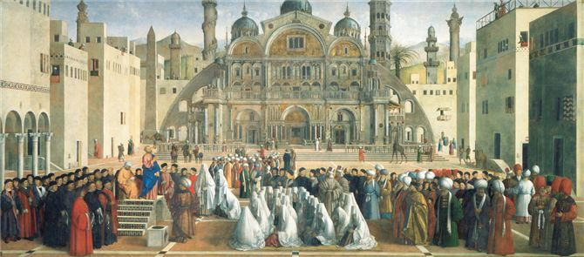
Interests in the Muslim World
A painting by Venetian artists Gentile and Giovanni Bellini reflects Renaissance interests in the Muslim world. The painting depicts St. Mark (standing in the pulpit, left) preaching in Alexandria, Egypt. The audience includes Egyptians, Berbers, Turks, Persians, Ethiopians, and Mongols.

Slide 45
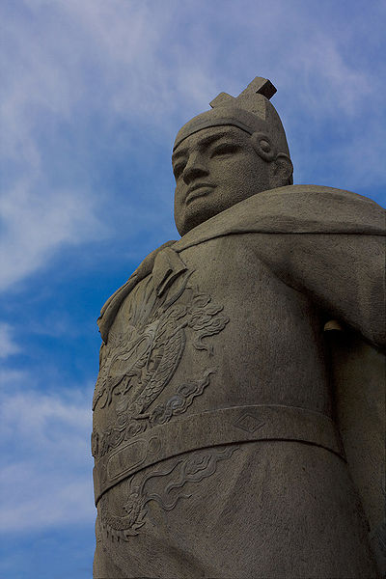
Exploration and Colonization
Ming dynasty hesitant to have large foreign populations
  Mongol experience
  Allowed small populations in port cities
Yongle engaged Admiral Zheng He to mount seven massive naval expeditions, 1405-1433
  Placed trade under imperial control
  Demonstrated strength of Ming dynasty
  317 ships, 28,000 armed troops, 9 masts w/ 4 decks, 500 or more passengers
Successful, but aborted as Mongols presented new threat in the north
  Chinese destroy the nautical charts, gave up plans to maintain presence in Indian Ocean

Slide 46
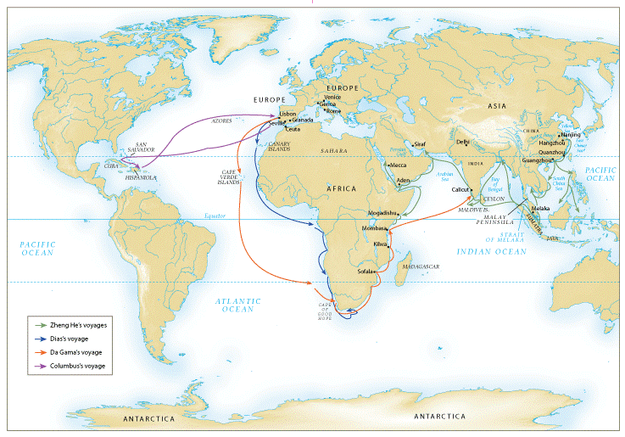
Chinese and European voyages of exploration, 1405 – 1498

Slide 47
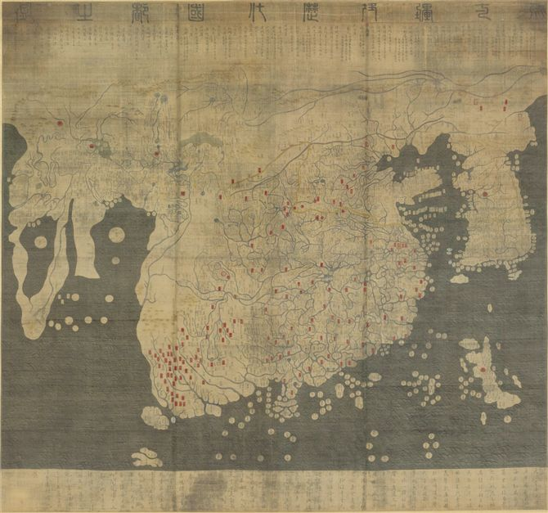
The Kangnido Map (1470) is one of the few surviving large-scale maps from east Asia before modern times. Produced in Korea, it draws on Chinese and Muslim sources, while exaggerating the size of the Korean peninsula.

Slide 48
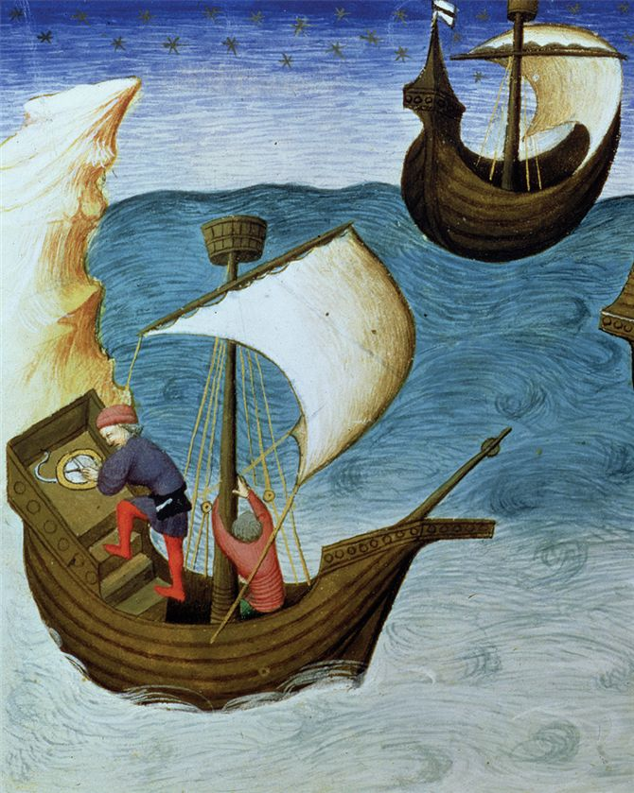
A fifteenth-century manuscript illustration depicts a mariner (left) using an astrolabe (an adapted version of an instrument from the Hellenistic Mediterranean) to determine his latitude while sailing on the Indian Ocean.

Slide 49
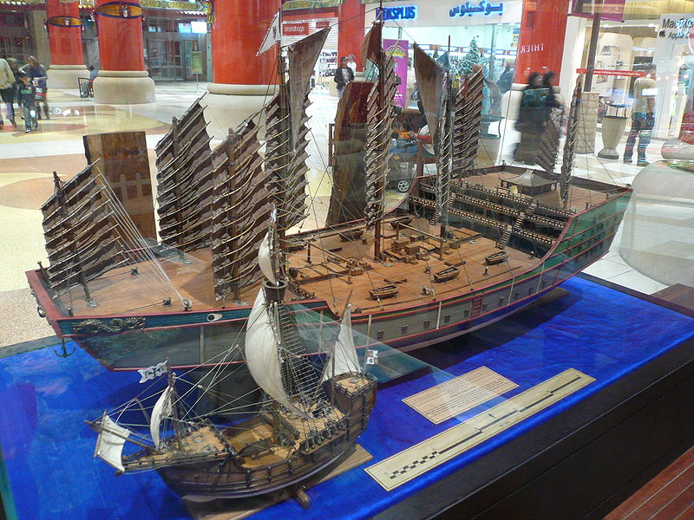
The Ming Dynasty's fleet of giant ships predates the Columbus expedition across the Atlantic. Photograph of the display in the China Court of the Ibn Battuta Mall in Dubai.

Slide 50
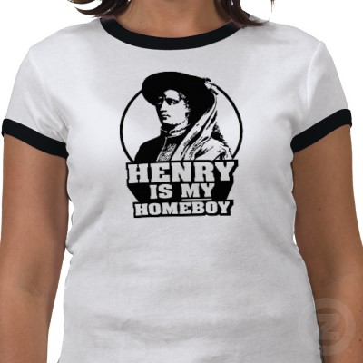
European Exploration in the Atlantic and Indian Oceans
Motives: profit, missionary activity “God, Glory, Gold”
Portuguese early leaders in Atlantic exploration
Search for sea route to Indian Ocean basin
Prince Henrique (Henry the Navigator) seizes Strait of Gibraltar, 1415
Begins encouragement of major Atlantic voyages

Slide 51
Colonization of the Atlantic Islands
Madeiras, Azores Islands, etc.
Investments in sugarcane plantations
Exploration of west African coast
Dramatically increases volume of slave trade
Ultimately, some 12 million Africans deported to Americas for slave labor

Slide 52
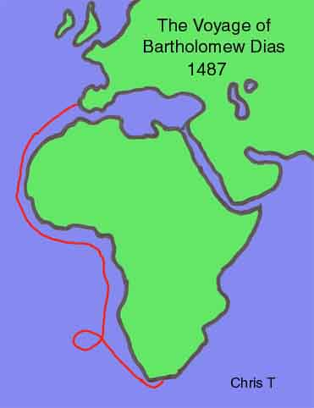
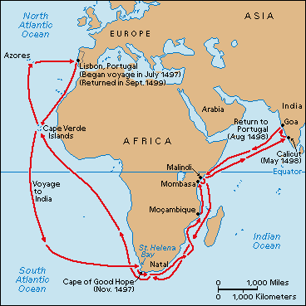
Indian Ocean Trade
Attempt to avoid using Muslim middlemen in trade with east
  1488 Bartolomeu Dias sails around Cape of Good Hope
  1497-1499 Vasco de Gama sails this route to India and back w/ pepper and spices
Portuguese gun ships attempt to maintain trade monopoly
Beginnings of European imperialism in Asia

Slide 53
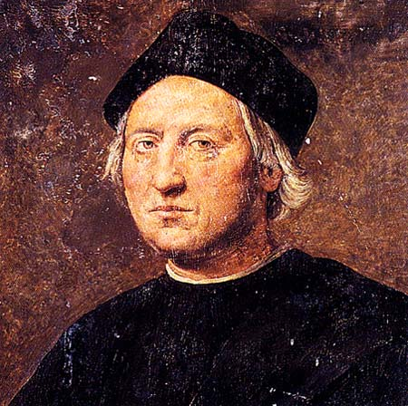
Christopher Columbus
Search for western sea route to Indian Ocean
Portuguese consider his proposal impractical, reject it
Ferdinand and Isabella of Spain underwrite voyage, departs in 1492
Makes landfall in San Salvador
  Believed he had reached islands off coast of Asia

Slide 54
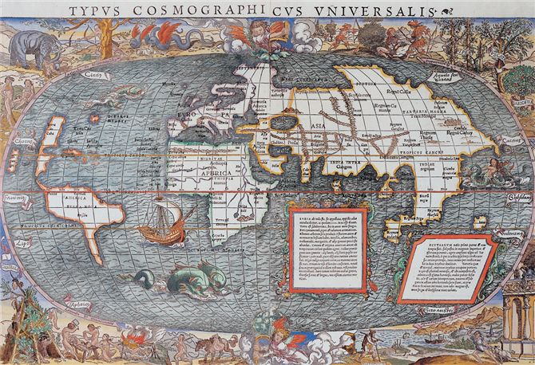
Although Christopher Columbus believed that he had sailed into Asian waters, later mariners soon realized that the Americas were continents unknown to geographers of the eastern hemisphere. This map, prepared in 1532 by the German cartographer Sebastian Münster, shows that by the early sixteenth century, European geographers had acquired a rough but accurate understanding of South America but had reconnoitered only the Atlantic coastline of North America.

