Slide 1
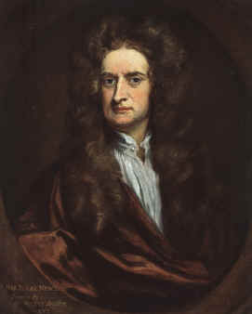
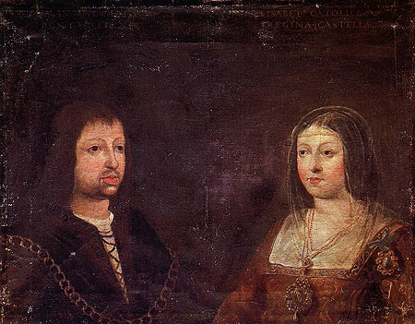
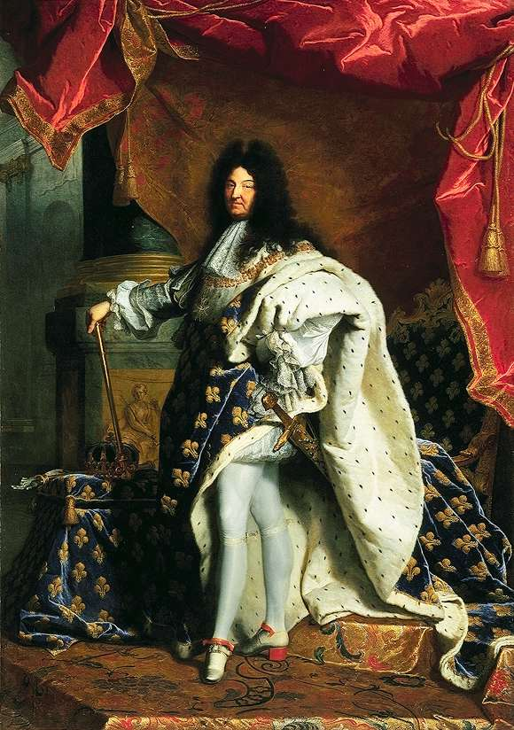
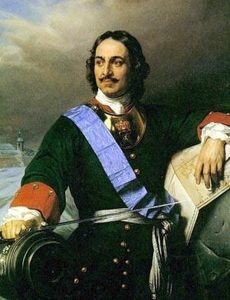
Chapter 24
The Transformation of Europe

Slide 2
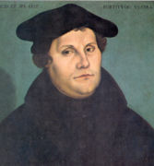
The Protestant Reformation
Martin Luther (1483-1546) attacks Roman Catholic church practices, 1517
  Indulgences: preferential pardons for charitable donors
Writes Ninety-Five Theses, rapidly reproduced with new printing technology
Excommunicated by Pope Leo X in 1521
1520s-1530s dissent spread throughout Germany and Switzerland
Martin Luther at age forty-two, depicted as a conscientious and determined man by the German painter Lucas Cranach in 1525.

Slide 3
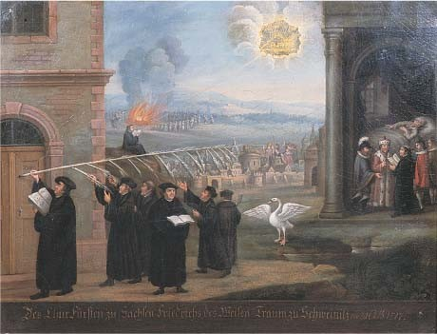
The Demand for Reform
Luther’s expanded critique
  Closure of monasteries
  Translations of Bible into vernacular
  End of priestly authority, especially the Pope
    Return to biblical text for authority
German princes interested
  Opportunities for assertion of local control
Support for reform spreads throughout Germany
This sixteenth-century painting by the well-known German artist Lucas Cranach the Elder shows Martin Luther and his supporters using a giant quill to write their demands for religious reform on a church door. It memorializes the posting of the Ninety-five Theses in 1517, which launched the Protestant Reformation.

Slide 4
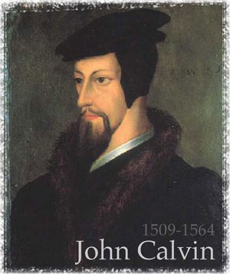
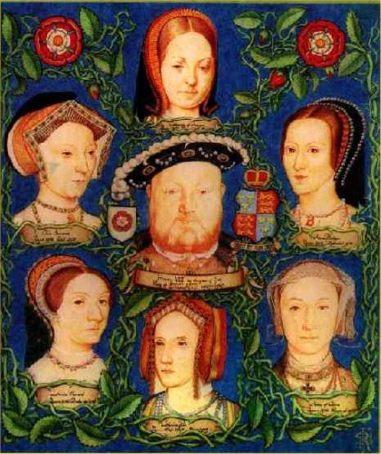
Reform outside Germany
Switzerland, Low Countries follow Germany
England: King Henry VIII (r. 1509-1547) has conflict with Pope over requested divorce
  England forms its own church by 1560: Anglican Church
France: John Calvin (1509-1564)
  Wrote Institutes of the Christian Religion that codifies Protestant teachings while in exile in Geneva
  Organized a theocracy w/ strict moral code and discipline in the city
  Predestination
Scotland, Netherlands, Hungary also experience reform movements

Slide 5
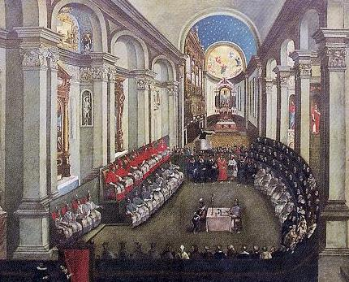
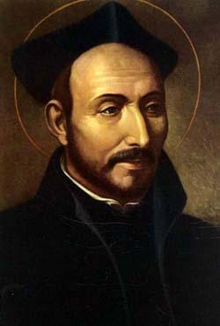
The Catholic Reformation
Roman Catholic church reacts
  Refining doctrine, missionary activities to Protestants, attempt to renew spiritual activity
Council of Trent (1545-1563) periodic meetings to discuss reform
Relied on works of St. Thomas Aquinas
Demands church authorities to have more training
Establish schools
Society of Jesus (Jesuits) founded by St. Ignatius Loyola (1491-1556)
  Rigorous religious and secular education
  Effective missionaries
  Attracted converts in India, China, Japan, Philippines, and Americas
  ALSO founded universities in US

Slide 6
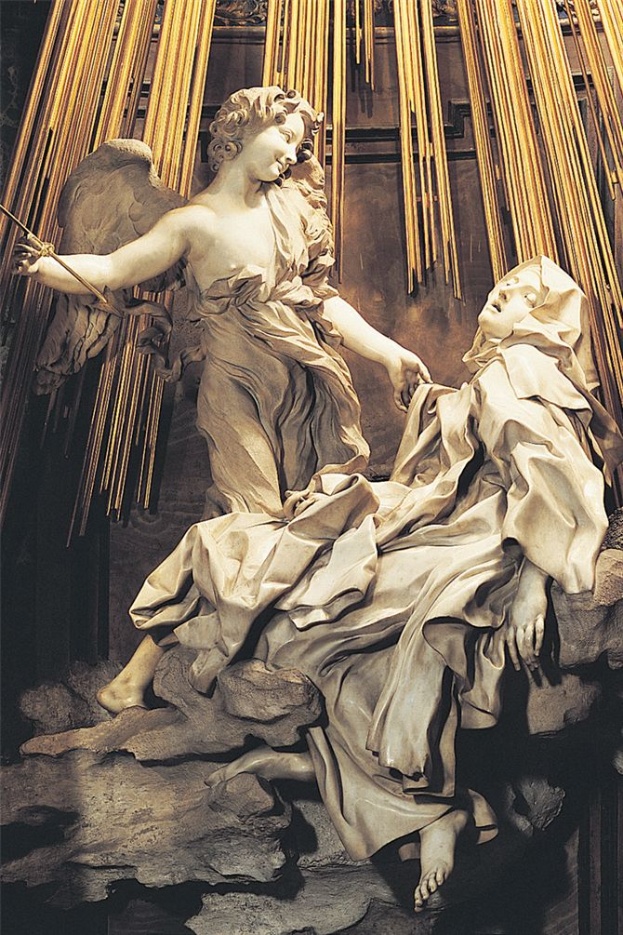
Under inspiration of the Catholic Reformation, many devout individuals sought mystic union with God. One of the most famous of the mystics was St. Teresa of Avila (in Spain), who founded a strict order of nuns and often experienced religious visions. A famous sculpture by the Italian artist Gianlorenzo Bernini depicts St. Teresa in an ecstatic trance accompanied by an angel.

Slide 7
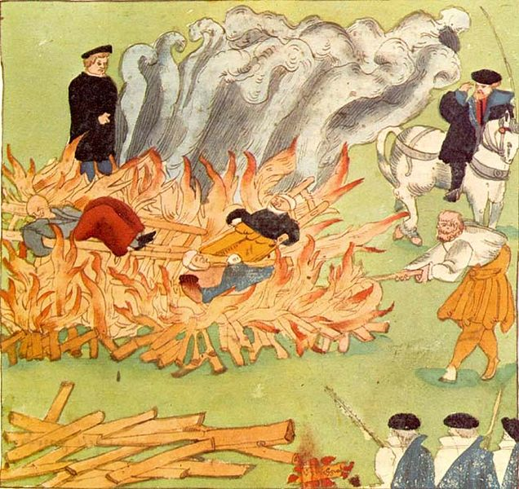
Witch Hunts
Most prominent in regions of tension between Catholics and Protestants
Late 15th century development in belief in Devil and human assistants
16th-17th centuries approximately 110,000 people put on trial, some 60,000 put to death
  Vast majority females (95%), usually single, widowed
  Held accountable for crop failures, miscarriages, etc.
Spread to colonies in 17th c.
  New England: 234 witches tried, 36 hung
Last execution in Europe was in Switzerland
Burning of three witches in Baden, Switzerland (1585)

Slide 8
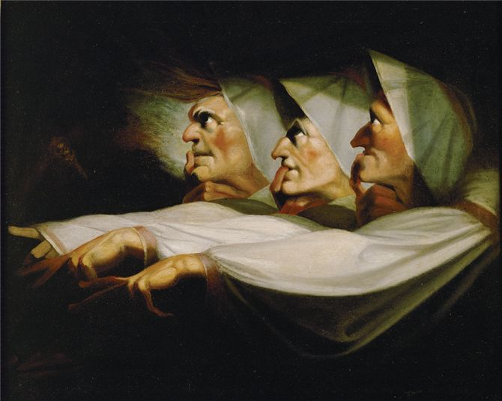
Henry Fuseli's 1783 painting offers a dramatic depiction of three witches. The painter based his image on the three witches who appear in William Shakespeare's play Macbeth. He titled his painting “The Weird Sisters” or “The Three Witches.” Which physical features identify these women as “weird” witches?

Slide 9
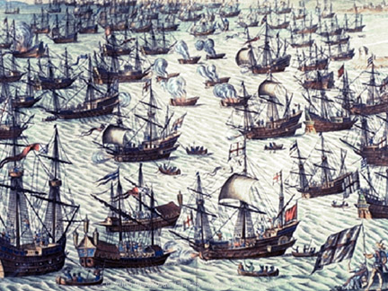
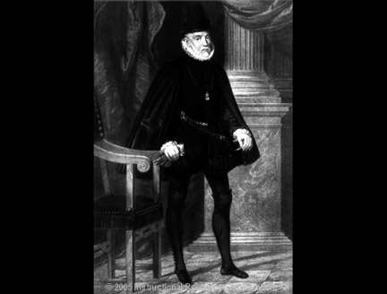
Religious Wars
Protestants and Roman Catholics fight in France (1562-1598)
1588 Philip II of Spain attacks England to force return to Catholicism
  English destroy Spanish ships by sending flaming unmanned ships into the fleet
Netherlands rebel against Spain, gain independence by 1610

Slide 10
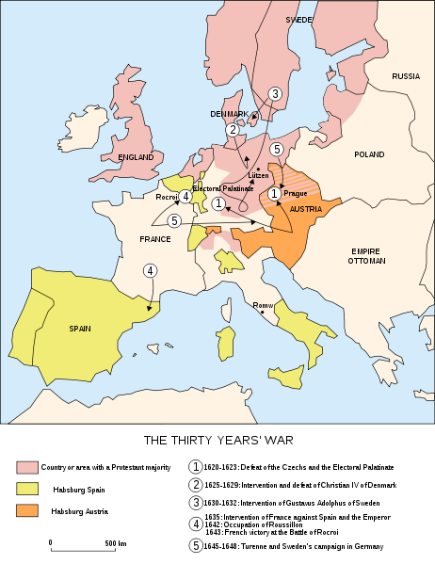
The Thirty Years’ War (1618-1645)
Holy Roman emperor attempts to force Bohemian subjects to return to Roman Catholic Church
  Protestant v. Catholic
All of Europe becomes involved in conflict
  Spanish, French, Swedish, Dutch, German, Polish, Bohemian, and Russian
  Principal battleground: Germany
Political, economic issues involved
  Not just religious
Most destructive European conflict before the 20th century
Brutality by undisciplined soldiers
  Approximately one-third of German population destroyed

Slide 11
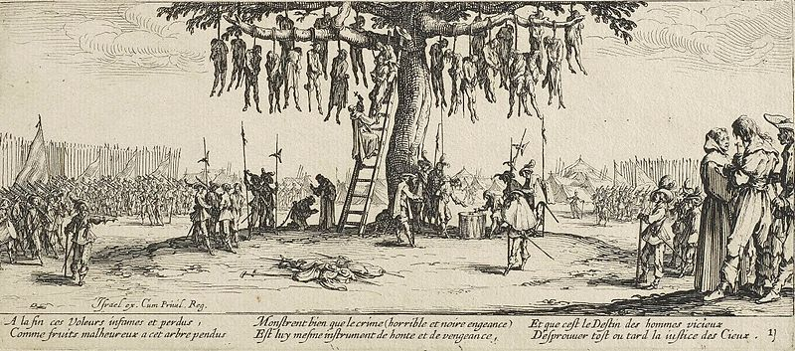
Thirty Years War offered abundant opportunity for undisciplined mercenary soldiers to prey on civilian populations. Engraving below from 1633, rarely soldiers receive punishment.

Slide 12
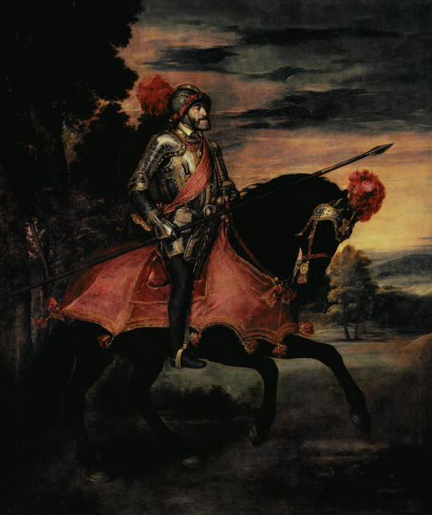
The Consolidation of Sovereign States
Emperor Charles V (r. 1519-1556) attempts to revive Holy Roman Empire as strong center of Europe
  Through marriage, political alliances the Hapsburgs accumulated rights and titles throughout Europe
  Ultimately fails
    Protestant Reformation provides cover for local princes to assert greater independence
    Foreign opposition from France, Ottoman Empire
      Both fear him absorbing their realm and extending authority over all of Europe
  Unlike China, India, Ottoman Empire, Europe does not develop as single empire, rather individual states
  Charles V abdicates throne and retires to monastery in Spain
    His son, Philip II of Spain gains his holdings in Spain, Italy, Low Countries and Americas
    His brother, Frederick, inherited Hapsburg family lands in Austria

Slide 13
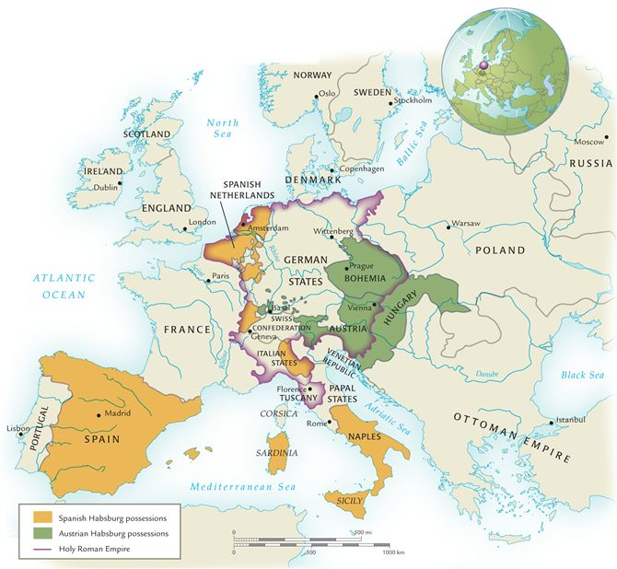
16th Century Europe
Note the extent of Habsburg territories and the wide boundaries of the Holy Roman Empire.
With such powerful territories, what prevented the Habsburgs from imposing imperial rule on most of Europe?

Slide 14
The New Monarchs
Italy well-developed as economic power through trade, manufacturing, finance
France, and Spain surge ahead in 16th century, innovative new tax revenues and powerful armies
  So large that nobles could not match them
Protestant Reformation helped increase monarchs power as they took wealth from church
  England: Henry VIII
    Confiscated monastic holdings and Church wealth after he broke away
  France: Louis XI, Francis I
    New taxes on sales, salt trade
    Large new army

Slide 15
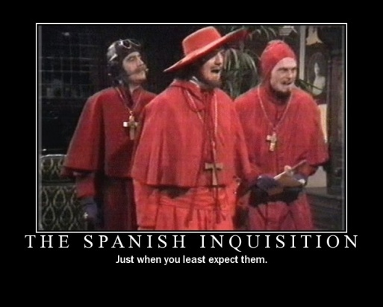
The Spanish Inquisition
Founded by Ferdinand and Isabella in 1478
Example of an institution that relied on religious justification to advance state
Original task: search for secret Christian practitioners of Judaism or Islam, later search for Protestants
  Spread to Spanish holdings outside Iberian peninsula in western hemisphere
Imprisonment, executions (by hanging or burnt at stake)
  Intimidated nobles who might have considered Protestantism
    Intimidated into silence
  Archbishop of Toledo imprisoned 1559-1576

Slide 16
Constitutional States
After Thirty Years War, European states developed along 2 lines
  Absolute monarchies
  Constitutional states
England and Netherlands develop institutions of popular representation
  England: constitutional monarchy
  Netherlands: republic
  *Didn’t come easy into being

Slide 17
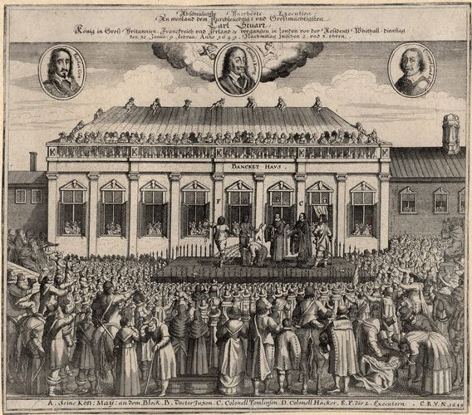
English Civil War 1642-1649
  Begins with opposition to royal taxes not approved by Parliament
  Religious elements
    Anglican church favors complex ritual, complex church hierarchy
    Under authority of monarch
    Opposed by Calvinist Puritans who wanted to rid church suggestive of Roman Catholicism
  King Charles I and parliament raise armies against each other
    Loyalists v. Roundheads
  King loses, is beheaded in 1649 to shock of Europe
    Revolutionary bc no monarch executed in public

Slide 18
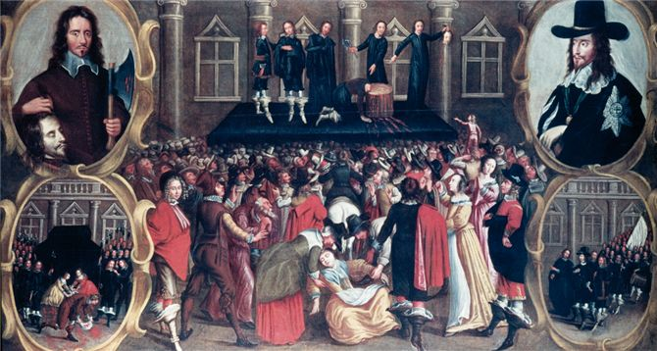
In this contemporary painting, the executioner holds up the just-severed head of King Charles I of England. The spectacle of a royal execution overcomes one woman, who faints (at bottom). How does the image of a beheaded king reflect the ongoing political changes in Europe?

Slide 19
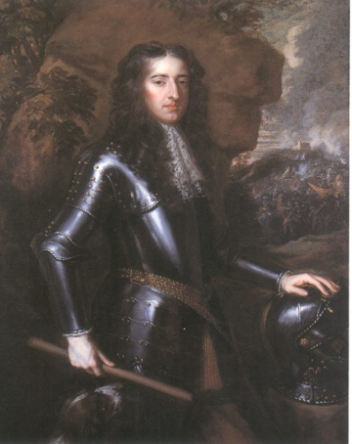
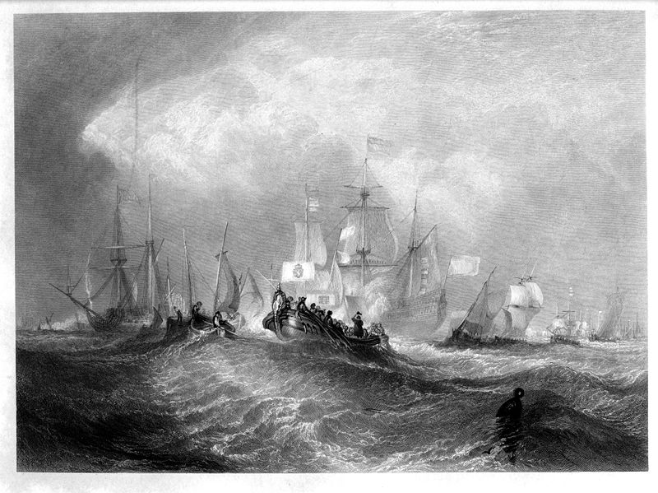
The Glorious Revolution (1688-1689)
Puritans take over, becomes a dictatorship
  Oliver Cromwell 1649-1658
Monarchy restored w/Charles II (1660-1685, also Charles Town) and then James II
  James provokes Parliament after baptizing his heir Roman Catholic
Resolution with bloodless coup called Glorious Revolution
King James II deposed, daughter Mary and husband William of Orange take throne
  Shared governance between crown and parliament: constitutional monarch
  English Bill of Rights created in 1689
    Limitations on the monarch
William of Orange

Slide 20
English Bill of Rights Influence
US rights influenced by English Bill of Rights
Habeous corpus: can’t hold you in jail w/out being charged
Freedom of speech and worship
Checks and balances

Slide 21
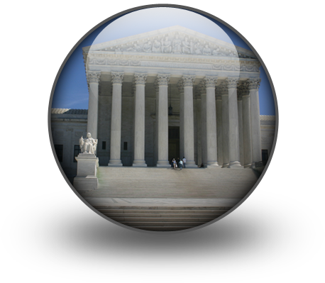
The Dutch Republic
Mid-16th century, authority over Low Countries rested w/ Spain
King Philip II of Spain attempts to suppress Calvinists in Netherlands, 1566
Large-scale rebellion follows, and by 1581 Netherlands declares independence
  Spain officially recognizes their independence at the end of the Thirty Years’ War in 1648
Based on a representative parliamentary system
  England and the Dutch republics were historical experiments
  Allowed for merchants to be part of politics
    State policy favored maritime trade and building commercial empires overseas

Slide 22
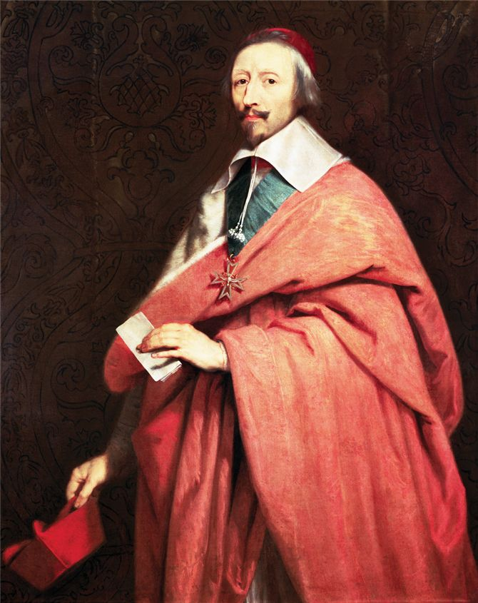

Absolutism and Divine Right
Absolutism
  Absolute rule
  Prinicple of “Divine Right of kings”
  Authority given by god and they serve as “Gods lieutenants on earth”
  Rebellion is “blasphemy”
Chief architect of French absolutism was Cardinal Richelieu
  Helped undermine the power of the French nobles
Although best known as Louis XIII's “first minister,” Cardinal Richelieu also gained fame for his patronage of the arts. Most notably, he founded the Académie Française, the learned society responsible for matters pertaining to the French language.

Slide 23
Louis XIV (The “Sun King,” 1643-1715)
L’état, c’est moi: “The State – that’s me.”
Magnificent palace at Versailles, 1670s, becomes his court
  Largest building in Europe
  1,400 fountains
  25,000 fully grown trees transplanted
  230 acres of formal gardens
  Capable of housing 10,000 people
Power centered in court, important nobles pressured to maintain presence

Slide 24
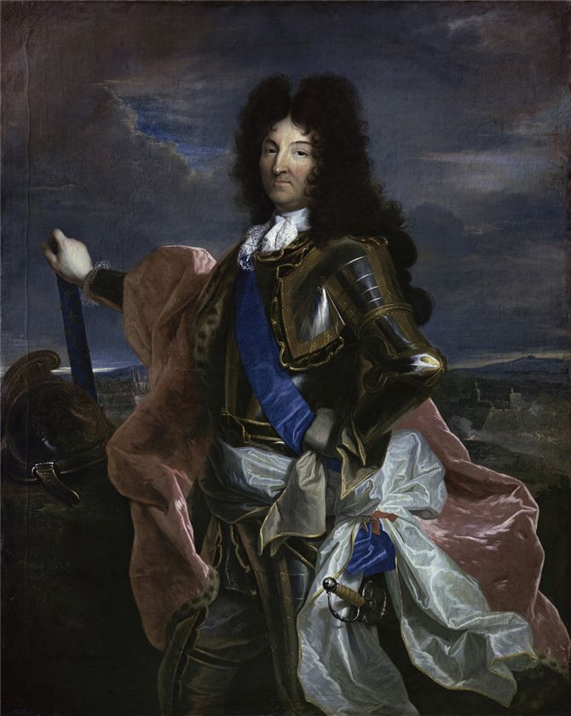
Louis XIV
The French painter Hyacinthe Rigaud, renowned for his portrait paintings of the royalty and nobility of Europe, created this vision of Louis XIV. Louis' reign, from 1643 to his death in 1715, lasted seventy-two years, three months, and eighteen days, and is the longest documented reign of any European monarch.

Slide 25
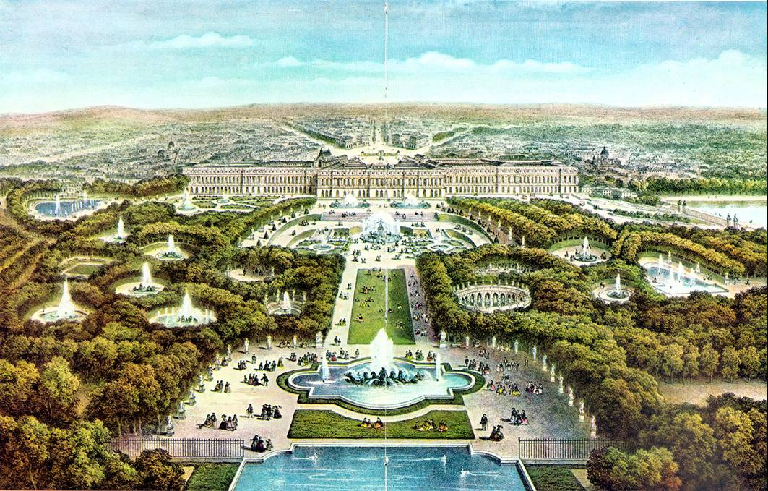
Versailles

Slide 26
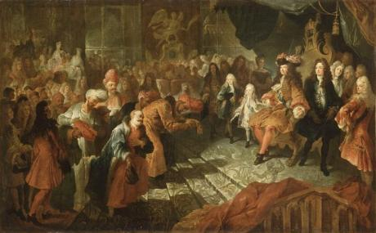
Louis XIV and Nobles at Court
Prominent nobles established residence at Versailles w/ families
  Kept his eye on them
  They master court rituals and attended banquets, concerts, opera, balls, and theatrical performances
Patronized painters, sculptors, architects, and writers
Ran the state
Louis XIV meets Persian ambassador

Slide 27
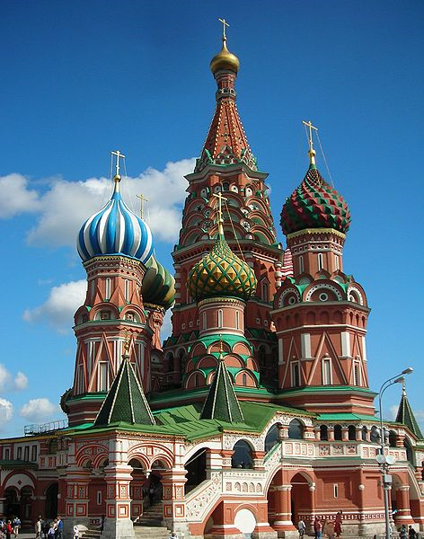
First Czars of Russia
Ivan III (1462-1505)
Conquered territory around Moscow and liberated Russia from Mongols
Ivan IV also known as “The Terrible”
Came to throne at 3 and boyars (nobles) tried to control him
Seized throne at 16 and made himself Czar = “caesar”
Early period was the “good years”
Bad years after wife dies
Secret police killed 1,000s
1581, he killed his oldest son in a quarrel
  Left only his weak 2nd son as heir

Slide 28
Russia: The Romanov Dynasty (1613-1917)
Peter the Great
Reigned 1682-1725
Worked to modernize Russia on western European model
  Toured Germany, Netherlands, England to learn Western administrative methods, military technology
    Rowdy group
  Developed modern Russian army, reformed Russian government bureaucracy, demanded changes in fashion: beards forbidden
  Built new capital at St. Petersburg

Slide 29
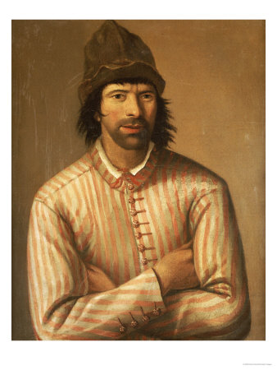
Peter the Great icognito

Slide 30
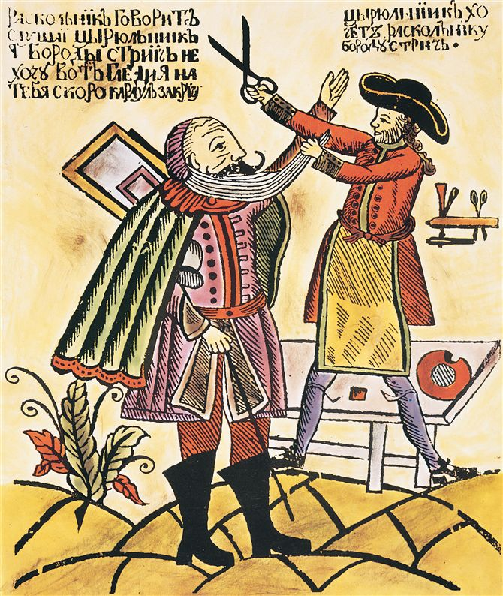
More examples of “Westernization”
Introduced potatoes, became a staple of their diet
Started 1st Russian newspaper
Ordered nobles to wear Western fashion
Opened schools to advance navigation, science, arts
Tsar Peter the Great, with a pair of shears, readies himself to remove the beard of a conservative noble. Peter had traveled widely in Europe, and he wanted to impose newer European customs on his subjects. That included being more cleanly shaved. Nobles wishing to keep their beloved beards had to pay a yearly tax to do so.

Slide 31
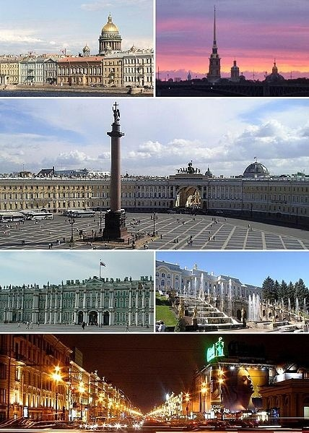
St. Petersburg
Warmwater seaport built in 1703 to serve as capital and for the navy
  Capital until the Russian Revolution in 1917
Goal was to dominate the Baltic Sea
25,000-100,000 people died from harsh conditions building it

Slide 32
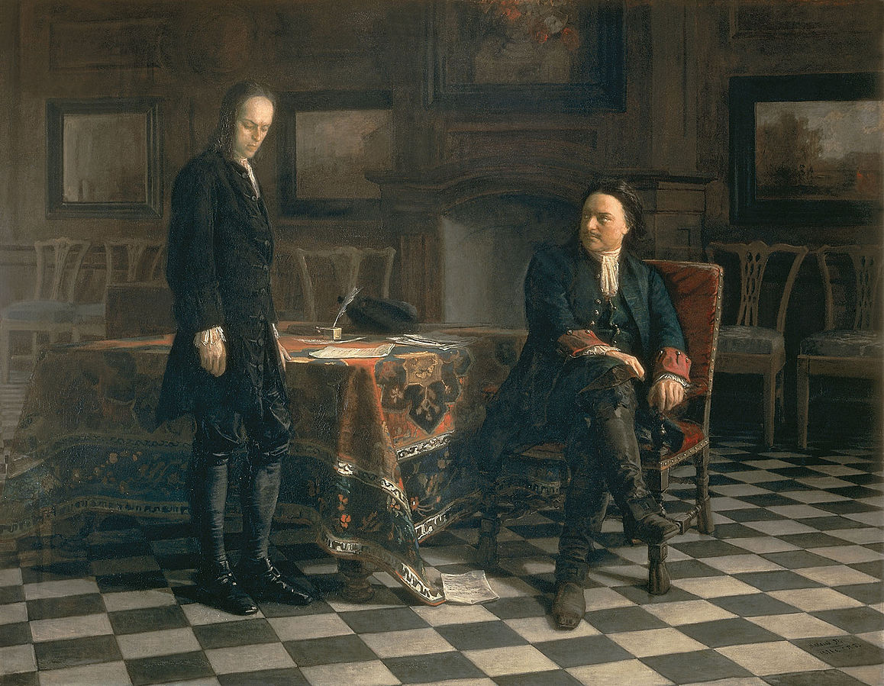
Peter Interrogating
Czarovich Alexei at Peterhof
Alexei never had an interest in ruling. He fled Russia. After returning in 1718, Alexei begged forgiveness. Soon Peter thought he was plotting against him. He was later tortured and died.

Slide 33
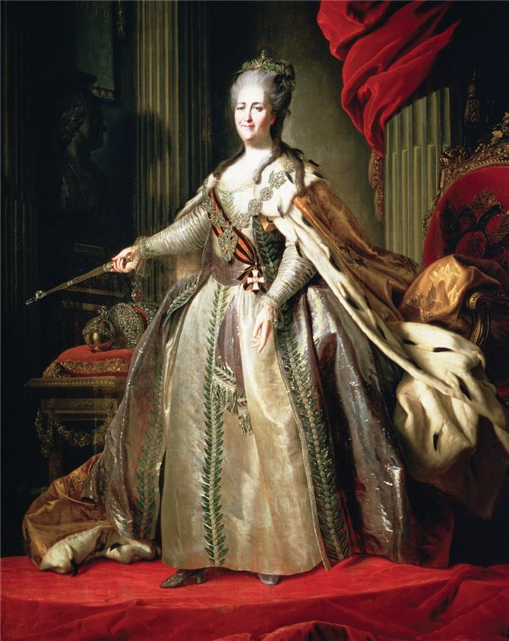
Catherine the Great
1762-1796
Referred to as an Enlightened Despot
Worked to improve gov’t efficiency, expand Russia, and improve conditions for the serfs
Worked to improve boyars treatment of serfs
  Ex. Stop penalties –torture, beating, mutilation
Social Reform ends after Pugachev Rebellion
This is a regal Russian portrait of the German-born empress of Russia, Catherine II. Although admired by many Russians as a source of national pride, she is also remembered as a ruthless ruler who affirmed autocracy and extended serfdom on a large scale.

Slide 34
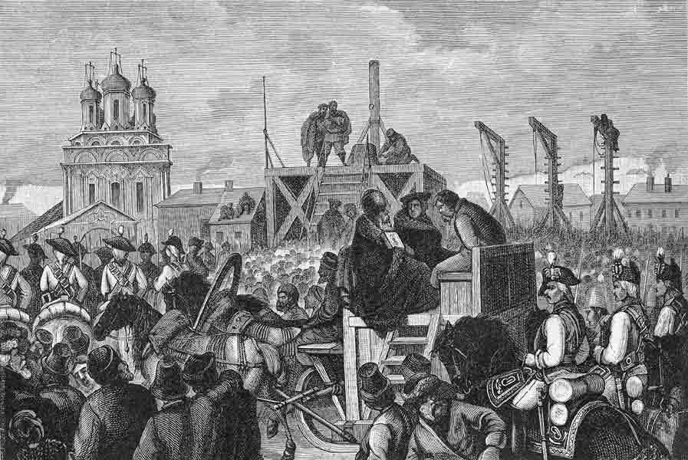
Pugachev Rebellion 1773-1774
End of Catherine the Greats social reforms and continuation of Russian serfdom
Yemalian Pugachev, a disgruntled soldier, mounts rebellion
Raises an army of soldiers, serfs, exiles
Killed 1,000s boyars
Pugachev executed

Slide 35
Serfdom in Russia
Labor System in Russia until 19th c.
Way that czars kept allegiance from the boyars
Romanov czars restricted freedoms of Russian serfs
  1649 established a law code that provided strict state control over labor force w/ castelike social order
  Restricted occupational and geographic mobility
In 17th and 18th centuries, nobles sold serfs to one another
Effect: Allowed boyars to operate estates w/ inexpensive labor and huge income

Slide 36
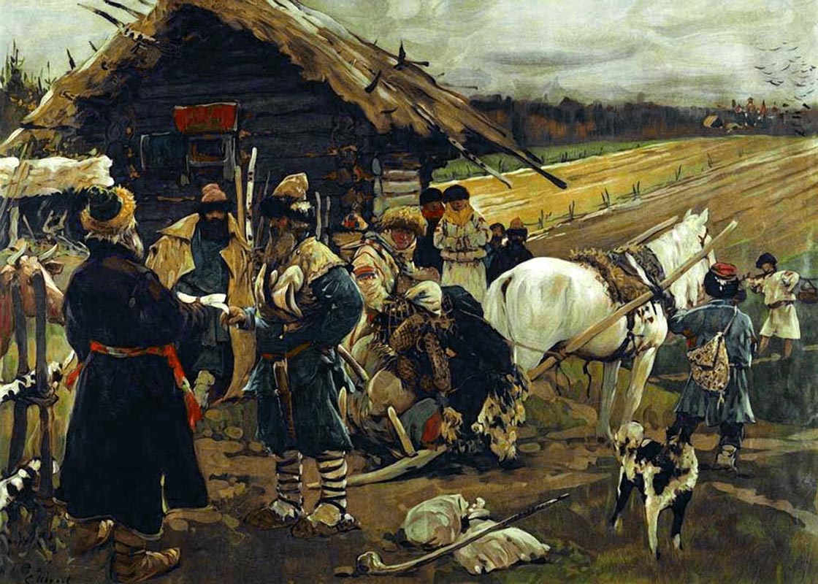
This is a picture of a peasant leaving his landlord on Yuriev Day which was a feast celebrated twice a year (in spring and autumn.) This was the only time of year when the Russian serfs were free to move from one landowner to another. However, the government made this illegal when they declared it a criminal offense for a serf to leave an estate.

Slide 37
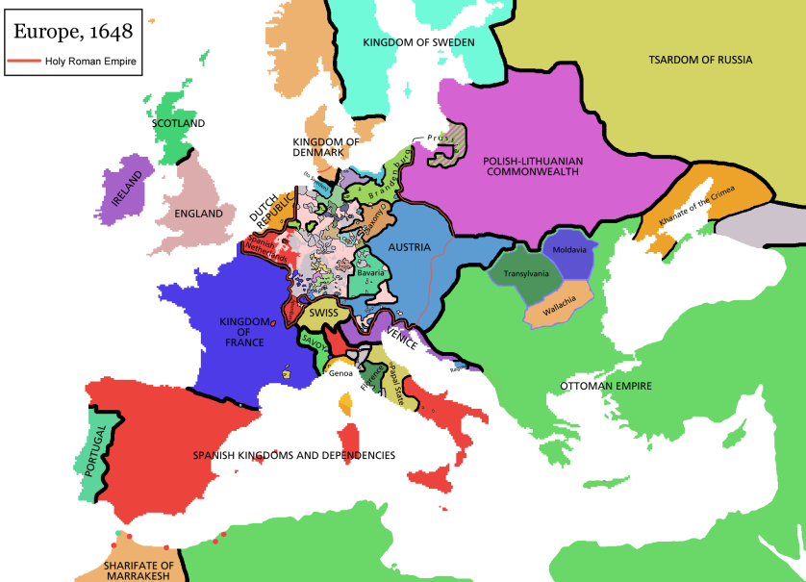
The European States System
Peace of Westphalia (1648) after Thirty Years’ War
European states to be recognized as sovereign and equal
  Religious, other domestic affairs protected
  End of religious unity or papal authority
Warfare continues: opposition to French expansion, Seven Years’ War
Balance of Power tenuous
  No ruler wanted to see another state dominate others so they formed coalitions against each other
Innovations in military technology proceed rapidly
  China, India, Islamic lands didn’t have a need to build up b/c only used w/in their boundaries

Slide 38

Population Growth and Urbanization
Rapidly growing population due to Columbian Exchange
  Improved nutrition
    Role of the potato (considered an aphrodisiac in 16th and 17th centuries)
    Replaces bread as staple of diet
  Better nutrition reduces susceptibility to plague
  Epidemic disease becomes insignificant for overall population decline by mid-17th century

Slide 39
Early Capitalism
Capitalism
  Private parties offer goods and services available on a free market in order to make a profit
  They own means of production: land, labor, and capital
    Land, machinery, tools, buildings, workshops, raw materials
  They hire, decide what to make
Supply and demand determines prices
CONTINUITY:
  Postclassical Age: Desire to accumulate wealth by merchants in China, India, sw Asia, Med., and Africa
Banks, stock exchanges develop in early modern period
Joint-Stock Companies help build empires
Medieval guilds discarded in favor of “putting-out” system

Slide 40
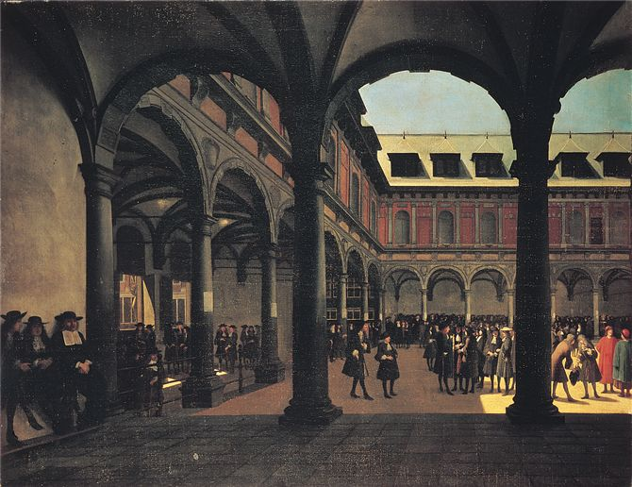
Amsterdam Stock Exchange
The Old Stock Exchange of Amsterdam, depicted here in a painting of the mid-seventeenth century, attracted merchants, investors, entrepreneurs, and businessmen from all over Europe.
There they bought and sold shares in joint-stock companies such as the VOC and dealt in all manner of commodities traded in Amsterdam.

Slide 41
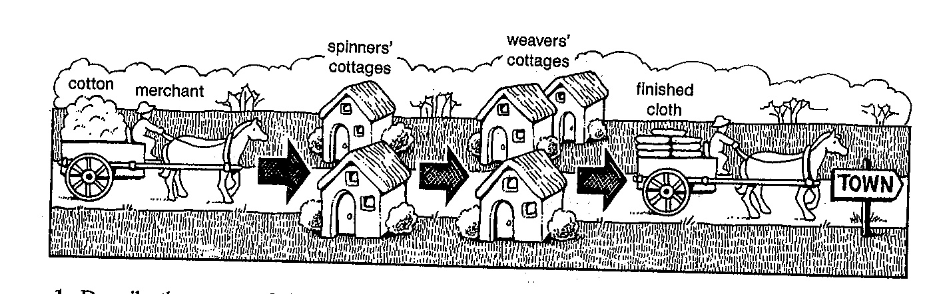
“Putting Out” System
Deliver unfinished raw materials to countryside
Men and women spin, weave, cut, and assemble garments
Entrepreneurs pick them up to sell at market
  Rural workers were plentiful so cheap labor
  Allows for great profits

Slide 42
Impact of Capitalism on the Social Order
Rural life
  Improved access to manufactured goods
  Increasing opportunities in urban centers begins depletion of the rural population
Inefficient institution of serfdom abandoned in western Europe, retained in Russia until 19th century
Nuclear families replace extended families
Gender changes as women enter income-earning work force

Slide 43
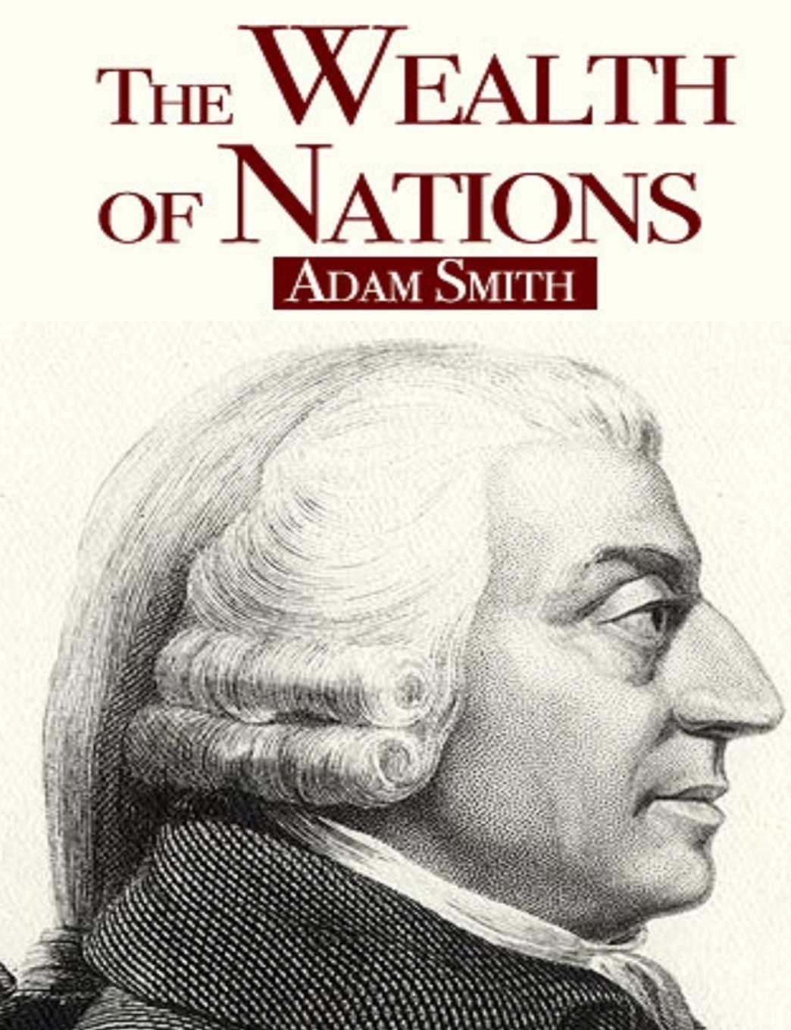

Adam Smith
Champions free, unregulated markets and capitalist enterprise as the ingredients to prosperity
Society benefits when individuals pursue their own interests and trade on a free market
Lassez-faire
  Means hands off in French
  No gov’t interference

Slide 44

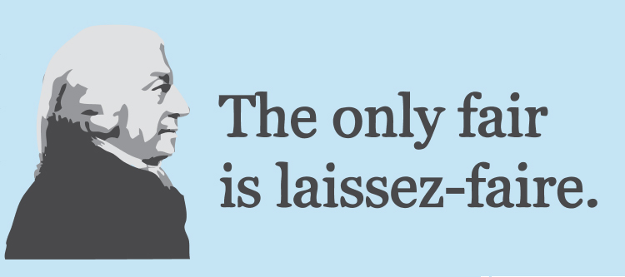

Slide 45
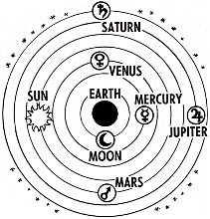
Scientific Revolution
In 17th and 18th c. they elaborated a new vision of the earth and the universe
Rely on observation and mathematics to transform natural sciences
Starts with new reconception of the universe
Ptolemaic system of the universe

Slide 46
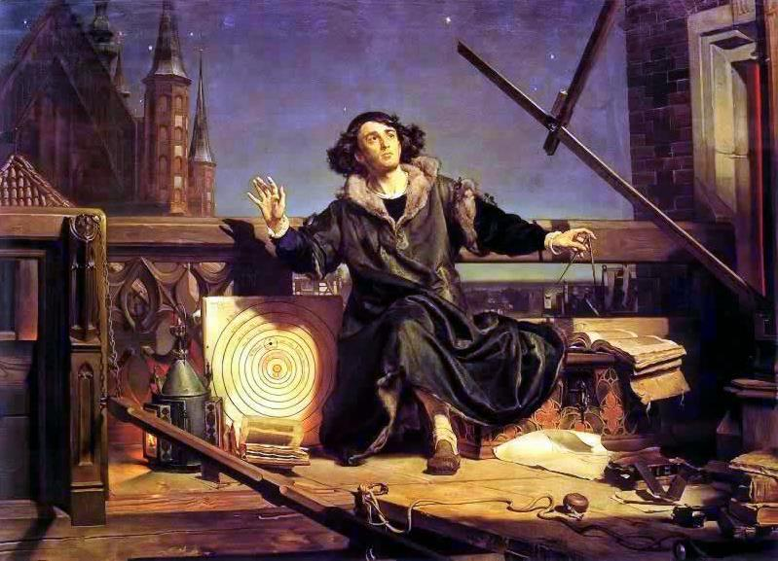
The Copernican Universe
Reconception of the Universe
  Reliance on 2nd-century Greek scholar Claudius Ptolemy of Alexandria
  Motionless earth inside nine concentric spheres
  Christians understand heaven as last sphere
Difficulty reconciling model with observed planetary movement
  Sometimes planets slow down, stopped, or turned back on their course
1543 Nicholas Copernicus of Poland breaks theory
On the Revolutions of the Heavenly Spheres
Argued that the sun stood at center and planets revolve around it
Challenges prevailing science and religious beliefs

Slide 47
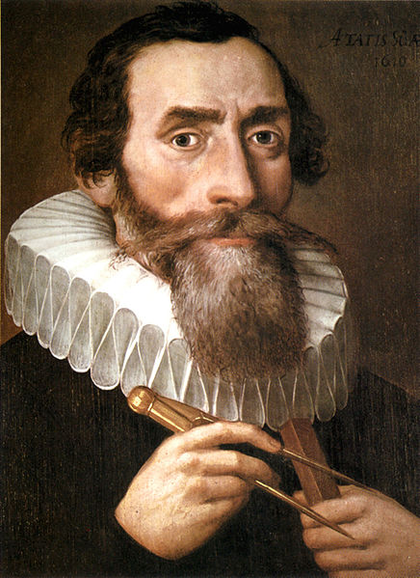
The Scientific Revolution
Johannes Kepler
Germany, 1571-1630
Demonstrated that planetary orbits are elliptical, not circular as in Ptolemaic theory

Slide 48
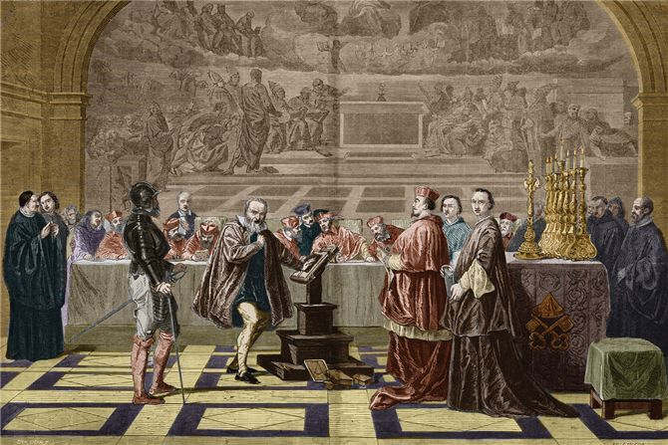
Galileo Galilei
Italy, 1564-1642
Reinforces Copernican model
Lived under house arrest after trial
W/ telescope, observed spots on moon, sun
Discovered Jupiter has 4 moons
Experiments w/ velocity
In this seventeenth-century engraving, Galileo Galilei faces the Inquisition, a Roman Catholic institution that prosecuted individuals accused of a wide variety of crimes related to heresy. At a trial in 1633, the Inquisition found Galileo “vehemently suspect of heresy,” forced him to recant Copernicanism, and placed him under house arrest for the remainder of his life.

Slide 49

Isaac Newton 1642-1727
Revolutionizes study of physics
Outlined his views of the natural world in “Mathematical Principles of Natural Philosophy”
Argued that the laws of gravity regulates the motions of bodies in the universe and the earth
He synthesized the sciences of astronomy and mechanics
Explained the ebb and flow of tides
Symbol of the Scientific Revolution
Rigorous challenge to church doctrines

Slide 50
In 17th and 18th centuries, anatomy, physiology, microbiology, chemistry and botany underwent a thorough overhaul

Slide 51
The Enlightenment or Age of Reason
Intellectual movement that stressed reason and thought and the power of individuals to solve problems
John Locke (England, 1632-1704), Baron de Montesquieu (France, 1689-1755) attempt to discover natural laws of politics
Center of Enlightenment: France, philosophes
  Not as much philosophers as public intellectuals
Voltaire (1694-1778), caustic attacks on Roman Catholic church: écrasez l’infame, “erase the infamy”

Slide 52
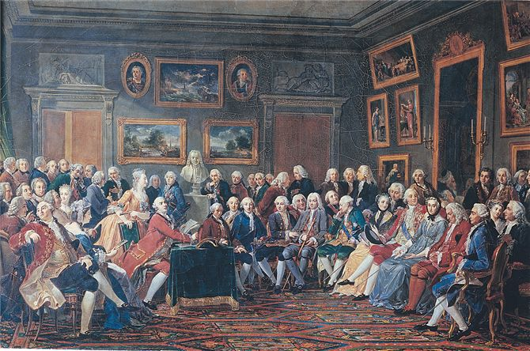
Socially prominent women deeply influenced the development of Enlightenment thought by organizing and maintaining salons—gatherings where philosophes, scientists, and intellectuals discussed the leading ideas of the day. Though produced in 1814, this painting depicts the Parisian salon of Mme. Geoffrin (center left), a leading patron of the French philosophes, about 1775. In the background is a bust of Voltaire, who lived in Switzerland at the time.

Slide 53
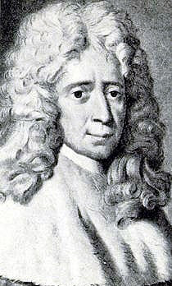
Montesquieu
Devoted himself to the study of political liberty
Proposed the separation of powers would keep any individual or group from gaining total control of gov’t
“Power should be a check to power”
  Basis for US Constitution

Slide 54
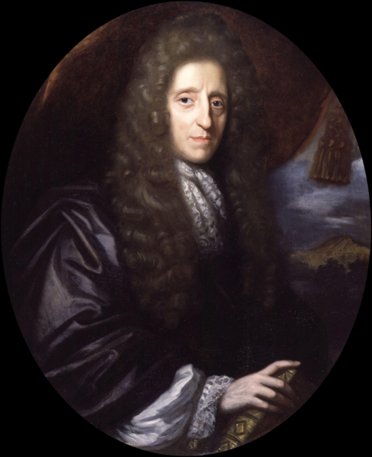
John Locke
Believed people could learn from experience and improve themselves
Criticized absolute monarchs and favored idea of “self-gov’t”
People are free and equal w/ 3 rights: life, liberty, and property
Gov’t comes from the consent of people
Influenced American Revolution

Slide 55
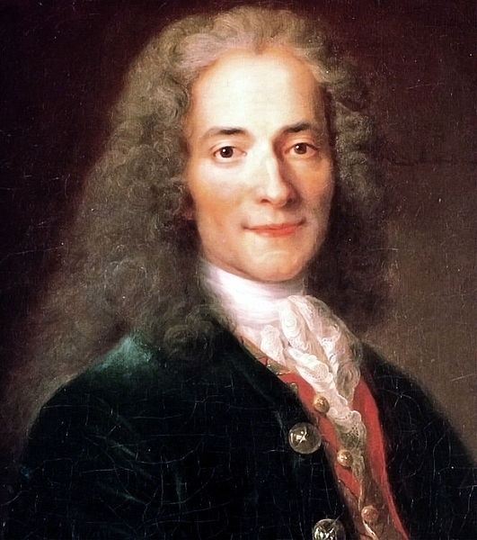
Voltaire
Published 70 political essays, philosophy, and drama
Often used satire
Never stopped fighting for tolerance, reason, freedom of speech, religion, and speech
“I do not agree with a word you say but defend to the death your right to say it.”

Slide 56

Emilie Du Chatalet
Émilie du Châtelet was perhaps the most exceptional female scientist of the Enlightenment. Although she had to contend with the conventional demands on women, she remained committed to her study of Newton and science.

Slide 57
Emilie Du Chatelet
French mathematician and physicist
Voltaire’s mistress
Fluent in 6 languages
Raised by an Enlightened father who educated her like a son
Translated Isaac Newton’s Principia Mathematica which remains the standard French translation
Died shortly after childbirth at 43
Voltaire sent letter to his friend Frederick II, king of Prussia…”du Chatelet was a great man whose only fault was being a woman.”

Slide 58
Deism
Some philosophes were Christian, but some were Deists
Believe in the existence of a god but denied the supernatural teachings of Christianity
  God was like the watchmaker who did not need to interfere constantly in the workings of his creation
  Universe was an orderly realm

Slide 59
The Theory of Progress
Constant progress became the ideology of the philosophes
Assumption that Enlightenment thought would ultimately lead to human harmony, material wealth
  Decline in authority of traditional organized religion
The idea of progress, prosperity and the Enlightenment continues to influence European and Euroamerican societies today

Slide 60

Joseph Wright of Derby's painting entitled “A philosopher gives a lecture on the orrery” centers on a three-dimensional image of the cosmos (the orrery); his use of light offers a metaphor for the Enlightenment and natural philosophy.

