Slide 1
The Congress of Vienna
Chapter 23 section 5
Standard 6

Slide 2
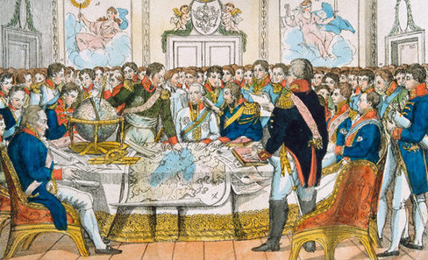

Slide 3
The Congress
European heads of government wanted to establish long-lasting peace and stability on the continent.
Wanted collective security and stability in Europe.
Series of meetings in Vienna, Austria called the Congress of Vienna was an attempt to achieve these goals.

Slide 4
The Congress
The five great powers: Russia, Prussia, Austria, Great Britain and France.
Foreign Minister of Austria, Klemens von Metternich was most powerful. He wanted to
Prevent future French aggression by surrounding France with strong countries.
Wanted to restore a balance of power
Wanted to restore Europe’s royal families to the thrones- why?

Slide 5
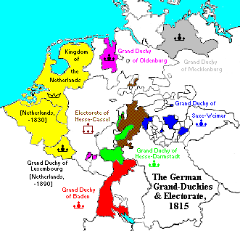
Containment of France
Kingdom of the Netherlands was formed.
39 Germany states joined to form the German Confederation (controlled by Austria).
Switzerland gained independence.
Sardinia and Genoa unite in Italy.
These changes helped to contain France and ensure it could not overpower its surrounding countries again.

Slide 6
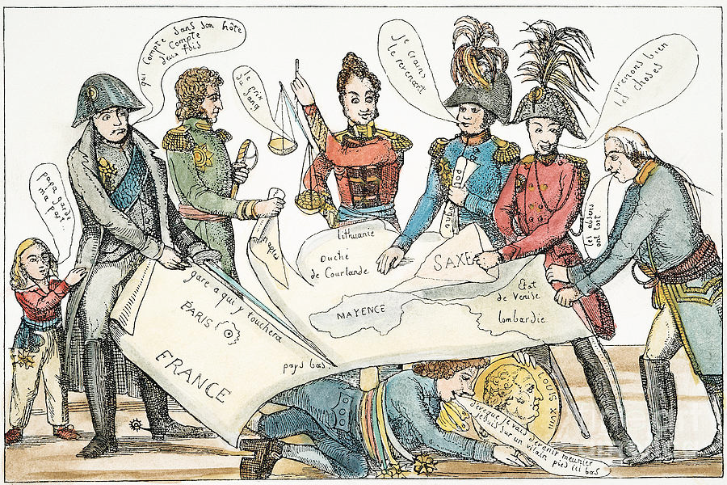

Slide 7
Balance of Power
The congress did not set out to punish France- why?
What could happen as a result of drastically weakening France?
France remained a major European power
This helped make it so that no European country could easily overpower another.

Slide 8
Legitimacy
The Congress set out to return power and the throne to those deposed under Napoleon.
The Congress felt this would help stabilize political relations among nations.
The Congress represented the first time that all of the nations from a continent worked together to control political affairs.
Congress was a success. All members were happy with the arrangements which would help prevent future wars. (Can we think of any times a congress like this did not work out for the best?)

Slide 9
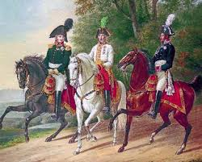
Political changes
Britain and France now had constitutional monarchies
Governments in Eastern and Central Europe were more conservative- Russia, Prussia and Austria were absolute monarchs.
The Holy Alliance- Russia, Austria and Prussia make an alliance in 1815. They wanted to combat the forces of revolution.
The Concert of Europe – agreement stating that the nations would help one another if revolution broke out.

Slide 10
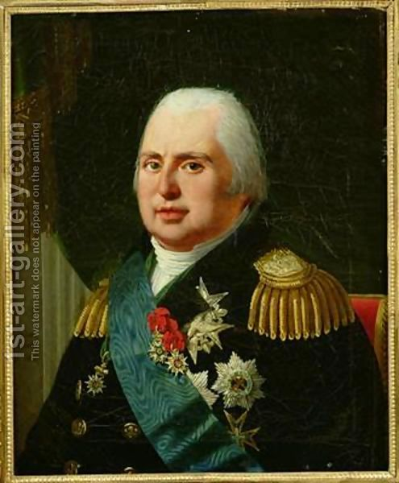
Liberty, Equality and Fraternity!
The ideas of the revolution were still holding firm in Europe.
France was deeply divided politically.
Conservatives were happy with Louis XVIII
Liberals wanted the king to share more power with the legislature.
The French Revolution failed but new political ideas were put into motion all over the world.

