Slide 1
Early civilization in China
The Xia, Shang Dynasties

Slide 2
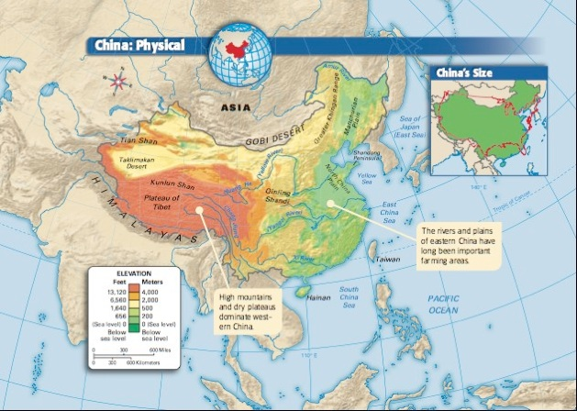
Geography of China
Isolated
Natural barriers
Himalayas
Gobi Desert
Pacific Ocean
Mostly covered by mountains
Rivers: Huang He (Yellow River) and Yangtze River
Facilitate the east-west movement for trade, travel etc.
River valleys allowed for intensive agriculture

Slide 3
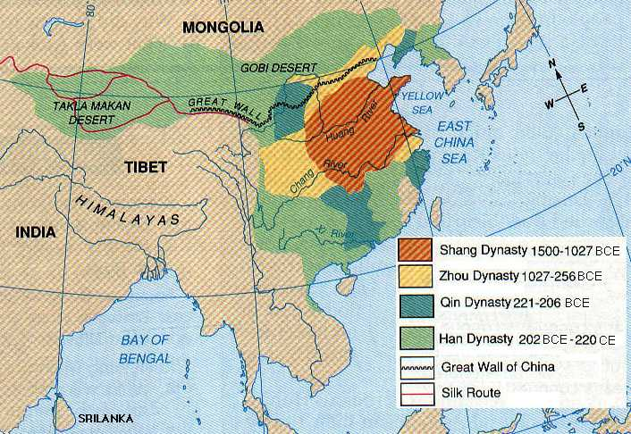

Slide 4
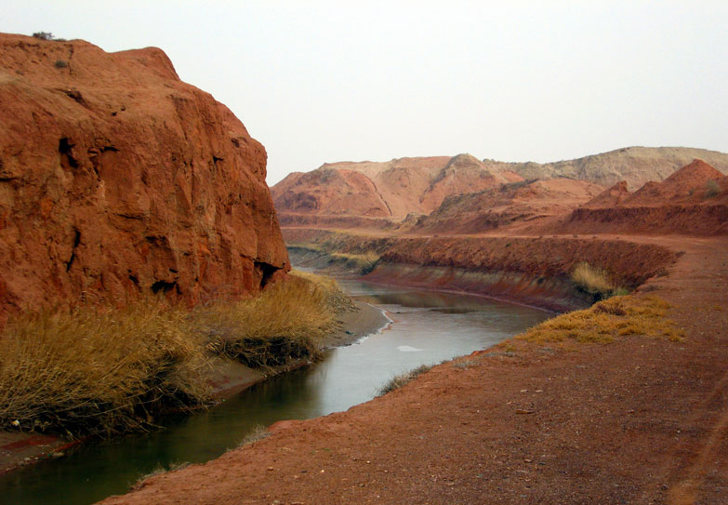
Huang He or “Yellow River”
Actually “yellow”
2,920 miles emptying into the Yellow Sea
Loess deposited from the blowing winds from Central Asia
Left behind extremely fertile and soft soil
Tremendous floods earned it the nickname “China’s Sorrow”

Slide 5
Satellite image of Yellow River

Slide 6
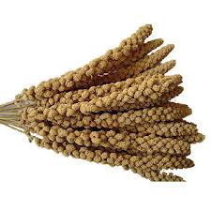
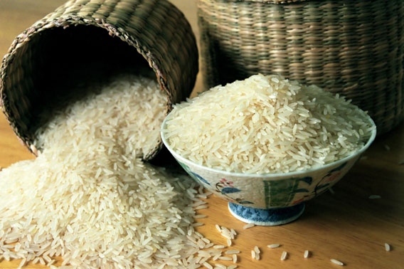
Agriculture
Millet and wheat to north
Rice in the Yangtze River Valley

Slide 7
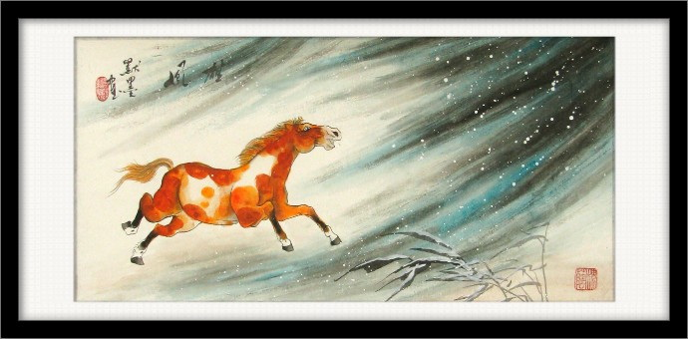
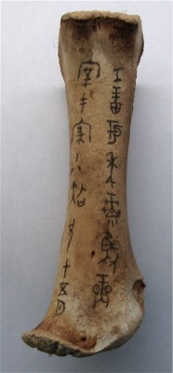
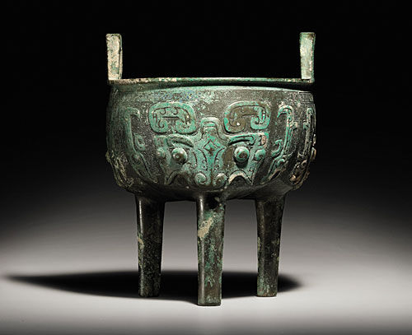
Early Origins
Organized state that regulated irrigation
By 2000 BCE, they had an advanced technology and intellectual life
They were skilled at riding horses and pottery making
They used bronze and iron by 1000 BCE, soon coal as well
Writing: ideographic symbols
Astronomy
Chinese art
Music
Shang bronze vessel from 12-11th c.BCE sold at auction for $86,500 in March 2011

Slide 8
Dynasties of China
Xia
Began approximately 2200 BCE
Created a monarchy
Founder: sage-king “Yu” who organized the organization of effective flood control projects
No information survives but we do believe the dynasty encouraged the founding of cities and development of metallurgy

Slide 9
Shang Dynasty 1766 – 1122 BCE
Excavation of Anyang
Warlike nomads who fought on horseback from chariots with bronze weapons
Compare them to the Aryans conquering n. India
Shang Bronze Axe with human face

Slide 10
Strong Shang Kings
Intermediary between supreme being, Shang Di and mortals
Directed affairs of state and responsible for the fertility of kingdom
Ex. Ceremonies such as the dance with female fertility spirits
Burned alive to placate the spirits

Slide 11
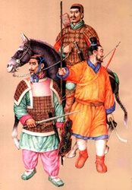
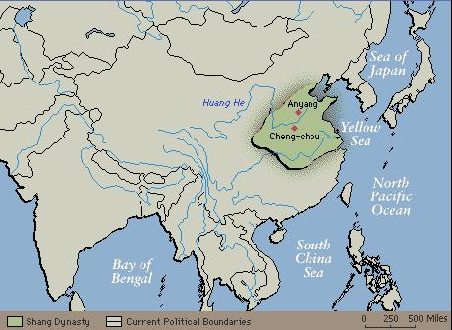
Government
Shang had sizeable bureaucracy in Anyang
Peasant and artisans were governed by local rulers who were vassals to king
Feudalism
The vassals depended on produce and labor from peasants
The warriors collected tribute (agricultural produce) to give kings and supplied soldiers for king’s armies

Slide 12
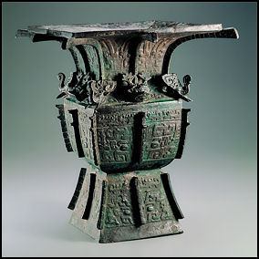
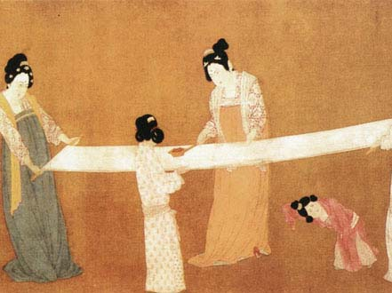
Art
Silk
Ornately carved bronze vessels used to make offerings
Grain, incense, wine, animals
Water festivals
Capsized, offered to gods of fertility and good harvest

Slide 13
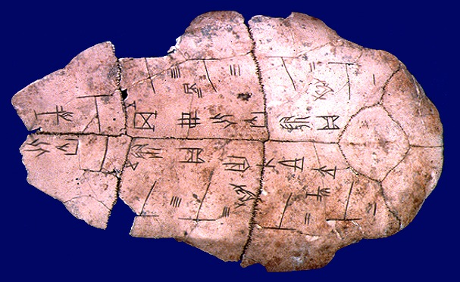
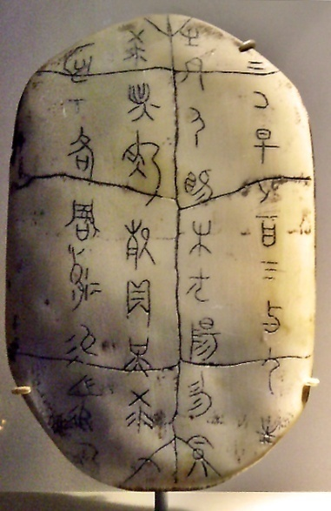
Religion
Shang Di
Offerings
Priests serve as oracles who would prophesy the future
Warriors in battle, officials embarking on journeys, families negotiating marriage etc.
Used bones of sheep, turtle shells, etc
Priests greatly influenced the beliefs and behavior
Helped give rise to writing

Slide 14
Family in Ancient China
Family was central to Chinese society
Patriarchal Society
Elderly males head
Women occasionally played prominent roles during Shang times
Fu Hao
Veneration of ancestors
Tend to graves of ancestors
Ancestors support and protect the family if one tended to the spirit’s needs
Bury tools, weapons, jewelry, and other material goods
W/out organized religion, patriarchal head of family presided over the rights and ceremonies honoring ancestors

Slide 15
Writing
Oracle bones offer 1st glimpse of early Chinese writing
Pictograph like Sumer and Egypt
Pictographs combined would become the ideographs
Characters used today are direct descendants of writing used in Shang time
Today it is more stylized, conventional, and abstract

Slide 16
Ideographs
# increased dramatically
3,000 at end of Shang era
Well-educated scholars today know 8,000
Becomes artistic expression
Numerous Chinese speaking a variety of languages
Becomes a bond for all groups in China

