Slide 1
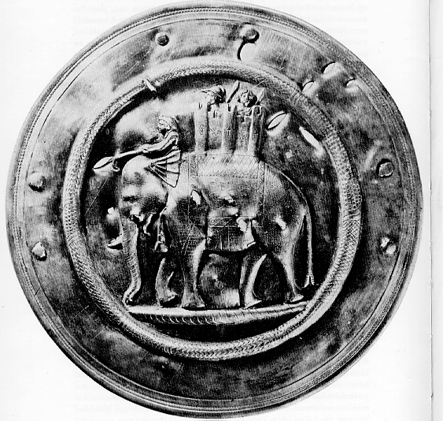
Early Societies in South Asia

Slide 2
AP Exam Tip
Indian subcontinent is called South Asia

Slide 3
Review the Harappa and the collapse

Slide 4
Early Aryan India

Slide 5
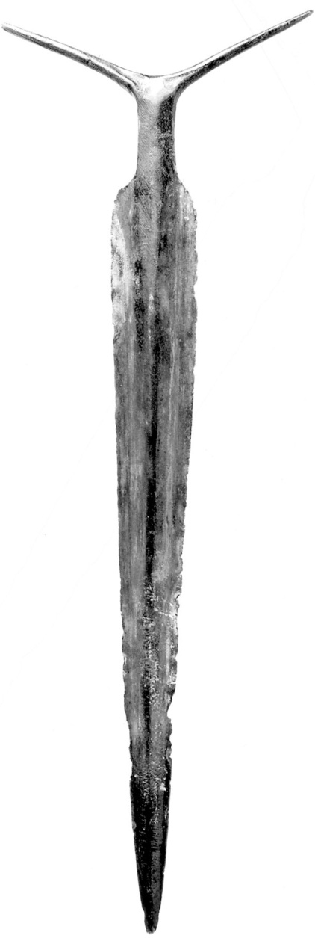
Early Aryans
After 1500 BCE, for centuries Dravidian and Indo European peoples intermarried, interacted and laid foundations of society
Who were they?
Light-skinned Indo European language speakers
Pastoralists
Sheep, goats
Prized horses
Expensive b/c rare in India
Harness to carts, wagons, chariots
Principal measure of wealth: cattle
This bronze sword manufactured by Aryan craftsmen was a much stronger and more effective weapon than the lighter swords of Harappan defenders.

Slide 6
Vedic Age 1500 BCE-500 BCE
Shows early Aryan society
Had no writing originally
Passed down religious and literary works orally in their sacred language, Sanskrit
Vedas is the collection of hymns, songs, prayers, and rituals honoring the various gods
“Veda” means “wisdom” or “knowledge”
Rig Veda is the most important
1,028 hymns to Aryan gods
Earliest and most important

Slide 7
What do we see from the Vedas?
Refers frequently to the conflicts w/ the indigenous people “dasas” meaning “enemies”
Ex. Indra-war god and military hero
Ravages citadels, smashed dams, destroyed forts

Slide 8
Changing Political Organization
Aryans began to settle and rely on agriculture
Created regional kingdoms

Slide 9
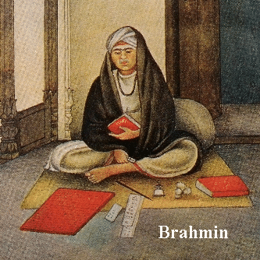
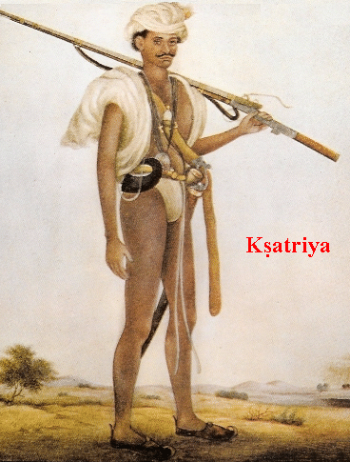
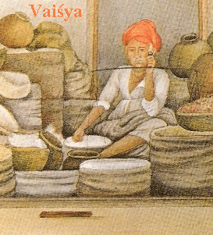
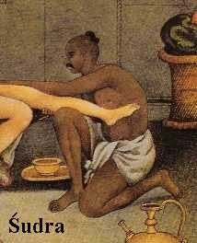
Varnas: The Caste System
Caste comes from Portuguese word “casta” or “race” or “purity of blood”
Social Organization
Varna means “color” but becomes “class”
Origins in Aryan domination of Dravidians
Jati (means “birth group) subsystem of castes
Related to urbanization, increasing social and economic complexity
Each one had its proper occupation, duties, rituals

Slide 10
Caste and Varna
Older than jati, system of broad categories in the hierarchy
Brahmins rituals and sacrifices ensure proper functioning of the world
Tribal medicine men and sorcerers will find place here
Kshatriyas: warrior and rulers protect and govern society
Frequently in conflict over ranking higher over Brahmin, but eventually Brahmins will emerge top
Vaisya were commoners that cultivated the land
Business class or merchants become dominant
Top 3 castes regarded as pure Aryans
Called the “twice born”
B/c they experienced physical birth and born into status as people of Aryan descent

Slide 11
Sudras
Servants to the top castes
Margins of Aryan society
Not allowed to hear or take part in Aryan rituals
Valued little
Ex. Brahmins could kill a Sudra and be penalized as if he had killed a cat or dog

Slide 12
Harijans or “Untouchables”
Outside of the varna system
Most unclean and polluting jobs
This 1947 photograph from Life magazine illustrates the “purity and pollution” thinking that has long been central to the ideology of caste. It shows a high-caste dropping wages wrapped in a leaf into the outstretched hands of his low-caste workers. By avoiding direct physical contact with them, he escapes the ritual pollution that would otherwise ensue.

Slide 13
Harijans or “Untouchables”
Although the Indian constitution of 1950 legally abolished “untouchability,” active discrimination persists against this lowest group in the caste hierarchy, now known as Dalits, or the oppressed. Sweeping is just one of many Dalit occupations; here several sweepers perform their tasks in front of an upper-caste home.

Slide 14
Caste as Jati
Jati is your occupational group (subcaste)
Marriage and eating together permitted only w/in your own jati
Each jati had own set of duties, rules and obligations
It defined their place in society
“It’s better to do one’s duty badly than another’s well.”

Slide 15
AP Exam Tip
Understand and be able to compare social inequalities of all types, not just caste system in India (Foundations unit)

Slide 16
Patriarchal Society
Enforced in the The Lawbook of Manu
Dealt w/ proper moral and social behavior
“A virtuous wife should constantly serve her husband.”
Woman’s most important role is to bear children and maintain home
Later in history, women seen as “unclean below the navel”, so forbidden to learn the Vedas and excluded from public rituals
Caste, Jati, inheritance through male line
This greenish-blue schist (metamorphic rock) carving illustrates the devotion of a mother to her child.

Slide 17
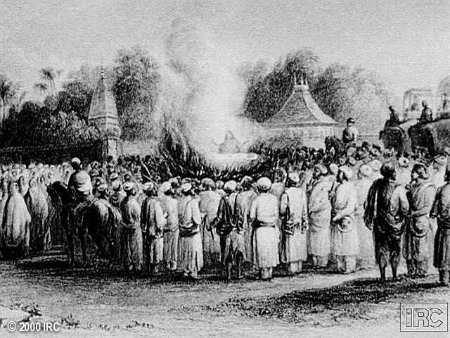
The practice of “sati”
Best example of women’s dependence on men
Widow voluntarily threw herself onto the funeral pyre of her deceased husband to join him in death
Never became widely practiced
Moralists recommended it to socially prominent men
Reinforced subordination of women

Slide 18
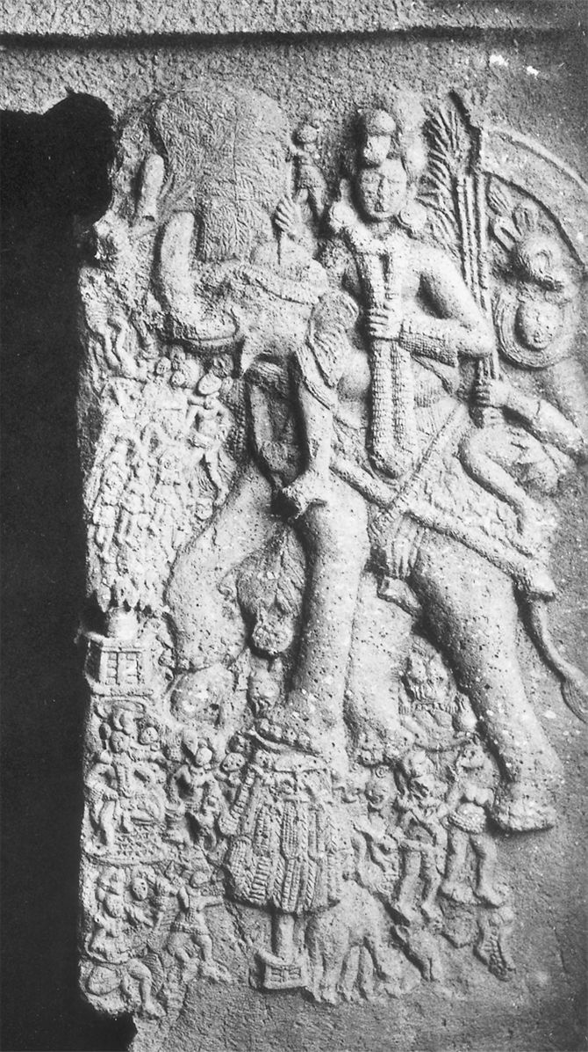
Aryan Religion
Major deity of Rig Veda: Indra, war god, rain, water
Polytheistic
Elaborate ritual sacrifices to gods
Role of Brahmins important
Sacrifice or slaughter 100s of animals, chanted, used soma
Accompanied by an attendant bearing his banner and weapons, Indra, chief deity of the Rig Veda, rides an elephant that carries him through the clouds, while a king and a crowd of people in the landscape below worship a sacred tree.

Slide 19
Teachings of the Upanishads
Composed 800-400 BCE, some later collections until 13th century CE
Dialogues from sages to students -dialogues
Emphasized high ethical standards
Discourage greed, envy, gluttony,
Advocated honesty, self-control, charity, mercy, personal integrity
Respect to all living things –animals also
Doctrine
Brahman: the Universal Soul
Samsara: reincarnation
Karma: the good /bad deeds that follow to the next life
Moksha: deep dreamless sleep that came from permanent liberation from physical incarnations and become one with Brahman

