Slide 1
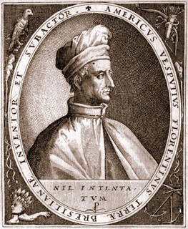
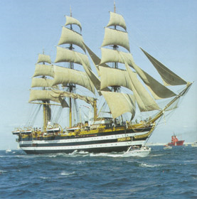
Age of Exploration
Europeans Explore the East

Slide 3
Why Exploration?
Thanks to the Renaissance, Europeans had a new spirit of adventure and curiosity
Early 1400’s, the desire to grow rich, spread Christianity, and advanced technology spur exploration

Slide 4
“God, Glory, and Gold”
1400’s – Why go exploring?
Grow rich
Spread Christianity
Sailing technology

Slide 5
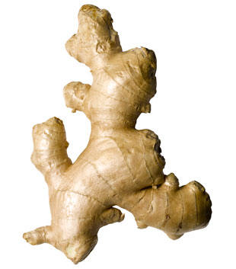
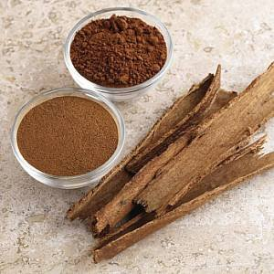
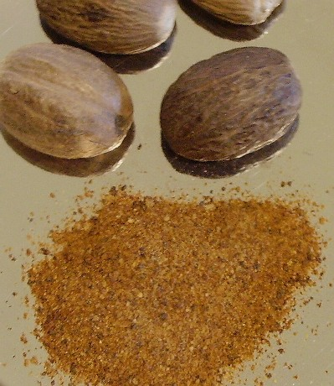
“God, Glory, and Gold”
Getting rich
The Crusades had introduced Europeans to spices and luxury goods from Asia.
Muslims and Italians controlled spice trade.
Finding a new route to Asia would cut off the “middle man” and allow their own profits .

Slide 6
“God, Glory, and Gold”
Spread Christianity.
Stop Islam and spread Christianity.
Crusades left distrust
Bartholomew Dias explains his reason
“To serve God and His Majesty, to give light to those who were in darkness and to grow rich as all men desire to do.”

Slide 7
“God, Glory, and Gold”
Technology – Making exploration possible
Caravels with triangular sails (could also carry weapons).
Caravel was up to 65’ long
Triangular sails for manueverability
Square sails for power
Trained sailors – they could navigate
Astrolabe than sextant which measured height of stars
Cartographers’ skills improved
Ptolemy – created grid system (longitude and latitude)
Steering system

Slide 8
Only had sun, moon, stars to guide them
Sailors/ inventors experimented with new tools for navigation and new designs for sailing ships

Slide 10
Portugal
Portugal – first to go exploring in N. Africa
Conquered Muslim city w/ exotic stores and gold,silver, jewels
Prince Henry the Navigator
Founded a navigation school after
Mapmakers, instrument makers, shipbuilders, scientists, and sea captains
Eventually establish trading posts along West Africa (gold, ivory, slaves)

Slide 11
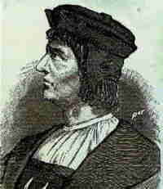
Now, Lets get to Asia
Bartholomeu Dias
Sailed around the southern tip of Africa – Cape of Good Hope.
Storm blew them around tip of Africa
However, returns home due to little food and exhausted crew.

Slide 12
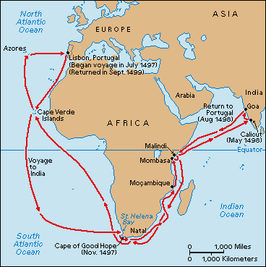
Still Portugal
Vasco da Gama
Began to explore s.e. Africa
Sailed from Portugal to India (it took 10 months)
Found silk, porcelain, gems, and spices
His cargo was 60 times the cost of voyage
His voyage was 27,000 miles direct to India

Slide 13
Spain
Spain – Conquistadors – God, Glory, and Gold.
Columbus – 1492 -sails to try and find Indies, but lands on Hispaniola (Dominican Republic and Haiti)
Thought he had reached East Indies
Portuguese, not happy… Increased tensions b/n Spain and Portugal
Did Columbus find lands that Portuguese sailors might have reached 1st

Slide 14
Treaty of Tordesillas – 1494 drawn up by Pope Alexander VI
Claimed to divide the world between Spain and Portugal. (Line of Demarcation)
France, England, and others saw the “New World” as fair game.

Slide 15
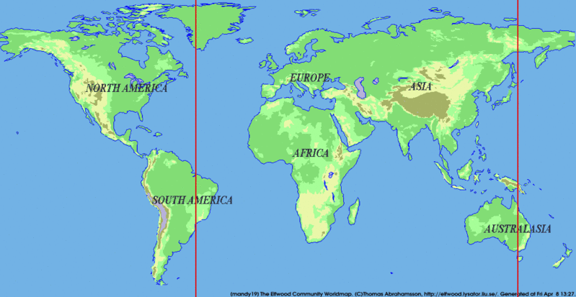
Treaty of Tordesillas
Spain got everything to the West, with Portugal gaining eveything to the East

Slide 16
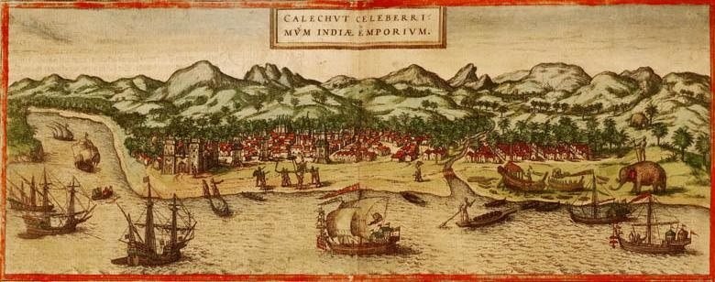
Race to Riches
Portugal – already found Asia
Take control of Spice trade.
1510 – Capture Goa
1514 – Control Straits of Hormuz
Other nations see this success, and join in.

Slide 17
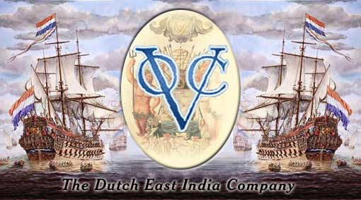
Race to Riches
England and the Netherlands battle for dominance in Asia
1600 – begin to challenge Portugal
Dutch have 20,000 ships which they use to throw out Portugal
East India Company (English and Dutch)
Dutch (wealthier) eventually boots out England

Slide 18
Race to Riches
The Netherlands
Control Indian Ocean
Amsterdam becomes a leading commercial center.
English East India Company is still around, but not as influential.

Slide 19
Practical Navigation
Refer to the primary source page, Practical Navigation, and look for pictures of tools that were used for navigation on ships during the Age of Exploration.
Next match the correct term to the correct description and use of each instrument.
Then draw an illustration of the instrument and a short explanation of the use of that tool on chart paper.

Slide 20
