Slide 1
The Building of Global Empires
19th Century Imperialism

Slide 2
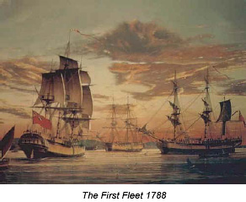
Imperialism
19th term described as the domination of European powers, the US, and Japan over subject lands in the larger world.
  Sometimes by force, but often from trade, investment, business activities that enable them to profit subject societies and influence their affairs without going to trouble of exercising direct political control
Establishment of colonies in foreign lands seen since ancient times
Modern colonialism now also dominates the political, social, economic, and cultural structures
Two types of modern colonialism
  Colonies where they are ruled and settled by the migrants from home society
    North America, Australia, S.Africa
  Colonies controlled by the imperial power without much settlement
    Ex. India, SE Asia, sub-Saharan Africa

Slide 3
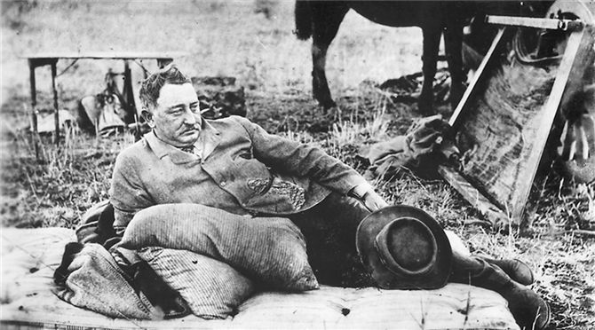
Economic Motives for Imperialism
Europeans merchants and entrepreneurs made personal fortunes
Colony serve as reliable source of raw materials
  Rubber plantations in Congo River basin
  Copper-Africa
  Tin in SE Asia
  Petroleum-SW Asia
Colony was potential market for their goods
Cecil Rhodes resting in the goldfields of south Africa, about 1897. His dominating economic, cultural, and political influence on southern African territories for personal and British gain was a model of European imperialist values.

Slide 4
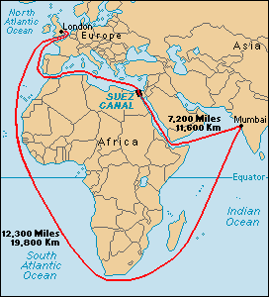
Political Motives
Geopolitical Reasons
Strategic location: Harbor, port control
Locate naval ships, control sea lanes
Think “Suez Canal” or “Panama Canal” or Hawaiian islands
Suez Canal was completed in 1869 .

Slide 5
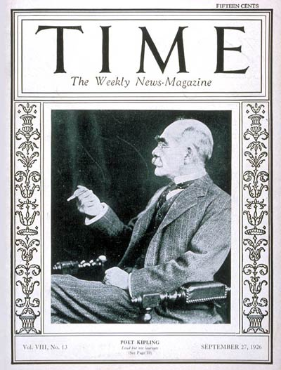
Cultural Motives
Christian missionaries sought to converts in Africa and Asia
  Sometimes facilitated the communication b/n imperialists and subject people
“Civilizing mission”
“White man’s burden”, by Rudyard Kipling
  Duty of Europeans to bring order and enlightenment to distant lands
Used as justification for expansion
Kipling, age 60, Sept. 27, 1926

Slide 6
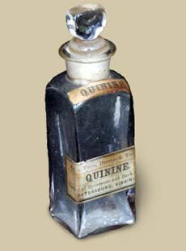
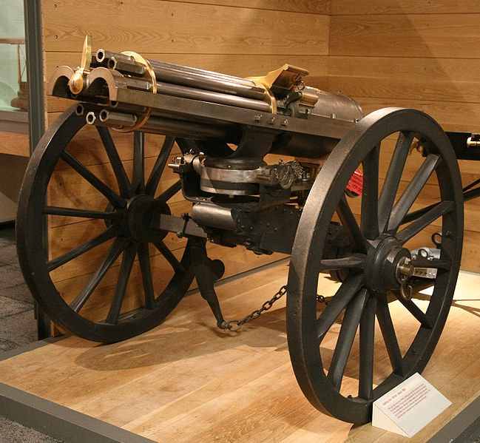
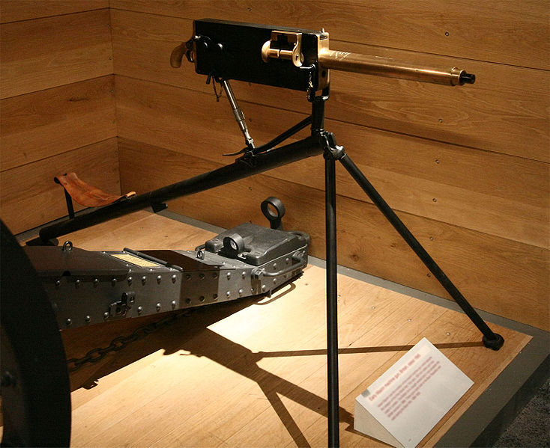
Tools of Imperialism
Transportation technologies
  Steam-powered gunboats
  Railroads
Military technologies
  Firearms: Muskets to machine guns
Communication technologies
  Telegraph cut message time from years to hours
Gatling Gun, designed during Civil War was one of earliest machine guns. By the end of 19th c., it had given US and Britain an enormous military advantage.
Maxim gun, 1895 used 1st by British. Fired 11 bullets per second.

Slide 7
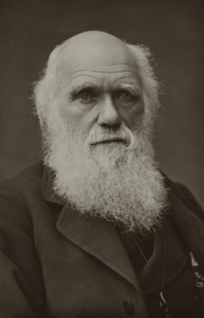
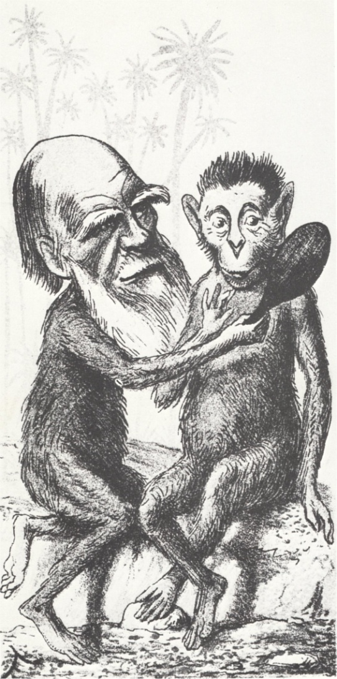
Charles Darwin
Ideas most widely cited and misunderstood
1859 published book On the Origins of the Species
Living beings over 1,000s of years had either evolved or struggle for survival or become extinct

Slide 8
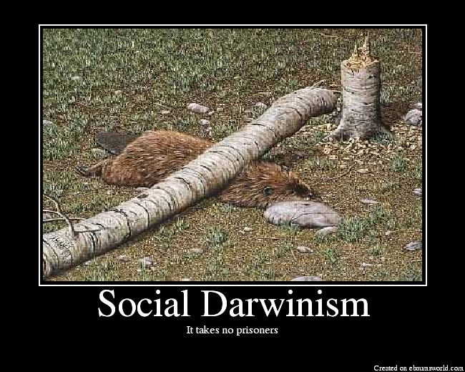
Social Darwinism
Western culture in 19th century
  Powerful over weak
  Men over women
  Rich over poor
  Europeans over other races
  Humans over Nature
Look to science for support of political dominance

Slide 9
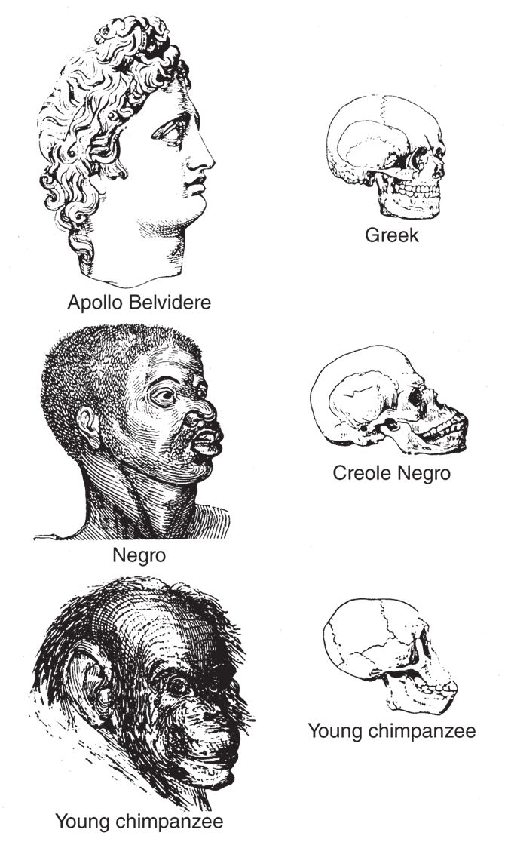
Herbert Spencer
Philosopher 1820-1903
Took Darwin’s ideas of “natural selection” and “survival of the fittest” and applied them to society.
Developed pseudo-scientific theories of racial differences
Result of natural processes-biology
Opposed state-intervention to alleviate process
Not based on science, however ideas gave a scientific-sounding justification for the privileged
From book Indigenous Races of Earth, Illustration deliberately distorts facial and skull features to suggest a close relationship b/n African peoples and chimpanzees.

Slide 10
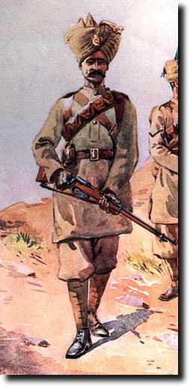
The British Empire in India
British East India Co. built fortified ports on coastline during of Mughal Empire
  Ex. Calcutta, Madras, Bombay
During the decline of Mughal Empire, they began to conquer India to protect their commercial interests
  1757 victory at Battle of Plassey
  “Doctrine of lapse” policy
    If a ruler didn’t produce a biological male heir, his kingdom went to East India Co.
Ruled with a small British army and a large # of Indian troops known as sepoys

Slide 11
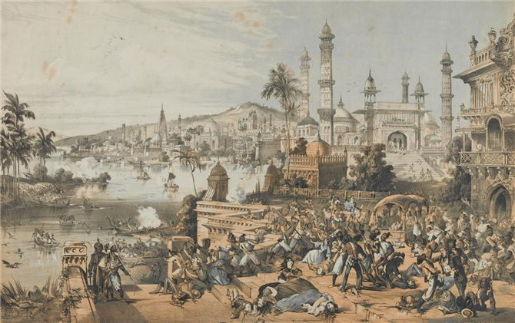
Sepoy Mutiny 1857
Revolt leads to direct British imperial rule in India
Originally over the cartridges for their Enfield rifles
  Animal fat? Cow/Pig?
Staged mutiny, killed British officers, proclaimed restoration of Mughal authority
Minor rebellion turns to large-scale rebellion
Britain benefit from powerful weapons and telegraphic communications
Some examples of violence against the British
  Ex. Cawnpore
British forces extract revenge on rebels
By May 1858, Britain had crushed rebellion and restored authority in India
British print depicting the atrocities at Cawnpore. At left, sepoys kill British troops and men, while women and children fall in foreground. At right, rebels stuff victims’ corpses in a well.

Slide 12
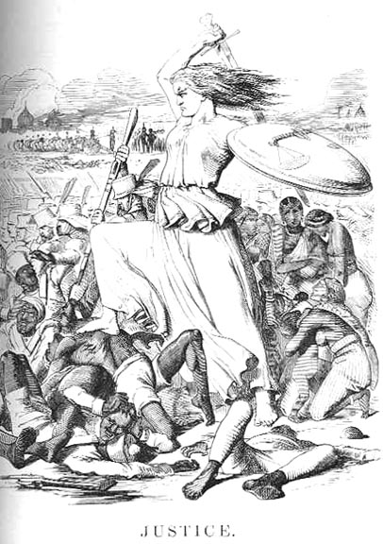
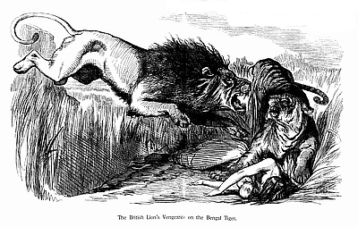
Political Cartoons from England after Sepoy Rebellion from England’s Punch magazine 1857

Slide 13
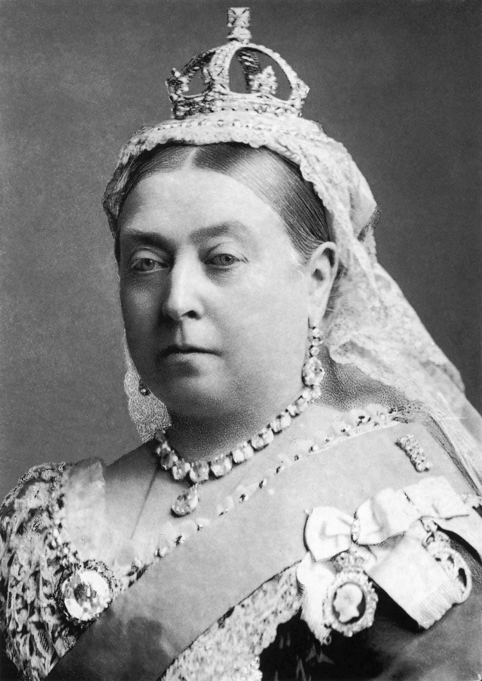
Queen Victoria (1837-1901)
After rebellion, she abolishes East India Company in favor of direct rule by British gov’t
Viceroy represents the British royal authority
Elite Indian civil service run by English
Low-level bureaucracy -Indians

Slide 14
British Imperial Rule of India
After the Sepoy Rebellion: 1858
British viceroy represented the royal authority
  High-level British civil service aided viceroy
  Indians serve as the low-level bureaucratic positions
Extend rule to all of India and Ceylon (Sri Lanka)
Cleared land for cultivation of coffee, tea, opium
Built railroads, telegraph lines for global trade
Construct, canals, harbors, irrigation methods to support commerce and agriculture
Establish European-style schools for Indian elites
Suppress Indian customs
  Ex. 1829 officially outlaw the practice of sati

Slide 15
Nationalism and Anticolonial Movements
Imperial expansion and colonial domination leads to nationalism and anticolonial movements
Ex. Indian National Congress

Slide 16
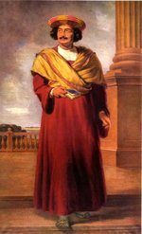
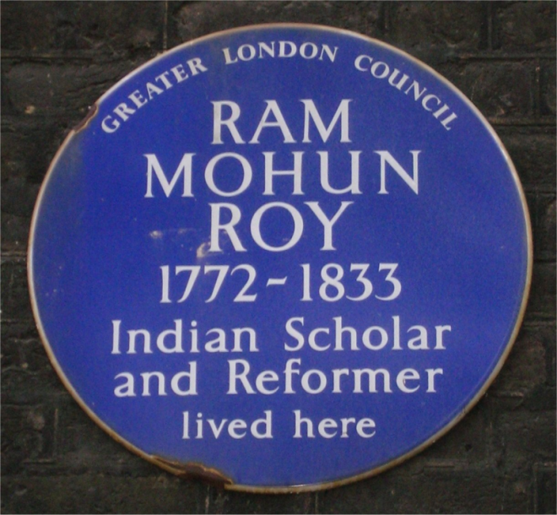
Indian Nationalism
Ram Mohan Roy 1773-1833
  “Father of Modern India”
  Sought an Indian society based on European science and reformed Hindu traditions
  Known for his efforts to abolish sati, child marriage, caste rigidity
    Doc. 20.2 “Letter to Lord Amherst” –his response to the British governor about the establishment of a school in Calcutta w/ the focus on Sanskrit texts and Hindu learning
27 September 1833 died and was buried in Bristol, England.

Slide 17
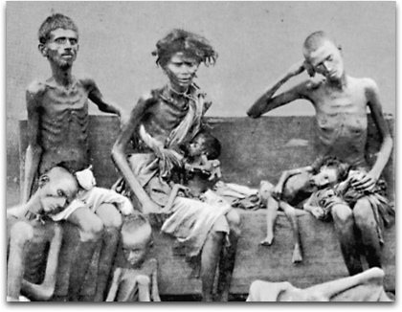
Indian National Congress
  Reform group founded in 1885
  Members were the educated-elite from India
  Met w/ British officials to discuss public affairs
  Congress aired grievances and sought Indian self-rule
  Examples:
    Relief for drought and famine
    Poverty
    Transfer of wealth from Britain to India
    British racism toward Indians
Western India experienced famine in 1896-1897.
British relief efforts were often heavy-handed and
Insensitive, and did little to alleviate the problem.

Slide 18
Impact of Indian Nationalism and Independence Movements
Serve as a model for anticolonial campaigns in other lands
All leaders of the movements were European-educated elites who absorbed Enlightenment values and turn them into an attack on European colonial rule
  Ex. Jomo Kenyatta-Kenya
  Ex. Kwame Nkrumah-Ghana

Slide 19
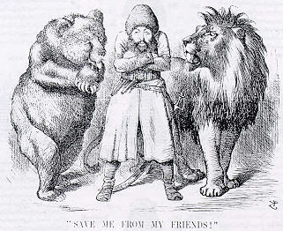
Imperialism in Central Asia
“Great Game” refers to the competition b/n Russia and Britain in central Asia
Russian & British explorers mapped terrain, sought alliances w/ local rulers from Afghanistan to Aral Sea
Never colonize this area, but Russia dominates it until 1991
Political cartoon depicting the Afghan Emir Sher Ali with his "friends" the Russian Bear and British Lion (1878)

Slide 20
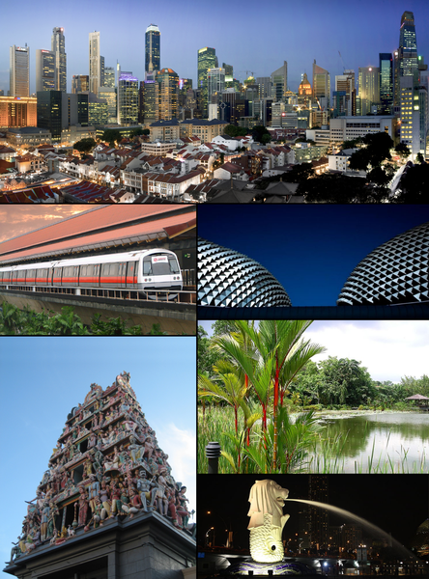
British colonies in SE Asia
By 1880’s established colonial authority in Burma for teak, ivory, rubies, jade
1824 Port of Singapore founded; base for conquest of Malaya (modern Malaysia)

Slide 21
French Indochina
Built their SE Asian empire in Indochina
Consisted of the modern states of Vietnam, Cambodia, Laos b/n 1859-1893
Established European-style schools
Established close connections with native elites
Encouraged conversion to Christianity so Roman Catholic church became prominent

Slide 22
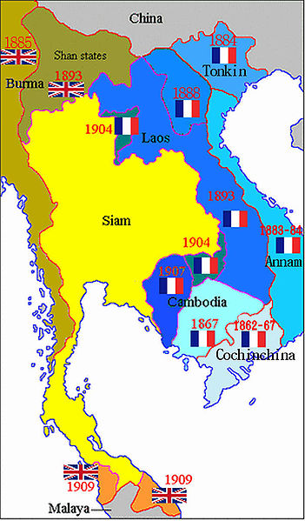
Kingdom of Siam
Modern Thailand
Preserved independence b/c it served as the buffer b/n British-dominated Burma and French Indochina

Slide 23
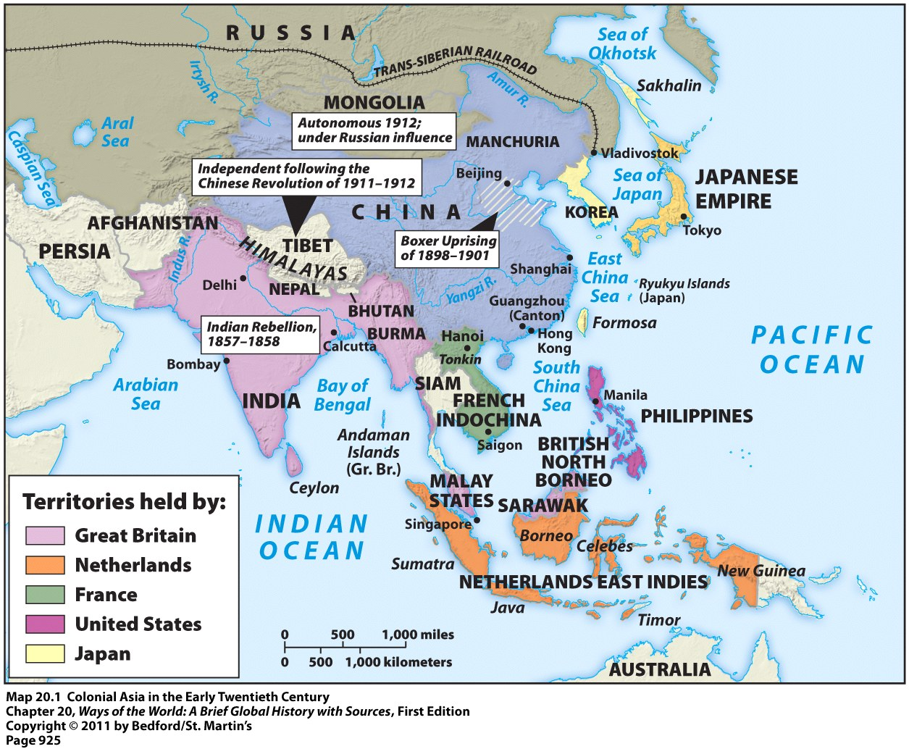
Imperialism in Asia

Slide 24
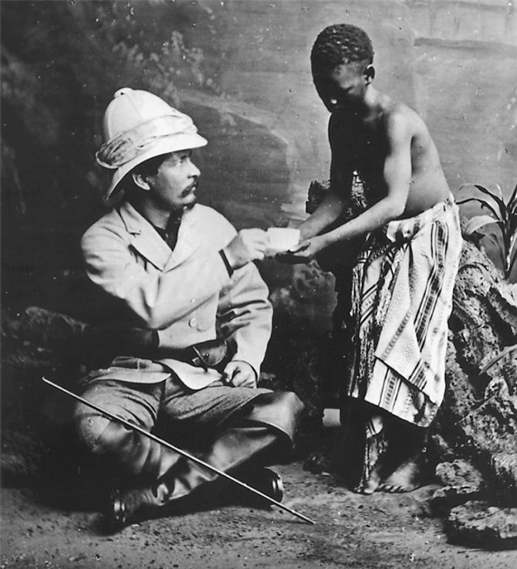
“The Scramble for Africa”
B/n 1875-1900, European powers seized almost the entire continent
Built on early explorers and adventurers
  Dr. David Livingston, Scottish minister
  Henry Stanley
1870’s sent by King Leopold II of Belgium to establish colony in Congo
Britain –Egypt
Henry Morton Stanley spent a great deal of time in the field, but here he appears, along with his gun bearer Kalulu, in front of a painted backdrop in a photographer's studio.

Slide 25
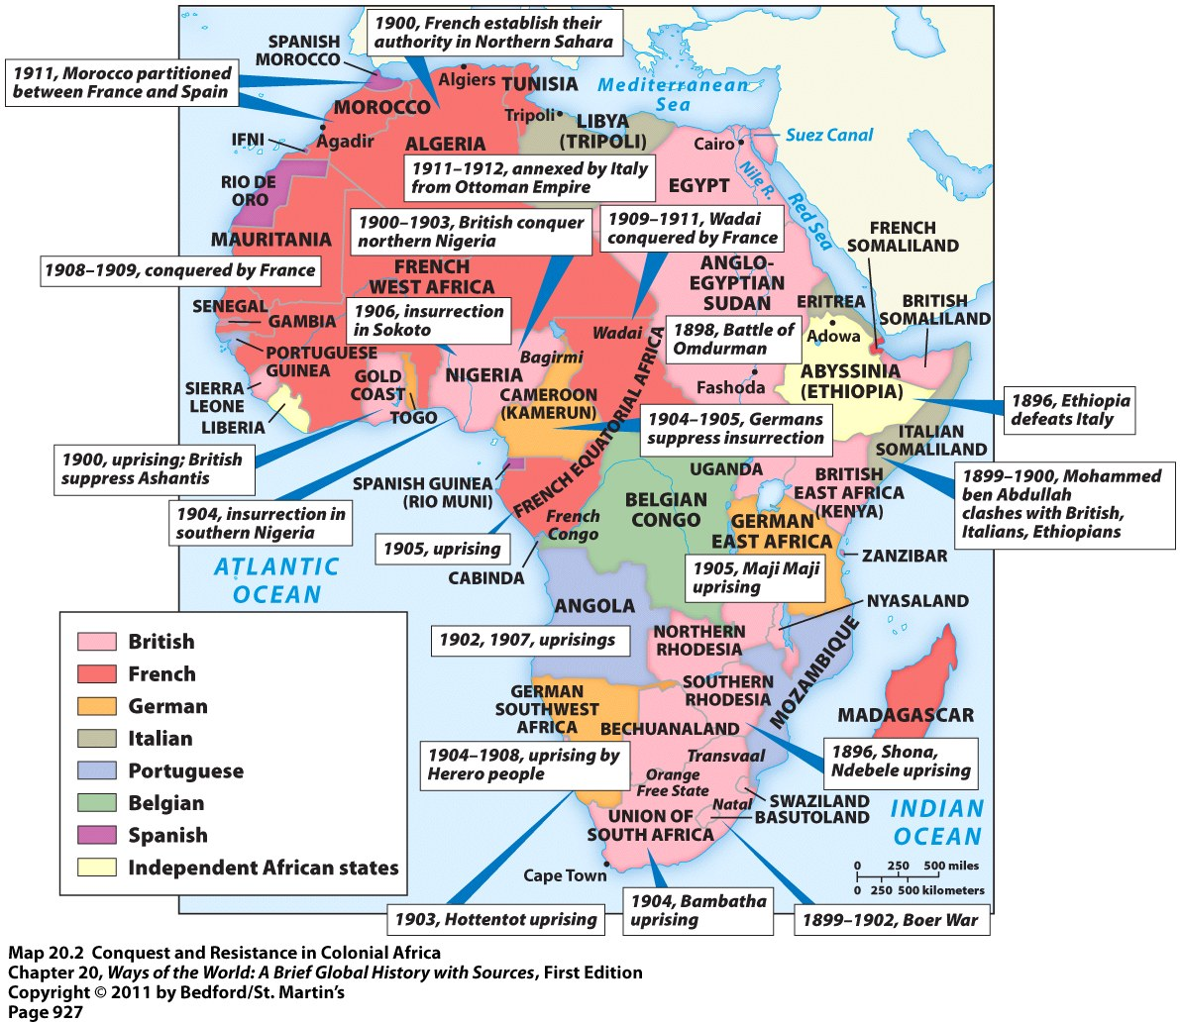

Slide 26
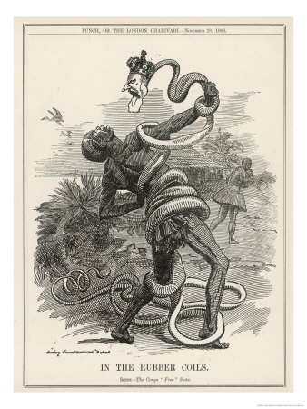
Congo Free State
1870s King Leopold II of Belgium established colony in basin of Congo River
  To stop competition, he announced a “free-trade” zone accessible to merchants from all of Europe
He established for himself lucrative rubber plantations
  Use rubber for bicycle or automobile tires
Forced labor and conditions so brutal that humanitarians protested Leopold’s colonial regime
1908 Belgian gov’t took control of colony to be known as Belgian Congo

Slide 27
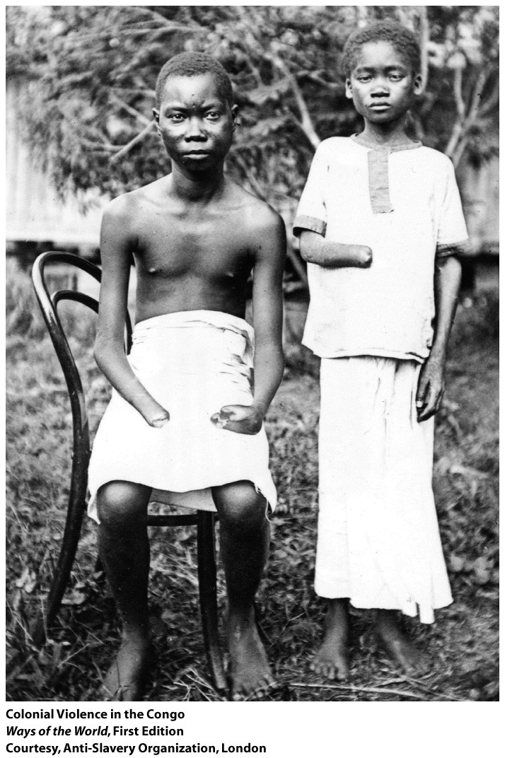
Colonial Violence in the Congo
These young boys with severed hands were among the victims of a brutal regime of forced labor undertaken in the Congo during the late nineteenth and early twentieth centuries. Such mutilation was punishment for their villages’ inability to supply the required amount of wild rubber. (Courtesy, Anti-Slavery Organization, London)
By the end of Belgian rule, 11 million Congolese had died

Slide 28
South Africa
1652 Cape Town established by Dutch East India Co. as supply station for ships enroute to Asia
Settlers known as “Boers”(means farmer in Dutch) or “Afrikaaners”
Steady stream of Europeans increase population
British take over in 1806 which disrupts Afrikaan society

Slide 29
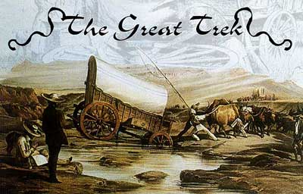
Great Trek
British rule disrupts Afrikaner society so they “trek” to the northeast to claim new lands
  Subject to British law & language
  Slavery abolished in S.Africa in 1833 hurt financially the Afrikan farmer
Sometimes violent conflict with natives
Leads to the establishment of the Afrikaners free states

Slide 30

Boer War 1899-1902
Boers discover diamonds and gold in their new lands
Leads to influx of British settlers
White vs. white fighting over the rights to the resource
Some black Africans also served as soldiers and laborers
Afrikaners defeated and British establish the Union of South Africa in 1910
  Constitution allowed only white men to vote, so natives had few rights
  African National Congress founded in 1912 by educated South Africans in an effort to oppose European colonization and policies

Slide 31
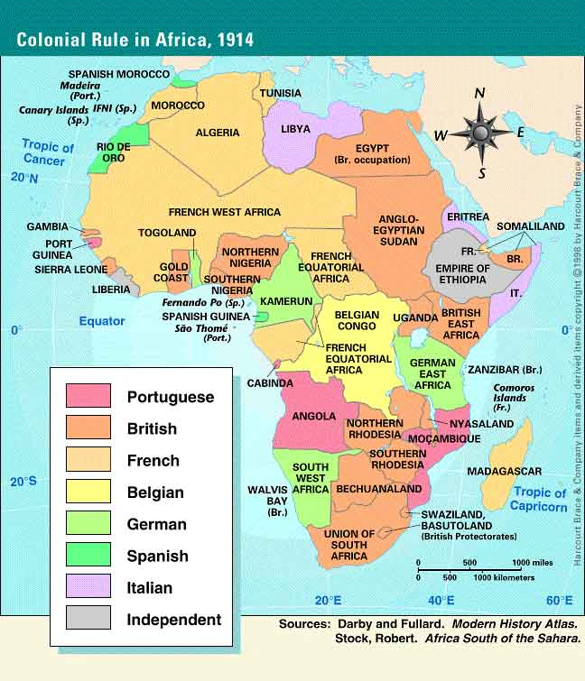
Berlin Conference 1884-1885
European rulers set rules for carving Africa
14 states from Europe
Not one African was present
Any European state could establish colonies after notifying others of intentions
Members spelled out noble-minded objectives for colonized lands:
  End to slave trade
  Extension of Christianity
  Commerce and trade
By 1900, all of the Africa taken except for Ethiopia (natives fought Italians to end) Liberia (US sets up for freed slaves)
  Battle of Adwa
No thought to tribal boundaries so difficult for opposition
For next 25 years, consolidated claims and impose colonial rule with the use of the latest weapons technology
Often battles were one-sided

Slide 32
Systems of Rule in Africa
Direct Rule
Indirect Rule
French model
Intentionally cut ethnic boundaries to weaken power
Rulers replaced with Europeans
Policy of “Paternalism”
  Govern in fatherly way by providing needs but not rights
Policy of “assimilation”
  The population would be absorbed into French culture
  Tried to pattern all schools, courts, business after French institutions
  Did not work so settled on “association” which meant that they recognized African culture. However seen as inferior
Justified as a “civilizing mission” but hard to find enough European personnel
Ex. French West Africa
  3,600 Europeans rule 9 million Africans
British model
Use existing tribal authorities
  Idea is to train them in British method of government
  Ex. British protectorate over the Niger River delta (palm-oil)
Worked well in highly organized African societies

Slide 33
Imperialist Control
Form | Definition | Example
Colony | A Country or territory governed internally by a foreign power | Somaliland in East Africa was a French Colony
Protectorate | A Country or territory with its own internal government but under the control of an outside power | Britain established a protectorate over the Niger River Delta
Sphere of Influence | An area in which an outside power claims exclusive investment of trading privileges | Liberia was under the sphere of influence of the United States
Economic Imperialism | An independent but less developed country controlled by private business interests rather than other governments | The Dole Fruit company controlled pineapple trade in Hawaii

Slide 34
Imperial Management
Indirect Control | Direct Control
Local government officials used Limited self-rule Goal: to develop future leaders Government institutions are based on European Styles but may have local rules | Foreign officials brought in to rule No self-rule Goal: assimilation Government institutions are based only on European styles
Examples: British colonies such as Nigeria, India, Burma U.S colonies on Pacific Islands | Examples: French colonies such as Somaliland, Vietnam German colonies such as German East Africa Portuguese colonies such as Angola

Slide 35
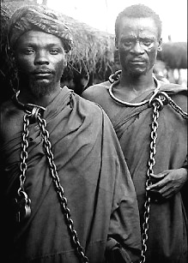
Unsuccessful Resistance: Maji Maji Rebellion
Africans in German East Africa
African villagers resisted the Germans’ insistence that they plant cotton for export rather than food crops
1905, the belief in a magic water “maji maji” would turn German bullets into water
Resistance fighters armed w/ spears and protected by the magic water attack the Germans
Germans recorded 26,000 resisters were dead
2x more die from a famine after the rebellion
Prisoners of the Maji Maji Rebellion

Slide 36
Ethiopia
Only African nation to successfully resist
Victory due to the emperor, Menelik II
Italians, French, and British all were striving to bring Ethiopia into their sphere of influence
Russia and France sold modern weapons to them
Menelik was about to sign a treaty with Italy to give up a small part of Ethiopia when Italy invades from north
Battle of Adwa
  Ethiopian forces defeat the Italians

Slide 37
European Imperialism in Pacific
Australia
James Cook explores in 1770
1778 British fleet arrives at Botany Bay with 1,044 people
  696 convicted criminals
  348 free individuals
By 1830’s, voluntary migrants outnumber convicts
  Discovery of gold in 1851 also
Aborigines
Population devastated by smallpox and measles
British settlers consider Australia to be “land belonging to no one” b/c aborigines were nomadic
Pushed them to the desert regions

Slide 38
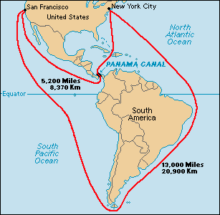
United States: Imperialism
Manifest Destiny
  Brought almost all of temperate regions of N. America as the US
  Similar example to Australia : Native Americans pushed to marginal lands and reservations
  Also purchase Alaska 1867 from Russia as territory, Hawaii annexed in 1898
    Sugarcane plantations in Hawaii
Monroe Doctrine 1823
  Warns European states that Western Hemisphere is off limit
  Justification for U.S. intervention in hemisphere
  Benefits US entrepreneurs and resources
Spanish American War
  Defeated Spain and gained Guam, Philippines, Puerto Rico
  Cuba gained independence
Panama Canal
  Built by US in 1904-1914
  Allowed b/c of the Roosevelt Corollary: Exerted the right to intervene in the domestic affairs of nations within the hemisphere if they demonstrated an inability to maintain security deemed necessary to protect US investments
    We helped rebels establish the breakaway state of Panama from Colombia in 1903

Slide 39
Legacies of Imperialism
Increase in TRADE
Increase in MIGRATION
Colonial CONFLICT
RACISM
NATIONALISM
ANTICOLONIAL MOVEMENTS

Slide 40
GLOBAL TRADE
Global trade surged during the 19th & 20th centuries
Advantage to the colonial power
Timber
Rubber
Petroleum
Gold
Silver
Diamonds
Coffee
Tea
Forces the people to export what they have instead of keeping it
  Ex. Cotton in India

Slide 41
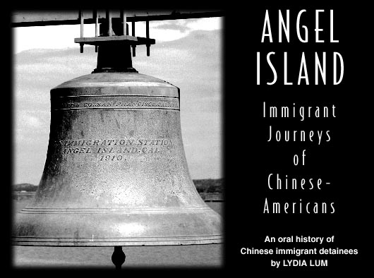
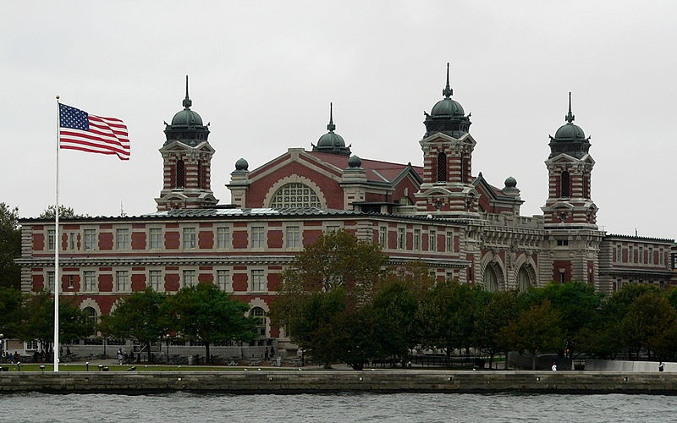
Labor Migrations
European Migration
  50 million migrated b/n 1800-1914
  ½ of these to US
  Most became cultivators, herders, or skilled laborers
Indentured Labor
  2.5 million during 1820-1914
  Slavery in decline but still need labor
  Offer free passage, provide shelter, clothing, food, modest compensation if commit to 5-7 years of labor
  Most from India
  China, Japan, Java, Africa also
  Tropical and subtropical
Empire and Migration
  Imperialists recruit people to their lands
19th century migrations influenced societies because large communities of people with distinctive ethnic identities are in lands far from their homes

Slide 42
19th Century Emigration from China and India
Labor shortages in plantation agriculture, the mineral extraction industry, and transportation projects led to large migrations of the Chinese and Indians to migrate

