Slide 1
Imperialism
1850-1914
Standards 5/6
Chapters 27 and 28

Slide 2
Unit Standards
Standard MWH-5:
The student will demonstrate an understanding of the influence of ideas and technology on the development of nation-states and empires in the sixteenth through the nineteenth centuries.
MWH-5.6Analyze Asia’s relationship with European states through 1800, including Japan’s policy of limiting contacts with foreigners.
Standard MWH-6:The student will demonstrate an understanding of the creation of nation-states in Europe and the struggle by non European nations to gain and/or maintain sovereignty.

Slide 3
Imperialism: Introduction
What have we already learned that is going on in the world during the years 1850-1914?
What does the term “Imperialism” mean?
What does the term “colonization” mean and how do these two terms differ?
What empires have we studied so far in this course?

Slide 4
Differences

Slide 5
Why Study this Period of History?
Helped establish national powers that continue to influence world events
Many current conflicts have their root during this time (longtime enemies were forced together by imperial nation building).
Struggles for independence have their root in this time period- like where?
Spread of culture and language during this time.

Slide 6
Why Imperialism?
1. Industrial Revolution- gave a reason to add lands to their control. New markets and materials to improve economy.

Slide 7
Why Imperialism?
Belief in European superiority-
Europeans believed they were better than others
Racism- The belief that one race is superior to others
Social Darwinism- “survival of the fittest”.
Non-Europeans were considered to be on a lower scale of cultural and physical development.

Slide 8
Social Darwinism
“I contend that we [Britons] are the first race in the world, and the more of the world we inhabit, the better it is for the human race…”-Cecil Rhodes

Slide 9
Missionaries
Worked to convert peoples from Asia, Africa and the Pacific Islands to Christianity.
Wanted to make “civilized” or “westernized”.

Slide 10
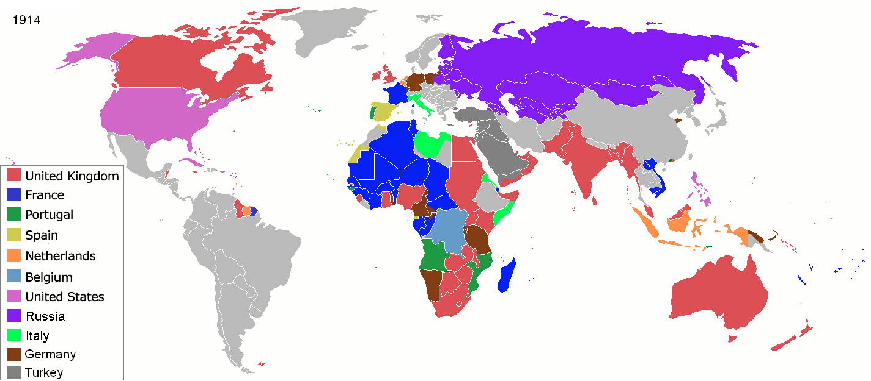
Imperialism- Where was it most Prevalent?

Slide 11
Imperialism Unit
Africa
Muslim Lands
British Imperialism in India
Southeast Asia
China and Japan- resistance!

Slide 12
Africa
What first comes to mind when I ask you about Africa?
What do we already know about Africa’s history?

Slide 13
Africa
European powers wanted Africa.
Berlin Conference (1884-1885)- Rules for the division of Africa.
Divided the continent with little thought about how African ethnic or linguistic groups were distributed. – what might this cause?
By 1914- only Liberia and Ethiopia remained free from European control.

Slide 14
What did Europeans hope to gain from Africa?
Slaves (however this is prior to this time period- the slave trade is all but ended).
Rich mineral resources-
Belgian Congo- wealth in copper and tin.
South Africa- gold and diamonds.
Businesses developed cash crops (peanuts, cocoa, rubber)- displaced the food crops grown by farmers to feed their families.

Slide 15
Imperialism- What made it easy and difficult for Europeans?
Advantages | Disadvantages
Weapons- far superior (Machine guns etc.) Technological Advancements introduced during the Industrial Revolution. (steam engine, railroads, cables etc.) Large amount of cultures and languages- why would this matter? | Disease- Malaria kept Europeans close to the coast. (500 million cases and 1 million deaths/year still occur!)

Slide 16
South Africa
Africans, Dutch and British fighting for land and resources.
Dutch- first to settle Cape of Good Hope (1652)
Dutch settlers later become known as “Boers” (Dutch for farmer).
British- took over the colony permanently in early 1800s.

Slide 17
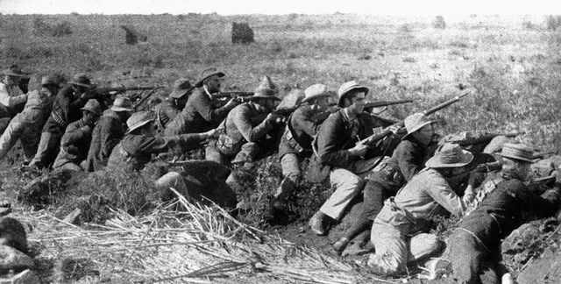
Boer War
Boer War is also known as the South African War.
Total war with guerilla tactics.
Many black South Africans put in concentration camps by British.
British won- created the self-governing Union of South Africa (controlled by British).

Slide 18
Africa Continued
“Europeans made efforts to change the political, social and economic lives of the peoples they conquered.”
Europeans wanted to shape the economies (of Africa) to benefit European economies.
Wanted the people to adopt European customs.

Slide 19
Imperialism
Exploration- 15th and 16th centuries | Imperialism 18th and 19th centuries
Imperial powers did not penetrate far into conquered areas in Asia and Africa. Did not always have substantial influence on the lives of the people. | European powers demanded more influence over economic, political and social lives of the people. Wanted countries to adopt European customs. Wanted more influence to shape economies to benefit those of Europeans.

Slide 20
Different Techniques- four forms of colonial control emerged
Colony (Somaliland was a French colony) | Country or territory governed internally by a foreign power.
Protectorate (Britain and protectorate of the Niger River delta) | A country or territory with its own internal government but under the control of an outside power.
Sphere of Influence (Liberia under U.S S.O.I) | An area in which an outside power claims exclusive investment or trading privileges.
Economic Imperialism | An independent but less-developed country controlled by private business interests rather than other governments.

Slide 21
Imperialism
Methods of Management-
Indirect Control→
Relied on existing political rulers.
Limited self-rule.
Government based on European styles but used local rulers.
British colonies- Nigeria, India, Burma
U.S colonies on Pacific Islands
Direct Control→ Foreign officials brought in to rule.
No self-rule.
Goal was assimilation.
Government based on European styles.
French- Somaliland, Vietnam
German East Africa
Portuguese colonies like Angola

Slide 22
Vocab Check!
Legislative- having to do with the making of laws
Nominated- named, appointed
Paternalism- treating people as children
Assimilation- adoption of a conqueror’s culture by conquered
Diplomatic- done by discussion
Bureaucrat- person who manages a government department.

Slide 23
European Colonial rule- positive or negative?
Negatives | Positives
Africans lost control of their lands and independence. Many died of diseases such as smallpox. Lost thousands of people in resistance to Europeans. Famines resulted from change to cash crops. Traditional cultures disrupted. Traditional authority figures replaced. Men forced to leave villages for other work Artificial boundaries combined or unnaturally divided groups creating problems. | Reduced local warfare. Humanitarian efforts improved sanitation, provided hospitals and schools. Lifespan increased, literacy rates improved. Economic expansion African products valued on international market. Technological advancements- dams, railroads, telephone and telegraph lines etc.

