Slide 2
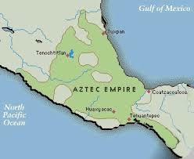
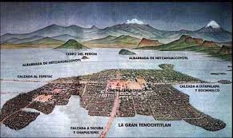
Postclassical mesoamerica 1000-1500
Collapse of Teotihuacan
Abandonment of Mayan cities- 8th century
Political and cultural changes
Toltecs build large empire in central Mexico (Capital at Tula)- 968 CE
Aztecs consider the Toltecs their givers of civilization

Slide 3
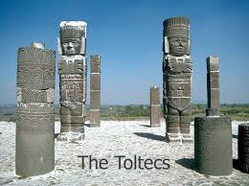
Toltec heritage
Toltec Empire-
1000 CE extended their rule to Yucatan and former Mayan regions.
Commercial influence extended northward as far as the American southwest
Some think that due to similarities, they may have even extended as far as the Mississippi and Ohio valleys but no evidence of this has been found.

Slide 4
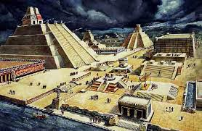
aztecs
Transform from being clans to a society under a powerful ruler
Aztecs- people chosen to serve the gods
Human sacrifice- important part of their culture
Sacrifice used as means of political terror.

Slide 5
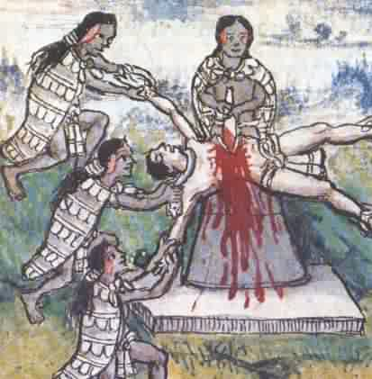
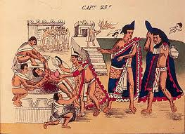
Aztec religion
HUNDREDS OF MALE AND FEMALE GODS-
REPRESENTED THINGS LIKE RAIN, FIRE ETC.
ARRANGED INTO:
GODS OF FERTILITY, AGRICULTURE, MAIZE, WATER
CREATOR DEITIES: GOD OF THE SUN, GOD OF THE NIGHT SKY ETC.
GODS OF WARFARE AND SACRIFICE
MAIN DEITY: HUITZILOPOCHTLI
SACRIFICE SOMETIMES ALSO INCLUDED CANNIBALISM
FATALISTIC VIEW OF HISTORY: THE WORLD HAD BEEN CREATED AND DESTROYED SEVERAL TIMES.

Slide 6
TENOCHTITLAN
CAPITAL OF THE AZTEC EMPIRE
CENTRAL PALACES SURROUNDED BY DISTRICTS AND MARKETS
BY 1519- 5X MILES AND HAD A POPULATION OF 150,000
EACH CITY SECTION CONTROLED BY A KIN GROUP (CALPULLI)
TRIBUTE WAS REQUIRED TO BE PAID TO THE IMPERIAL CITY FROM ALL DEPENDENTS

Slide 7
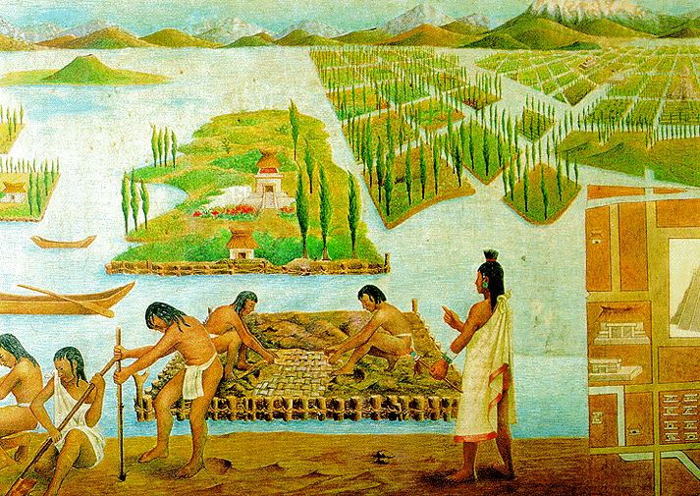
THE ECONOMY OF THE EMPIRE
CONQUERED PEOPLE LOST LAND AND GAVE FOOD AS TRIBUTE
IRRIGATED AGRICULTURE AROUND THE LAKES AND THE DEVELOPMENT OF CHINAMPAS
PEASANT PRODUCTION AND TRIBUTE IS WHAT SUPPLIED BASIC FOOD
MARKETS FOR EXCHANGE AND A MERCHANT CLASS
STATE-CONTROLLED MIXED ECONOMY:
TRIBUTE, MARKETS AND DISTRIBUTION WERE ALL REGULATED

Slide 8
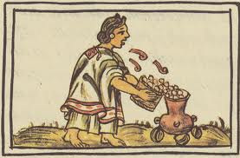
AZTEC WOMEN
WOMEN HAD A VARIETY OF ROLES:
HELPED IN THE FIELD
HOUSEHOLD
ARRANGED MARRIAGES
POLYGAMY WITHIN THE NOBILITY
LACK OF TECHNOLOGY MEANT WOMEN IN PARTICULAR HAD STRENUOUS WORK LIKE TIME SPENT GRINDING MAIZE

Slide 9
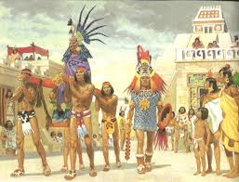
TRIBUTE EMPIRE
THE RULER OF TENOCHTITLAN WAS THE MAIN RULER
IMPORTANCE OF THE MILITARY AND TRIBUTE= DESIRE FOR CAPTIVES AND SACRIFICE.
IN ORDER TO GAIN MORE CAPTIVES THE AZTECS WERE DRIVEN TO FURTHER CONQUESTS.
AZTECS DOMINATED POLITICALLY AND DEMANDED TRIBUTE FROM THOSE CONQUERED BUT DID NOT DIRECTLY CONTROL THEM.

Slide 10
THE WORLD OF THE INCAS
SEVERAL WARRING STATES ALL FIGHTING FOR POWER IN THE ANDES.
THE STATE OF CHIMOR EMERGES AS THE MOST POWERFUL (900ISH)
AFTER 1300 THE INCAS DEVELOP A NEW CIVILIZATION

Slide 11
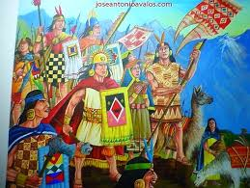
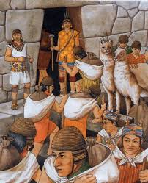
INCAN RISE TO POWER
QUECHUA-SPEAKING CLANS (AYLLUS) AROUND CUZCO BEGIN TO GAIN POWER.
BY THE LATE 15TH CENTURY THE INCAS HAD DEVELOPED AN EMPIRE STRETCHING FROM COLOMBIA TO CHILE AND EASTWARD TO BOLIVIA AND ARGENTINA
9-13 MILLION PEOPLE WERE UNDER INCA RULE

Slide 12
CONQUEST AND RELIGION
SPLIT INHERITANCE:
ALL OF THE RULER’S POLITICAL POWER WENT TO THE SUCCESSOR
WEALTH AND LAND PASSED TO THE MALE DESCENDANCE FOR THE ETERNAL SUPPORT OF THE CULT OF THE DEAD RULER’S MUMMY.
JUSTIFICATION FOR ENDLESS EXPANSION

Slide 13
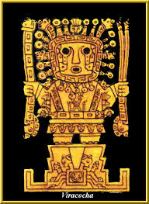
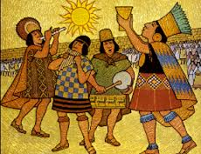
RELIGION
SUN WAS THE HIGHEST DEITY
RULER (INCA) WAS GOD’S REPRESENTATIVE ON EARTH
PRAYERS AND SACRIFICES OFFERED AT HOLY SHRINES
TEMPLES: SACRIFICES, FESTIVALS AND CELEBRATIONS

Slide 14
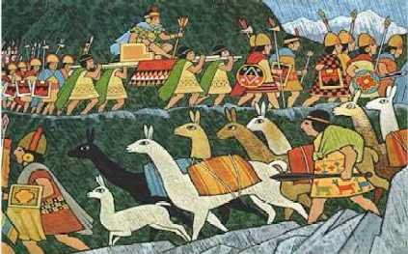
INCAN IMPERIAL RULE
SYSTEM OF TRIBUTE AND LOYALTY TO BE PAID TO THE RULER
COMPLEX SYSTEM OF ROADS AND BRIDGES
CONQUERED PEOPLE SUPPLIED LAND AND LABOR
INCAN STATE ORGANIZED BUILDING AND IRRIGATION PROJECTS
RECIPROCITY BETWEENTHE STATE AND LOCAL COMMUNITY ALLOWED TE EMPIRE TO FUNCTION EFFICIENTLY
NOBILITY BUT NO DISTINCT MERCHANT CLASS BECAUSE OF EMPHASIS ON SELF-SUFFICIENCY AND STATE MANAGEMENT OVER THE ECONOMY.

Slide 15
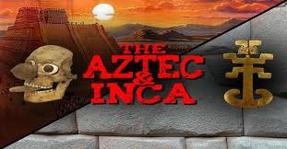
COMPARING THE INCAS AND AZTECS
BOTH:
DEVELOPED ON LONG DEVELOPMENT OF CIVILIZATIONS
IMPERIAL AND MILITARY ORGANIZATION
AGRICULTURE
HIERARCHY IN WHICH THE NOBILITY DOMINATED
SYSTEM OF TRIBUTE
EMPIRES BASED ON CONQUESTS

Slide 16
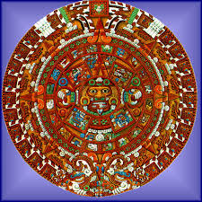
DIFFERENCES
TRADE AND MARKETS MORE DEVELOPED AMONG AZTECS
AZTECS HAD A SYSTEM OF RECORDING HISTORY THAT THE INCAS DID NOT HAVE.
HOW MANY WERE THERE?
WERE THEY, OR WERE THEY NOT, CIVILIZATIONS?
EXPLAIN
WERE THERE ANY OTHER CIVILIZATIONS AROUND THIS AREA AT THIS TIME?

