Slide 1
Italian Renaissance

Slide 2
During the late Middle Ages
Europe suffered from war and the plague
People began to question the Church
People wanted to celebrate life and the human spirit

Slide 3
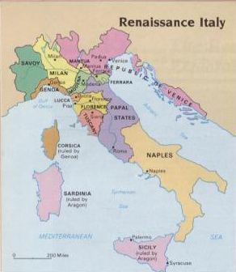
The Renaissance
Renaissance (rebirth)-an explosion of creativity in art, writing, and thought.
1300-1600
Why Italy?
1. Thriving cities
2. A wealthy Merchant Class
3. Classical heritage of Greece and Rome

Slide 4
1. City-States
1. City- States
Crusades spur trade
Growth of large city-states in northern Italy
Cities=places where people exchange ideas
In 1300s bubonic plague killed 60% of population, disrupts economy
With few opportunities to expand business, merchants began to pursue other interests, such as art

Slide 5
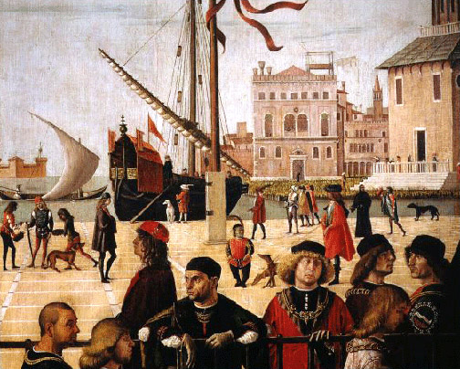
2. A Wealthy Merchant Class
2. A wealthy merchant class
Merchants
More emphasis on individual achievement
Dominated politics
Banking family, the Medici family, controls Florence

Slide 6
3. Inspiration from Greece and Rome
3. Inspiration from Greece and Rome
Middle Ages art and architecture
Artists, scholars study Greeks and Romans (monasteries kept documents intact)
Christian scholars move to Rome after fall of Constantinople in 1453 and brought Greek manuscripts with them

Slide 7
Classical and Worldly Values
Study of classics lead to Humanism
Humanism
Intellectual movement focused on human potential and achievements
Humanists studied classical texts to understand Greek values in subjects such as
History
Literature
Philosophy

Slide 8
The Good Stuff
Renaissance society was secular—worldly
Even church leaders
Wealthy enjoyed fine food, homes, clothes, music
Humanists suggested that one can enjoy life without offending God

Slide 9
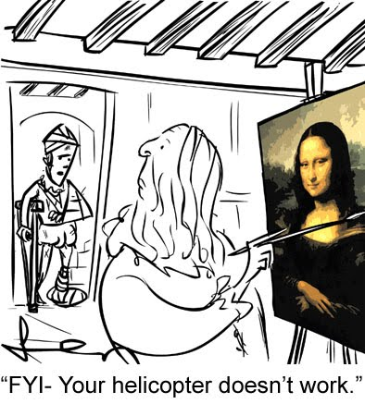
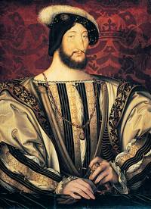
Patrons
Patron-a financial supporter of artists
Church leaders spend money on artworks to beautify cities
Wealthy merchants also patrons of the arts

Slide 10
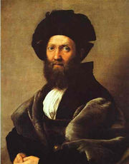
The Renaissance Man
Renaissance Man
Excels in many fields: the classics, art, politics, combat
Baldassre Castiglione’s The Courtier (1528) (Should be charming, witty, well educated in the classics; should dance, sing, play music, and write poetry; should be a skilled rider, wrestler, and swordsman)
The book teaches how to become a “universal” person

Slide 11
Revolution in Art
Revolution in Art
Artists use realistic style copied from classical art
Portraits of Individuals
Painters use perspective-a way to show three dimensions on a canvas

Slide 12
Changes in Literature
New Trends in Writing
Writers use vernacular
Self-expression or to portray individuality of their subjects
Why was it important that writers began writing in the vernacular?
More accessible to everyday people; possible to read literature without learning to speak Latin

Slide 13
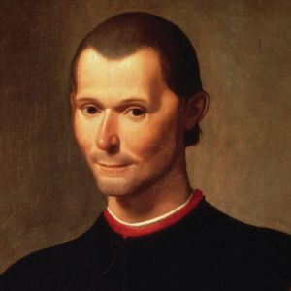
Niccolo Machiavelli
Lived 1469-1527 in Florence
Philosopher, politician, writer, historiographer
Influential politically until falling out of favor with Medici family
Accused of conspiracy, imprisoned and tortured
Wrote “The Prince” to gain back the favor of the Medici family. (1532)
The Prince 1532
Guidebook or “how to” book for princes (rulers) to rule
Has left a lasting impact on modern politics
“Does the end justify the means?”
“Is it better for a ruler to be feared or loved?”

Slide 14
Homework
Find a piece of Renaissance art, print it our and bring it to class. Answer the following questions to go along with your art piece:
1. Who is the artists?
2. When and where was it painted?
3. What is the name of the artwork?
4. Why did you choose this piece to bring to class?

