Slide 1
Nationalism
The Unification of Italy and Germany

Slide 5
Nationalism in 19th Century
Fueled efforts to build nation-states
See nationalism help topple the “three aging empires”
All contained a mixture of ethnic groups
Austrian Empire of the Hapsburgs
Russian Empire of the Romanovs
Ottoman Empire of the Turks

Slide 6
The Creation of Austria-Hungary
An empire of Slovenes, Hungarians, Germans, Czechs, Slovaks, Croats, Poles, Serbs, and Italians.
1866 Austria defeated by the Prussians in Austro-Prussian War
Caused the Hungarians to put pressure on them to split
Becomes the Austro-Hungarian Empire
Independent states with Emperor Francis Joseph of Austria as ruler for both
Exists for next 51 years (1867-1918)
Nationalist disputes continue to weaken them for the next 40 years

Slide 7
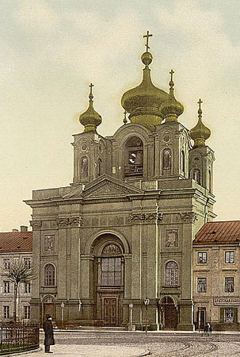
The Russian Empire Crumbles
Multicultural, multilingual, multiethnic empire that stretched from Poland to the Pacific Ocean
22 million Ukrainians, 8 million Poles, and smaller numbers of Lithuanians, Latvians, Estonians, Finns, Jews, Romanians, Georgians, Armenians, Turks, and others.
The Romanovs were determined to maintain iron control over these groups
Instituted the policy of Russification
Force Russian culture on all ethnic groups in the empire
Only strengthens the nationalist feelings of the ethnic groups and helped disunify Russia
Roman Catholic Church in Warsaw, Poland
Russian Orthodox Church, Warsaw, Poland

Slide 8
Ottoman Empire on the Decline
Controlled Greeks, Slavs, Arabs, Bulgarians, and Armenians
Called the “Sick man of Europe”
Attempt to reform and modernize from 1839-1914
Ex. Grant equal citizenship to all people under their rule
Angers conservative Turks
Massacre and deport Armenians from 1894-96 and again 1915
Armenian Genocide 1-1.5 million

Slide 9
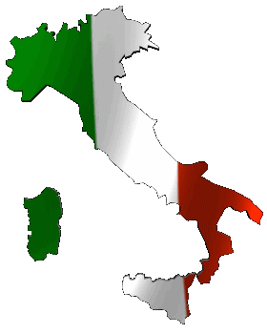
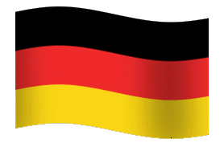
Nationalism built Nations
Case Study of Italy and Germany

Slide 10
Italy After Congress of Vienna
Austria ruled the Italian provinces of Venetia and Lombardy to the north
The Spanish Bourbon family ruled the Kingdom of Two Sicilies
Discontent grows among Italians between 1815-1848

Slide 11
Parts were independent & had their own king
In the 1830s, nationalism led to a unification movement as Italians began to see themselves as having a shared history (ancient Rome, Renaissance), shared territory, shared enemies (Napoleonic Wars)
Parts were controlled by the Pope
Parts were foreign controlled by Austria & France

Slide 12
Sardinia Leads Italian Unification
Kingdom of Piedmont-Sardinia is the largest, most powerful state
1852 Sardinia’s King Victor Emmanuel II named Count Camillo di Cavour as his prime minister

Slide 13
Camillo di Cavour
Major goal was to get control of northern Italy for Sardinia
In 1859, won 2 victories against Austria
Succeeded in taking over northern Italy except for Venetia

Slide 14
Cavour Looks South
In 1860, there was now a northern Italian kingdom (with the exception of Venetia), the Papal States in the middle, and the kingdom of the Two Sicilies in the south
Cavour looks to control the south

Slide 15
Giuseppe Garibaldi 1807-1882
May 1860, Garibaldi leads a small army, known as the Red Shirts, to capture Sicily
Revolutionaries flock to join him
In an election, voters give him permission to unite southern areas with Kingdom of Piedmont-Sardinia

Slide 16
Challenges After Unification
Rivalries among the different Italian provinces
Greatest tension b/n industrial north and agricultural south
Different ways of life
In Italian Parliament, disorganized parties squabble
Many prime ministers, cabinets
Severe economic problems
Peasant revolts in south
Strikes and riots in north
RESULT: Italy enters 20th century as a poor country

Slide 17
Unification Continues
1866, province of Venetia became part of Italy
1870 Italian forces take over Papal States
City of Rome became capital of Kingdom of Italy
Pope would govern section of Rome known as Vatican City
Vatican City Coat of Arms

Slide 18
Prussia Leads German Unification
Prussia had mainly a German population
Army most powerful in central Europe
1848 Berlin rioter’s forced a constitutional convention
Paved way for unification

Slide 19
The Rise of Prussia
Most important political development in Europe b/n 1848-1914
Transforms the balance of economic, military, and international power

Slide 20
Otto von Bismarck 1815-1898
Prime minister that led them to unify
Debated legacy
Positive
Greatest and noblest of Germany’s statesmen
Unified & raised it to greatness
Negative
Devious politician who abused powers and led them into a dictatorship
“It is the destiny of the weak to be devoured by the strong.”
“We Germans shall never wage aggressive war, ambitious war, a war of conquest.”

Slide 21
Realpolitik
Bismarck a master of this style of politics
Means “the politics of reality”
Describes tough power politics with no room for idealism
Realism and practicality
Politics that are coercive, amoral, or “Machiavellian”

Slide 22
Bismarck’s “Realpolitik’s”
“The great questions of the day will not be settled by speeches or by majority decisions-that was the great mistake of 1848-1849- but by blood and iron.”

Slide 23
More Bismarck Quotes
“Never believe anything in politics until it has been officially denied.”
“To retain respect for sausages and laws, one must not watch them in the making.”
“People never lie so much as after a hunt, during a war or before an election.”
“If there is ever another war in Europe, it will come out of some damned silly thing in the Balkans”

Slide 24
Germany Expands
1864- Bismarck forms an alliance with Austria in order to go to war with Denmark to win border provinces
1866-Seven Weeks’ War- war with Austria due to border disputes
Quick victory increases
pride with Prussia

Slide 25
Franco-Prussian War
By 1867, a few southern German states were independent of Prussia
Majority Catholic (difference)
Bismarck reasons that war w/ France would rally south to unite (threat from outside)
Creates an “incident” that causes France to declare war on Prussia in 1870

Slide 26
Victory in the Franco-Prussian War
July 19, 1870 France declares war on Prussia
Paris withstands the Germans for 4 months and surrenders
Food scarce during siege
Parisians ate sawdust, leather, and rats
Slaughtered zoo animals for food
“Defense of Paris-Students Going to Man the Fortifications"

Slide 27
Creation of the Second Reich
January 18, 1871 at the captured palace of Versailles, King Wilhelm I of Prussia was crowned Kaiser (emperor)
First Reich was the Holy Roman Empire
Bismarck had achieved Prussian dominance by “blood and iron”
William I is proclaimed German Emperor in the Hall of Mirrors in Versailles, France (painting by Anton von Werner)

Slide 28
Balance of Power Shifts
1815 the Great Powers were nearly equal in strength
Britain, France, Austria, Prussia, Russia
By 1871, Britain and Prussia most powerful militarily and economically

