Slide 1
Latin American Peoples Win Independence
Haiti, Spanish Colonies, and Mexico

Slide 2
Colonial Society Divided
Peninsulares
Born in Spain or Portugal (Iberian PENINSULA)
They are only ones who could hold high office and govern
30,000 by 1800
Creoles
Spanish/Portuguese born in Latin America
3.5 million in 1800
Could not hold high-level political office
Can be officers in colonial armies
Bolivar, San Martin
Mestizo/Mulattoes were majority -10 million
Africans and Indians at bottom of social ladder

Slide 3
Creoles Dominated Republics?
Established plantations and ranches
Resented administrative control and economic regulations
Inspired by Enlightenment political thought
Didn’t desire the need for social reform like French, nor establishment of egalitarian society like Haiti
Want political independence on the model of United States
Displace the peninsulares but retain privileged status in society
Between 1810-1825, creoles led movements that brought independence to all Spanish colonies except Cuba and Puerto Rico

Slide 4
18th Century Mexico
Painting from artist Miguel Cabrera in 1763
Known for paintings depicting mixed-race couples and their children
Women is of Indian ancestry
Man is of African and Native American ancestry (zambo)
Woman wears the huipil, Mayan tunic or blouse
Man is dressed European style
Reflects the Spanish fascination with race and the European interest in classification
Give examples of status ambition or upward mobility .
Why is the women shown in traditional costume while man is in European dress? Cultural tradition of the child?

Slide 5
18th Century Society in Mexico
Cabrera’s painting shows a Spanish man, a Native American woman, and their mestizo child
By the 20th century, mixed race mestizos represented the majority of the population of Mexico
Cultural blending had become a central feature

Slide 6
Events in Europe Trigger LA Revolutions
1808 Napoleon’s conquest of Spain and Portugal triggers rebellion in LA
Creoles felt no loyalty to new king, Napoleon’s bother, Joseph
After defeat of Napoleon , return Spanish but still want independence
See revolts in Argentina, Venezuela, and Mexico

Slide 7
Simon Bolivar 1783-1830
Most significant heroic figure of the Spanish American independence movements
Bolivar triumphantly entering his hometown , Caracas, Venezuela
He will be disappointed in the outcomes of independence as his dream of a unified South America perish amid the rivalries of separate countries

Slide 8
South American Wars of Independence
Simon Bolivar
Inspired by Enlightenment and popular sovereignty
Wealthy Venezuelan creole
Studied in Europe
Called Libertador
Romantic and practical, writer, and a fighter
Inspired by George Washington, took up arms against Spanish rule in 1811
Simón Bolívar, creole leader of the independence movement in Latin America, was a favorite subject of painters in the nineteenth century. This portrait depicts him as a determined and farsighted leader.

Slide 9
Bolivar’s Route to Victory
1811 Venezuela declares independence from Spain
His volunteer army suffered numerous defeats
Turning point
Aug. 1819, led army of 2,000 through Andes
B/c of the surprise, he won battle in Bogota
By 1821, he won Venezuela’s independence

Slide 10
Bolivar’s Vision
A single country extending from present day Venezuela to modern Bolivia
Create the Republic of Gran Colombia
Wants a confederation like US
By 1826, civil war break out
Venezuela withdraws, Ecuador as well
Never becomes reality
Retires in 1830 and dies later that year of tuberculosis

Slide 11
Jose de San Martin
Joins Bolivar to decide the future of LA revolutionary movement
1816 Argentina declared independence
1817 led his army across Andes to free Chile
1821 led army to drive out Spanish in Peru, Ecuador
Left his army with Bolivar and went to Europe
Dies in 1850 in France

Slide 12
Mexico Ends Spanish Rule
Padre Miguel Hidalgo
1753-1811
Born a creole
Priest, poor but well-educated
Believer in Enlightenment ideals

Slide 13
The “Grito de Delores!”
Means the “Cry from Delores” for freedom from the Spanish
Sept. 16, 1810, rang bells of village church calling for a peasant rebellion against the colonial Spanish rule

Slide 14
A Cry for Freedom
Hidalgo led 80,000 Indian and mestizo followers on a march toward Mexico City
Many contemporaries see this as social and economic warfare against elites of Mexican society
A Spanish army defeats Hidalgo in 1811
Hidalgo is captured by conservative creoles and executed
Father of Mexican Independence
Mexican Independence Day celebrated on Sept.16th

Slide 15
Padre Jose Maria Morelos
Rallies rebels after death of Hidalgo
Led revolution for 4 years
Defeated by creole officer Agustin d’ Iturbide
Captured and executed by firing squad for treason in 1815

Slide 16
Mexican Independence
Agustin de Iturbide
Despite his defeat of Padre Morelos, he proclaimed independence in 1821
Declares himself emperor
Why he switched sides?
As a creole, he feared loss of privileges in colony
Agustin D’Iturbide

Slide 17
Central America’s Call for Independence
1821, several Central American states (part of New Spain) declared independence as well from Mexico
Iturbide refused to recognize them and will be overthrow in 1823
Central America will declare absolute independence
Takes name: United Provinces of Central America

Slide 18
Brazil’s Royal Liberator
Occurs without violent upheaval or bloodshed
1807, Portuguese royals fled as Napoleon’s armies invaded Spain and Portugal
Took court and royal treasury to Brazil
Ruled until defeat of Napoleon
King John VI returns to Portugal but leaves son, Dom Pedro to stay
Dom Pedro I

Slide 19
Brazilian Independence
King John VI returns to Portugal but leaves son, Dom Pedro to stay
8,000 Brazilians signed a petition asking Dom Pedro to rule
September 7, 1822,he officially declares Brazils independence

Slide 20
Little Social Change in LA
LA society still rigidly stratified as it was in 1800
Peninsulares return to Europe
Creole elites dominate politics
Enlightened but have little experience
Go from one constitution to another
Less than 5% active in public affairs during 19th century
After independence, new states granted military authority to caudillos , local strongmen or regional military leaders

Slide 21
How do Latin American Revolutions compare?
Little change to society
Peninsulares return to Europe and LA stays rigidly stratified
Lasted much longer b/c of the many types of societies
Took place under fear of French & Haitian revolution
Simon Bolivar called for “the people” to prevail against Spanish but some thought of themselves as Spanish
Impossibility of uniting the various Spanish colonies b/c of geography and regional identities
Aftermath in Americas
US emerges as democratic, stable, influential and industrialized
LA is underdeveloped, politically unstable, and dependent on technology and investment

Slide 22
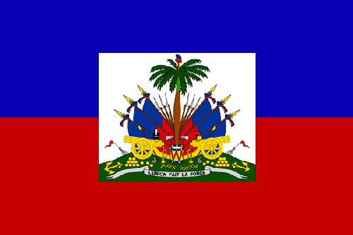
Haitian Revolution

Slide 23
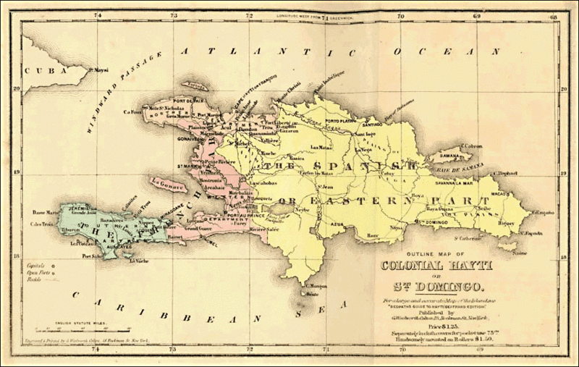
French Colony: Saint Domingue
First Latin American territory to free itself of foreign rule
Located on the western side of island of Hispaniola
One of the richest of the European colonies in the Caribbean
1/3 of France’s foreign trade came from the sugar, coffee, and cotton produced there

Slide 24
Population and Social Structure
Whites
40,000
Divided into two groups
Grand blancs: The very well-to-do plantation owners, merchants, and lawyers
Poor whites or petit blancs: artisans, shopkeepers, slave dealers, and day laborers
Gens de couleur libres = Free people of color
30,000
Mixed-race background-mulattoes, some black
Artisans, domestic servants, overseers
Slaves
500,000-most African born
Toil fields in brutal conditions
Mortality rates high
The French Revolution ideals meant different things to all these groups
Maroons
Maintain own societies and sometimes attacked plantations for food, weapons, tools and additional resources

Slide 25
The French Revolutions Ideals Influence on Haitian Population
Wealthy plantation owners
Want greater self-rule and fewer economic restrictions on trade
Resent the poor whites demand for equality of citizenship for all whites
Because outnumbered, many feared rebellion
Both white groups opposed to idea of equal treatment for all free people regardless of race
Gens de Couleur fought in American Revolution and want to reform society
Slaves a threat
Ideas of personal freedom was a threat to entire slave system

Slide 26
Fight for Freedom
1791 African Vodou priest, Boukman, organizes revolt
12,000 slaves join
Soon 100,000 slaves revolt
They burned 1,000 plantations and killed hundreds of whites and gens de couleur libres
Smoke obscured day from night
Soon all groups battled one another
Slaves recruit the maroons
Foreign armies also get involved
French troops in 1792 come to restore order
Britain and Spain intervene in 1793 trying to benefit from France’s difficulties
Battle at San Domingue

Slide 27
The slave rebellion in Saint-Domingue struck fear in the hearts of European and Euro-American peoples.
This French print depicts outnumbered white settlers under attack on a plantation.

Slide 28
Toussaint Louverture (1744-1803)
Francois-Dominique Toussaint
Son of slaves
Calls himself Louverture meaning “opening” b/c skilled in finding openings in the enemy lines
Learned to read and write from Roman Catholic priest
Rose to position of livestock overseer and planted coffee on leased land w/ rented slaves
Untrained in military and diplomacy, but rose to become skilled at both
When revolt broke out in 1791, he even helped his masters escape to a safe place, then left to join the rebels
By 1801, he promulgated a constitution that granted equality and citizenship to all of Saint-Domingue

Slide 29
French Troops Land in Saint-Domingue
January 1802, Napoleon dispatches 40,000 to restore French authority
Toussaint attempts to negotiate peace but is arrested and sent to France
Toussaint agreed to halt revolution if they would end slavery
Despite agreement, he is seized and put in prison in French Alps
Died 10 months later
General Toussaint Louverture on a Haitian banknote.

Slide 30
Toussaint Louverture
Liberator Hero
Former slave and effective military leader, Toussaint Louverture led the Haitian revolution.

Slide 31
Haiti’s Independence
Yellow fever ravages the French army
General Jean-Jacques Dessalines took up the fight and defeats remaining French troops
January 1, 1804, he declared the colony independent
1st black colony to free itself from European control and 2nd independent republic in western hemisphere
Named Haiti meaning “mountainous land” in original Taino language
Example of the lowest order in society, SLAVES, becoming free, equal, and independent
A mural of Dessalines, in Port-au-Prince, Haiti.

Slide 32
“Revenge Taken by the Black Army”
Engraving from 19th century
Illustrates the violence and racial dimension of the upheaval in Haiti

Slide 33
January 1, 1804, Jean-Jacques Dessalines
With formal declaration of independence, Dessalines, is quoted:
“I have given the French cannibals, blood for blood. I have avenged America.”

Slide 34
Effect of the Revolution
Economically: plantation system (sugar, coffee) destroyed
See racism emerge despite the granting of equality of all citizens
Whites fled or were killed
Lands gets redistributed to gens de couleur libres or freed slaves
Only small-farms, no export
Becomes example of slave uprising that inspires others
To whites, the cautionary saying “Remember Haiti” reflects the fear
Napoleon’s defeat in Haiti persuades him to sell Louisiana Purchase
Ironically leads to expansion of slavery in Caribbean b/c sugar plantations no longer in Haiti
Meaning of Haitian Flag:
Coat of Arms depicts a trophy of weapons ready to defend freedom. The royal palm is for independence. The motto is “L’union Fait La Force” or “Unity Makes Strength”

