Slide 1
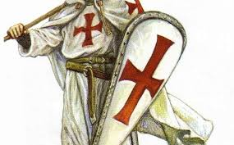
The Crusades and the middle ages
Standard 1.2- Explain the impact of the Crusades and the Renaissance on European exploration, including the significance of humanism, the revival of learning, and the transfer of knowledge about sailing and ancient philosophy from the Arabs to the Europeans.

Slide 2
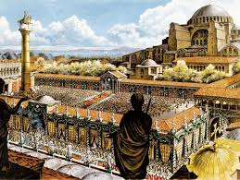
Background- The Great Schism and the Byzantine empire
What is going on with the Church?
300 AD- Roman emperor Constantine moves capital of Roman Empire from Rome to the East.
Creates Constantinople (modern-day city of Istanbul in the country of Turkey)
Roman Empire officially divided into East and West in 395 CE
Western Roman Empire falls by 476CE (dates vary)

Slide 3
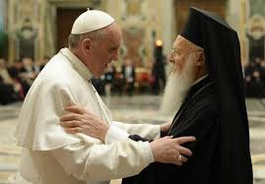
The Great Schism- 1054
What were the major differences between the Eastern and Western Roman Empires?
East- develops a unique culture (spoke Greek instead of Latin etc.)
Belonged to the Greek Orthodox church (did not follow the Catholic Church or the Pope)
1054- Split becomes permanent
Byzantine Empire expands and Russians begin practicing the Orthodox religion.

Slide 4
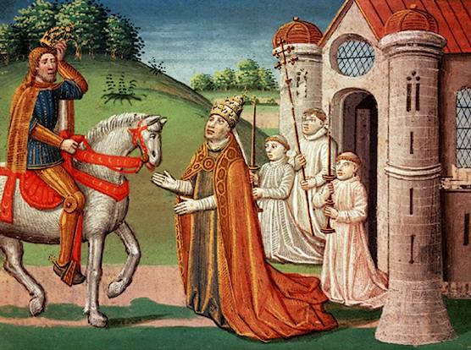
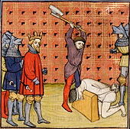
Medieval Europe? The Middle Ages? The Dark Ages? The Age of Faith?
Which of the above best describe the time period we are about to discuss?
Let’s take a look at some images…

Slide 5
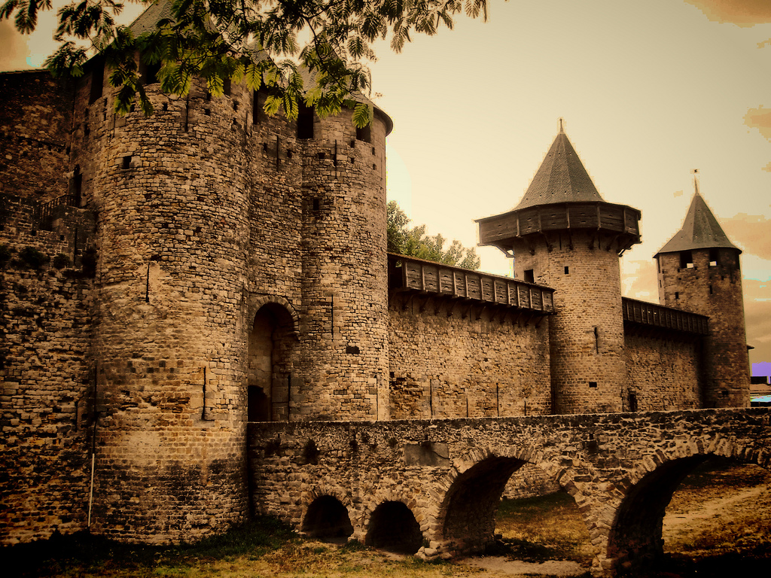

Slide 6
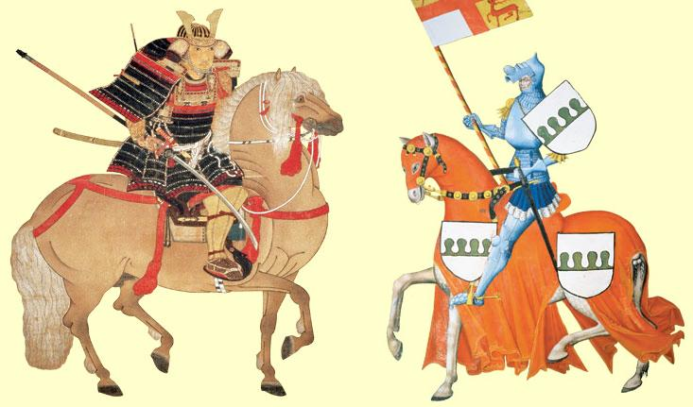

Slide 7
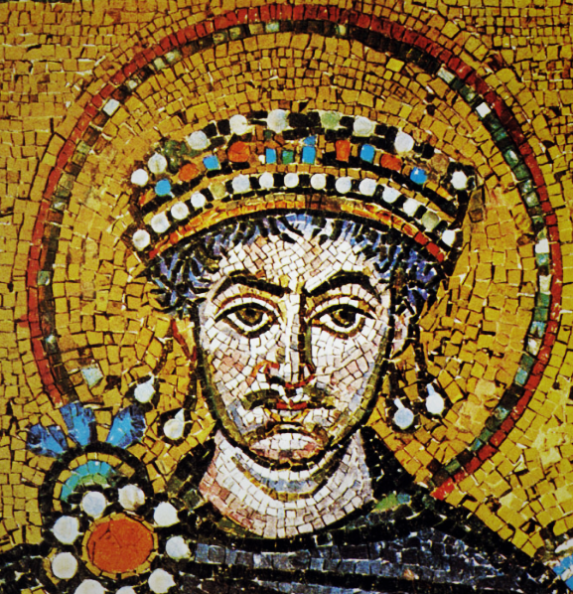
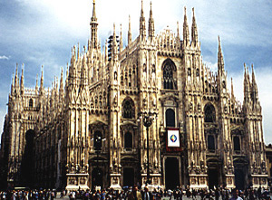

Slide 8
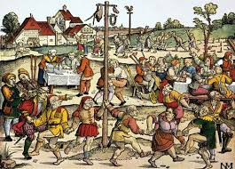

Slide 9
Background- what did Europe look like at the time of the crusades?

Slide 10
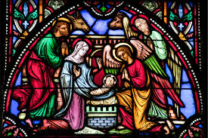
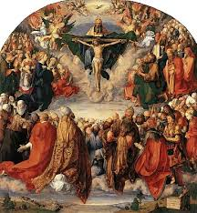
Renewal of Faith
Church reform- reorganization of church structure
Group that made church law (Curia)
Friars- new church group. Traveled place to place to spread Church ideas.
Europe begins to build magnificent Cathedrals- Gothic style
And finally- renewed faith led to war…

Slide 11
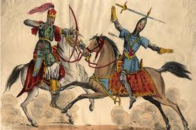
What were the crusades?
1093- Beginning of Crusades
Byzantine emperor asked for help against Muslim Turks who were threatening Constantinople.
Pope urges leaders of Western Europe to begin holy war.
Christians- gain control of Jerusalem and the rest of the Holy Land!
First of several crusades over the next 200 years.

Slide 12
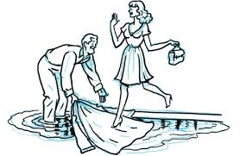
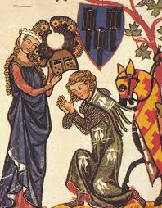
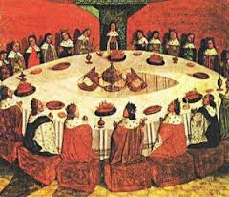
Who was fighting?
Knights and common people.
Knights- trained for fighting and chivalry
Some common people joined due to deep religious feeling.

Slide 13
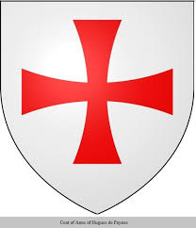
Crusades
Begun in 1096- badly organized
Crusaders succeeded in capturing some of Holy Land including Jerusalem!
2nd and 3rd Crusades- Muslims win back some of the Holy Land and other Crusades follow to try to once again recapture it.
4th (Final) Crusade- Ended in disaster
Western army attacked Byzantine Empire instead of Muslims.
1204- Crusaders loot and take Constantinople
This leads to a lasting split between western and eastern Christian churches.

Slide 14
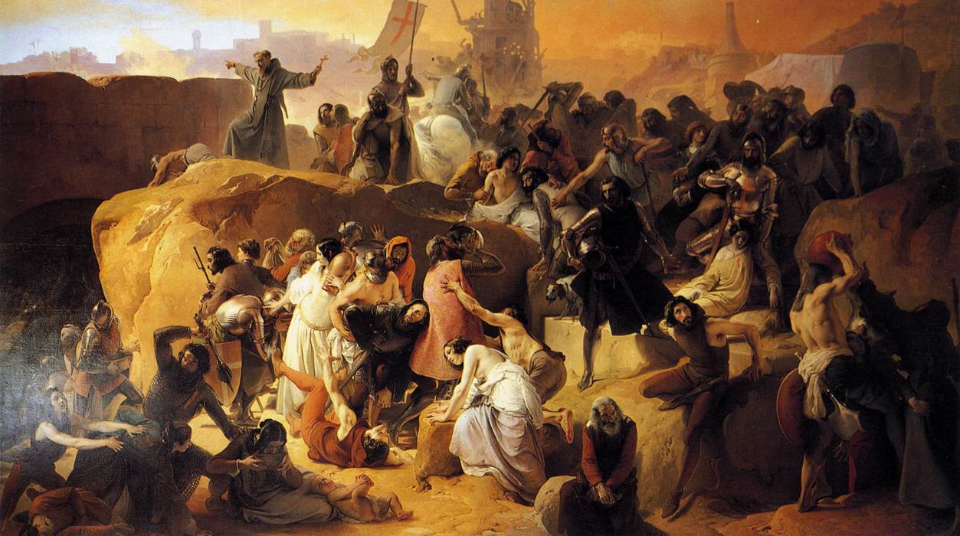

Slide 15
Children’s Crusade

Slide 16
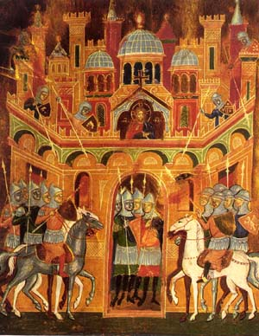
Impacts of the Crusades
1.Byzantine Empire is weakened
2. Pope’s power declines
3. Power of feudal lord weakens
4. Kings become stronger
5. Many knights die
6. Religious intolerance grows.
7. Italian cities expand trade and grow rich
8. Muslims increasingly distrust Christians.
9. Trade grows between Europe and the Middle East
10. European technology improves as Crusaders learn from Muslims.
11. For Jews in Europe, the Crusades were a time of increased persecution

