Slide 1
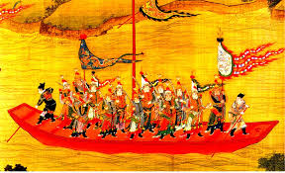
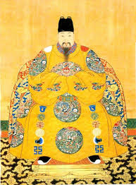
China- Ming/Qing Dynasty
Chapter 19 section 2
Standards 1.6, 4.3 and 4.4

Slide 2
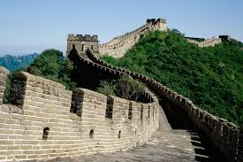
Today
1. Bell Work- discuss
2. Chinese introduction
3. China!- Venn Diagram
4. Zheng He video

Slide 3
Standards
1.6- Evaluate the role the Ming emperors played in extending Chinese influence over East Asia
4.3- Explain the similarities between the Qin and Ming dynasties in China, including foreign relations, culture and economic practices.
4.4- Evaluate the success of the Ming dynasty in sustaining a prosperous Chinese empire and strengthening Chinese hegemony in Asia.

Slide 4
Venn Diagram
Today, fill out the Venn Diagram detailing the similarities and differences between the Ming and the Qing dynasty.

Slide 5
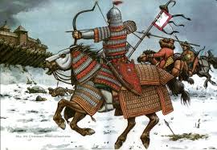
China Limits European Contacts
China drives out the Mongols (1368-1644)
China- dominant power in Asia under the Ming Dynasty.
Korea and Southeast Asia- paid tribute
China would not let outsiders destroy peace the Ming had brought to China.

Slide 6
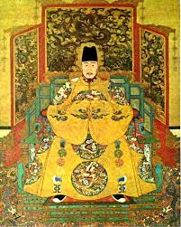
Rise to Power
Hongwu (peasant) drives Mongols out of China in 1368.
Becomes first Ming emperor.
Hongwu brings stability to China.
Return to Confucianism.
Merit-based civil service exam
Eventually becomes Tyrant.

Slide 7
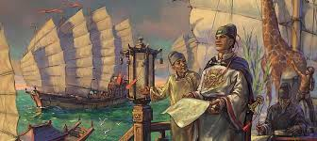
Ming Dynasty Continued
Yonglo (Hongwu son) takes over as ruler- moves the capital to Beijing.
Curious about outside world- 1405 launches first of seven voyages for exploration.

Slide 8
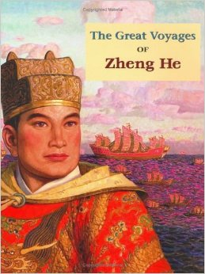
Zheng He
Led seven voyages- Southeast Asia to eastern Africa.
What do you remember of these voyages from the reading?
Distributed gifts of silver and silk to show Chinese superiority.
16 countries send tribute to Ming court!
1433- Voyages end and China goes into isolation.
Why?

Slide 9
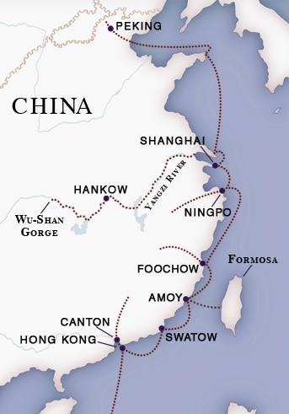
Trade and Isolation
Only government could conduct trade.
Three ports- Macao, Canton and Ningbo
Trade flourished- paid in silver from Americas
Industry grew rapidly- manufacture and commerce increased.

Slide 10
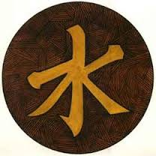
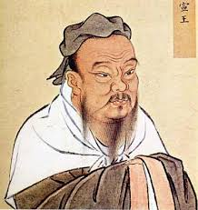
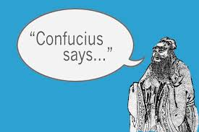
But…
China did not become highly industrialized for two reasons
Against Confucianism- supported foreigners and robbery!
Chinese economic policy favored farmers. Tax on industry was very high!

Slide 11
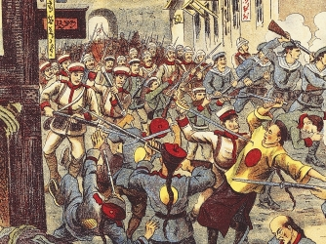
Ming Dynasty Continued
China also opposed Christian presence- why?

Slide 12
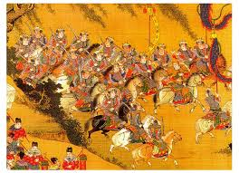
Fall of the Ming
By 1600- Dynasty weakening
Ineffective rulers
Corrupt officials
Limited funds in the government
Higher taxes
Bad harvest- millions starved
Rebellion followed

Slide 13
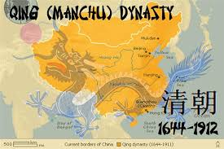
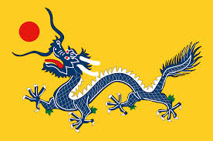
Manchus
Manchus invade China (1644)- collapse of the Ming.
Name their dynasty the Qing
Ruled for 260 years
Expand China’s borders to include Taiwan, Central Asia, Mongolia and Tibet.

Slide 14
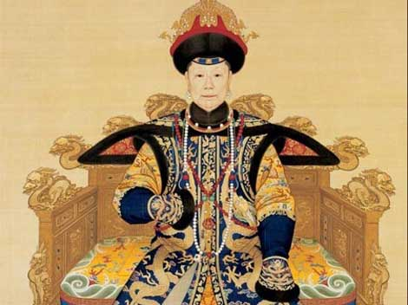
Qing
Upheld Confucian beliefs and social structures.
Kangxi (first ruler- 1661)- reduced government expenses and lowered taxes.
Scholar and patron of the arts
Enjoyed company of Jesuits at court.
Informed him on science, medicine, mathematics etc.

Slide 15
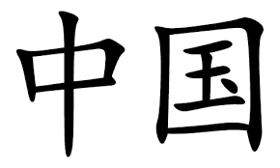
Zhongguo
Qian-long (emperor) 1736-1795- China reaches greatest size and prosperity!
China = Middle Kingdom
→ Why do you think China is called the “Middle Kingdom”?
If other countries want to trade with China, they must follow China’s rules!

Slide 16
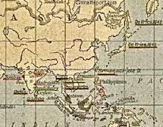
Isolation Continued- The Dutch
Dutch- Accepted China’s restrictions.
Accepted China’s restrictions.
Paid tribute
Learned rituals
Dutch returned home with porcelains and silk as well as a new trade item- tea.
By 1800- tea would make up 80% of shipments to Europe.

Slide 17
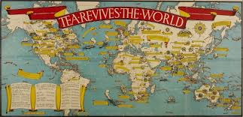
The British
Did not like China’s trade restrictions.
1793- delivered letter asking for better trade arrangements
Emperor declares to king- China is self-sufficient and does not need the British…

Slide 18
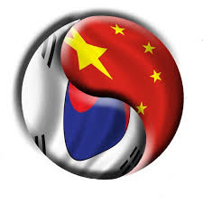
Korea
Manchus conquered Korea and made it a vassal state.
Korea lived in China’s shadow-
Adopted China’s Confucianism, technology, culture, and policy of isolationism.
With the arrival of the Qing dynasty relationship did not change but attitude did.
More Korean resistance against China.

Slide 19
Life in Ming and Qing China
1600s and 1700s- Life improved for most Chinese.
Population explosion occurred- what could account for this?
Female infanticide- what could account for this?
What do you think was the role of traditional Chinese women?

Slide 20
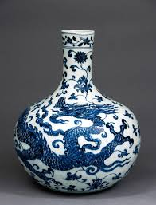
Cultural Developments in China
Dream of the Red Chamber was written. Very popular book.
Artists painting in traditional style- favored technique over creativity.
Porcelain
Drama

Slide 21
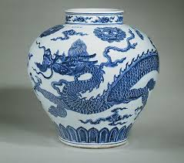
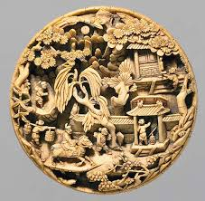
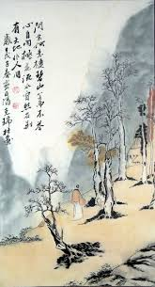
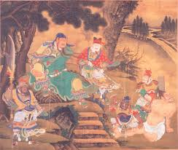
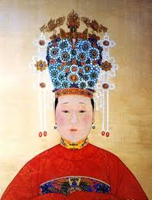
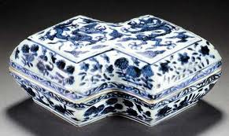
Ming Dynasty Art

Slide 22
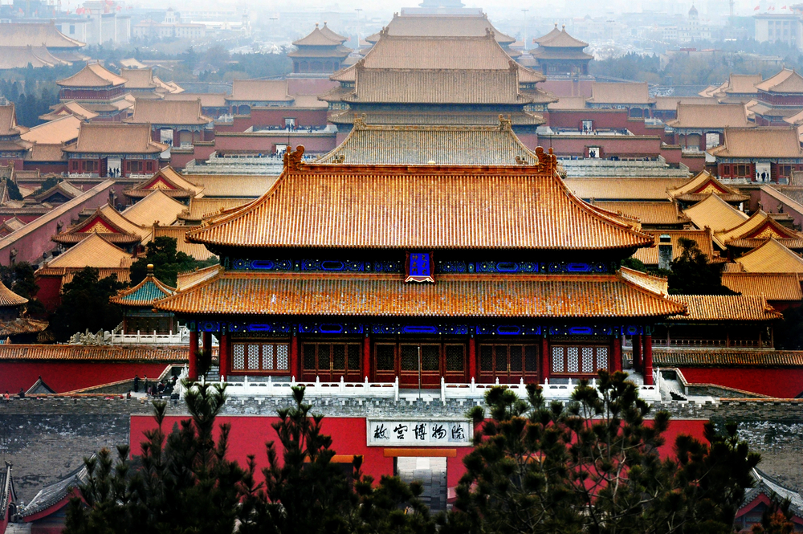
Forbidden City- Beijing

