Slide 1
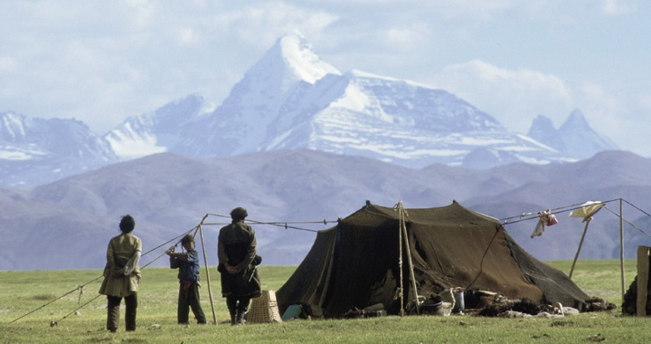
Chapter 18
Nomadic Empires and Eurasian Integration

Slide 2
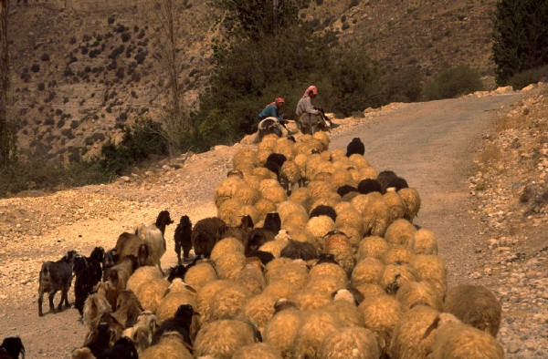
Nomadic Economy and Society
Rainfall in central Asia too little to support large-scale agriculture
Herded grazing animals, especially sheep, horses, but also cattle, goats, camels
  Move w/ animals in migratory cycle
  Eat meat, milk, and hides of animals
  Large tents called yurts
Small-scale farming, rudimentary artisanry

Slide 3
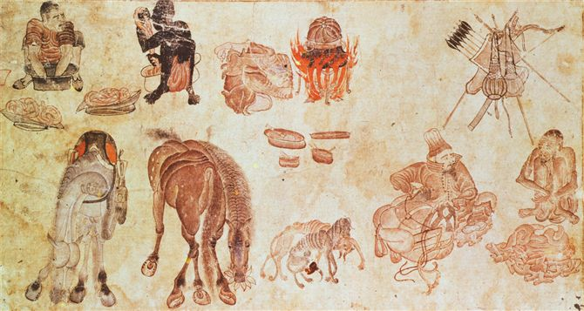
A painting from the late fourteenth century by the central Asian artist Mehmed Siyah Qalem suggests the physical hardships of nomadic life. In this scene from a nomadic camp, two men wash clothes (upper left), while another blows on a fire, and a companion tends to a saddle. Bows, arrows, and other weapons are readily available (top right)

Slide 4
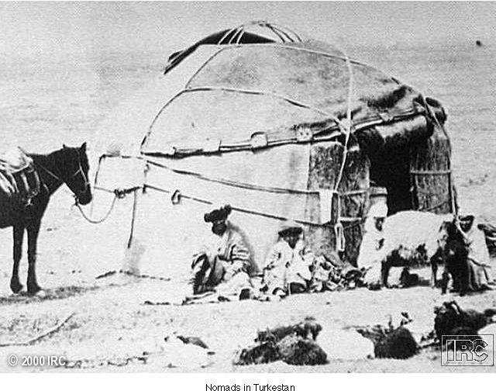
Nomads in Turkmenistan

Slide 5
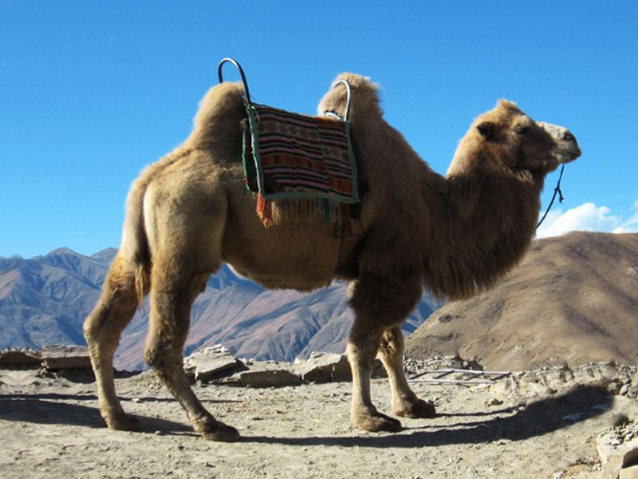
Nomadic Economy
Trade links between nomadic and settled peoples
Nomads engage in long-distance travel
  Caravan routes

Slide 6
Nomadic Society
Governance basically clan-based
Charismatic individuals become nobles, occasionally assert authority
Two classes:
  Nobles
  Commoners
Unusually fluid status for nobility
  Hereditary, but could be lost through incompetence
  Advancement based on merit

Slide 7
Nomadic Religion
Shamans center of pagan worship
Appeal of Buddhism, Nestorian Christianity, Manichaeism from 6th century CE
Turkish script developed, partially to record religious teachings
Conversion to Islam in 10th century due to Abbasid influence

Slide 8
Military Organization
Large confederations under a khan (ruler)
Authority extended through tribal elders
Exceptionally strong cavalries
  Mobility
  Speed
  Learned to ride as a child, superior equestrian skills
  Arrows flex w/ deadly accuracy

Slide 9
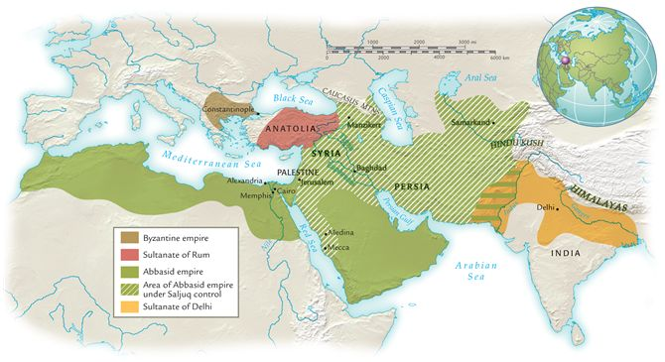
Turkish empires and their neighbors, ca. 1210 c.e
.After about 1000 c.e., nomadic Turkish peoples conquered and ruled settled agricultural societies in several regions of Eurasia and north Africa

Slide 10
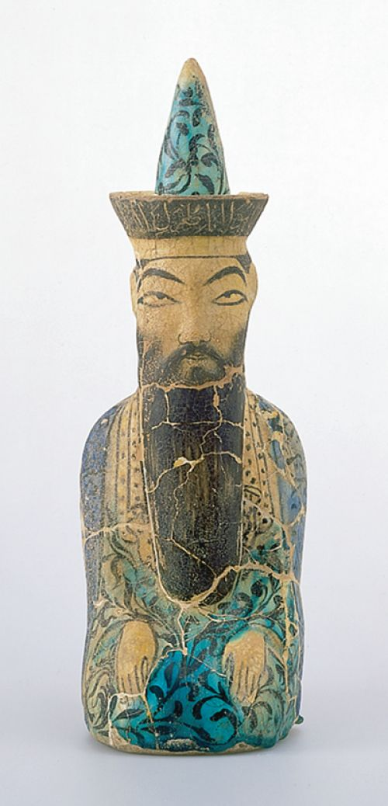
Saljuq Turks and the Abbasid Empire
8-10th centuries Turkish peoples on border of Abbasid empire
  Service in Abbasid armies
Eventually came to dominate Abbasid caliphs
1055 Saljuq leader Tughril Beg recognized as sultan or chieftain
Tughril consolidated his hold on Baghdad, then extended rule to other parts of the empire
Abbasid caliphs served as figure heads of authority
A carved statuette depicts a Turkish sultan of the thirteenth century, perhaps Tughril II or Tughril III, while at prayer.

Slide 11
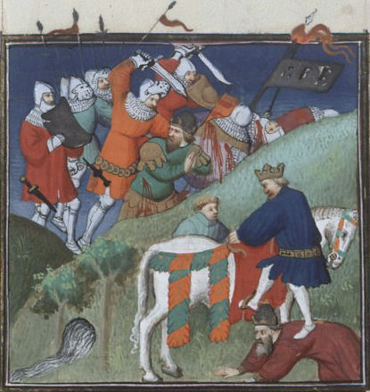
Saljuq Turks and the Byzantine Empire
1071 Saljuq Turks defeat Byzantine army at Manzikert, take emperor captive
Large-scale invasion of Anatolia
  Peasants felt liberated b/c displaced under Byzantines
Many conversions to Islam
  Gave political, social, economic opportunities
Ottoman Turks conquer Constantinople 1453

Slide 12
Ghaznavid Turks and the Sultanate of Delhi
Mahmud of Ghazni, Afghanistan, invades northern India
At first for plunder, later to rule
  Constant challenges from Hindu princes and other Turkish, Mongol invaders
Northern India completely dominated by 13th century
Encouraged Islam conversion
Persecution of Buddhists, Hindus
  Frequent raids on temples, monasteries, shrines
  Stripped Buddhist, Hindu establishments of wealth, destroyed their buildings, and slaughtered residents

Slide 13
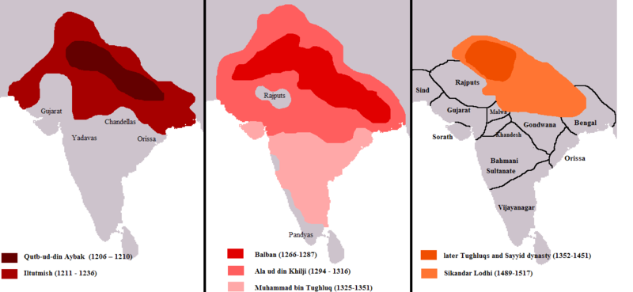

Slide 14
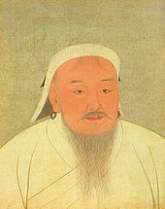
Chinggis Khan (1167-1227) and the Making of the Mongol Empire
Temüjin, b. 1167
Father prominent warrior, poisoned c. 1177, forced into poverty
Mastered steppe diplomacy, elimination of enemies
Brought all Mongol tribes into one confederation
1206 proclaimed Chinggis Khan: “Universal Ruler”
Unification sets in motion military campaigns, massive killing, and empire building
This painting by a Chinese artist depicts Chinggis Khan at about age sixty. Though most of his conquests were behind him, Chinggis Khan's focus and determination are readily apparent in this portrait.

Slide 15
“In a flash, the Mongol warriors would defeat every army, capture every fort, and bring down walls of every city they encountered. Christians, Muslims, Buddhists, and Hindus would soon kneel before the dusty boots of illiterate young Mongol horseman.”

Slide 16
Explaining the Mongol Moment
Reorganization of army
  Units of 10,100, 1,000, 10,000
  Conquered tribes broken up and members scattered in new units
Impressive discipline and loyalty
  One or 2 desert, they all subject to death penalty
Incorporate huge #s of conquered people into their military
  Artisans, craftsmen identified and sent to serve
  Chinese introduced them technology of siege warfare

Slide 17
Explaining the Mongol Moment
Brutality and destruction as psychological warfare
  Cities destroyed
  Soldiers executed
  Women and skilled craftsmen enslaved
  Unskilled civilians used as human shields or as human fill in moats
Ability to mobilize human and material resources in growing empire
  Effective system of relay stations fostered trade
  Marco Polo claimed they maintained 10,000 stations and 200,000 horses
  Central capital: Karakorum
Religious toleration
  Buddhists, Daoists, Christians, Muslims

Slide 18
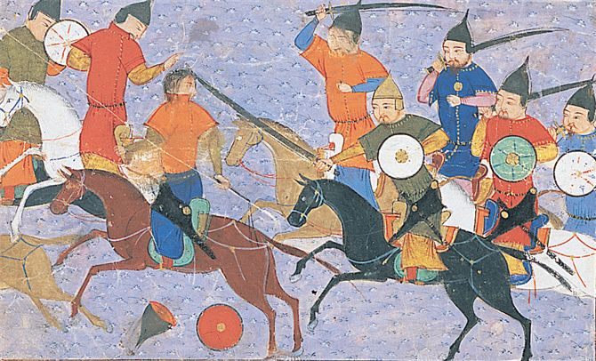
A Persian manuscript illustration depicts Chinggis Khan and his cavalry in hot pursuit of retreating forces. On his road to power, Chinggis Khan depended not only on military might but also on strategic alliances with tribes and new political structures organized around loyalty and talent rather than tribal or kinship ties.

Slide 19
Mongol Arms
Mongol population only 1 million (less than 1% of Chinese population)
  Army c. 100-125,000
Strengths:
  Cavalry (travel 100 km or 62 miles per day)
  Short bows (200 meters or 656’)
  Rewarded enemies who surrender, cruel to enemies who fight (slaughter whole populations)

Slide 20
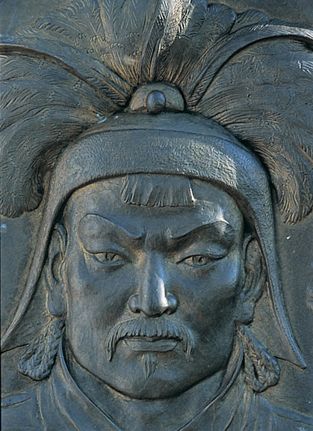
Mongol Conquests
Conquest of China
Most difficult, lasting 70 years

Slide 21
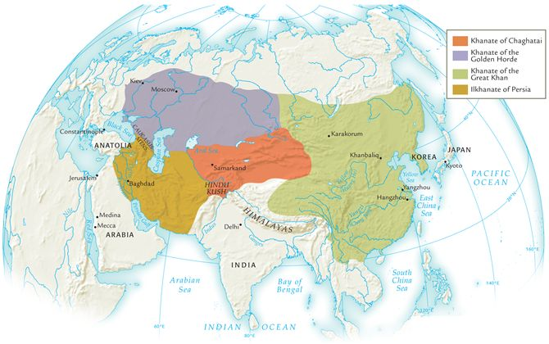
The Mongol Empires about 1300 CE

Slide 22
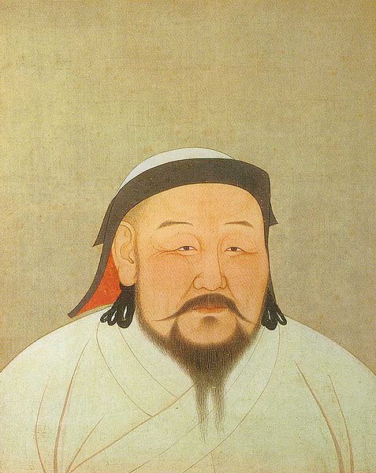
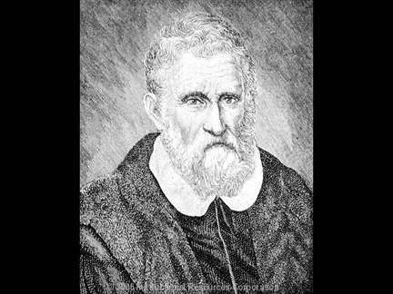
Khubilai Khan (r. 1264-1294)
Grandson of Chinggis Khan
Rule of China
Ruthless warrior, but religiously tolerant
  Hosted Marco Polo
  Promoted Buddhism, Support for Daoism, Christianity, Muslims
Established Yuan dynasty (to 1368)
Two attempted invasions of Japan (1274, 1281) turned back by typhoons (kamikaze: “divine winds”)
  Didn’t adapt to the humid, tropical jungles
  4,500 Mongol vessels destroyed carrying 100,000 armed troops

Slide 23
Mongol Rule in China
Strove to maintain strict separation from Chinese
  Intermarriage forbidden
  Chinese forbidden to study Mongol language
Imported foreigners to administrate empire
  (esp. Arabs, Persians, Marco Polo?)
Ended privileges enjoyed by Confucian scholars, dismantled education and examination system
Yet tolerated religious freedoms

Slide 24
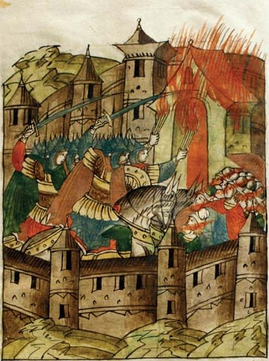
The Golden Horde
Conquest of Russia, 1237-1241
City after city fell
  Many laborers, craftsmen, deported or sold into slavery
Didn’t occupy Russia!!
  Maintained army on the steppes north of Black Sea as prime pastureland
  Exploit it
Established tributary relationship to 15th century
  Princes of Moscow took advantage of rule b/c they collected tribute for Mongols
  Use it to grow wealthy
Impact on Russia
  Russian princes adopt Mongol weapons, diplomatic rituals, taxation, military draft
Mongol policies helped Moscow gain power
Russia breaks their hold in the 15th century
This sixteenth-century painting depicts the Mongol burning of the Russian city of Ryazan in 1237. Similar destruction awaited many Russian towns that resisted the invaders. (Sovfoto/Eastfoto)

Slide 25
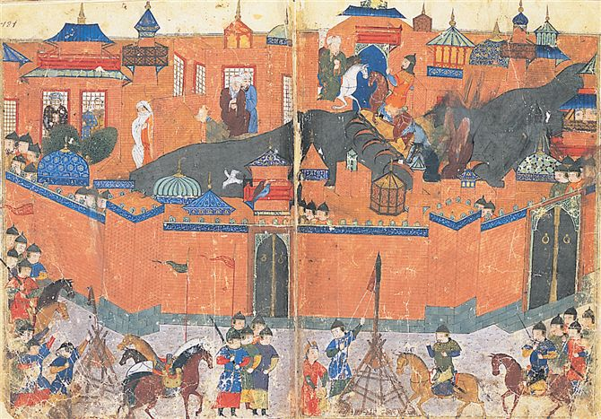
The Ilkhanate of Persia
Toppled Abbasid empire
  Executed the caliph
Baghdad sacked, 1258
  200,000 massacred
Irrigation canals and agricultural land reduced to waste
Mongol rule “a disaster on a grand and unparalleled scale”
The siege of Baghdad in 1258 c.e.: a Persian manuscript illustration depicts Mongol forces camped outside the city walls while residents huddle within. What role did catapults play in sieges like this?

Slide 26
Mongol Rule in Persia
Lasts until 1330’s
Mongols transformed in Persia
Used the Persian bureaucracy
Made efforts to rebuild cities, repair irrigation
Assimilate into Persian society
  Convert to Islam
  Abandon nomadic ways
  Marry locals

Slide 27
The Mongols and Western Integration
Mongol rulers positively encouraged travel and communication over long distances
  Maintained courier network used for news, info, gov’t orders
Long-distance trade
Diplomatic missions protected
  From ranks of conquered people, came soldiers, bodyguards, administrators, metalsmiths, miners, translators, physicians etc.
  Khans maintained close communications this way
Missionary activity increases
  Ex. Sufi missionaries spread Islam to Turkish peoples
Mongol resettlement policies
  B/c lacked skilled artisans & educated individuals, they moved people far to the sites where they could make use of their services

Slide 28
Long-distance Trade
Experience with long-distance trade
  Protection of traveling merchants
    Ex. Marco Polo, Ibn Battuta
  Volume of trade across central Asia dwarfed earlier eras
  Movement of products, merchants, diplomats,
    Encountered new languages, laws, customs
      Ex. New styles and huge quantities of silk, porcelain
      The “paisa” was a card or sign that gave permission to travel through region
        Became ancestor to modern passports for Europe

Slide 29
Decline of the Mongol Empire in Persia
Overspending, poor tax returns from overburdened peasantry
Ilkhan attempts to replace precious metal currency with paper in 1290s
  Trying to drive the metal currency to gov’t
  Failure, forced to rescind
Factional fighting
Last Ilkhan dies without heir in 1335, Mongol rule collapses

Slide 30

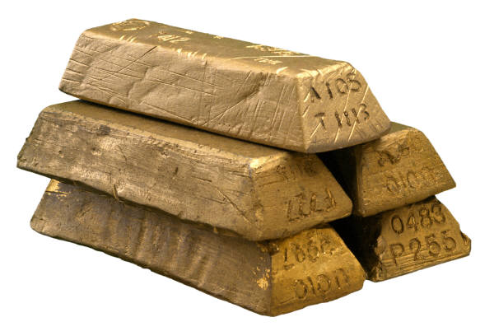
Decline of the Yuan Dynasty in China
Mongols spend bullion that supported paper currency
Public loses confidence in paper money, prices rise
From 1320s, major power struggles
  Imperial assassinations, civil war
Bubonic plague spreads 1330-1340s
  Depopulation, labor shortages weaken Mongol regime
1368 Mongols flee peasant rebellion

Slide 31
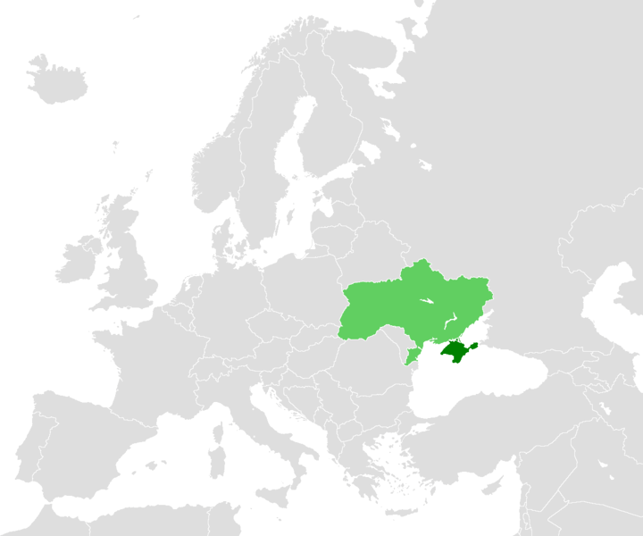
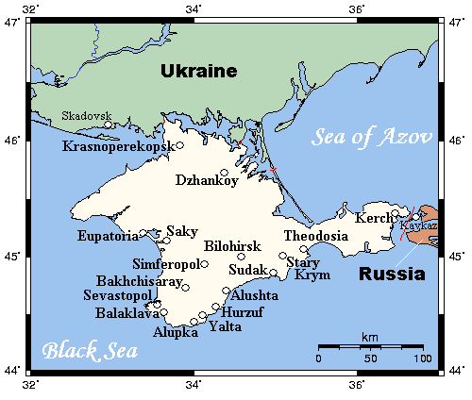
Surviving Mongol Khanates
Khanate of Chaghatai in central Asia
  Continued threat to China until 18th c.
Golden Horde in Caucasus and steppes n. of Black Sea until mid-16th century
  Continued threat to Russia until 18th c.
  Mongols in the Crimean Peninsula retained identity until Josef Stalin forces them to other parts of Soviet Union
Dark Green=
Crimean Peninsula

Slide 32
After the Mongols
Turkish people resume the expansive campaigns
Tamerlane built a central Asian empire to rival Genghis Khans

Slide 33
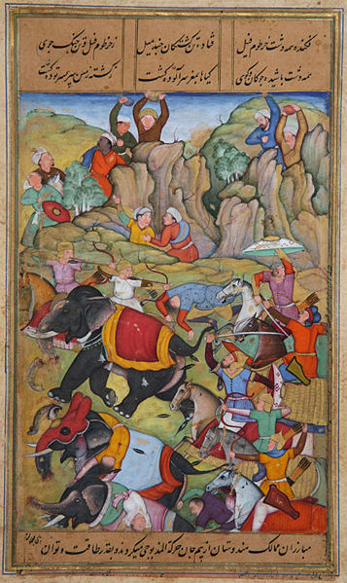
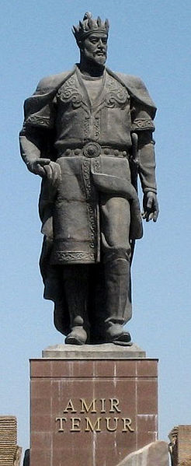
Tamerlane the Conquerer (c. 1336-1405)
Turkish conqueror Timur
  Timur the Lame: Tamerlane
United Turkish nomads in Khanate of Chaghatai
Major military campaigns
  Built capital in Samarkand
  Conquered Persia, Afghanistan, Golden Horde, India
Died before he conquered China
Great conqueror but not ruler
Ruled through tribal leaders who were allies

Slide 34
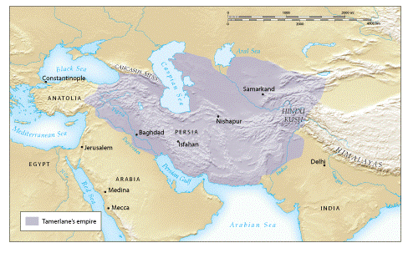
Tamerlane’s Empire about 1405 CE

Slide 35
Tamerlane’s Heirs
Poor organization of governing structure
Power struggles divide empire into four
Yet heavily influenced several empires:
  Mughal
  Safavid
  Ottoman

Slide 36
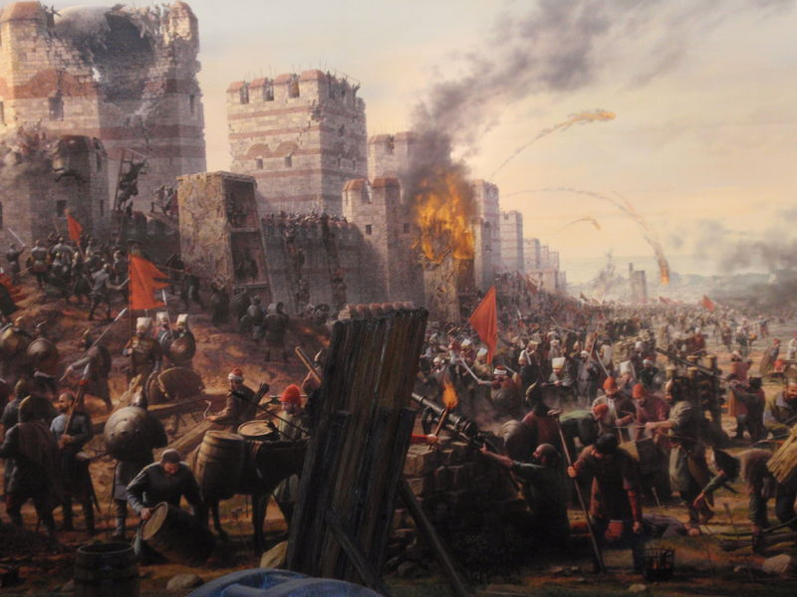
The Ottoman Empire
Osman, charismatic leader who dominates part of Anatolia
Declares independence from Saljuq sultan, 1299
Attacks Byzantine empire 1453
  Mehmed II captures Constantinople
  Followers known as Osmanlis (Ottomans)
Fall of Constantinople

Slide 37
Ottoman Conquests
1350s conquests in the Balkans
Local support for Ottoman invasion
  Peasants unhappy with fragmented, ineffective Byzantine rule
Tamerlane defeats Ottoman forces in 1402, but Ottomans recover by 1440s

Slide 38
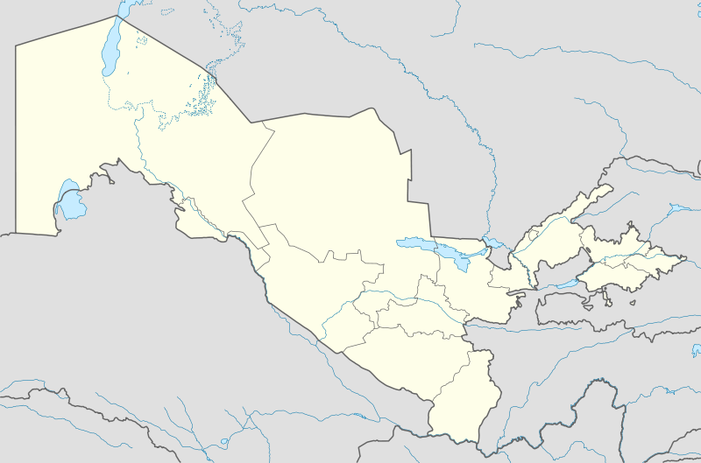
Samarkand, Modern Day Uzbekistan

Slide 39
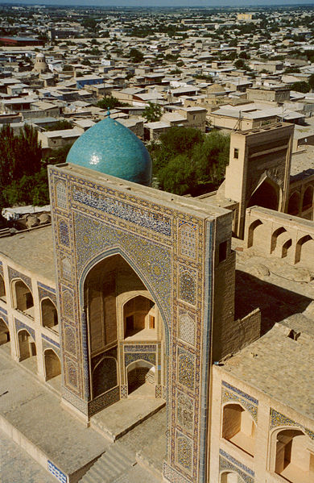

Slide 40
The Capture of Constantinople, 1453
Sultan Mehmed II (“Mehmed the Conqueror”)
Renamed city Istanbul, capital of Ottoman empire

