Slide 1
Napoleon

Slide 2
Standard 6
SS.HS-6: The student will demonstrate an understanding of the creation of nation-states in Europe and the struggle by non-European nations to gain and/or maintain sovereignty.
SS.HS- 6.2: Analyze the reasons for independence movements as exemplified by the French and Haitian revolutions and eighteenth century South American rebellions.

Slide 3
Napoleon- Questions to Consider
Did Napoleon do more to preserve the legacy of the French Revolution or to destroy it?
Although Napoleon assumed dictatorial powers, he became First Consul as well as Emperor with the enthusiasm and approval of the French people. Should this affect how we judge him in the role of "tyrant"?
Must we assume that all conquerors throughout history are villains? When, if ever, can a conqueror be hero?
Did Napoleon conquer others for a higher purpose, or only for his own glory?
Should a leader's personal and romantic life be factored into the assessment of hero or tyrant, and if so why or why not?
https://www.youtube.com/watch?v=t05O-iVx2R8

Slide 4
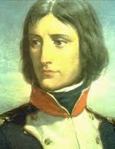
Napoleon Bonaparte
Born: Mediterranean Island of Corsica in 1769
Education: Sent to a military school at the age of 9
Military: Became a lieutenant in the military in 1785 at age 16
Napoleon joined the army of the new government when revolution broke out.
Height: 5’2-5’6 (5’2 according to the internet, 5’3 according to your textbook, 5’6 according to a video).
What does it mean to have a “Napoleon Complex?”

Slide 5
Hero of the Hour
1795- Napoleon saves the republic from counter-revolutionary forces in France. Became the “hero of the hour”.
1796- The Directory (government that took over after Robespierre’s execution) appointed Napoleon to lead army against Austria and Italy where he was very successful
Napoleon also invaded Egypt (why?) but was less successful.

Slide 6
Coup d'état (Blow to the State)
1799- Napoleon stages a coup d'état against the Directory once he returned from Egypt.
The directory is replaced with three consuls (one is Napoleon).
Napoleon took the title of First Consul and soon became dictator.
By 1802 (as a result of war and diplomacy) Europe was once again at peace.

Slide 7
Question
Why did the people of France allow Napoleon to rise as dictator?
What reasons can you find to explain this and how does this contradict the early ideals of the revolution in France?

Slide 8
Napoleon as Dictator
Did not try to return to the days of Louis XVI
Economy- created efficient method of tax collection and a national banking system.
Attempted to limit corruption in government and began government-run public schools (lycees).
Concordat (agreement) with the church- why?
Napoleonic Code- limited individual rights, restored slavery in FWI etc.

Slide 9
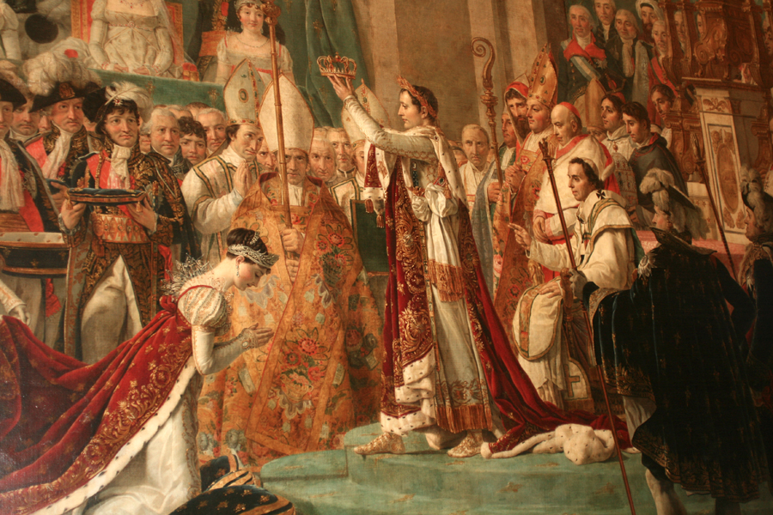
Emperor Napoleon
December 2nd, 1804- Napoleon crowns himself emperor- what is the significance of this?

Slide 10
Revolution in Haiti
Revolutionary ideas spread to Saint Domingue (Haiti)
Slave rebellion erupts and the French are driven out of Haiti.
Napoleon decides to cut his losses in the Americas
Sells Louisiana Territory to the United States for 15 million dollars (3 cents an acre!- 233 million today)
Why would Napoleon do this?

Slide 11
Napoleon sets to conquer Europe
Annexed the Austrian Netherlands and parts of Italy
Set up a puppet government in Switzerland

Slide 12
War in Europe
Fearful of his ambition, Great Britain, Russia, Austria, and Sweden joined together against France.
Napoleon, a brilliant military strategist, crushed the opposition. – Russia, Prussia and Austria sign peace treaties with France.
Napoleon now has largest European empire since Rome!
GB remains France’s #1 enemy.

Slide 13
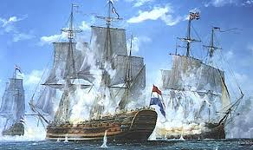
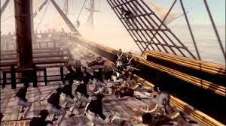
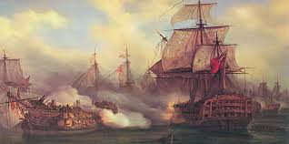
The Battle of Trafalgar
Important naval battle against the British- France loses and much of its navy is captured.
What is the legacy?
Cements British as being the dominant naval power for the next 100 years
Causes Napoleon to abandon his hopes of taking Britain.

Slide 14
The French Empire
By 1812 most of Europe was under French control (Britain, Portugal, Sweden and the Ottoman Empire excluded).
Napoleon would appoint family members as rulers of conquered countries as puppet governments.
By 1812 the empire was too big and therefore unstable
Have we seen this pattern with any other empires we have studied?

Slide 15
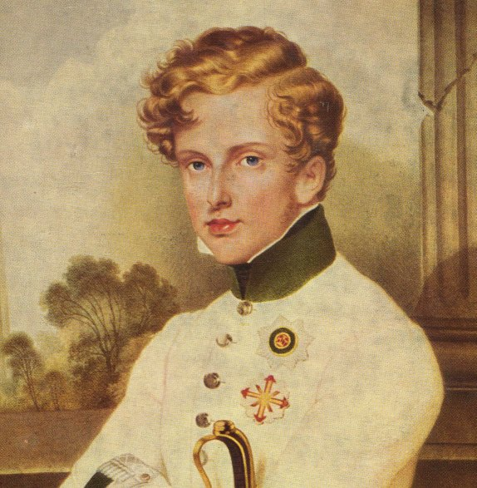
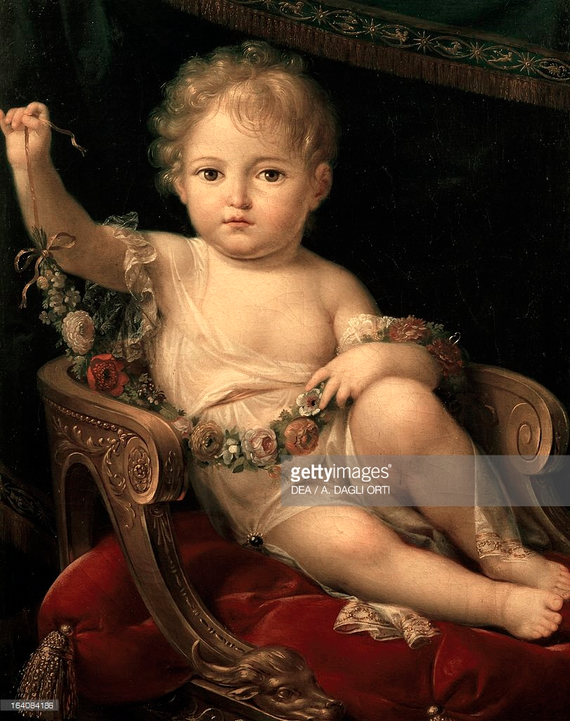
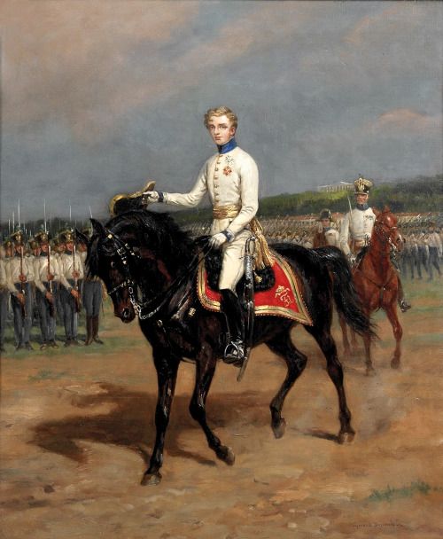
The Empire Collapses
Napoleon wanted an heir. Divorced his wife, married the grandniece of Marie Antoinette and had a son in 1811 (Napoleon II) whom he named King of Rome.

Slide 16
Three Strikes, You’re Out
Napoleon made three large mistakes causing the collapse of his Empire.
The Continental System (1806)- blocking all ports from Great Britain in an attempt to hurt their economy. The plan backfired.
The Peninsular War (1808)- Napoleon sent an invasion force through Spain. This angered the Spanish and Napoleon responded by putting his own brother on the throne in Spain. This caused Spain and other countries (Germans, Italians) to also turn against France.
The Invasion of Russia (1812)- Napoleon invades Russia (distrust between them) Russians retreated and implemented scorched-earth policy. As the French army turned back to France, tens of thousands died of cold, hunger and exhaustion. The army dwindled to only 10,000 troops.

Slide 17
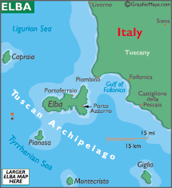
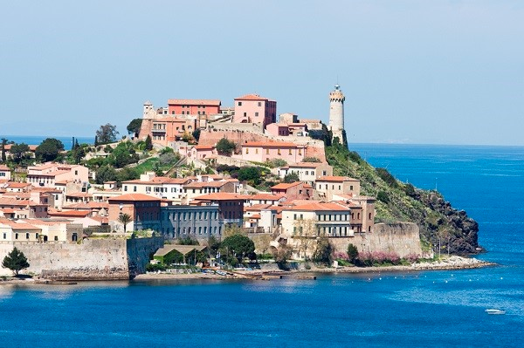
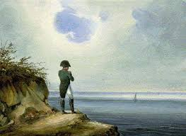
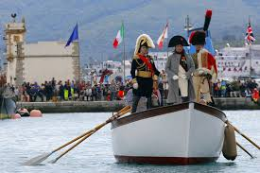
The End of Napo
With a much diminished army, the European powers allied against France.
1814- Allies invaded Paris and were victorious.
April 1814- Napoleon agreed to surrender and gave up the throne.
Napoleon is exiled to Elba island

Slide 18
Napoleon Returns!
After Napoleon’s exile, France returned to monarchy with Louis XVIII in power.
The French began to be unhappy under Louis and Napoleon escaped from Elba and returned to France.
Large crowds welcomed Napoleon and he reclaimed his throne to once again be Emperor of France.

Slide 19
The Hundred Days
The Allies once again rose in opposition to Napoleon.
Prepared for battle near Waterloo in Belgium.
The British and Prussians defeated Napoleon and his hundred days came to an end.
Napoleon is this time exiled to St. Helena
Napoleon dies six years later while still in exile.
“Napoleon’s defeat opened the door for the freed European countries to establish a new order”

Slide 20
Homework Assignment
Your homework assignment is to write an obituary for Napoleon Bonaparte.
You should write the obituary from the perspective of one of the following people (next slide).
This assignment should be typed and styled in a newspaper format and be a minimum of 300 words and a maximum of 500.
Please be sure your obituary is based in fact AND CITED.

Slide 21
Choices for Obituary
An aristocratic lady who fled France during the Revolution after several relatives were guillotined.
A worker in Paris who was among those who stormed the Bastille in 1789.
A soldier who fought with Napoleon at the Battle of Austerlitz in 1805.
A French mother who lost two sons in the Retreat from Moscow in 1812 and who lives in a village with families still grieving for other young men who died during the many years of warfare under Napoleon's rule.
A bureaucrat in the National Bank (created by Napoleon) who would not formerly have merited a government position under the Ancien Regime.
A recipient of the Legion of Honor, established in 1802 by Napoleon.
A priest whose church was desecrated during the French Revolution.
A French Jew who, thanks to the Revolution and Napoleon's enlightened policies, is now a citizen.

