Slide 1
Nationalism
Latin American Peoples Win Independence

Slide 2
What is going on in Latin America?
Who is in charge?
Who owns which area?
What is life like for the people living there?

Slide 3
Social Structure
Peninsulares- people born in Spain, now living in L.A
Creoles- Spaniards born in Latin America
Mestizos- European and Native American ancestry
Mulattos- European and African Ancestry
The Peninsulares and the Creoles controlled land, wealth and power.

Slide 4
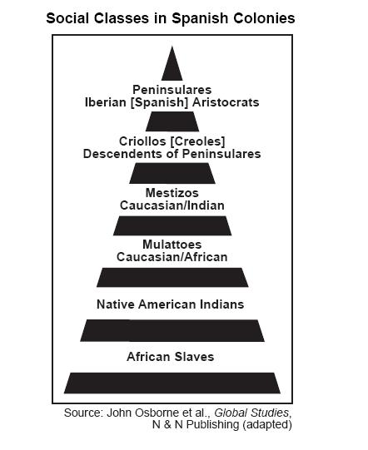

Slide 5
Independence
Which country in L.A has already fought for and won their independence?

Slide 6
Latin American Revolutions
Napoleon removed King Ferdinand VII from the Spanish throne. What did he do after this?
Joseph- many creoles felt no allegiance to Joseph.
Remember- John Locke “consent of the governed”? How did these enlightenment ideas have an impact on those in Latin America.
1810- Rebellion broke out in parts of Latin America

Slide 7
Simon Bolivar and Jose de San Martin
Bolivar- wealthy Venezuelan creole
Jose- Argentinian
1811- Venezuela declares independence
1821- With the help of Bolivar, Venezuela wins independence
Bolivar marches into Ecuador where he meets Jose de San Martin.
Together they decide the future of the L.A revolutionary movement.

Slide 8
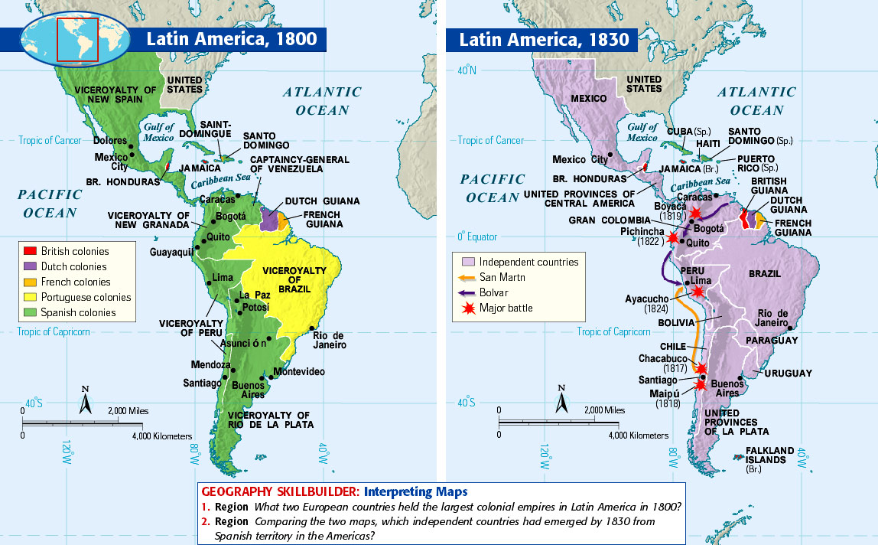

Slide 9
Jose de San Martin
1816- Argentina declares independence- from which country?
Spanish forces in Peru and Chile are still a threat
In 1817 Chine is also freed
Martin and Bolivar meet in Ecucador in 1822- Bolivar becomes the commander of not only his, but also Martin’s army.
Bolivar’s army wins against the Spanish
Venezuela, Colombia, Panama and Ecucador were united into a country called Grand Colombia

Slide 10
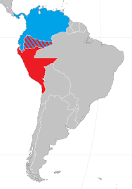
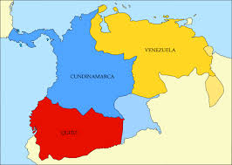
Grand Colombia

Slide 11
Revolution in Mexico
Mexico- Ethnic and racial groups mixed more freely than in South America
Indians and Mestizos played a leading role
Miguel Hidalgo- Believed in enlightenment ideals and took a leading role in independence.
1810- He and followers began a march towards Mexico City.
The army soon had 80,000 men!
Spanish army and creoles became worried- why?
The Spanish army defeated Hidalgo in 1811
Others followed- Jose Morelos, Iturbide etc. with power going back and forth for years.

Slide 12
Mexican Independence
1820- Revolution in Spain broke out!
Creoles feared the loss of their privileges- how can they preemptively try to stop this from happening?
United in support of Mexico’s Independence.
Iturbide declares Mexican Independence in 1821.
1821- Central American states began to declare their independence as well (From Spain AND from Mexico)
United Provinces of Central America (Nicaragua, Guatemala, Honduras, El Salvador, and Costa Rica).

Slide 13
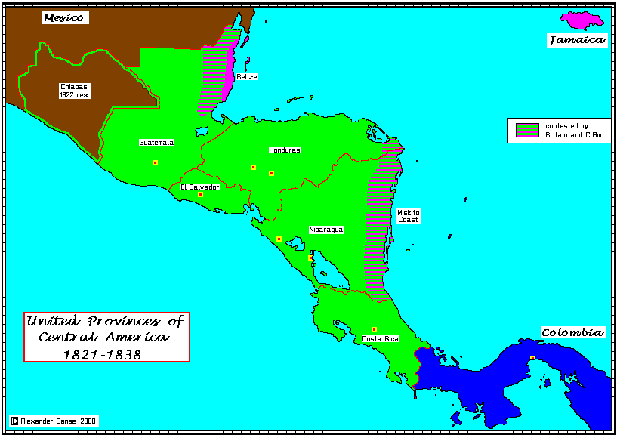

Slide 14
Brazil!
Brazil at this time is part of which European empire?
Occurred without violence and bloodshed.
Portugal’s royal family played a part in their independence
Royal family moved to Brazil as Napoleon invaded the Iberian Peninsula
Rio de Janiero became the capital of the empire (14 years)
After Napoleon, the royal family moved back to Portugal- son Dom Pedro- stayed behind.
Brazil did not want to return to colonial status
1822- Creoles demanded independence
Dom Pedro rules Brazil as an independent nation

