Slide 1
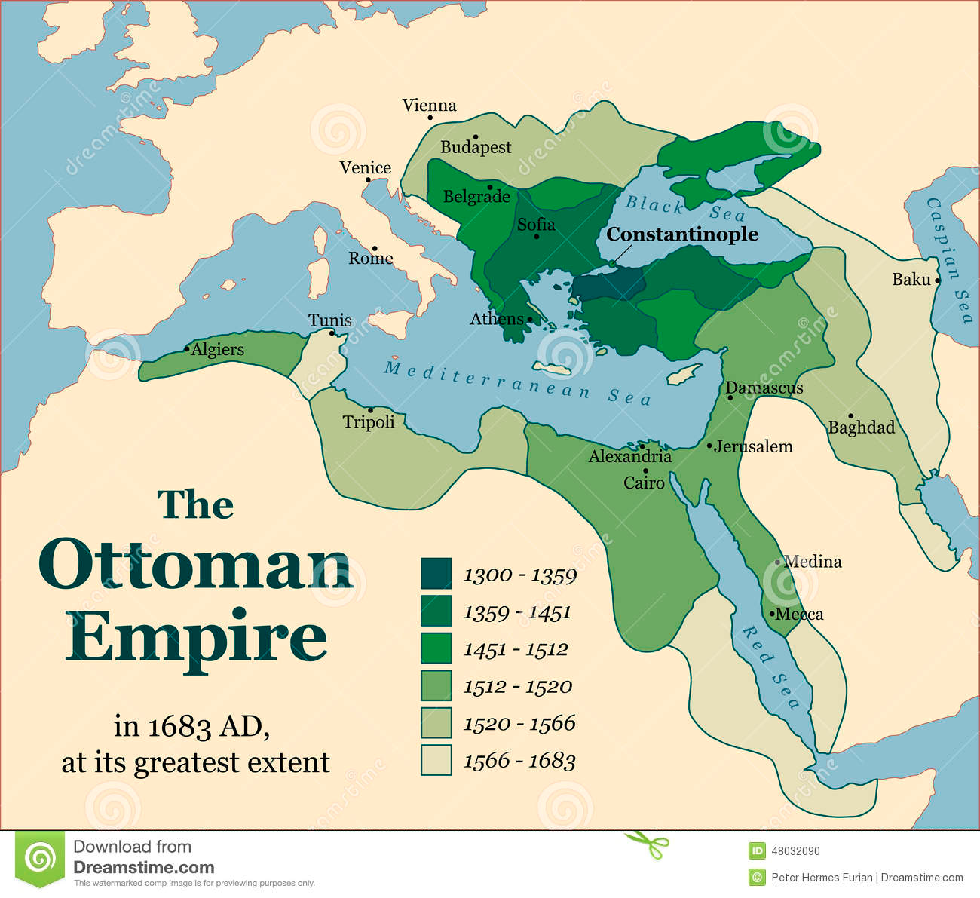
Part I- The Ottomans
What do we know about the Ottomans?

Slide 2
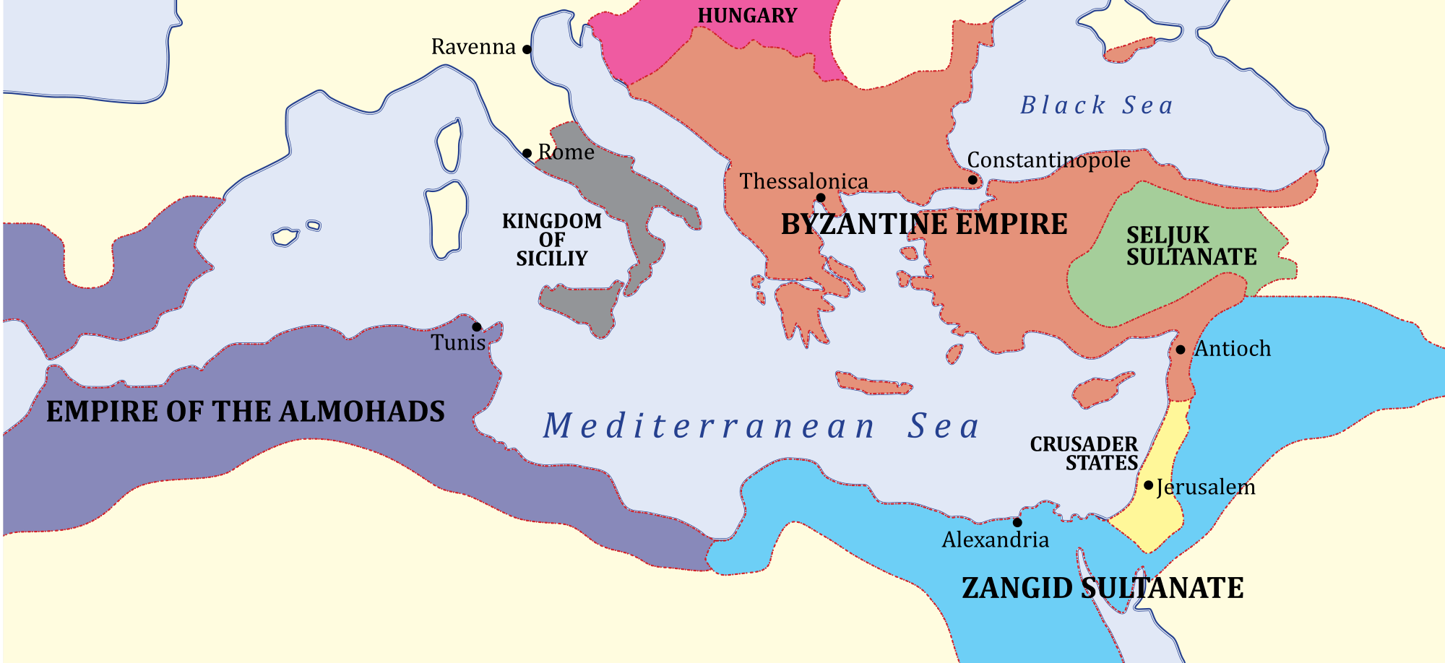
Let’s back it up…
What do we know about the Byzantine Empire? How did it begin? Why is it ending?

Slide 3
Map Time
You have 15 minutes to complete a map.
Use your phone, or book etc. in order to complete this.
Please make sure you have covered everywhere on your list.
Coloring always helps!

Slide 4
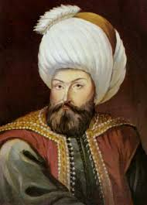
Osman
Osman is the most successful leader. His followers are called Ottomans.
Built a Muslim state in modern-day Turkey between 1300-1326.
Success due to gunpowder and cannons to break through city walls.
Osman’s son- Orkhan- becomes sultan (one with power) and now new Turkish empire is beginning.

Slide 5
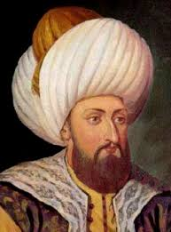
Expansion
Mehmed I and son Murad II expand the empire.
Defeated the Venetians!
Invaded Hungary!
Defeated the Italians in the Balkans!
Mehmed II
Sacks Constantinople! (What is this, again?) (1453)
Opened Constantinople to new citizens of many religions and backgrounds (Jews, Christians, Muslims, Turks, Non-Turks)
We shall call this Istanbul!

Slide 6
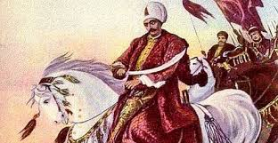
More Ottoman Expansion!
Selim the Grim – 1512
Defeated the Safavids! (Persia)
Conquered Syria and Palestine
Captured Mecca and Medina
Moved into North Africa and conquered Egypt!

Slide 7
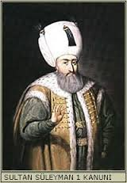
Suleyman the Lawgiver (1520) (Loving the names yet?)
Selim the Grim’s son
Ottomans reach their peak size
Conquered Belgrade
Captured and dominated the entire Mediterranean!
Hungary and Austria
Became the most powerful monarch on earth.

Slide 8
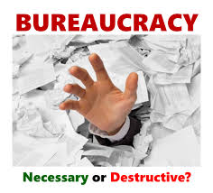
Structured Social Organization
Suleyman- Created law code
Which types of laws do you think were necessary?
Simplified system of taxation and reduced government bureaucracy.
What does this mean?

Slide 9
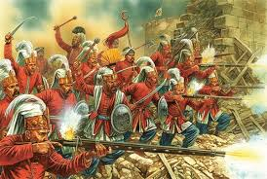
Janissaries
Devshirme system- process of drafting boys from the peoples of conquered Christian territories
Why would this be beneficial?
Educate them, convert to Islam and train them as soldiers.
Janissaries- soldiers trained to be loyal to the sultan only.
Do we have anything like this today?

Slide 10
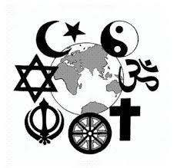
Islamic Law states that…
Freedom of worship to other religious communities must be allowed (Jews and Christians).
Communities are known as millets (nations) and are allowed to follow their own laws and practices.
System kept conflict among people of various religions to a minimum.

Slide 11
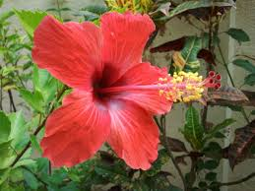
Cultural Flowering
Reign of Suleyman = Ottoman Renaissance
Poetry, art, history, geography, mathematics, astronomy etc.
Looked to Persia and Arabia as models in art and poetry.
Sinan’s Mosque of Suleyman

Slide 12
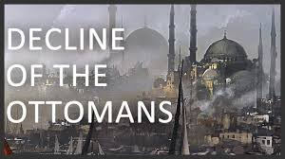
Decline of the Empire
Three sons- killed one, drove one into exile, left the throne to third one who was incompetent.
Why would he kill and drive off sons? Why do some sultans kill their own brothers or keep their sons prisoners in harems?
Causes weak line of sultans who bring ruin to the empire.
Ottoman Empire remains into the 20th century but with more limited power and influence.

Slide 13
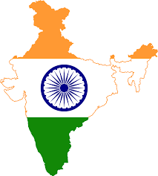
Part II- The Mughals- Bell Work
What do we know about India?
Bell Work→
You have 5 minutes to write down everything you know about India.
Your journal may be listed today.

Slide 14
Mughals- Bell Work Day #2
From what we have studied so far this year (or other examples you know)…
Write down as many examples as you can think of in which religion has been the cause of an empire’s end or the creation of a new one.
What religion/s were involved? What was the result?
***Example: Rome and the Great Schism

Slide 15
Today: What you need to know
MWH- 4.5- Analyze the factors that contributed to the collapse of the Mughal Empire in India, including the role of religious intolerance.
How did the Mughal Empire begin?
What themes of cultural blending can we see?
Why and how did the Mughal Empire end?

Slide 16
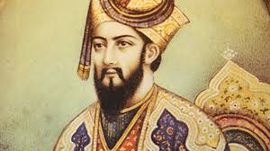
Turks Invade
Sultan Mahmud and Turks invade the empire. (1000ish)
Delhi Sultanate forms- treated Hindus as conquered people
Delhi in despair until Babur!

Slide 17
Babur
Inherited a kingdom in what is now Uzbekistan and Tajikistan.
Brilliant general! - Swept down to India and laid foundation for Mughal Empire in 1526
Babur’s grandson- Akbar (meaning “greatest one”)
Ruled India with wisdom and tolerance from 1556-1605.
“ A monarch should ever be intent on conquest, otherwise his neighbors rise in arms against him.”
Unifies land of 100 million (more than amount in all of Europe combined!)

Slide 18
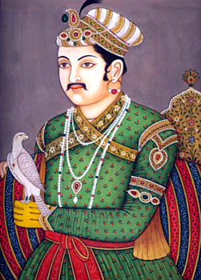
Akbar’s Rule
Was Muslim but defended religious freedom
Married two Hindus, a Christian and a Muslim.
Abolished tax on non-Muslims
Anyone could rise to high office! Ability not religion
Implemented tax system like the U.S graduated income tax. – brought money to the empire.
After his death the empire declined- end of religious toleration

Slide 19
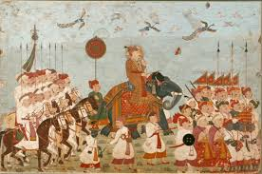
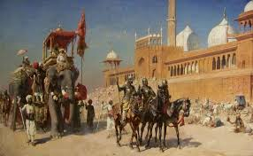
More Cultural Flowering
Expansion of Mughal Empire=more cultural influence from other regions.
Affected art, education, politics and language.
Persian in the language of the court and high culture.
Common people spoke Hindi (Persian+ local language)
Mughal armies spoke Urdu (official language of Pakistan today)

Slide 20
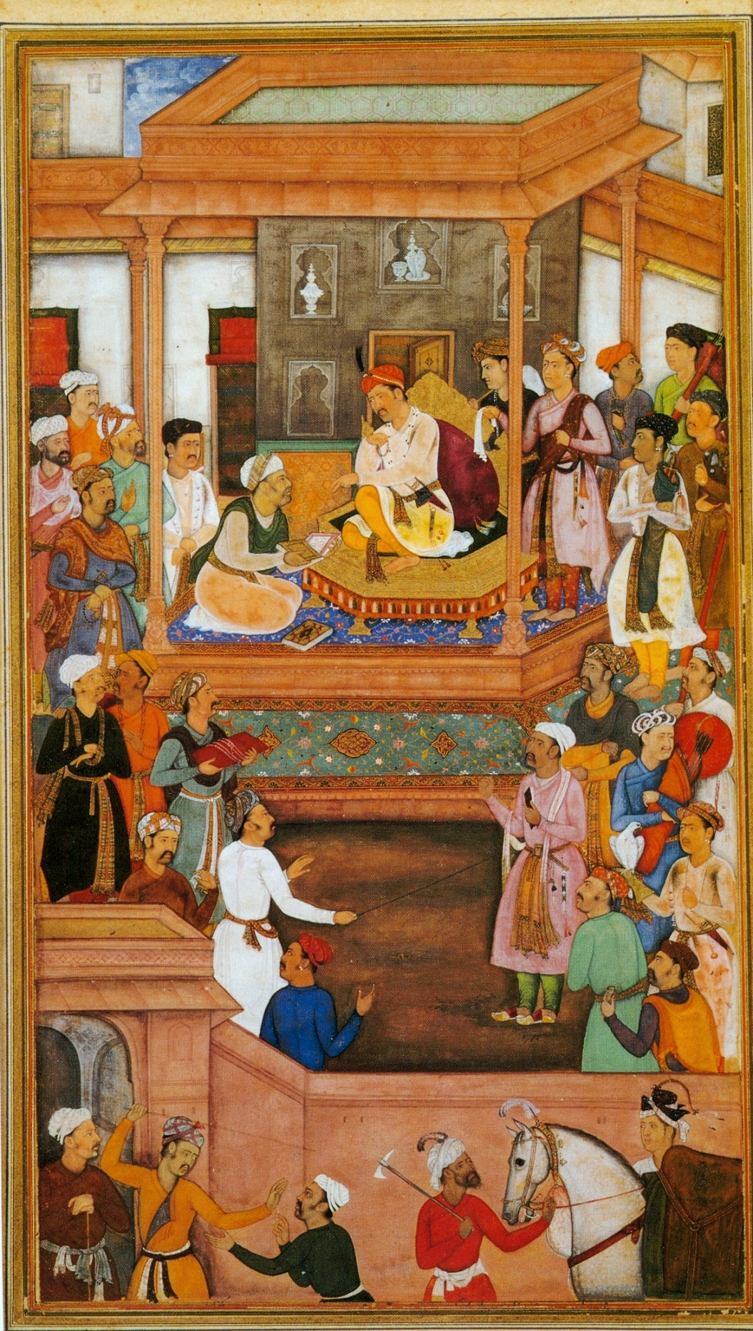
Mughal Art and Literature
“Miniatures” brought from the Safavid Empire.
Book of Akbar
Indian art also drew from Western traditions.
Revival of Hindu literature
Ramayana- epic love story of Rama and Sita

Slide 21
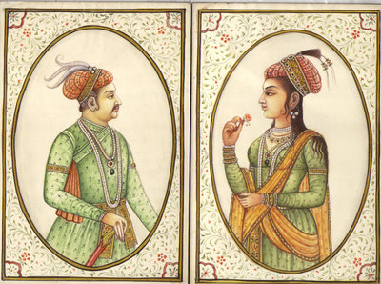
Akbar’s Successors
Akbar’s death- 1605
Jahangir and Nur Jahan
Jahangir (“Grasper of the World”)- his wife, Nur, mostly ran the empire.
Nur Jahan- Persian Princess- understood the use of power.
Khusrau- Jahangir and Nur’s son
Rebelled against his rather.
Cause long and bitter conflict.

Slide 22
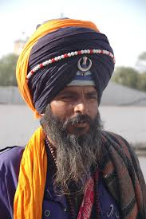
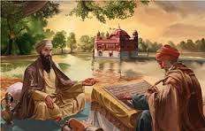
Religious Conflict
Jahangir- tried to promote Islam in the Mughal state but was somewhat tolerant of other religions.
Khusrau rebelled and turned to Sikhs
Sikhs- blend of Buddhism, Hinduism, and Sufism
Sikhs become target of Mughal’s hatred.

Slide 23
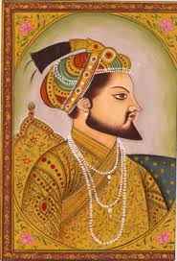
Shah Jahan
Jahangir’s successor
Assassinated all possible rivals to the throne
Two obsessions- wife (Mumtaz)and beautiful buildings
Mumtaz dies at 39 during childbirth (of 14th child!)
Shah Jahan orders a temple built for her
Taj Mahal

Slide 24
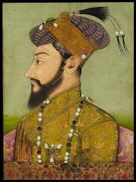
After Shah
Beautiful buildings built but not good for the people…
Raised taxes to support the buildings, wars and the ruler’s extravagant living.
Shah Jahan becomes ill in 1657- four sons want the throne!
Son #3 (Aurangseb) kills oldest brother and arrests father!
Rules from 1658-1707
Expands empire to its largest size
Empire weakens during his reign

Slide 25
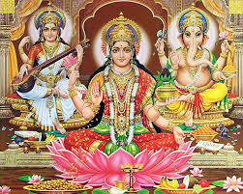
Weakening Empire
Oppressed his people
Enforced Islamic laws
Outlawed drinking, gambling and other activities
Appointed censors to police his subjects’ morals.
Wanted to erase all gains made by Hindus under Akbar
Actions outraged Hindus!
Southwest (Hindus) and Northwest (Sikhs) rebelled.

Slide 26
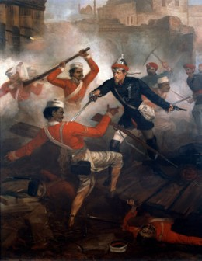
Decline of the Empire
Empire becomes drained of resources
2 million people die of famine
Central state weakened- power of local lords grew
Mughal emperor turns into merely a wealthy figurehead
How did religion add to the decline of this empire?

Slide 27
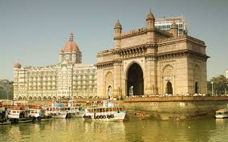
Decline Continued
Mughal Empire weakens= invasion of other countries.
Western traders gain power- who have we previously mentioned?
Portuguese
Dutch
French
English- Aurangzeb gives English port at Bombay (What is this foreshadowing?)

Slide 28
Exit Ticket
Draw a line down the middle of your note card.
Ottoman Empire Where was it? How did it begin Reason/s for decline | Mughal Empire Where was it? How did it begin Reason/s for decline

Slide 29
Homework = Culture Collage
We have been talking a lot about “cultural blending”.
What aspects of your cultural background have blended to make you who you are today?
Create an 8.5 x 11 (normal size sheet of paper) collage to bring to school next Tuesday/Wednesday and we will post them in the room to see what cultures can be seen in our classroom!

Slide 30
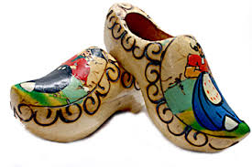
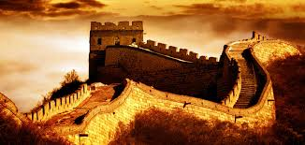
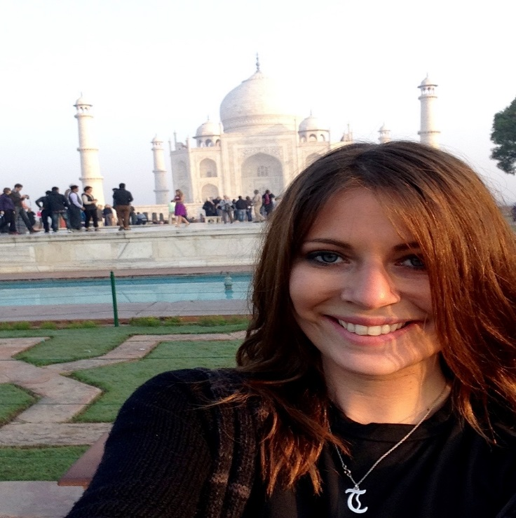
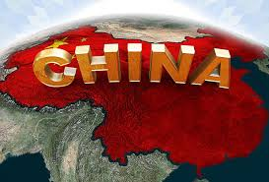
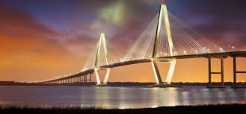
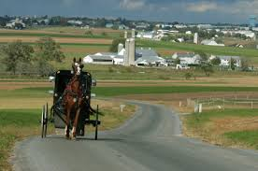
My collage!

