Slide 1
Reviewing standards 1.1 and 1.2
MWH-1.1 Describe the diffusion of people and goods between Europe, Asia, and Africa during the fourteenth and fifteenth centuries to show the networks of economic interdependence and cultural interactions
MWH-1.2 Explain the impact of the Crusades and the Renaissance on European exploration, including the significance of humanism, the revival of learning, and the transfer of knowledge about sailing and ancient philosophy from the Arabs to the Europeans

Slide 2
New Standards
MWH-1.4 Evaluate the impact of the collapse of European feudal institutions and the spread of towns on the transmission of goods, people, and ideas in Europe.
MWH-1.5 Explain how the development of banks in Europe influenced the transfer of goods throughout Europe.
MWH -2.3 Explain the competition between European kingdoms for space and resources, including the Hundred Years’ War between France and England, the rise of the Holy Roman Empire in Central Europe, and the response to Islam on the Iberian Peninsula.
MWH-3.2 Evaluate the impact of religious dissent on the development of European kingdoms during the sixteenth century, including the warfare between peasants and feudal lords in German principalities, the conflict between the nobility of the Holy Roman Empire and the Hapsburg emperors, the creation of the Church of England, and the dynastic and religious competition in France.

Slide 3
Essential Questions in Unit II
What factors led to the collapse of feudalism?
What was the role of a guild in medieval towns?
What are the effects of the growth of towns on European authority?
How did the Commercial Revolution influence the transfer of goods throughout Europe?
How did trade and finance change the period from 1000-1500?
What role did the Renaissance play in launching an age of exploration?
What were the causes of the Hundred Years’ War?
How did the Hundred Years’ War change warfare in Europe?
What impact did Joan of Arc have on the Hundred Years’ War?
What were the historical and religious issues that sparked the Reformation?
What was Martin Luther’s role in the movement to reform the Catholic Church?
How did Protestantism spread to England?
What is Calvinism?
What led to the St. Bartholomew’s Day Massacre, and what did it achieve?
What was the Edict of Nantes?
How did Henry VIII’s marriages and divorces cause religious turmoil in England?
After the death of Henry VIII, what changes did Mary I make?
How did Elizabeth I restore Protestantism and bring peace to England?

Slide 4
New vocabulary- unit ii
German Peasants’ Revolt
Peace of Augsburg
Henry VIII
French Huguenots
St. Bartholomew’s Day Massacre
Edict of Nantes
Mary Tudor
Elizabeth I
Anglican Church
Protestant Reformation
Lutheran
Protestant
Anglican
predestination
Calvinism
Presbyterianism
Anabaptist
Catholic Reformation
Council of Trent
Hundred Years War
Joan of Arc
longbow
cannons
Commercial Revolution
letter of credit
usury
merchant
banker
Burgher
humanism
Renaissance

Slide 5
European Renaissance and Reformation Chapter 17
Topics:
The Plague and impacts on the Renaissance- 1347
The Italian Renaissance 1300-1600
The Hundred Years War and the fall of the Feudal System ca. 1337- 1453
The Northern Renaissance 1450
The Protestant Reformation 1577

Slide 6
Review of Middle Ages
What were some items/goods transferred by trade during the Middle Ages?

Slide 7
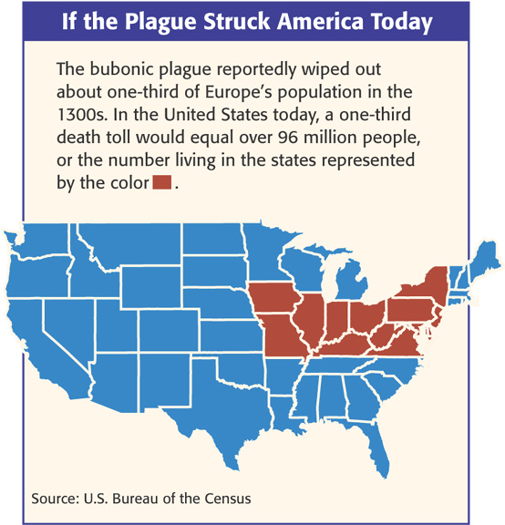
The Plague!
Known as the Black Death
One-third of the population of Europe died (20-25 million)
4 million died in SW Asia
35 million in China!

Slide 8
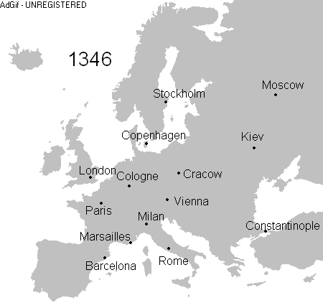
Origins?
Where did the plague begin and how did it spread?
Began in Asia and spread through trade
Rats and fleas

Slide 9
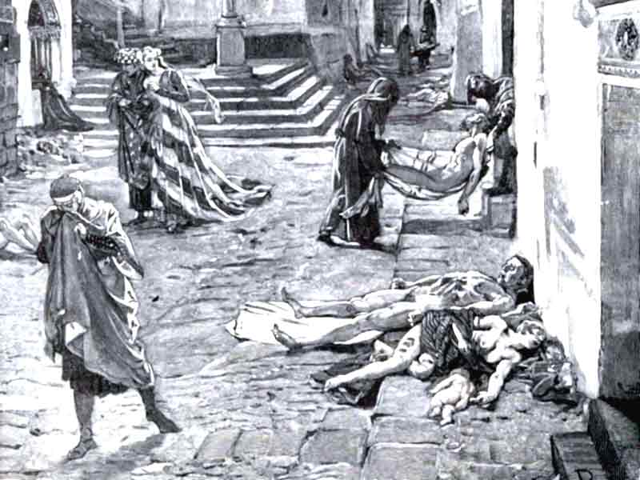
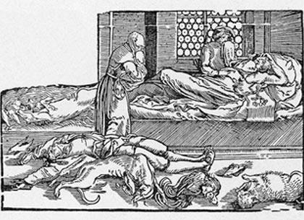
The Plague
Painful swellings called buboes in the lymph nodes (armpit & groin)
Purplish or black spots on skin
Extremely high fever, chills, delirium, and in most cases death

Slide 10
Primary Sources of the plague
Epidemic terrifies and rips apart society
“This scourge had implanted so great a terror in the hearts of men and women that brothers abandoned brother, uncles their nephews, sisters their brothers, and in many cases wives deserted their husbands. But even worse,…fathers and mothers refused to nurse and assist their own children.” – Giovanni Boccaccio The Decameron

Slide 11
Why is this happening?
Why is this happening to us???
Vapors from earthquakes?
Alignment of planets and stars?
Divine punishment for sins?
Poisoned by the Jews?

Slide 12
Impact of Plague on Jews
Impact on Jews in Europe
Became scapegoats
Accused of poisoning the town wells
Persecuted in Spain
Worst in Germany (Holy Roman Empire)
60 Jewish communities in Germany wiped out
Many fled to Poland b/c king provided them protection

Slide 13
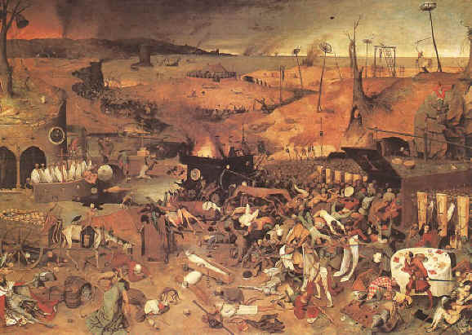
Effects of the Plague
Town populations fall
Trade declines
Prices rise
Some serfs leave manors for paying work (decline of the manorial system)
Many Jews blamed and killed

Slide 14
How did the plague affect the Church?
When prayer and penance failed to stop the plague, the Church lost prestige.

