Slide 1
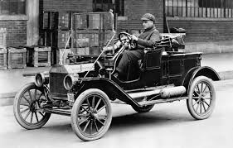
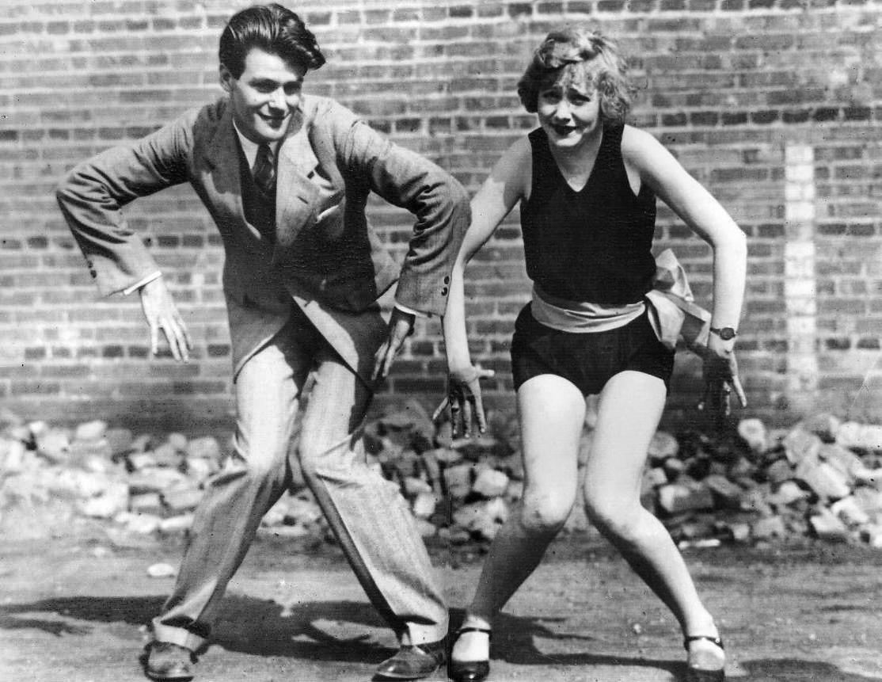
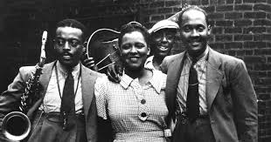
Postwar Changes and Uncertainty
Chapter 31

Slide 2
What do you think was the most influential change in the postwar years?
How did each of the following reflect the changing attitudes of the postwar era?

Slide 3
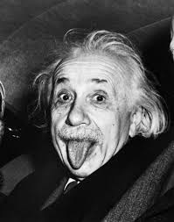
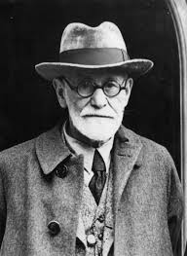
Changes in Science
Einstein’s Theory of Relativity
Sigmund Freud’s theory of the “unconscious”

Slide 4
Literature
How does this reflect the time period?
Many anxious and writing disturbing things of the present and future
T.S Eliot- society has lost spiritual value. Lost hope and faith
Nietzche- Western ideas like progress, democracy and reason have stifled creativity and actions. Wanted return to pride, assertiveness and strength. (Germany and Italy).
Existentialism: No universal meaning to life. Each person creates their own.
The “Lost Generation”- American writers moving to Europe trying to find the “meaning in life”.

Slide 5
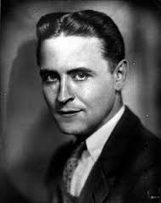

Slide 6
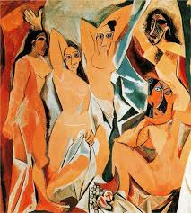
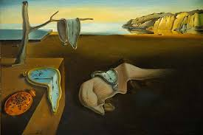
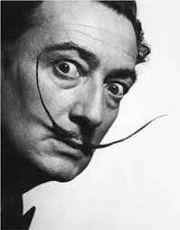
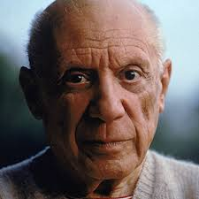
Art- Painting
Wanted to paint emotion and imagination rather than realism.
Surrealism: “Beyond or above reality”
Cubism
George Braque-
Pablo Picasso-

Slide 7
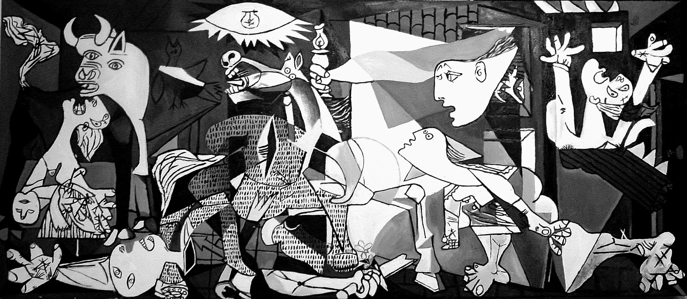
Picasso’s “Guernica”

Slide 8
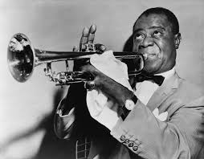
Art- Music
New styles and irregular rhythms- composers.
Jazz!
African Americans in New Orleans, Memphis and Chicago.
“New Freedom of the Age”.

Slide 9
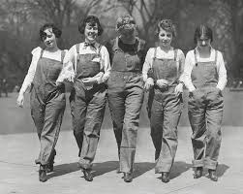
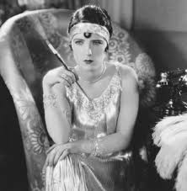
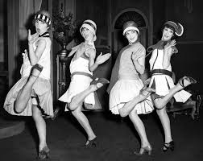
Women
War effort= Independence
Women’s suffrage!- U,S, Britain, Germany, Sweden, Austria
Clothing
Smoking
Drinking
Hairstyles
Birth Control
New Careers- medicine, education, journalism

Slide 10
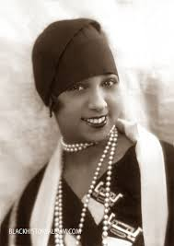
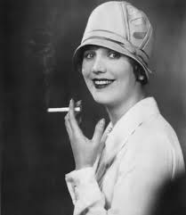
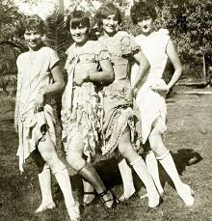
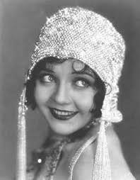

Slide 11
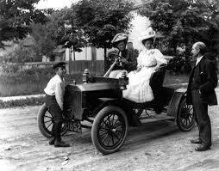
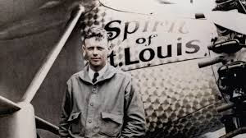
Technology Improves Life
Automobiles- impacts?
Airplanes- impacts?
Lindberg
Radio- impacts?
Motion Pictures
Hollywood!
Charlie Chaplin

Slide 12
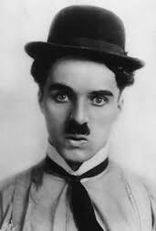
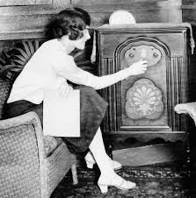
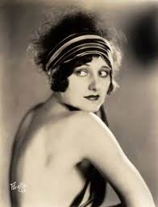
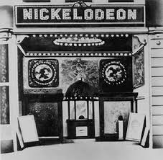

Slide 13
Other Modern Conveniences
Refrigerator
Washing Machine
Coffee Pot
Vacuum Cleaner
Iron

Slide 14
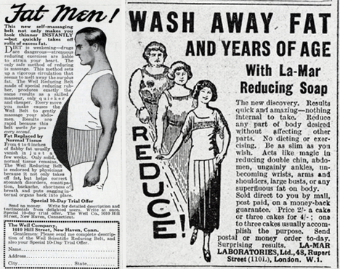
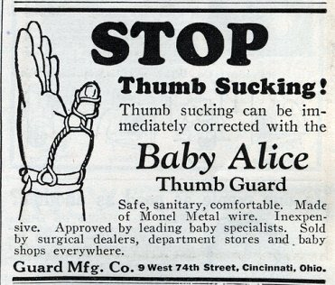
Advertisements!

Slide 15
Based on what we have learned…
What continuities and changes can we see from the time period pre WWI and post WWI?

