Slide 1
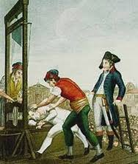
Revolution Brings Reform and Terror

Slide 2
The Assembly Reforms France
In a response to the uprisings during the Great Fear, Aug. 1789, some nobles and clergy join the National Assembly
Give up feudal privileges
Signals the end of the Old Regime
Three weeks later, the National Assembly adopted revolutionary ideals

Slide 3
Reforms
Declaration of the Rights of Man and the Citizen
Reflects influence from the Declaration of Independence
Guaranteed rights
“life, liberty, property, and resistance to oppression”
Provide citizens equal justice, freedom of speech, and freedom of religion

Slide 4
Slogan for the Revolution
Liberty, Equality, Brotherhood

Slide 5
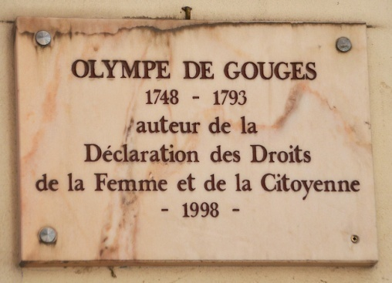
Olympe de Gouges
French butcher’s daughter who educated herself
Won fame as a journalist, actress, and playwright
Revolutionary and strong feminist
Campaigns to raise standing of women in French society
Published Declaration of the Rights of Woman and Female Citizen which attracted attention but little support
Her ideas are rejected
She was executed in 1793 for her crusade for women’s rights

Slide 6
Reforms of the Church
State-controlled church
Take over the Church lands
Took lands to sell and use it to pay France’s debts
Declare Church officials and priest would be elected and paid
As devout Catholics, peasants offended by the state-control
Thought that pope should rule over
They will be against many of the reforms
Notre Dame of Paris

Slide 7
Louis XVI tries to escape
Louis XVI’s advisors worried about the monarch’s safety
1791 Royal family tries to escape to Austrian Netherlands but will be recognized at the border
Guards returned them to Paris
Sealed his fate
One of the people who stopped Louis XVI recognized him from a picture on a French banknote.

Slide 8
Legislative Assembly
For 2 years, National Assembly argues over constitution
1791 created a constitution that limited monarchy
Created the Legislative Assembly that had power to make laws and power to approve or end wars
Factions split France
Questions on how to handle food shortages and gov’t debt led to divisions
1793 the Execution of Louis XVI

Slide 9
Factions Split France
How to handle problems caused a split in 3 groups, each sitting at different parts of meeting hall
Radicals
Left side of hall
Opposed monarchy
Want sweeping changes in gov’t
Moderates
Sat in the center
Want some change
Conservatives
Right side of hall
Upheld a limited monarchy
Want little change in gov’t
Legislative Assembly as it convened Oct. 1, 1791

Slide 10
Connection to Today
We use the terms left, right, and center to describe people’s politics today
Left Wing=Radical change in gov’t
Center=Moderate change
Right wing=Few or no change in gov’t

Slide 11
Outside Factions
Emigres, nobles who had fled France
Want to undo the Revolution and restore Old Regime
Sans-culottes
“Those without knee britches” (represent nobles)
Regular trousers
Don’t have place in Legislative Assembly but exert power in Paris
Idealized sans-culotte by Louis-Léopold Boilly (1761–1845).

Slide 12
France at War with Austria and Prussia
Austria and Prussia encourage France to restore Louis XVI to throne
Legislative Assembly responds with a declaration of war
Aug. 1792 Prussians threaten to destroy Paris if harm is done to the royal family
20,000 men and women invade the palace and imprison the royal family
Rumors start about the king’s supporters held in prisons want to break out and seize control of Paris
Leads to the September Massacres
Angry citizens raid and murder over 1,000 prisoners
Nobles, clergy, and loyalist were victims

Slide 13
National Convention
Under pressure from radicals and members , the Legislative Assembly sets aside the Constitution of 1791
Abolished the monarchy, dissolved parliament and declared France a republic
National Convention becomes the new governing body
Adult men were granted the right to vote and hold office
Not women

Slide 14
Jacobins Take Control
By Sept. 1792, most gov’tal changes came from members of the radical political club: Jacobin Club
Most prominent member: Jean Paul Marat

Slide 15
John Paul Marat
One of the most prominent members of the Jacobins
Radical
Editor of the newspaper , L’Ami du Peuple (The Friend of the People)
Writings stirred up the violent mood of the people
Called for the death of all that supported the king
In the beginning…“five or six hundred heads cut off would have assured you peace, liberty, and happiness?”
Later…“Today 50,000 would be necessary.”

Slide 16
The Death of Marat
Because of suffering from a painful skin disease, he found comfort soaking in a bath
Wrote their also
Charlotte Corday, a supporter of a rival faction, gained an audience with Marat in bathroom
She stabbed him to death
Marat becomes a revolutionary martyr
The Death of Marat, Jacque Louis David

Slide 17
Georges Danton
Also a Jacobin
Lawyer
One of the club’s most passionate speakers
Known for his devotion to the rights of Paris’ poor

Slide 18
Execution of Louis XVI
National Convention tries him for treason
Found guilty, sent to the guillotine on January 21, 1793

Slide 19
War continues in 1793
Great Britain, Holland, and Spain join Austria and Prussia
To reinforce their armies, Jacobins in the Convention ordered a draft of 300,000 French citizens between 18 and 40
Known as the “Levee en masse”
Idea is that new given rights to the French people also creates new obligations to the state
By 1794, the army grew to 800,000 including women

Slide 20
Reign of Terror 1793-94
Fought foreign wars and now “enemies within” France
Examples
Peasants horrified by king’s execution
Priests not accepting gov’t control
Rival leaders who stir up rebellions
How do they contain and control them?
Reign of Terror!

Slide 21
Robespierre Takes Control
Robespierre, Jacobin leader
Wants to create a “republic of virtue” by wiping out France’s past
B/c believe in reason, they try to wipe out religion
Change the calendar to 12 months of 30 days
Rename the months
No Sundays- too old-fashion
Close all the churches in Paris and throughout France
Began counting years from 1791-year 1

Slide 22
Committee of Public Safety
Created in July 1793 to protect the Revolution from its enemies
Robespierre became leader and governs as a dictator
Committee tried “enemies” in the morning and guillotined in the afternoon

Slide 23
“Enemies of the Revolution”
Most often radicals who challenged Robespierre, fellow revolutionaries
Example is George Danton
Jacobin
His own friends in the National Convention were afraid to speak up, condemned him to the guillotine

Slide 24
More “Enemies of the Revolution”
Approximately 40,000 people sent to the guillotine on flimsy charges
Ex. 18 yr. old boy for cutting down a tree that was planted as a symbol of liberty
85% were peasants, members of the urban poor, or middle class
People that the revolution was supposed to help

Slide 25
End of the Terror
July 1794, members of the National Convention sent Robespierre to the guillotine
Ended the Reign of Terror
French public opinion from all classes turns as they are tired of the Terror and skyrocketing cost of necessities
In 1795, moderate members of the National Convention draft a new gov’t: the Directory (3^{rd since 1789)}
Gov’t made up of a two-house legislature and an executive body of 5 men
Bring order to France
They will chose Napoleon Bonaparte to command their armies…

