Slide 1
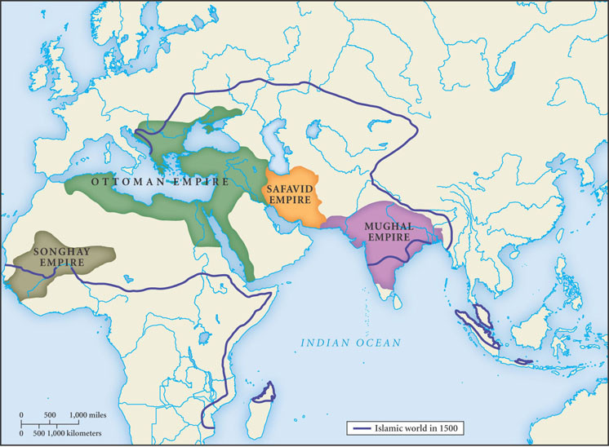
The Islamic World of 1500
The most prominent political features of the vast Islamic world in the fifteenth and sixteenth centuries were four large states: the Songhay, Ottoman, Safavid, and Mughal empires.
Ottomans, Safavids, and Mughal Empires also known as the “Gunpowder Empires”.

Slide 2
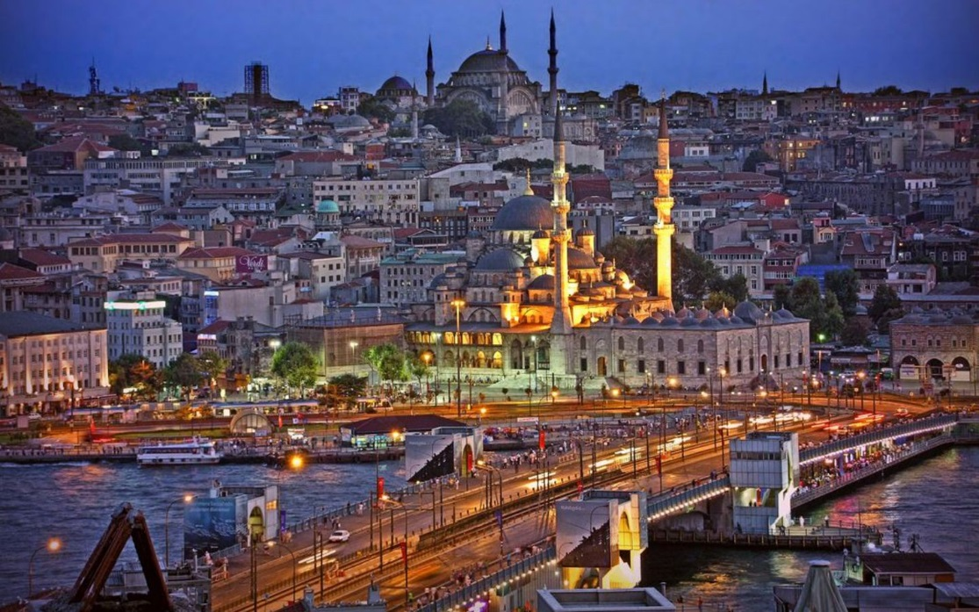
Ottoman Empire
One of the great empires in history
  Lasts from 14th -20th century
Huge territory, long lasting, incorporation of diverse peoples, and economic and cultural sophistication
Represents the Turks as the dominant people of the Islamic World
  No longer the Arabs of the previous caliphates
“They sought to bring a renewed unity to the Islamic world, while also serving as protector of the faith, the “strong sword of Islam.”

Slide 3
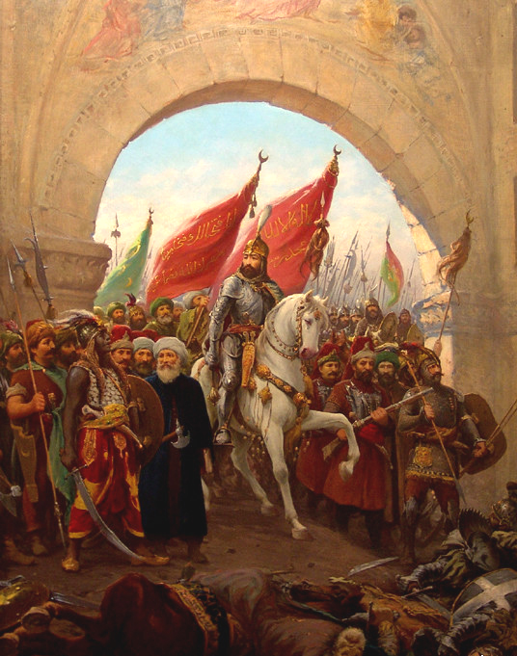
The Ottoman Empire 1450-1750
Turkic speaking people from central Asia
The most long-lived of the post-Mongol Muslim empires
1300-1922
Timeline
13-14th century built an empire that covered the eastern Mediterranean
1350-Conquer Balkans
1453 –Conquered Constantinople
  Mehmed II “the Conqueror”
    Ottoman’s sultan that led his armies into the city for 7 weeks
    Ordered his gunners to batter a portion of the wall with massive siege cannons
    Looted and pillaged city for 3 days
    City was only 50,000 but controlled access to the Bosporus Strait
1517 Ottomans capture Syria and Egypt
Mehmed II rides into Constantinople after the fall

Slide 4
Account Control of Bosphorus
From the walls of the castle, the Turks began to shout ‘Lower your sails, Captain’ … and when they saw that he was unwilling to lower them, they began to fire their cannon and many guns and a great number of arrows, so that they killed many men ... After he had lowered his sails, the Turks stopped firing, and then the current carried the galleys towards Constantinople. And when they had passed the castle and the Turks could not reach them any longer with their cannon, the captain quickly raised his sails and got through safely. –
See more at: http://www.historytoday.com/judith-herrin/fall-constantinople#sthash.hGMIdDGk.dpuf

Slide 5
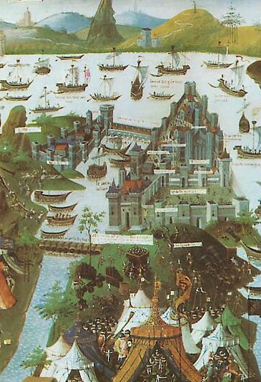
Siege of Constantinople
April 6-May 29th, 1453
Bombarded city with the 26’ cannons that fired ammunition weighing 1,200 lbs. for weeks
Failed to break the chains placed at the mouth of the Golden Horn
Came by land as a surprise
Ships were carried over by ropes and slid over slipways

Slide 6
“As the Ottomans closed in on their prize, Constantinople became the last outpost of Christian faith in the Middle East, and its inhabitants had to face their historic destiny. The battle between Christianity and Islam was joined around the city.
Constantine XI was the first to realise this and his disappearance during the last day of fighting heightened the myth of 1453. Although a head was solemnly presented to Sultan Mehmet and a corpse given to the Greeks for formal burial, Constantine’s body was never found. As a result many stories of his escape and survival circulated. The idea that he had found shelter within the walls of the city and would emerge to triumph over the Muslims is typical. The prolonged resistance and bravery of the defenders made heroes of them all. And within a few years, to have been present in the city on May 29th, 1453, became a badge of honour, claimed by many who had been elsewhere. By the same token Sultan Mehmet would have delighted in the nickname which recognised his role in the fall: from the late 15th century onwards, and even today, 550 years later, he is still known as Mehmet the Conqueror.”
See more at: http://www.historytoday.com/judith-herrin/fall-constantinople#sthash.hGMIdDGk.dpufA

Slide 7
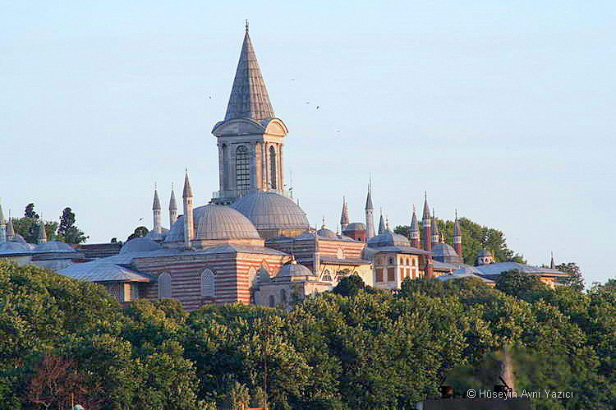
The Sultans and Their Court
Sultans
  Absolute monarchs with religious and political rule
  They “combined roles of a Turkic warrior prince, a Muslim caliph, and a conquering emporer”
Elaborate court rituals based on Byzantine, Persian, and Arab dynasties
  Palace, slaves, wives, concubines
Vizier, head of Ottoman bureaucracy, carried out the day-to-day administration
  Often held more power than the sultan
No clear right of political succession so often contested
  Hereditary, although not to the eldest son b/c fathered many heirs with many women
  New sultans would often kill all his brothers to eliminate competition
Topkapi Palace housed gov’t offices such as mint, meeting places. Sultan’s residence with harems, gardens, etc.

Slide 8
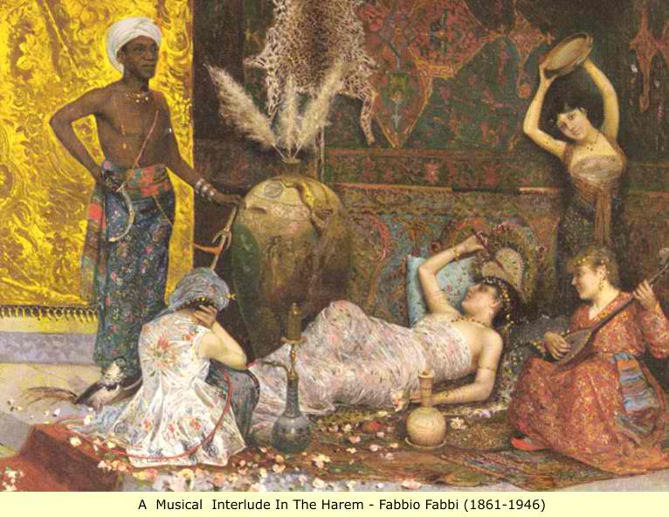
Ottoman “Harem”
Means “sacred place”
The Imperial harem contained the combined households of Queen Mother, the Sultan's favorites, and the rest of his concubines
Powers of the harem women were exercised through their roles within the family.
  Ex. Queen Mother served as advisor to sultan -2nd in power to sultan
Power was also given as their favor grew with the sultan
  “Sultan’s favorites” were equivalent to a legal wife, given apartments, slaves, and eunuchs
Concubines were educated to read Quran, to sew, to perform music

Slide 9
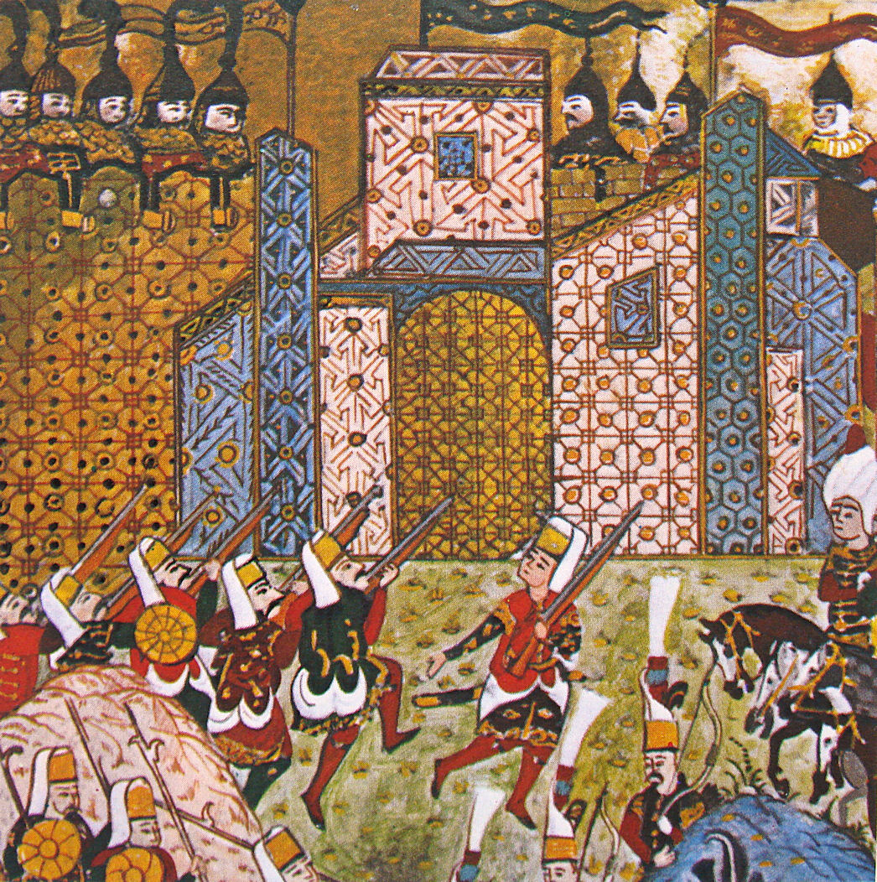
A State Geared to Warfare
Military leaders play a dominant role
Economy of the empire geared to warfare and expansion
Warrior sought to become ghazi
  Religious warriors
Slaves acquired as part of policy of devshirme: drafted boys from conquered Christian territories
  Ex. Areas of the Balkans
  Became Janissaries or bureaucrats

Slide 10
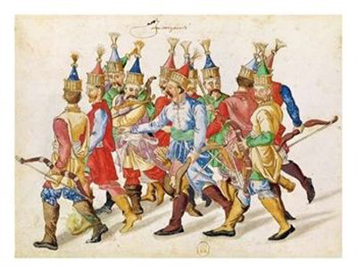
Janissaries
From 15th century, imperial armies dominated by an elite force of 30,000 soldiers known as Janissaries
  Forcibly recruited from conquered areas such as Balkans, where majority faith is Christian
  Legally slaves, but educated and given advancement
  Convert to Islam
  Some served in palace or bureaucracy
  Controlled the artillery and firearms
  Tried to translate their military service into political influence

Slide 11
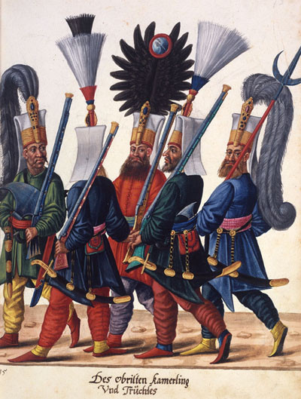
Ottomans: Gunpowder Empire
Originating in the fourteenth century, the Janissaries became the elite infantry force of the Ottoman Empire. Complete with uniforms, cash salaries, and marching music, they were the first standing army in the region since the days of the Roman Empire. When gunpowder technology became available, Janissary forces soon were armed with muskets, grenades, and handheld cannon. This image dates from the seventeenth century.(Austrian National Library, picture archive, Vienna: Cod.8626, fol. 15r)

Slide 12
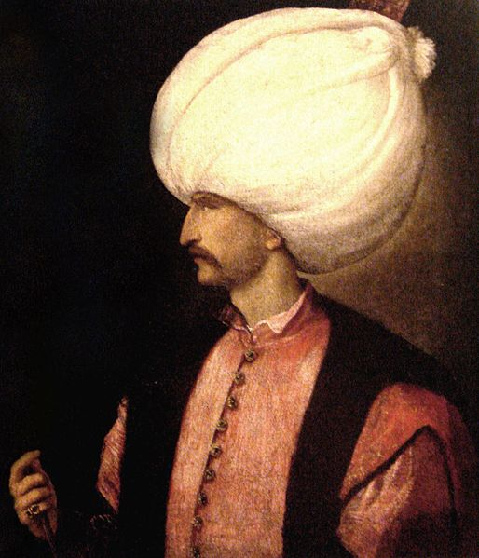
Suleyman The Magnificent
Important military leader
  1521 conquered Belgrade, island of Rhodes to control Eastern Europe, ports in N. Africa
  1529 First siege of Vienna, Austria (Last siege in1683)
    Failed to capture it
Suleyman the Lawgiver
R. 1520–1566
In the halls of the U.S. Congress are images of some of the greatest lawgivers of all time. Included in that group are such persons as Thomas Jefferson, Moses, and Suleyman.
Suleyman’s law code prescribed penalties for various criminal acts and for bureaucratic and financial corruption.
He also sought to reduce bribes, did not allow imprisonment without a trial, and rejected promotions that were not based on merit.

Slide 13
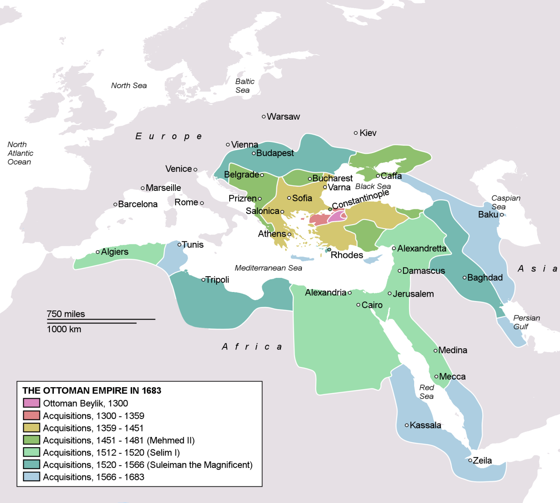
Ottoman Empire in 1683

Slide 14
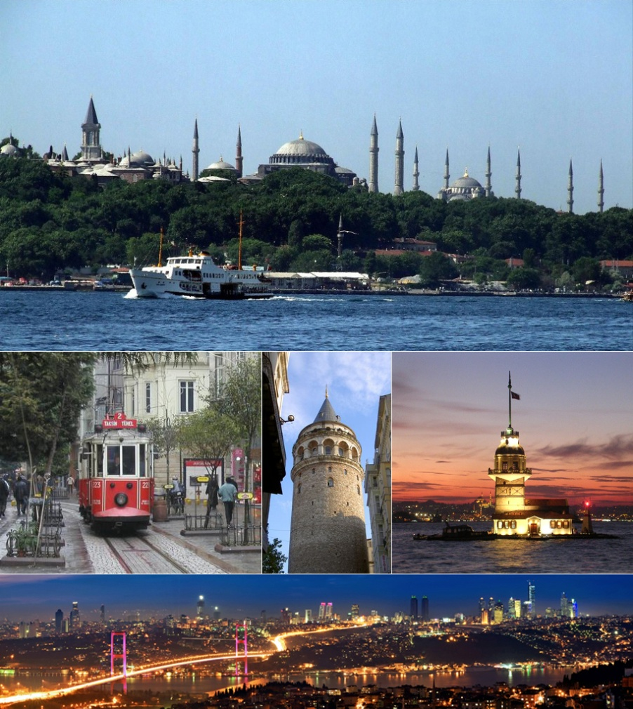
Constantinople’s Restoration
Sultans and administrators built mansions, rest houses, religious schools, hospitals
City stretched on both sides of Bosphorous, the stait between Med.and Black Sea
Harbor and the Golden Horn, a triangular bay that formed the northern boundary of the city, were crowded with merchant ships
Bazaars filled w/ merchants and travelers
  Commodities such as spices, ivory, slaves, forest products, carpets
Coffeehouses
  Major part of cultural life
  Poets, scholars congregate to read aloud, debate politics
  Drink, smoke tobacco, play chess

Slide 15
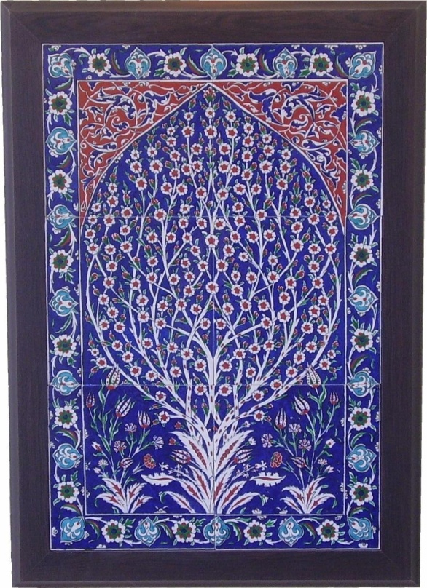
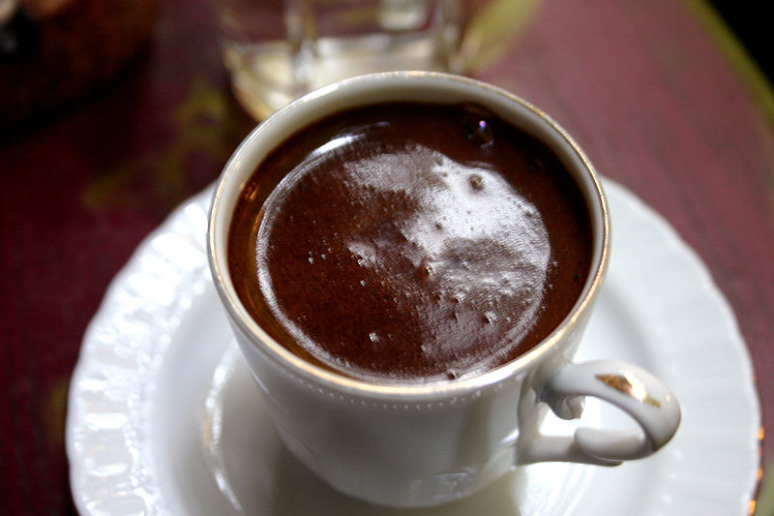
Ottoman Culture
Merchants and artisans make up a sizeable portion of population
Ottoman regime regulated the commercial exchanges and handicraft production
  Gov’t inspectors ensure standard weights/measures
  Entry for artisans into trade
Guilds for artisans like medieval Europe
Turkish language of Ottoman court becomes that of poets, historians, and bureaucracy
Turkish Blue Tile

Slide 16
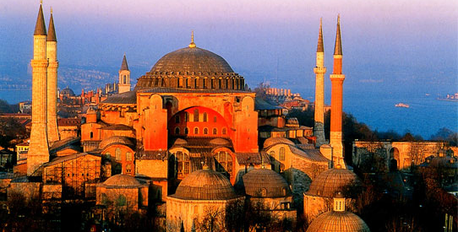
Constantinople Restored: Istanbul
Hagia Sophia converted to a mosque after 1453

Slide 17
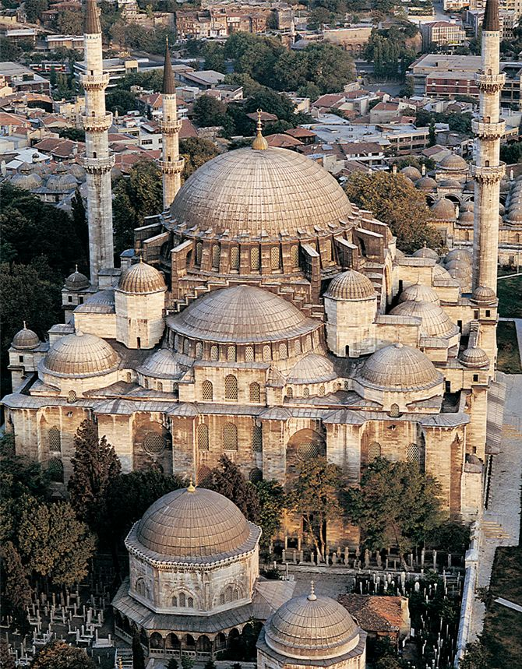
The Suleymaniye Mosque
Built during reign of Suleyman I in the 1550s by the architect, Sinan
One of largest and greatest engineering achievements of Islamic civilization
Most celebrated of all the monuments of Istanbul
Pencil-thin minarets flank the great dome which was uniquely characteristic of Ottoman architecture
Blend of Islamic and Byzantine architecture
The massive Süleymaniye mosque built for Sultan Süleyman the Magnificent by the Ottoman architect Sinan Pasha in 1556.

Slide 18
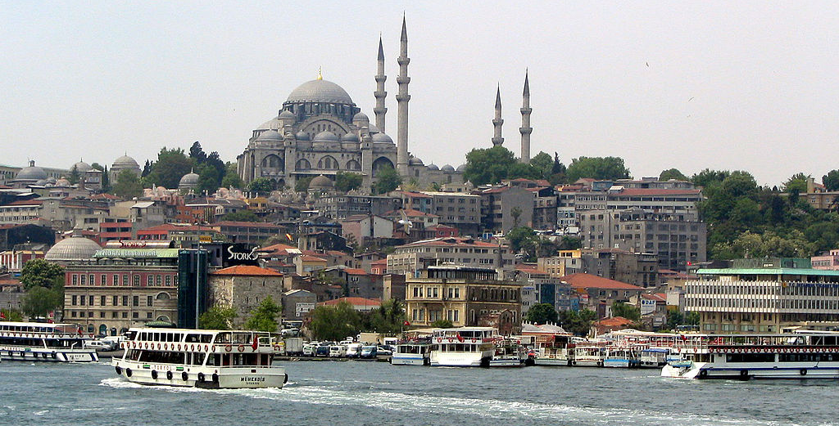
Suleymaniye Mosque
Built by Sinan, the Imperial Architect, was brought from Anatolia to Istanbul in the devshirme, the annual roundup of talented Christian youths, and educated at one of the elite palace schools. He became the chief architect and the closest Turkey gets to a Renaissance architect. Sinan died at aged 97, having built 131 mosques and 200 other buildings.

Slide 19
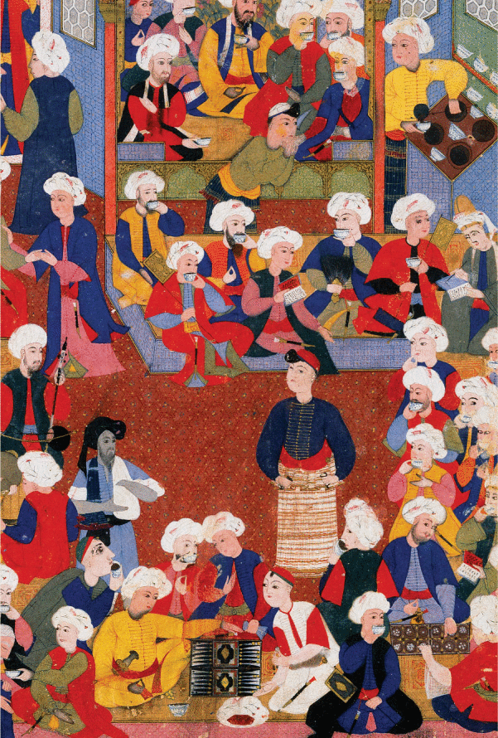
Coffee and Tobacco
“Europeans, of course, were not the only people to embrace foreign tastes newly available in the early modern era. Tobacco and coffee, like tea, soon found a growing range of consumers all across Eurasia. Originating in the Americas, tobacco smoking spread quickly to Europe and Asia. Well before 1700 it had become perhaps the first global recreation. In the Ottoman Empire, as elsewhere, it provoked strenuous opposition on the grounds that it was an intoxicant, like wine, and was associated with unwholesome and promiscuous behavior. It was also associated with coffee, which had entered the Ottoman Empire in the sixteenth century from its place of origin in Ethiopia and Yemen. Coffee too encountered considerable opposition, partly because it was consumed in the new social arena of the coffeehouse. To moralists and other critics, the coffeehouse was a “refuge of Satan,” which drew people away from the mosques even as it drew together all different classes. Authorities suspected that coffeehouses were places of political intrigue. None of this stopped the spread of either tobacco or coffee, and the coffeehouse, in the Ottoman Empire and in Europe, came to embody a new “public culture of fun” as it wore away at earlier religious restrictions on the enjoyment of life.^{33”}
Ottoman Coffeehouse in the 16th century

Slide 20
The Problem of Ottoman Decline
Dynasty endures for 600 years
Long decline begins in mid-17th century until the 20th
Decline in the effectiveness of the administrative system
  Corruption and incompetence in state bureaucracies
No more “warrior-emperors” of early Ottoman history
  Weak rulers, addicted to drink, drugs, and pleasures of the harem
Lack of discipline and leadership in armies
  Fall behind Europe in the art of waging war
Lost edge to Portugal as seafarers in the Indian Ocean in the 1500s
  Lost revenues to Portuguese as the middle-men to Europe for spices
Influx of silver bullion from New World into their economy caused inflation
17th century and 18th century Ottomans fall behind Western Europe in technology, science, and commerce
  Leads to isolation of the empire and the decline

Slide 21
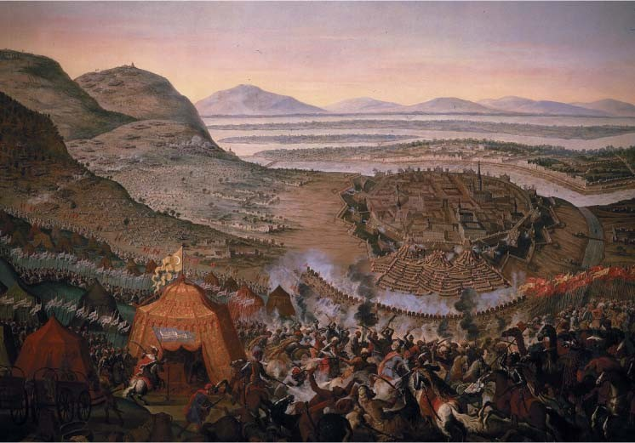
The Ottoman Siege of Vienna, 1683
In this late 17th c. painting by Flemish artist Frans Geffels, the last Ottoman incursion into the Austrian Empire pushed back with French and Polish help, marking the end of a serious Muslim threat to Christian Europe.

Slide 22
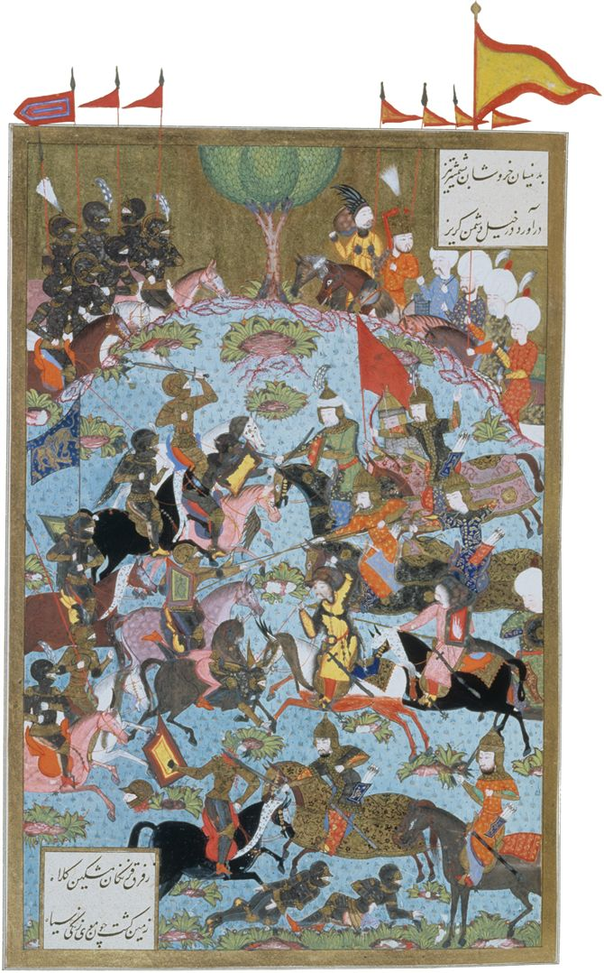
All the Islamic empires fought numerous wars, many of which exhausted resources without adding to the productive capacities of the empires. This illustration depicts Ottoman forces (right) clashing with heavily armored Austrian cavalry near Budapest in 1540.

Slide 23
The Safavids
Chief rivals to the Ottomans
Centralized state based on military conquest and dominated by Shia Islam
Ismail young military leader, r. 1501-1524
  Orphaned, parents killed by enemies
Becomes Shah, proclaims official religion of realm Twelver Shiism
  Twelve infallible imams (religious leaders) after Muhammad
  12th imam in hiding, one day return ready to take power
  Wore distinctive red hat, called quzilbash (“red heads”)
Empire called Safavid, after Safi al-Din (1252-1334), Sufi thinker

Slide 24
Battle of Chaldiran
Ottoman, Selim the Grim, attacks Safavids
  Launched persecutions on Shiite Muslims in Ottoman empire already
Heavy use of Ottoman gunpowder technology give them the upper hand
  Safavids had technology but unreliable
Ismail escapes, two centuries of ongoing conflict
Shah Abbas the Great (r. 1588-1629) revitalizes weakened Safavid empire
  Reforms administration, military
  Expands trade
  Military expansion

Slide 25
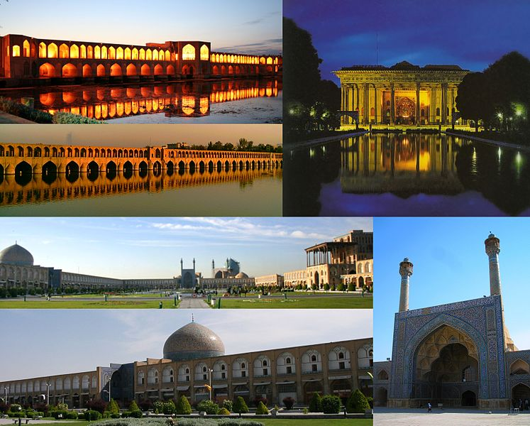
Isfahan, Iran
Capital of the Safavid Empire
Palaces not as large as Ottoman or Mughal
Gardens, pools
Architecture was blend of central Asian traditions with Hindu architecture

Slide 26
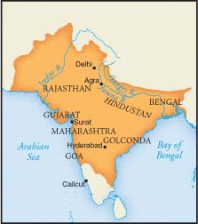
The Mughal Empire
South Asia where Islam and Hindu cultures interact
  Ruling dynasty and only 20% of population Muslim
From Central Asia
Turkic culture but Muslim religion
Claim descent from Genghis Khan
With the aid of gunpowder weapons, Mughals (Persian term meaning Mongol) invade India in 16th century
The empire becomes is a cosmopolitain and hybrid Indian-Persian-Turkic culture

Slide 27
What makes them important?
Dominates the Indian subcontinent for 300 years
Unites almost the entire subcontinent
Southern India below the Deccan plateau had always been isolated
Hinduism was firmly established in South

Slide 28
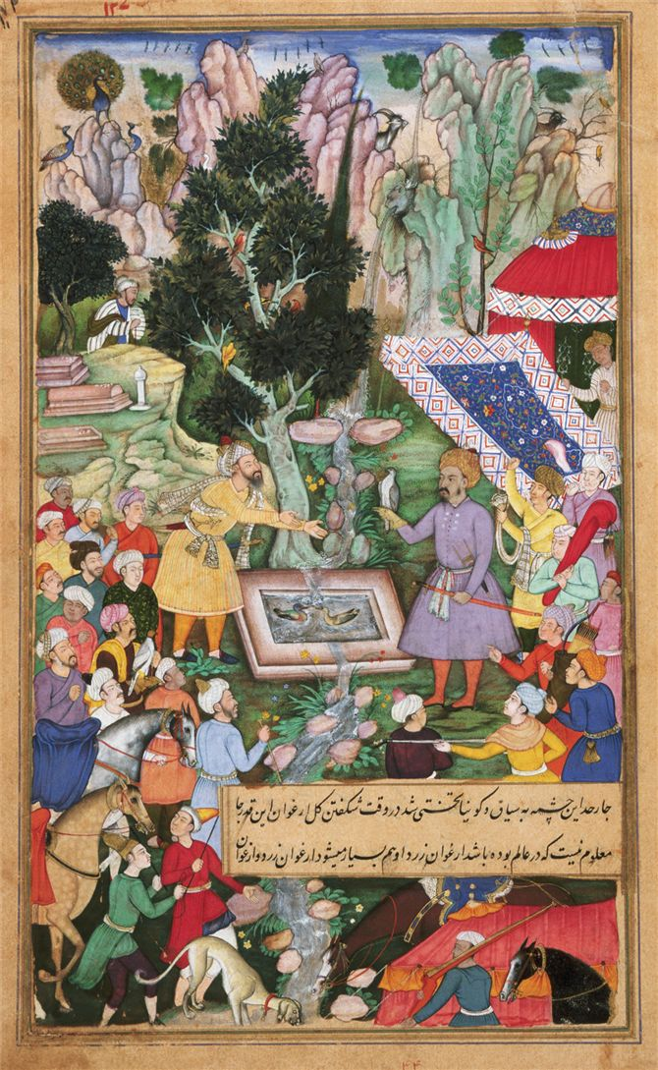
Babur
Founder of Mughal dynasty (Persian term for Mongol)
Adventurer, soldier who wanted to gain a glorious central Asian empire
Launch invasion w/ aid of artillery & firearms
Took Delhi in 1525
Empire stretched from Kabul to borders of Bay of Bengal
This colorful scene at a spring in Kabul highlights Babur (1483–1530), founder of the Mughal dynasty, who stands in a central position near the life-giving water.

Slide 29
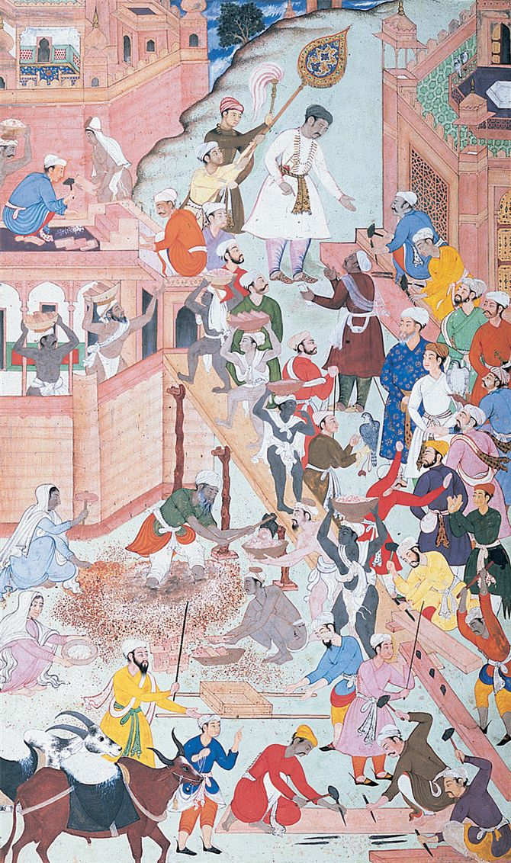
Akbar the Great
Reigned 1556-1605
Charismatic, reflective, tolerant, thoughtful
Pursued religious toleration
  Encouraged syncretic faith: Sikhs
    Combined elements of Hinduism and Islam
  Allowed Hinduism and Islam to be practiced openly
    Married several Hindu women who retained their religion
  Supports building of Hindu temples, mosques
Abolishes the jizya on Non-Muslims
Attempts to eliminate sati for women, set aside special market days for women
Creates his own “divine faith”
  Emphasized loyalty to the emperor
  Glorified him as the “lord of wisdom” who would guide his subjects to understanding the creator god
  Drew on Islam, Hinduism, and Zoroastrianism
This manuscript illustration from about 1590 depicts Akbar (at top, shaded by attendants) inspecting construction of a new imperial capital at Fatehpur Sikri.

Slide 30
Blended elite culture under Akbar
“He associated with every race and creed and persuasion…The professors of various faiths had room in the broad expanse of his incomparable sway.”
    Son of Akbar, Emperor Jahangir (r. 1603-1627)
Empire is blended elite culture
  Examples
  Persian artists and artists welcomed
  Hindu epic Ramayana was translated into Persian
  Persian classics appear in Hindi and Sanskrit

Slide 31
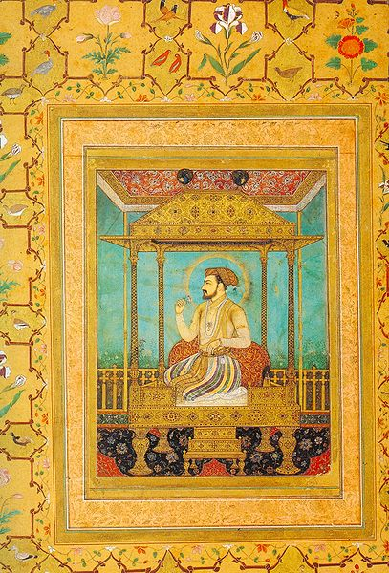
Shah Jahan
Destroyed temples to Hinduism
His wife Mumtaz Majal bore him 14 children and served as his advisor
She dies in childbirth and he goes into severe mourning
Builds Taj Mahal as her tomb
Built new capital at Delhi
His late rule plagued by infighting
His son, Aurangzeb, takes the crown
  He spends his last years confined to a small cell with a tiny window, and only w/ aid of mirror could he see his beloved wife’s final resting place
Shah Jahan sitting on the Peacock Throne with 4 legs of gold, 12 pillars of emeralds, and emerald canopy.

Slide 32
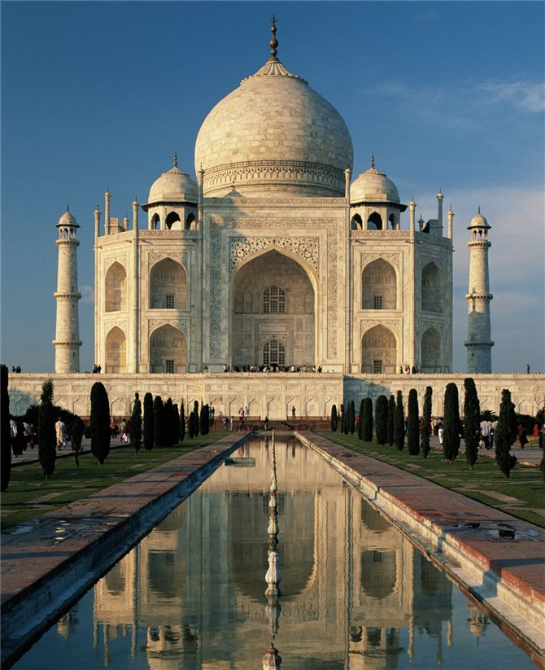
The Taj Mahal was a sumptuous mosque and tomb built between 1632 and 1649 by Shah Jahan in memory of his wife, Mumtaz Mahal

Slide 33
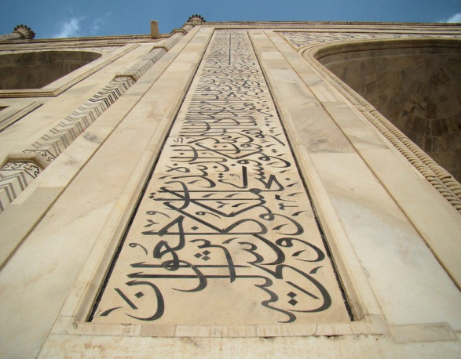
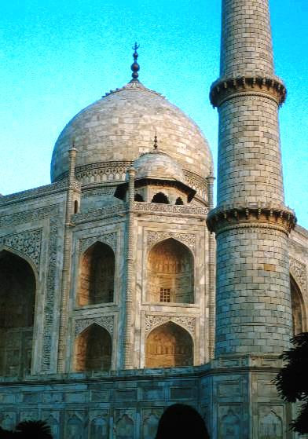
Building of the Taj Mahal
Some 20,000 workers labored for 22 years to build the famous tomb.
It is made of white marble brought from 250 miles away.
The minaret towers are about 130 feet high.
Them building itself is 186 feet square.
The design of the building is a blend of Hindu and Muslim styles.
The pointed arches are of Muslim design, and the perforated marble windows and doors are typical of a style found in Hindu temples.
The inside of the building is a glittering garden of thousands of carved marble flowers inlaid with tiny precious stones. One tiny flower, one inch square, had 60 different inlays.

Slide 34
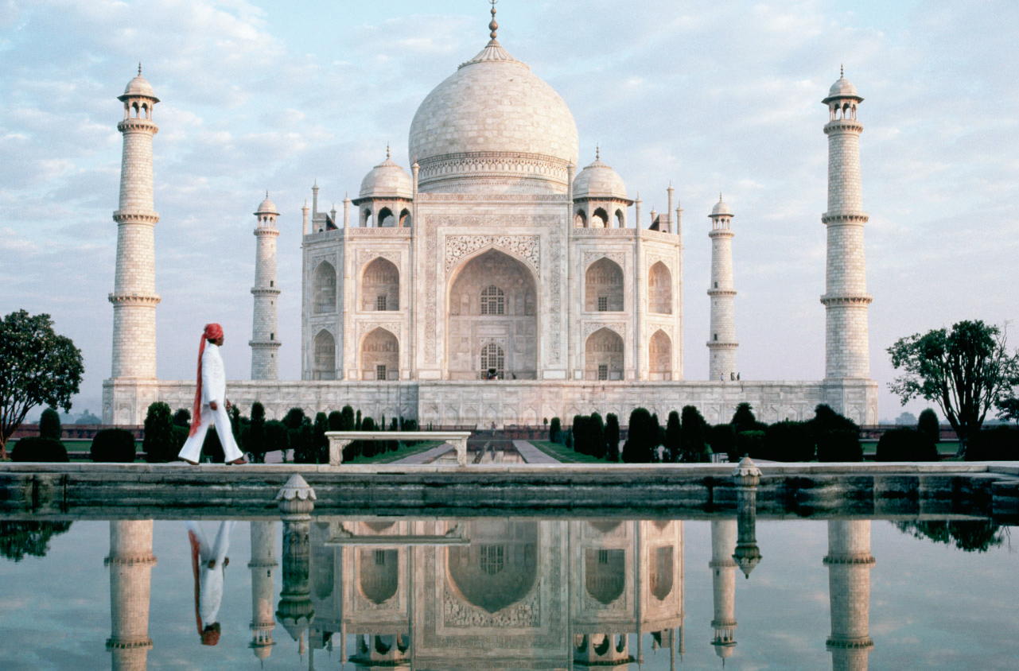

Slide 35
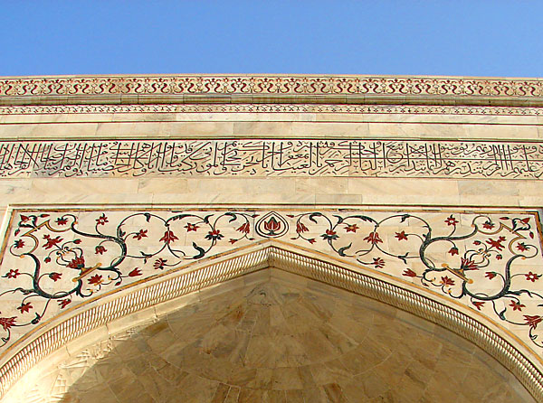
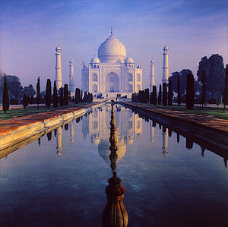
Taj Mahal
Fuses the domes, arches, and minarets of Islam with the Hindu love of ornamentation
White marble, inset with semiprecious stones arranged in floral and geometric patterns
Marble reflecting pools

Slide 36
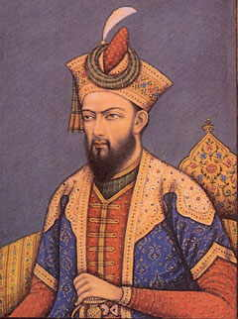
Aurangzeb
Reigned from 1658-1707
Reversed Akbar’s policy of accommodation and sought to impose Islamic supremacy
Music and dance banned at court
Jizya was reimposed
Enforced strict Islamic law
Destroy Hindu temples
Demand for taxes to support wars of expansion led to Hindu opposition
  Inflames tensions between Hindus and Muslims
Fractures the Mughal Empire and opens the way for a British takeover

Slide 37
Significance of Mughal Empire
Example of an encounter between 2 great religions
Began with an experiment in multicultural empire building
  Think of Akbar the Great
Ended in growing antagonism between Hindus and Muslims
  Think of Aurangzeb
Pattern continues in the centuries to follow…

Slide 38
Thinking about TRADITIONS: Religious Diversity
An overarching feature of all three Islamic empires was the ethnic and religious diversity of the subject populations. What measures did the rulers of the Ottoman, Safavid, and Mughal states take to maintain harmony among the different ethnic and religious communities?

Slide 39
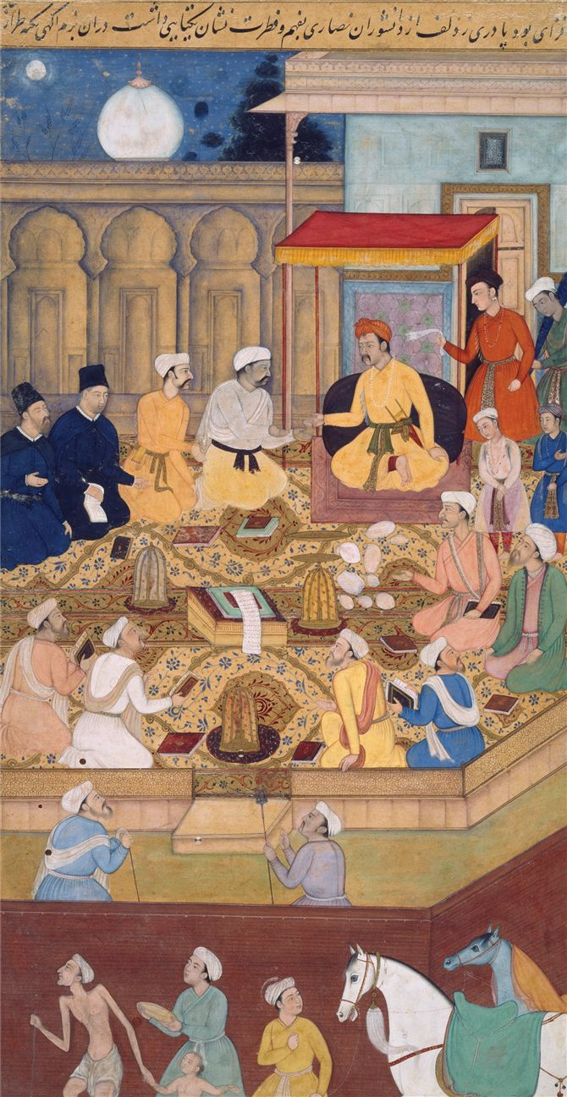
Religion in the Islamic Empires
All the Muslim Empires had populations that were religiously and ethnically diverse
Ottomans
  Large numbers of Christians, Jews in the Balkans, Armenia, Lebanon, Egypt
Safavid
  Zoroastrians, Jews, Christians
Mughals
  Hindu, Muslim, Jains, Zoroastrians, Christians, Sikhism
  Portuguese port of Gao became center of Christian mission in India
    Establish schools but never converted emperor
In a seventeenth-century painting, the emperor Akbar presides over discussions between representatives of various religious groups. Two Jesuits dressed in black robes kneel at the left.

Slide 40
Status of Religious Minorities
Extended the status of dhimmi
  Protected people
Payment of jizya
  Retain freedom, property, practice religion, and handle their legal affairs
Lived in autonomous religious communities known as millet
  Retain civil laws, traditions, and culture
  The Mughals did not have a millet system
    Too impractical due to the large number of religious communities-Hindu

Slide 41
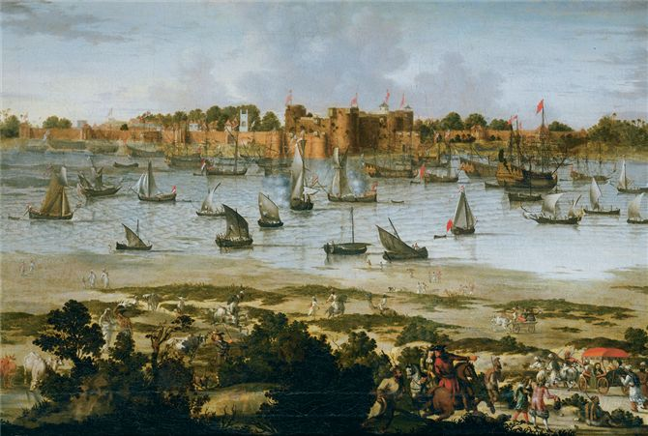
Agriculture and Trade
American crops effect less dramatic change in Muslim empires
  Coffee, tobacco important
  Initial opposition from conservative circles, fearing lax morality of coffee houses
Population growth also reflects territorial additions and losses
Mughals encouraged the establishment of the English East India Company and Dutch VOC trading outposts
  Mughal treasury derived significant income from foreign trade
In this anonymous painting produced about 1670, Dutch and English ships lie at anchor in the harbor of the busy port of Surat in northwestern India. Surat was the major port on the west coast of India, and it served as one of the chief commercial cities of the Mughal empire.

Slide 42
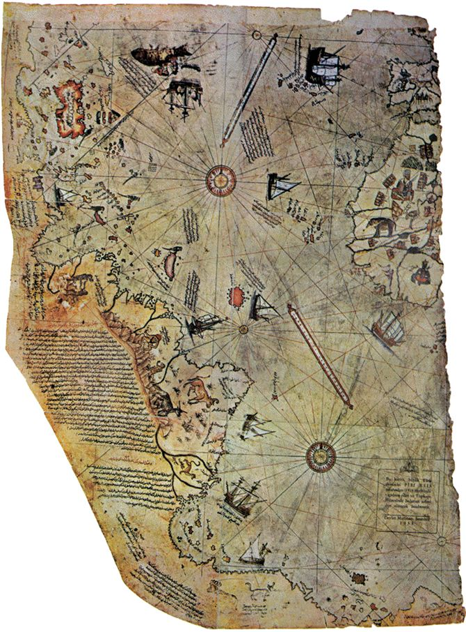
Cultural Conservatism
During their decline, the Islamic Empires neglected the cultural developments of the larger world
European visitors advocated serious study of the Islamic lands
Exception was in geography and mapmaking which held military value
Ottoman cartographer Piri Reis drew on European charts when preparing this map of the Atlantic Ocean basin in 1513. Caribbean and South American coastlines are visible at left, while Iberian and west African coastlines appear in the upper right corner.

Slide 43
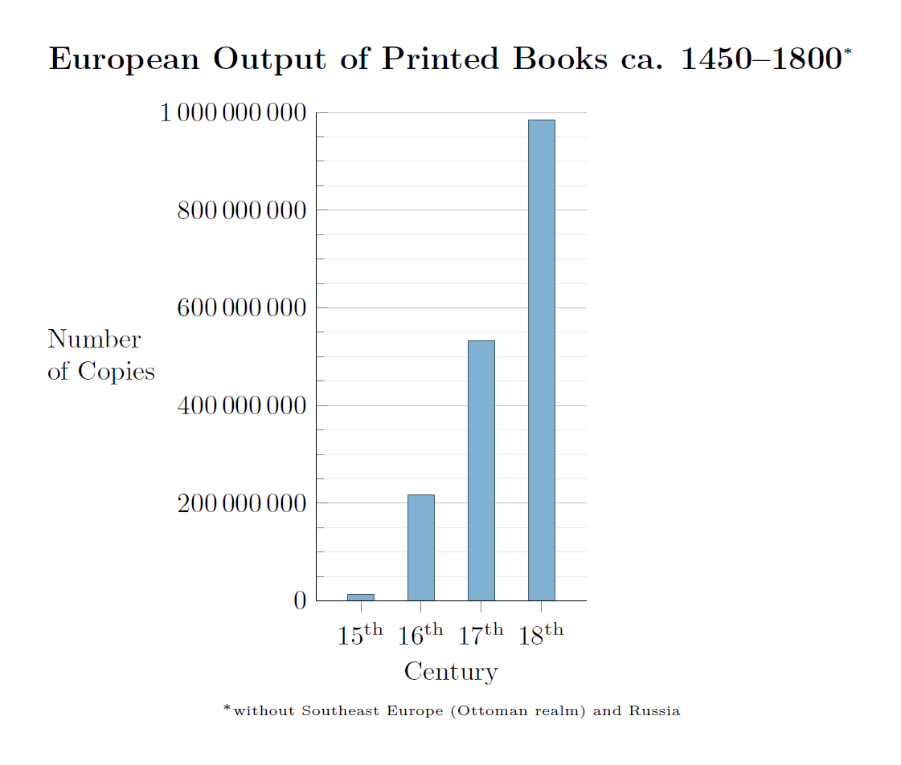
Cultural Confidence
Muslim rulers and subjects were confident in superiority and believed they had nothing to learn from Europeans
Ex. Printing Press in Ottoman Empire
  Introduce by Jewish refugees in late 15th c.
  Books only allowed in their own language, not Turkish or Arabic
  Prefer elegant handwritten books, especially Quran
  Also feared spread of dangerous ideas

