Slide 1
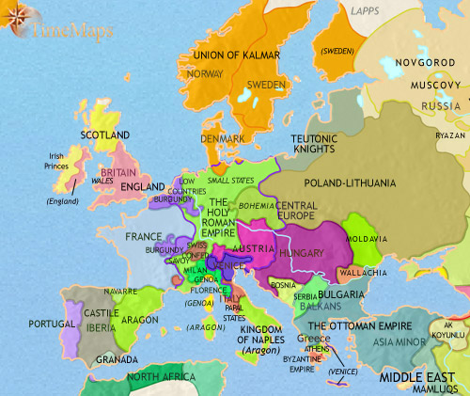
Rise in Nationalism
France and England both experience nationalism for the first time after the Hundred Year’s War (1453).
What about the rest of Europe???

Slide 2
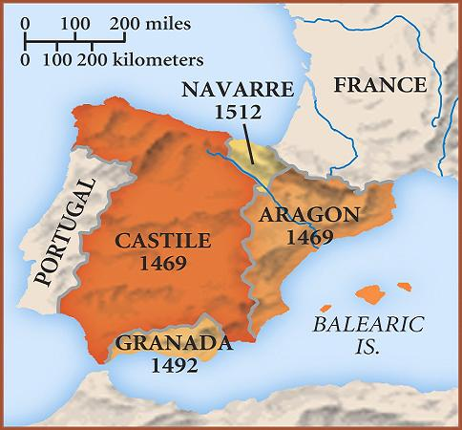
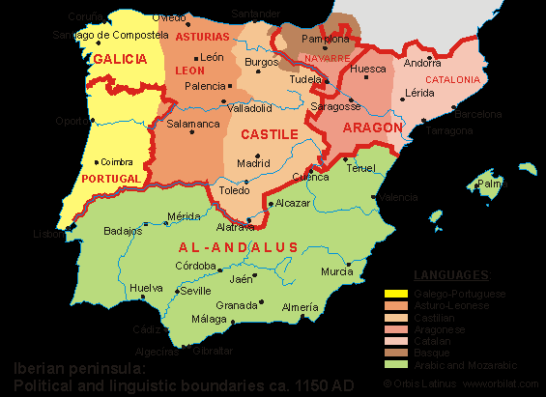
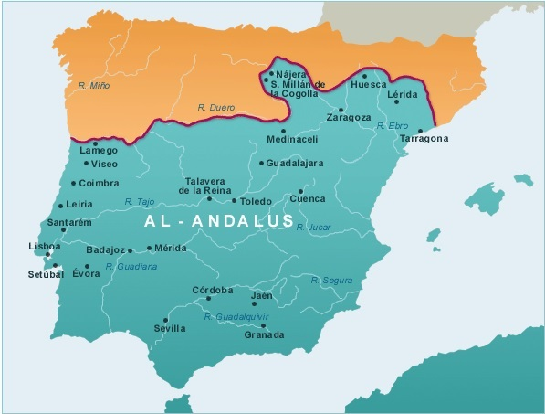
Rise and fall of Islam in the Iberian Peninsula

Slide 3
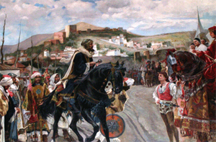
Islam On the Peninsula
The Islamic faith in the Iberian peninsula (Spain and Portugal) dates back to 711 AD
Tariq Ibn- Ziyad brought the country under Islamic rule.

Slide 4
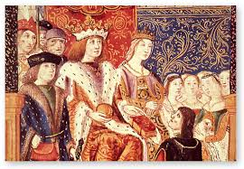
Ferdinand and Isabela
This control lasted until 1492, when Muslims were forcibly removed from much of Spain during the Reconquista.
Queen Isabella (Castille) and King Ferdinand (Aragon) married to form a Christian alliance in Spain and forced out the Jews and Muslims.
The Reconquista was an almost eight hundred year period in which the northern Catholic kingdoms of Spain succeeded in defeating and conquering the southern Muslim states.

Slide 5
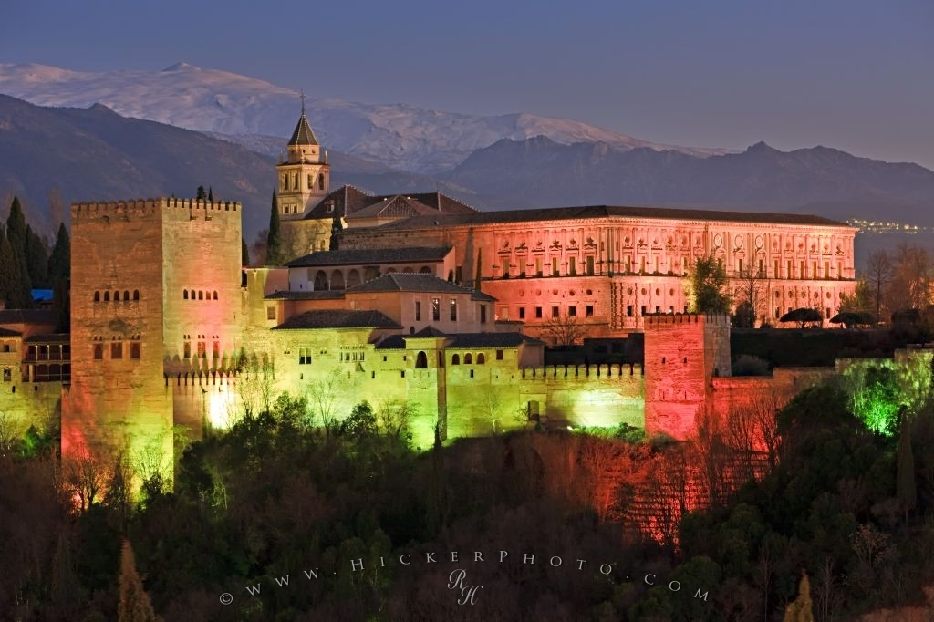
Continuity and Change: Elements of Islam in the Iberian Peninsula today?
-Architecture!
-Knowledge!
-Language!
arroz (rice), alfombra (carpet), jarra (jug), and paraiso, or paradise
Azul, azulejo, jota (h sound) etc.

Slide 6
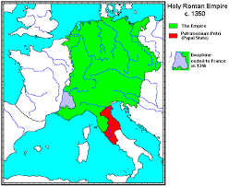
Holy Roman Empire

Slide 7
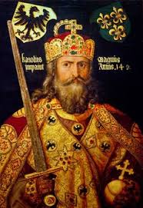
Holy Roman Empire
Emerged after fall of Roman Empire
Different dates of when it began
Name Holy Roman Empire used beginning in 13th century
In area of what is today known as Germany (and surrounding areas)
Emperor was often elected by highest ranking nobles.

Slide 9
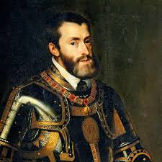
Rise of the holy Roman Empire
1519- Charles I chosen as Holy Roman Emperor
Inherited the Spanish thrones of Castile and Aragon in Spain from Isabela and Ferdinand (Aunt Isabela).
Used his resources to stop Islamic invasion into southeastern Europe
Charles wants to centralize power and create the largest and strongest state in all of Europe
This fails due to political rivalries and alliances as well as the Protestant Reformation.

Slide 10
