Slide 1
Stalin and the Soviet Union

Slide 2
Communism in Russia
Must defend the world’s 1st “dictatorship of the proletariat”
Civil War in 1918-1920: Reds-Bolsheviks v. Whites
Bolshevik Red Army wins
Tsar executed as well as enemies of revolution
Lenin institutes the NEP: New Economic Policy 1921
-Temporarily restores market economy
-Large industry, banks, transportation, communications stay under state control
NEP-Period Marketplace 1921
Small-scale private trade brought rural
foodstuff into city marketplaces.

Slide 3
The Stalin Revolution
1920’s recover from Revolution & civil war
1929, Stalin leads them to economic and social transformation
Part of the Bolshevik Revolution, works his way up w/in party
Makes himself absolute dictator

Slide 4
Totalitarianism
A gov’t that takes total, centralized state control over every aspect of public and private life
Mass communications made it possible to reach into all aspects of their lives
Joseph Stalin at a Soviet congress in 1936. By 1928 Stalin had prevailed over his opponents to become the dictator of the Soviet Union, a position he held until his death in 1953.

Slide 6
Methods of Control
Police Terror
To enforce gov’t policies
May use spying, brutal force, or murder
Indoctrination
Instruction in the gov’ts beliefs
Begins very young
Propaganda and Censorship
Biased or incomplete information to sway people to accept beliefs
Control mass media
Suggesting that it is incorrect is treason and punished
Imprisonment or killed
Religious or ethnic persecution
“Enemies of the state”

Slide 7
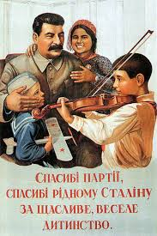
Propaganda and Censorship
Controlled all newspaper, motion pictures, radio etc.
Writers, composers, artists censored
No toleration of individual creativity
Rewarded those artists who created works of propaganda
All glorified the achievements of the Communist state, Stalin

Slide 8
Five Year Plans
Plans to industrialize the Soviet Union rapidly
Set goals for output of steel, electricity, and machinery
Created whole industries and cities from scratch
Peasants work in mines, factories, offices
Roads, canals, railroads cut landscape

Slide 9
Education and Indoctrination
Control of education
From nursery schools to universities
Learned virtues of Communist Party
Party leaders lecture on ideals
Stress importance of sacrifice and hard work to build Communist state

Slide 10
Religious Persecution
Replace religious teachings with ideals of communism
“Museums of atheism” displayed exhibits to show religious beliefs were superstition
Russian Orthodox church was the target of persecution
Leaders killed or sent to camps
Destroy churches and synagogues

Slide 11
Women’s Role in Soviet Society
Soviet women won equal rights after Bolshevik Revolution 1917
Under Five Year Plan, they are forced to join labor force
Same jobs as men
Work in factories, built dams, roads
Careers in science engineering
75% of Soviet doctors were women in 1950
Motherhood was patriotic duty to provide state with future, loyal, obedient citizens
Liberated women-build up socialism
1926

Slide 12
Collectivization of Agriculture
Men and women drive tractors out of one of the Soviet Union's Machine Tractor Stations to work fields where mechanization had been a rare sight.

Slide 13
Collectivization of Agriculture
Consolidated the small private farms into vast collectives
Farmers had to work together in commonly owned fields
Collectives required to supply gov’t w/ fixed amount of food and distribute the rest
Kulaks (better-off peasants) resisted
Soldiers came at gunpoint & burnt crops, smashed equipment, slaughter livestock
½ of horses & cattle and 2/3 of sheep & goats slaughtered
Stalin orders the liquidation of kulaks as a class
8 million executed, sent to gulags, or starve to death

Slide 14
Famine
Peasants left to farm were least competent
Could not plant or harvest enough to meet demands of cities
Gov’t took everything they found
1933-34 famine killed some 5 million people

Slide 15
Stalin’s Second Five Year Plan
Ran from 1933-37 emphasized heavy industry to produce armaments
Metals and machines increase 14 x over but consumer goods scarce
Leaves Soviets without clothing, food, and housing

Slide 16
The Great Purge
A campaign of terror directed at eliminating anyone who threatened power
Estimate 8-13 million deaths
Stalin used secret police, the NKVD, to prevent rebellion
Arrested engineers and technicians for fear of counterrevolutionary ideas
Expelled 1 million members of Communist party
Great Purge Trials
Accused Communist party members of treason
Executed or sent to “gulags” or forced labor camps for “crimes against the Soviet state”

Slide 17
Gulags
People from all walks of life arrested for any or no reason
Millions sent without trials to gulags
There they die of exposure of malnutrition
At height, some 8 million sent/ 1 million die

Slide 18
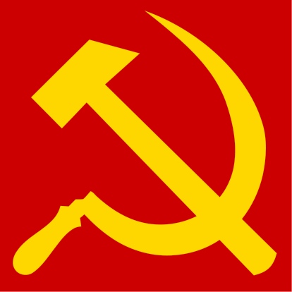
Outcome of Stalin’s Regime
Citizens supported his regime with new industries, cities, employment opportunities for everyone
His brutal methods helped them industrialize faster than any country had done
By late 1930’s, USSR was the 3rd largest industrial power after US and Germany

