Slide 1
STATE, Society, and the Quest for Salvation in India

Slide 2
Buddhism
Siddhartha Gautama, c. 563-483 BCE
Encountered age, sickness, death, then monastic life
Abandoned comfortable life to become a monk

Slide 3
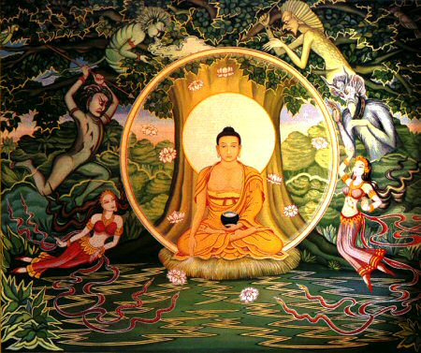
Siddhartha’s Search for Enlightenment
Practiced intense meditation, extreme asceticism
49 days of meditation under fig tree to finally achieve enlightenment
Attained title Buddha: “the enlightened one”

Slide 4
The Buddha and his Followers
Begins teaching new doctrine c. 528 BCE
Followers owned only robes, food bowls
Life of wandering, begging, meditation
Establishment of monastic communities
Many surviving gold coins reflect the commercial vitality of northern India in the late first and early second centuries c.e. This one depicts the Buddha gesturing to his followers.

Slide 5
Buddhist Doctrine: the Dharma
The Four Noble Truths
all life is suffering
there is an end to suffering
removing desire removes suffering
this may be done through the Eight-fold path
(right views, intention, speech, action, livelihood, effort, mindfulness, concentration)
Achieve Nirvana
Buddhist state of Enlightenment
State of tranquility

Slide 6
Appeal of Buddhism
Less dependence on Brahmins for ritual activities
No recognition of caste, jati status
Philosophy of moderate consumption
Public service through lay teaching
Use of vernacular, not Sanskrit
Stupas: shrines housing relics of the Buddha and his 1st disciples that pilgrims venerated
Monastic communities help spread it
Monasteries serve as social, economic, and cultural influence
EX. Serve as banks for the community
Asoka supported it as well

Slide 7
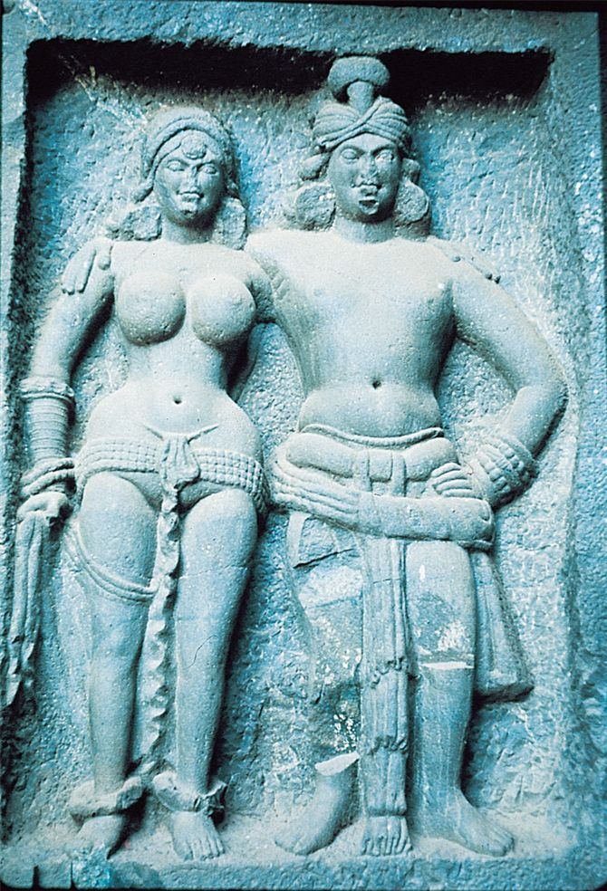
Changes in Buddhist thought
3rd c. BCE – 1st c. CE
Buddha considered divine
Institution of Bodhisattvas (“saints”)
Men and women who achieved enlightenment and were on threshold of nirvana, but chose to be reborn in order to help others
Charitable donations to monasteries regarded as pious activity
Buddhist art often depicted individuals as models of proper social relationships. Here a sculpture from a Buddhist temple at Karli, produced about the first century c.e., represents an ideal Buddhist married couple.

Slide 8
A painting produced in the late fifth century c.e. depicts the Buddha seated under a pavilion as servants attend to his needs and anoint him with holy water.

Slide 9
Mahayana Buddhism
Mahayana Buddhism(“greater vehicle”), newer development
Focus is on the reverence of Buddha and for bodhisattvas
Allowed to enjoy comforts of the world and still gain salvation
Attracted wealthy classes
Educational institutions promoted this faith, monasteries
India, China, Japan, Korea, central Asia

Slide 10
Jainism
Mahavira-founder
Doctrine
Everything in universe has a soul
Observe principle of ahimsa: nonviolence to other living things or souls-(influence Gandhi, MLK Jr.)
Monks go to extremes to avoid harming souls - Ex.?
Live ascetic life
Give up worldy goods, even clothes
Popular among lower castes such as merchants, scholars b/c non-violent
Mahavira, 540 BCE-468 BCE

Slide 11
Vardhamana Mahavira with one of his disciples.
Representations of the early Jains often depicted them in the nude because of their ascetic way of life.

Slide 12
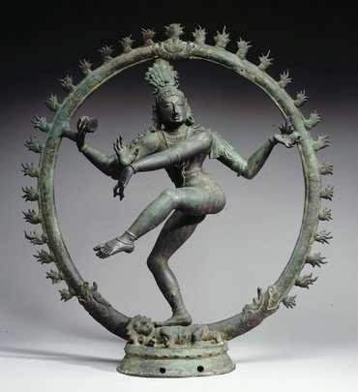
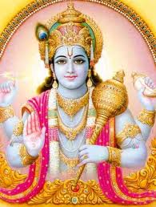
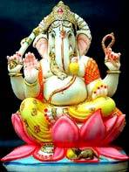
Hinduism
Shiva
Roots in Vedic religion of Aryans
Polytheistic, however seen today as a single divine force that pervades the universe
Emphasized a personal devotion to a particular deity
Brahma
Creator of the universe
Vishnu
The preserver and helps in times of need
Restores the balance of good and evil
Shiva
Represents creation and destruction
Ganesha
Half man/elephant
God of education, knowledge, wisdom, wealth
Remover of obstacles
Vishnu

Slide 13
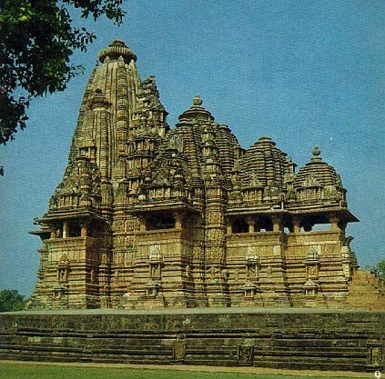
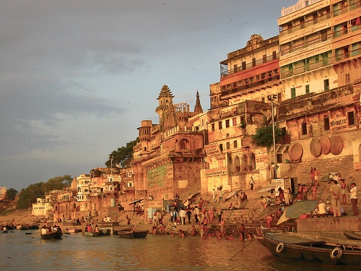
Forms of Worship
Variety of approaches
Through knowledge of sacred truth, mental & physical discipline (yoga) or deep devotion to the deity
Worship centers on temples
Humble to richly decorated shrines
Pilgrimage to famous shrine
All over Indian subcontinent
Mountains, caves, certain trees, plants, rocks all are sacred
Attendance at festivals allow to show more devotion
Ganges River is sacred
Ganges River

Slide 14
Hindu Symbol v. Nazi Symbol
Hindu symbol found in India meaning good fortune, luck or well being.
Adopted by the Nazis because it was known as an Aryan symbol indicating racial purity and superiority.

Slide 15
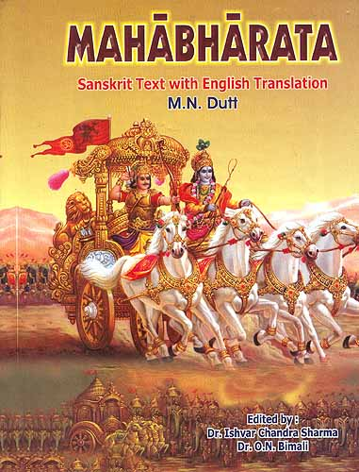
Emergence of Popular Hinduism
Mahabharata
Indian epic of war, princely honor, love, and social duty
Story of a great war between cousins in Aryan society for control of the kingdom
106,000 verses
10x longer than Iliad and Odyssey
Most famous part is the Bhagavad Gita
Most important of Hindu sacred literature
Dialogue b/n Arjuna and Krishna on one’s duty and fate of spirit
Ramayana illustrate the Hindu values
Epic tale tracing the adventures of King Rama and his wife, Sita
Epics reflecting more settled agricultural society and better organized political unit (compared to Rig Veda)
Will become the dominant religious and cultural tradition in India with the support of Gupta Empire

Slide 16
Bagavad Gita
Dialogue b/n Arjuna and Krishna on one’s duty and fate of spirit
“He who thinks this Self [eternal spirit] to be a slayer, and he who thinks this Self to be slain, are both without discernment; the Soul slays not, neither is it slain. . . . But if you will not wage this lawful battle, then will you fail your own [caste] law and your honor, and incur sin. . . . The people will name you with dishonor; and to a man of fame dishonor is worse than death.”
KRISHNA, speaking in the Bhagavad Gita

Slide 19
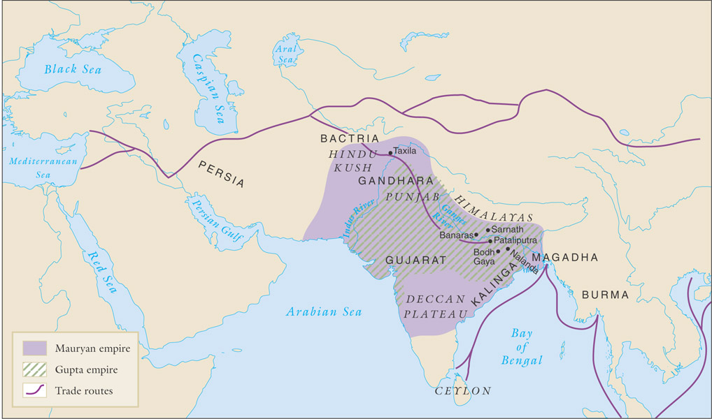
The Mauryan Empire324-184 BCE
Political unity in India has been achieved on rare occasions
Geography: different terrains
Complex social hierarchy
2 empires did arise in the Ganges Plain
Mauryan Empire
Gupta Empire

Slide 20
The Mauryan and Gupta empires, 321 b.c.e.–550 c.e.

Slide 21
Changdragupta Maurya’s Conquest
During 320s BCE, Chandragupta Maurya laid foundation of the first centralized and unified gov’t to Indian subcontinent
Seized control of the regions of Magadha, overthrew the ruling dynasty, conquered Greek state in Bactria
By end of 4th century BCE, he had all of northern India from Indus to Ganges
Mauryan Empire-India’s 1st centralized empire

Slide 22
Chandragupta’s Government
Guided by the political handbook called the Arthashastra
Outlined methods to administer empire, oversee trade and agriculture, collect taxes, maintain order, foreign policy, wage war etc.
Ex. Foreign Policy- “My enemy’s enemy is my friend.”
Ex. Taxes – ¼ the value of harvest
Ex. Army- Infantry, cavalry, chariots, elephants
Ex. Standard coins for trade
Used spies as informants
Built bureaucratic administrative system like China

Slide 23
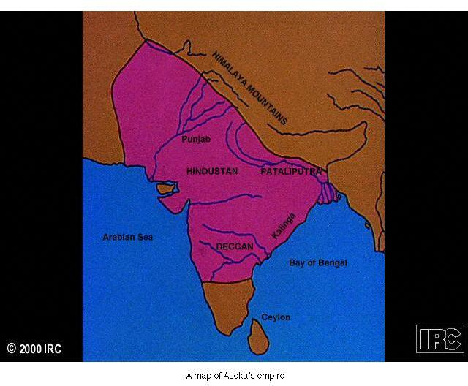
Asoka Maurya 268-232 BCE
Grandson of Chandragupta
His rule is high point of Mauryan Empire
Conquered southern India-Kalinga

Slide 24
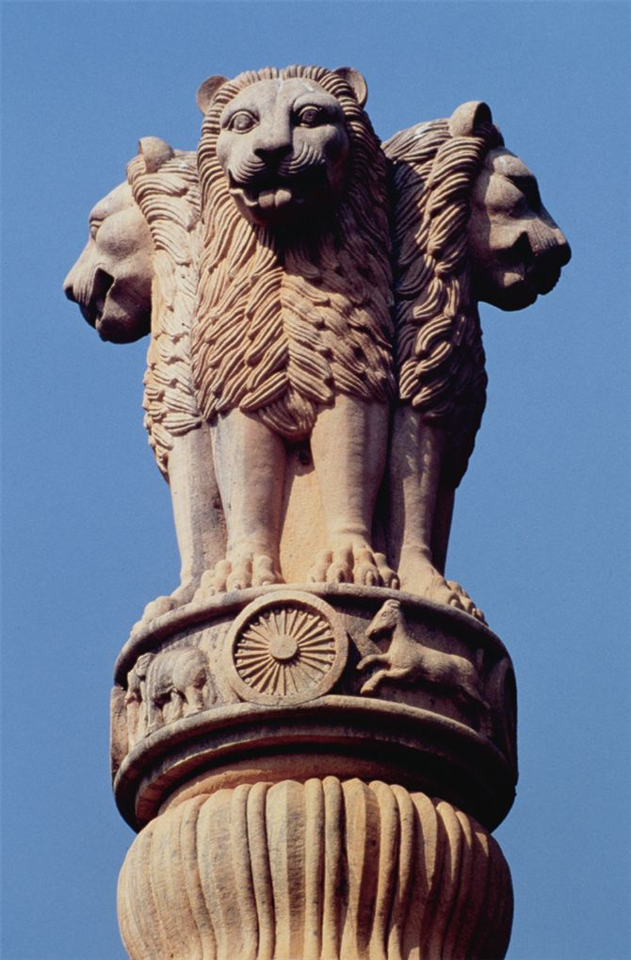
Asoka’s Conquest Promoted Change
In his conquest of Kalinga, 1,000s killed, wounded, or deported
Overwhelmed by brutality, he converted to Buddhism
Preached nonviolence, morality, moderation, and religious tolerance in govt & life
Ruled by Buddha’s teachings “peace to all beings”
Despite this…
“the king, remorseful as he is, has the strength to punish the wrongdoers who do not repent”
Built extensive roads throughout to make travel and communication easier
Equipped w/ trees, wells, and inns
As a symbol of his rule, Asoka had this sculpture of four lions mounted atop a column about 20 meters (66 feet) tall. The lion capital is the official symbol of the modern Republic of India. Why might this sculpture more than two thousand years old be an attractive symbol for modern India?

Slide 25
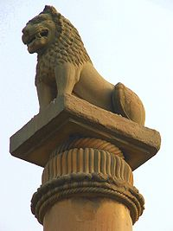
Asoka’s Edicts on Stone Pillars
Publicized his policies on great rocks and polished pillars throughout empire
Surviving inscriptions are the earliest decipherable Indian writing
King Asoka erected many stone pillars such as this handsome column, which stands 10 meters (32 feet) tall, to promote Buddhist teachings, direct travelers to holy sites, or commemorate significant events of the Buddha's life.

Slide 26
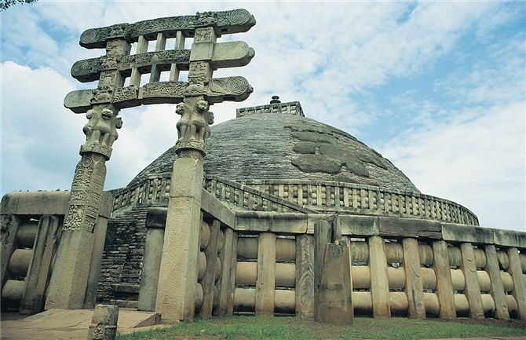
The famous Buddhist stupa at Sanchi, originally built by Asoka and enlarged in later times, is a domed shrine—representing the dome of heaven over the earth—intended to contain sacred relics of the Buddha. The shrine is flanked by four entry gateways carved with intricate scenes from the Buddha's life; the pillars of the southern gateway, pictured here, are each crowned with four lions, a Buddhist symbol associated with strength and power.

Slide 27
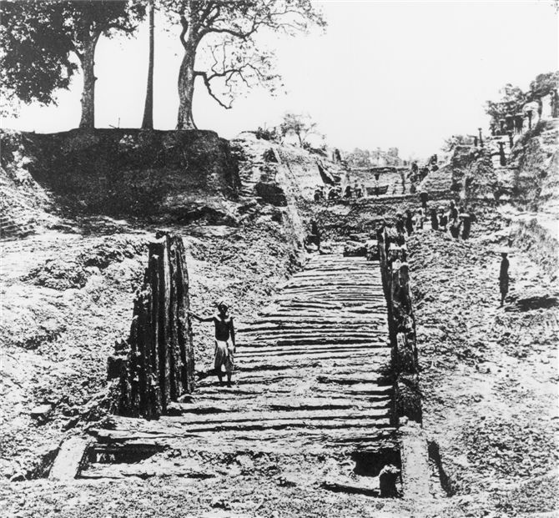
Archaeological excavations have unearthed parts of the defensive palisade, constructed of timbers almost 5 meters (16 feet) tall, that surrounded Pataliputra during Mauryan times.

Slide 28
Decline of Mauryan Empire
Economic crisis follows death of Asoka
High costs of bureaucracy, military not supported by tax revenue
Frequent devaluations of currency to pay salaries
Regions begin to abandon Mauryan Empire
Disappears by 185 BCE
500 years pass before another indigenous state has control over northern India

Slide 29
Trade and Manufacturing
Flourishing towns helped trade develop
Guild of merchants and artisans became politically powerful in absence of strong central gov’t
Overland trade routes with exports of cotton, black pepper, pearls, gems
Lots of goods go to Mediterranean markets-Rome
Spread Hinduism and Buddhism spread to SE Asia through the trade
Indian Ocean trade
Mariners use the monsoon seasons

Slide 30
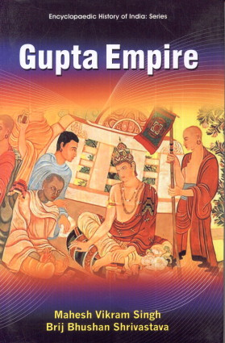
The Gupta Empire
Modeled after Mauryan but smaller
Founder called himself Chandra Gupta (320-335)
Strategic advantage being located on important trade routes
Highly decentralized leadership (smaller, less pervasive)
Standing army to keep control
Governors control outlying areas
Distant kingdoms sent tribute
Good example of a “theater state”
Used to “persuade” outlying areas to follow its lead
Solemn rituals, dramatic ceremonies, and exciting cultural events used as reason
Collected luxury goods and give them out as gifts to subordinate princes

Slide 31
Jewel-bedecked flying goddesses drop flowers on the earth from their perch in the heavens. Their gems and personal adornments reflect the tastes of upper-class women during the Gupta dynasty. This painting on a rock wall, produced about the sixth century c.e., survives in modern Sri Lanka.

Slide 32
A painting produced in the sixth century c.e. in the Ajanta caves of central India depicts individuals of different castes, jati, and ethnic groups in a crowd scene.

Slide 33
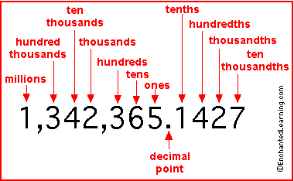
During Gupta Reign
Supported astronomers, mathematicians, and scientists, doctors
Ex. plot movement of stars & planets
Recognize earth is round
Lavish temple building
Concept of “Zero”
“Arabic” numerals
Place value notation
Flourishing of literary and artistic production
Poetry, music, drama, dance

Slide 34
The Decline of the Gupta Empire
Frequent invasions of White Huns, 5th c. CE
Tries to push them out but too costly and lack resources
Weakens them
Huns set up several kingdoms in north and western India
Gupta Dynasty continues in name only
Not until Mughal Empire founded in 16th c. will we see much of India united

