Slide 1
The Bubonic Plague

Slide 2
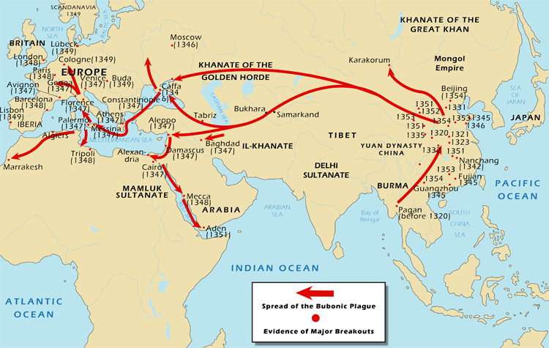
Origins of the Plague
Appears 1st in China
Carried by fleas on rodents
Ex. Rats, squirrels, prairie dogs
Fleas seek other hosts –Humans
Yersinia pestis is the bacteria in stomach of fleas that infect the rodents
Mongol campaigns spread disease from sw China to Chinese Interior in 1331
Mongols, merchants, and travelers spread the plague westward
Oases, trading towns, ports abundant breeding grounds
By 1348, following trade routes, plague sparked epidemics in Western Europe

Slide 3
Symptoms of the Plague
Chills, high fever, delirium, vomiting, rapid heartbeat
Internal hemorrhaging discolored the inflammations blue and black
“Black Death”
Inflamed and discolored lymph nodes in neck, armpits, groin area called “Buboes”
Buboes, hence Bubonic
60-70% mortality rate, within days of onset of symptoms
Wiped out towns, villages etc.
In Europe, plague erupted in 1340s-late 17th century

Slide 4
Regions not affected by the Plague
Regions of Scandinavia b/c of long, cold winters which discouraged proliferation of rodents
India for reasons unknown
Sub-Saharan Africa

Slide 5
Population decline

