Slide 1
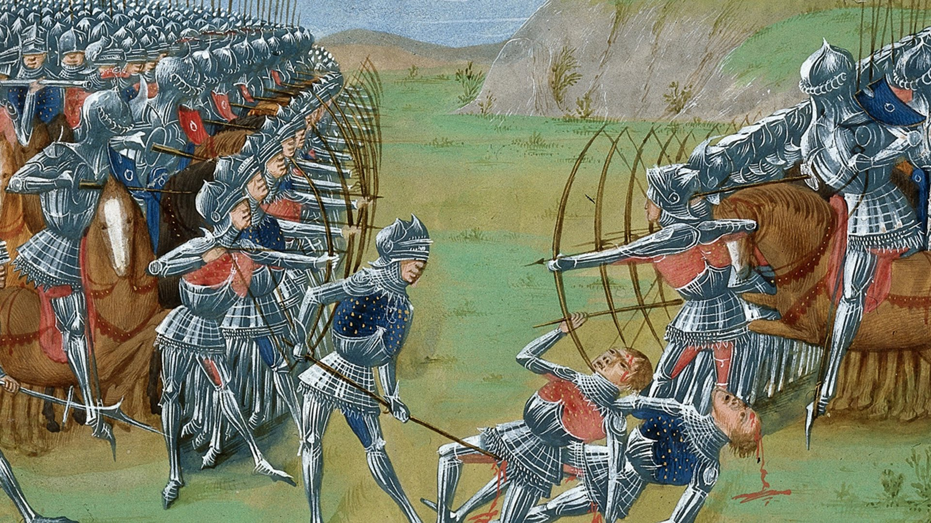
The Hundred Year’s War and the fall of feudal Europe

Slide 2
Standards
MWH-1.4 Evaluate the impact of the collapse of European feudal institutions and the spread of towns on the transmission of goods, people, and ideas in Europe.
MWH -2.3 Explain the competition between European kingdoms for space and resources, including the Hundred Years’ War between France and England, the rise of the Holy Roman Empire in Central Europe, and the response to Islam on the Iberian Peninsula.

Slide 3
England- A brief History
Formed by blending of cultures
1066- Duke of a land in Northern France invaded and took control of the island of Britain.
William the Conqueror declared all of England his.
1154-1189- King Henry II- gains territory in France through marriage
1215- Magna Carta is signed against King John- this document limited the power of the kings

Slide 4
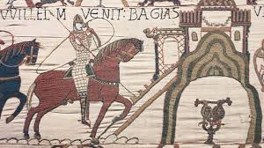
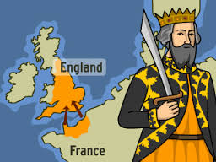
William the Conqueror

Slide 5
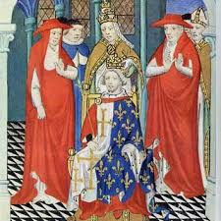
France- A brief History
987-1328- Capetians- dynasty of kings ruled
France separated into 30 separate territories each ruled by different lord
Kings- ruled only small area near Paris
1180-1223- King Philip II- seizes more territory to rule including some English land in France.
Succeeds in making a stronger central government in France.

Slide 6
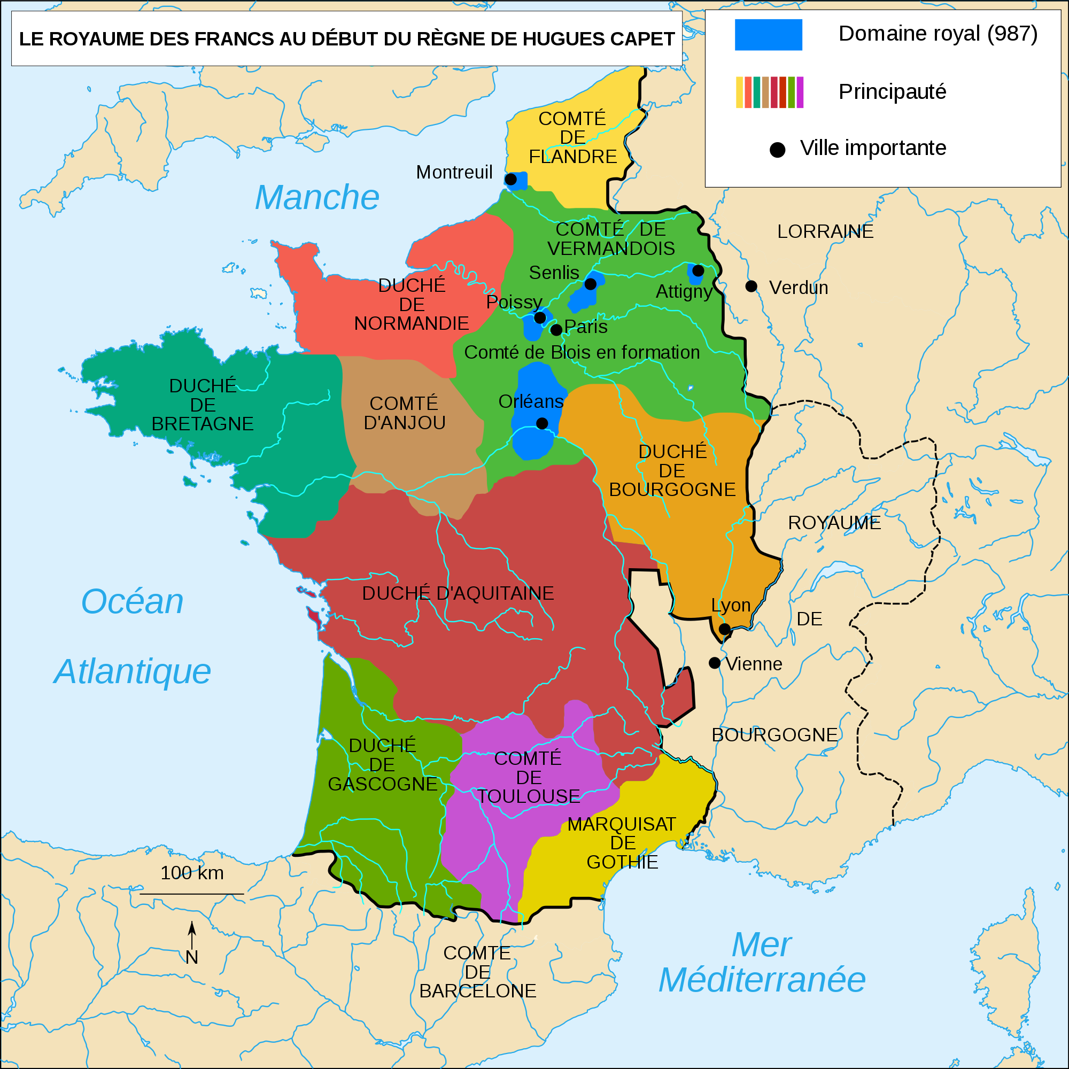

Slide 7
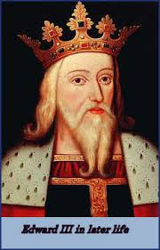
The Hundred Year’s War
Last Capetian king of France died in 1328- had no heir!
Edward III of England claimed the throne- (grandson of Philip IV of France).
1337-Edward began a war known as the Hundred Year’s War to win France

Slide 8
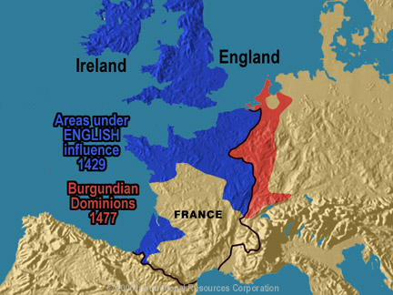
The Hundred Years’ War
1337–1453
England vs. France
Why? English king Edward III claims French throne
War marks the end of medieval society
Change in style of warfare
War fought on French soil

Slide 9
The Battle of Crecy
The Battle of Crecy
Aug. 26, 1346
English greatly outnumbered
French army used archers w/ crossbows, on horseback, w/ armor
The English used longbow
Victory of longbows signals end of reliance on knights

Slide 10
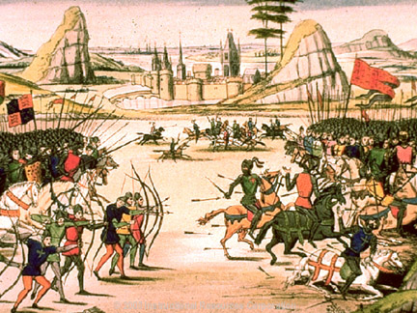
Battle of Poitiers
English repeat victory w/ use of longbow

Slide 11
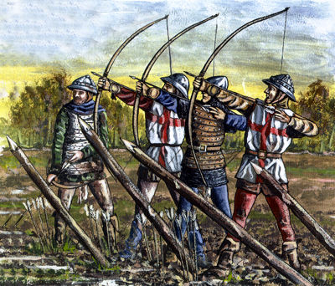
Battle of Agincourt
1415
English outnumbered 6,000 troops to France’s 20,000-30,000
Longbow successful for English again

Slide 12
Joan of Arc
Joan of Arc
Peasant girl who believes in visions of the saints
Visions tell her to drive out English and give the French crown to Charles VI’s son
May 7, 1429 – Battle of Orleans
Captured by the Burgundians in 1430 where she is turned over to the English
Church condemns her as a witch & heretic for her voices
Burned at the stake on May 30, 1431; her trial lasted 3 months

Slide 13
Charles VII o France
French king owed his crown to Joan but did nothing to rescue her
On July 7, 1456, twenty five years after Joan’s death, Charles found Joan not guilty of the original charges, leaving her reputations “washed clean…absolutely.”
Charles succeeded in uniting France as Joan had believed he would.

Slide 14
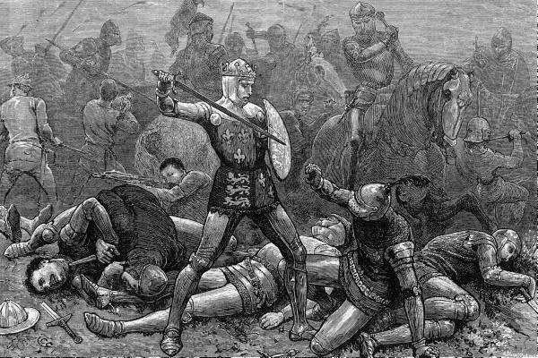
What was the outcome of the war?
France eventually won and England left France.

Slide 15
Impact of the Hundred Years’ War
Hundred Years’ War ends in 1453
END OF THE MIDDLE AGES and end of Age of Faith
France and England experience major changes
Rise in nationalistic feelings
King becomes national leader
Power and prestige of French monarch increases
Religious devotion and the code of chivalry crumbles
England begins period of turmoil, War of the Roses

Slide 16
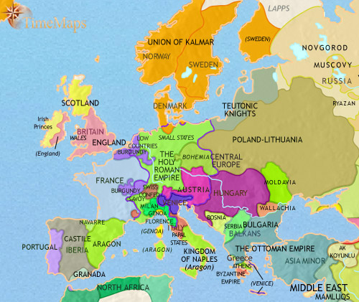
Rise in Nationalism
France and England both experience nationalism for the first time after the Hundred Year’s War (1453).
What about the rest of Europe???

