Slide 1
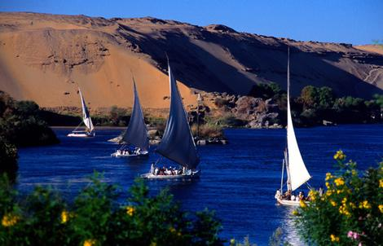
The Land of Egypt

Slide 2
The Nile valley, 3000–2000 b.c.e.
Note the difference in size between the kingdom of Egypt and the kingdom of Kush.
What geographic conditions favored the establishment of large states north of the first cataract of the Nile River?

Slide 3
"The Gift of the Nile"
Greek traveler Herodotus called Egypt this
Flows northward from Lake Victoria to Mediterranean Sea
Delta for last 100 miles
“Black Land” and “Red Land”
Upper/Lower Egypt
Cataracts hinder travel in parts of Nile
Agriculture entirely dependent on the river!!
Regular flooding in September

Slide 4
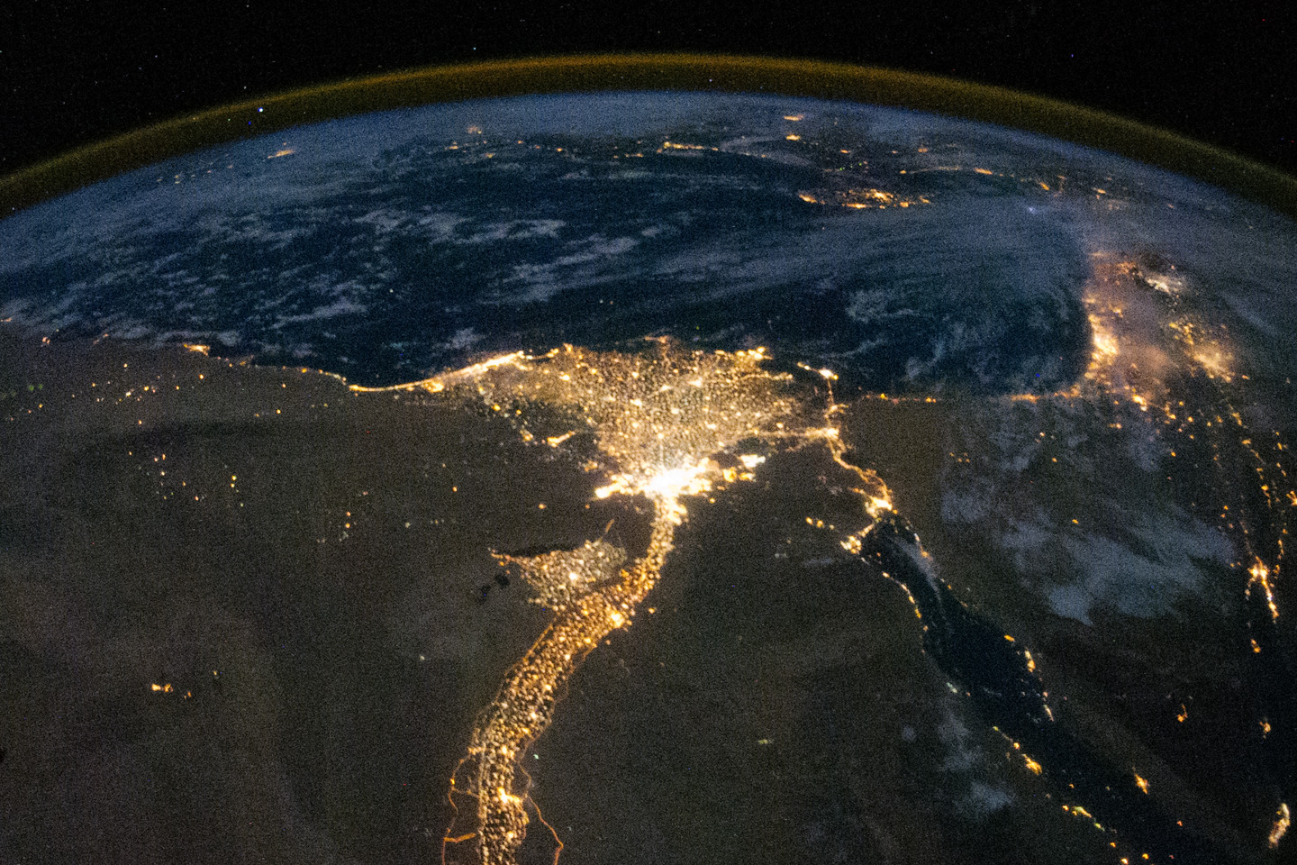

Slide 5
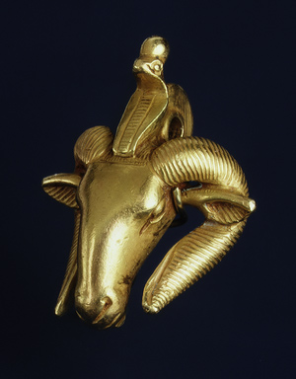
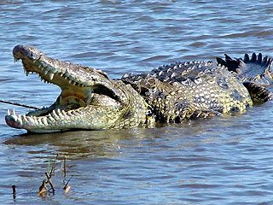
Natural Resources
Papyrus reeds for sails, ropes, paper
Abundant wild animals, birds, fish
Stone quarried and floated downstream
Clay for mud bricks/pottery
Copper/turquoise deposits in Sinai desert
Gold from Nubia

Slide 6
Divine Kingship
Pharaohs were gods sent to Earth to maintain order of universe
His rule ensures wealth and prosperity
Elaborate tombs built to ensure well-being of their journey to rejoin the gods
Perpetual offerings to them
Old Kingdom, pyramids were built

Slide 7
Pyramids
Built with stone tools
No machinery, just levers, pulleys, rollers
Blocks
Large number of people used to build them
80,000 laborers estimated working 80 days per year for 20 years

Slide 8
Tomb Painting
Building pyramids and other large structures involved heavy work, especially by the less privileged classes. Here an Egyptian manuscript painting produced about 1000 b.c.e. depicts a supervisor overseeing a group of laborers as they drag a sled loaded with building blocks.

Slide 9
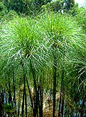
Administration and Communication
Large organized bureaucracy
Hallmark to administrative class was literacy
Hieroglyphics
Used for administration but also for tales of magic, religious hymns, love poetry and instruction manuals
Wrote on papyrus
Scribes kept records
Appointed officials to the pharaoh administer empire

Slide 10
Cities in Egypt
Lacked real cities unlike Mesopotamia’s urban centers
Most people lived in rural villages and engaged in agriculture
Many ancient urban sites lie under modern communities

Slide 11
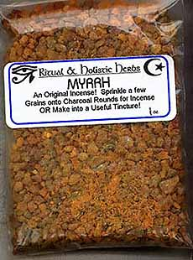
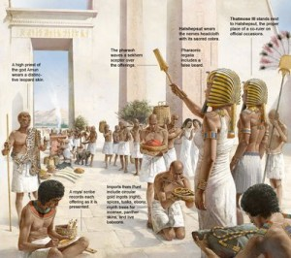
Trade in Egypt
Egypt mostly interested in acquiring valuable resources
Nubia to the south with gold
Land of Punt, source of fragrant myrrh resin burned on altars of Egyptian gods

Slide 12
A wall painting from the tomb of an Egyptian imperial official in Nubia depicts a delegation of Nubians bringing tribute in the forms of exotic beasts, animal skins, and rings of gold.
Why might these unusual gifts have been welcome tribute for Egyptians?

Slide 13
The People of Egypt
No formal class structure unlike Mesopotamia
Top=king and high-ranking officials
Middle= low-ranking officials, local leaders, priests, artisans, wealthy farmers
Bottom=Peasants
Women of upper classes depicted in art with dignity and affection

Slide 14
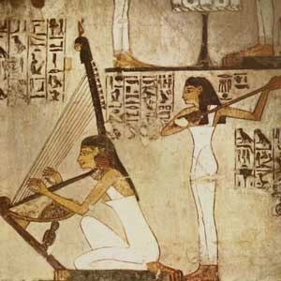
Women in Egypt
Depicted with dignity and affection
Could own property, inherit from their parents, and will their property to whomever
Marriage and could divorce
More rights than in Mesopotamia

Slide 15
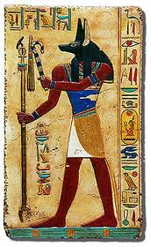
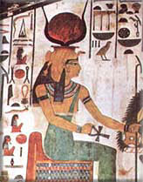
Religion
Natural environment was a place of recurrent cycles and periodic renewal
Some Gods depicted with animal heads, human bodies
Gods: Re, Osiris, Isis, Anubis etc.
Temples built for prominent deities

Slide 16
Religion and the Afterlife
Strong belief in afterlife
Death is a journey beset with hazards
Egyptian Book of the Dead excavated in tombs
Contained spells, rituals to protect the person
Weighing of deceased heart in the presence of Judges

Slide 17
Mummification
Vital organs removed, preserved, stored in jars
Body cavities filled with packing materials
Body immersed in natron to dehydrate and preserve it, eventually wrapped in linen
Placed in one or more wooden caskets and placed in tomb

Slide 18
Burial
Constructed elaborate tombs which indicated your wealth and status
Common people made do with simple grave pits
Pyramids, Valley of Kings
Built on edge of desert so not to interfere with farmland
Filled with pictures, food, and objects of everyday
“Shabti” dolls included to play the servants needed
Shabti dolls

Slide 19
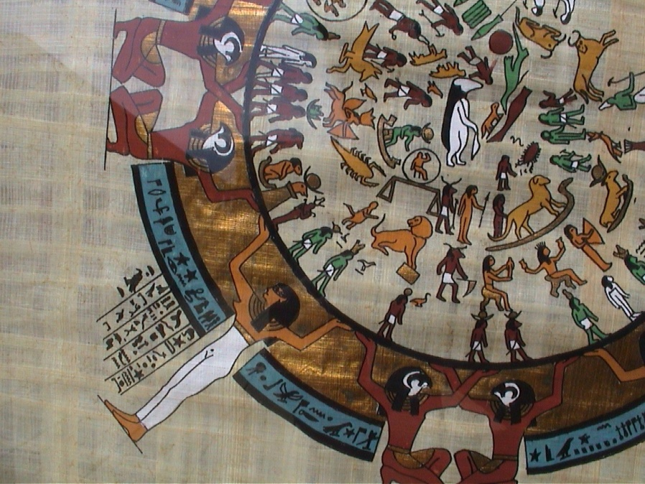
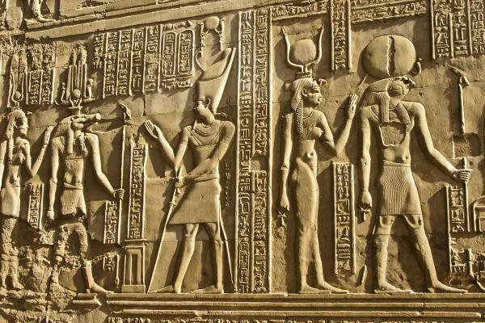
Science and Technology
Human anatomy
Mathematics to measure dims. of fields and what owed to state in fields
Most accurate calendar in world
Engineering: pyramids, temples, monumental bldgs
Canals

