Slide 1
The Middle East during the Early Iron Age
Israel and the Persians

Slide 2
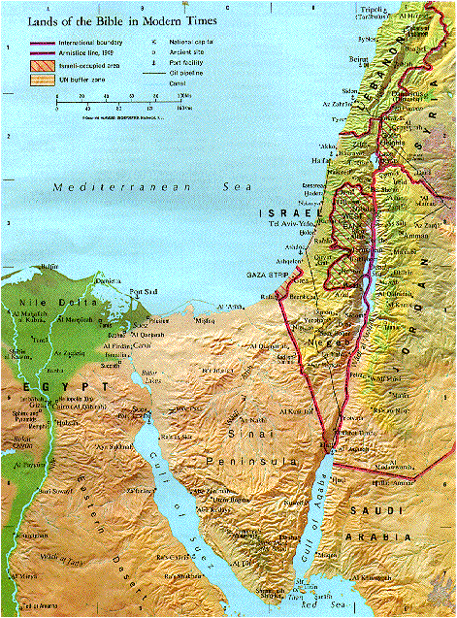
Israel 2000-500 CE
Israel always been a crossroads
Few natural resources
Desert on Sinai
Med. Coastal plain
Galilee w/ sea was a fertile land of grassy hills & small plains
Jordan River runs to Dead Sea

Slide 3
AP Exam Tip
Judaism is one of the major belief systems that is important to understand for success on exam.

Slide 4
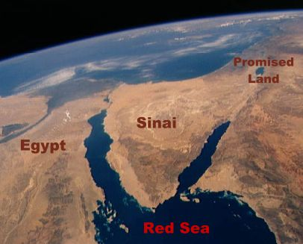
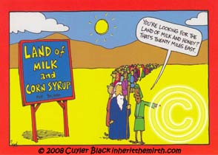
Various Names in history
Land
  Canaan
  Israel
  Palestine
People
  Hebrews
  Israelites
  Jews
  Israelites in antiquity

Slide 5
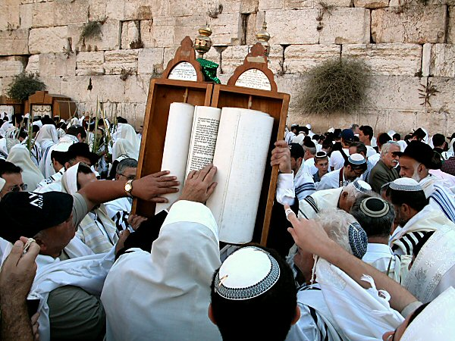
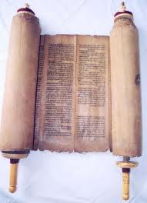
Torah
Hebrew Bible originally passed down orally
10th century BCE written down in Phoenician script
5th century BCE text we have today

Slide 6
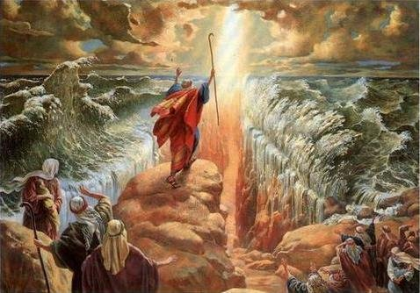
Pattern in Middle Eastern History
Started as “Early Pastoralists”
  Begins with Abraham 1800 BCE approx. migrates from Mesopotamia to Canaan
  Settled people suspicious of them
    Ex. Innocent shepherd Abel, killed by farmer brother Cain
    Ex. Sodom & Gomorrah destroyed by Yahweh b/c of wickedness
  Later migrate to Egypt and eventually enslaved them
  Moses leads them out, receives 10 Commandments
Settle down to an agricultural way of life
Develop a unified state

Slide 7
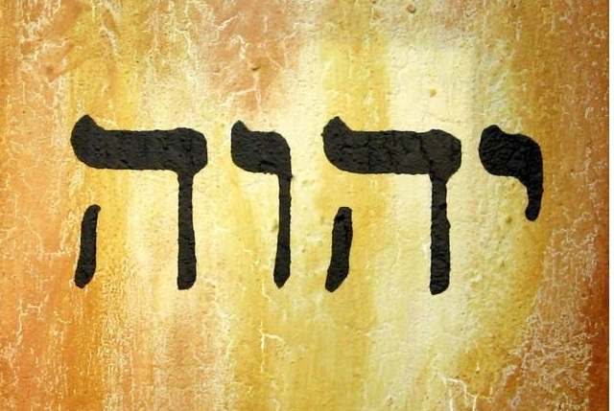
Yahweh
Their God whom demanded their exclusive loyalty
Consider the Jews to be “chosen people"
10 Commandments serve as guide
  “Thou shalt not have no other gods before me”
Divine
  God of social justice and compassion
  Singular, transcendent, personal, ruling over the natural order, engaged in history and demanding social justice and moral righteousness
Foundation on which Christianity and Islam were built

Slide 8
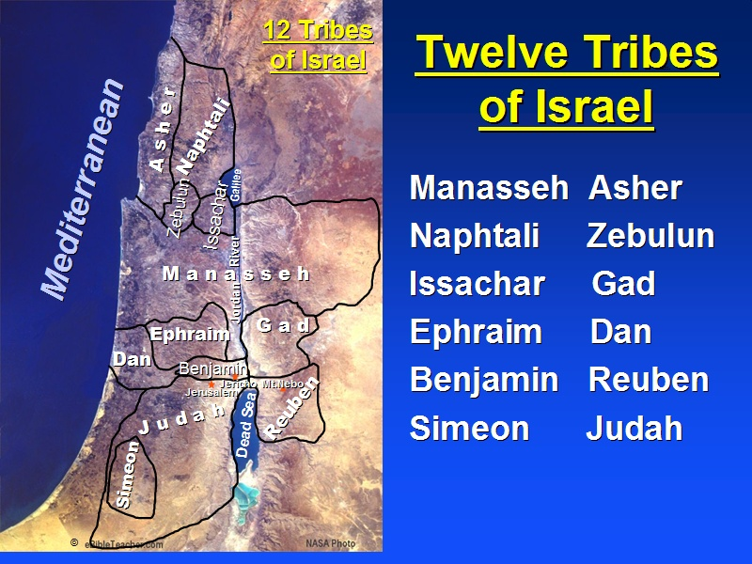
Pattern of World History in Middle East
Settle down to an agricultural way of life
  Joshua led the Israelites to Canaan
“Children of Israel”
  12 tribes descended from Jacob and Joseph
  Located in different parts of the country & by one or more chiefs
  “Judges” mediated disputes & welfare of people
  Tribes share the Ark of Covenant (10 Commandments)

Slide 9
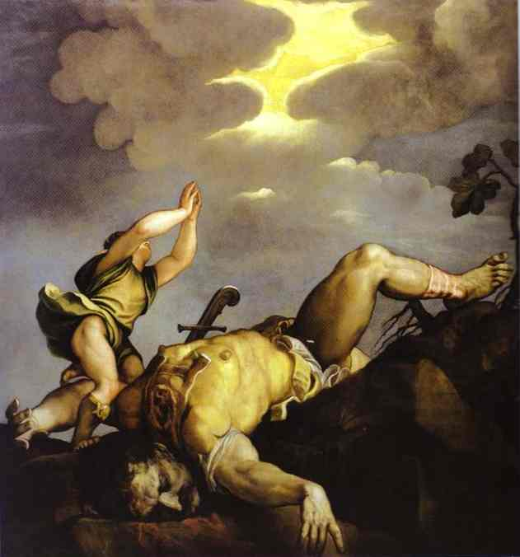
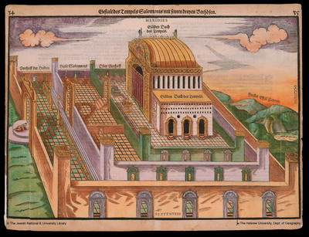
Kingdom of Israel 990-930 BCE
David
  Unites the tribes
  Made Jerusalem capital
Solomon
  High point
  Alliances and trade
  Built the First Temple that could compete w/ any major religion
David and Goliath 1542 by Titian

Slide 10
Fragmentation and Dispersal
920 BCE – Soloman’s death
Israel to the North
Judah to the South around Jerusalem
Formalized “monotheism” during this period

Slide 11
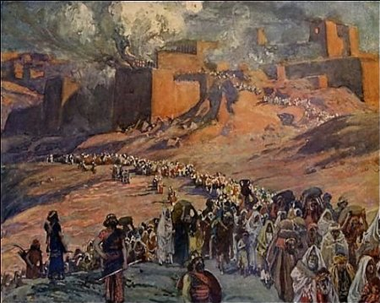
Temple Destroyed and Babylonian Captivity
721 BCE Assyrians destroy northern kingdom & deport most of population to the east
Judah survives for more than a century by paying tribute
Babylonian Exile
  Babylonians capture Jerusalem in 587 BCE
  Destroy temple
  During exile, Jews renew their cultural identity
Cyrus the Great allows them to return
Rebuild temple
  Some don’t leave (origin of the Diaspora) and create a strong Jewish identity
Babylonian exile: “By the rivers there we sat down, we wept, when we remembered Zion (Jerusalem).”

Slide 12

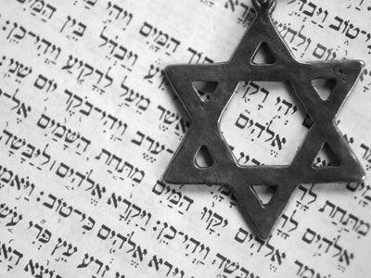
Jewish Identity
Unyielding monotheism
Lived by rigid rules
  10 Commandments
  Dietary restrictions: pork
  Ritual baths
  Sabbath-Saturday
  Ban on marrying “non-Jews”
  They were protected

Slide 13
Empire
“Supreme and extensive political domination; esp. exercised by an ‘emperor’…or by a sovereign state over its dependencies.”
Using the word, empire, explain why Persia qualifies as an empire.

Slide 14
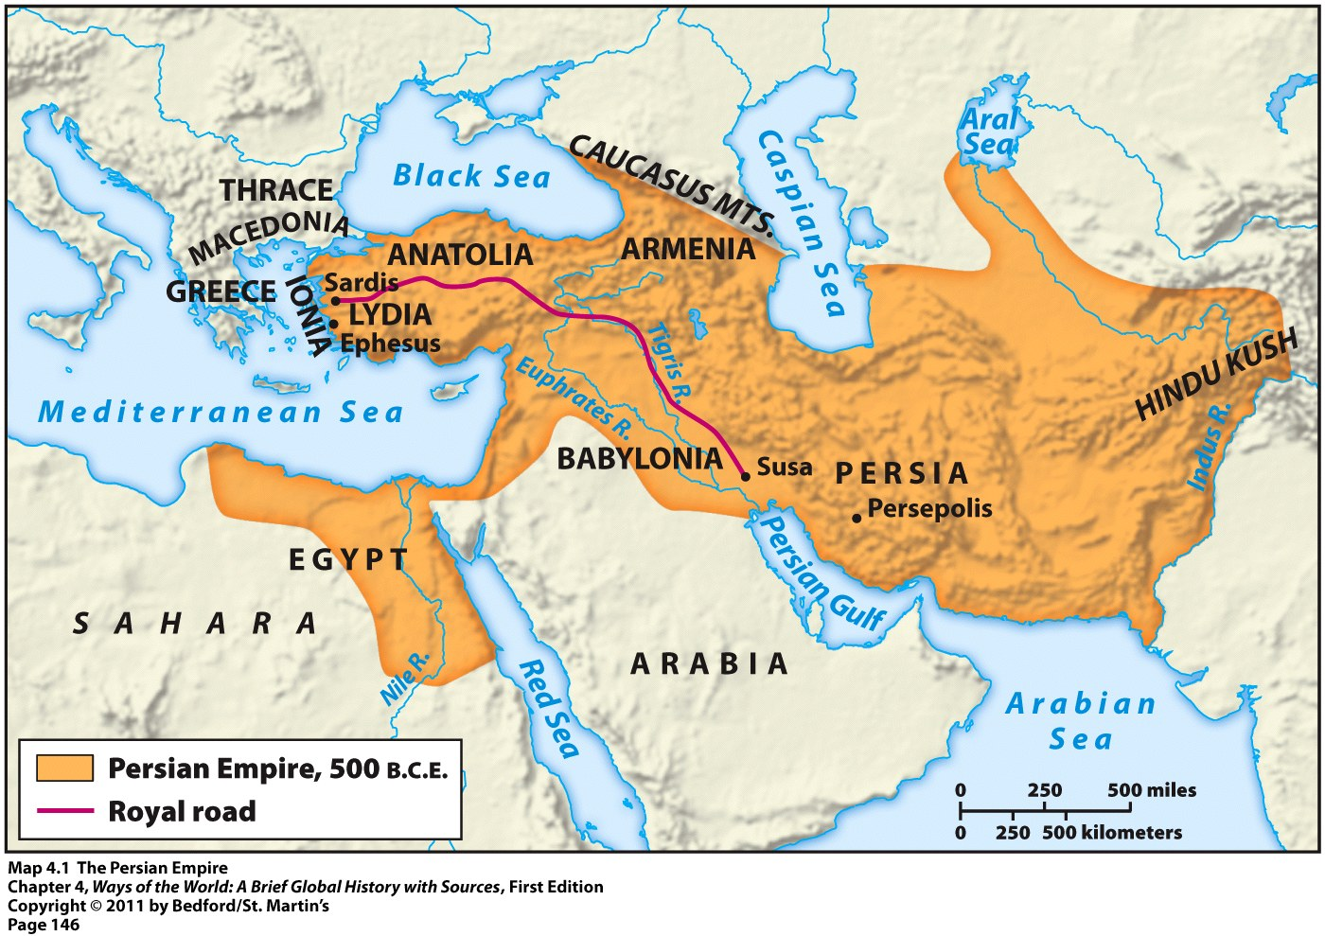
The Persian Empire
Iran “land of the Aryans”
6th century BCE created largest empire in world
Get accounts from Greeks

Slide 15
Political Style and Innovations
Tolerance – Ex. Cyrus the Great
Strongly authoritarian- Darius
Infrastructure for entire empire
Zoroastrianism

Slide 16
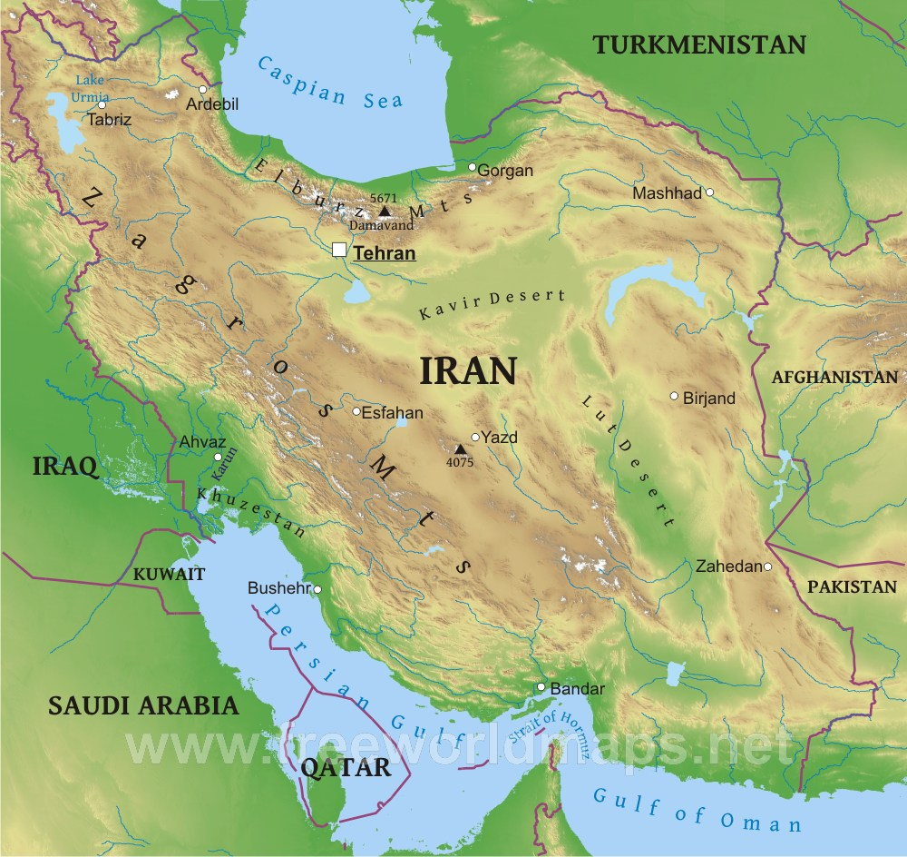
Geography and Resources
Modern-day Iran
Zagros Mountains in west
Caucasus Mountains and Caspian Sea to nw and n
Mountains of Afghanistan
Persian Gulf
Mineral resources
  Copper, tin, iron, gold, sliver
  Heavily wooded mountain slopes provide materials for bldg

Slide 17
Empire Centered on “Cult of Kingship”
Rule by will of great Persian god Ahura Mazda
Absolute monarchs

Slide 18
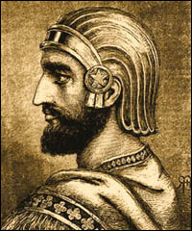
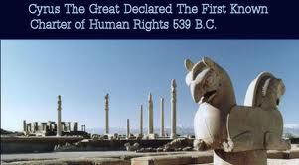
Cyrus the Great 550-530 BCE
Conquered Anatolia, Mesopotamia, Babylon
Known for tolerance
Respectful to native customs
Allowed Jews to return to homeland

Slide 19
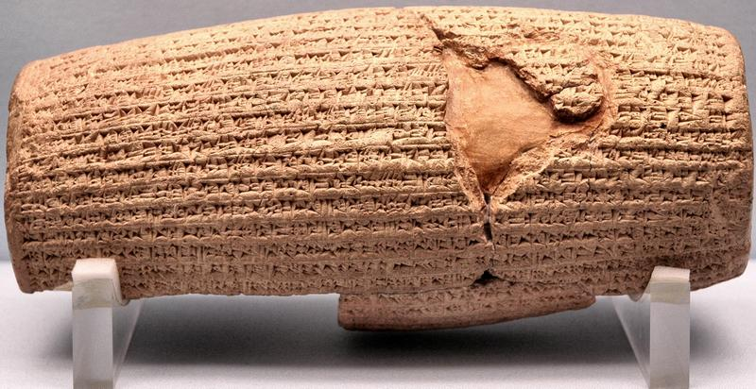
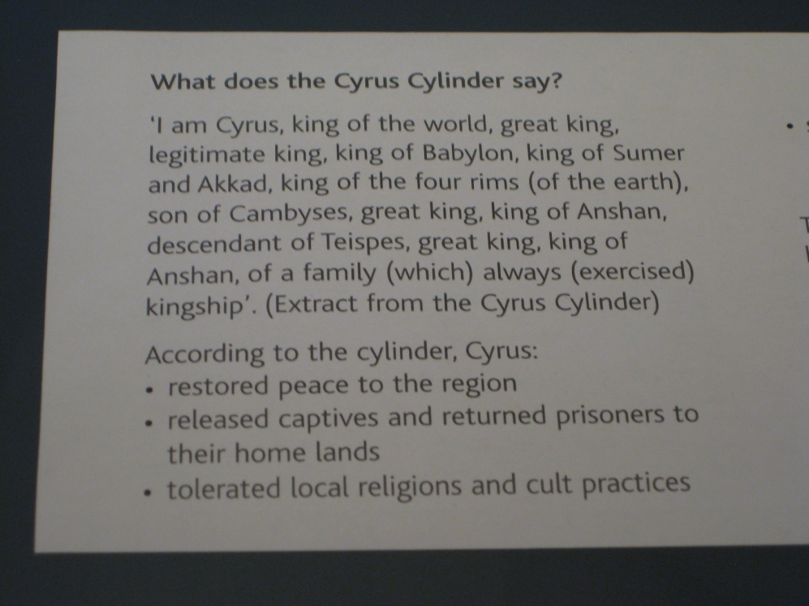
Cyrus Cylinder

Slide 20
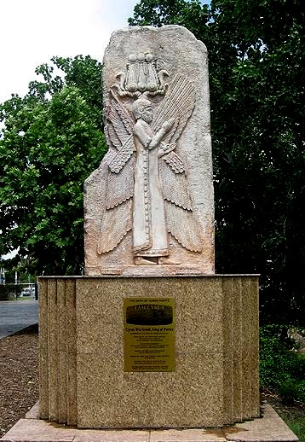
In 1994, a replica of a bas relief depicting him was erected in a park in Sydney, Australia.
Monument is intended as a symbol for multiculturalism, and to express the coexistence and peaceful cohabitation of people from different cultures and backgrounds.

Slide 21
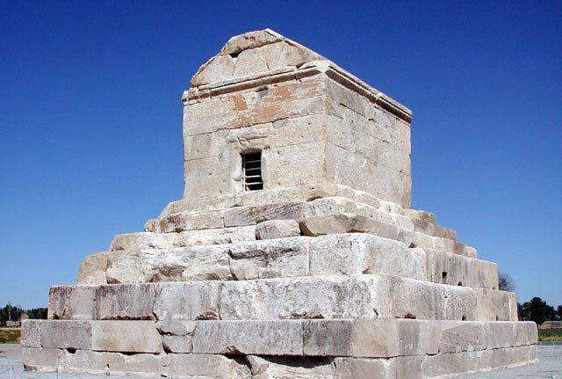
530 BCE Cyrus the Great Mortally Wounded
The tomb of Cyrus at Pasargadae—one of the few Achaemenid monuments that have survived to the present.
“O man, I am Cyrus the son of Cambyses. I established the Persian Empire and was king of Asia. Do not begrudge me my memorial.”

Slide 22
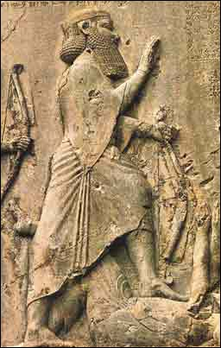
Darius I -522 BCE-486 BCE
Seizes throne in 522 BCE with help of the “10,000 Immortals”
  Elite soldiers
Extends empire to Indus Valley, some of Europe
Erected forts in Thrace(N.E. Greece & Bulgaria)

Slide 23
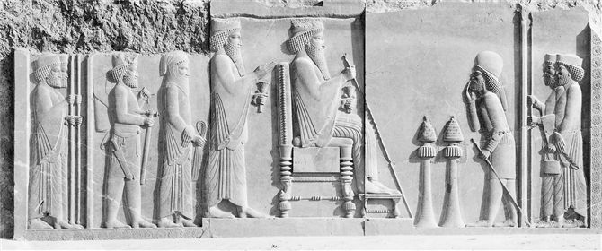
Administration: Satraps
Divided empire into 23 provinces
Under supervision of satrap or governor
  Usually connected to royal family
  Encouraged the intermarriage, cultural and technological exchange
  Military officers & tax collectors served as checks on the power of the satraps
Sent tribute to the king
Royal Roads connected the outlying provinces
Imperial spies known as the “eyes and ears of the king”
Standardized coinage
Stone carving from Persepolis showing an enthroned Darius (with his son Xerxes standing behind him) receiving a high court official, as incense burners perfume the air. In what ways does the official's posture indicate respect and submission to the emperor?

Slide 24
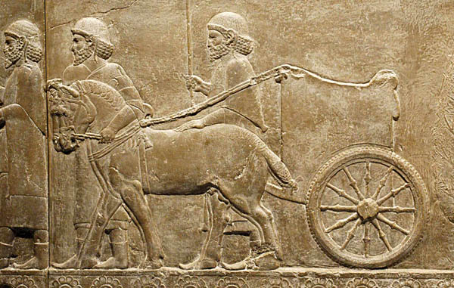
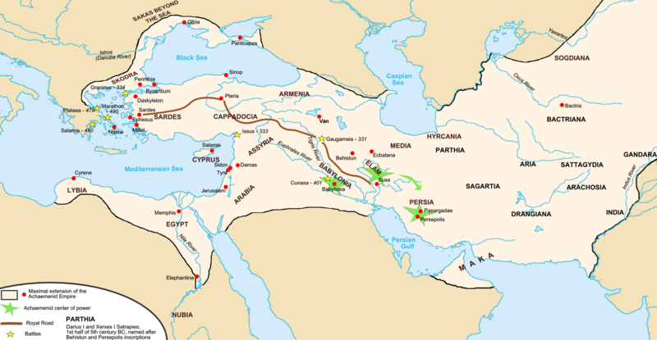
Royal Roads
1,600 miles
Communication and commerce
Ephesus to Sardis in Anatolia, along Tigris River to Susa in Iran, Persepolis
Caravans cross in 90 days
Courier service w/ 111 postal stations used for communication
Fresh horses every 30 miles

Slide 25
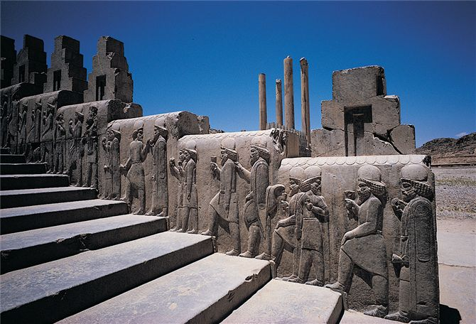
King and family
Numerous wives and children
Persian elite women may have been influential
King & court moved with the seasons, living in luxurious tents and in palaces of the ancient capitals of Mesopotamia & Iran
Large entourage w/ groups of sons of Persian aristocrats, noblemen, administrators, the royal bodyguard, and courtiers & slaves
In this sculpture from Persepolis, Persian nobles dressed in fine cloaks and hats ascend the staircase leading to the imperial reception hall.

Slide 26
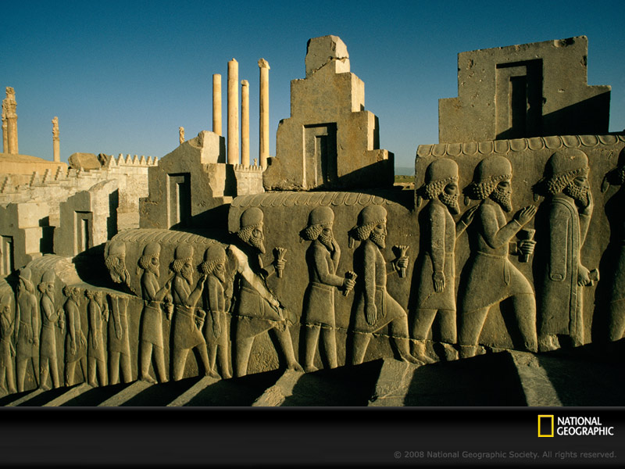
Persepolis
Constructed by Darius and Xerxes
Became the ceremonial capital
Palace, audience halls, treasury buildings, and barracks
Symbol of their power & wealth
Coronations, weddings, and funerals of the Persian kings held here
Luxuriant relief sculpture cover the foundations, walls, stairwells
Show diverse people bringing gifts to the king
Kings buried in tombs cut into cliffs around

Slide 27
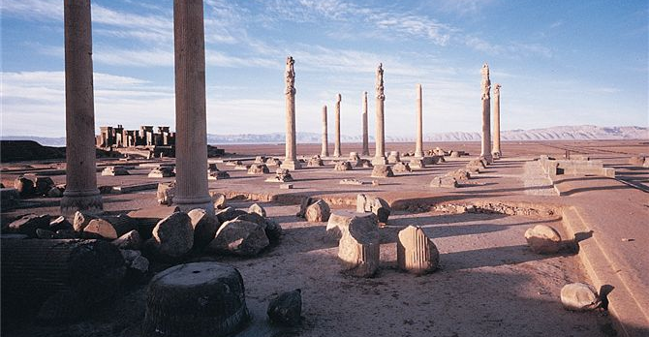
Persepolis
Ruins of Persepolis, showing the imperial reception hall and palaces. The columns rise about 19 meters (62 feet) and once supported a massive roof.

Slide 28
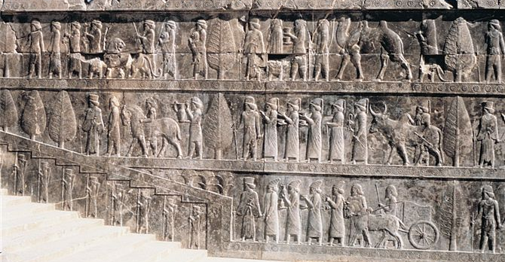
Walls of Persepolis
Tribute bearers from lands subject to Achaemenid rule bring rams, horses, and fabrics to the imperial court at Persepolis. Representatives of twenty-three lands offered tribute at the imperial new year festival.

Slide 29
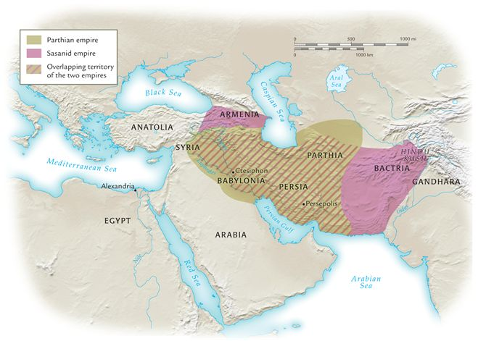
The Parthian and Sassanid empires, 247 b.c.e.–651 c.e.
Note the location of the Parthian and Sassanid empires between the Mediterranean Sea and northern India.
What roles did these two empires play in facilitating or hindering communications between lands to their east and west?

Slide 30
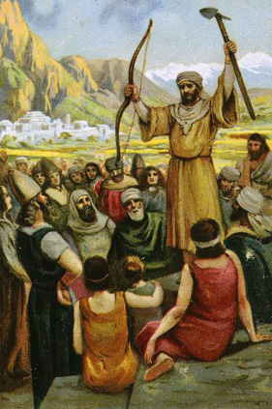
Zoroastrianism
Religion that originated in Iran
From the teachings of Zoroaster 7th or 6th century BCE
  Left home in search of wisdom & experienced visions of Ahuramazda, became prophet to spread message
Belief in supreme benevolent deity, Ahuramazda, “the wise lord”

Slide 31
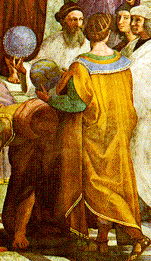
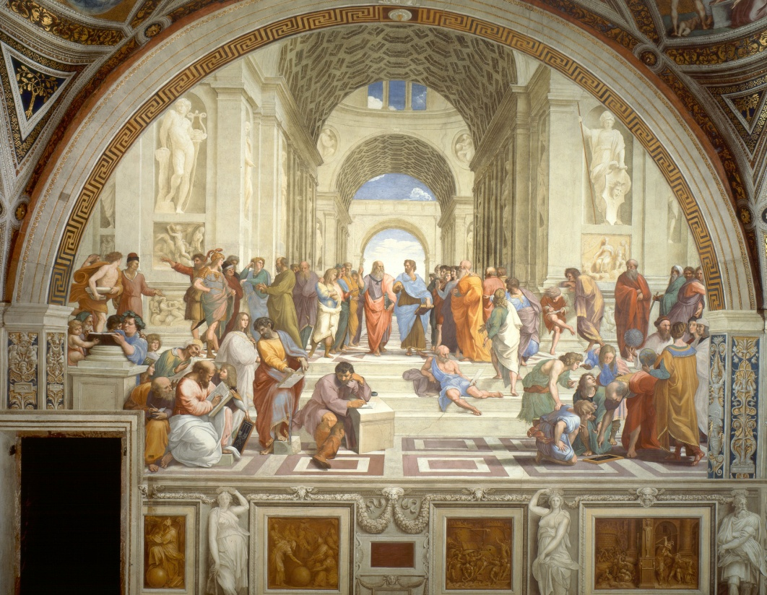
Renaissance: School of Athens-Raphael
Zoroaster holds the star-studded globe as he speaks to Ptolemy with the globe.

Slide 32
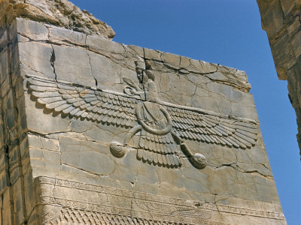
Zoroastrian Teachings
Recognize Ahura Mazda as supreme deity
Lesser deities
Not strict monotheists
Cosmic conflict with an evil spirit, Angra Mainyu, and eventually the forces of good would prevail and evil would disappear forever
  Good v. evil
Humans are rewarded or punished in their afterlife for their actions in life

Slide 33
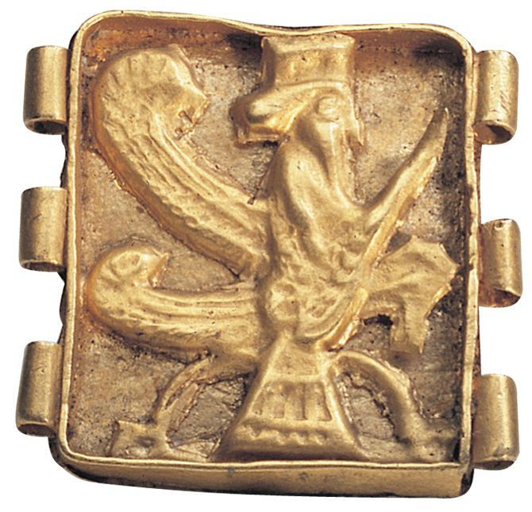
A gold clasp or button of the fifth century b.c.e. with the symbol of Ahura Mazda, a Zoroastrian deity, as a winged god.

Slide 34
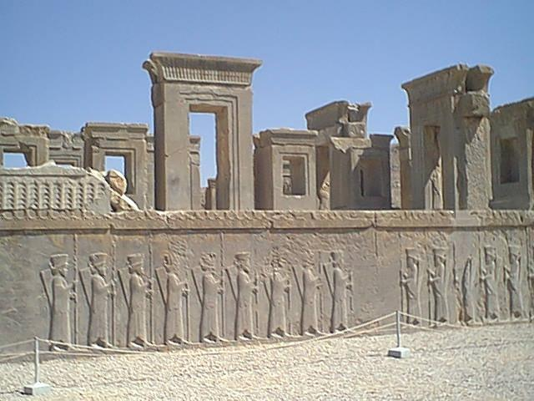
The Zoroastrian Legacy
Preached one supreme god
Held humans to high ethical standards
Promised salvation
Influenced Judaism and Christianity as Empire spread to west
  God and Devil
  Heaven and Hell
  Reward and punishment
  Messiah and End of Time
Today only small # of Parsees in Iran and India practice today

Slide 35
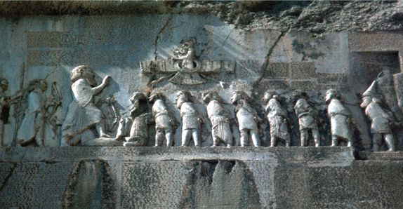
Zoroastrianism
Darius faces Ahura Mazda, the Zoroastrian deity to whom he attributed his authority, as the various kings subject to him acknowledge him as their lord.

