Slide 1
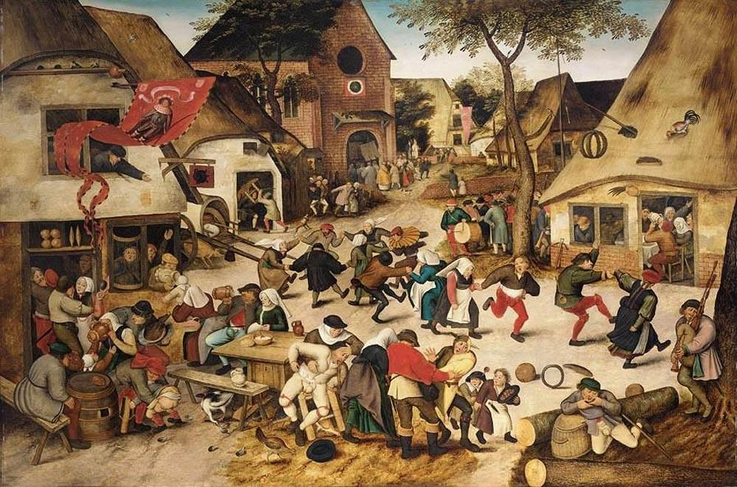
The Northern Renaissance

Slide 2
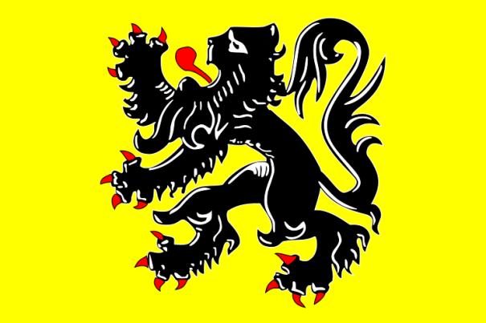
Where was the Northern Renaissance?
England
France
Germany
Flanders (Netherlands/Belgium)

Slide 3
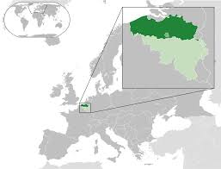

Slide 4
The Northern Renaissance:1450
Bubonic Plague ended and the population was recovering
Hundred Year’s War between France and England was ending.
New ideas from Italy spread to Northern Europe and were quickly adopted.
Educated people in Northern Europe became interested in classical learning
Difference from Italy- were more likely to combine this with interest in religious ideas.

Slide 5
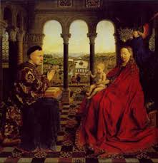
Factors leading to Renaissance in Northern Europe
Population recovers from plague
Hundred Years’ War ends in 1453
Patrons
Cities grow rapidly
England and France unify under strong monarchs who are art patrons
Students and visitors from Italy bring back ideas
Artists and writers move to northern Europe fleeing war in Italy (1494)

Slide 6
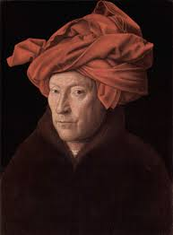
Art in northern Renaissance vs. Italian Renaissance
Northern Renaissance artists were interested in realism
Major artists appeared in parts of Germany, France, Belgium and the Netherlands.
Durer, Holbein, van Eyck and Bruegel
Use of oil-based paints becomes popular.
Religious subjects and realistic landscapes often painted.
Scenes of peasant life also become popular.

Slide 7
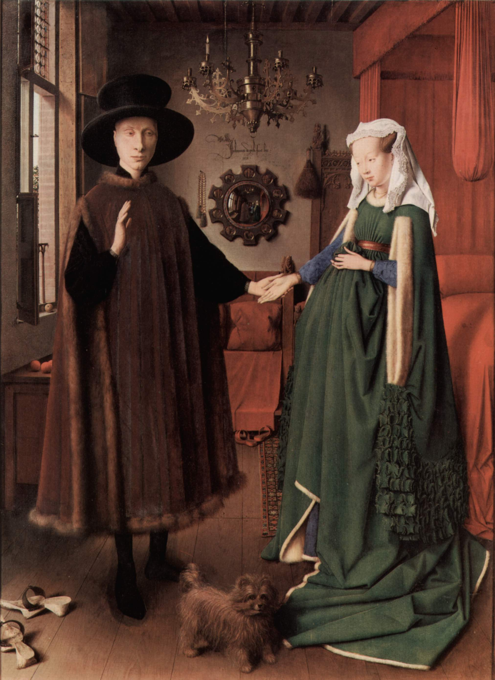
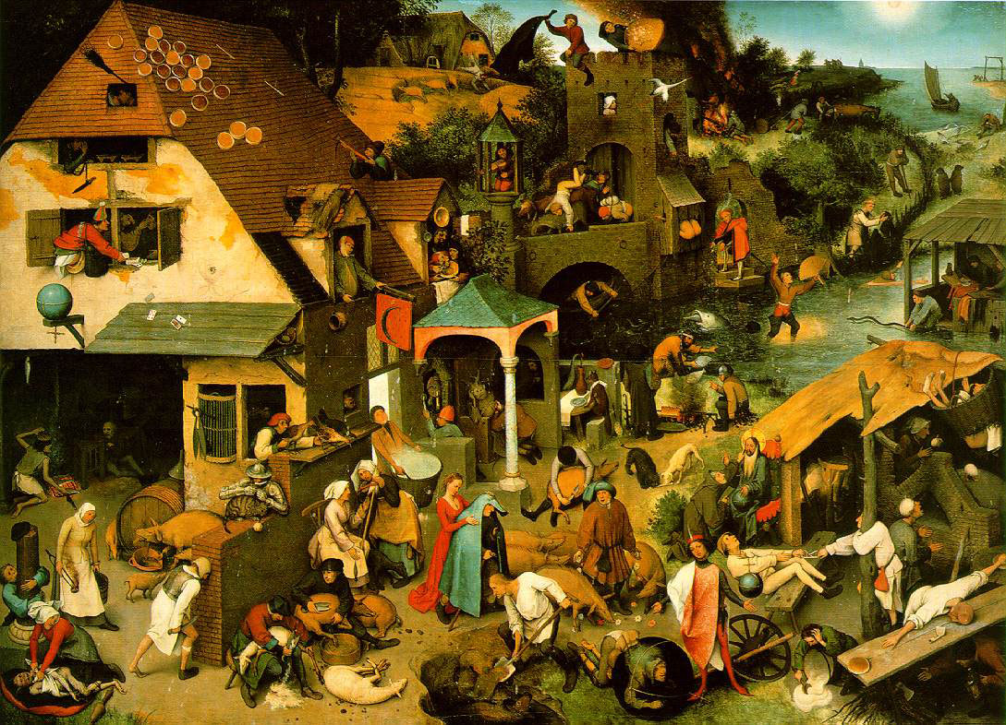

Slide 8
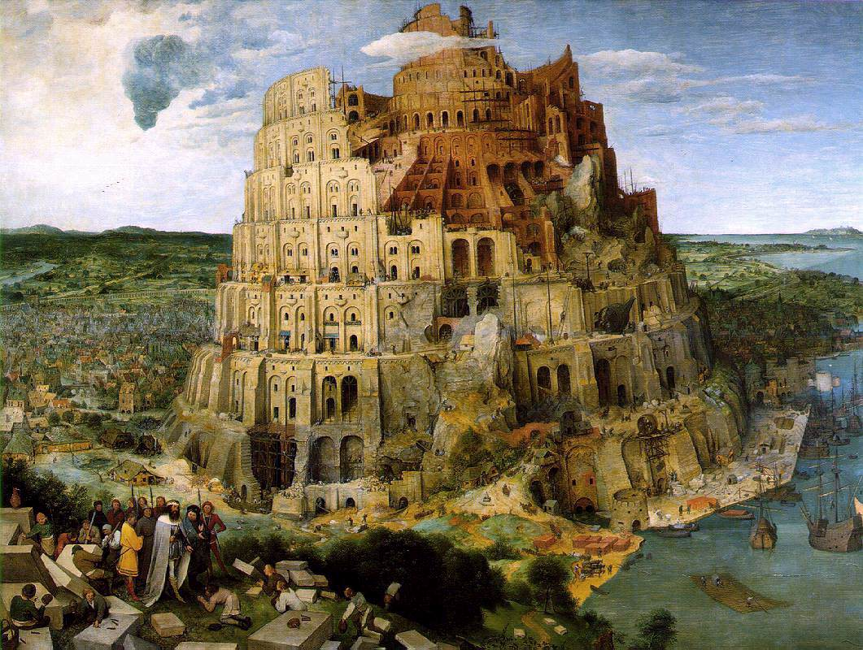

Slide 9
Bruegel
Peasant Wedding
The bride sits under the paper crown
Notice the furnishings
Groom may be the one sitting across from the bride
Relaxed, humorous, and focused on ordinary people

Slide 10
What can be learned about people’s daily lives from examining the painting Peasant Wedding?
Where ordinary people lived, what they ate, how they dressed, how they celebrated

Slide 11
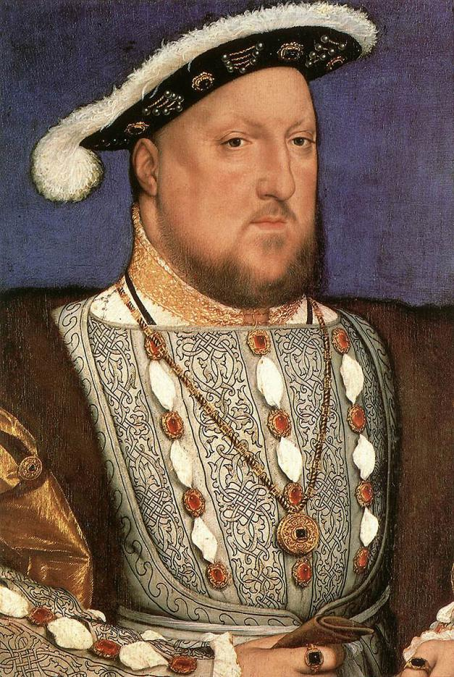
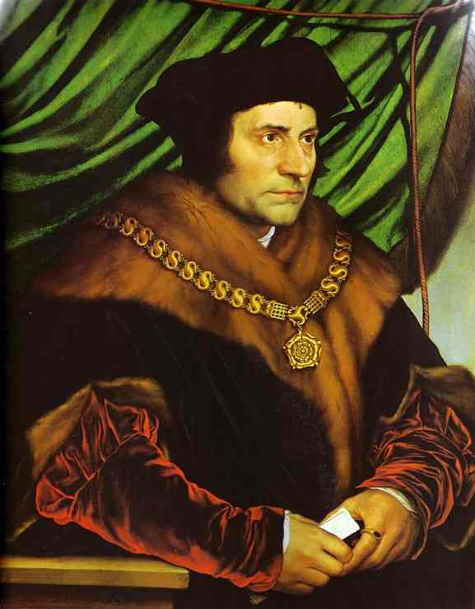
Hans Holbein the Younger
German painter who moved to London and painted for Henry VIII

Slide 12
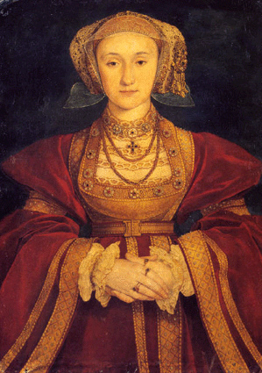
Hans Holbein the Younger
Portrait of Anne of Cleves
Henry VIII criticized the portrait as having been too flattering

Slide 13
Question:
What factors might have influenced the trend toward a more realistic style of art?
Artists could travel and thereby learn better techniques; oil paints made more realistic, subtle paintings possible

Slide 14
Northern Writers
Writers combined humanism with deep Christian faith.
Wanted reforms in the Church and society to try to make people more just and devoted to God.
Desiderius Erasmus-
Christian humanist
Wrote The Praise of the Folly- poked fun at flaws in real people.
Thought people should read the Bible for themselves

Slide 15
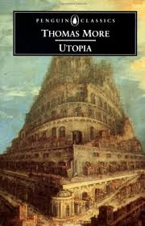
Writers continued
Thomas More-
Christian humanist
Wrote Utopia (means “no place”)- no war, corruption, greed, little use of money)
Based off of Plato’s The Republic
Beheaded by King Henry VIII (one of his best friends!)

Slide 16
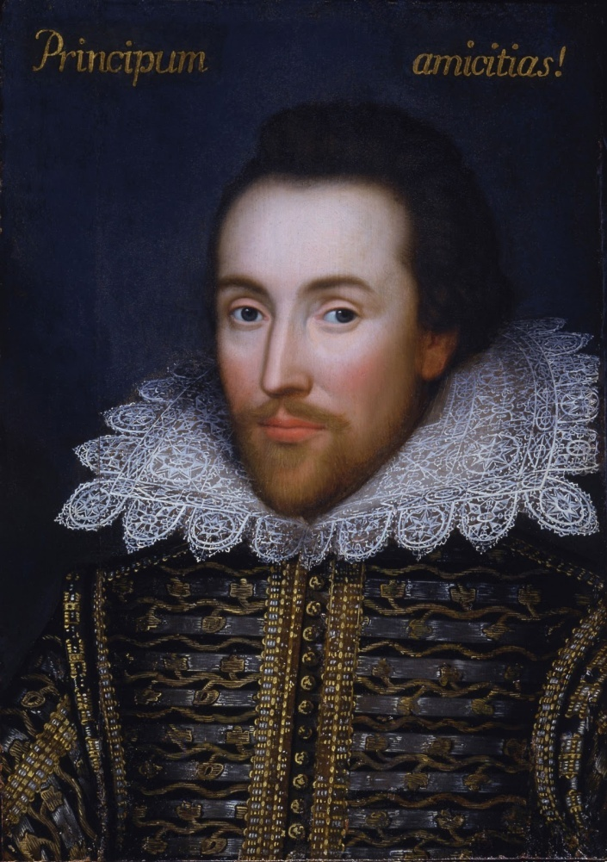
Shakespeare
Many times viewed as the greatest playwright of all time. – Do you agree?
Plays examine deep human flaws- Can you think of any?
Drew on Greek and Roman classics
What works from Shakespeare do you know?

Slide 17
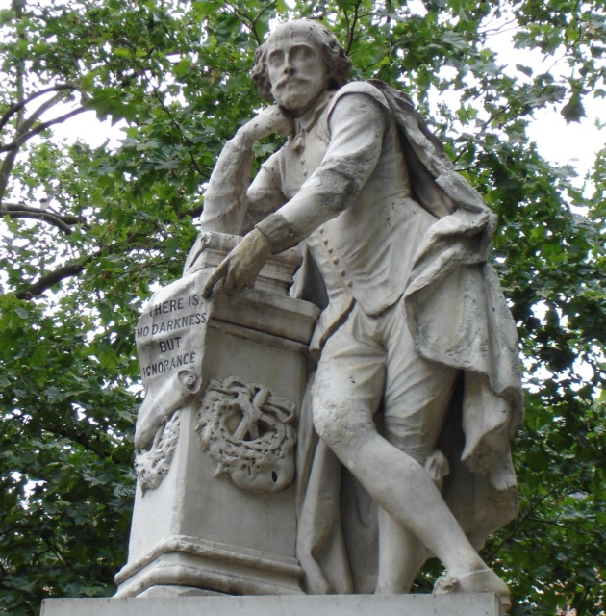
Phrases from Shakespeare’s plays
Today, almost 400 years after his death, the language of Shakespeare is all around us.
“at one fell swoop”
“foul play”
“good riddance”
“high time”
“lie low”
“Mum’s the word”
“vanish into thin air”
“neither here nor there”
“the game is up”

Slide 18
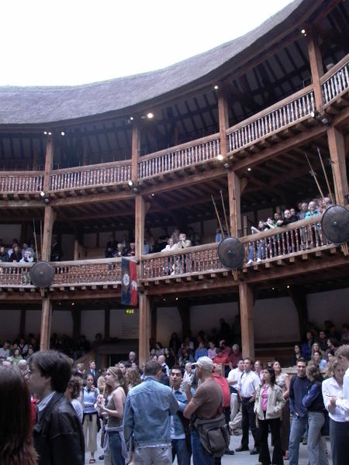
Globe Theater
Performances were often wild affairs.
If the audiences did not like the play, they booed loudly, pelted the stage with garbage (oranges, nuts, apples, and gingerbread) and sometimes attacked the actors.
A full house was about 3,000 paying customers.

Slide 19
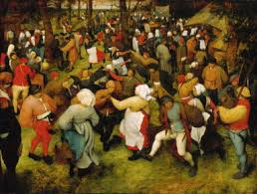
Life in the Renaissance
1500s- 75% of Europeans lived in rural areas.
London 200,000 people in 1600
Cost of living
If a pound was worth $400 in today’s currency, then a shilling was worth $20 and a penny was worth about $1.66.
This means that a skilled worker earned $5,200 per year.
A merchant would earn about $40,000.
The cost of a theater performance was 1 shilling ($20) for the lords’ room, 6 pence ($10) for the gentlemen’s rooms, 2 pence ($3.30) for the galleries, and 1 penny ($1.66) for the pit.
One in every 10 people in London went to the theater at least once a week.

Slide 20
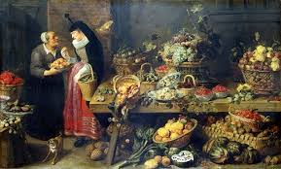
Food? Yuuuuummmmm
A typical meal for wealthy Londoners
Fish, several kinds of meat, bread, and a variety of vegetables, served on silver or pewter tableware.
The diet of the poor was simpler.
Rarely ate fish, meat, or cheese. Usually their meals consisted of a pottage-a kind of soup-of vegetables. They ate their meals from a hollowed out slab of bread or wood.

Slide 21
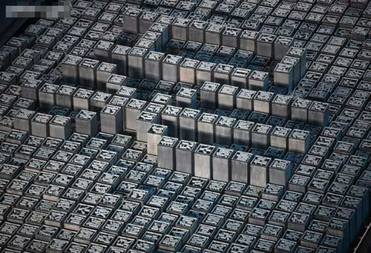
Printing Spreads Renaissance Ideas
Chinese Invention
Around 1045 Bi Sheng of China invents movable type

Slide 22
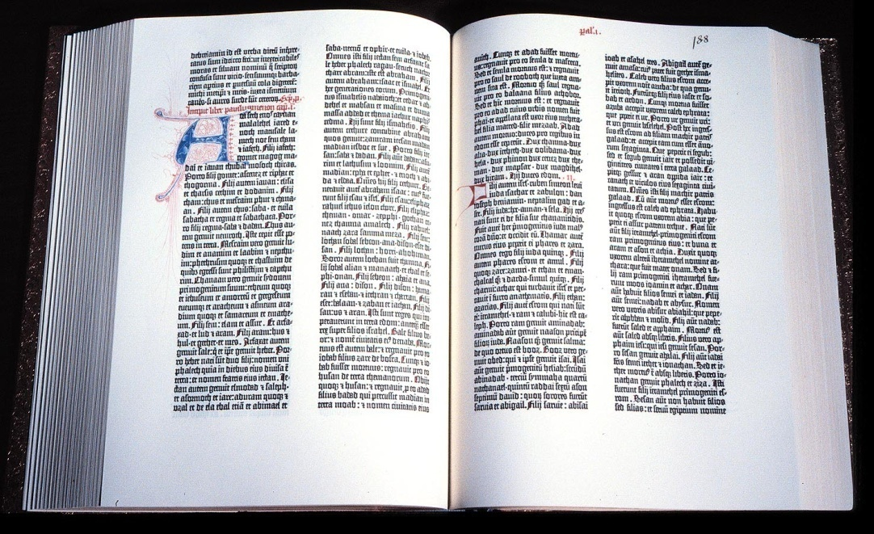
Gutenberg Improves the Printing Press
Around 1440 Johann Gutenberg of Germany develops printing press
Printing press allows for quick cheap book production
First book printed with movable type, Gutenberg Bible (1455)

Slide 23
Book Production
It took 5 months to copy a single book by hand
One man and a printing press could produce 500 books in the same amount of time.

Slide 24
Printing Press
How did the invention of the printing press help spread learning and Renaissance ideas?
Book were cheaper (more could buy them)
News quicker
Rise of literacy
Published accounts of maps and charts lead to more discoveries
Political structures and religious practices are questioned

Slide 25
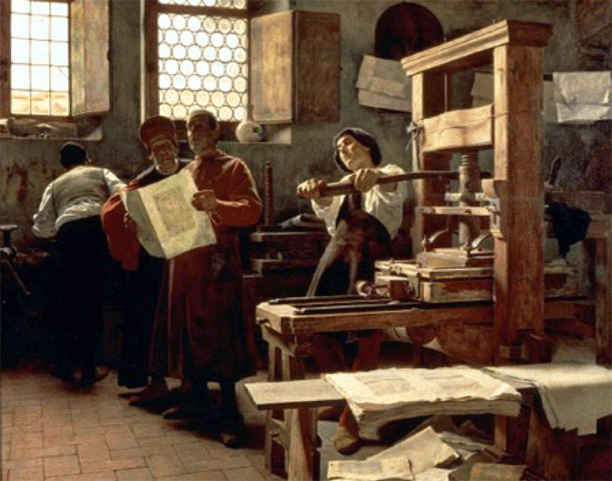
Printing Press

Slide 26
The Legacy of the Renaissance
Art influenced by classical Greece and Rome
Realistic portrayals of individuals and nature
Art is both secular and religious
Writers use vernacular
Art praises individual achievements

Slide 27
What similarities and differences?
How did the northern Renaissance differ from the Italian Renaissance?
Stronger interest in realistic art; more of an emphasis on changing society
In what ways did Renaissance art connect to the past?
Copied Greek and Roman styles, created religious works
In what ways did it break with the past?
Increase in secular art, more realistic style, use of vernacular, emphasis on the individual

