Slide 1
The Reformation Continues and the Scientific Revolution
As Protestant reformers divide over beliefs, the Catholic Church makes reforms

Slide 2
The Reformation Continues after Luther (1517) and Henry VIII (1531)
Switzerland
Swiss priest Huldrych Zwingli
War breaks out between Catholics, Protestants
Zwingli killed (1531)

Slide 3
John Calvin
Institutes of the Christian Religion (1538)
We are sinful by nature and cannot earn salvation.
Predestination
Calvinism
Taught that people should enjoy God’s gifts.
No colorful clothes
Statues, incense, altars, candles, chants, organ music, and stained-glass windows, were not allowed in Calvinist church.

Slide 4
Reformation in Switzerland
Calvin says ideal government is theocracy-rule by religious leaders
Geneva becomes a strict Protestant theocracy led by Calvin

Slide 5
Calvinism Spreads
John Knox brings Calvinism to Scotland, followers are called Presbyterians
Church governed by laymen called presbyters, or elders

Slide 6
Calvinism Spread
Calvin’s followers in France called Huguenots
Catholics massacre Huguenots in Paris (St. Bartholomew’s Day Massacre) 12,000 Huguenots killed (1572)

Slide 7
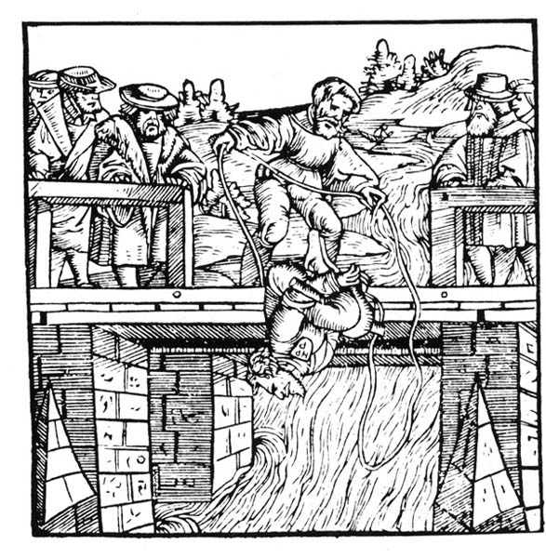
Other Protestant Reformers
The Anabaptists
Anabaptists believe in separation of church and state, oppose wars, and share possessions
Influenced the Mennonites, Amish, Baptists, and Quakers

Slide 8
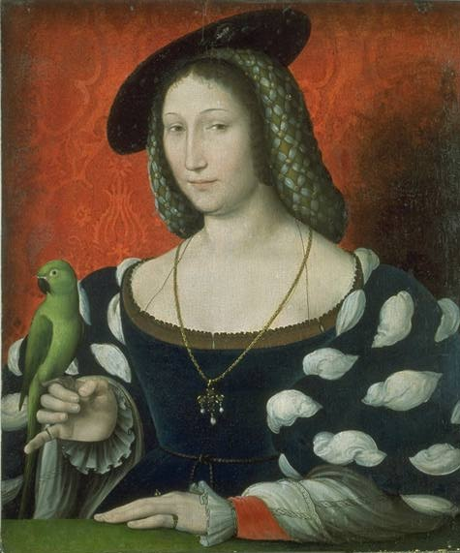
Women’s Role in the Reformation
Marguerite of Navarre protected Calvin in France
Katherina von Bora, Luther’s wife promotes equality in marriage

Slide 9
The Catholic Reformation
AKA Counter Reformation
Um, didn’t we already have a Reformation?
Catholics want to reform Church from within

Slide 10
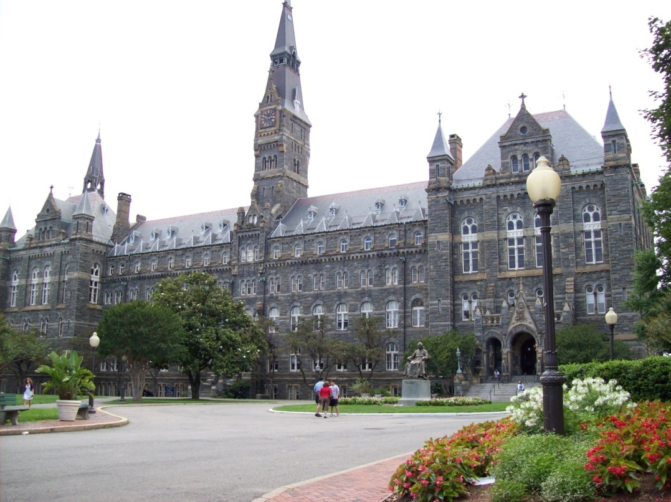
Ignatius of Loyola
Leading Catholic reformer
His Spiritual Exercises (1522) calls for meditation, prayer, and study
Pope creates Society of Jesus religious order, the Jesuits led by Ignatius
Start schools, convert non-Christians
Jesuit colleges in US
Boston College, Georgetown University, Creighton, Gonzaga, Loyola, Marquette, St. Louis University, Xavier

Slide 11
Reforming Popes
Pope Paul III and Pope Paul IV lead reforms
Paul III calls Council of Trent to lay out reforms:
Protestantism is bad
Church’s interpretation of Bible is final
Christians need faith and good works for salvation
Bible and Church traditions equally important
Indulgences are valid expressions of faith
Better educated Catholic bishops and clergy
Use Inquisition to seek out heresy

Slide 12
Reforming Popes
Paul IV issues Index of Forbidden Books (1559)
Books burned

Slide 13
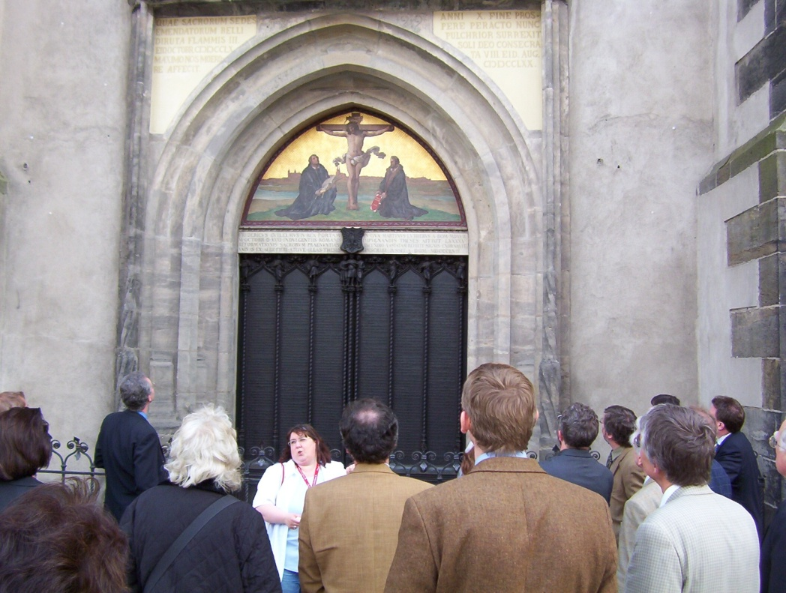
The Legacy of the Reformation
Religious and Social Effects of the Reformation
Catholic Church is unified; Protestant denominations grow
Catholics and Protestants create schools throughout Europe
Status of women does not improve

Slide 14
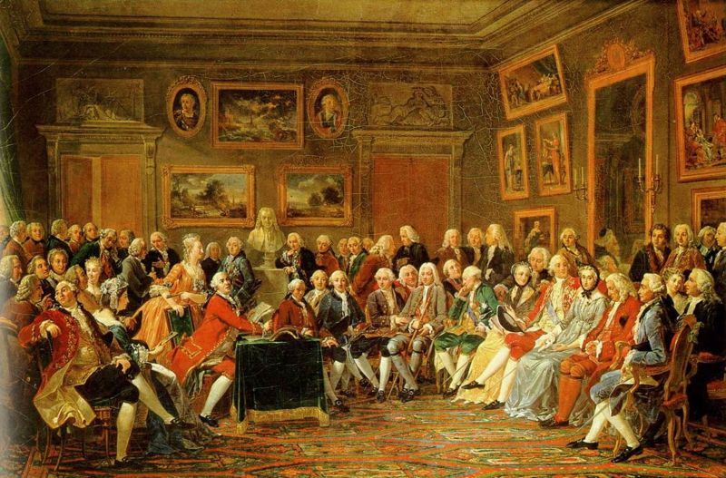
Political Effects of the Reformation
Catholic Church’s power lessens
Power of monarchs and states grow
Reformation’s questioning of beliefs brings intellectual ferment
Late 18th century sees a new intellectual movement-the Enlightenment

