Slide 1
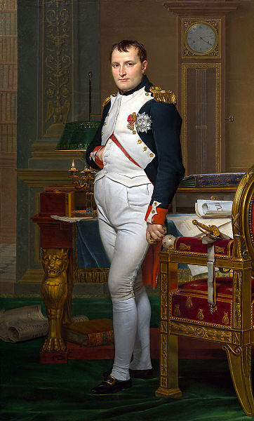
The Reign of Napoleon
1799-1815

Slide 2
Napoleon
Jacques-Louis David's Napoleon on Horseback at the St. Bernard Pass (1800) presents a famously heroic image of Napoleon's attack on Italy in 1800. David's art clearly served the interests of Napoleon's political regime. The powerful and dynamic image was intended to convey Napoleon's greatness and his place in the history of conquering heroes.

Slide 3
Young Napoleon
Born in Corsica
Supporter of the Revolution

Slide 4
Napoleon’s Early Life
Born in Corsica in 1769
Officer in Louis XVI’s army
General by age of 24
Supported the revolution; defended the Directory (1795-1799)
Invaded Egypt in 1798, however defeated by British
Battle of the Pyramids, François-Louis-Joseph Watteau, 1798–1799

Slide 5
Coup d’Etat
Overthrew the Directory in Nov. 1799 in a coup d’etat
Named himself “consul for life” in 1802
Crowns himself emperor in 1804

Slide 6
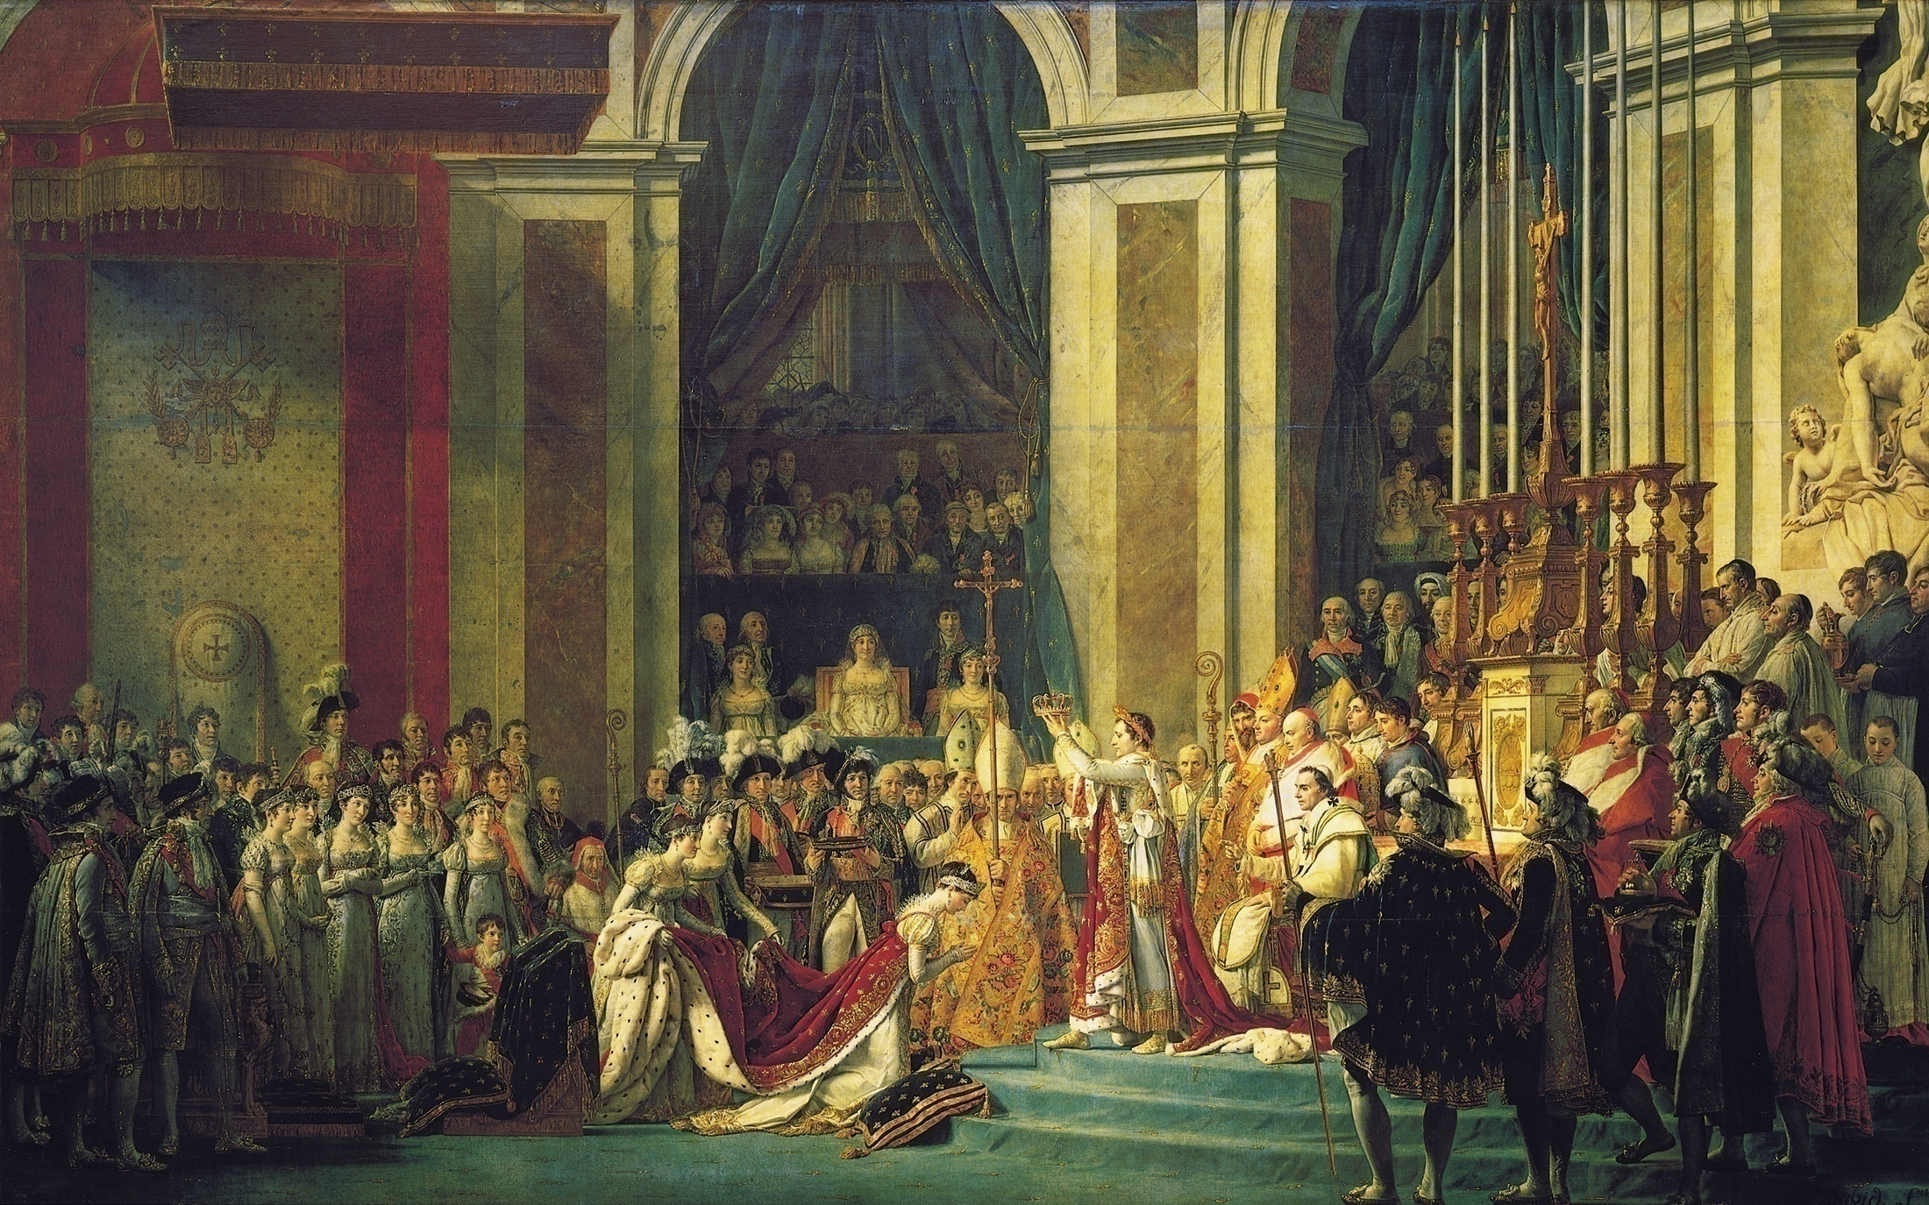
Jacques Louis David, Napoleon’s Coronation

Slide 7
Napoleonic France
Concordat of 1801
Recognized Roman Catholic Christianity
Agreed to pay salaries of clerics
French state retains church lands
Extends freedom of religion to Protestants and Jews
Napoleonic Code
Stabilized French society
Equality to all adult men
Merit-based society
Restored patriarchal authority in family
Model for civil codes elsewhere
Quebec Province, Canada, Netherlands, Italy, Spain, state of Louisiana
Limits free speech, censors newspapers
Sells off the Louisiana Purchase
Established a secret police force
Use spies , detained political opposition
Use of propaganda

Slide 8
Louisiana Purchase
Sold for $15 million
“The sale assures forever the power of the United States and I have given England a rival who, sooner or later, will humble her pride.”

Slide 9
Napoleon’s Empire
Brilliant general and strategist
Armies conquered Iberian and Italian peninsulas, occupied Netherlands, defeated Austria and Prussian forces
Sent brothers and relatives to rule conquered and occupied lands
Unravels in 1812

Slide 10
Napoleon’s Empire in 1812
Observe the number of states dependent on or allied with Napoleon as opposed to those who were at war with him.
Were there geographic conditions that allowed some states to resist Napoleon's efforts at conquest better than others?

Slide 11
Napoleon’s Mistakes
Continental System
Cut off all British trade with the European Continent
Hurt Europe instead
Fought Britain at Battle of Trafalgar- at sea
Defeated by British Admiral Horatio Nelson
Invade Iberian Peninsula
Depose the monarchs and put brother on throne
Spanish use Guerilla warfare against them
Disastrous invasion of Russia in 1812

Slide 12
Failed Invasion of Russia 1812
Led his “Grand Army” of 600,000 soldiers to Moscow
He captures Moscow but czar refuses to surrender
Russian burn Moscow and land as they retreat
Scorched-earth policy
Napoleon orders retreat but already snowed in
30,000 soldiers return back to France w/ him

Slide 13
Fall of Napoleon
Coalition of British, Austrian, Prussian, and Russian armies force him to abdicate the throne in 1814
Restore French monarchy and send him to exile in Elba
March 1815 he returns and brings back his army
100 days he ruled France until defeated at Waterloo
Sent again to exile at St. Helena Island where he dies in 1821

Slide 14
Congress of Vienna
“Great Powers” of Europe attempt to restore order in Europe
Guided by influential Austrian foreign minister: Prince Klemens Von Metternich (1773-1859)
Dismantle Napoleon’s Empire
Restore thrones
Create diplomatic “Balance of Power” that will last until 1914
Took measures trying to stop revolution
Failed in repressing nationalism

