Slide 1
The Resurgence of Empire in East Asia
The Sui, Tang, and Song Dynasty
Chinese influence in Korea, Vietnam, and Japan

Slide 2
Please locate the following on the map of southeast asia
Yellow River
Yangzi River
Chang’an (Xian)
Grand Canal
Luoyang
Beijing (Peking)
Kaifang
Manchuria
Mongolia
Hangzhou
Korea
Vietnam
Japan

Slide 3
Sui and Tang Empires, 581-755
After fall of Han in 220 CE, China enters a period of political fragmentation
China reunified under Sui and Tang in 581 CE

Slide 4
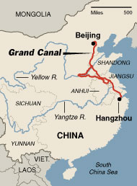
Sui Dynasty
New capital: Chang’an in Wei River Valley
Northern China is Sui heartland, but Yangtze River also population center
Built the Grand Canal linking the Yellow River with the Yangtze
  Extended 1,240 miles
  Roads parallel on each side
  Purpose to facilitate trade (rice, crops to north)
  Principle conduit for internal trade
Improved on Great Wall on northern frontier

Slide 5
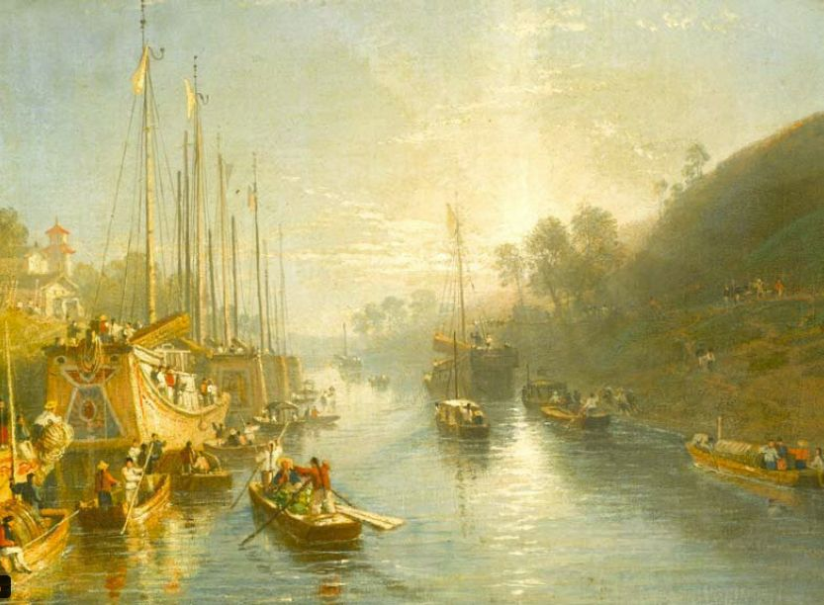
Sunrise on the Grand Canal

Slide 6
Sui Military Ambition leads to new dynasty
Extended to Korea and Vietnam, and Inner Asia
  Military defeat in Korea
Required high levels of organization and resources
Leads to rebellion and assassination of emperor which brought dynasty to end

Slide 7
Tang dynsty
Survives 300 years, 618-907 CE
Maintained transportation and communication network
  Routes based on horses, runners
  Maintained inns, postal stations, stables, rest
  Travel in 8 days using couriers
Distributed land based on “equal-field” system
  Equal distribution of land
  Allotted based on fertility of land and need of family
  1/5th was hereditary, remaining left to redistributed
Relied on a bureaucracy of merit
  Recruited candidates who had progressed through Confucian educational system
  Most officeholders won posts b/c of intellectual ability

Slide 8
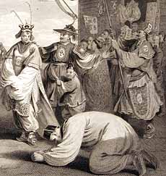
Tang’s Military Expansion and Foreign Relationships
Among largest in Chinese history
Middle Kingdom
Establish tributary relationships with neighboring lands
  These lands recognize Chinese emperors as overlords
  They regularly deliver gifts and perform the “kowtow”
  Benefit to the tribute-payers b/c they now have access to trading rights w/ China

Slide 9
Tang Decline
Later years saw turmoil b/c of conflict with Tibetan and Turkic Uighers
Mid-8th century rebellions captured capital and secondary capital
  Leaves dynasty weakened
  Turkish Uighers expel the rebels
  Popular discontent: pillage and give back to poor
  Tang never recover

Slide 10
Economic Development
Agricultural Development
Fast-ripening rice from Vietnam
  Harvest 2 crops per year giving more supply
Improved techniques
  Iron plows
  Harness oxen in north/ water buffaloes in south
  Reservoirs, dikes, dams, canals, pumps, waterwheels
    Allow them to have terrace-farming
Population growth
  800 CE, 50 million
  1000 CE, 60 million
  1200 CE, 115 million

Slide 11
Urbanization
During Tang dynasty, Chang’an most populous city with 2 million
Under Song dynasty, China is most urbanized land in world
Hangzhou, southern Song capital of 100,000
  Supported 100’s of restaurants, taverns, teahouses, gardens, markets, specialty stores for silk, porcelain, gems etc.
  Commercialized agricultural economy emerges
  Cultivators specialized in crops and export them
    Ex. Province of Fujian import rice and produced oranges, sugarcane

Slide 12
Patriarchal Social structures
Tightening of patriarchal social structure
Veneration of ancestors more elaborate
Descendants dilligently sought graves of earliest forefathers
Whole families traveled great distances to attend annual rituals
  Gave them sense of identity and cohesiveness

Slide 13
Footbinding
Spread during Song dynasty among privileged classes
Women could not walk easily or naturally
Never universal
  Wealthy families did it to enhance their attractiveness, display their high social standing, and gain control
Similar to veiling in Islamic world

Slide 14
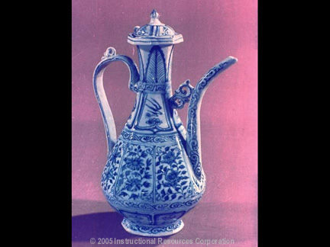
Technology During Tang and Song Dynasties
Porcelain
  Work of art
  Exported vast quantities
  For the wealthy in se Asia, India, Persia, E. Africa
Metallurgy
  Iron and steel for weaponry and agricultural tools
  Techniques diffused to other lands, nomadic peoples used them against Chinese
Gunpowder
Printing
Naval Technology

Slide 15
Gunpowder
  Daoist chemists learn how to make it
Experiment with charcoal, saltpeter, sulphur, and arsenic
Mid 10th c., they were using gunpowder in bamboo “fire lances”
Earliest gunpowder weapons had limited effectiveness
By late 13th c., gunpowder diffused through Eurasia
Metal-barreled cannons also used

Slide 16
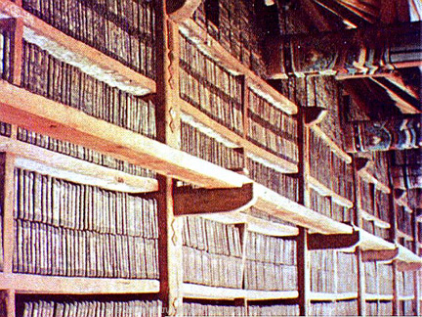
Printing
Became common during Tang dynasty
Block printing
Because formal writing in the Chinese language involved so many as 40,000 characters, movable type is inconvenient
Wood block used longer than movable type
Europe
  Used parchment or vellum(skins of goat, calves)
  15th century began to use paper
Islamic World
  Used in central Asia in 8th c.
  Paper mill in Baghdad in 794
  Used paper in Islamic Spain 1150
  Didn’t use printing presses until 19th c.
    Calligraphy was an art
    Didn’t want to mass-produce the Quran

Slide 17
Naval Technology
Before Tang dynasty, China did not venture far from land
Develop taste for spices and exotic products of SE Asian isands
Chinese seafarers sail ships
  Iron nails, waterproofed w/ oils
  Watertight bulkheads
  Canvas and bamboo sails
  Steered by rudders
  Navigated w/ aid of the magnetic compass
    Becomes common property to the mariners of Indian Ocean

Slide 18
Emergence of a Market Economy
Chinese products fueled rapid economic expansion
Financial institutions
  Letters of credit, promissory notes, checks
  Paper Money
              9th c. , cash deposits issue printed notes
              12th c. forbade private individuals from issuing paper $, left only to the state
              Nomadic peoples adopt it
              Problems
                Counterfeit notes
                Print currency for more value than actually possessed
                Provided a powerful stimulus to Chinese economy
Cosmopolitan Society
  Trade and urbanization transform Tang and Song
  Mariners from Indian Ocean & South China Sea arrive
  Byzantine’s travel on Silk Roads
Hemispheric Economy
  Chinese consumers develop taste for exotic goods that stimulate trade throughout Eastern hemisphere

Slide 19
Cultural Change: Buddhism
Establishment of Buddhism in China is the most important gift from India
  Until adoption of Marxism in 20th c., Buddhism was the only large-scale cultural borrowing in Chinese history.
After fall of Han, Confucianism suffers loss of credibility
It came over on Silk Roads
Mahayana Buddhism found popularity during Tang and Song
  4th c. built hundreds of cave temples in W.China
  Also built libraries of religious literature & scriptoria to produce Buddhist text
Attracted Chinese b/c of high standards of morality, intellectual sophistication, and promise of salvation
  Built monasteries that where they cultivated the land and gave back to local residents
  Some Chinese believed the monasteries were economically harmful, since they paid no taxes, others scorn it as inferior b/c of foreign origin
Buddhists missionaries tailor message to Chinese audiences
  Dharma becomes “Dao”
  One son in a monastery would bring salvation for 10 generations

Slide 20
Chan Buddhism
Buddhism w/ Chinese characteristics
Emphasized intuition and insight in search of spiritual enlightenment
Monasteries built in all major cities
Stupas throughout as well
Pilgrims travel to India to visit holy sites
  Help establish it as a popular faith

Slide 21
Hostility to Buddhism
Daoists and Confucians were critics of it
In the 840s under the Tang, emperors ordered the closure of monasteries, expulsion of Buddhists, Zoroastrians, Manichaeans etc.
  Despite this, Buddhism survives

Slide 22
Neo -Confucianism
Song emperors sponsor the studies of Confucian scholars and subsidized the printing of Confucian writings
Confucians of the Song study classic works of their tradition with the writings of Buddhists
  Buddhist thought dealt with issues such as nature of the soul and individual’s relationship with the cosmos
Reason for its important cultural development
  Illustrates the deep influence of Buddhism and Chinese society
  Influences east Asian thought over a long period of time
    Until the 20th century
    Korea, Vietnam, Japan

Slide 23
Chinese Influenced on Korea
Chinese armies had ventured into Korea during the Qin and Han dynasties
It drew inspiration from the Chinese

Slide 24
Silla Dynasty in Korea
Tang armies conquered much of Korean peninsula
Became a tributary state to China
  Gifts and the “kowtow”, but received gifts more valuable than they delivered
Organize their courts and bureaucracy like Chinese
Model their capital like Chang’an
Korean scholars study Chinese thought and literature
Elite classes adopted Confucianism
Peasants and commoners adopted Chan Buddhism
Political initiative involved ruling classes only
  No meritocracy like the Chinese

Slide 25
China’s Influence on Vietman
More tense
Tang forces win control and try efforts to absorb them in society
Viets adopted Chinese agricultural and irrigation systems, Chinese schools, administrative techniques
Tributary relationship
Resent the Chinese and revolt against Tang
Keep their indigenous religions
Women have more prominent roles
Model of gov’t: Bureaucracy like China
Buddhism won large following

Slide 26
Early Japan
Nomadic peoples from NE Asia migrate to Japan
Migrations from Korean peninsula bring rice, bronze and iron, horses
Nara Japan
  Modeled after Tang
  Imperial authority to centralize gov’t
  Chinese-style bureaucracy
  Equal-field system
  Support Buddhism and Confucianism
  Actually develop their own culture
  Still observe rights to Shintoism
  Veneration of ancestors and nature spirits and deities

Slide 27
Heian Japan 791-1185 CE
Japanese emperors rarely ruled, but serve as ceremonial figureheads’
Power with another powerful clan
  Leads to ruling parties and factions “come and go”, but the imperial house survived
Literature followed Chinese models
Japanese writing borrowed from China
  Borrow Chinese characters for Japanese words

Slide 28
The Tale of Genji
Aristocratic women wrote literature in Japanese
Talereflects Heian court life

Slide 29
Decline of Heian Japan
Equal field system in disuse
Aristocratic clans accumulated most of the lands
Minamoto clan claim rule in name of emperor
  Install the clan leader “shogun” as a military governor who ruled

Slide 30
Medieval Japan
Middle Era between age of Chinese influence and court domination of political life in Japan
Decentralized political order in the Kamakura and Muromachi periods
  Local lords and clans vie for power and have no use for Chinese-style bureaucracy
  Valued military talent and discipline
  Led to the samurai

Slide 31
The Samurai
Professional warriors who specialized in the use of force and the arts of fighting
Serve the provincial lords
  Military service
  Freed from obligations to feed, clothe, and house themelves
  Devoted to hunting, riding, archery, martial arts

Slide 34
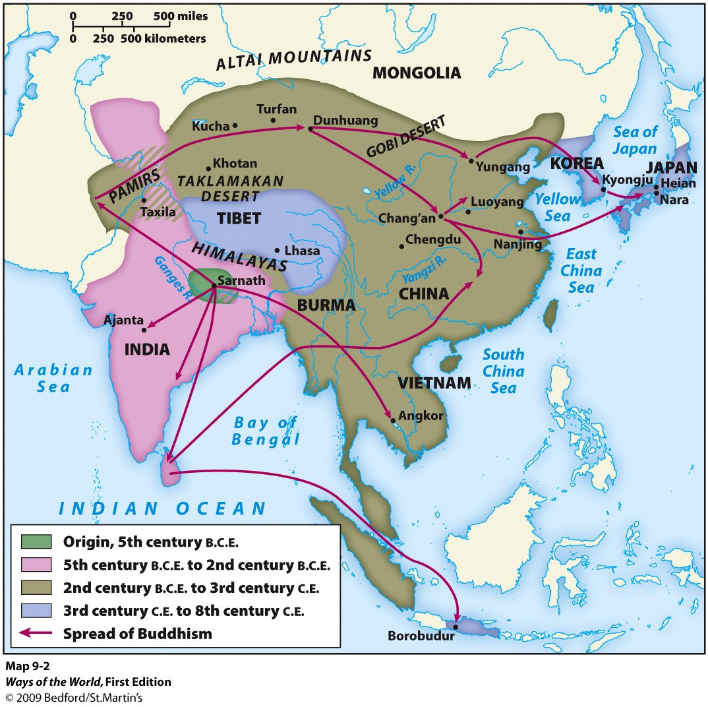
Spread of Buddhism

Slide 35
