Slide 1
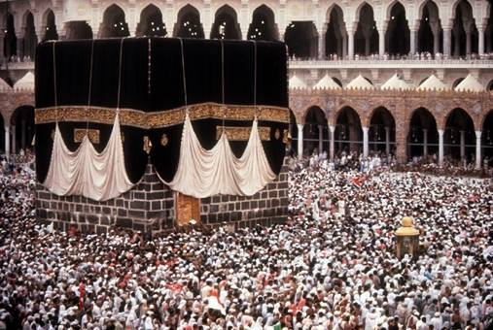
The Rise of Islam
600-1200 CE

Slide 2
The Arabian Peninsula Before Muhammad
Arabs lived exclusively on desert fringes of Syria, Iraq, Jordan
More people subsisted on farming rather than as pastoral nomads
The sea of sand known as the “Empty Quarter” isolated the densely populated southern regions
They knew more about Africa, India, and Persian Gulf than the interior and scattered nomads

Slide 3
Mecca, a caravan city
On a barren mountain valley, halfway b/n Yemen and Syria
Quraysh (Mecca’s dominant tribe) settled there in 5th century and control trade
Prosperous
Arabia at the time of Muhammmad

Slide 4
Caravan Trade
Nomads derived income from providing camels, guides, and safe passage to merchants bringing products to the south
Trade aromatic resins frankincense & myrrh
See rise of Arab-dominated caravan cities after the invention of military efficient camel saddles
Replaced horse-drawn carriages, ox cart by 600 CE
Bedouin Life

Slide 5
Pilgrimage Center
Ka’aba was the cubicle shrine w/ idols
Pilgrimage site
Associated shrine with stories of Jews & Christians
Abraham built the Ka’aba
Site also identified as the location that Abraham was preparing to sacrifice his son

Slide 6
Some northern Arabs went to great lengths to demonstrate their devotion to Christianity. This structure, carved out of sheer rock along the wall of a ravine at Petra in modern-day Jordan, served as a monastery.

Slide 7
Muhammad in Mecca
Born in 570
Married Khadija, business women
Son died in childhood, but several daughters survive
Around 610, he began meditating at night in mountains around Mecca

Slide 8
Messenger of God
Convinced he was hearing the words of God, Allah, he shared revelations until his death in 632
At the time, people believed in unseen spirit gods, demons, and desert spirits who were thought to possess seers and poets
His earliest revelation called people to witness that one god had created the universe and everything in it, including themselves
At the end, their soul would be judged, their sins balanced against their good deeds
Heaven & hell

Slide 9
Guidance
Quran
Means “Recitation”
Written in the 650s after his death
Arabic
Hadith
Sayings and deeds of Muhammad
Appear in 9th /10th c.
No single collection of them

Slide 10
Quran and representations of Muhammad and Allah
Current Islamic doctrine forbids artistic representations of Muhammad and Allah to prevent the worship of their images as idols. Although artists of previous centuries occasionally produced paintings of Muhammad, Islamic art has emphasized geometric design and calligraphy. This handsome page from a Quran written on vellum dates from the ninth or early tenth century.

Slide 11
Revelation called people to submit to God and accept Muhammad as his last messenger
Islam
“Submission” to will of Allah
Muslim
One who “submits”

Slide 12
Revelations against Judaism and Christianity
Earlier messengers mentioned in his revelations included Noah, Moses, and Jesus
Muhammad charged that Jews and Christians with negligence in preserving God’s revealed word
Abraham is the 1st Muslim, as builder of the Ka’aba which superseded Jerusalem as focus of Muslim prayer
Muhammad’s revelations more pure than Bible b/c direct word of God

Slide 13
Muslims, Jews, and Christians
The close relationship of three Middle Eastern monotheistic traditions is illustrated in this fifteenth-century Persian painting, which portrays Muhammad leading Moses, Abraham, and Jesus in prayer. The fire surrounding the prophet’s head represents his religious fervor. The painting reflects the Islamic belief that the revelations granted to Muhammad built upon and completed those given earlier to Jews and Christians. (Bibliothèque nationale de France)

Slide 14
Muhammad’s Migration to Medina
Known as the Hijra
B/c of religious and economic conflict, fled Mecca in 622 to Medina
Known as the hijra and the beginning of the Muslim calendar
Organized followers into the Umma
The community defined by the acceptance of Islam and Muhammad as “Messenger of God”
Muhammad provided it w/ legal and social code and for widows, orphans, the poor, made alms
Refers to himself as prophet, the “Seal of the prophet”
The final prophet that Allah chose to reveal his message to mankind
Returns and conquers Mecca in 630 and destroys idols
Muhammad dies in 632, and most of Arabia under his control

Slide 15
Five Pillars of Islam
Acknowledge Allah as one god and Muhammad as messenger
Pray 5x/day to Mecca
Alms to poor
Fast during Ramadan
Pilgrimage to Mecca 1x in life
Framework that has bound the “umma” as a whole
A watercolor painting from sixteenth-century Iran depicts a caravan of pilgrims traveling to Mecca while making the hajj. In what ways did the hajj facilitate social and business relationships?

Slide 16
Mecca’s New Look
The illuminated clock face o f the Royal Mecca Clock Tower, completed in 2011, looms high above the enclosure housing the cube-shaped shrine of the Kaaba. The writing on the clock says “God is the Greatest.” Because Muhammad instructed all Muslims who could afford the trip to make the pilgrimage to Mecca, many Muslims believe that all pilgrims should experience the same travel conditions. But in recent years new luxury high-rise apartments have been built near the Kaaba, offering the well-to-do a better view and more comfortable rooms than those available to the ordinary hajj pilgirms.

Slide 17
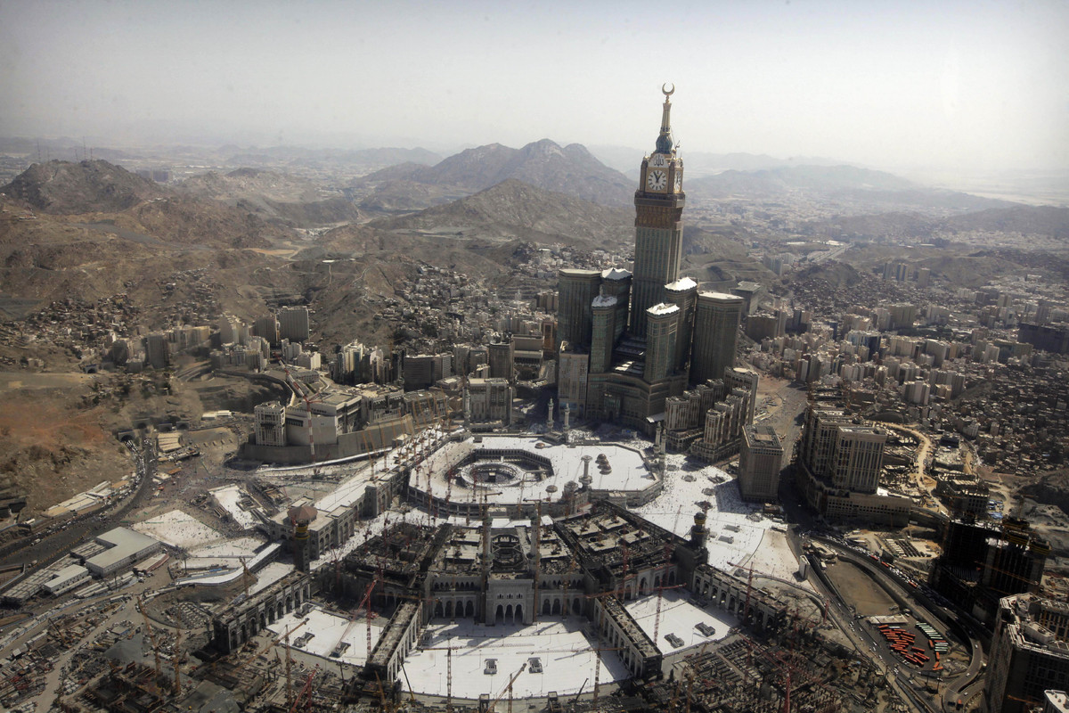

Slide 18
Jihad
Some consider it to be 6th Pillar
Means “struggle”
Combat vice & evil
Against ignorance and unbelief by spreading the word of Islam
Involves physical struggle, obliging them to take up sword and wage war against unbelievers who threaten Islam

Slide 19
Islamic Law: Sharia
Detailed guidance on proper behavior in all aspects of life
Inspired by Quran and life and teachings of Muhammad
Guides marriage, family life, inheritance, slavery, business, political authority under Islamic rule, crime

Slide 20
Expansion of Islam
The caliph, deputy-leader who serves as “substitutes of Muhammad”
Abu Bakr is 1st caliph
Four “Rightly Guided” caliphs who were elected
Ali is the last and will be assassinated
Islamic armies took advantage of larger empires weakness
633-637 seized Byzantine Syria, Palestine
640 Byzantine Egypt and n. Africa
711 conquered the Hindu kingdom in nw India
718 extended authority in nw Africa and Iberian peninsula
Stopped at Frankish kingdom

Slide 21
The expansion of Islam, 632–733 c.e.
During the seventh and eighth centuries, the new faith of Islam expanded rapidly and dramatically beyond its Arabian homeland. How might you explain the spread of a new faith? What political and cultural effects followed from the expansion of Islam?

Slide 22
Problems of governance and administration
Disagreements on the selection of caliphs led to the emergence of the SHIA sect of Islam
Originated as a sect supporting Ali, the last elected caliph and all his descendants
He, his relatives, all were assassinated
Party of Ali, Shia, created to resist the Umayyads
Teachings
Observe holy days in honor of leaders & martyrs
Teach that descendants of Ali are infallible, sinless, and divinely appointed to rule
Interpret Quran to support their views
The early expansion of Islam was a bloody affair. This illustration from an Arabic manuscript of the thirteenth century depicts a battle between Muhammad's cousin Ali and his adversaries.

Slide 23
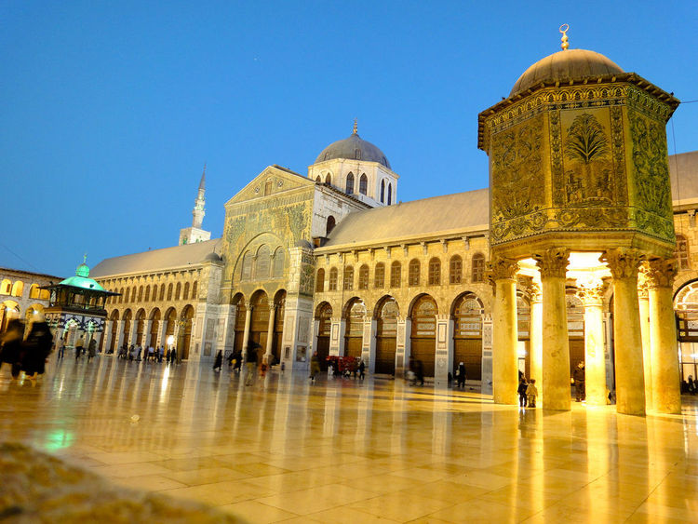
The Umayyad Dynasty (661-750 CE)
Establish capital at Damascus
Tight central rule: dar-al Islam or Islamic rule
Use Arab military aristocracy as governors and administrators of conquered lands
Distributed wealth among the privileged class

Slide 24
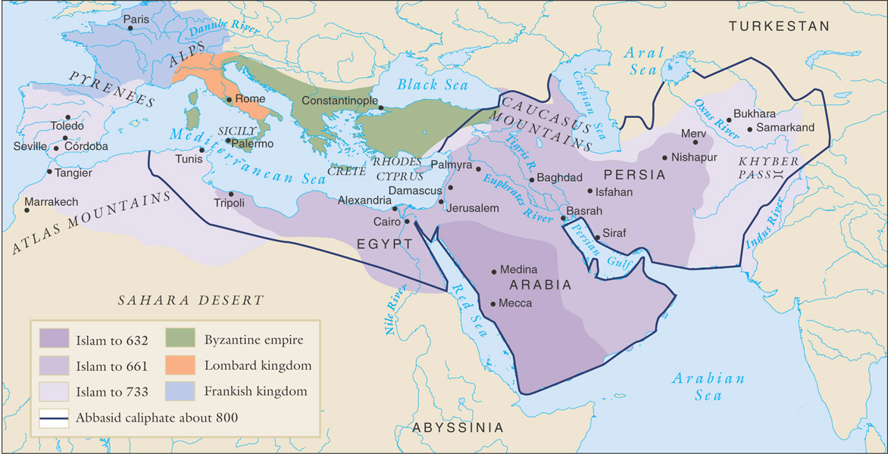
The Expansion of Islam

Slide 25
Policy toward “Conquered Peoples”
Allowed to observe own religions
Christians, Jews, Zoroastrians, Buddhists
Indians, Persians, Mesopotamians, Greeks, Egyptians, nomadic Berbers
Special tax, jizya, on those who don’t convert
Resentment builds under Umayyad rule b/c those who did convert still didn’t enjoy access to wealth

Slide 26
Umayyad Decline
Devoted themselves to luxurious living
Casual attitude towards Islamic doctrine and morality
Discontent of conquered peoples and disillusionment of Muslim Arab military leaders
Great Mosque of Damascus

Slide 28
The Abbasid Dynasty
Founded by Abu al-Abbas, Sunni Arab
Last members of Umayyads arrested and slaughtered at a banquet
Dynasty more “cosmopolitan”
Rulers don’t show favor to the Arab military aristocracy
Not a conquering dynasty, but marginally expanded
Defeated Chinese at Battle of Talas (near Samarkand)
Ended expansion of Chinese into central Asia
Opened door for spread of Islam to Turks

Slide 29
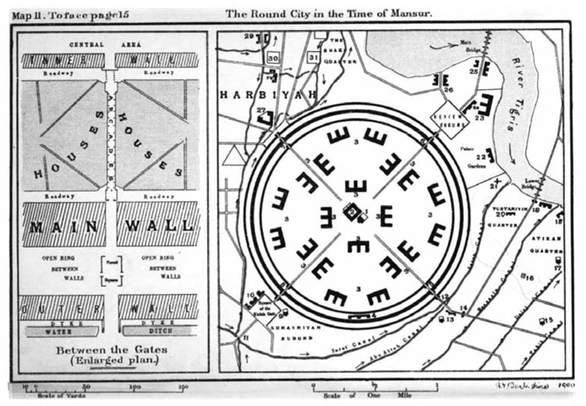
Abbasid Administration
Relied on Persian techniques
Baghdad is capital
Provinces with governors
Ulama means “people w/ religious knowledge”
Scholars who develop public policy in accordance w/ Quran and sharia law
Qadis or “judges “
Set moral standards in communities
Heard cases and rendered decisions based on Quran and sharia law
Kept standing army
Ministers in charge of finance, coinage, postal svc.
Maintained roads inherited from previous empire
Baghdad in the 8th century

Slide 30
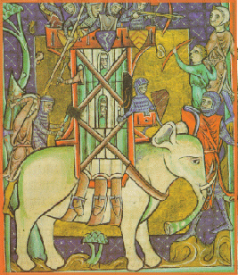
Harun al-Rashid (786-809 CE)
Under his reign, highpoint of dynasty
Made Baghdad a center for banking, commerce, crafts, industrial production, pop. of several 100, 000s
He provided support for artists, writers,
Sent luxurious gifts to his favorites
Ex. White elephant
Gave $ to poor and common classes
Toss $ on streets
Al Rashid sent a gift of a white elephant and rich presents to Charlemagne in western Europe.

Slide 31
Abbasid Decline
Period of decline after al-Rashid’s rule
Civil war b/n al-Rashid’s sons damaged their authority
Provincial governors built up their own power
Uprisings and peasant rebellions
Become figureheads when Seljuk Turks take possession of Baghdad
Seljuk “sultan”
Mongols extinguish the dynasty in 1258
Siege of Baghdad 1258

Slide 32
Economy of the Islamic World
New crops introduced to western lands from east
Sugarcane, rice, wheat
Veggies: spinach, artichoke, eggplant
Fruit: oranges, lemon, limes, banana, coconut etc.
Cotton, henna, indigo had industrial use
Agricultural manuals circulated
Increased agricultural production led to rapid urban growth
New industry: papermaking
Facilitated the administrative and commercial records
Mills produced paper
Oranges in Cordoba

Slide 33
In a thirteenth-century manuscript illustration, a fictional Muslim traveler passes a lively agricultural village. On the left a woman spins cotton thread. Sheep, goats, chickens, and date palms figure prominently in the local economy.

Slide 34
Formation of a Hemispheric Trading Zone
Islamic society drew prosperity through commerce
Took advantage of the extensive road networks of the classical era
Linked the Islamic world
Excellent highways for merchants, missionaries, pilgrims
Caravanserais-Rest stop
Caravanserais offered splendid facilities for caravan merchants, but they sometimes harbored dangers. In this illustration from a thirteenth-century manuscript, drugged merchants sleep soundly while burglars relieve them of their valuables.

Slide 35
Caravanserais in Istanbul

Slide 38
Caravanserais in Sarajevo, Bosnia

Slide 41
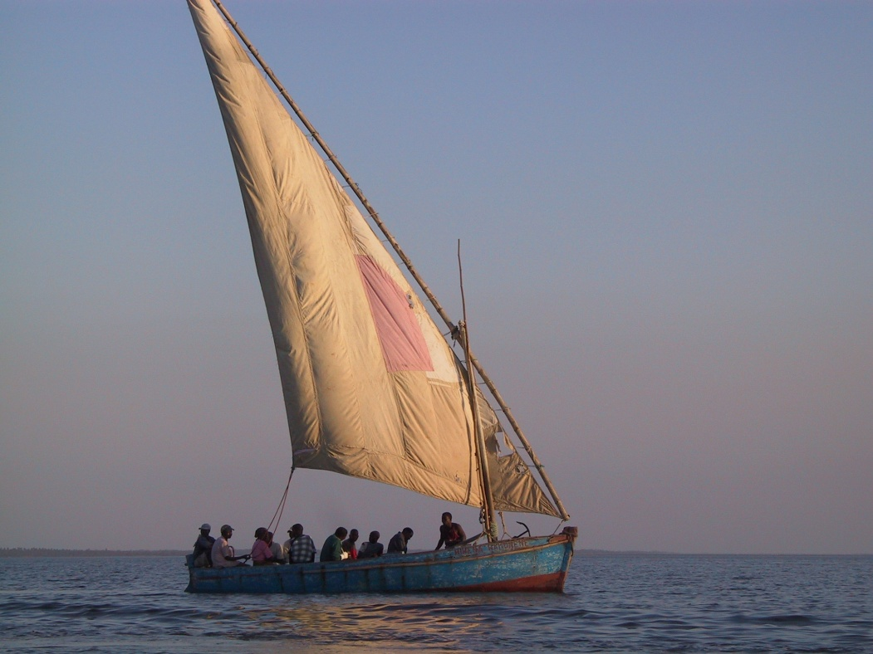
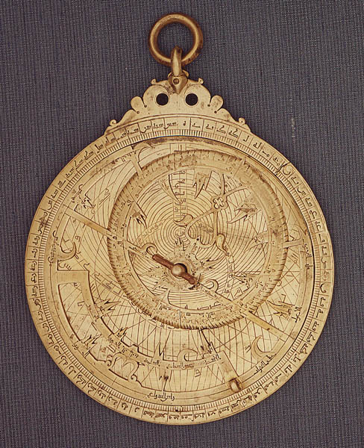
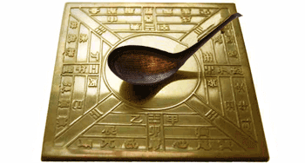
Innovations
Overland trade
Camels, camel saddles, caravanserais
Maritime trade
Compass borrowed from Chinese
Lateen sails (Triangular) from India
Astrolabe from Hellenistic Mediterranean

Slide 42
Cartography
A map produced in the eleventh century by the Arab geographer al-Idrisi shows the lands known and reported by Muslim merchants and travelers. Note that, in accordance with Muslim cartographic convention, this map places south at the top and north at the bottom.

Slide 43
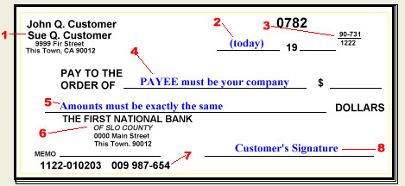
Banking
Business on larger scale
Money lender, investment broker, money exchanger
Multiple branches that honored letters of credit “sakk”

Slide 44
Methods of Organization
Entrepreneurs pooled resources to spread risk
Long distance trade surged
Dealt in silk, ceramics from China; spices and aromatics from India
Trade w/ W. Africa: Steel for gold, salt, slaves, skins
Trade w/ Russia and Scandinavia for skins, fur, amber, slaves etc.
In this thirteenth-century manuscript illustration, merchants at a slave market in southern Arabia deal in black slaves captured in sub-Saharan Africa. Slaves traded in Islamic markets also came from Russia and eastern Europe.

Slide 45
Al-Andalus: Islamic Spain
Example of harmony and tolerance b/n Muslims, Jews, and Christians
Erodes however in 10th century
After 1200, Christians try to reconquer it
1492 Ferdinand and Isabella take Granada, last Muslim stronghold
Thriving business in Cordoba, Toledo, Seville
Al -Andalus enjoyed reputation for excellence and helped pay for excellence
Free Islamic schools, lighted roads, library w/ 400,00 volumes
Significance is their role in making the rich heritage of Islamic learning available to Christian Europe
European scholars wanted knowledge of Greek and Arab philosophy, medicine, optics, astronomy, botany
Great Mosque of Cordoba

Slide 46
Inside the Great Mosque
Interior of the mosque at Córdoba, originally built in the late eighth century and enlarged during the ninth and tenth centuries. One of the largest structures in the dar al-Islam, the mosque rests on 850 columns and features nineteen aisles.

Slide 47
The Changing Status of Women
Patriarchal society
Women could inherit property, divorce, and engage in business ventures
Khadija was a business women
Quran outlaws female infanticide
As Islam spread, their rights gradually erode
Sharia reinforced male dominance

Slide 48
Quran and Women
Quran clearly says men and women equal
Social terms they aren’t
Women inferior and subordinate
Women subjected to the social and sexual lives to strict control of male guardians
Examples
Wealthy women in separate quarters
“honor killing” for violating sexual taboos
Female circumcision
Permitted men to follow Muhammad’s example and take up to 4 wives
Veiling adopted from Persia, Mesopotamia, eastern Med.
Sign of modesty

Slide 49
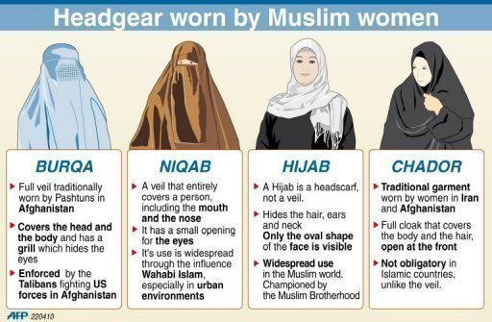

Slide 50
Men and Women at worship
This sixteenth-century Persian painting of a mosque service shows older men with beards toward the front, younger men behind them, and veiled women and children in a separate area. (Bodleian Library, University of Oxford, Ms. Ouseley. Add 24, fol. 55v)

Slide 51
How were Islamic Values Spread?
The Quran, sharia, ulama, qadis, Sufi missionaries help spread Islamic values throughout dar-al Islam
Formal educational institutions, the madrasas, also promote it
Located in the cities
Madrasa in Samarkand

Slide 52
Sufism
Most effective Islamic missionaries were the mystics known as Sufis
Didn’t find formal religious teachings meaningful
Work to deepen spiritual awareness instead
Sought mystical, union with Allah
Rely on sermons, passionate singing, or spiritual dancing to bring them to high state of emotion
Helped poor
Led pious, ascetic lives, gave up possessions, live as beggars
Whirling Dervishes dancing

Slide 53
Islam and Cultural Traditions
House of Wisdom in Baghdad
Foreign scholars invited
Cartographers, translations of Greek, Latin, and Sanskrit into Arabic
In this manuscript illustration a Muslim teacher (the figure with the open book) instructs students in a library near Baghdad in the fine points of Islamic law.

Slide 54
Persian Influence
Persian administrative techniques (Abbasids)
Persians influence literature, poetry, history
Arabian Nights
Through song, dance, and ecstatic experiences, sometimes enhanced by wine, Persian Sufis expressed their devotion to Allah, as in this sixteenth-century painting. How did Sufis facilitate the spread of Islam beyond Arabia?

Slide 55
Indian Influence
India introduced mathematics, science and medicine
Examples
Hindi Number system
0,1,2,3 etc.
Advanced math led to 1st book on Algebra
Encyclopedia of medicine
Arab physicians made note of medicines used in Persian, Indian, and Greek societies and added more of their own. In this manuscript illustration, two physicians instruct a pharmacist in the preparation of medicines.

Slide 56
Greek philosophy and Math
Ibn Rushd
Philosopher and Qadi of Seville
Studied Aristotle to understand the world in a rational way
Shaped Islamic philosophy and European scholasticism which harmonized Christian thought and Aristotle
Greek geometry
An illustration from a thirteenth-century, Arabic-language manuscript depicts the Greek philosopher Aristotle teaching three students about the astrolabe, an instrument that enabled the user to determine latitude.

