Slide 1
The Way We Were
Paleolithic v. Neolithic

Slide 2
The First Human Societies: Hunters and Gatherers
Small, bands of 25–50 people
Very low population density
Seasonally nomadic
Highly egalitarian
Defined rules and structure (gender roles)

Slide 3
Economy
Hunter/Gatherers used to be viewed as primitive and impoverished
Recent findings point out that they worked fewer hours
Wanted little
Life expectancy was low (35 years)

Slide 4
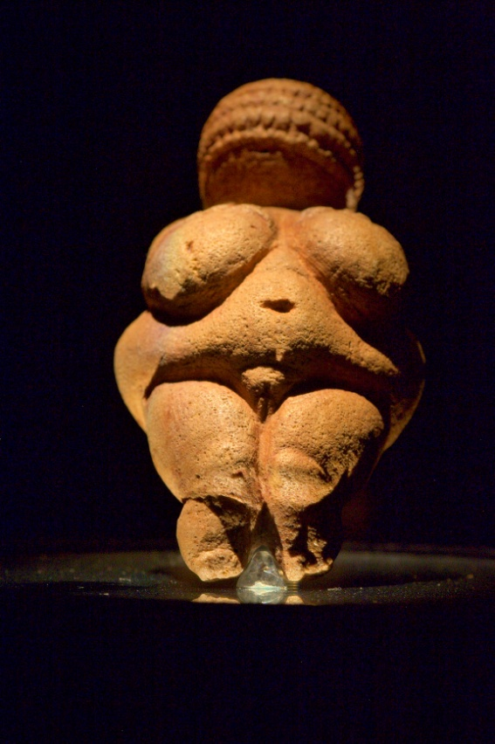
“The Realm of Spirit in the Paleolithic Age”
Hard to decipher without written records
Do have evidence for rich ceremonial life
Rock art in caves
Elaborate burial sites
Led by shamans
Frequent use of psychoactive drugs to contact spirits
Various beliefs in a Creator Deity, spirits, spirits of dead ancestors
Prevalence of Venus figures in Europe suggest that religion was strongly feminine with a Great Goddess
The Venus of Willendorf found in Austria is the most famous female figure, less than 4 1/2 “ and dates from about 25,000 years ago

Slide 5
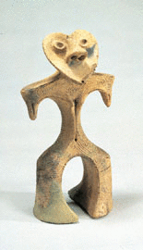
The Great Transition
Ice Age ended 16,000-10,000 years ago
Allowed for richer environment
See gradual change as population grew, climate changed, and people interacted
Collection of wild grains-16,000 years ago
Populations rise
Beginnings of our first settlements
Societies become larger more complex
Led to inequality b/c of storage and accumulation of goods
Jomon Figurines
Female figurines, dating to perhaps 4,000 years ago, have been found among Japan’s Paleolithic people, known as the Jomon. Many scholars believe these carvings had a ritual function, associated with fertility. (Tokyo National Museum, Collection of Mrs. Kane Yamazaka)

Slide 6
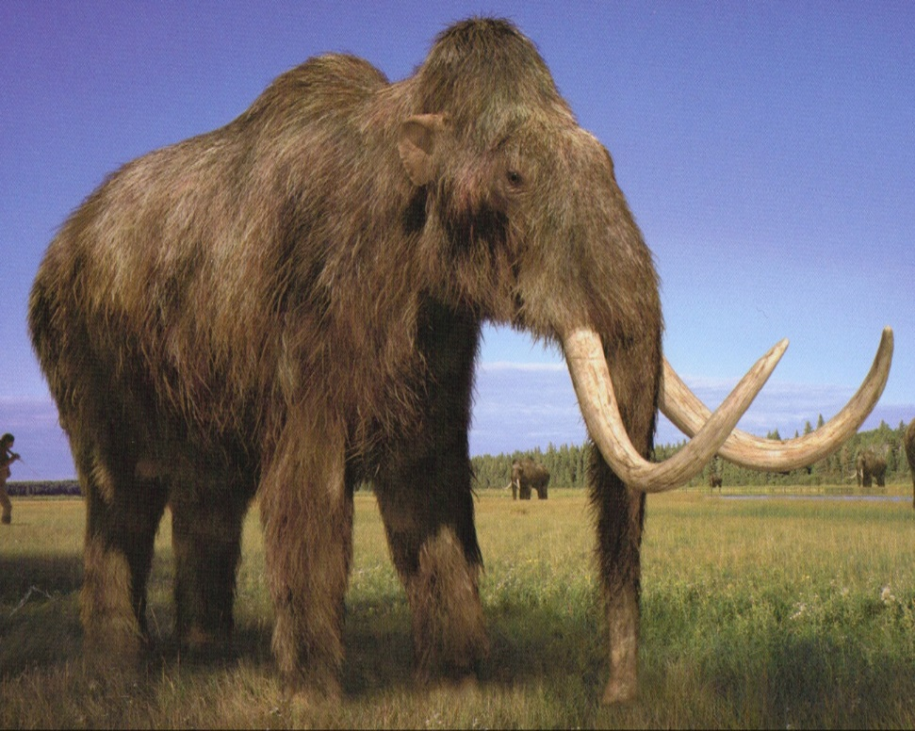
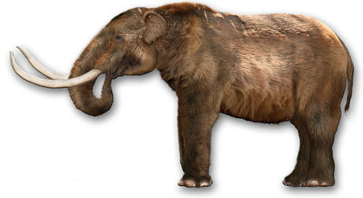
Animals hunted to extinction

Slide 7
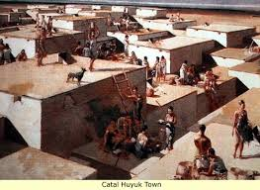
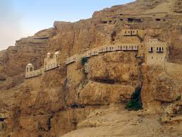
Pre-Civilization
Jericho
Pre 8000 BCE
2,000 inhabitants
Had limited trade
Surrounded by moat and walls.
Catal Huyuk
7250-5400 BCE
5,000 inhabitants
Specialization of labor- what does this mean?

