Slide 1
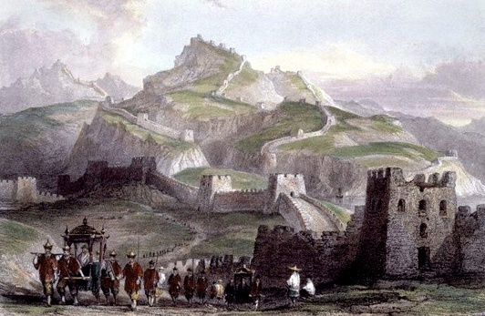
The Unification of China

Slide 2
AP Exam Tip
Understand the role of legalism in the development of the Chinese bureaucracy.
Be prepared to discuss the political structure of ancient China, but no specific dynastic traditions.
Understand the impact of philosophical systems in the creation of social systems.

Slide 3
In Search of Political and Social Order
Xia, Shang, Zhou Dynasties
Zhou 1122 BCE-256 BCE
Used Mandate of Heaven to justify deposition of Shang
Late centuries of the Zhou is called “Period of Warring States”
403 BCE- 221 BCE
Political Chaos
Forces them to reflect on the nature of society and proper roles of humans
Cultural flowering
Philosophies emerge during this time
Confucianism
Daoism
Legalism

Slide 4
Mandate of Heaven
Justification for rule that influenced gov’t and political legitimacy
Heavenly power granted the right to an individual to rule as the “son of heaven”
He had the duty to govern wisely, with honor and justice, and maintain order
If he failed, chaos would rule and heavenly powers would withdraw the “mandate”

Slide 5
Confucianism
Confucius or Kongzi (551-479 BCE)
Withdrew from political life after unsuccessful efforts to find employment as an official and advisor to rulers
Becomes an educator
Attracted followers for his ideas on morality, conduct, and government
Sayings compiled into Analects, and became core texts for Confucianism

Slide 6
Confucian Belief about Family
Social harmony arose from the proper order of human relationships
Fundamental component of society
Behavior at home prepares them as citizens of the state
Each person has a place & duty in hierarchal order
“Filial piety”(xiao) of children to parents requires obedience, reverence, and love

Slide 7
Confucian Values
People should have these qualities
“Xiao” or Filial piety
“Ren” meant an attitude of kindness and benevolence
Someone who is courteous, respectful, diligent, and loyal
Needed in gov’t officials
“Li” where individuals have a sense of propriety, (behave in appropriate fashion)
W/ respect, defer to elders or superiors

Slide 8
Confucius’ Goals for Society
Individuals who possessed these traits would gain influence in society
These people would have the power of leading others by example
This would restore political and social order in China
He wasn’t just interested in just personal morality, but in the creation of junzi or “superior individuals” who would bring order to the state

Slide 9
Confucius’ Enduring Legacy
Reverence for education
Reciprocal roles of societal relationships

Slide 11
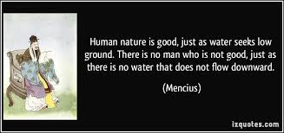
Mencius 372-289 BCE
Influenced by Confucius
Popularized Confucian ideas
Emphasized ren by advocating benevolence and humanity in gov’t
Believed in goodness of all human beings
If people are shown the right way by virtuous rulers, they would do the right thing
Ex. Rulers would levy light taxes, avoid wars, support education, encourage harmony

Slide 12
Xunzi 298-238 BCE
Emphasized “li”, sense of propriety
Less rosy picture of human nature
People have to be compelled to make appropriate choices
Need clear well-publicized standards of conduct with limits and harsh social discipline
Led to development of Legalism

Slide 13
Daoism
The sage, Laozi (6th century BCE, is the founder
Not much known about him
He is credited w/ the foundational text of Daoism, Classic of the Way of Virtue
They devoted energy to reflection and introspection, in hopes of understanding natural principles that govern the world

Slide 14
The Dao
“The way of nature” or “the cosmos”.
Eternal and unchanging
Extremely passive force
“dao does nothing, yet it accomplishes everything”
Ex. Like water
Soft & yielding; yet also so powerful it erodes the hardest rock in its path
Ex.Like the cavity of a pot
Empty space, but useful tool

Slide 15
The Doctrine
Moral trait: wuwei
Individuals should refrain and disengage in the affairs of the world
Live simply, unpretentiously, and in harmony with nature
The less government, the better
Envision a world of tiny, self-sufficient communities
B/c neither Confucianism and Daoism were exclusive faiths, some individuals that study Confucian curriculum and take posts in gov’t, but devote hours to reflection on human nature
Confucians by day, Daoists by night
A jade statue produced about the tenth century c.e. depicts the sage Laozi on an ox. Legends reported that Laozi rode a blue ox from China to central Asia when spreading his teachings. Why would simple dress and transport be appropriate for Laozi?

Slide 16
Legalism
Shang Yang (ca.390-338 BCE)
Han Feizi (ca.280-233 BCE) establish theory
Student of Xunzi and advisor to the Qin
Devoted all attention to the state, which they sought to strengthen and expand at all costs
Foundation of a state’s strength were agriculture and armed forces
Discourage careers such as merchants, entrepreneurs, scholars, educators, poets, philosophers etc. b/c it did not advance the state

Slide 17
Legalist Doctrine
Strict laws w/ clear expectations and severe punishment
Harsh penalties
Ex. Amputation of hands or feet for disposing trash in street
Established collective responsibility
Members of family or community observed others & reported infractions
Failure led to punishment like the actual violator

Slide 18
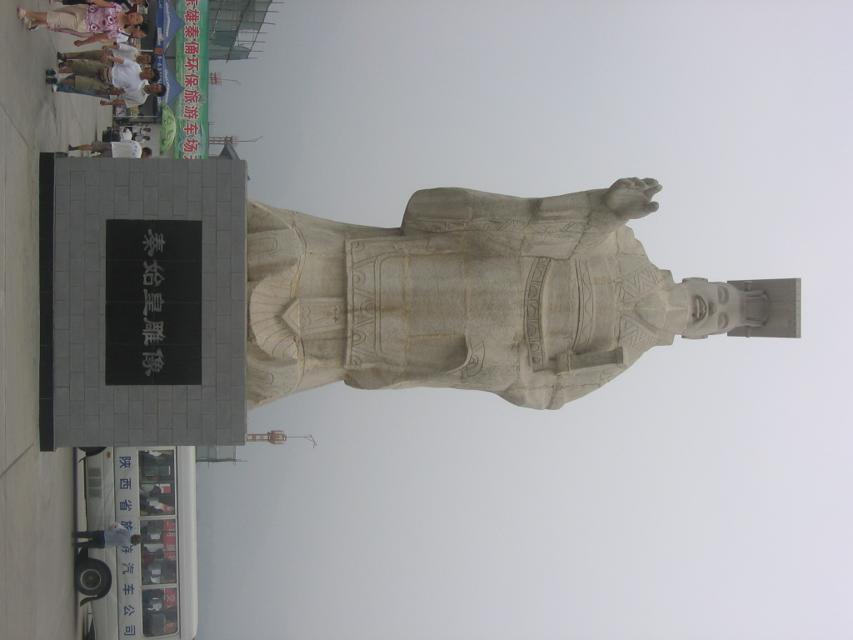
Unification of China
Zhou Dynasty 1045 BCE-256 BCE
“Warring States Period” 481 BCE-221 BCE
By 221 BCE, Qin Shi Huangdi emerges as the triumphant conqueror of the 6 coexisting kingdoms
China’s First Emperor

Slide 19
The Qin Dynasty (221-207 BCE)
Lasts only 14 years
Foundation for the central imperial rule
Governed by Legalist principles

Slide 20
Shi Huangdi
Ruled by centralized bureaucracy
Divide empire into provinces
Disarmed regional military forces
Drafted hundreds of thousands to build defensive walls-Great Wall

Slide 21
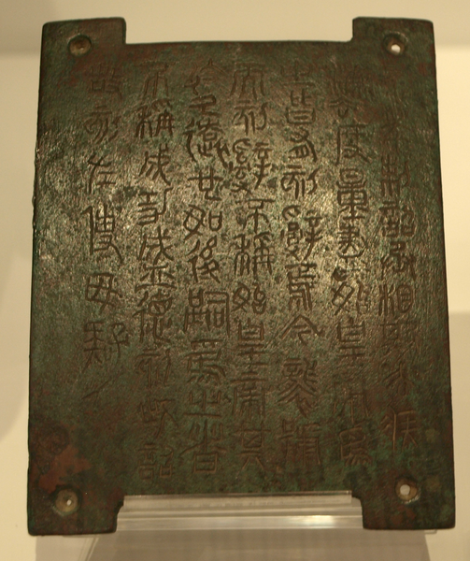
Qin Centralization
Standardized currencies, weights and measures
Built roads and bridges
Encouraged commerce and for military
Mandated the use of common script throughout empire
Law code that regulated life in detail
When accused, you were interrogated and flogged, then given punishment
Harsh punishments for injury to others, robbery, tax evasion, murder
Range from death, hard labor for 6-8 yrs., amputation, high fines

Slide 22
Resistance to Qin Policies
Shi Huangdi ordered the execution of 460 scholars criticizing the regime
Confucians and Daoists
Books on philosophy, ethics, history, and literature were burnt
Medicine, fortune-telling, and agriculture were kept

Slide 23
Visual Source Analysis
What signs of imperial authority are apparent in the painting?
What impression of the First Emperor does the painting convey? Do you think the artist sought to celebrate or criticize Shi Huangdi?
What accusations against Shi Huangdi might arise from the action depicted at the bottom of the painting?

Slide 24
Visual Source Analysis 2
How do you suppose Shi Huangdi thought about the function of this “army” in the larger context of his tomb complex?
What kind of organizational effort would be required to produce such a ceramic army?

Slide 25
Death of Shi Huangdi
Died in 210 BCE
Drafted 700,000 laborers to construct permanent tomb
Laid to rest in underground palace line w/ traps & crossbows rigged to fire intruders
Terra-cotta soldiers buried in vicinity of tomb
Since 1974, 15,000 sculptures found including weapons, horses

Slide 26
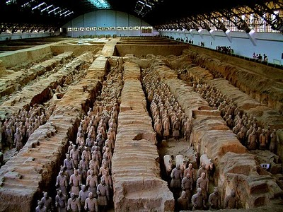
Terra Cotta Army

Slide 27
Collapse of Qin dynasty
After death of Shi Huangdi, revolts began
In 207 BCE, waves of rebels overwhelm the Qin court, slaughter gov’t officials, burn state bldgs.
Dissolves in chaos

Slide 28
A life-size model of an infantryman suggests the discipline that drove the armies of Qin Shihuangdi, the self-proclaimed First Emperor of China.

Slide 29
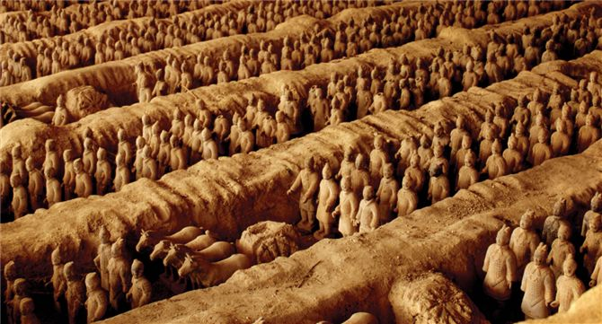
One detachment of the formidable, life-size, terra-cotta army buried in the vicinity of Qin Shihuangdi's tomb to protect the emperor after his death. The army consists of soldiers by the tens of thousands, along with weapons, horses, carts, and equipment. What does the construction of such a tomb suggest about Qin Shihuangdi's power and ability to command resources?

Slide 30
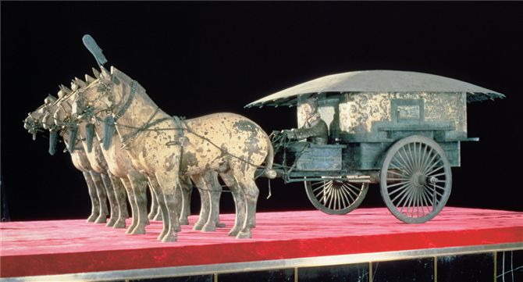
Model of a luxury chariot of the kind used by high imperial officials in the Qin and Han dynasties. Crafted from bronze with silver inlay, this model is about one-third life size.

Slide 31
The Han Dynasty 202 BCE – 220 CE

Slide 32
Overthrow of the Qin
202 BCE Liu Bang prevailed and inaugurated a new dynasty, the Han
Longest dynasty in Chinese history (400 yrs)
Chinese people today refer to themselves as ethnically “Han”
An eighteenth-century painting depicts the Han emperor discussing classical texts with Confucian scholars

Slide 33
Liu Bang
First Han ruler
Peasant qualities: fondness for drink, blunt speech, easy manner
Denounced harshness of Qin, but maintained some laws as well

Slide 34
Sima Qian
Lived during Han dynasty
Regarded as the Chinese “father of history”
Castrated for defending a disgraced general
Term is “Eunoch”
He created organization framework that became standard and he sought cause of the events
Organized in different way from Western writing
Same event narrated in more than one section, inviting reader to compare & interpret the difference

Slide 35
Han Dynasty
Adopt Confucianism as the official ideology of the imperial system
Confucian Educational System
Emerged from the Need to recruit 1,000’s of intelligent, educated individuals to run bureaucracy
Opened university in Chang’an
Local officials ordered to send promising students from their districts to university
Prepared them for government service
Confucianism was the basis for its curriculum
By the end of the Han dynasty, 30,000 students

Slide 36
Chinese Society
Rulers
Soldiers, Administrators or Scholar-Gentry
Peasants
“Mean” People
Family and ancestors important
Must produce sons
Valued loyalty, obedience to authority, respect, concern for honor
Top 3 classes all contributed to the state and were important in the social hierarchy

Slide 37
“Mean” People
Meaningless skills
Anyone who lacked skills or direct production of goods
Actors, artists, poets, etc.

Slide 38
Merchants
Merchants devoted to moneymaking instead of learning and political service (Confucianism)
Viewed with suspicion
Low status endures

Slide 39
Women
Patriarchal Social Order
Women’s status depended on her “location” within society
Ex. Women in royal families could be influential
Mother’s in law had authority over son’s wife
“Lessons for Women”, 1st c. CE, instructs daughters to conform to traditional expectations
Ex. Obey males, maintain husband’s household, perform domestic chores, raise children
Book was one of most popular and widely read about role of women until 20th century

Slide 40
Scholar-gentry
They were educated, privileged group who were prepared for governmental service
Made gov’t run more efficiently
Gov’t jobs depended on the performance on exams
Han depended on these local officials for day-to-day administration to far off territories

Slide 41
Technology
Watermill
Horse collar that didn’t restrict breathing
Roads and canals
Early seismometer to register earthquakes & indicate direction it took place
Crossbow
Ship’s rudder

Slide 42
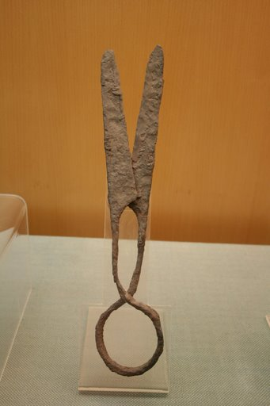
Iron Industry during Han
Production rapidly grows
Many uses
Agriculture
Shovels, picks, hoes, sickles, spades
Enabled cultivators to produce more food
Artisans
Produce iron pots, stoves, knives, needles, axes, hammers, saws etc.
Military
Designed suits of iron armor, swords, spears, arrowheads

Slide 43
Silk Production
Expands to most parts of China
Origins 3000 BCE
Chinese producers bred their silkworms
Fed them on finely chopped mulberry leaves
Unraveled their cocoons to obtain long fibers of raw silk
Wove into light, strong fabrics
Led to Silk Roads

Slide 44
Paper
100 CE, craftsmen begin to fashion hemp, bark, and textile fibers into sheet of paper
Less expensive than silk, and easier than bamboo
Became preferred medium

Slide 45
Population Growth
Early part of Han dynasty see rapid population growth
20 million in 220 BCE
60 million by 9 CE

Slide 47
Economic Difficulties
East Asia and central Asia at the time of Han Wudi, ca. 87 b.c.e.Note the indication in this map that Han authority extended to Korea and central Asia during the first century b.c.e.What strategic value did these regions hold for the Han dynasty?
Military adventures of emperors caused severe economic stress
Ex. Expeditions to fight the Xiongnu cause them to raise taxes

Slide 48
Problems of Land distribution
Poor harvests, high taxes, or crushing debts forced small landowners to sell or forfeit land to pay off debts
Owners of large estates increase in size and efficiency by employing cheap labor
Ex. Slaves or tenant farmers
Wang Mang-”Socialist Emperor”
Limits amount of land family could hold
Chaos and rebellion

Slide 49
Social Tensions
Great distinctions b/n rich and poor
Han gentlemen sport luxurious silk gowns as they engage in sophisticated conversation. Wealthy individuals and ruling elites commonly dressed in silk, but peasants and others of the lower classes rarely if ever donned silk garments.

Slide 50
Clay model of an aristocratic house of the sort inhabited by a powerful clan during the Han dynasty. This model came from a tomb near the city of Guangzhou in southern China.

Slide 51
In Han times the wealthiest classes enjoyed the privilege of being buried in suits of jade plaques sewn together with gold threads, like the burial dress of Liu Sheng, who died in 113 b.c.e. at Manzheng in Hebei Province. Legend held that jade prevented decomposition of the deceased's body. Scholars have estimated that a jade burial suit like this one required ten years' labor. What does such a suit tell us about the lives of the Chinese elite during the Han dynasty?

Slide 52
A painted brick depicts a peasant working in the fields with a team of oxen and a wooden harrow. By the Han dynasty, many plows of this type had iron teeth. Produced in the third or fourth century c.e., this brick painting came from a tomb in Gansu Province in western China.

Slide 53
Yellow Turban Rebellion
Land distribution never resolved
Named after distinctive headgear
Serious revolt that tested Han in late 2nd century CE
Weakens the Han State in 2nd /3rd century

Slide 54
Fall of the Han
Political problems internally
Imperial family members, Confucian scholar bureaucrats, and court eunuchs all seek to increase their influence
Ex. 189 CE, faction led by imperial relative slaughtered 2,000 beardless men in an effort to destroy the eunuchs as a political force
220 CE Han disintergrated
Next four centuries China remained divided into several large regional kingdoms
Though it dates from a somewhat later era, about the sixth century c.e., this cave painting from Dunhuang in Gansu Province (western China) offers some idea of the chaos that engulfed China as the Han dynasty crumbled.

