Slide 1
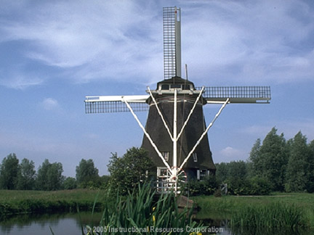
Western Europe during the High Middle Ages

Slide 2
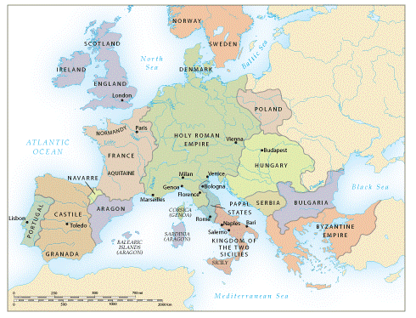
The Establishment of Regional States
Holy Roman Empire
France
England
Italian States

Slide 3

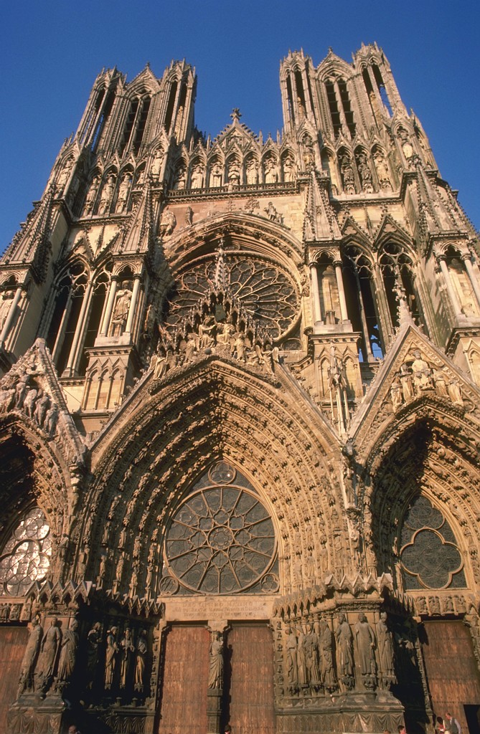

High Middle Ages
1000 – 1300 CE
Europeans built a vibrant and powerful society on the political, economic, and cultural foundations of the early Middle Ages

Slide 4
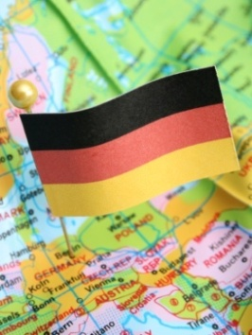
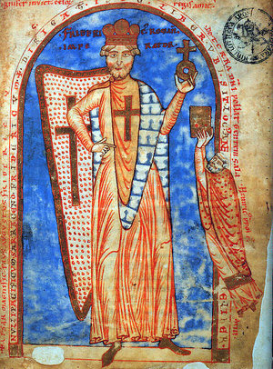
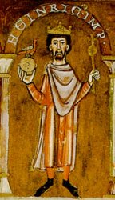
Holy Roman Empire
Late 10th c., German princes formed it
Viewed as a revival of the Roman Empire, however never really was
Otto I or Otto the Great
  Extended their rule to eastern Europe
  B/c of his aid to the Church, he was crowned emperor in 962
  Despite this, tension surrounded popes/emperors
Investiture contest
  Gregory VII banned lay investiture
  Emperor Henry IV rejected policy
  Pope intervenes w/ help of supportive German princes
  Gives German princes more power and diminishes Emperor
Frederick Barbarossa
“the Red Beard”
1152 CE -1190 CE
Sought to absorb N.Italy however popes w/ help of other European states forced him to relinquish his rights there
Another example of how papal authority limited the rule of emperor

Slide 5
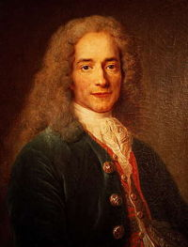
Voltaire, 18th century, on the Holy Roman Empire
“The Holy Roman Empire is neither holy, nor Roman, nor an empire.”
Empire only in name
Just a regional state that intermittently wielded influence in eastern Europe and Italy

Slide 6
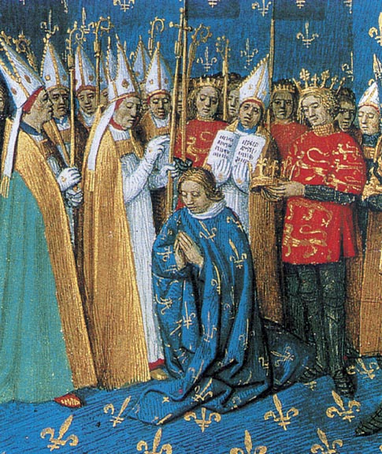
Capetian France
Hugh Capet elected as king in 987 CE by the lords of France
Held only small territory around Paris
Capetian kings gradually added resources and political influence
By 14^{th c.}, they had gradually centralized power and authority in France
Coronation of Philip II of France

Slide 7
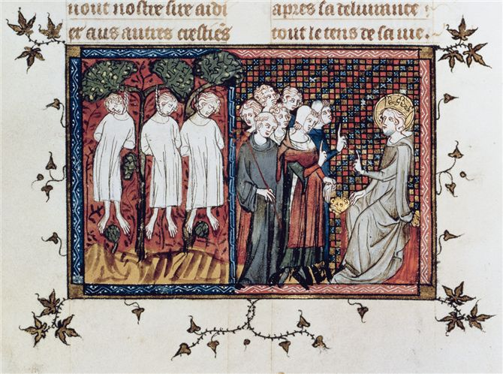
King Louis IX (reigned 1226–1270), also known as St. Louis, helped to consolidate the Capetian hold on the French monarchy. In this fourteenth-century manuscript illustration, he hears the petitions of humble subjects (right), while hanged criminals (left) serve as a reminder of felony's results.

Slide 8
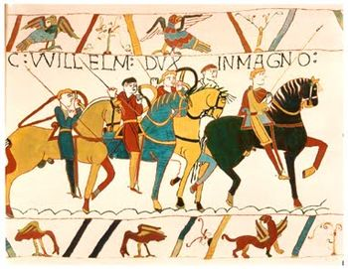
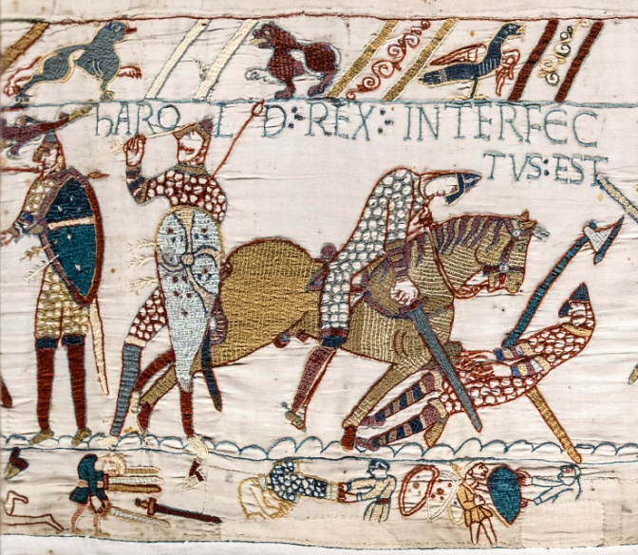
Norman England
Descendants of the Vikings in France (Normandy)
1066 William, Duke of Normandy, invades England at Battle of Hastings to become King
Rule is more centralized than Capetian kings
Periodically battled w/ Capetian kings to expand possessions in France

Slide 9
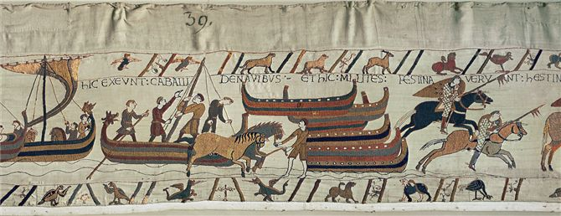
Bayeux Tapestry in Normandy
The Bayeux tapestry, a magnificent mural of woven linen about 70 meters (230 feet) long, depicts the Norman invasion and conquest of England in 1066. In this section Norman warriors sail across the English Channel and disembark in southern England.

Slide 10
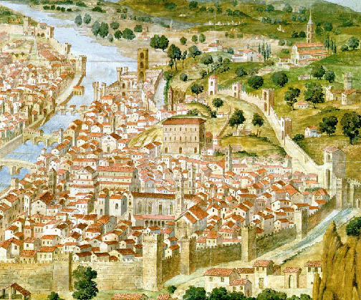
Italian States
No single regime controlled peninsula
“Ecclesiastical” states
  Popes and bishops of major cities had huge influence in political affairs
- City-states
  Florence, Bologna, Milan, Venice etc.
Papal States
  Central Italy
  Popes rule
Normans conquer Southern Italy
  Laid foundation of kingdom of Naples
  Helped conquer from Byzantine and Muslim authorities in South
Florence grew rapidly during the High Middle Ages-early 14th century.

Slide 11
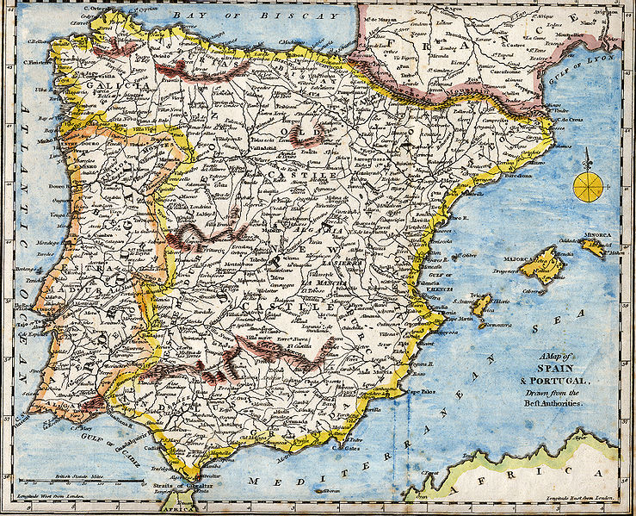
Christian and Muslim States In Iberia
Regional states
Muslims ruled most of peninsula from 8th – mid-11th century
By 13th c., Christian kingdoms of Castile, Aragon, and Portugal controlled most of Iberian Peninsula
Granada only Muslim kingdom

Slide 12
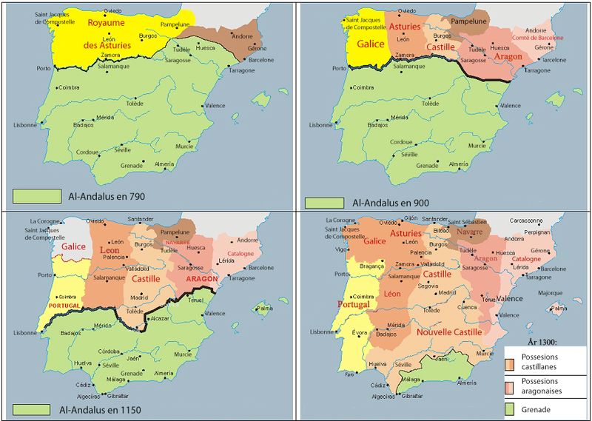

Slide 13
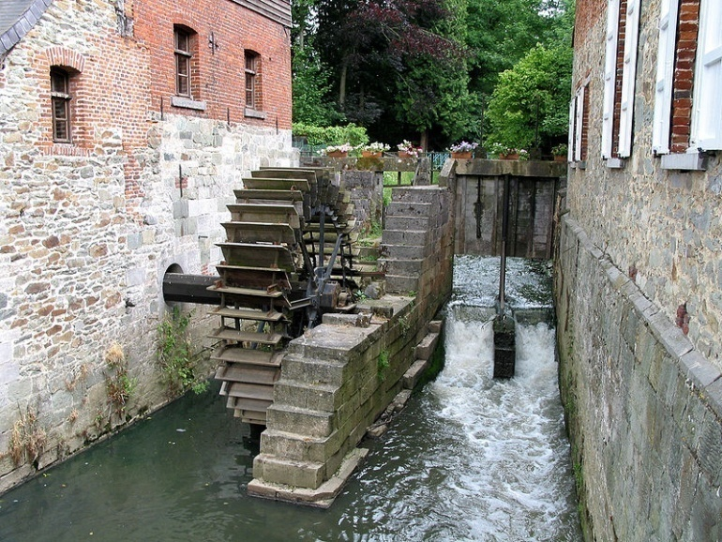
Agriculture
Expansion of arable land
  Clear forests, drain swamps
  By 1300, forest cover reduced to 20% of land area
Improved techniques
  3 field system
New tools and technologies
  Water mills and windmills
  Heavy plows
  Horseshoe and horse collar
New crops
  Beans, peas
  Wheat, rice, spinach, artichoke, eggplant, lemon, lime, oranges, melon

Slide 14
European Population 800-1300 CE

Slide 15
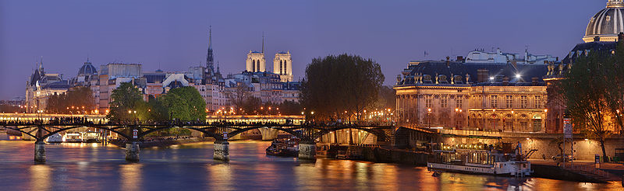
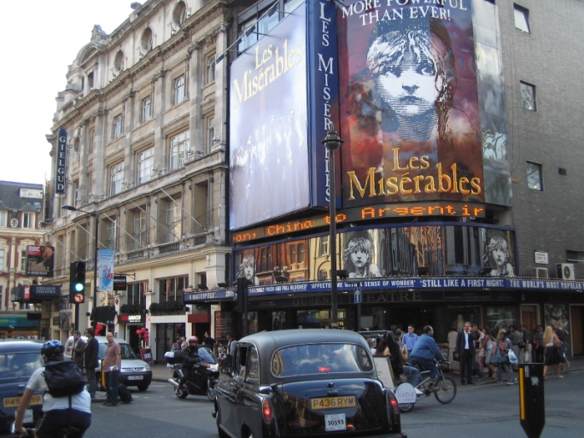
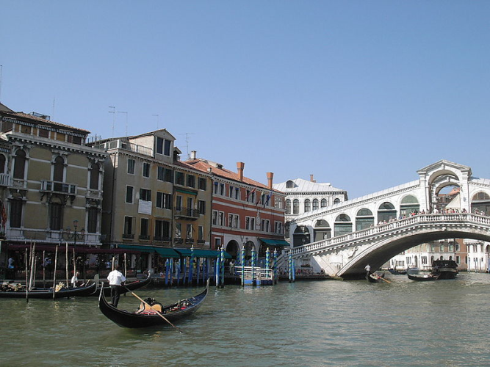
Growth of Towns and Trade
Urbanization w/ increase of food
  Paris, London, Toledo
Increasing manufacturing and trade
  Textile production
Mediterranean trade
  Urban society most pronounced in Italy
  Merchants in Venice engage in trade w/ Byzantine & Muslim partners

Slide 16
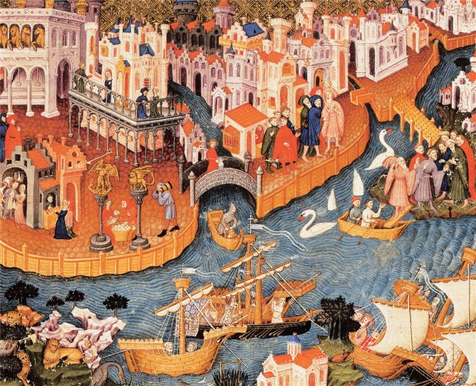
Venice
Venice, home of Marco Polo and a legion of merchants, drew enormous prosperity from trade. Street vendors, shopkeepers, and merchant ships figure prominently in this illustration from a fourteenth-century manuscript. How did its geographic location help Venice become a center of Mediterranean trade?

Slide 17
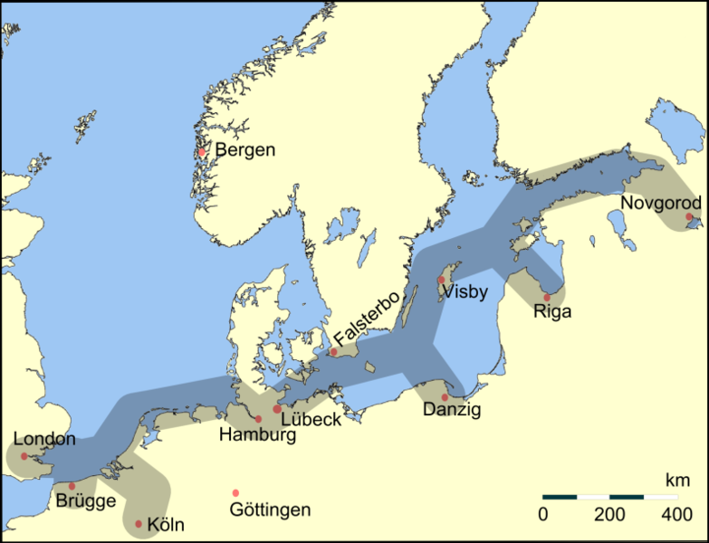
Hanseatic League
The trade network that grew in the North and Baltic Sea
  Also known as the Hansa
  Banned together to establish common trade practices or monopoly from region to world
  Over 100 cities join
Dominates trade in fish, fur, timber, and pitch
Rivers link it to the Mediterranean trade networks
Significance: Leads to large middle-class in Northern Europe and sets precedent for the Dutch and English Trading Companies later
Hanseatic League
  *Stretched from Novgorod, Russia to London

Slide 18
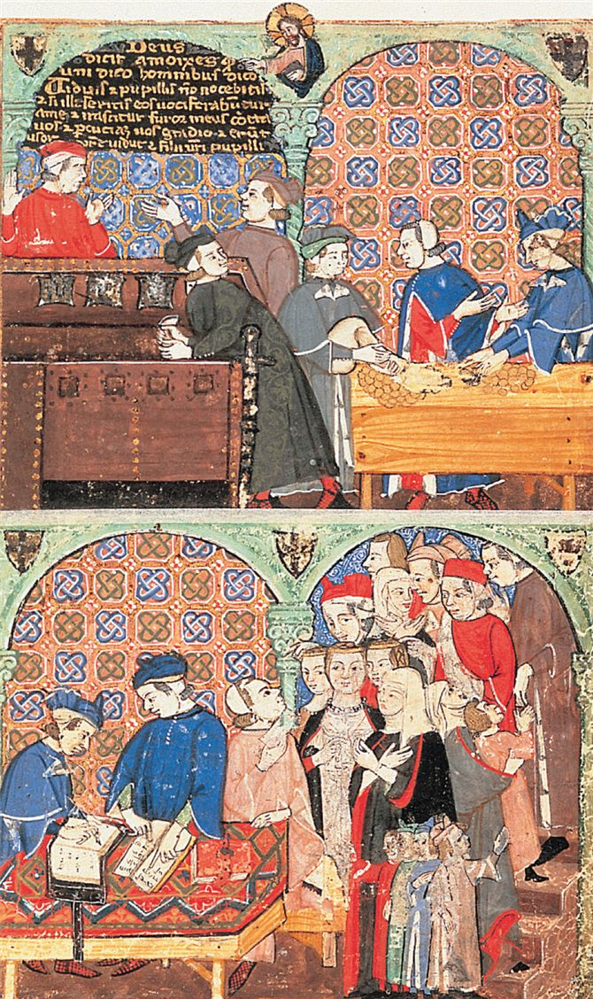
Improved Business Techniques
Development of credit, banking
  Ex. Letters of credit
    Didn’t have to carry large amounts of cash or bullion
    W/out them, it would be impossible to carry out long-distance trade
Partnerships with other merchants to spread out risk
Genoese bankers change money and check the accounts of their clients in this fourteenth-century manuscript illustration.

Slide 19
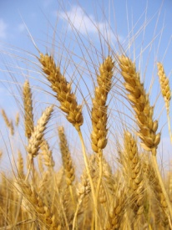
Social Change
The Three Estates
Those who pray: clergy
  Priest, bishop, cardinal, popes
Those who fight: knights
  Nobles, inherited position, educated in military
Those who work: peasants
  Majority of population
Society marked by political, social, economic inequality

Slide 20
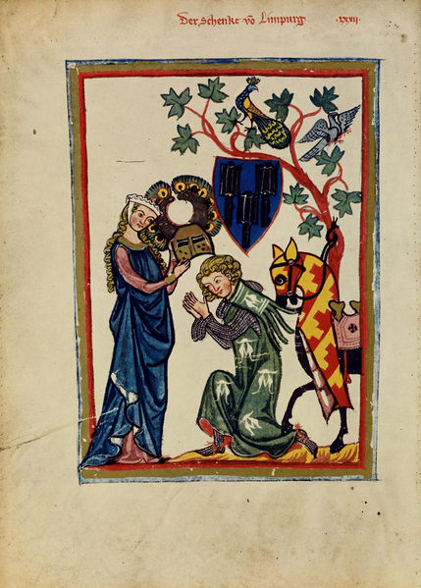
Chivalry
Code of conduct for nobles
  Compared to bushido in Japan
Sponsored by Church to minimize fighting among Christians
Technically, knight to dedicate his efforts to promotion of Christianity
  Devote himself to order, piety, and Christian faith
  Protection of women

Slide 21
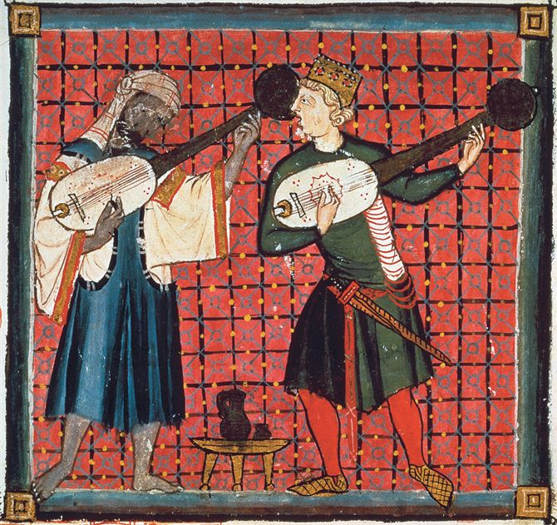
Troubadours
Class of traveling poets, minstrels, entertainers
Borrowed Islamic traditions of love poetry
Spread of cultural ideas to Europe
  Popular among aristocratic women
  Eleanor of Aquitaine (1122-1204) major supporter
Popularization of idea of romantic love, refinement of European knights
A thirteenth-century manuscript illustration depicts two lute players: Muslim (left) and Christian (right). Muslim artists deeply influenced the poetry and music of the medieval troubadours.

Slide 22
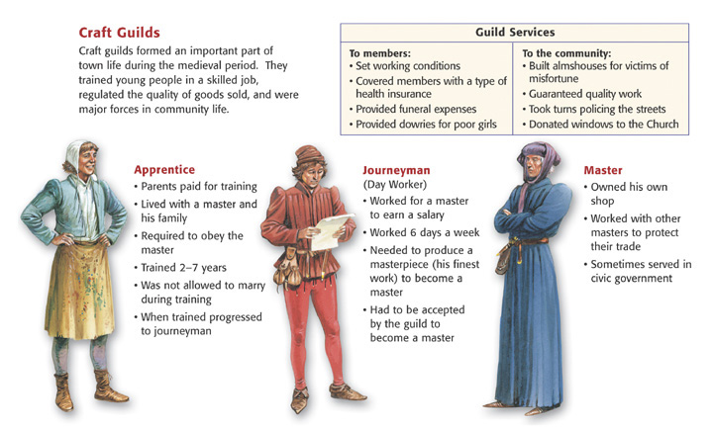
Guilds

Slide 23
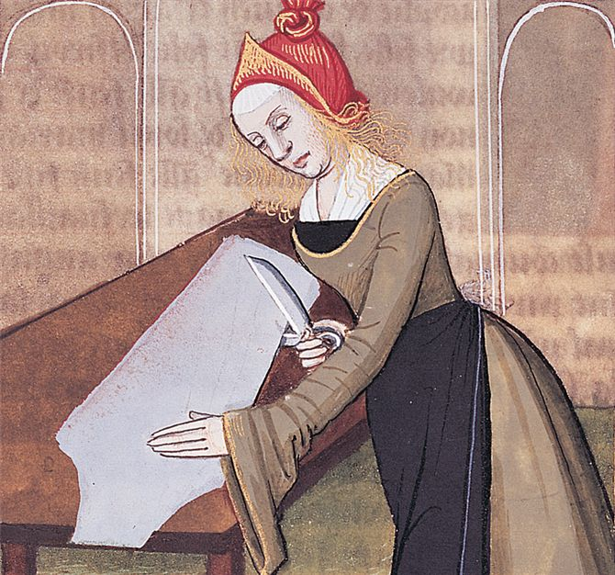
Urban Women
Fresh opportunities for women in cities as well as men
Most guilds admitted them
Work along w/ men
  Baker, brewer, candle maker, fishmonger, shoemaker etc.
Dominated certain professions
  Sewing, spinning, weaving, making hats, wigs, fur garments

Slide 24
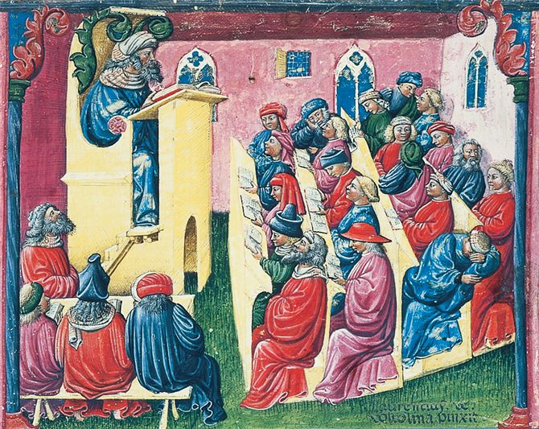
European Christianity During High Middle Ages
In cities, increase in wealth allowed more resources for education
Started w/ Cathedral Schools
  Curriculum of Latin writings
  Emphasize literature, philosophy
    Bible, writings of Church fathers
  Some law, medicine, theology
A manuscript illustration depicts a professor, at top left, lecturing in a medieval German university. About half the students listen and take notes diligently, while the others catch up on their sleep or chat with friends.

Slide 25
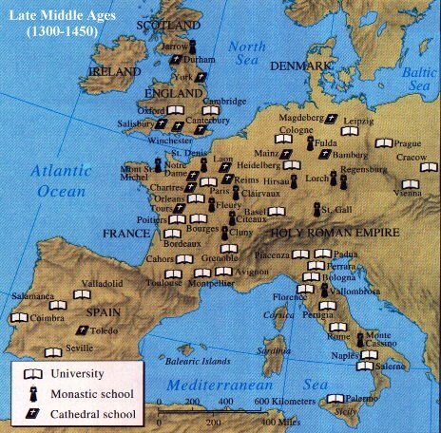
What can be learned from the following map?

Slide 26
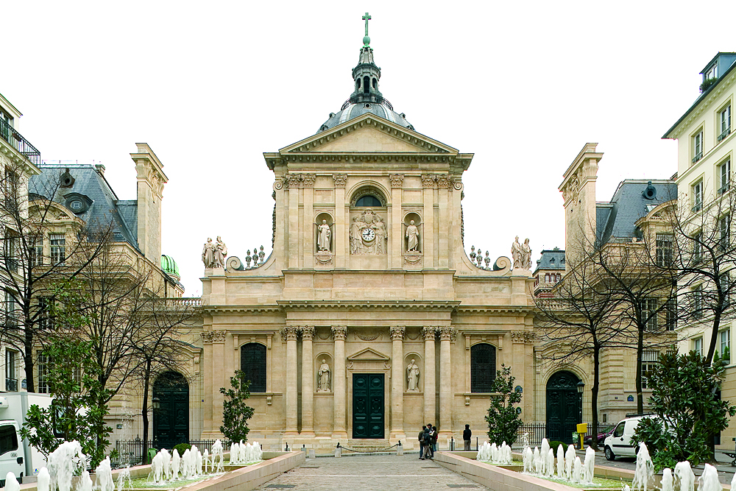
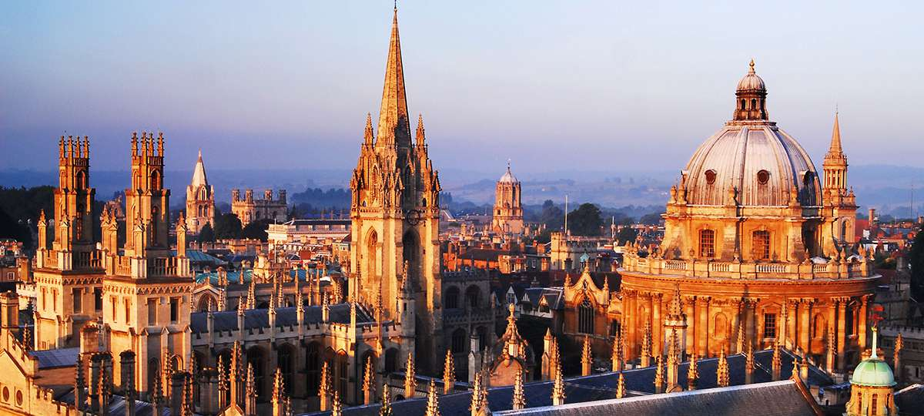
Universities
Academic and faculty guilds formed in 12th century
  Bestow academic degrees that served as licenses to teach
  Control the curriculum
Higher standards of education promoted
University of Paris-Sorbonne
University of Oxford

Slide 27
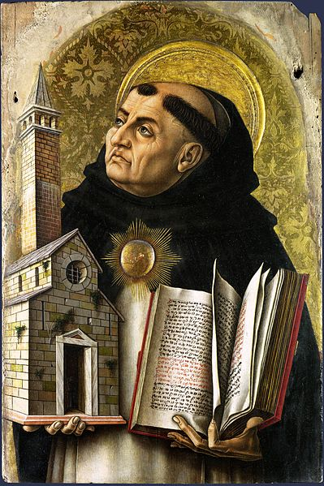
Influence of Aristotle
Latin translations of Byzantine Greek texts circulate in Europe
Jewish and Muslim scholars provide other translations from Arabic translations
  Leads to scholasticism
    Synthesis of Christianity and Aristotle
St. Thomas Aquinas(1225-1274), major proponent of Scholasticism
  Career at University of Paris
  Summa Theologica
  Synthesized faith and reason
St. Thomas Aquinas 1225-1274

Slide 28
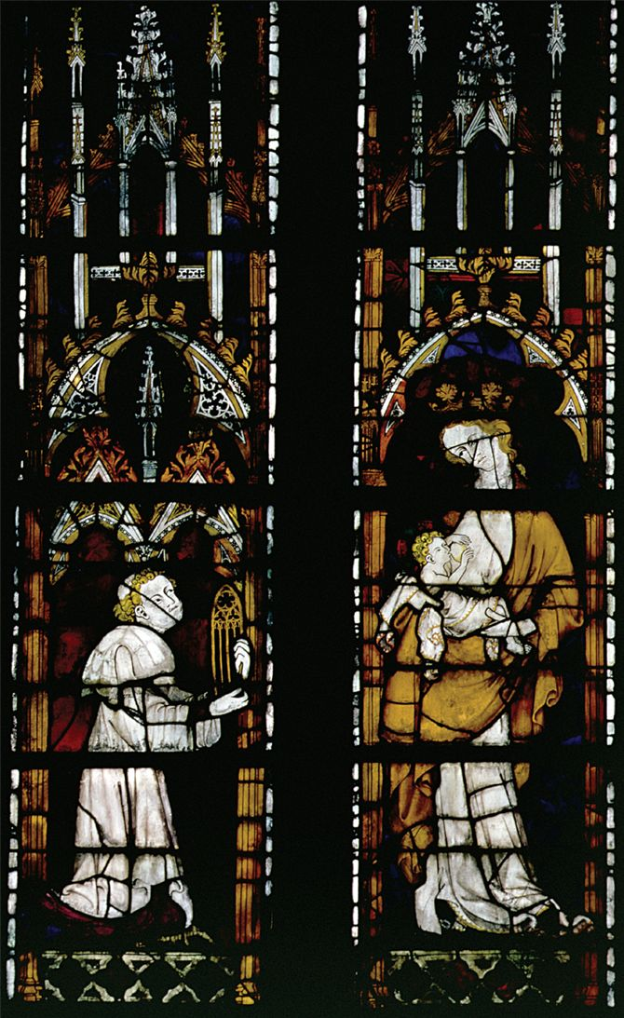
Popular Religion
Population at large remained unaffected by Scholasticism
The Seven Sacraments gain ritual popularity
  Esp. Eucharist
Devotion to Saints
  Pray for saints to look after their spiritual interests
Most popular saint: The Virgin Mary
  Ideal mother
  100s of churches and cathedrals devoted to her
  Notre Dame dedicated to her “Our Lady”
Saints’ relics
  Venerate relics or physical remains
  Ex. Clothes, locks of hair, hair, teeth, bones
Pilgrimage to Rome, Jerusalem etc.
Here a 14th century stained glass window from the Notre Dame Cathedral in Evreux, France, represents the Virgin holding the infant Jesus in the company of an admirer.

Slide 29
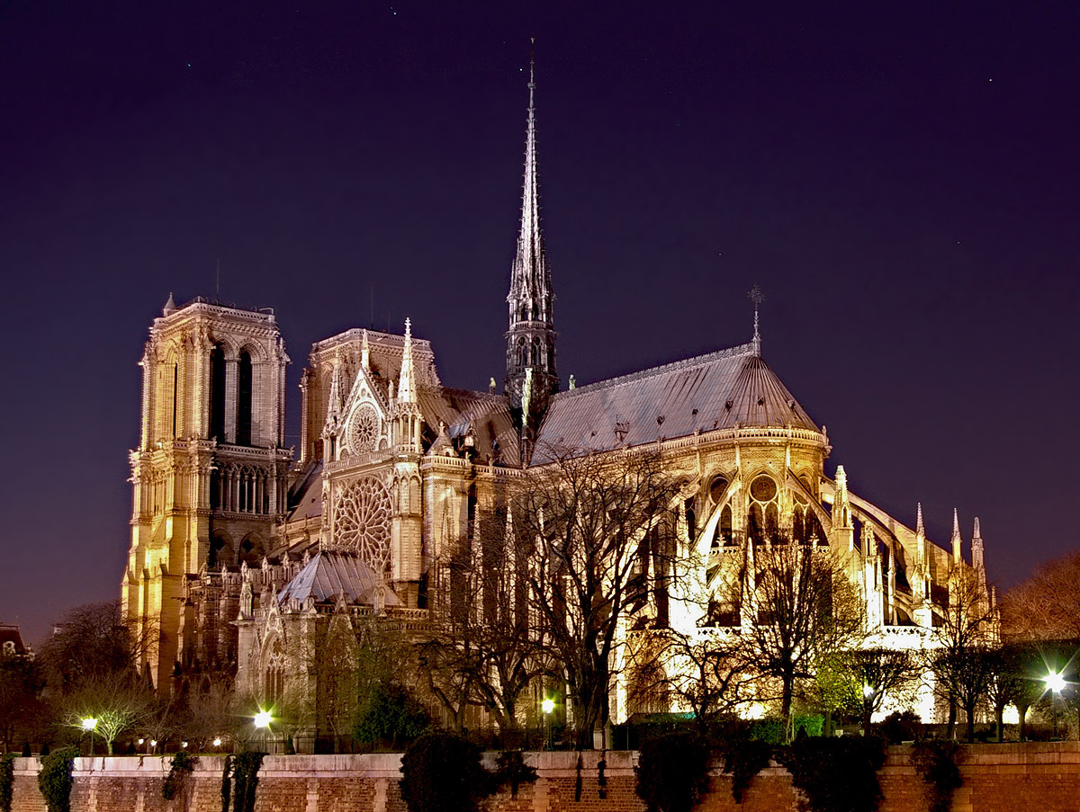
Notre Dame in Paris

Slide 30
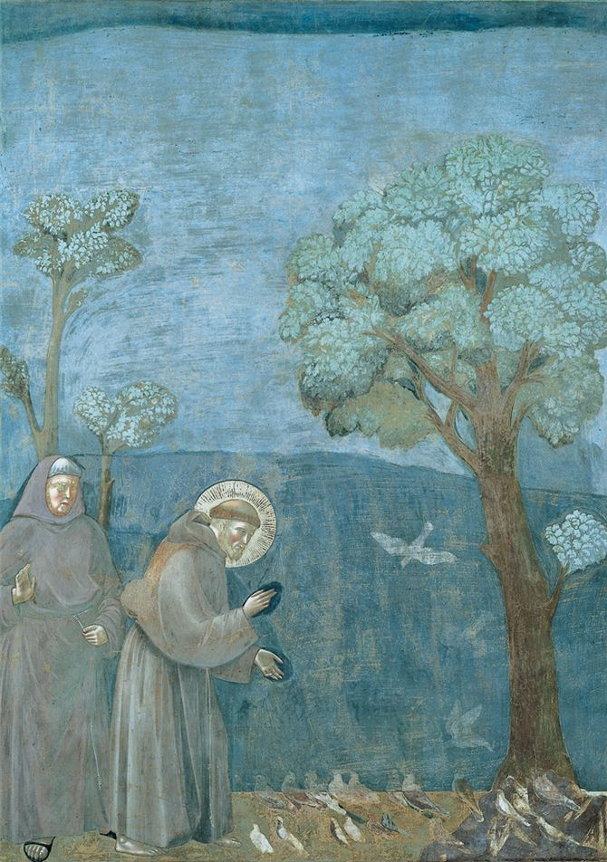
Reform Movements
Rebellion against perceived materialism of Roman Catholic Church
St. Dominic (1170-1221) and St. Francis (1182-1226) create orders of mendicants or “beggars”
  Vows of poverty
Popular preachers
Religious zealots, very opposed to heretical movements

Slide 31
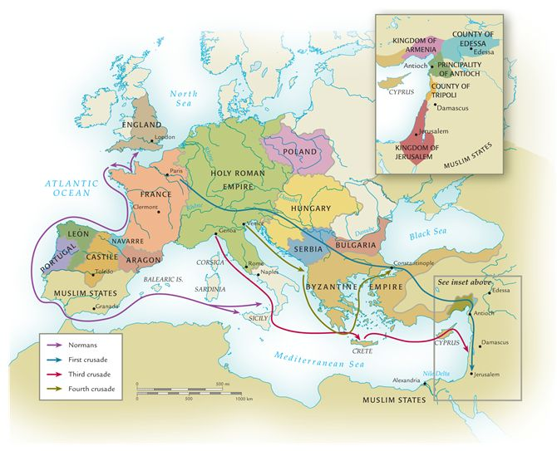

Slide 32
The Medieval Expansion of Europe
Atlantic and Baltic Colonization
  Scandinavians explore North Atlantic Ocean
    Iceland, Greenland, Vinland (Canada)
    Canadian settlements do not succeed
  Kings of Denmark nominally convert to Christianity, Sweden and Finland follow

Slide 33
Reconquest of Sicily and Spain
Expansion of Christian Europe in Med.
Sicily taken by Muslims in 9th century, reconquered by Normans in 11th century
  Missionaries and clergy reintroduce it
  Muslims scholars introduced them to Arabic translations that led to scholastic philosophers
Reconquista of Spain
  Began in 1060s
  Christian forces lured reinforcements from France and England
  Campaigns led forces all the way to kingdom of Granada
  Granada survives until 1492

Slide 34
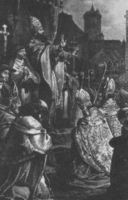
The Beginning of the Crusades
Pope Urban II calls for liberation of Jerusalem from Muslim control, 1095
Salvation promised for casualties
Rapid, enthusiastic response
Peter the Hermit raises popular frenzy
  Organizes a ragtag army (no training, discipline, weapons, supplies or plans)
  Fought Greeks, Turks and themselves on way
  Some died, captured by Turks & sold into slavery
  Few made it to Jerusalem
“Deus vult-”God Wills It”

Slide 35
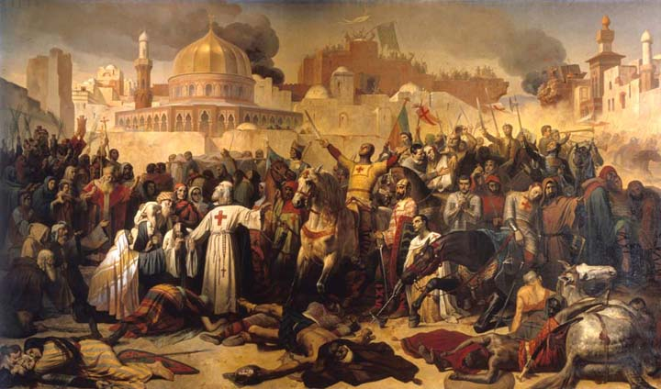
First Crusade
1096-1099 more organized expedition
Captures Jerusalem, largely due to poor Muslim organization
Salah al-Din (Saladin) recaptures Jerusalem in 1187

Slide 36
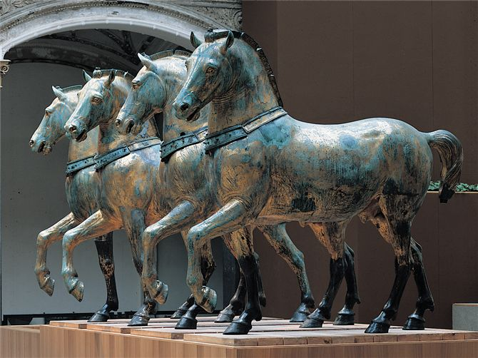
Fourth Crusade
During the sack of Constantinople in 1204, crusading forces seized and carted away Byzantine treasures of all sorts-including the great bronze horses that now stand over the entrance to St. Mark’s Basilica in Venice.

Slide 37
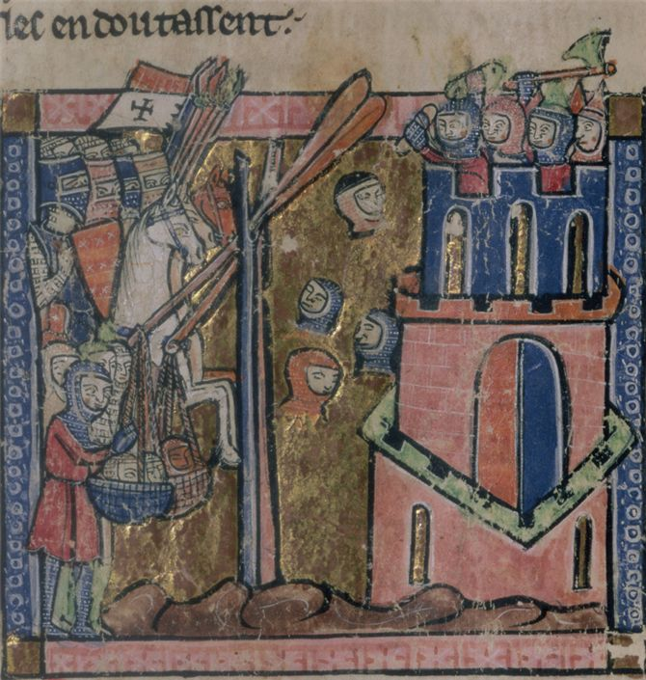
Atrocities during the Crusades
The Crusades involved brutal conflict and atrocities from all sides. In the 12th century manuscript illustration, crusaders lob severed heads at Muslims defending a fortress.

Slide 38
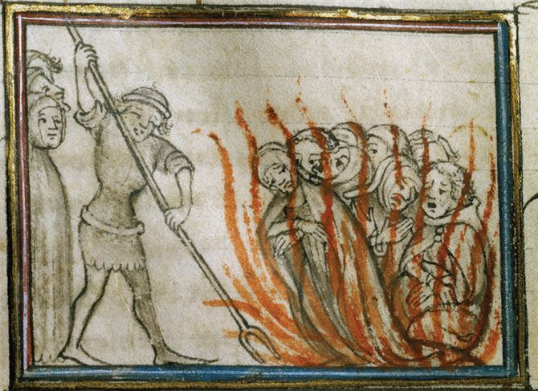
Atrocities
A 14th century manuscript illustration depicts Muslims burning captured crusaders at the stake.

Slide 39
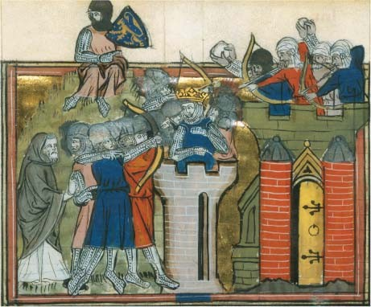
Christians and Muslims
This fourteenth-century painting illustrates the Christian seizure of Jerusalem during the First Crusade in 1099.The crowned figure in the center is Godefroi de Bouillon,a French knight and nobleman who played a prominent role in the attack and was briefly known as the king of Jerusalem. (Snark/Art Resource, NY)

Slide 40
Later and Consequences of Crusades
Failure as military venture, but reason for European reintegration into the eastern hemisphere
Five crusades by mid-13th century, none successful
Fourth Crusade destroys Constantinople, 1202-1204

Slide 41
Consequences of the Crusades
Provides direct contact with Muslim ideologies, trade
  Aristotle, “Arabic” numerals, paper production
  New foods, spices, silk, cotton textiles, carpet, tapestries
Demand for new commodities increased allowing Italian merchants to develop and market them in port cities
  Ex. Marco Polo
Travel well beyond Egypt, Palestine to avoid Muslim intermediaries

Slide 42
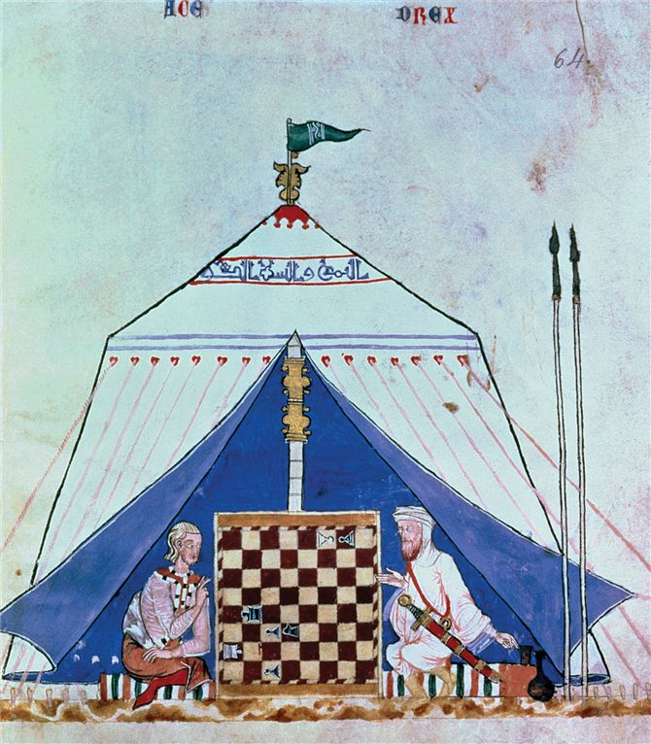
An illustration from a manuscript of 1282 depicts a Christian (left) playing chess with a Muslim (right). Chess was one of many cultural elements that passed from Muslim to Christian societies during the crusading era.

Slide 43
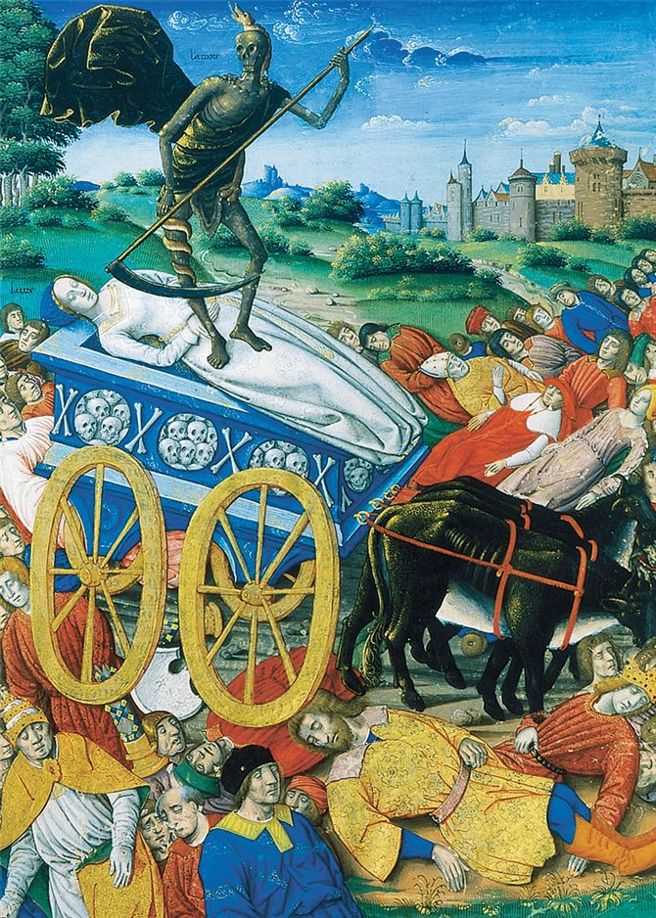
The Black Death
A painting of 1503 graphically communicates the horror felt by medieval Europeans when bubonic plague struck their communities. Here death takes away a cartload of victims while others die beside the road.

Slide 44
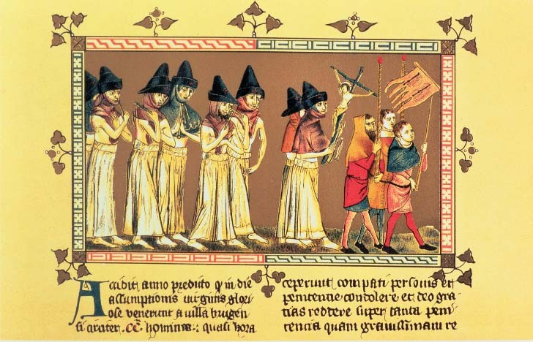
The Flagellants

Slide 45
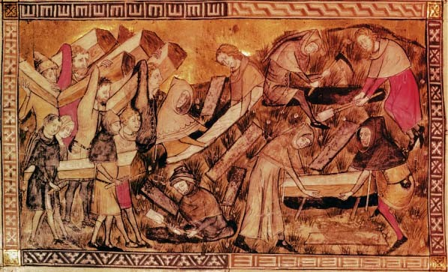
Burying the Dead

Slide 46
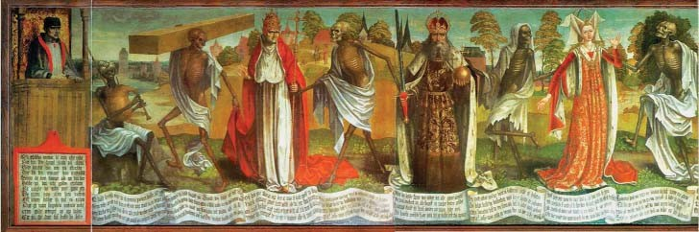
Culture of Death
In the inscriptions at the bottom of the painting, each living character addresses a skeletal figure, who in turn makes a reply. Here is the exchange between the empress (shown in a red dress at the far right of the image) and Death. First, the empress speaks:
Empress:
I know, Death means me!
I was never terrified so greatly!
I thought he was not in his right mind,
after all, I am young and also an empress.
I thought I had a lot of power,
I had not thought of him
or that anybody could do something against me.
Oh, let me live on, this I implore you!
Death’s reply:
Empress, highly presumptuous,
I think, you have forgotten me.
Fall in! It is now time.
You thought I should let you off?
No way! And were you ever so much,
You must participate in this play,
And you others, everybody—
Hold on! Follow me, Mr Cardinal!⁴⁷

Slide 47
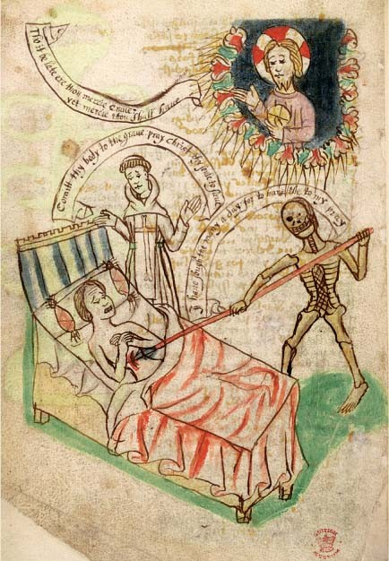
Questioning of Faith
In the late-fourteenth-century clergyman in England expressed the dismay that many must have felt:
“For God is deaf nowadays and will not hear us
And for our guilt, he grinds good men to dust.”
The captions, from top to bottom, read: Christ figure: “Tho it be late ere thou mercie came: yet mercie thou shalt have.” Priest figure:“Commit thy body to the grave: pray Christ thy soul to save.” Death figure: “I have sought thee many a day: for to have thee to my pray.”
* How do these captions influence your understanding of the painting?

Slide 48
Assessing motives: Do you think the artists who created these visual sources sought to reinforce traditional Christian teachings or to challenge them?
Using art as evidence: What do these visual sources tell you about the impact of and responses to the plague in fourteenth-and fifteenth-century Western Europe?
Connecting past and present: Considering the various ways that people sought to avert, cope with, or explain the plague in these visual sources, what parallels to the human responses to crises or catastrophes in more recent centuries or in our own time can you identify?

Slide 49
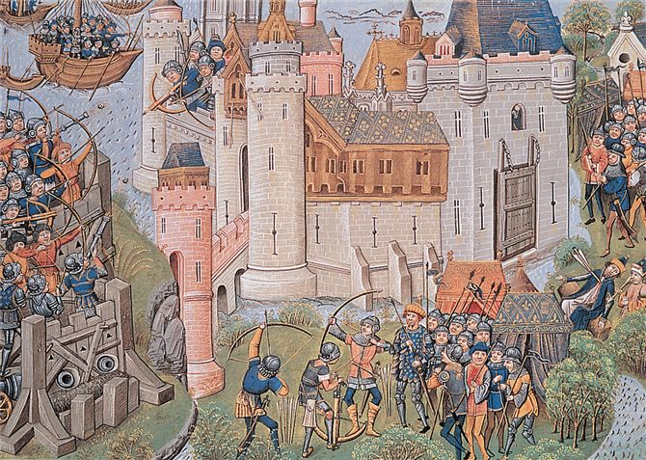
English forces besiege a French citadel during the Hundred Years' War (1337–1453). Note that the besiegers on the left side of this manuscript illustration employ cannons and smaller firearms that launch gunpowder bombs.

