Slide 1
What is “Civilization”?

Slide 2
According to Stearns, Civilization is…
More subjective…
Can we call “Catal Huyuk” a civilization? Why?

Slide 3
The emergence of civilization occurs in many areas though not all agricultural societies.
Some agricultural societies did move around
Agricultural people using “slash and burn” farming
Herding peoples moved in tribal bands

Slide 4
Civilizations need cities?
“Civilization” comes from the Latin term for city
Civilization depends on significant cities
Why?

Slide 5
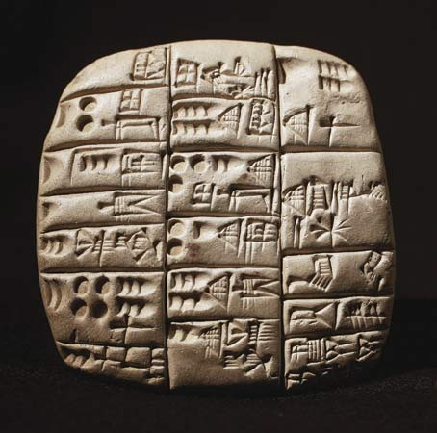
Civilizations develop writing
Cuneiform emerged in the Middle East 3500 BCE
What is its use?
Accounting, recording, specifics of laws etc.

Slide 6
Civilizations develop…
Formal political organizations or states!
Not just tribes
Religion
Social classes?
Male supremacy?
Artistic and intellectual forms?
Technology

Slide 7
Achievements of Earliest Civilization
Writing
Codes of law
City planning
Architecture
Institutions for trade
Use of money

Slide 8
Tigris-Euphrates Civilization
Mesopotamia
Middle East –Modern Iraq
Imitated no one
River valley –Fertile Crescent
Unpredictable flooding with no natural barriers

Slide 9
Achievements
Copper/Bronze tools
Wheel
Art
Irrigation
Writing: Cuneiform
Statues
Frescoes
Science: astronomy
Numbers based on units of 10,60,360

Slide 10
Religion
Ziggurat
Many powerful gods
Divine force in natural objects
Ideas about gods influenced the Old Testament
Creation and flood story
Gloomy, afterlife of punishment
Original concept of hell

Slide 11
Political Structure
City-states
Ruled by king who represented gods
80% of population live in cities
Regulated religion
Provided court system
Kings and priests important
Slaves worked land (could earn freedom)
Sargon of Akkad, 1st Empire

Slide 12
King Hammurabi
Sumer, Akkad, later the Babylonians rule over the region
Hammurabi’s legacy is his code of law to promote welfare of the people
Established rules of procedure for courts and regulated property rights

