Slide 1
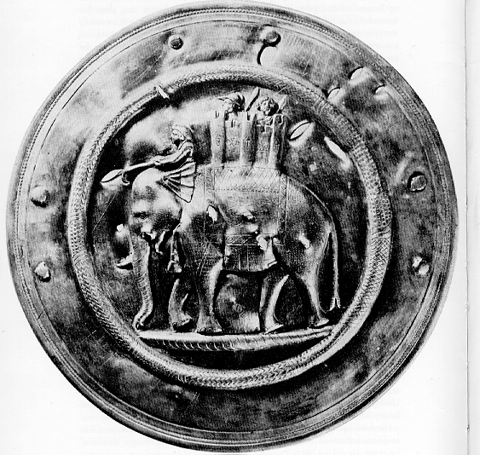
History of India
Notes:
1

Slide 2
History of India
Divided in 10 Periods
Indus Valley Civilization: led by the city states of Mohenjo-Daro and Harappa
Aryans (2500BC – 322BC)‏
Hinduism and regional kingdoms develop
The Mauryan Empire (322BC – 188BC)‏
Spread of Buddhism and the first Indian Empire started by Chandragupta
Gupta Period (320AD – 480AD)‏
Golden Age of India
Muslim Invasions (1175AD – 1300AD)‏
Muslims Turks from Afghanistan invade and begin to re-unite India into small kingdoms

Slide 3
Indian Civilization (cont)
Delhi Sultanate is the largest of these kingdoms ruled by Muslim Turks
Mughals – most powerful of Indian dynasties controlled most of today’s India, Pakistan and Bangladesh
Europeans begin to Rule (1500AD – 1850AD)‏
Portuguese, French, Dutch, and English centers of rule dominated by Corporations not countries
English Imperialism – ruled as an English colony for almost 100 years
Independence and Democratic India – Muslim and Hindu political groups push for and eventually gain independence from European Imperialism. Today India is one of the most important, powerful countries in the world and is rapidly growing in influence.
Notes:
3

Slide 4
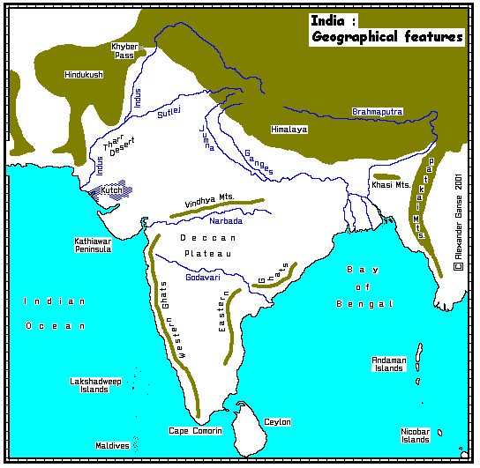

Slide 5
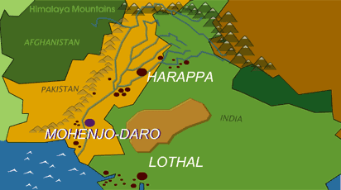
Indus Valley Civilizations

Slide 6
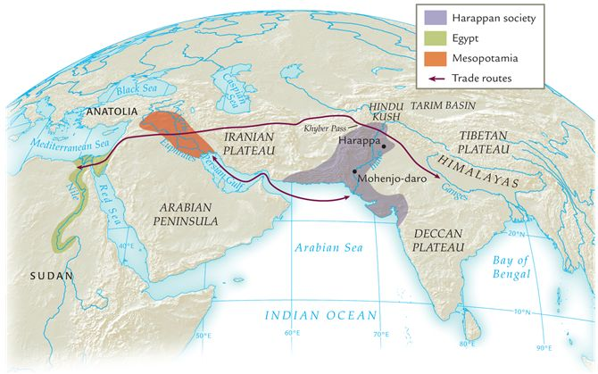
Harappan society and its neighbors, ca. 2000 b.c.e.
Compare Harappan society with its Mesopotamian and Egyptian contemporaries with respect to size. What conditions would have been necessary to enable trade to flow between the Indus River valley and Mesopotamia?

Slide 7
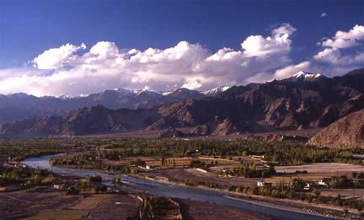
Indus Valley

Slide 8
Aerial View of Mohenjo-Daro
This aerial view of the excavations at Mohenjo-daro illustrates the careful planning and precise layout of the city.
What does the city's layout suggest about the planning abilities of the city's builders?

Slide 9
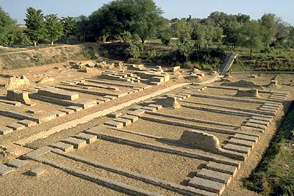
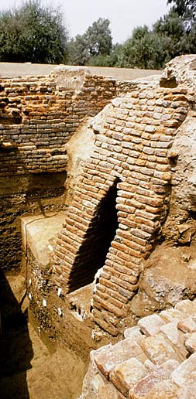
Indus River Valley Civilization 3500-1500 BCE
Where would we be? Modern Pakistan
Two main cities:
Harappa
Mohenjo-Daro
Both had
Centrally planned cities laid out on square grid pattern
City walls made of kiln-dried bricks
Extended 1 mile east /west
½ mile north/south
Citadel-fortress on high ground
Granaries
Stored grain for shortage, sale
Toilets, wells, drainage system
Brick lined sewers in the streets

Slide 10
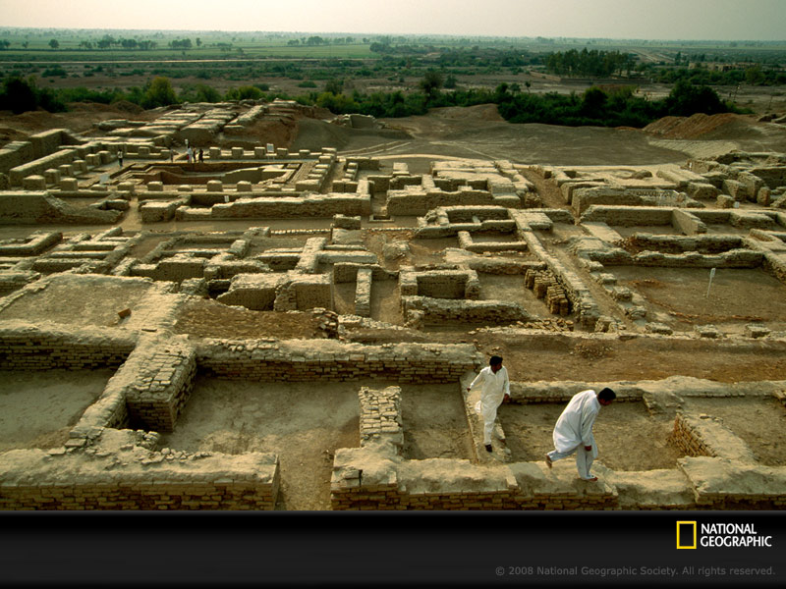

Slide 11
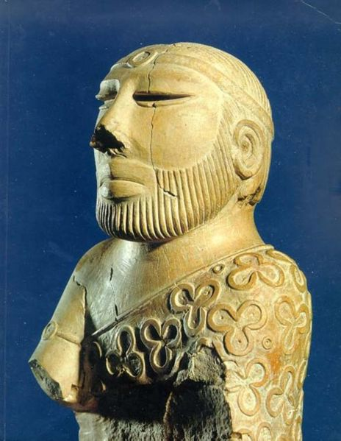
Political
Governed by powerful priestly class who ruled from citadel
The Indus Valley script has never been translated
We know very little about their lifestyle or belief system beyond what architecture tells us
The statue is called the “Priest-King” because scholars believe it may represent someone with religious and secular authority, but the true identity and status is unknown.

Slide 12
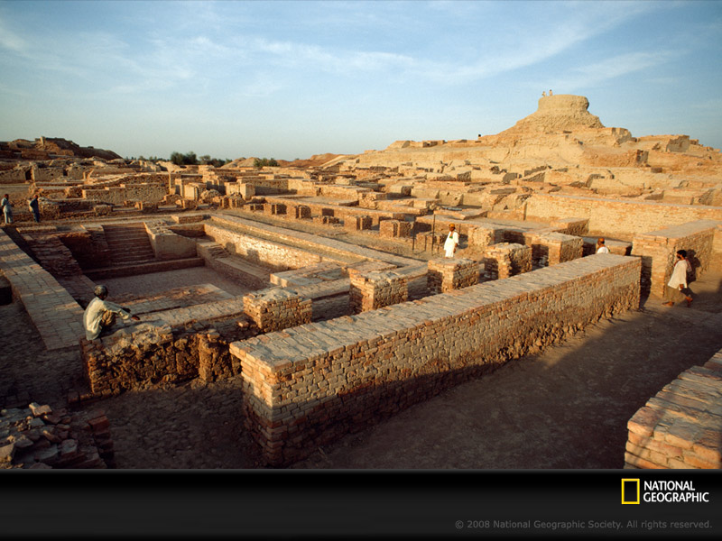
Ruins of Mohenjo Daro
Citadel
Great Bath

Slide 13
Citadel
An elevated, enclosed compound containing large buildings
Sanctuary in time of attack
Palace
Assembly halls
Places of worship
Public baths

Slide 14
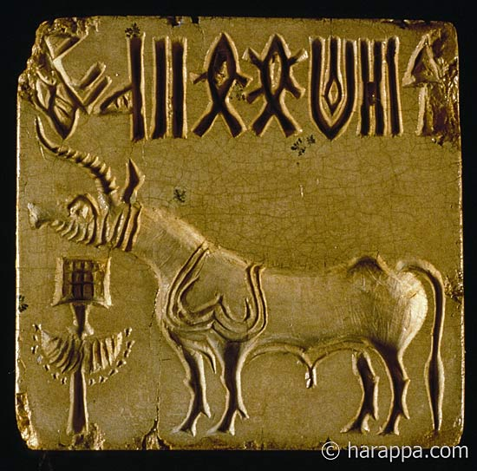
Indus Valley Civilization Economy
Major trading center in Harappa
Pottery, tools, decorative items
Received gold, silver, copper, gems, semiprecious stones
Stone seals used in trade found as far as Mesopotamia
Agricultural economy
Wheat, rye, peas, rice
Cotton
Domesticated animals
Fish from rivers

Slide 15
Harappan Seal
The carving on a seal discovered at Mohenjo-daro depicts a man wearing cattle horns and meditating while surrounded by both domestic and wild animals. The figure may well represent a Harappan deity.

Slide 16
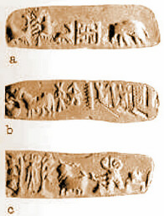
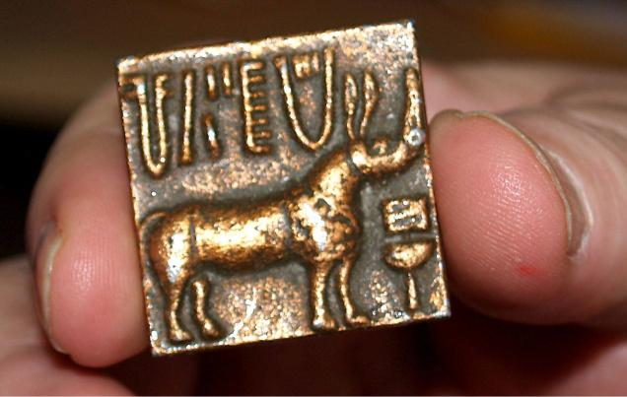
Writing
Found on stone seals
Depicting animals and human figures
Some believe the writing on the seals might represent names of merchants who stamped their wares
Undeciphered

Slide 17
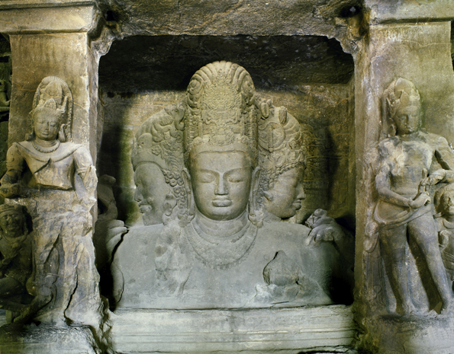
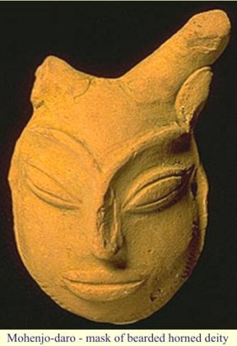
Religion
Polytheist nature gods
Influenced later peoples
Reflects strong concern for fertility
Mother goddess
Priests/kings had high importance
Worshiped the horned-god
The Indus Valley culture influenced later peoples. This is the Hindu god Shiva, a three-headed statue in India.

Slide 18
Dancing Girl
A bronze statuette produced at Mohenjo-daro between 3000 and 1500 b.c.e. depicts a lithe dancing girl.
4” tall
She has been described as a queen, a high-status woman, a sacred temple dancer, and a tribal girl
“…perfectly confidant of herself and the world.”

Slide 19
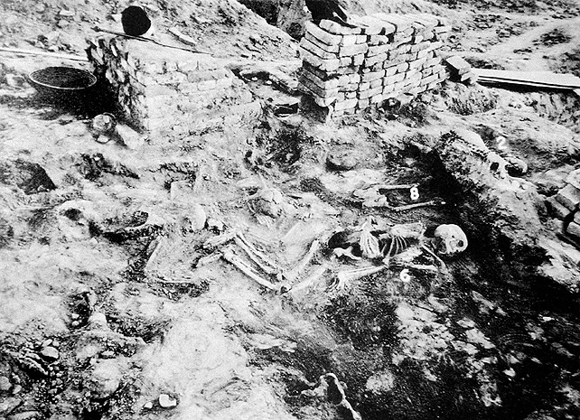
End of the Indus Valley
Environmental effects
Repeated Floods caused the course of the Indus River to shift away from the cities
Severe earthquakes compound effects
New cultural group called Aryans migrate/invade and merge with the Indus Valley peoples
May have been violent conflict
Skeletons from Mohenjo-Daro. Were they killed when the city was attacked? Or were their bodies left in the city when people fled from disease or some other disaster?

