Slide 1
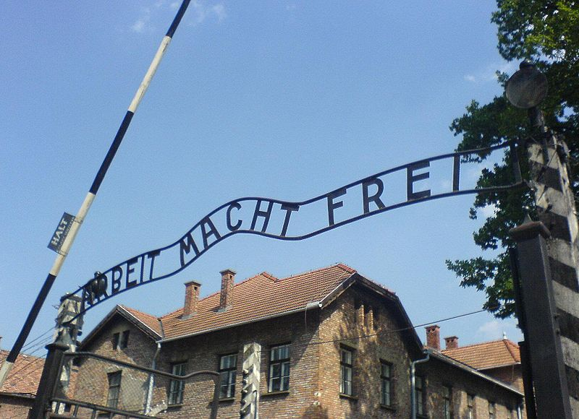
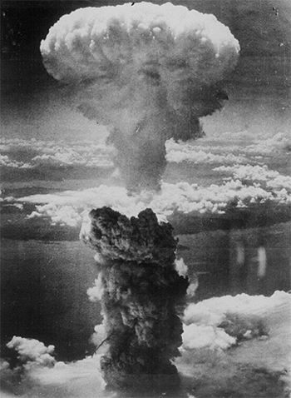
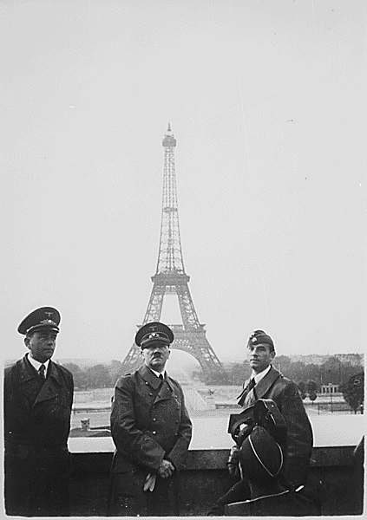
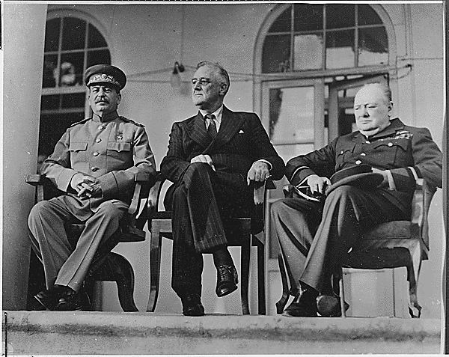
World War II and the Cold War

Slide 2
“This war is a new kind of war. It is warfare in terms of every continent, every island, every sea, every air lane.”
  Franklin Roosevelt from one of fireside chats 2 months after the US became embroiled in war 1942
  Mobilize every material and human resource
  Every weapon known to humanity used
  Every part of the world

Slide 3
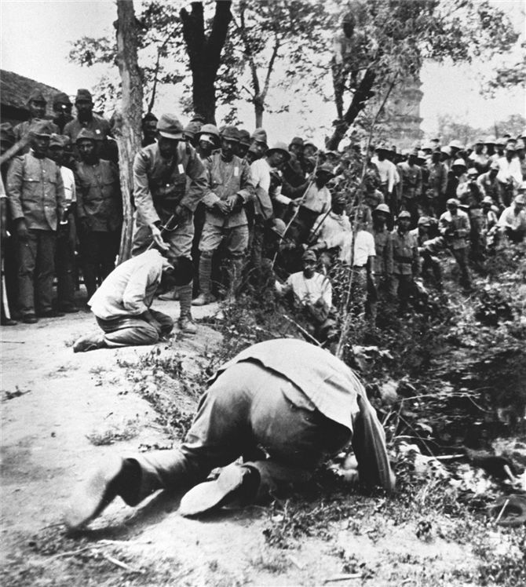
Japan’s War in China
Global conflict began when Japan invaded Manchuria in 1931
  Mukden Incident
  1933 League of Nations condemns Japan so they leave
1937 Japan launches full invasion of China
Japanese soldiers execute Chinese prisoners. In the Japanese invasion of China, four hundred thousand Chinese died when the Japanese used them for bayonet practice or executed them.

Slide 4
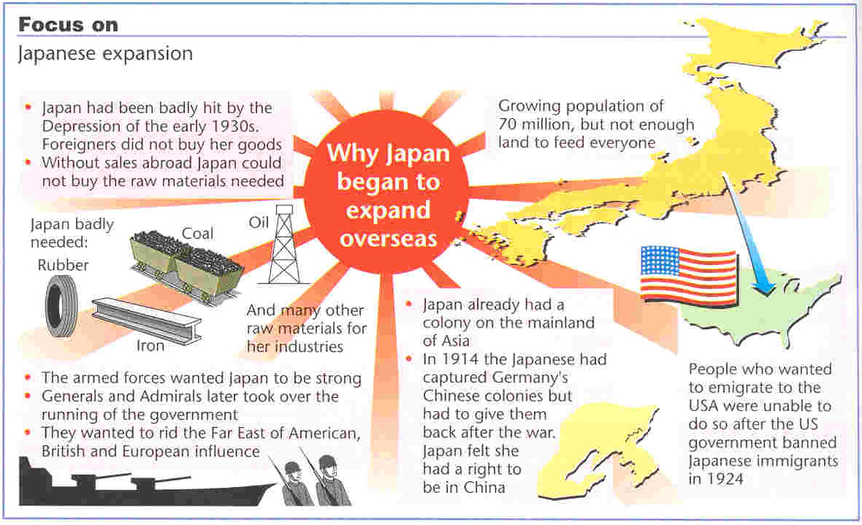

Slide 5
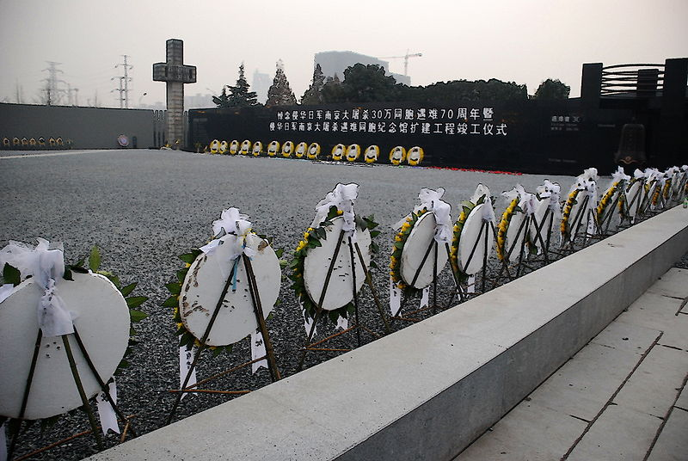
The Rape of Nanjing
First “war against civilians”
Aerial bombing of urban centers
Rape of 7,000 women, murder of hundreds of thousands of unarmed soldiers and civilians
Burned 1/3 of Nanjing
400,000 Chinese lost their lives as Japanese soldiers used them for bayonet practice and machine-gunned them into open pits
Nanjing Massacre Memorial

Slide 6
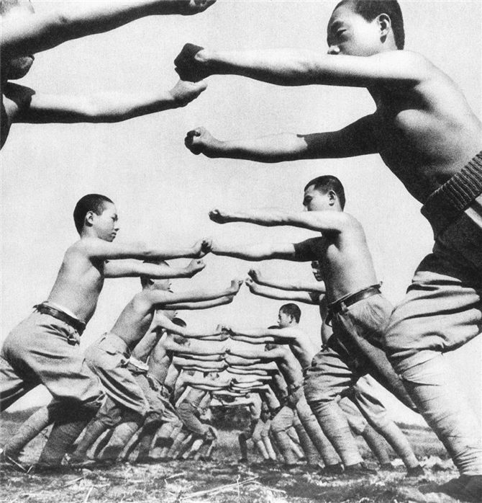
Japan in China
Japanese soldiers in 1938 engaged in strenuous physical education and kept fit in order to fight the Chinese.

Slide 7


Chinese Resistance
Nationalists and Communists formed “united front” against Japanese
Unable to work effectively
Communist used guerilla warfare against them
  No air force and artillery, so use hit and run operations from the mountains
  Sabotage bridges and railroads
They gained loyalty of Chinese peasants through their resistance

Slide 8
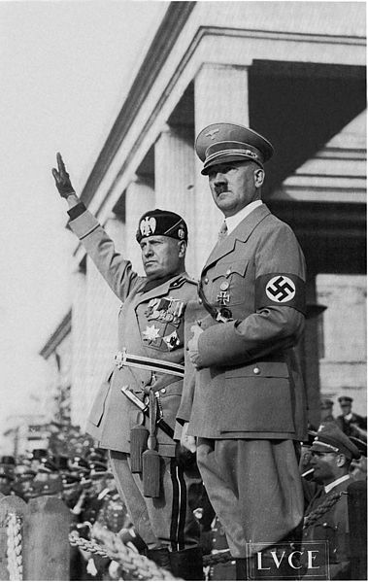
Italian Aggression
WWI , 600,000 soldiers died
Italians felt they slighted in Paris Peace Conference
Mussolini promises to bring glory and empire
Conquest of Ethiopia in 1935-36
  Killed 250,000 Ethiopians
  League of Nations offered no opposition
Intervened in Spanish Civil War on side of General Francisco Franco who overthrew gov’t
Goal was to create an empire, but never did
Notes:
cr

Slide 9
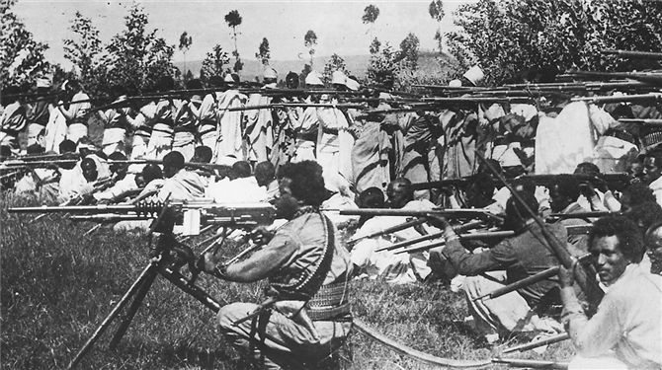
Conquest of Ethiopia
Ethiopian soldiers train with outmoded equipment that proves no match for Italian forces. At the end of the Great War, Italy, under Benito Mussolini, sought to redress perceived wrongs that denied it territorial gain by conquering Ethiopia with an army of a quarter-million soldiers.

Slide 10
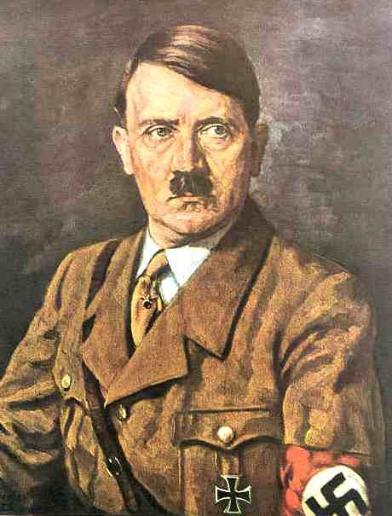
Germany
Hitler in power in 1933
Refers to the WWI armistice as the “November Crime”
  Hitler blamed it on Jews, communists, liberals
1933 Withdraw from The League of Nations
Reinstates military service to strengthen it in 1934
March 1938 Germany forced Anschlus with Austria or “union”
1938 Hitler demands control of Sudetenland in western Czechoslovakia
  No one stops this

Slide 11
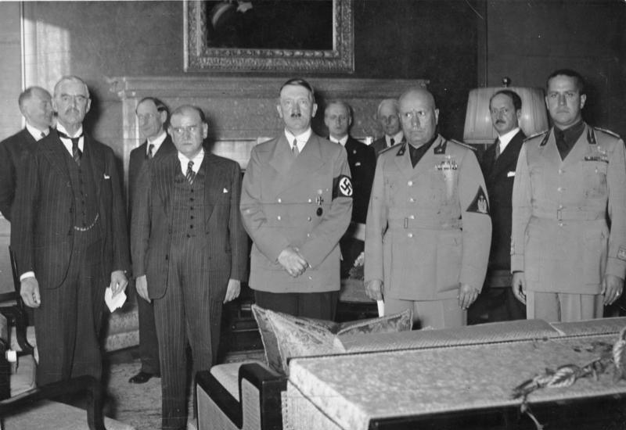
Peace for Our Time
1938 Munich Conference
  Italy, France, Britain, and Germany attend
Germany “appeased” by allowing him Sudetenland in w. Czechoslovakia
British Prime Minister returns to announce “Peace for our time”
1939 Hitler’s troops moved into Czechoslovakia
Policy of appeasement abandoned by Britain and France & guarantee to protect Poland

Slide 12

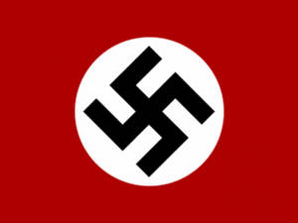
Russian-German Nonaggression Pact
Nazi-Soviet Pact promised neutrality in the event of war with a third party
Prevents war on 2 fronts
Also divided eastern Europe into 2 for Germany/Soviet Union

Slide 13
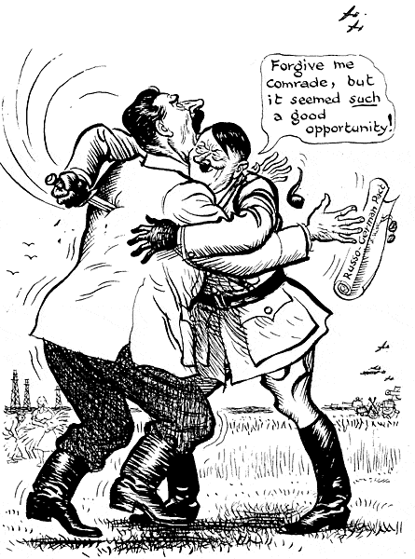
From : Daily Mail, London, 23 June 1941
How does the artist convey who the cartoon is about?
What is the artist’s reason for the polite words “Forgive me comrade”?
What is the source?
Is there a significance to the date?
What is the point of the cartoon?

Slide 14
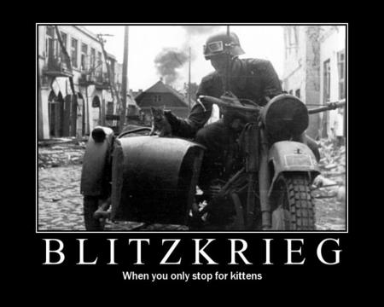
Blitzkrieg
Strategy of a “lightning war”
  Fighter planes scatter troops and take out communications
  Tanks go through defenses
  Infantry encircle & capture enemy troops
  Damage economy w/ blockades, sub attacks, and bombing raids
Sept. 1, 1939 Nazi invasion of Poland
Within 1 month, Poland is defeated
Hitler divides it with the Soviet Union
His “blitzkreig” strategy works

Slide 15
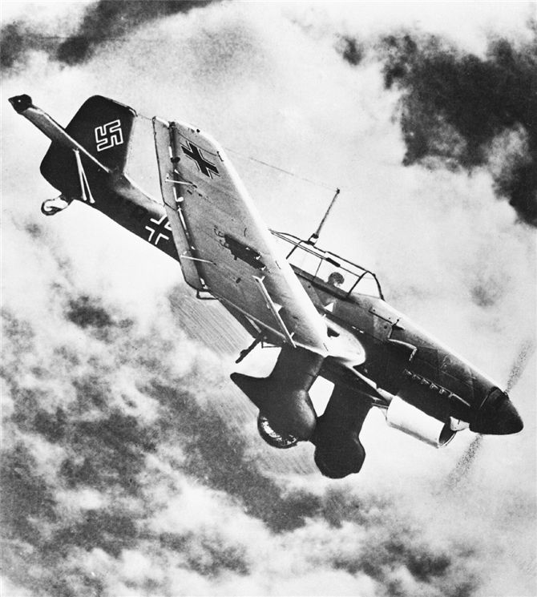
Blitzkreig
German dive-bombers like this one dominated the early air war in World War II and played a significant role in Blitzkrieg.

Slide 16
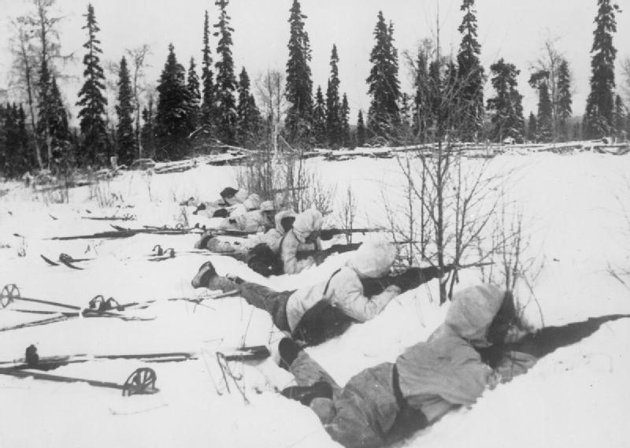
Soviets troops occupy eastern half of Poland
Move to annex Lithuania, Latvia, Estonia
Finland resisted when 1,000,000 Soviet troops invade
  Finns defend on skis but will still be defeated

Slide 17
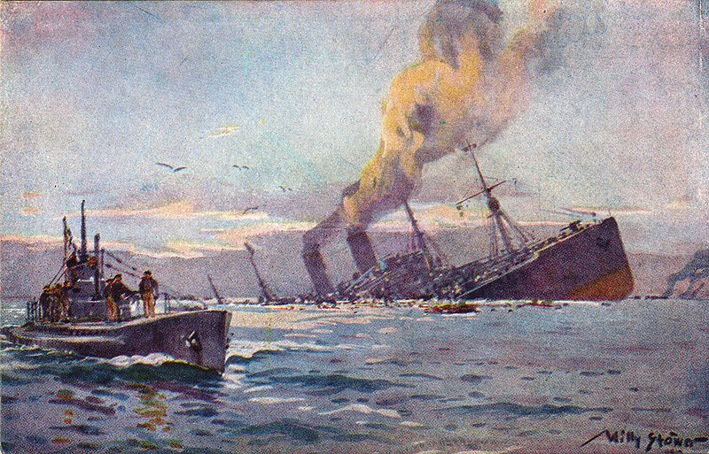
Battle of the Atlantic
German U-boats against the British ship convoys
British convoys carry food and war material to the fronts

Slide 18
Phony War
France and Britain declare war on Germany Sept. 3, 1939
Stationed troops on “Maginot Line”, a system of fortifications along France’s border with Germany
Siegfried Line was the German fortifications
Nothing happened
Nicknamed “sitzkrieg” or sitting war or “phony war”

Slide 19
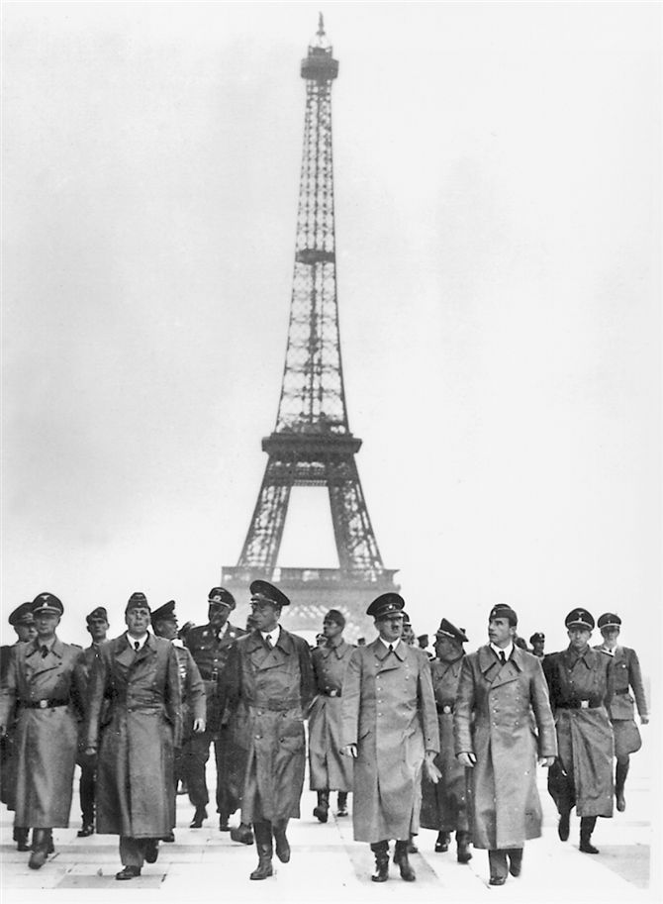
The Fall of France
Nazis swiftly conquered Denmark, Norway, Belgium, Netherlands
  Part of the strategy to invade France
Invade France
  Squeezed through Belgium/Luxembourg and the Maginot Line and reach French coast in 10 days
French sign armistice in June 1940
  Same railcar as the Germans were forced to sign in WWI
Italy’s Mussolini joins Nazi’s to reap the rewards
Adolf Hitler proudly walks through conquered Paris in 1940, with the Eiffel Tower as a backdrop.

Slide 20
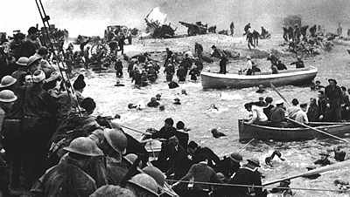
Rescue at Dunkirk
Germans trap Allied troops around the northern city of Lille
Allies were outnumbered, outgunned retreat to Dunkirk
Great Britain sends a fleet of 850 ships to rescue soldiers
  Royal Navy ships and civilian crafts
    Yachts, lifeboats, motorboats, fishing boats
May 26 – June 4 carried 338,000 soldiers to safety

Slide 21
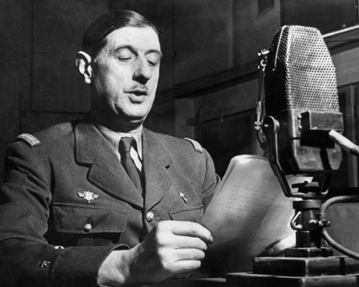
French Government in Exile
French sign armistice in June 22, 1940
  Same railcar as the Germans were forced to sign in WWI
After fall, Charles de Gaulle sets up a “government in exile” in London
  Committed to reconquer France
  Organized the Free French military forces who battled the Nazis until liberation in 1944
De Gaulle speaking on BBC radio In London during the War

Slide 22
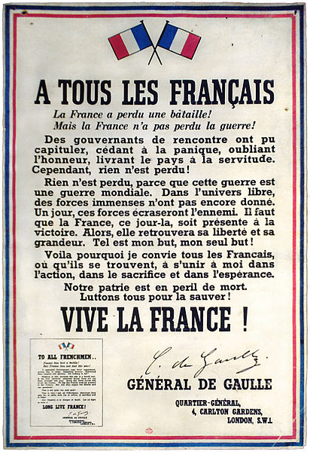
“It is the bounden (obligatory) duty of all Frenchmen who still bear arms to continue the struggle. For them to lay down their arms, to evacuate any position of military importance, or agree to hand over any part of French territory, however small, to enemy control would be a crime against our country.”
  General Charles de Gaulle, quoted in Charles de Gaulle: A Biography

Slide 23
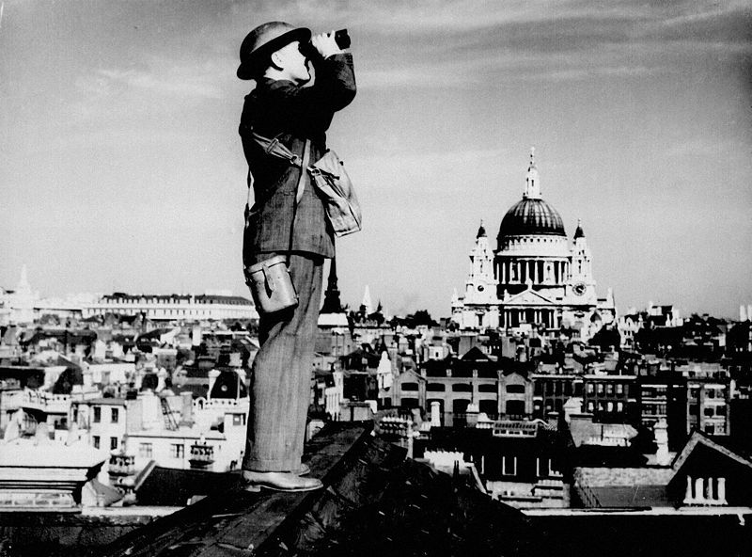
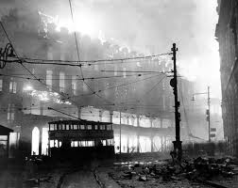
Battle of Britain
German’s strategy to defeat Britain solely through airstrikes –”The Blitz”
  Knock out the RAF and then land 250,000 on England’s shores
Summer of 1940 target British airfields and factories
By September, focus on cities
  London
Aerial bombing killed 40,000 British civilians
RAF prevented defeat and force him to abandon plans in May 1941
  Radar could tell #, speed, direction of incoming planes
  German code-making machine “Enigma” smuggled enabled them to decode German message

Slide 24
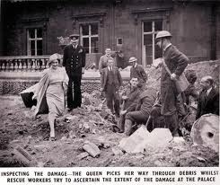
London Strikes
From 7 September to 2 November 1940 the city of London was bombed every single night without miss.
Buckingham Palace was struck twice, though it was the working-class East End and the dockyards that were heaviest hit during the Blitz.
The pounding continued well into 1941, with massive raids in March, April, and May.
On 10 May, London suffered its worst raid ever: 1,436 people were killed, Westminster Abbey and the Tower of London were damaged, the House of Commons destroyed. Rubble blocked a third of London’s streets.
King George VI and Queen Elizabeth(Queen Mum)

Slide 25
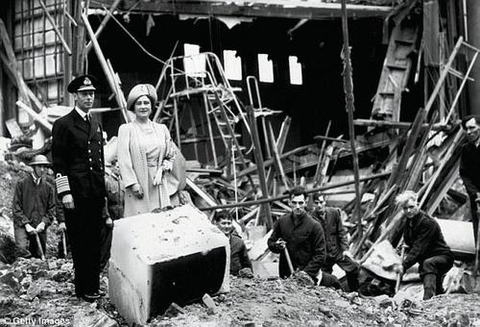
When Buckingham Palace was bombed in September 1940, some officials wanted to keep the news quiet.
“Stupid fools! Spread the news at once! Let the humble people of London know…that the King and Queen are sharing the perils with them!”
  Winston Churchill 1940
King George VI and Queen Elizabeth (later Queen Elizabeth the Queen Mother) inspect bomb damaged suffered by Buckingham Palace, London, during the "Blitz“ late 1940. The Queen was quoted as remarking, "At least I can now look the East End in the eye" - the East End of London, a port and commercial area at the time, had suffered particularly heavily in the "Blitz".

Slide 26
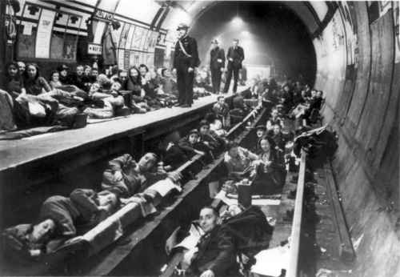
Battle of Britain
At the height of the Blitz, 177,000 people were sleeping in London’s Underground, putting into public view the most private of habits while some 1.3 million Londoners were evacuated to the country side.

Slide 27
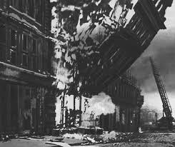
London Bombing

Slide 28
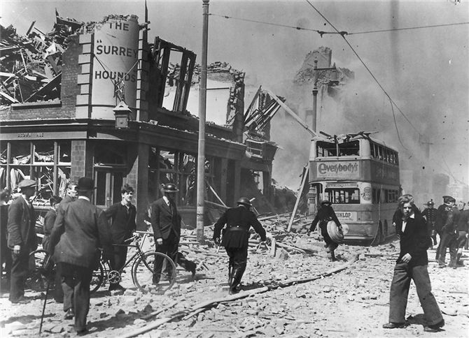
The devastation caused by German bombardments is visible in the wreckage of a London neighborhood in 1944.

Slide 29
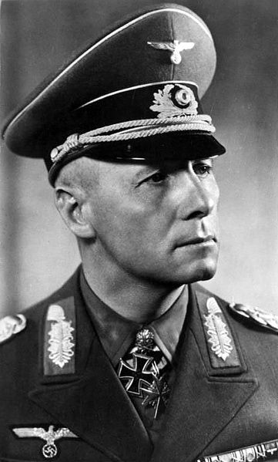
Germany in N. Africa and Balkans
Summer 1941, Germans control Balkans and N.Africa
B/C of British resistance, Hitler turns to North Africa and Balkans then to Soviet Union
Mussolini’s armies attack British-controlled Egypt
Hitler sends General Erwin Rommel to attack British forces against Italians
Nicknamed “Desert Fox”

Slide 30
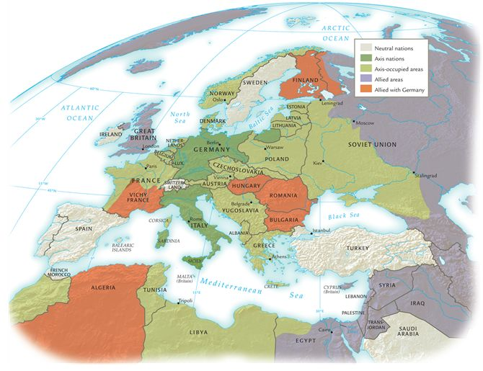
High tide of Axis expansion in Europe and north Africa, 1942–1943.

Slide 31
http://www.authentichistory.com/1939-1945/1-timelines/1-39-41/index.html

Slide 32
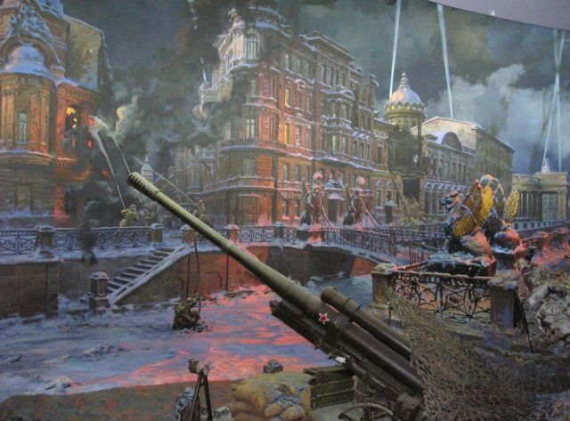
German Invasion of the Soviet Union
Operation Barbarossa
June 1941, German surprise invasion of the Soviet Union
Largest and most powerful invasion force in history w/ 3.6 million soldiers, 3,700 tanks, 2,500 planes
Front of 1,900 miles
Took Stalin by surprise
By Dec. 1941, Germans had reached Leningrad and gates of Moscow
Leningrad in 1941

Slide 33
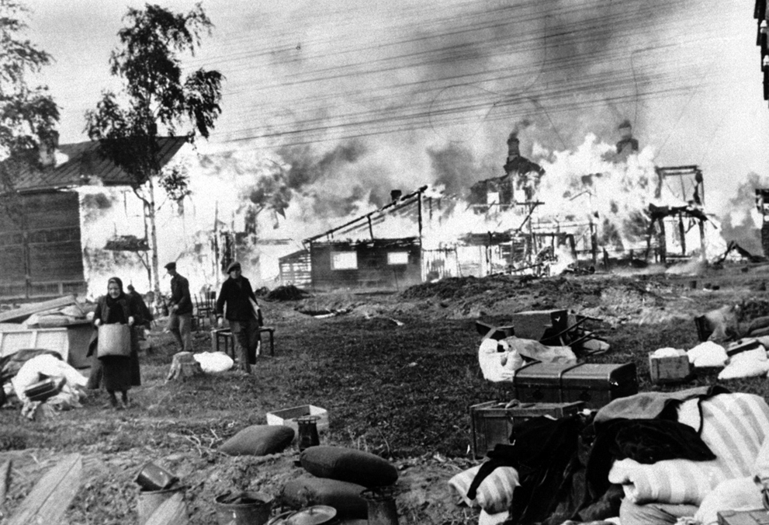
Siege of Leningrad 1941-1942
Russians use “scorched earth policy”
Germans cut off Leningrad and try to force surrender
Bomb warehouses
People eat cattle and horse feed, cats, dogs, crows and rats
1 million die
Russian men and women rescue their humble belongings from their burning homes, said to have been set on fire by the Russians, part of a scorched-earth policy, in a Leningrad suburb on October 21, 1941.

Slide 34
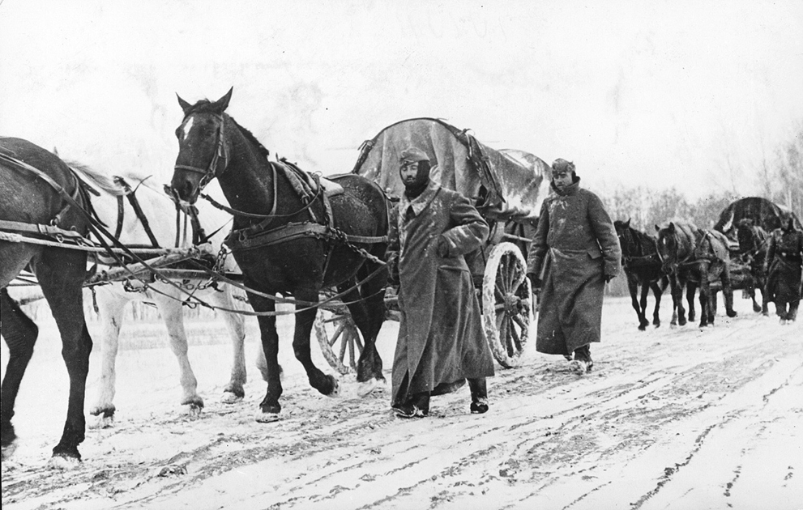
Nazi drive in Moscow on Oct. 2, 1941
Soviet counterattack in December
German soldiers retreat (summer uniforms)
Hitler orders “No retreat”
Hold line until March 1943
German infantrymen in heavy winter gear march next to horse-drawn vehicles as they pass through a district near Moscow, in November 1941. Winter conditions strained an already thin supply line, and forced Germany to halt its advance - leaving soldiers exposed to the elements and Soviet counterattacks, resulting in heavy casualties and a serious loss of momentum in the war.

Slide 35
Blitzkrieg Fails in Russia
Soviets have tremendous reserves in military, industrial capacity
Allied aids with trucks and equipment
Germans face 360 Soviet divisions of the Red Army against their 150 German divisions
Russian winter caught Germans unprepared

Slide 36
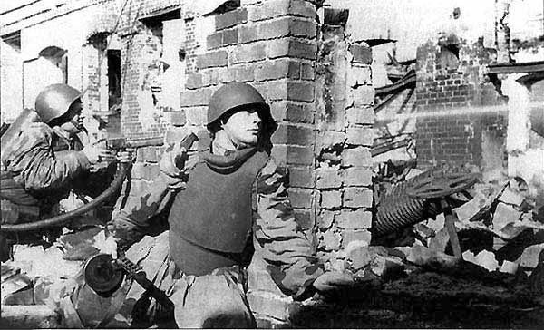
Battle of Stalingrad
Aug. 1942-Feb. 1943
Turning point in the war and bloodiest battle in history
Key to the Volga River and supply of oil
German and Soviet soldiers fought over every street and house
  Stalin ordered commanders to defend the city named after him to the death
Feb. 1943 remnants of German army surrendered
Hitler lost and was his last chance of defeating Soviets

Slide 37
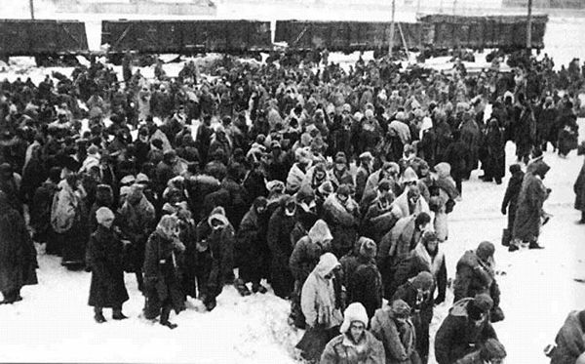
Stalingrad, Feb. 1943
90,000 frostbitten, half-starved Germans surrender
All that remained of the 330,000 German army
The defense of Stalingrad cost the Soviets 1 million soldiers
City was 99% destroyed
German POWs waiting for a train

Slide 38
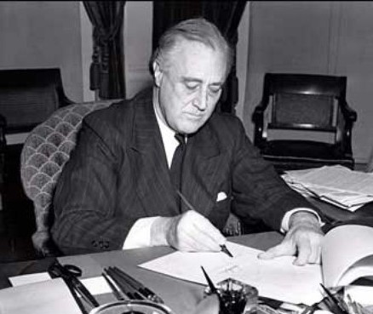
Battles in Asia and Pacific
US support of Allies before Pearl Harbor
  Lend-Lease Program 1941
    Lend or lease arms or supplies
Roosevelt sold and then “loaned” arms and war material to the British
  By summer 1941, US was escorting British ships carrying US arms
  Hitler orders subs to sink any cargo ship
Later supplied the Soviets and the Chinese
President Roosevelt signing the Lend-Lease in March of 1941

Slide 39
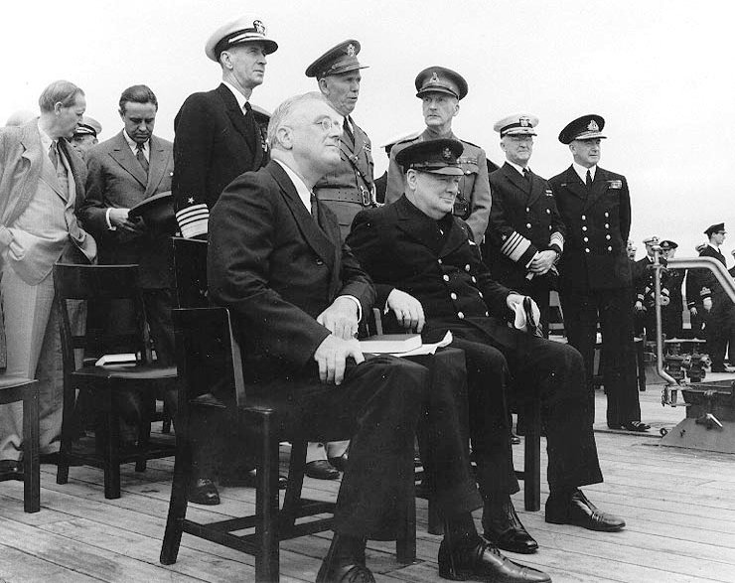
Atlantic Charter
Goals and aims for the war and post-war Europe
It upheld free trade among nations and the right of people to chose their own gov’t
FDR and Churchill issue joint declaration on Aug. 14, 1941 aboard ship

Slide 40
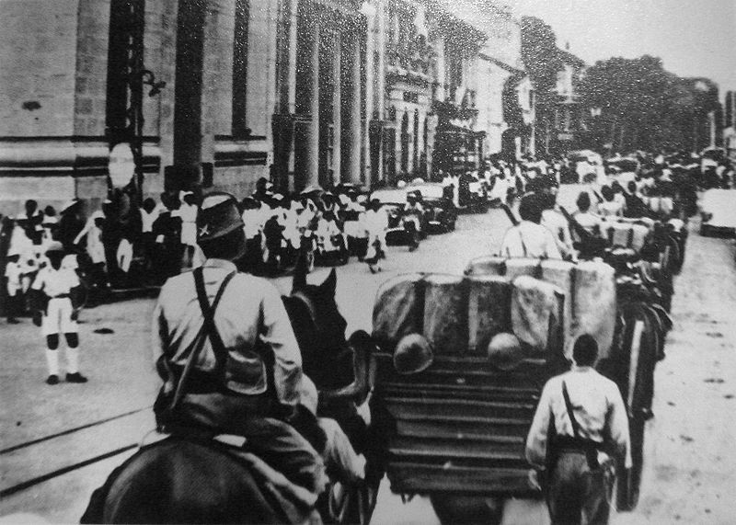
Japanese expansion into Indochina
July 1941, Japanese overran French Indochina
US froze Japanese assets and implemented an oil embargo
  Demanded w/drawal from China and se Asia
Japan wanted to clear the way for conquest and create a defensive perimeter around Japan’s homeland
Plan of attack done by Prime Minister Tojo Hideki and Admiral Yamamoto
  …US fleet in Hawaii was a “dagger pointed at our throat”
Japanese troops enter Saigon 1941

Slide 41
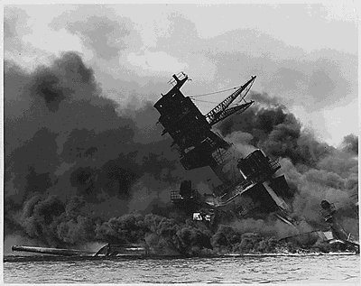
December 7, 1941
“A date which will live in infamy.”
Attack on Pearl Harbor
Devastated the US naval power in the Pacific
  19 ships damaged or sunk
    8 battleships included
  2,300 Americans killed
  1,100 wounded
US declares war on Japan
German and Italy declare war on US
USS Arizona, 1,117 men on board killed

Slide 42
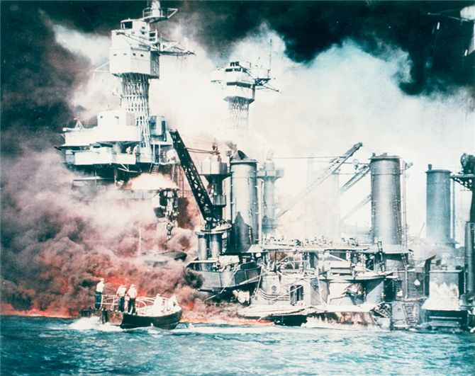
Flames consumed U.S. battleships in Pearl Harbor after the Japanese attack on 7 December 1941.

Slide 43
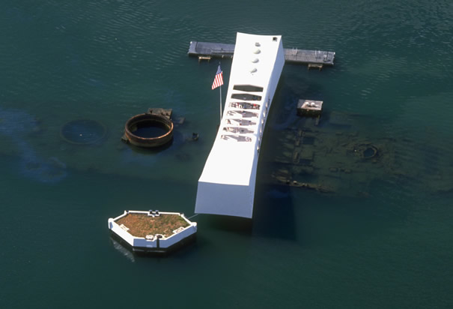
Pearl Harbor Memorial
Aerial view of the USS Arizona Memorial at Pearl Harbor, Hawaii. The ship’s wreckage has been leaking oil for nearly 70 years.

Slide 44
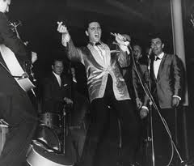
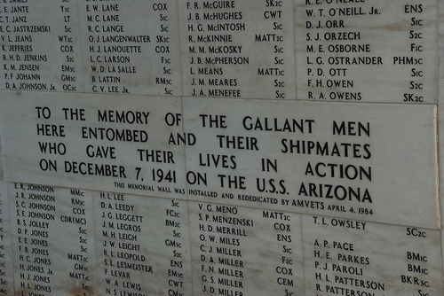
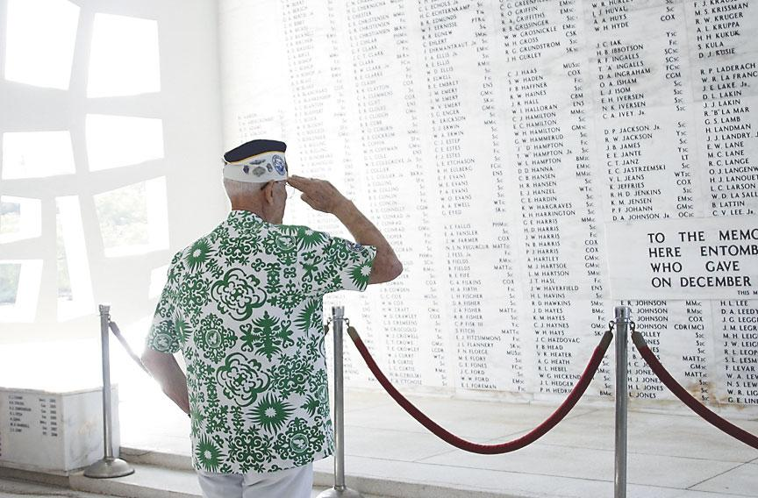
In Memory
Elvis performed a benefit concert at the Pearl Harbor Bloch Arena on March 25, 1961, which raised more than $50,000 for the construction of the national memorial at Pearl Harbor. Monument was dedicated in 1962.

Slide 45
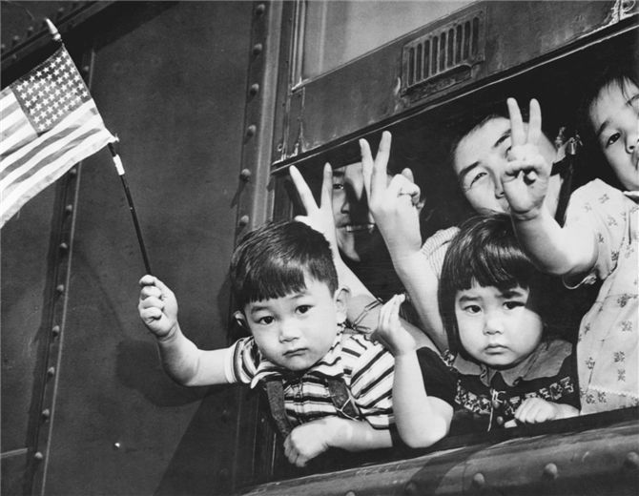
Japanese Internment Camps
After the Pearl Harbor attack, Americans expressed great hostility toward the Japanese nationals and Japanese Americans living in the United States, primarily on the west coast. In 1942 President Franklin Roosevelt authorized the forcible removal of approximately 120,000 Japanese and Japanese Americans to relocation or internment camps. This photograph from Seattle in March 1942 shows both the gloom and the patriotism of those on a train bound for a camp; the family is flashing the World War II “V for victory” sign while a boy holds the American flag.

Slide 46
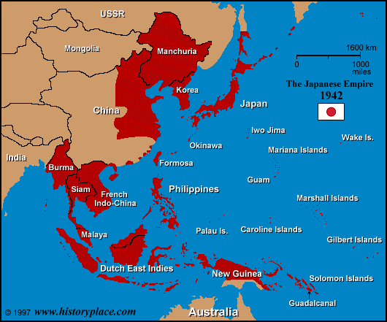
The Japanese Empire at its Height
Seize SE Asia
  Philippines, Burma, Siam, French Indochina, Dutch East Indies
Try to win support with slogan “Asia for Asians”
  Still treat colonies w/ cruelty
1 million square miles and 150 million people
  Worse treatment for Allied POWs

Slide 47
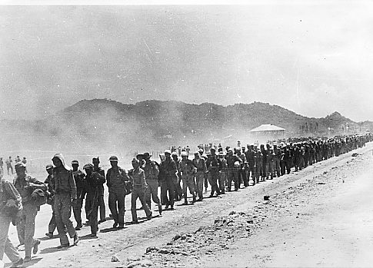
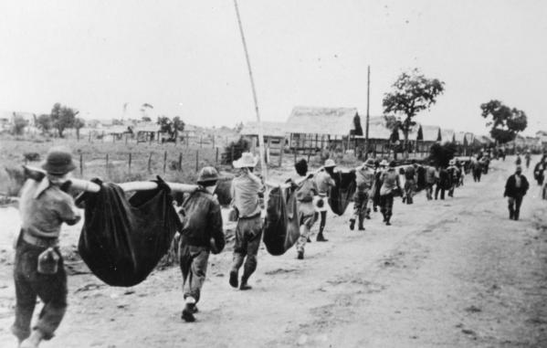
Bataan Death March
Forced march for 55 miles to the POW camp on Bataan Peninsula. Of the 70,000 POWs only 54,000 survived.
“I was questioned by a Japanese officer, who found out that I had been in a Philippine Scout Battalion. They hated the Scouts…Anyway, they took me outside and I was forced to watch as they buried six of my Scouts alive. They made the men dig their own graves, and then had them kneel down in a pit. The guards hit them over the head with shovels to stun them and piled earth on top.”
Lieutenant John Spainhower, quoted in War Diary 1939-1945.

Slide 48
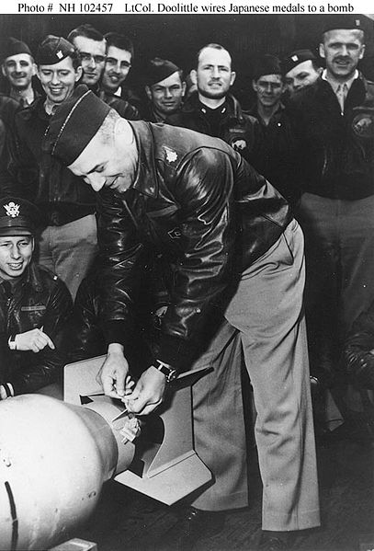
War in the Pacific
Doolittle Raids: April 1942 American planes bombed Tokyo
  16 B-25 bombers
  Led by Lieutenant Colonel James H. Doolittle
  Little damage but important psychologically for US
May 1942 US Navy defeats Japanese at Battle of the Coral Sea
  Stops their plans to conquer Australia

Slide 49
Douglas McArthur and “Island-Hop” Strategy
Commander of the Allied troops in Pacific
His “Island-Hop” strategy was to leapfrog over the heavily fortified Japanese positions
  Storming each island would be long and costly
Concentrate on islands that are not well defended but capable of supporting the drive to the Japanese mainland
Battle of Guadalcanal was first target

Slide 50

Battle of Midway, June 1942
Key American airfield in Pacific
Japanese strike in June 1942
American pilots destroy 332 Japanese planes, 4 aircraft carriers, one support ship
American victory turns tide of the war
Sinking of Japanese ship Mikuma

Slide 51

The End of the War
Soviet Union
  Battle of Stalingrad gave the Soviet Union the advantage
  By 1943, Red Army pushed Germans back toward Germany
Italy
  July 1943 Allies capture Sicily and invade Italy
  Italy signs armistice but Germans hold off for 2 years

Slide 52

“We shall fight on the beaches, we shall fight on the landing grounds, we shall fight in the fields and in the streets, we shall fight in the hills; we shall never surrender.”
  Winston Churchill, June 4, 1944 given to Parliament

Slide 53


Slide 54

D-Day Invasion, June 6, 1944
Operation Overlord
General Dwight Eisenhower as commander of the Allied forces planned the attack
Dummy army set up across from French seaport of Calais
British, American, and Canadian troops land on coast of Normandy
Largest seaborne assault in history
3,000 American soldiers died that day

Slide 55

American Cemetery in Normandy
President George W. Bush in January 2009

Slide 56

French Liberation
More than 1 million troops landed
Allies punch holes in German defenses near Saint-Lo
August 1944 Allies march into Paris
By September all of France liberated
American troops march down Champs Elysee on August 25, 1944

Slide 57

End of War in Europe
February 1945 Allies launch massive air strikes on Dresden, se of Berlin
  35,000-135,000 women, children, elderly killed (varies)
  Symbolic for “total war” on military & civilians
March 1945 the Allies cross into Germany
Six million Soviet troops approach from east
Surround Berlin
V-E Day: May 7,1945 Germans surrender, one week after Hitler commits suicide
Berlin 1945

Slide 58

Victory Parade in June 1945, Red Square, Moscow

Slide 59

Iwo Jima and Okinawa
Japanese use their kamikazi pilots
Island 600 miles from Tokyo
American marines take it in March 1945
Okinawa
Japanese lost 110,000 troops to Americans 12,500
Okinawan citizens refused to surrender
  US convinced that Japanese will not surrender
Flag raising in Iwo Jima March 1945

Slide 60
Japanese Surrender
US firebombing raids devastate cities
August 6, 1945, US drops an atomic bomb on Hiroshima killing b/n 70-80,000 people, 120,000 die from burns and radiation
August 9, another destroys Nagasaki
  37,500 killed
Sept. 2, Japanese surrender to General MacArthur

Slide 61

Japanese Surrender
A photograph titled “Planes over Tokyo Bay,” taken from the U.S.S. Missouri, visually captured a sense of U.S. power and victory on V-J Day, 1945.

Slide 62

V-J Day
Japanese surrender to General Douglas MacArthur on Sept. 2 on the US battleship Missouri in Tokyo Bay
Victory in Japan Day-Times Square, Sept. 1945

Slide 63

Holocaust
Calculated policy of exterminating whole races of people
Jews deprived of citizenship and legal rights
Jewish population sent to ghettos in major cities
  Die of starvation & disease
1942, Nazis carry out Hitler’s “Final Solution”
  “lebensunwertes Leben” or “Life unworthy of life”
  Use modern industrial methods to slaughter humans
  1,000s supported and aided the genocide
  Victims Jews, gypsies, Russians, Poles, homosexuals
Jewish children in the ghetto of Warsaw, Poland

Slide 64
Final Solution
Killing squads had killed 1.4 million by 1941
Those that could work went to the concentration camps
  Separate strong from weak
  Millions of prisoners of war worked to death or die of starvation
1942 Nazis send people to the extermination camps or gas chambers
  Auschwitz, the biggest camp, was designed to kill 12,000/ day
    Led into chambers and poisoned with cyanide gas, then sent to crematoriums to burn bodies
  Victims Jews, gypsies, Russians, Poles, homosexuals
Claimed 6 million Jews
“Work will make you free.” at the entrance of Auschwitz

Slide 65

Jewish Resistance
Warsaw ghetto uprising in April 1943
  Most lost lives
  Approx. 60,000 revolt
1943 at Treblinka, small group revolted
  Broke into armory, stole guns, attack guards and set fire to gas chambers
  Most fighters died

Slide 66
Life During Wartime
No safe home front because of widespread bombing of civilians
Civilian deaths tolls exceeded military casualties

Slide 67
Occupation
Japan’s conquered territories
They would install puppet-governments
  Ex. Manchukuo, Japanese-controlled China
Some required direct control
  Ex. Indochina, Dutch East Indies, Hong Kong etc.
Hitler’s racist ideology determined how administered
  N. Europe had civilian gov’t –Vichy gov’t w/ collaborators
  E. Europe military took over gov’t-harsh occupation

Slide 68

Exploitation
Japan and Germany exploited labor and resources
Slave labor w/ POW’s and local populations
Germany
  Poland, Soviet Union, France, Balkan forced into labor camps
Japan
  China and Korea
Shaved Jewish women selected for labor.

Slide 69

Collaboration
In Japanese-occupied Asia, not too different from colonial administration
Many did it to gain power
Anti-communism led some in W. Europe to join Nazi SS troops
Emblem for the multi-ethnic and multi-national military force of the Third Reich.

Slide 70


Resistance
Sabotage
Armed assaults
Assassination
  Several attempt to Hitler
  Operation Valkyrie
  By a group of officers and civilians on July 20, 1944
  Condemned men executed by firing squad
Hitler’s conference room after the explosion.

Slide 71
Atrocities
Japan and Germany committed atrocities against those that rebelled
  Ex. Hitler’s assassination attempt
    Men die after being suspended from meat hooks
Ex. Japan
  Forced Chinese laborers tracked down and tortured to death
Resistance movements grew despite atrocities

Slide 72

Women in War
Women joined from Great Britain and US armed forces, but not for combat
Chinese and Soviet women took up arms
Females excelled at resistance work b/c less suspect
Jewish women suffered as much as men or boys

Slide 73

Women’s Roles
Gained independence and confidence as they took jobs or head the household
Will be temporary
Expected to return home and assume traditional roles as wives and mothers

Slide 74

Comfort Women
Japanese army forcibly recruited 300,000 women to serve in military brothels
Presented as a “gift from the emperor”
80% came from Korea
Many massacred at end of war to cover up operation
Women that survived suffer deep shame
Recruitment advertisement for comfort women

Slide 75
Postwar Settlements and Cold War

Slide 76
War Created Refugees
8 million Germans fled to Great Britain and US territories escaping Soviet occupiers
12 million German and Soviet POWs return home
Survivors of death camps
3 million from Balkans return

Slide 77
Cold War 1947-1991
Soviet Union and United States emerged as the 2 superpowers
Political, ideological, and economic hostility b/n the 2
The conflict divided global populations

Slide 78

United Nations
Int’l organization founded in 1945 to promote world peace and cooperation
Two main bodies
  General Assembly
    Representatives from all member states
  Security Council
    Five permanent members
    China, France, Great Britain, US, and Soviet Union
    Seven rotating members
Operates by majority vote, but the Security Council has veto power

Slide 79

Creation of Israel
Example of an early resolution
1947 UN resolution to divide Palestine into sovereign Jewish and Arab states

Slide 80
Origins of Cold War
Alliance of Soviet Union, Great Britain, and US held during war but with much tension
Cold War
  Confrontation for global influence principally b/n US and Soviet Union
  Lasted 5 decades and affected every corner of the world
  Formation of military and political alliances
  Creation of client states
  Arms race
Stalin, FDR, and Churchill

Slide 81
Yalta and Potsdam: Wartime Conferences
Yalta (Feb. 1945)
  Each Allied power occupied the liberated countries of Eastern Europe
  Agreed to try major war criminals
Potsdam (July 16-Aug.2, 1945)
  In a Berlin suburb and last wartime summit
  Stalin’s plans prevailed
  Poland and eastern Europe occupied by Soviets
    Britain and France try to convince Soviets to allow democracy in Poland
  Install communist government in Poland and eastern Europe

Slide 82

Truman Doctrine 1947
US would support “free peoples resisting subjugation”
  $ or aid to those resisting communism
U.S. perception of a world divided between “free” (democratic) and “enslaved people” (communist)
Committed to an interventionist foreign policy dedicated to the “containment” of communism

Slide 83
Containment
Foreign policy adopted by President Truman
Directed at blocking Soviet influence and stopping the expansion of communism

Slide 84
“At the present moment in world history every nation must chose between alternative ways of life. I believe that it must be the policy of the US to support free peoples who are resisting attempted subjugation by armed minorities or by outside pressures.”
  Truman to US Congress 1947

Slide 85

“Iron Curtain”
“From Stettin in the Baltic to Trieste in the Adriatic, an iron-curtain has descended across the continent…I am convinced there is nothing they (the communists) so much admire as strength, and there is nothing for which they have less respect than weakness, especially military weakness.”

Slide 86

The Marshall Plan
US gov’t plan to rebuild European economies through cooperation and capitalism
  Provided $13 billion to reconstruct Europe
Soviet Plan
  Invited to participate, but countered w/ own plan
  COMECON: Council for Mutual Economic Assistance
Gave both superpowers lucrative markets or resources

Slide 87

NATO
1949, the US established the North Atlantic Treaty Organization
Regional military alliance against Soviet aggression
Intent was to maintain peace in postwar Europe
Had a more structured military focus after Soviet’s detonation of 1st atomic bomb and Korean War
Original members
  Belgium, Canada, Denmark, Great Britain, Iceland, Italy, Luxemburg, the Netherlands, Norway, Portugal, US
NATO flag

Slide 88

History of NATO

Slide 89

Warsaw Pact
Soviet countermeasure to NATO
Formed in 1955
Made up of eastern and central communist European nations
  Soviet Union, East Germany, Czechoslovakia, Poland, Hungary, Romania, Bulgaria, and Albania
Warsaw Pact Conference, May 1955

Slide 90

A Divided Germany
Fault lines of Cold War most visible in Germany
Reflect growing divisions b/n Soviet Union and United States
Germany
  East Germany=Soviets
  West Germany= Allies
Berlin
  Divided among all 4 powers
Churchill phrase “iron curtain” came to represent Europe’s division b/n a mostly democratic Western Europe and a Communist East Europe
Occupied Berlin

Slide 91

Berlin Blockade and Airlift
1st test of Cold War
Soviets blockade all road, rail, and water links between Berlin and West Germany
11 months, British and US aircrews flew round-the-clock missions to supply W.Berlin with the necessities of life
Soviets call off blockade in May 1949

Slide 92

Occupied Germany 1945-1949

Slide 93

Berlin Wall
Barbed wire and a concrete wall in front of the Brandenburg Gate in Berlin symbolized the cold war division of Europe.
By 1961, communist E. Germany see stead drain of refugees leave to W. Germany
3.5 million E. Germans
Watchtowers, searchlights, antipersonnel mines, and border guards ordered to shoot to kill
Accomplished its purpose, but at cost of shaming regime and legitimacy

Slide 94

Globalization of Cold War
People’s Republic of China
1920’s two groups had arisen to reassert Chinese control
  Nationalists and Communists
After WWII and Japanese defeat, Chinese Communist Party defeats Nationalist
Establish the People’s Republic of China on October 1, 1949
Chinese and Soviets partnered in 1950s
  Beijing recognizes Moscow as undisputed authority in world communism in exchange for Russian military equipment and economic aid
Mao Zedong proclaims the People’s Republic of China

Slide 95


Confrontation in Korea
Summer of 1950
Korea partitioned off at the 38th parallel w/ northern zone-Soviet and southern-US after WWII
June 25, 1950 northern Korea, wanted to unify Korea by force, went into S.Korea and take Seoul
W/ UN mandate, US military went in to push N. Korea back to 38 th parallel
War settled into a stalemate
3 million dead, mostly Korean civilians
Both sides agree to cease-fire in July 1953

Slide 96

Domino Theory
Pres. Dwight D. Eisenhower’s new US strategy
Rationalized worldwide US intervention on the assumption that if one country became communist, neighboring ones would collapse to communism
US applies this to Central, South America, Africa, and Asia

Slide 97

Cracks in Soviet-Chinese Alliance
By 1964, rift b/n both became public
Both compete for influence in Africa and Asia
China also had successfully conducted nuclear tests which enhanced their prestige
Unintended consequence; countries gain more independent course by playing capitalist against communists
Long live the Sino-Soviet Pact
Lasts until 1964

Slide 98

Nuclear Arms Race

Slide 99

The Cold War
The visceral beauty of nuclear explosions, such as this one in the Marshall Islands in 1954, masked the terror and the tensions that beset the Soviet Union, the United States, and the rest of the world during the cold war.

Slide 100
Cuba: Nuclear Flashpoint
1959 revolutionary movement headed by Fidel Castro overthrew the autocratic Fulgencio Batista y Zaldivar
They accepted a Soviet offer of massive economic aid
“I have been a Marxist-Leninist all along, and will remain until I die.”
  Castro, Dec. 1961, declares support for Soviet’s foreign policy

Slide 101

This propaganda poster celebrated the leadership of Fidel Castro during his rise to revolutionary power in Cuba

Slide 102

Bay of Pigs Invasion
April 1961, the invasion of Cuba to overthrow Castro and his supporters
Invasion force of 1500 anti-Castro Cubans trained, armed, and transported by CIA
Invasion force failed to incite internal uprising
American air support failed to appear
W/in 3 days, Castro’s military killed or captured all
Hurt US prestige
Reason Cuba accepts Soviet aid: nuclear missiles as a deterrent

Slide 103

Cuban Missile Crisis
Oct. 26, 1962, US learns that Soviet technicians were assembling launch sites for medium-range nuclear missiles in Cuba
Pres. JFK issues ultimatum to w/draw all missiles from Cuba
Imposed an air and naval quarantine on nation
After 2 weeks, Soviets yielded to US demands
Kennedy agrees to refrain from attempting to overthrow Castro
World waited for the apocalypse

Slide 104

Dissent in Soviet Union
De-Stalinization 1956-1964
Nikita Kruschev’s policy
End the rule of terror and partial liberalization of Soviet society
Gov’t removed portraits of Stalin, renamed institutions and local ties w/ his name, and commissioned historians to rewrite textbooks to deflate Stalin’s reputation
Brought “thaw” in gov’t control
Release millions of political prisoners

Slide 105

Soviet Intervention
New political climate led to communist leaders in Eastern Europe to seek a degree of independence
Ex. Hungary 1956
Ex. “Prague Spring”-socialism w/ human face
Budapest, Hungary 1956 when Soviet tanks enter to crush uprising

Slide 106

Detente
Late 1960’s, leaders of Soviet Union and US agreed to policy, or reduction in hostility, trying to cool arms race and slow competition in developing countries
Pres. Richard Nixon and Leonid Brezhnev were 1st to test detente

Slide 107

The End of the Cold War
B/n 1989-1991, the Soviet system in Europe collapsed
Pres. Ronald Reagan reinvigorated cold war animosities, “evil empire”
Reagan advocated enormous military spending
His rhetoric and budgets challenged détente and Soviet’s ability to match US spending
“Mr. Gorbachev! Tear down this wall”

Slide 108

Mikhail Gorbachev (1931-
Economic weakness of communist regimes in eastern, central Europe and Soviet Union that they needed reforms
1985 Gorbachev came to power tried reforms to address economic deterioration
Perestroika – policy to restructure and decentralize the economy
Glasnost – the policy of opening of Soviet society to public criticism and admission of mistakes
  Led to ethnic and nationalist sentiments b/c only ½ of 285 million Soviet citizens were Russian

Slide 109

Revolutions in Eastern and Central Europe
Gorbachev visits Berlin in 1989 and announces that each country would be responsible for its own destiny
Poland, Bulgaria, Hungary were the first
Czechoslovakia –”Velvet Revolution” b/c done w/ little violence
  Czech Republic and Slovakia
Romania- violent b/c Nicolae Ceausescu refused to reform
1989 uprising ended w/ him and his wife dead

Slide 110

Fall of Berlin Wall
East Germans fled by 1,000s through openings
East German regime decided to open the Berlin Wall to intra-German traffic on November 9, 1989
1,000s of East and West Berliners tore down wall
1990 the 2 Germanies formed a united nation

Slide 111

Tearing down the Wall…

Slide 112

Collapse of Soviet Union
Pressures on Soviet Union
1979 Unsuccessful invasion of Afghanistan
  Pull out troops in 1989
Downward slide of industrial and agricultural production
Skyrocketing inflation
Soviet satellites declare independence in 1991
Boris Yeltsin led drive for independence
  August 1991, Yeltsin dismantles Communist Party and pushed reforms for market-oriented economy
Dec. 25, 1991, Soviet flag fluttered for last time- by end of year USSR ceases to exist
Taking down the face of Lenin

